Slide 1
Free-space Laser Performance
Randy Thurman-Keup
PIP2 Laserwire Preliminary-Review Follow-up
Nov 7, 2022

Slide 2
Laserwire Locations
Twelve laserwire stations in the PIP2 Linac proper
The laser room is upstream of the H- source which is at 0 meters

Slide 3
Designs
Charge #3
Laserwire at PIP2IT was a fiber-to-the-beamline-box system
Laser was 1 Watt at 162.5 MHz
Stripped electrons were collected by a faraday cup
Signal was small
  Self-stripped electrons were a significant background
  EMI was a problem
Laserwire at PIP2 is planned to be free-space to the beamline
  Various contributions to the choice of technique
    Signal over background/noise
    Available laser powers and pulse lengths
    Laser power/energy limits on vacuum windows
    Optical arrangements

Slide 4
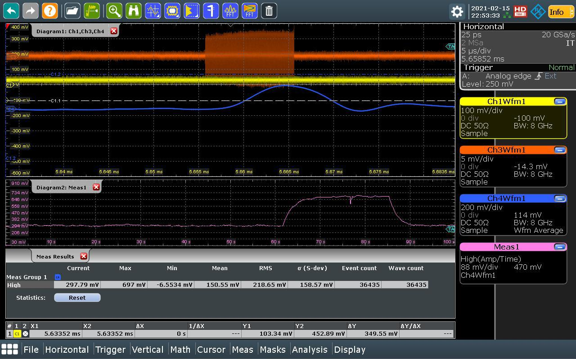
Background Studies - PIP2IT First Laser Induced Signal
Charge #3
Signal/Background
~ 1.3
Signal vs Laser Power
Self-stripped
Background
Laser Off
Laser On
690 mV
294 mV
1 W → 6 nJ / pulse

Slide 5
Background Studies
Charge #3
Background is significant if summing many low energy laser pulses
Big advantage to using small number of larger energy laser pulses
  Signal is the same, but background drops
Fiber laser for PIP2IT was 10 ps pulse length, 1 Watt, @ 162.5 MHz
Single laser pulse at 1 Watt would gain a factor of at least 1000 in signal to background

Slide 6
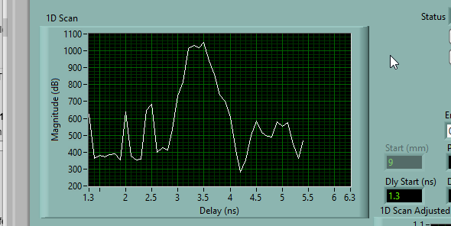
EMI Info
Charge #3
eLog entry from PIP2IT
  Collected data using the new firmware... Saw a clear signal using a total of 100 dB of gain, a 21.4-MHz, 100-kHz-BW bandpass filter, and a 30-MHz low pass filter. This involved 10 or 40 digitizer acquisitions, each with 1e6, 10-point samples, for each phase scan point. The beam was between 4 and 4.4 ms pulse length, 5 mA, no chopper.
To get the beam scan below took 10 million measurements per point, of a 21.4-MHz modulated signal with 100 dB of gain and the two filters above
This measurement used an amplitude
modulated laser pulse at 21.4 MHz to
which the digitizer was phase locked
Signal to noise is problematic
  Again, benefit from higher laser power
  per pulse

Slide 7
Laserwire Simulations
Charge #3
Need simulation to evaluate performance of various laser techniques
  Need to change many parameters of both the laser and beam
    Laser power and pulse length
    Optics of the laser focusing
    Jitter of the laser beam (and possibly H- beam)
    H- beam energy, size and bunch length
Need additional simulation capabilities of detection schemes
  Evaluate collection efficiency of laser-stripped electrons
  Possibly rejection efficiency of self-stripped electrons from upstream

Slide 8
Laserwire Simulations
Charge #3
We have a mix of Matlab and CST to accomplish most of the simulation features needed
Optical ray tracing (Matlab)
  Gaussian beam version
H- Stripping calculation (Matlab)
  Overlaps the laser with the H- beam
    Laser and H- beam are fully specified in 6-d phase space (some constraints with laser)
  Time evolution of stripping within fixed voxel space around interaction region
    Depletion of H- beam is included
      Laser is not depleted as laser has significantly higher density than H- beam
  Stripping cross section used in each voxel
    Number of stripped electrons in each voxel at each time step are stored
Stripped electron tracking (Matlab + CST)
  Full relativistic 3-d tracking of particles in arbitrary E and B fields using adaptive 4th order Runge-Kutta solver
  E and B fields of H- bunch generated separately and given time dependence during tracking
    No transverse motion of bunch
  E and B fields of external sources typically generated with CST model

Slide 9
Beam Depletion
Charge #3
Depleted H-
Demonstration of H- depletion in simulation
H-
H-

Slide 10
Beam Depletion
Charge #3
Depletion of H- while traversing the laser depends on laser energies and on optics of laser and H- beam
Laser Parameters
  Laser rms size on final focus lens = 6 mm
  PIP2IT
    Laser energy per pulse = 6 nJ
    Laser rms pulse length = 6 ps
  PIP2 free-space larger energy
    Laser rms pulse length = 30 ps
Higher energy bad for vacuum
windows and less efficient at
stripping
PIP2 Simulation Results
73% Drop
MEBT
Scaled by pulse energy from 0.01 uJ
39% Drop
HB650_4
Scaled by pulse energy from 0.01 uJ

Slide 11
Laser Jitter Effect
Charge #3
5 ps H- bunch
Plots of laser induced signal
for various laser jitter levels
30 ps rms laser pulse length
Shorter Laser Pulses
Longer Laser Pulses
10 ps H- bunch
More Jitter
30 ps laser pulse maximizes signal while minimizing jitter effect
20 ps H- bunch

Slide 12
Summary
Performance benefits to using small number of large energy laser pulses
  Lower self stripping background
  Lower gain needed and thus lower EMI noise
  Have simulation code to investigate performance parameters such as
    Signal intensity
    Stripping efficiencies
    Power on vacuum windows
    Jitter effects

