Slide 1
PIPII laserwire Laser System design
Jinhao Ruan
PIP-II Beam Instrumentation Preliminary Design Laser Wire Follow-Up Review
Nov. 7, 2022

Slide 2
Outline
PIPII-IT laser system
Pros and cons
PIPII laser system redesign
  Fiber portion
  Free space portion
Conclusion

Slide 3
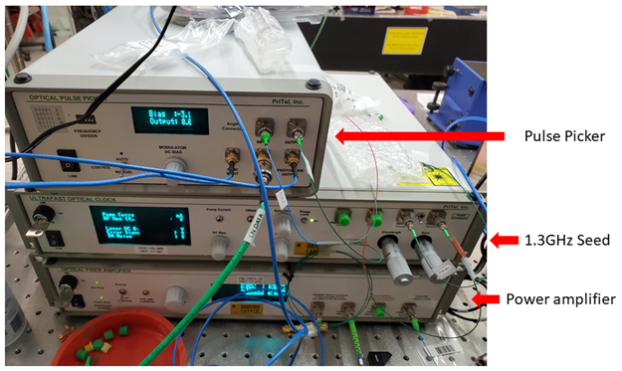
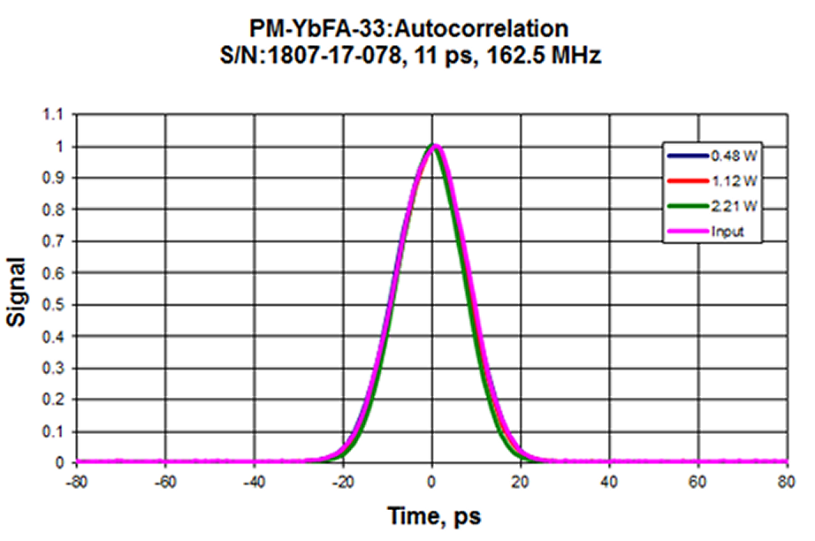
PIPII-IT laser system
Seed laser portion
Agilent 1.3GHz source
RF splitter
Control Volt
162.5 MHz pulses locked to RF
11 psec pulses at 1054 nm
Up to 1 W at beamline ~6nJ
LMA fiber transport
Minicircuit Phase shifter (1.3GHz)
Colby Unit
162.5MHz
Pritel Seed laser
Pritel pulse picker
Pritel Amplifier
1.3GHz
162.5MHz

Slide 4
What we learned from PIPII-IT experience
Pros
  Very reliable system turn-key operation for most of the time
  Be able to measure both spatial and temporal measurement
  LMA fiber offers Simple transport system
Cons
  Need multiple seed/amplifier system will increase the cost dramatically
  Only one pulse length available
  Power is limited (because of single-mode LMA fiber)
    Low signal to noise ratio
    Lock-in technique helped a little bit but still very low signal to noise ratio
  Very limited flexibility for future upgrade (due to multiple laserwire stations with fiber amplifier)

Slide 5
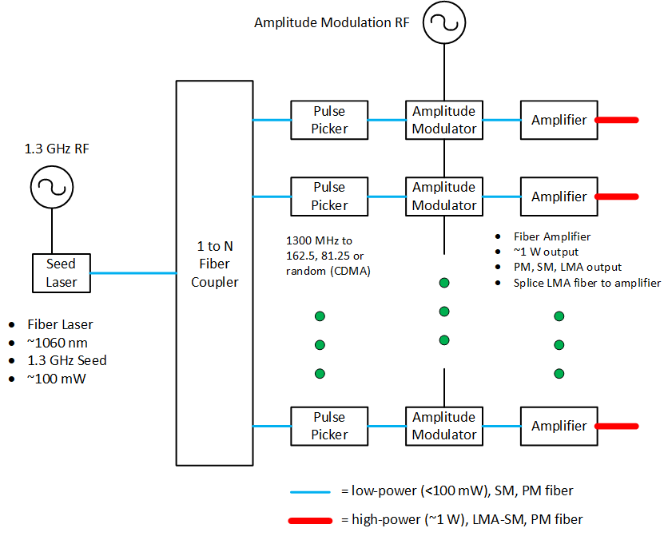
Initial PIP-II Fiber Laser System for N Laserwire Stations Concept
Complicated and expensive
Challenging to phase in each laser station for 162.5 MHz beam
  1.3 GHz laser pulses
  Pulse picker select correct pulse to ~800 ps
  Free-space delay line at each laserwire station does last 800 ps of phase shift
Limited power in fibers → poor signal-to-noise
Limited pulse length due to fiber non-linearities

Slide 6
What we want for PIPII
Enough power to get good signal noise ratio
Flexibility in terms of the pulse duration
Flexibility in terms of the future upgrade option
Lower the cost if possible
Fiber laser-free space laser hybrid system

Slide 7
PIPII laser option (hybrid version)
Seed laser (<1nJ)
Requirement
  Wavelength 1064nm
  Pulse width: at least 2 options 2-3ps/70-100ps FWHM
  Pattern: Programable option
  Turn-key system
  Final energy: nominally 100uJ/pulse
    Depends on signal-to-noise and total power on windows
  Max power of 3W/cm^2 on optical windows
    Only transport laser light while making beam measurements
Pritel Amplifier (4~5nJ)
Optical Engine
Fiber amp (>1uJ)
Free space
Amplifier (~100uJ)

Slide 8
Seed laser option
Short pulse Laser
  Use PIPII-IT version pulse width 2-3ps
  Specified design for longitudinal profile measurement
  Fiber based pulse picker to select pulse pattern
Long pulse Laser
  Implement design developed by Dave & Todd at Fermilab
  Start with CW laser source
  Use modulator to pick up the pattern we wanted aiming for
  30-40ps rms but programable(down to 25ps)

Slide 9
Amplification chain
Fiber portion
  Pritel
    Based on the PIPII-IT version again
    Make it suitable for both long and short seed portion
    Turn-key
  Optical engine
    Why we choose this?
      Use those state-of-art amplifier to boost the energy
      A lot of experience with it inside Fermilab
      Turn-key
      Multiple systems already on order

Slide 10
Amplification Chain
Free space Portion
  Northrup Grumann
    Commercially available
    Turn-key system
    Easy for align
    Been used for multiple system inside Fermilab already
      Beam strip
      NML drive laser

Slide 11
PIPII Laser Diagram
Free Space
RF signal
Short pulse
Fiber
Pritel fiber laser
Optical engine
Amp
Optical switch
Pritel
Amp
>1µJ
<1nJ
>5nJ
CW laser source
Modulator
Free Space
Amp
Long pulse
Random patter generation
~100µJ
Seed portion

Slide 12
Some consideration for the system
Pros
  Versatile
  Be able to deliver high signal noise measurement (see Randy’s talk)
  Cost effective (See Brian’s talk)
  Future upgrade option
Cons
  Need a beam transport structure (see Bob’s talk)
  Some technique still need to be studied
  Need some feedback for maintaining beam pointing when travel over long distance (see Randy’s talk)

Slide 13
Conclusion
Based on the comment from PIPII laser wire review we modified our design for laser system
New designed system is more versatile
Newly transport system will be designed and installed
New design will have higher signal-noise ration than old design but additional studies may still be needed
Free-space optical transport decouples laser system and makes it easier for future laser upgrades

