Slide 1
Optical Transport Line – Vacuum and Mechanical Systems
Bob Steinberg
PIP-II Beam Instrumentation Laser Wire Design Follow-Up Review
Nov. 7, 2022

Slide 2
Optical Transport Line – Overview
The Optical Transport Line (OTL) is a portion of the Laserwire Beam Profile Monitor system.
The main goal of the OTL is to safely provide a clean path for the free-space laser to travel. The OTL will house components that begin steering the laser towards the beamline for profile measurement.
The OTL begins at the Laser Hut on the upstream end and ends 200 meters downstream at the end of the PIP-II Linac.
The approximately 200 meters of aligned beam tube allows the laser to travel to the 13 Mirror Box locations.
The Mirror Boxes contain pick-off mirrors and other optical diagnostic components that steer and measure the laser path.

Slide 3
Overview cont…
The pick-off mirrors are driven in and out of the laser path by mechanical linear stages. They turn the laser path 90° downward at locations that have Laser Optics Boxes. These are the locations where beam profile will be measured.
The scope of the OTL is from the upstream Laser Hut to the furthest downstream Mirror Box, and from the ceiling where the Mirror Boxes are mounted down to the transition to the Optics Boxes below.
The entirety of the OTL is under rough vacuum.
The system contains a vacuum safety switch for protection from the laser.

Slide 4
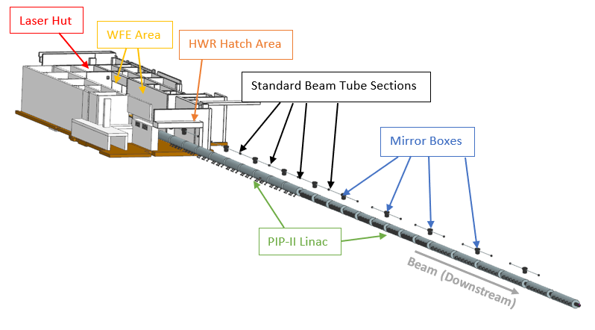
OTL and Mirror Boxes above Linac

Slide 5
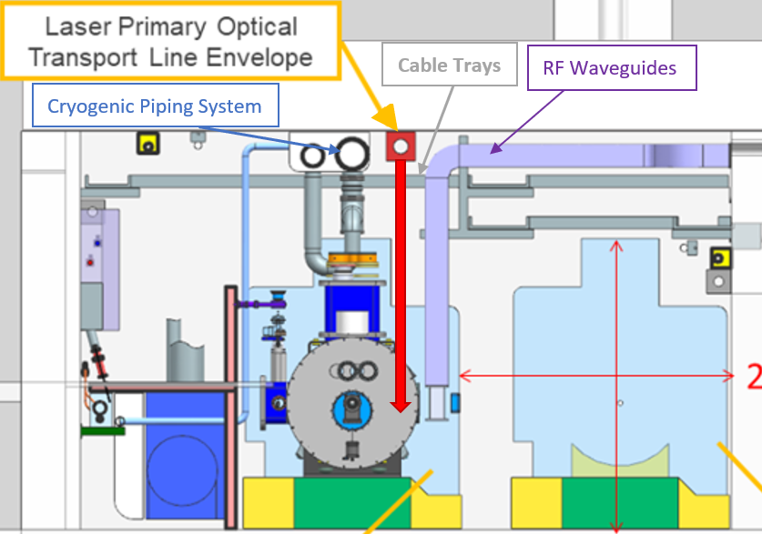
Cross-Sectional View of Tunnel
12” x 12” envelope for optical transport line.
Shares physical space with cryogenic piping header.
Shares physical space with cable trays.
Shares physical space with RF Waveguides.
Interface with CF to make connections at the ceiling.
Interface with Laser Optics Boxes to connect laser path to the beam line (see red arrow).
Access for installation and service of transport line is from the main aisle (right).

Slide 6
Optical Transport Line Interfaces
WBS 121.03.09.03.03.01
Optical Transport Line
WBS 121.03.09.03.03.01
Laserwire Transport System
Connect to Laser Optics Boxes
WBS 121.04
Installation
Mechanical installation and alignment of mirror boxes and beam tube sections Work within cryogenic (pipe), RF (waveguide), and electrical (cable tray) systems
WBS 121.03.06
Vacuum
Cleaning, assembly and vacuum certification of transport line components
WBS 121.03.08
Safety Systems
Laser system safety interlocks
WBS 121.06
Conventional Facilities
Laser hut

Slide 7
General Requirements
90mm (3.54”) aperture size requirement for entire length (longitudinally).
Approximately 200m (650’) in total length.
12” x 12” envelope for installation at the ceiling in the PIP-II tunnel.
13 mirror boxes – initial size 18” W x 24” H x 12” D
Removeable lid with access to install, inspect, and replace mirror components.
Span the gap at the HWR hatch (no ceiling to mount to).
Integrate the upstream end of the beamline into the Laser Hut.
Design for total range of adjustability of all components to ±1” in all directions (xyz). Fine adjustment required. Maintain optically straight beam tube within 5mm.
System vacuum requirement of <250 mTorr.
No visibility of laser beam allowed.

Slide 8
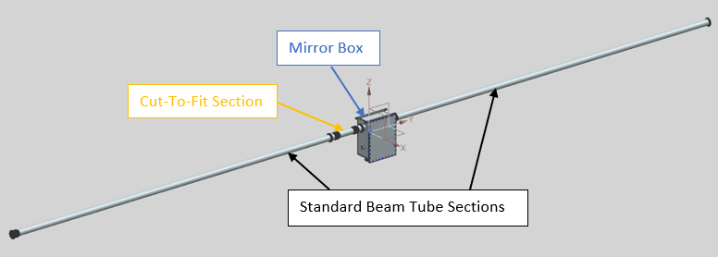
Standard Section - Optical Transport Line Components
A standard section of the Optical Transport Line consists of a
Mirror Box, some quantity of the standard 20’ long beam
tube sections, and a cut-to-fit beam tube section.

Slide 9
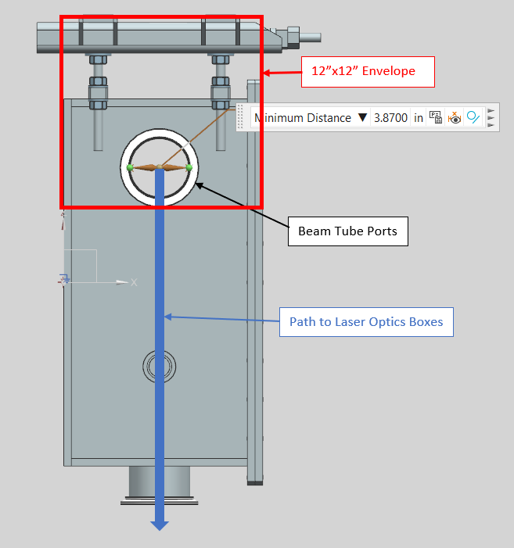
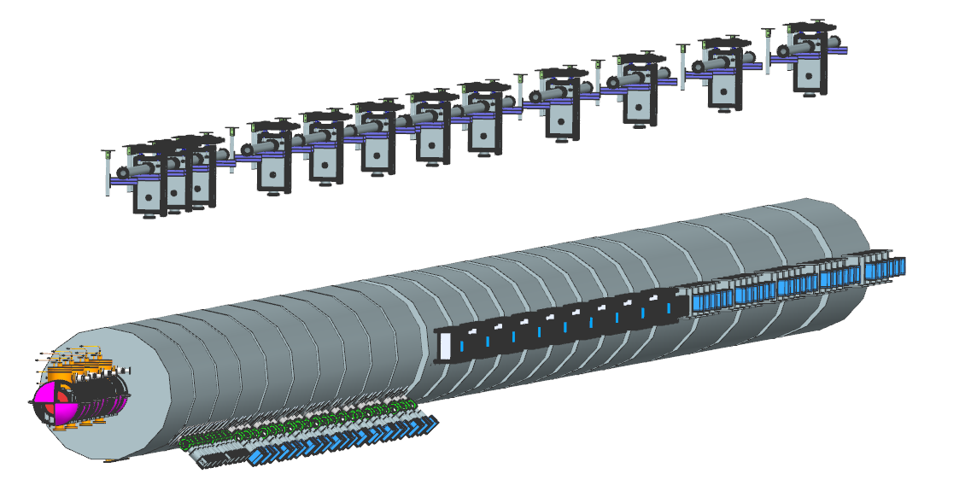
Aperture and Length
3.87” aperture is maintained along the entire laser line.
Transport line is confined within the 12” x 12” envelope specified by PIP-II.
Row view of 12 (13th out of view) Mirror Boxes above PIP-II Linac.
Total of 200 meters from Laser Room to end of OTL.

Slide 10
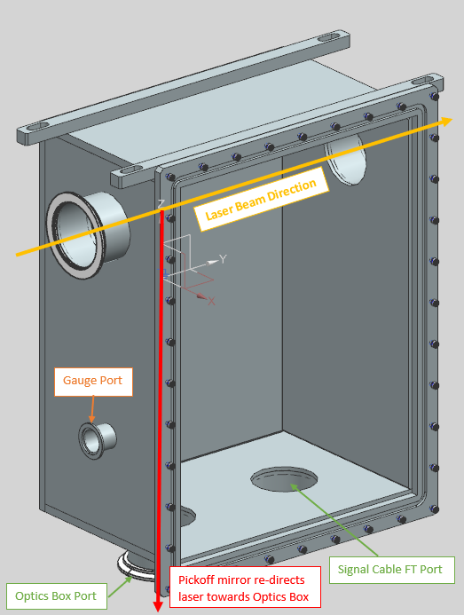
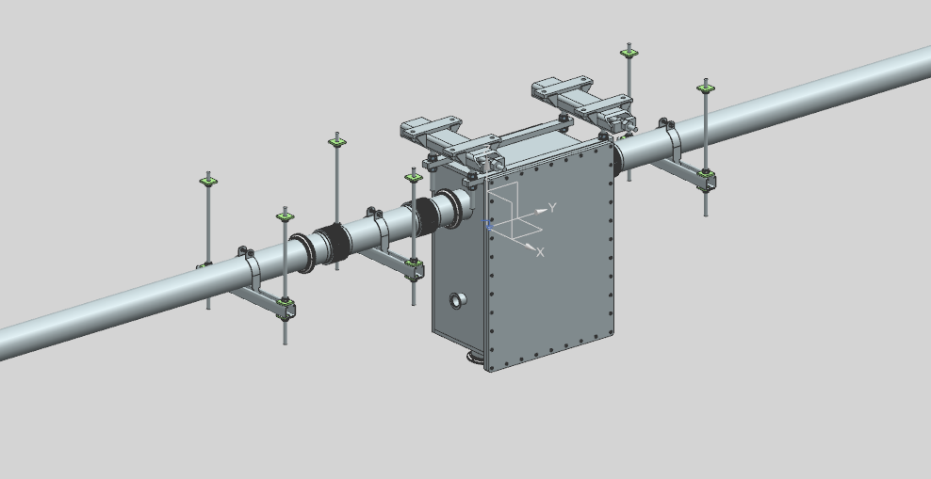
Mirror Box Design
Quantity 13 Mirror Boxes locations along OTL.
All ½” stainless-steel plate design.
Inside welded design (vacuum system).
The removable lid is aluminum for weight reduction during installation and service.
The initial size of 18”x24”x12” allows ample room for linear stages and pickoff mirrors.
The back plate is made of ¾” thick stainless-steel for mounting components (reduce deflection).
Laser ports designed w/ NW100 vacuum flanges.
Bottom ports are for laser transport to Laser Optics Boxes and signal cable feedthrough.
KF-40 port for optional gauging, pump out ports, etc…

Slide 11
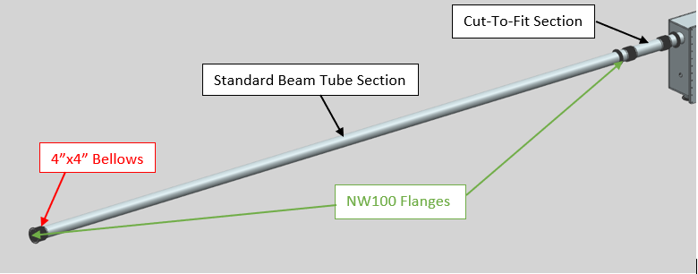
Beam Tube Sections
The standard beam tube sections are 20’ long sections of 4” diameter stainless steel pipes. One end contains a 4” x 4” hydroformed bellows. Then each end contains an NW100 vacuum flange. The cut-to-fit section incorporates an additional bellows (2 total) to allow for making up connections at both the rigid end of the standard section and the rigid mirror boxes. Most mirror box-to-mirror box spans contain 2-3 standard sections and a single cut-to-fit section.

Slide 12
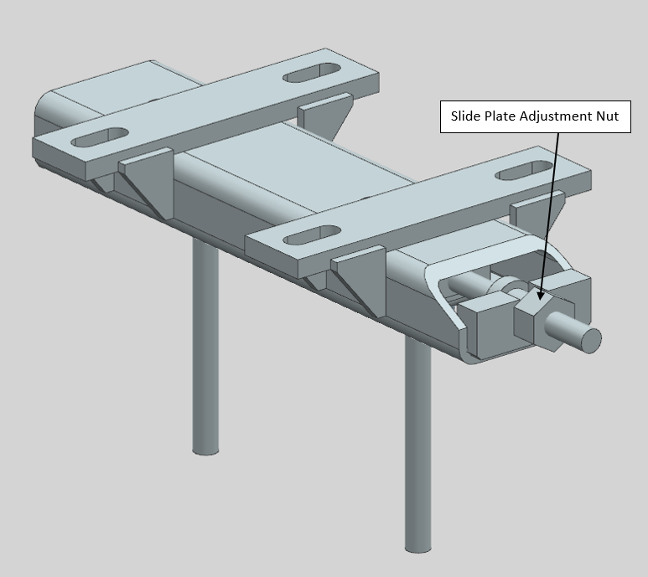
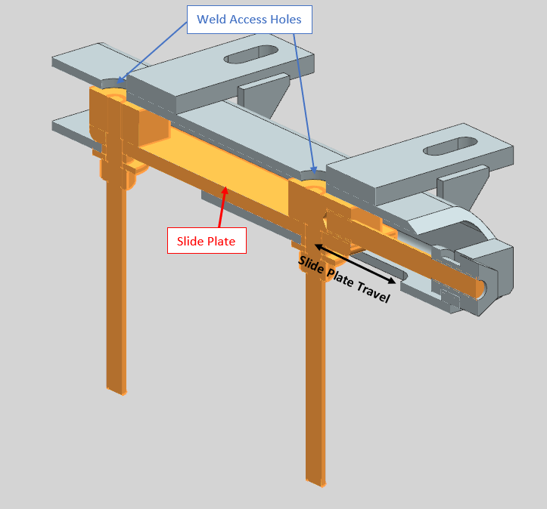
Mirror Box Hangers
Steel component construction.
Slotted ceiling plates to adjust for installation obstructions (rebar).
Also provides additional z-adjustment.
Slide plate design with threaded rod hangers (x and y adjustment).
Access holes at the top give ability to tack weld threaded rod for safety.
Will design a drilling template for ease of drilling Hilti locations in ceiling.

Slide 13
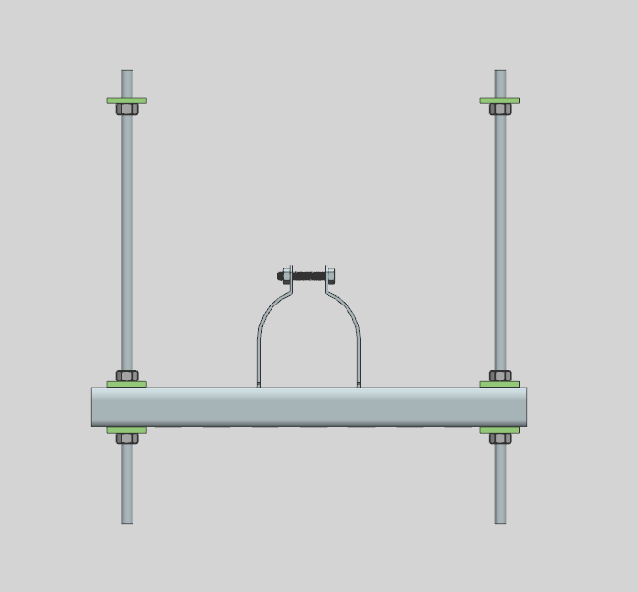
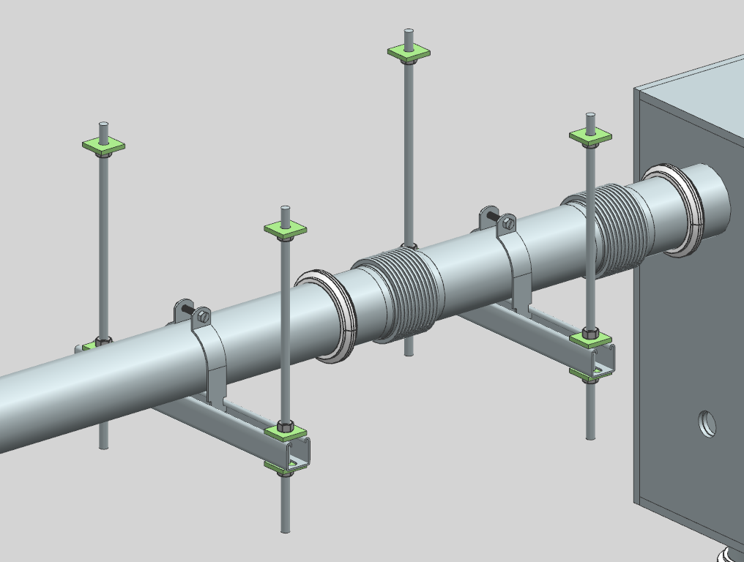
Beam Tube Hangers
Beam tube hangers designed using common Unistrut parts.
Design provides a wide range of alignment with sufficient adjustment.
Designed alignment tool – later described in alignment slides.
Due to concrete anchor requirements in ceiling (FESHM7080), these will need to be mounted one of two ways: a) suspended from existing Unistrut embedment or b) suspended from additional hung sections of Unistrut (spanning from embedment to embedment).

Slide 14
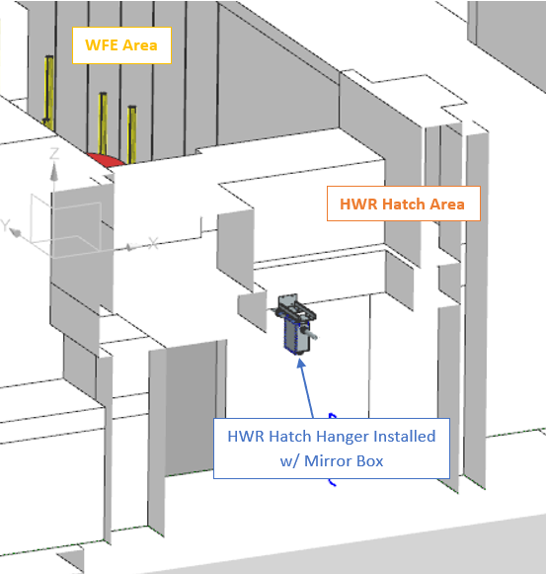
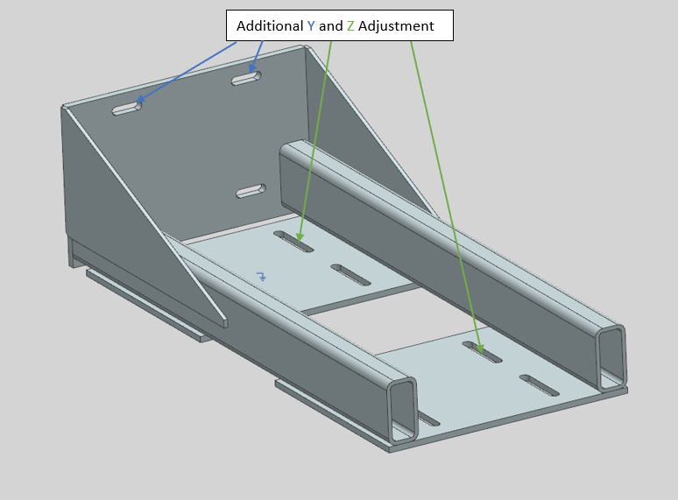
HWR Hatch Hanger
Requirements dictated that components inside the footprint of HWR hatch would require additional methods of installation.
HWR Hatch Hanger resolves the need for a Mirror Box that is positioned under the HWR hatch with no ceiling to mount to.
The design is a steel box tube cantilever structure.
Design iterations to follow as analysis begins for FDR (deflection, vibration, etc.)
Hatch Hanger plates designed to accept existing Mirror Box Hanger bolt pattern.

Slide 15
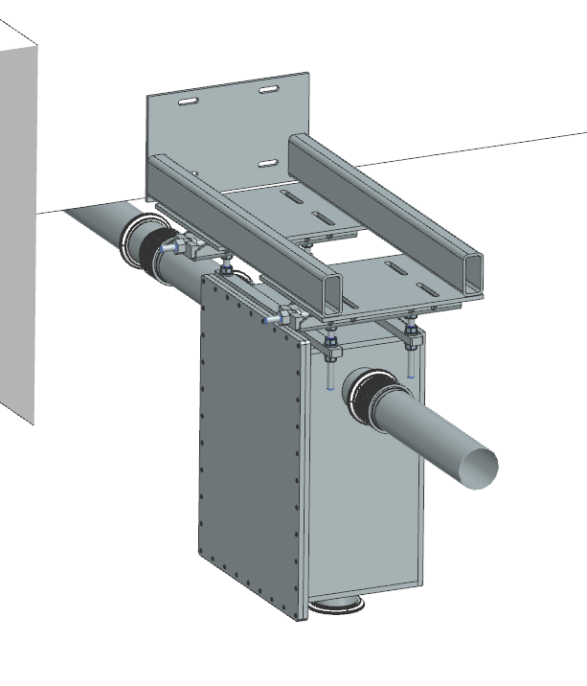
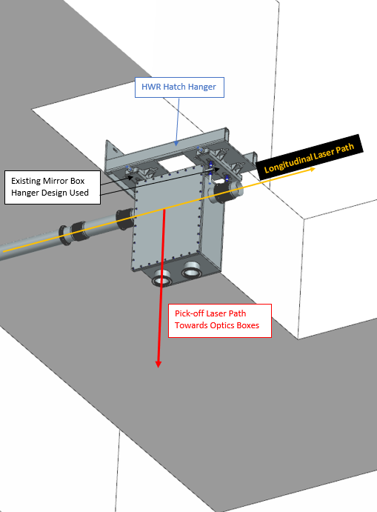
HWR Hatch Hanger cont…
Ground view – HWR Hatch Hanger essentially imitates an extension of the ceiling.
Note: Images shown here missing additional gussets.
Aerial Isometric View
The Mirror Box and HWR Hatch Hanger can be removed for HWR hatch use.

Slide 16
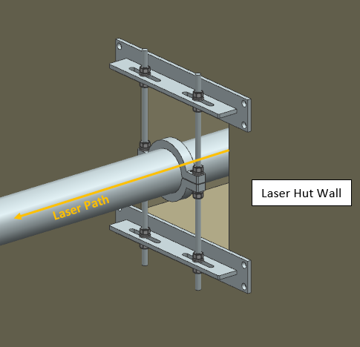
Laser Hut Wall Support
Vacuum loads are expected at the upstream and downstream ends of the Optical Transport Line.
The Laser Hut wall is concrete and provides a good location to tie into.
The Laser Hut Wall Support is mounted to the outside Laser Hut wall and provides support at the upstream end of the OTL.
The design contains sufficient alignment considerations in x, y, and z directions.

Slide 17
Device Alignment
Mirror Boxes, Beam Tube Hangers, and Laser Hut Wall Support will have alignment in x, y, and z directions.
Total alignment adjustment will be ±1” in all directions.
Fine alignment adjustments will be required.
Preliminary installation and alignment procedures are being worked on.
Randy Thurman-Keup has a more detailed explanation of the installation order, and alignment procedure.

Slide 18
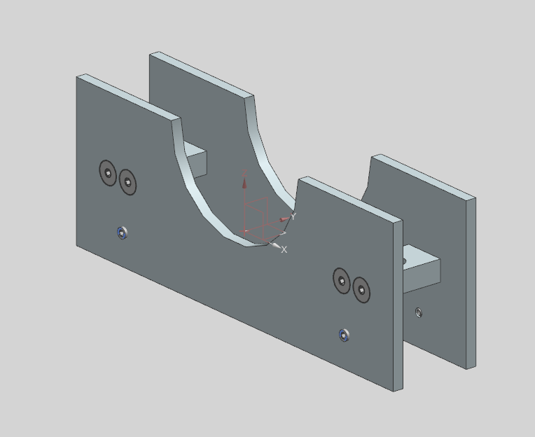
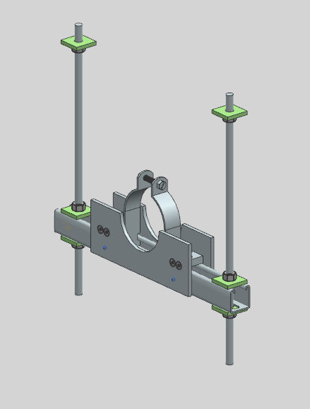
OTL Beam Tube Alignment Fixture
OTL Alignment Tool will help center and keep beam tube in place during initial alignment.
If beam tube needs removal or repair, alignment fixture will hold its position.
Beam tube clamps are able to be installed with alignment fixture in position.
Set screws for quick hold, holes for permanent Unistrut hold.

Slide 19
Vacuum & Safety Interlock System
The OTL is designed as a rough vacuum system with the goal of achieving <250 mTorr.
The Mirror Boxes are 100% stainless steel welded construction with a total 6 vacuum ports/openings.
2 main beamline ports utilizing the NW100 SS vacuum flanges with o-rings and clamps.
2 bottom ports (1 pickoff port, 1 feedthrough port), both utilizing NW100 SS flanges.
1 side mounted KF40 SS vacuum port with o-ring and clamp. To be used for gauging, pump out, etc…
1 main access lid - ¾” aluminum plate, with bolted o-ring and o-ring groove design.
Beam tube sections were detailed on slide 11.
O-rings are to be specified as EPDM or material with comparable radiation resistance and vacuum properties.
Estimated quantity of 80 o-rings, 50 bellows.

Slide 20
Vacuum & Safety Interlock System cont…
All elements of vacuum system shall follow standard UHV practices, including pre-clean and ultrasonic cleaning of vacuum parts.
Individual components and entire system shall be leak tight to a leak rate of 2.5x10^-10 Torr-L/s on a calibrated helium leak detector.
The vacuum pumping will consist of a rough vacuum pump at the center of the beam line. Gauging consisting of quantity 4 Pirani gauges (rough vacuum) will be installed, one at each end of the line, one near the middle, and one on the inlet of the pump. A roughing valve will isolate the pumping from the system when needed.
By making the laser transport line a vacuum system, we’re able to utilize a vacuum safety interlock switch to cut power to the laser when vacuum is let up to atmosphere.
The idea is to potentially have the safety switch where it can be valved out and tested independent of the beamline.
This will require that the roughing valve is a gate valve that can shut off the laser when closed, maintaining laser safety. Work with interlocks and Jinhao.

Slide 21
Quality Control
Quality of fabricated parts will be driven by the tolerances specified on the drawings.
Fabricated parts received from VMS or offsite vendors will be subject to inspection on important dimensions as specified by the designing engineer.
Quality of procured parts will be driven by the tolerances specified by the procurement specifications document provided to the vendor during the procurement process.
Procured parts will be subject to similar inspection process.
All vacuum components will be UHV cleaned and certified leak tight prior to installation. (Vacuum Group at NWA)
Mechanical Testing – Operate linear stages under vacuum, load test Hilti fasteners.

Slide 22
Summary…
The free-space laser option requires a low vacuum Optical Transport Line that is optically straight for its entire length.
The structures that support the OTL address the requirements and allow sufficient alignment considerations.
Installation and alignment procedures are still being worked out but have been extensively considered at this time.
Unique locations in the tunnel and their challenges are realized and have been addressed (HWR Hatch, Vacuum Loads).
Laser safety has been considered and has a solution (vacuum safety switch).
The preliminary design of the OTL shows it can meet the design requirements.

