Slide 1
Free-space Laser Alignment
Randy Thurman-Keup
PIP2 Laserwire Preliminary-Review Follow-up
Nov 7, 2022

Slide 2
Laserwire Locations
Twelve laserwire stations in the PIP2 Linac proper
The laser room is upstream of the H- source which is at 0 m

Slide 3
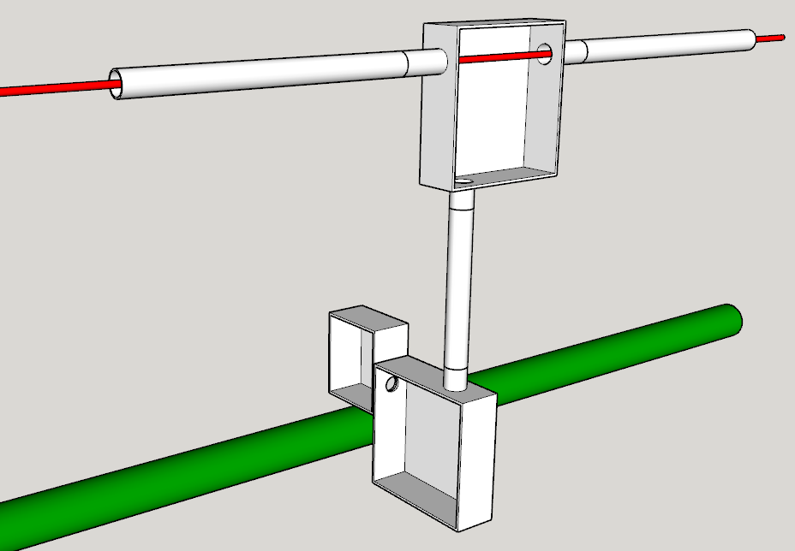
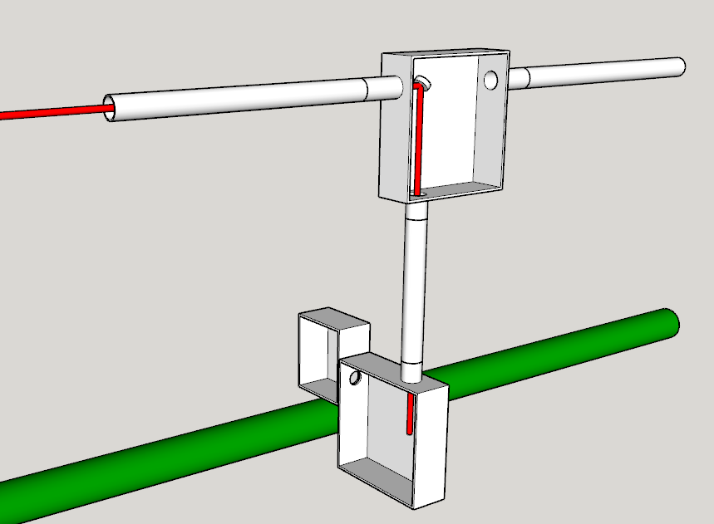
Laser Transport Functionality
Charge #2
Each Laserwire station has a transport line mirror box with an insertable mirror
Without mirror inserted
With mirror inserted
Transport Line
Laser
Mirror Boxes
Laser
Beamline
H- Beam
H- Beam
Beamline Boxes

Slide 4
Beamline Box
This optics section only used in free-space version
Charge #2
Laser from Mirror Box
Either discrete step
or linear stage
5
1
8
10
2
Mirror
8
5
9
3
3
Optical plate or breadboard
2
Linear stage
4
2
5
Focus Lens
1
5
4
6
Light-tight slide-on seal
7
3
4
7
Rails; maybe ball bearing
6
5
8
Sampler; Pellicle?
2
9
Photodiode
10
BPM
7
H- beam into page
Notes:
Emphasize importance of alignment to get vertical laser exact

Slide 5
Laser Transport Optics
Pursuing a transport line optical arrangement with a single optical waist generated by an initial collimating lens at the laser room
Each laserwire has an insertable pickoff mirror in the mirror box which leads to final focus lenses inside the beamline boxes
  Not shown here are other optical elements between the pickoff mirror and final lens
Initial
Collimating
Lens
Insertable Pickoff Mirror
Final
Focusing Lens
Laser
Optical
Waist
H-
Beamline
Laser
Room
Not to scale

Slide 6
Laser Transport Optics
Charge #2,3
A single waist but many pickoff points requires an optical evaluation of each laserwire location to ensure that the laser radius has the proper size at all points of interest
  Laser size does not become too large
  (or too small) down the transport
  Does not become too small on vacuum windows
  and optical elements
  Is small enough at the H- intersection
Laser optical behavior is more complicated
than basic thin lens, point source, etc…
  Slightly unintuitive
Four different waist sizes
Solid is M² = 1
Dashed is M² = 2

Slide 7
Laser Transport Optics
Charge #2,3
Area of interest
Plots are combinations of two focal lengths of collimating lens (500 mm and 1000 mm), and two nominal transport line waist distances (50 m and 100 m)
Test of sensitivity of waist to lens position
  i.e., control of waist via lens position, and stability of waist to small movements in lens position
Waist
Collimating
Lens

Slide 8
Laser Transport Optics
Charge #2,3
Determine danger of accidentally focusing laser on window
  Use 300 mm focal length focusing lens
  Use previous collimation lens scan result as input (100 m waist and 1 m focal length)
  Calculate focused laser size, distance from focus lens, and laser size on lens
Focused size and distance from focus lens
Laser size on focus lens
Area of interest

Slide 9
Laser Transport Optics
Charge #2,3
Laser size from source to focus lens
Five different collimating lens positions
Wide range of spot sizes
Need to control size down transport line (at initial setup)
  Cameras
    Laser Room
    MEBT
      Sufficient sensitivity
      Less radiation
    End of transport line

Slide 10
Laser Transport Optics
Charge #2,3
Laser size from focus lens through H-
Five different collimating lens positions
Focus point doesn’t move
  No danger of tight focus on windows
  Power on windows only a function of laser size at focus lens
    Controlled via previous slide description

Slide 11
Laser Transport Optics – Energy on Vacuum Window
Charge #3
Energy density on window depends on laser size on vacuum window
    Assume that window is midway between lens and H- beam
    Use 6 mm rms laser size on lens
At 100 μJ laser energy, the laser energy density on the vacuum window is
2.2 mJ/cm²
Power density depends on the number of pulses chosen
  Can run 50 100-uJ laser pulses per beam pulse at the 20 Hz linac rep rate and still be under our 3 W/cm² maximum power density requirement

Slide 12
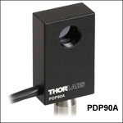
Laser Transport Optics – Feedback
Charge #2,3
Plan for monitoring of the laser position in each laserwire station beamline box
  See beamline box layout on earlier slide (labeled BPM)
Two possibilities
  Camera for full imaging
    Record position and apply to measured data
  Photodiode quadrant or lateral effect position sensor
    Could possibly be used for active feedback to the final laser room mirror
Neither solutions are particularly radiation tolerant
  Might need to replace periodically
Thorlabs Lateral Effect Position Sensor

Slide 13
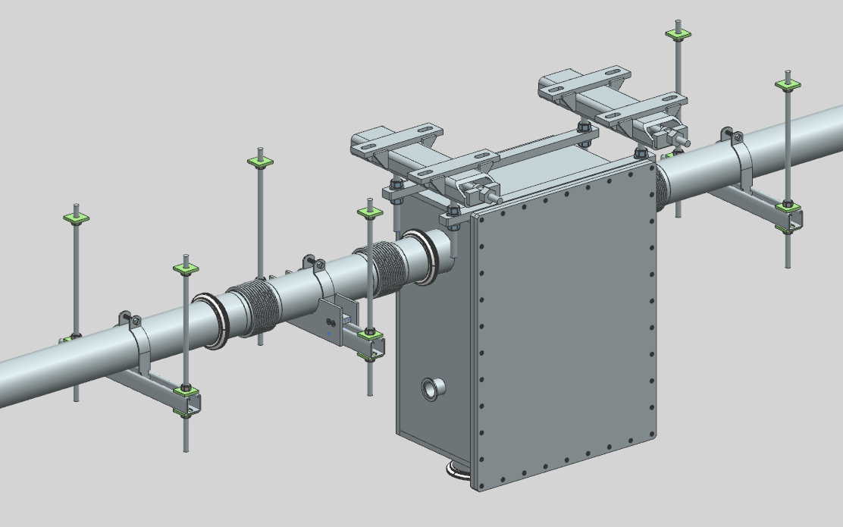
Alignment Activities – Transport Line
Charge #2
Alignment crew activities
  Install laser targets at exit of laser room and end of linac
  Mark installation points for each mirror box
    Transverse and Longitudinal marks
  Mark installation points for each
Install HeNe alignment laser
  Laser is aligned between the two
  previously installed targets at laser
  room and linac end
Mirror Box
Pipe Hangers

Slide 14
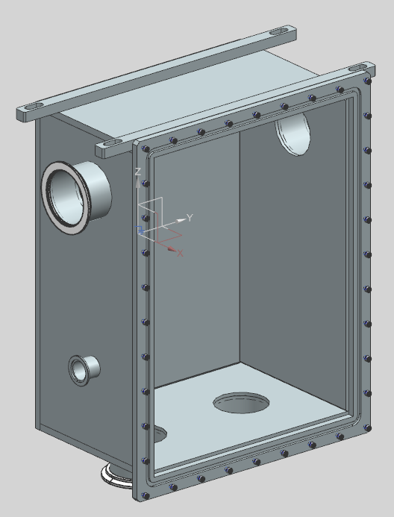
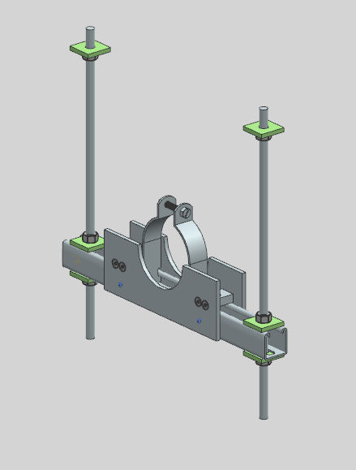
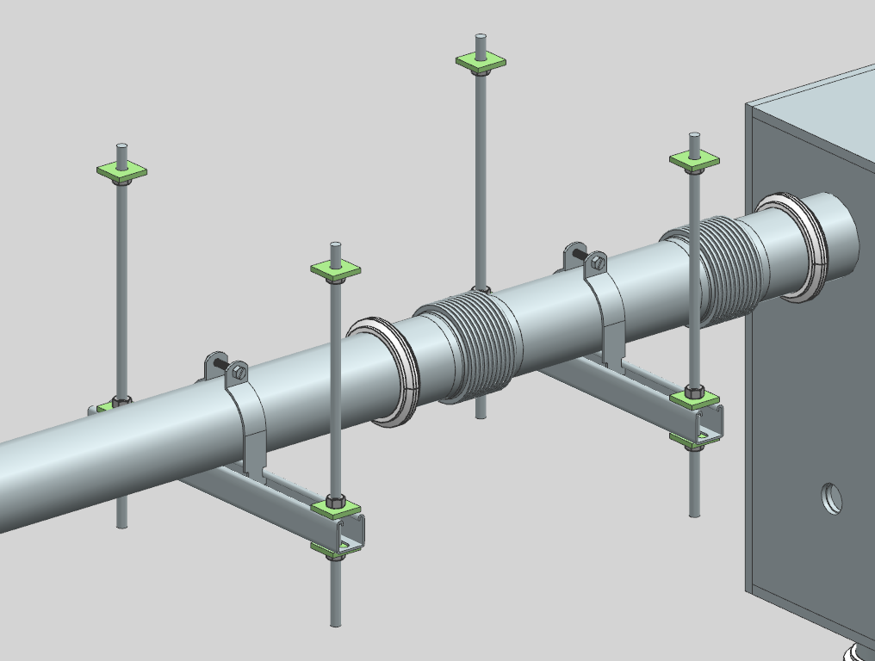
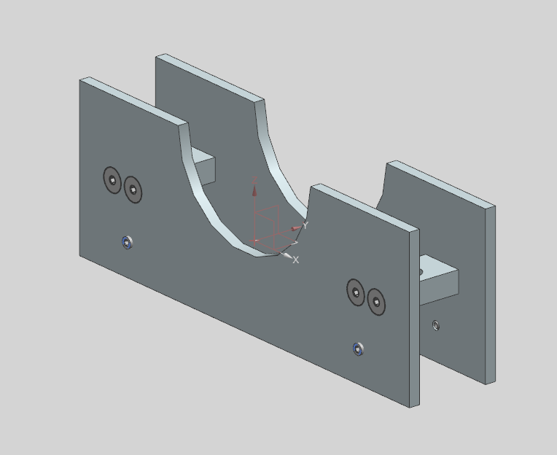
Alignment Activities – Transport Line
Charge #2
Install all mirror boxes
  Adjust longitudinal position to nominal as indicated by Alignment Team markings
  Adjust each box transversely such that the input and output flanges are concentric with alignment laser
Install pipes onto pipe hangers between mirror boxes
  Install using jig with laser target
    Aligning done prior to setting pipe
X
Alignment Laser
Target
(Second one on other side)
X
Alignment Laser
Pipe hanger alignment jig

Slide 15
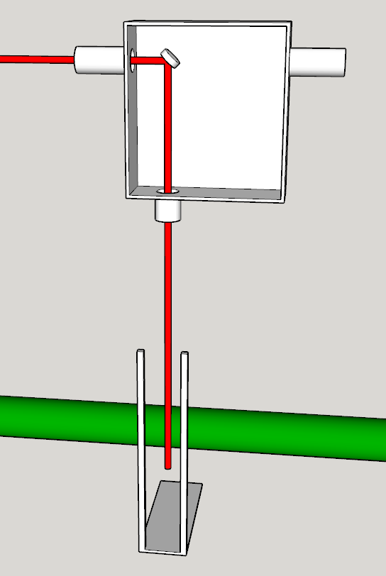
Alignment Activities – Beamline Box
Charge #2
Beamline box alignment can be done anytime after the transport line installation
Install mirror box mirror with longitudinal position adjustment
  Align mirror with alignment laser
Install alignment ‘beamline box frame’
  Open frame which fits as a real box and
  has a pair of vertical laser targets
Adjust downward alignment laser trajectory
  Mirror box mirror longitudinal adjustment
  and mirror adjustability
  Transverse position of beamline box frame
  Must traverse center of the two targets
X
Targets
Beamline box frame
X

Slide 16
Summary
Have a design for the transport optics
  Have considered control of the laser and potential issues with vacuum windows
Have a procedure for alignment of laser transport and beamline optics
  Transport alignment is coincident with installation of transport line
  Beamline box alignment is done after

