Slide 1
LaserWire Cost and Schedule
Brian Drendel
PIP-II Beam Instrumentation Laser Wire Design Follow-Up Review
Nov. 7, 2022

Slide 2
Overview
Charge #4
Comparing fiber vs free space system
  We are looking at cost and schedule impacts between the Fiber and Free Space technologies.
Labor Changes
  Initial evaluation shows that there will not be large changes.
  Additional installation scope will add 650h for installation.
M&S Changes
  Add Optical Transport Line and Mirror Box scope (new scope)
  Add Laser Scope
  Subtract overlapping costs from existing quotes.
Schedule Changes
  Changes will be minimal.
  Free space transport line build and installation are the schedule drivers.

Slide 3
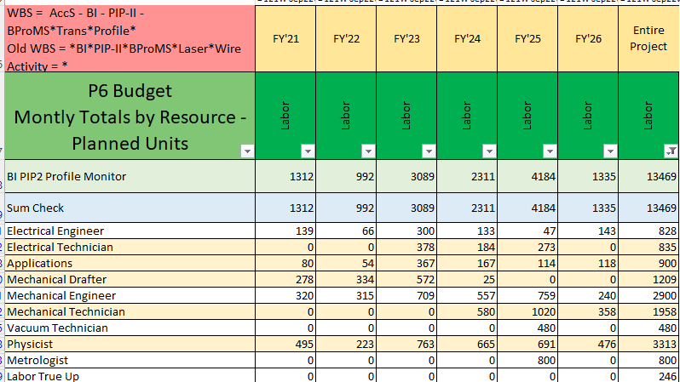
Current Laserwire Hours Totals
Charge #4
Current total is 7.7 FTE

Slide 4
Additional Labor Scope (Slide 1 of 2)
Charge #4
Add 650h for installation (estimate from Bob Steinberg)
Notes:
In order
HWR
Shop work at MWA is missing from here.

Slide 5
Additional Labor Scope (Slide 2 of 2)
This is new scope, with the majority of the labor hours in
  Transport Line Installation
    Mechanical Technician – 280h
  Mirror Box Installation
    Mechanical Technician – 133h
    Alignment – 104h

Slide 6
M&S Part 1: Add Optical Transport Line and Mirror Box
Charge #4
Adds $398K

Slide 7
M&S Part 2: Add Laser
Charge #4
Seed laser
  Short pulse $60K(could use the one from PIPII-IT)
  Long pulse CW laser 2K modulator $10K
Fiber Amplifier
  First stage >nJ level $30K
  Second stage >uJ level $70K
Free space amplifier
  Northrop Grumman amplifier $70K(including RBA($20K) unit and REA Unit($50K))
Total
  Adds $250K

Slide 8
M&S Part 3: Subtract Overlapping Scope
Charge #4
Step 1: Subtract overlapping scope
Cost reduced $824K
Largest reduction came from reduction in cost of the beamline laserwire unit (x13). Replaced by optical transport line and mirror box quote.

Slide 9
M&S total
Charge #4
Add Optical Transport Line Mirror Box Scope = +$397,288
Add Laser = +$250,000
Remove scope overlap = -$823,402
Grand Total = $177K savings from initial estimates
Estimates will be matured by
  More prototyping
  Updates on PIP2IT estimates.
  Updates on electronics estimates.
Estimate is good to ~20% which is consistent with design maturity.

Slide 10
LaserWire Optical Transport Line Schedule
Charge #4
Schedule as of 11/2/22
Design
Working with installation team
Free space transport line build and installation are the schedule drivers.
Electronics FDR
10/10/23
LW FDR
6/28/23
Procurement
Construction
Installation
HO MS
8/7/25
Linac
tunnel
AUP
9/26/24
Integrate System
Non-Beam
Commissioning
HO MS
4/8/26
May ‘24
WFE
Beam Commissioning
7/16/26
Today
FY22 FY23 FY24 FY25 FY26 FY27
Notes:
Raul – optics boxes for design are the biggest concern over tne next 8 months.
Procurement and construction may overlap somewhat.
Supply chain issues, don’t see any significant.

Slide 11
Summary
Charge #4
Comparing fiber vs free space system
  Based on initial estimates.
    Labor
      Adds 650h of installation
    M&S
      Initial estimates show a $178K savings
      Further maturation of cost estimates is expected.
    Schedule
      The team has confidence that we can maintain the same schedule.
The cost impact is break even within uncertainty of design maturity.

