Slide 1
Safety, Risk and Quality
Vic Scarpine
PIP-II Beam Instrumentation Laser Wire Design Follow-Up Review
Nov. 7, 2022

Slide 2
Outline
PIP-II BI Quality Control Plan
Beam Instrumentation PIP-II Risk Register Entries
Laserwire safety interlock system

Slide 3
PIP-II BI Quality Control Plan (PIP-II docDB 5520)
Charge #3
Beam instrumentation plan is consistent with the overarching PIP-II 121.03 Accelerator Systems Quality Assurance (QA) Plan (PIP-II docDB 4805)
  Covers the various acceptance and testing steps required to ensure these deliverables are provided to the project while meeting the required specifications
  Covers hardware, firmware, and software components for components for pickups and electronics
  Covers components for all BI systems including laserwire
Notes:
The QC Plan needs to be in a draft state by PDR. Identifying stakeholders, soliciting and incorporate feedback from them, and ultimately releasing the QC plan is required by FDR.

Slide 4
PIP-II Risk Register (PIP-II docDB 1233)
Charge #3
Any new or emerging risks shall be managed per the PIP-II Risk Management Plan (PIP-II docDB 163)
Identified critical project risks are documented in the PIP-II Risk Register (PIP-II docDB 1233)
During PIP2IT, BI had one laserwire risk register entry
  Preferred Laser profiling technology/transport mode does not work – retired based on PIP2IT
    Fiber-based system works but low signal-to-noise
Added 2 new risks related to the laser profile transport
  Premature aging of laser profile transport components
    Optical fibers is a specific concern in all fiber-based system
  Laser transport vacuum failure
    Under study. Part of this review.

Slide 5
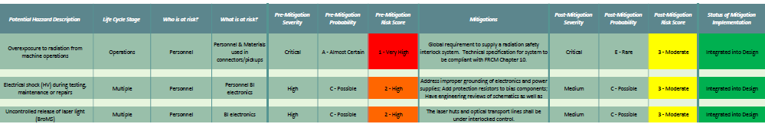
Prevention Through Design (PTD)
Charge #3
Safety risks to personnel were assessed using a Prevention through Design approach
  Identified major ones for the PDR; others maybe added as design and procedures evolve
  Lasers present a unique hazard for PIP-II profile instrumentation.
In addition, laser induced damage to the laser vacuum windows present a risk of damage to the SRF cavities.
Optical design to prevent over-focusing at vacuum windows (Alignment Talk)
Monitor laser power with interlock system
Limit optical power density on vacuum windows
Notes:
Tried to identify major ones for the PDR. As you progress in the design and procedures, I wouldn't be surprised if you identified smaller issues, ergonomics during installation or maintenance, lifting tooling for heavy items, etc., if that makes sense
These systems are covered under safety documents:
Fermilab FESHM 4260 – Lasers
ANSI Z136.1 – Safe Use of Lasers
Inclusion of lab laser safety officer in design verification
Inclusion of safety systems for interlock protection

Slide 6
Laserwire Operational Safety
Charge #3
Laser safety system protects personnel
Laserwire safety is controlled by interlock system. Primary monitored components of interlock system are:
  Laser hut door switches
  Optical transport line vacuum switch
  Beamline laserwire station switches
  Beamline vacuum switch
Control release of laser light from laser hut via
  Closing optical shutter
  Dropping of laser interlocks
PIP2IT laserwire interlock system will be the bases for PIP-II laserwire interlock system.

Slide 7
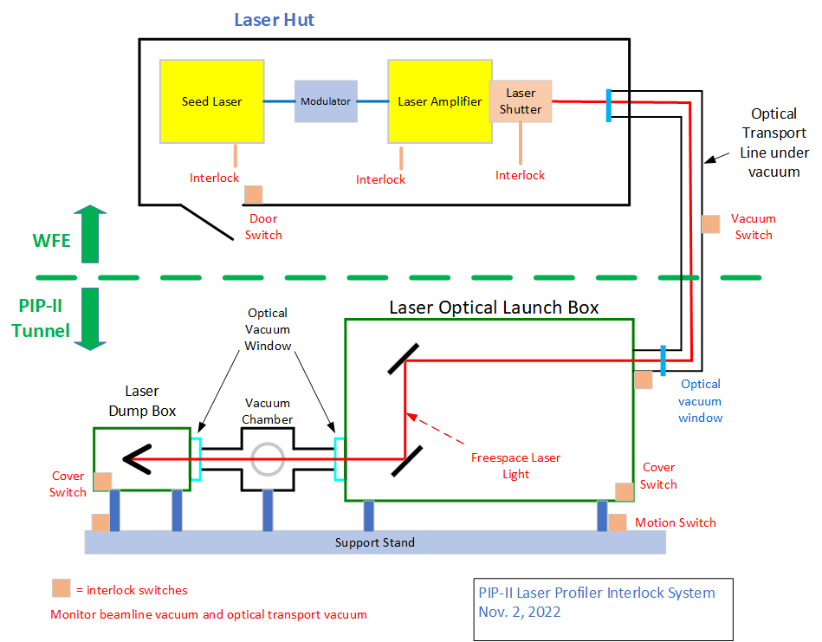
PIP-II Laserwire Interlock System
Charge #3

Slide 8
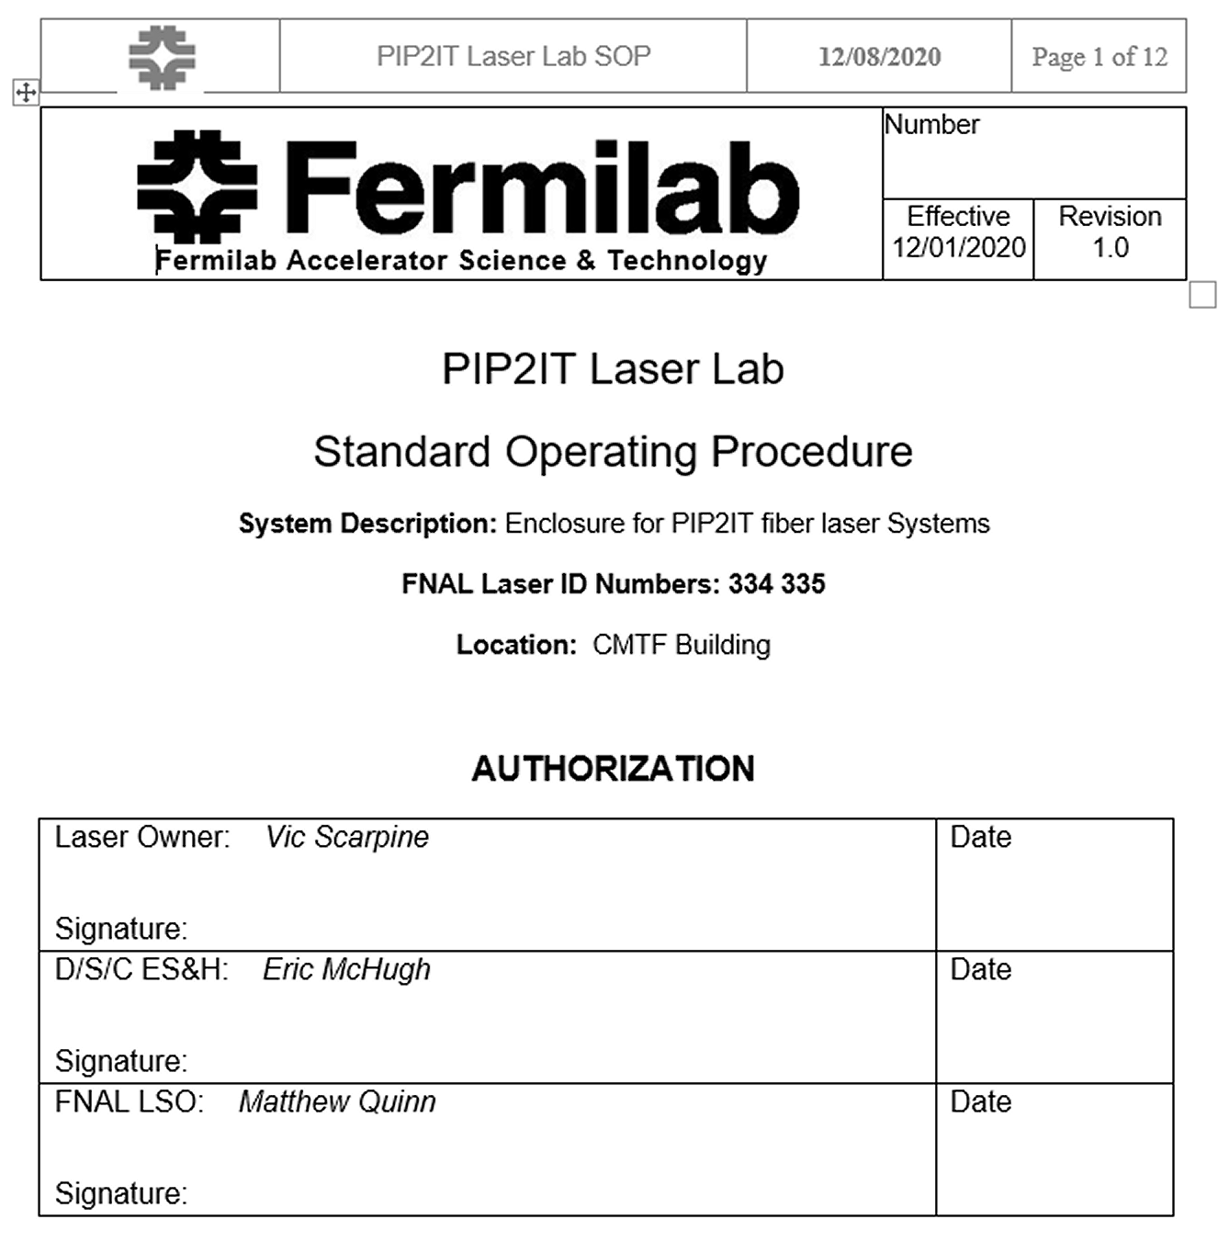
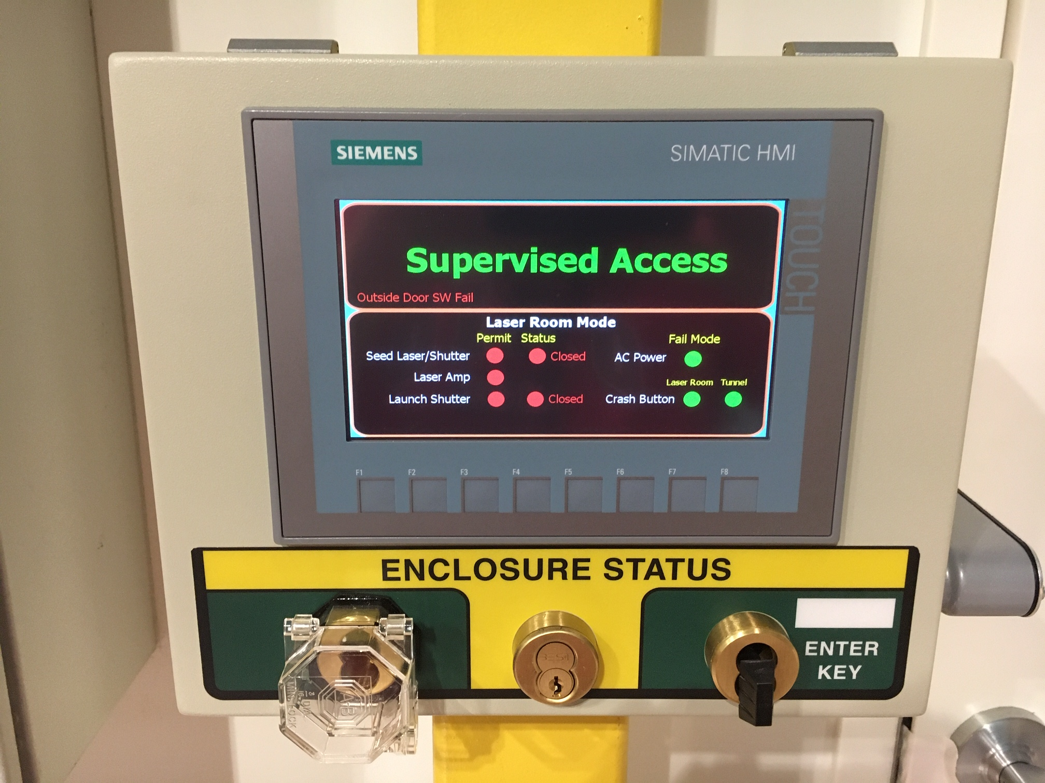
Laser Safety Operation for PIP2IT Laserwire
Charge #3
PIP2IT Laser Interlock access control and status
PIP2IT Laser Operation Procedure

Slide 9
Summary
Charge #3
PIP-II beam instrumentation has a quality plan including the laserwire profile monitor system.
Laserwire risks have been identified.
  Prevention through design to mitigate risks
  Monitor laser parameters for laser operations
Laserwire safety
  Follows PIP2IT laser safety system
  Interlock system to control uncontrolled release of laser
  Light-tight mechanical design or optical transport line and beamline laserwire stations
  Working with ESH and laser safety officer in design and operation of laserwire system

