Slide 1
A Brief Overview of artdaq
The artdaq Developers
ICARUS DAQ Workshop
9 November 2022

Slide 2
artdaq System Layout (Full)
Routing Manager
Routing Manager
Routing Manager
Online Monitor
Hardware
Board
Reader
Event
Builder
Data Logger
Dispatcher
Online Monitor
Hardware
Board
Reader
Event Builder
Data Logger
Hardware
Board
Reader
artdaq organizes the DAQ system into “layers”, with each process in each layer sending data to each process in following layers. BoardReaders communicate with readout hardware, EventBuilders construct full events from BoardReader “Fragments”, and EVBs, DataLoggers and Dispatchers provide art environments for running experiment-specific filtering, data writing, and analysis tasks.

Slide 3
artdaq System Layout (ICARUS)
Online Monitor
Hardware
Board
Reader
Event
Builder
Dispatcher
Online Monitor
Hardware
Board
Reader
Event Builder
Hardware
Board
Reader
In ICARUS DAQ, the EventBuilder art processes handle writing data to file and communicate directly with the Dispatcher. RoutingManagers are not used.

Slide 4
Design of artdaq - Transfers
Host 1
Transfer plugins are used to transport Fragments between artdaq layers. artdaq provides Shared Memory, TCPSocket and Autodetect transfers
Each Transfer is a point-to-point link, between two “ranks” in the artdaq system
DataSenderManager gets information from the applicable RoutingManager to determine the destination for a given Fragment’s Sequence ID
If RoutingManagers are not used, Fragments are sent round-robin
Rank 0
Rank 2
DataSender Manager
Shared Memory Transfer Plugin 0-2
DataReceiver Manager
Auto Transfer Plugin 1-2 (TCP)
TCP Transfer Plugin 0-3
Host 2
Rank 1
Rank 3
DataSender Manager
Autodetect Transfer Plugin 1-3 (Shmem)
DataReceiver Manager

Slide 5
Board Reader
BoardReaderCore
CommandableFragmentGenerator
Data Sender Manager
To EBs
HW
Fragment Generator
User-defined Fragment Generator reads hardware and creates Fragments. CommandableFragmentGenerator (CFG) packages those fragments based on Data Request Mode. BoardReaderCore calls CFG::getNext function to retrieve Fragments, then calls DataSenderManager’s (DSM) sendFragment method to send them on to EventBuilders.

Slide 6
Commandable Fragment Generator
getMonitoringDataLoop
getNext_
Fragment Buffer
Apply Requests
checkHWStatus_
Requests
Fragments Output
Receive Requests
CommandableFragmentGenerator uses up to four threads for data-taking, hardware status checking, request reception and request processing. If threads are not used, calls to getNext_ and checkHW_ occur synchronously in getNext (no underscore) method.
Notes:
ApplyRequests uses one of several modes (Buffer, Window, Single, Sequence, …) to match data from the buffer and send to output

Slide 7
Event Builder/Data Logger (DataReceiverCore)
DataReceiverCore
art Processes
Shared Memory
Data Receiver Manager
Fragment Header
Shared Memory Event Manager
Request
Sender
Fragment Header
Data Location
Shared Memory Reader (RawInput)
artdaq art Modules
Output Plugin(s)
Fragment Header
RawEvent
Transfer Plugins (one per source)
Data Location
Fragment Data
DataReceiverManager (DRM) runs a thread for each source. It reads the Fragment header and sends it to SharedMemoryEventManager (SMEM) to get the location in shared memory where the data should be placed. The Transfer Plugin is then instructed to receive data to that location. Once all Fragments for an event have been received, the Shared Memory Reader reads the event into art. The shared memory has an event-based structure, with a dual-semaphore system to synchronize access.

Slide 8
artdaq art Process
RootNetOutput
(EventBuilder to DataLogger or DataLogger to Dispatcher)
Data Sender Manager
RawInput (Shared Memory Reader)
artdaq art Modules
art::Event
Shared Memory
RootDAQOut
(DataLogger to Disk)
Artdaq::RawEvent
RootDAQOut
(DataLogger to Disk, Can use SelectEvents to separate into streams)
Shared Memory Event Receiver
TransferOutput
(Dispatcher to Online Monitor)
Transfer Plugin
art reads from the shared memory using the SharedMemoryEventReceiver. RawInput uses the SharedMemoryReader to translate the artdaq::RawEvent objects received using SMER to art::Event objects.
Events are fed into the provided art job, and sent to the configured outputs. art is configured at initialize by the EventBuilder and DataLogger, and when the register_monitor command is received in the Dispatcher (using the art job specification contained in that command).

Slide 9
Dispatcher and Online Monitors
DataReceiverCore
art Processes
Online Monitors
Shared Memory
Data Receiver Manager
Fragment Header
Shared Memory Event Manager
Fragment Header
Data Location
Shared Memory Reader (RawInput)
artdaq art Modules
Transfer Output
Transfer Input
artdaq art Modules
Fragment Header
Raw Event
Transfer Plugins (one per source)
Data Location
Fragment Data
The Dispatcher is similar to the EventBuilder and DataLogger, except that one art process is run per Online Monitor. When the Online Monitor registers itself with the Dispatcher (during the construction of the TransferInput art source), it sends the job description for the art process on the Dispatcher.

Slide 10
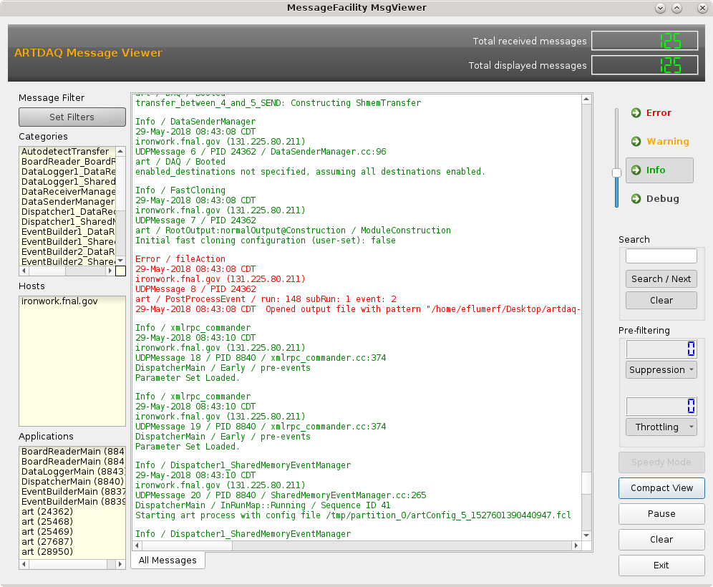
Message Logging and Metrics
artdaq uses TRACE and art’s MessageFacility for message logging and a custom metric interface for run-time metric reporting.
Designed to be a “fire-and-forget” system with minimal impact on operations
TRACE is a high-speed memory-based messaging interface
Messages can be enabled and disabled at run-time
MessageFacility supports a plugin-based output
artdaq provides a MessageFacility viewer for displaying messages
Metric data is aggregated on a dedicated thread
Metric Plugins handle sending metrics to various metric reporting services
Notes:
TRACE decided what to send to MessageFacility.

Slide 11
Configuring artdaq
artdaq inherits the FHiCL configuration language from art
Each component of artdaq is individually configurable, though “sensible defaults” are used wherever possible
Many run-time configuration variables are handled by the DAQInterface run control
Complete documents are stored in the data files and in the “run_records” directory managed by DAQInterface
Some key FHiCL Parameters:
max_fragment_size_words
fragment_id
request_mode
request_windows_are_unique
art_analyzer_count
expected_fragments_per_event (DAQInterface book-kept)
art_command_line (useful for debugging, can run art in GDB)

Slide 12
Configuring artdaq
Example Configurations:
https://github.com/art-daq/artdaq_daqinterface/tree/develop/simple_test_config
“Demo” Config
https://github.com/art-daq/artdaq_daqinterface/blob/develop/simple_test_config/demo/component01.fcl
https://github.com/art-daq/artdaq_daqinterface/blob/develop/simple_test_config/demo/EventBuilder1.fcl
https://github.com/art-daq/artdaq_daqinterface/blob/develop/simple_test_config/demo/DataLogger1.fcl
https://github.com/art-daq/artdaq_daqinterface/blob/develop/simple_test_config/demo/Dispatcher1.fcl

Slide 13
DAQInterface
DAQInterface is a Python package which handles the tasks of configuring artdaq for a runtime environment and managing the artdaq processes throughout their lifetime
It performs a large amount of “FHiCL book-keeping” to ensure that Transfer Plugins are correctly configured to find their endpoints, and that log and output file names are specified in the desired data directories
It starts the artdaq processes using SSH, and communicates with them over XMLRPC
It sends state transmission commands and checks the status, both to ensure that commands execute within a certain time-frame and to detect when artdaq processes exit abnormally
It also maintains the “run record”, which includes metadata about where the artdaq processes were run and the fully-resolved configuration documents

Slide 14
artdaq Plugins
artdaq supports plugins for performing various tasks within the DAQ, including
Data readout from hardware (FragmentGenerators)
Metric reporting
Message routing (See artdaq_mfextensions for examples of custom message routers)
Data transfers
Analysis and filtering (artdaq art Modules, which differ from standard art modules in that they should try to be self-contained (e.g., not use external database services if possible) and performant)
Command and Control (XMLRPC is the only current plugin of this type)
Routing Policies (FIFO, Round Robin, others)

Slide 15
Further Reading
Wiki documentation is available on the artdaq Github repositories:
https://github.com/art-daq/artdaq/wiki
https://github.com/art-daq/artdaq_demo/wiki
Migrated from Redmine wikis, some formatting and link errors may remain
Doxygen Source Code Browser
https://artdaq.fnal.gov/Doxygen/index.html
Services login required

