Slide 1
University of Liverpool
Progress
K. Bridges
J. Coleman
G. Elertas
L. Hawkins
S. Hindley
H. Throssell
K. Hussain

Slide 2
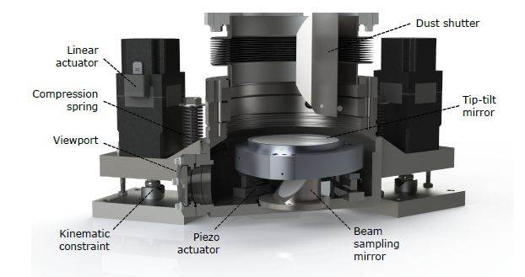
Retro-reflection Phase-shear Platform
Liverpool delivering for MAGIS
Retro-reflection phase-shear platform
Parts of steering chamber
Detector mechanics
High precision in-vacuum optics
Liverpool is also participating in physics simulations team

Slide 3
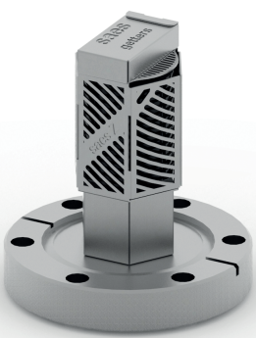
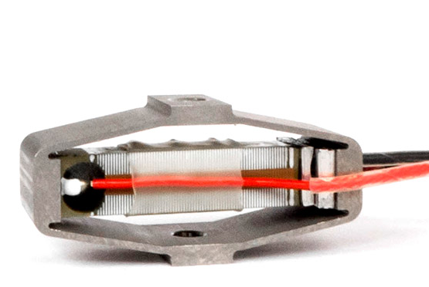
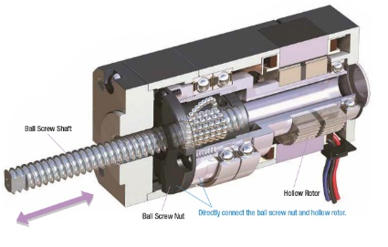
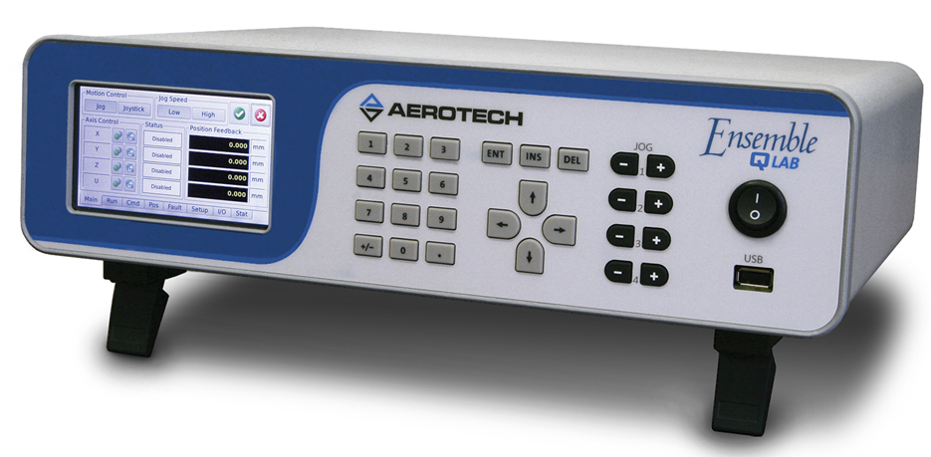
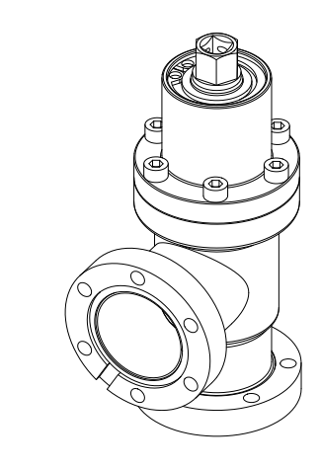
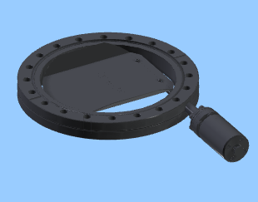
Specified Components & Ordered
PZT actuator:
Cedrat Technologies
APA60SM
6x Ordered
PZT controller:
Aerotech
EnsembleQLAB-A-3AX
3x Ordered & arrived
NEG pump:
SAES
CapaciTorr Z 100
2x Ordered & arrived
Stepper motor & controllers
6x Ordered & arrived (Retro-chamber)
3x Ordered (Steering chamber)
Angled valve:
VAT
54132-GE02
2x Ordered & Arrived
Viewport shutters:
Lesker
DS800VPS
2x Ordered & Arrived
Notes:
Supplier name Model No. Price Continuous current Peak current Trigger in, delay Bandwidth / sampling rate Setpoint resolution ADC resolution Amp Noise (mV) Amplifier ENOB Input range Amp range Sensor Aerotech Ensemble QLAB $ 4,950 130 mA 300 mA, 10 ms Yes, 50ns 20 kSPS 20 bit 16 bit (18 bit) 0.27 19.3 +/- 10V -30 to 150V Voltage (capacitive option)

Slide 4
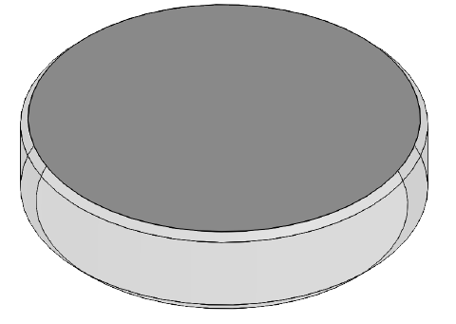

High Precision in Vacuum Optics
University of Liverpool sourcing high precision in vacuum optics for interferometry beam
Coating samples are being checked at Fermilab for UHV readiness
Highly specified 2 lenses and 5 mirrors:
Specs:
  λ/1000 flatness (5 mm radius at the centre of optics)
  Mirror 4 AR coated for 6 different wavelengths (461 nm, 679-707 nm, 780-785 nm, 805-815 nm, 980 nm, 1064 nm)
  Material Corning 7979 0AA for lenses and Corning 7980 for mirrors
  UHV compatible
  Custom sizes and shapes
Vendor found -
Order is imminent

Slide 5
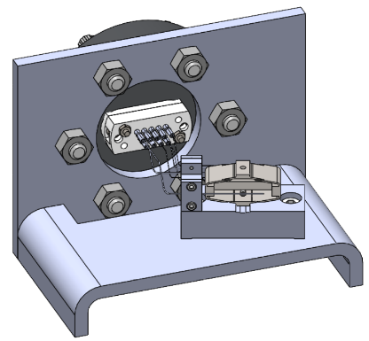
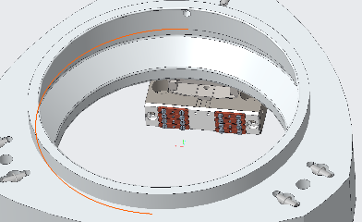
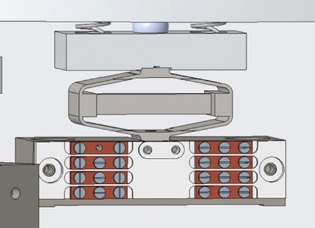
Cedrat’s Piezo Cables
8 thin in-vacuum cables
  Soldered on the PZT
  Need to reach DB9 feedthrough
Cedrat design was too expensive (more than cost of PZT)
  Main cost is work at clean lab
Liverpool design
  Separate feedthrough and PZT cables
  In-built strain relief
  Can use standard flexible in-vacuum cables
  Simpler to assemble
  Materials used copper and MACOR
Cedrat design
Liverpool design

Slide 6
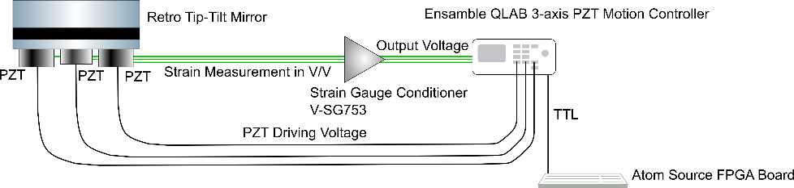
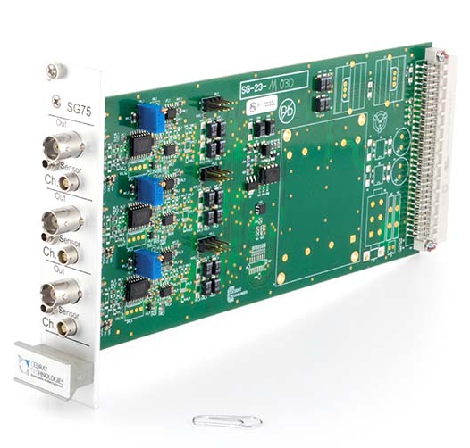
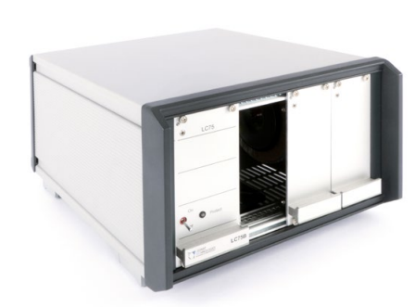
Out of Vacuum Cable Length Limitations for PZT and Strain Gauge
Strain gauge cable has to be as short as possible
  To get no signal degradation cable length of less than 1 m is recommended by Cedrat
This requires retro-chamber enclosure to house the strain gauge electronics
V-SG753
Box for V-SG753

Slide 7
Liverpool Workshop Progress

Slide 8
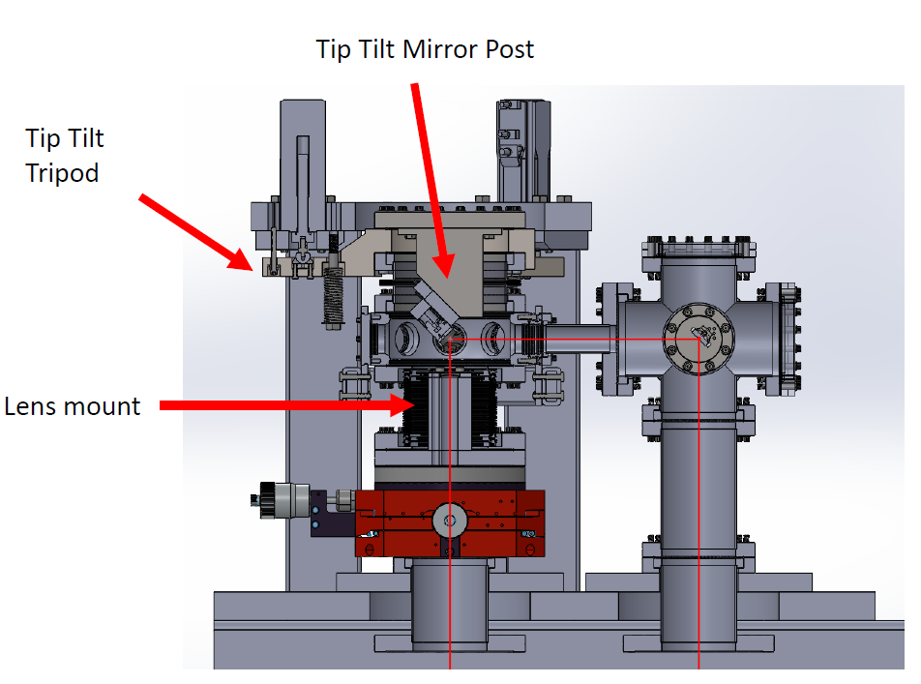
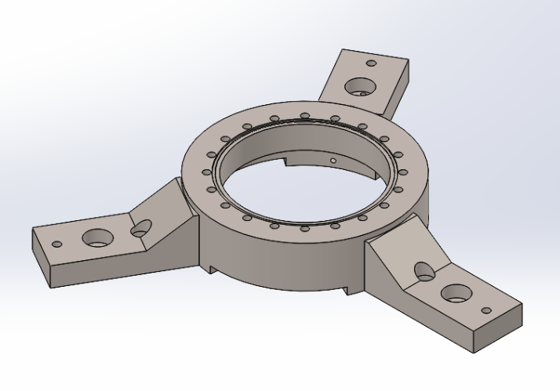
Steering Chamber
Liverpool making the body and legs of the chamber:
Notes:
Worm drive turning the lead screw
Range of few degrees, with accuracy of 15 µrad
MCL in vacuum PZT for Coriolis force compensation
Range 10 mrad, resolution 20 nrad

Slide 9
Back up

Slide 10
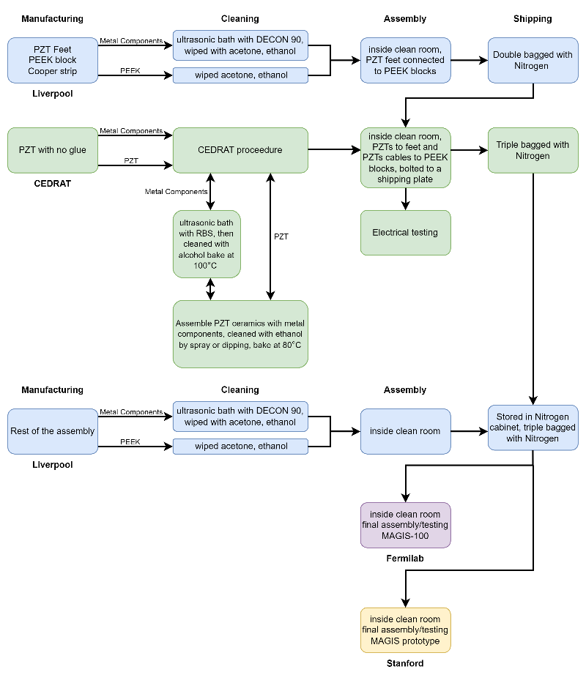
Assembly Procedure
Initial idea how the retro-chamber is going to be assembled
Important for PZT manufacturing
  Requires machined parts from Liverpool to mount the PZT

Slide 11
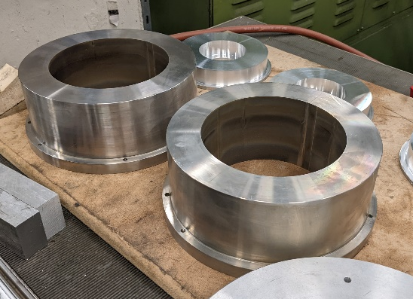
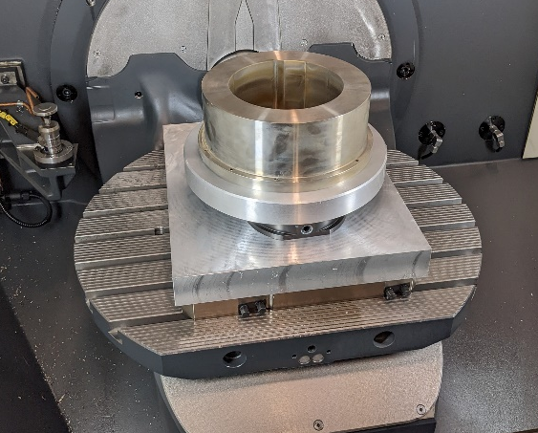
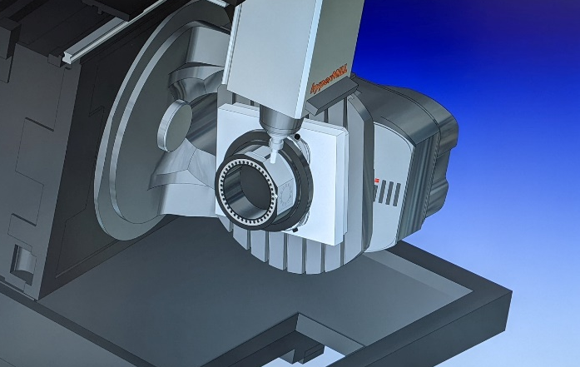
Parts made by Liverpool Detector Development Manufacturing Facility
Currently manufacturing the vacuum chamber for the phase-shear platform
Notes:
Add 4th pic

Slide 12
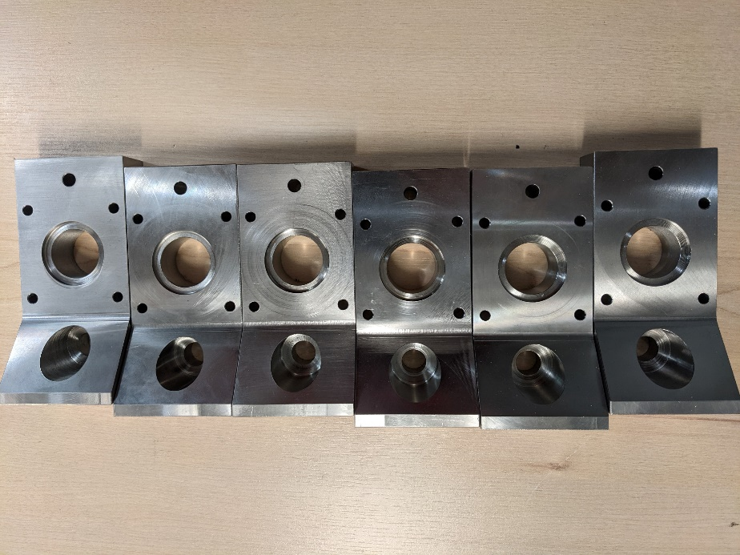
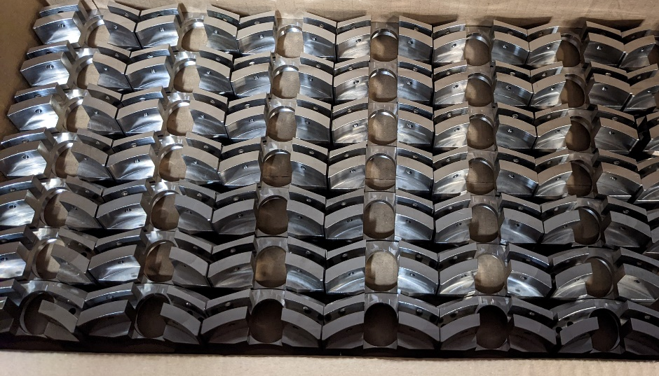
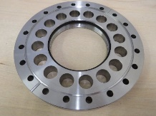
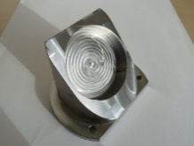
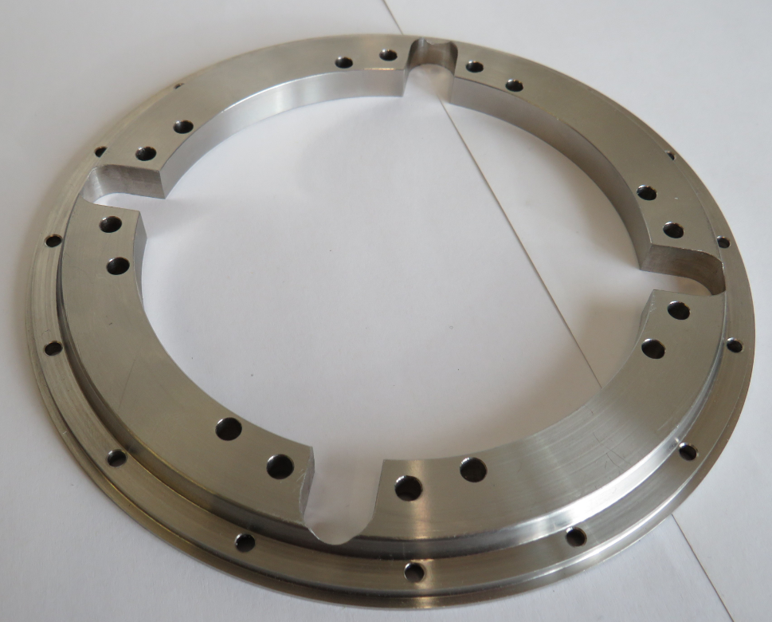
Parts made by Liverpool Detector Development Manufacturing Facility
Vacuum chamber legs
In-vacuum mirror mounts
Lens flange mount
In-vacuum beam sampling mirror mount
Heavy duty groove grabber plate
Notes:
Add 4th pic

