Slide 1
Study Chromaticity in NuMI horn
Katsuya Yonehara
ML meeting
10/26/2022

Slide 2

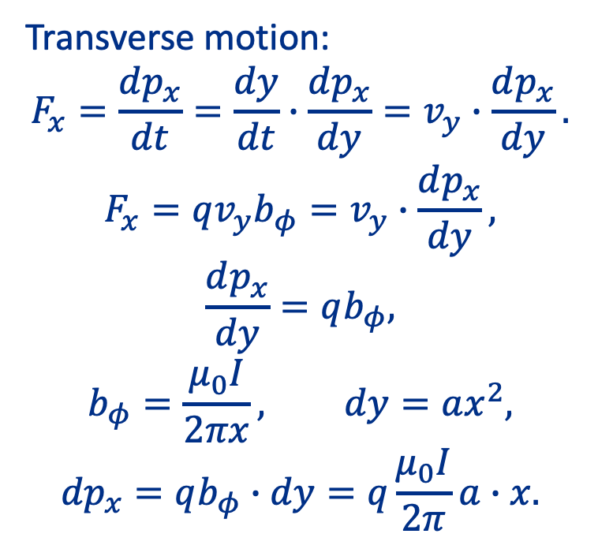
Analytical Formula (I)
Transverse motion:
$$F_{x}=\frac{dp_{x}}{dt}=\frac{dy}{dt}∙\frac{dp_{x}}{dy}=v_{y}∙\frac{dp_{x}}{dy}.$$
$$F_{x}=qv_{y}b_{φ}=v_{y}∙\frac{dp_{x}}{dy},$$
$$\frac{dp_{x}}{dy}=qb_{φ},$$
$$b_{φ}=\frac{μ_{0}I}{2πx}, dy=ax^{2},$$
$${dp}_{x}=qb_{φ}∙dy=q\frac{μ_{0}I}{2π}a∙x.$$
x
b_{φ}
v_{y}
F_{x}
y
Condition for focusing
Note: This is one dimensional motion. No $\dot{φ}$.

Slide 3

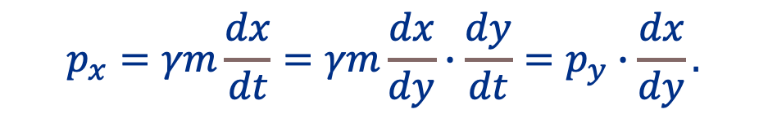
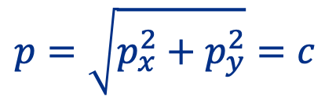
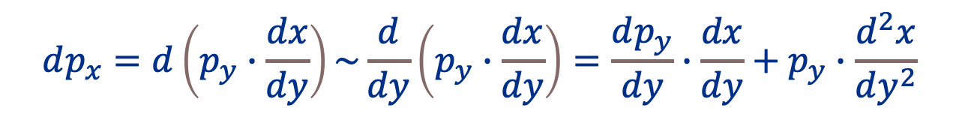
Analytical Formula (II)
$$p_{x}=γm\frac{dx}{dt}=γm\frac{dx}{dy}∙\frac{dy}{dt}=p_{y}∙\frac{dx}{dy}.$$
p, γ is constant
$$p=\sqrt{p_{x}^{2}+p_{y}^{2}}=c$$
$$\frac{p_{x}}{p_{y}}≅\frac{dx}{dy}$$
Known relation
$$dp_{x}=d\left(p_{y}∙\frac{dx}{dy}\right)\sim \frac{d}{dy}\left(p_{y}∙\frac{dx}{dy}\right)=\frac{dp_{y}}{dy}∙\frac{dx}{dy}+p_{y}∙\frac{d^{2}x}{dy^{2}}$$
I think this is tricky. I guess I need to differentiate all variables,
$d\left(p_{y}∙\frac{dx}{dy}\right)=\frac{d}{dp_{y}}$ $\left(p_{y}∙\frac{dx}{dy}\right)+\frac{d}{dx}\left(p_{y}∙\frac{dx}{dy}\right)+\frac{d}{dy}\left(p_{y}∙\frac{dx}{dy}\right)$
Can I remove the first and second terms?

Slide 4

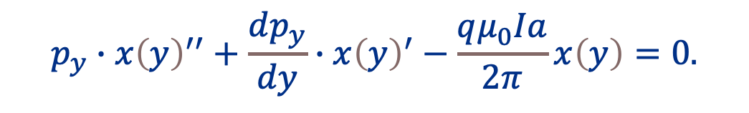

Analytical Formula (III)
$$p_{y}∙{x\left(y\right)}^{′′}+\frac{dp_{y}}{dy}∙{x\left(y\right)}^{′}−\frac{qμ_{0}Ia}{2π}x\left(y\right)=0.$$
$$\frac{dp_{y}}{dy}\sim 0$$
If
Coupling term
Beam converged if sign of second term is +
Beam diverged if sign of second term is -
$$x^{′′}−\frac{qμ_{0}Ia}{2π∙p_{y}}x=0$$

Slide 5
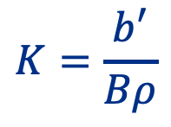

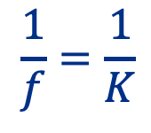
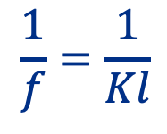
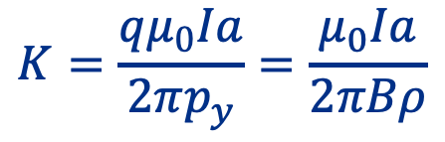
Compare with conventional equation of motion
$$x^{′′}+K\left(y\right)∙x=0$$
Dimension check
Quad focusing
Horn focusing
$$K=\frac{b′}{Bρ}$$
$$K=\frac{qμ_{0}Ia}{2πp_{y}}=\frac{μ_{0}Ia}{2πBρ}$$
[m-2]
[m-1]
$$\frac{1}{f}=\frac{1}{Kl}$$
$$\frac{1}{f}=\frac{1}{K}$$
This difference is caused by the dimension of “a” which has the dimension m-1. This unit comes from the parabola condition. I do not know how I treat this to match for the conventional equation of motion… Should “a” be a dimensionless parameter?

Slide 6
Summary
This model seems to be corrupted!
  I do not find a dimension match between the conventional equation and the proposed one
  I guess that I cheat when I stretch dpx
  I should establish the analytical model from other way

