Slide 1
DUNE Rucio Deployment and Plans for the Token Era
Steven Timm (Fermilab) / Doug Benjamin (BNL)
DUNE Data Management Group
Rucio Workshop 10 Nov 2022

Slide 2
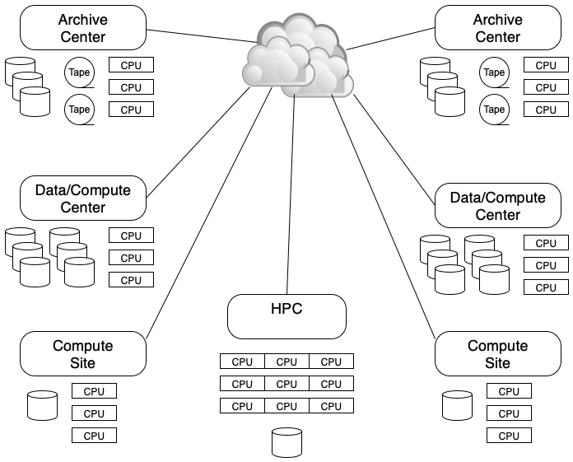
DUNE Compute and Storage Facilities
17 active RSEs around the world. 21PB data
Primary tape sites at FNAL and CERN, (raw data)
Secondary tape sites at RAL and IN2P3 (reconstructed data)
Topology – data at “local” “nearby” “stream”
Data model: Copies of current MC and reco on disk in US and Europe.

Slide 3
DUNE Software Terminology
Name | Purpose | Token-ready
Rucio | Replica manager | See this conf.
FTS3 | File transport | Testing
Declaration/Ingest Daemon | Declare files to Rucio | * (Planned)
MetaCat | Metadata daemon | * (Planned)
Data Dispatcher | File URL delivery to jobs | * (Planned)
dCache (Enstore) |  | Yes
EOS (CTA) |  | Yes
Other storage providers |  | ?
HTCondor | Batch system | Yes
GlideinWMS | Workload system | Yes
Workflow manager | Workflow system | No

Slide 4
CILogon Token Issuer
Operated by CILogon on behalf of Fermilab-based VOs
Driven by LDAP server which is filled from Fermilab’s FERRY DB
Authentication for tokens can be via Fermi Kerberos or the Fermi IdP
Issues tokens completely compatible with WLCG schema (see next slide)
Fermi users can use “htgettoken” utility
(don’t have to make an oidc client, etc.)
Common commands such as job submission, file transfer, get tokens if necessary, transparent to the user
Short-lived bearer tokens stored on volatile disk area.
Unlike IAM, CILogon is not an all-in-one server--does not support legacy voms-proxies (will keep legacy VOMS server up)
Any oidc-client workflows or SCIM scripts will need to be tested against this server too.

Slide 5
Physics Groups dCache
First exposure of DUNE users to token-based storage
11 extra token roles created, each with extra scope to create files in one group directory—quotas based on GID
{
"wlcg.ver": "1.0",
"aud": "https://wlcg.cern.ch/jwt/v1/any",
"sub": "dunendsim@fnal.gov",
"nbf": 1666573161,
"scope": "storage.create:/dune/scratch/users/timm storage.create:/dune/persistent/physicsgroups/dunendsim compute.create compute.read compute.cancel compute.modify storage.read:/dune",
"iss": "https://cilogon.org/dune",
"exp": 1666583966,
"iat": 1666573166,
"wlcg.groups": [
"/dune",
"/dune/neardetsim"
],
"jti": "https://cilogon.org/oauth2/453f0e3107421319a1b837bf2cd9ff13?type=accessToken&ts=1666573165975&version=v2.0&lifetime=10800000"
}

Slide 6
DUNE Data Challenge and Processing Workflows
New Workflow System being scale tested in Data Challenge 4.
5 copies * 500 TB of test data spread out around the world.
Ultra-late-binding: select workflow task and file to be processed at run time
Generic jobs are submitted to sites
Handle the tasks of requesting a workflow and file,
Use production credentials to access storage on behalf of the user.
Data is downloaded or streamed from nearest Rucio RSE
Use Rucio upload to send results back to Rucio RSE
This generates a lot of single file rules, want to get around this eventually.
Currently all in-job storage access done by X.509 proxy
Expect switching to tokens will be straightforward
All inputs and outputs under production ownership now,
Want to keep it that way in token era.

Slide 7
Current Permission Layout
Contrast—Fermilab (many users) and other sites (all the same user.
At Fermilab individual token subjects (and DN) map to individual user names—and then ”dunepro” owns all the production files
At remote sites all files managed Dunepro or the equivalent voms role /dune/Role=Production
This is the only way we know to make it so that the rucio daemon can move files via rules and delete them.
If we are missing something please let us know.
Corner cases exist:
most dCache space mounted @ FNAL via NFS v4.1, files can end up with different owners between tokens and unix.
X.509 proxies can write directories tokens can’t, and vice versa.

Slide 8
Constraints From External Software
All DUNE pilot jobs already being submitted with tokens
Grid Community Toolkit already end-of-life (as of May 2022)
Some key software still available in EPEL but not assured.
User job submission with tokens is in beta “Jobsub-lite”
HTCondor 9.0 supporting GSI goes away March 2023
There are rough plans to carry X.509 proxy in jobs for writing storage
Will have to maintain this hybrid mode at least until Rucio token support is ready (2024)?
May have to maintain this hybrid mode until our last DUNE SE supports tokens (end of LHC Run 3).

Slide 9
Questions on future token-exchange workflows
DUNE has variety of storage providers
EOS, XRootD, dCache, Enstore, CTA, DPM, ECHO, STORM, Ceph
Details of who owns the files are crucial
dCache @ Fermilab may be different than dCache @ BNL
DUNE’s goal to try to make all files movable/readable/deleteable by the rucio daemon
Expiration times of tokens—how long
Do they have refresh tokens on them
Scenarios to avoid:
User uploads file to Rucio which the rucio daemon then can’t move or control.
Multiple users owning various branches of a hashed rucio directory tree
Load on token issuer?

Slide 10
Future Plans
All our European storage elements shared with some other WLCG VO’s
Would be nice to have documented a hybrid configuration so we can test tokens in 2023-2024 time frame.
Goal: Be ready to use tokens for all storage when Rucio token support is complete
Will participate in WLCG data challenge 2024 using tokens.

Slide 11
BACKUP SLIDES

Slide 12
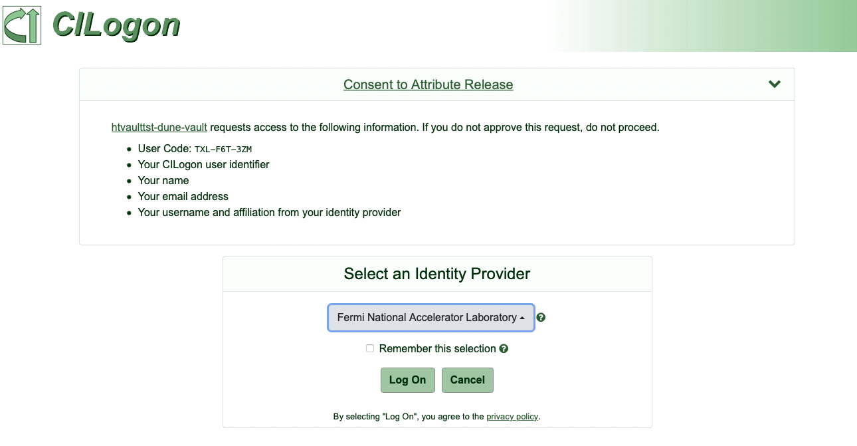
CILogon Web Auth Screen Shot

