Slide 1


Magnets 302.2.06
Coil Fabrication at BNL
Jesse Schmalzle - BNL
HL-LHC AUP Rebaseline DOE Rev. – December 13-15, 2022

Slide 2
Outline
Scope, Interfaces, Team
Progress / Achievements
COVID impacts
COVID BCRs
Schedule
Cost and Schedule Performance & VAR Reports
Estimate at Completion
QA / QC
Risks
ES&H
Summary

Slide 3
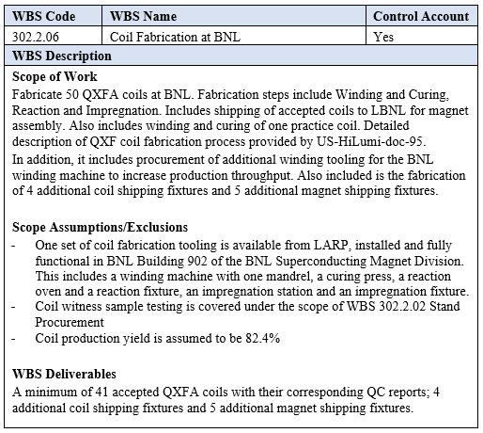
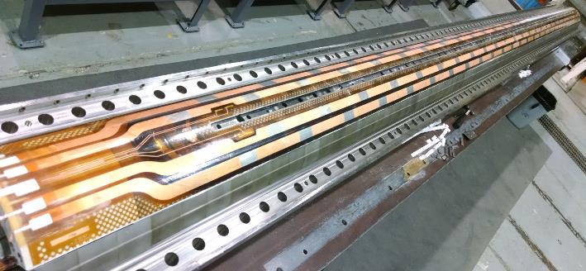
WBS 302.2.06 - Scope
Charge #9
Fabricate 50 coils.
  Fabrication includes winding, curing, reaction, impregnation and shipping.
  Deliver a minimum of 41 accepted coils.
  Production yield:
    Originally assumed to be 87.5% (1 in 8 rejected).
    Revised expected yield 82.4%, based on past performance.
    3 coils have been added to scope.
WBS Dictionary (US-HiLumi-doc-39)
Impregnated Coil

Slide 4
WBS 302.2.06 - Interfaces
Charge #9
Coil Fabrication interfaces with several other activities.
  Q1/Q3 Cryo-assembly Interface Control Matrix (US-HiLumi-doc-219).
Interface control documents (ICDs) detail the flow of materials and data from one WBS to another.
  Receive cable and coil parts from FNAL (US-HiLumi-doc- 270).
  Receive reaction witness samples from FNAL (and send them back after reaction) (US-HiLumi-doc-279).
  Send completed coils to LBNL (US-HiLumi-doc-309).

Slide 5
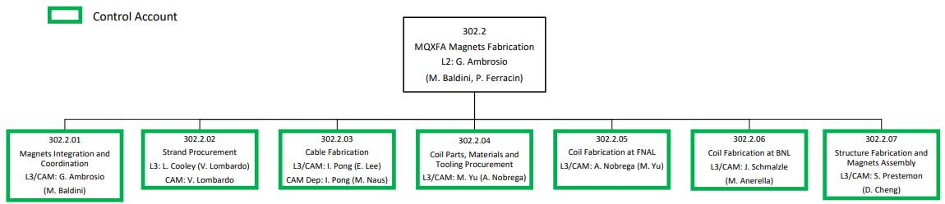
WBS 302.2.06 - Team
Charge #4
Organization Chart - US-HiLumi-doc-104
Technical Support
C. Atanasio
S. DiLoreto
M. Hartsough
G. Jochen
T. Levine
J. Martinelli
M. Milidantri
J. Perreco
W. Themann
T. Van Winckel

Slide 6
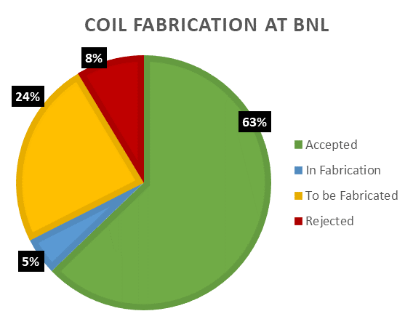
WBS 302.2.06 – Progress / Achievements
Charge #5
Coil fab started in late 2018.
Coil fabrication to date:
  29 coils completed.
  5 coils in progress (2.5 complete).
  3 coils rejected.
  3 coils on hold.
Yield originally assumed to be 87.5%, updated to 82.4%.
  Current BNL coil yield:
  88% after coil fabrication
  80% after magnet assembly & test
- Assumes 1/2 of coils on hold are accepted
- Rejected % does not indicate coil yield
Design is the same at FNAL & BNL.
  BNL working to FNAL Coil Drawings.
BNL Coil fab production readiness review completed April 2020.
Coil acceptance reviews for every magnet.

Slide 7
WBS 302.2.06 – COVID Impacts
Charge #1
Coil fab was halted for approximately 14 weeks while BNL was closed.
AUP coil fabrication was made a priority on re-start.
  Coil techs were included with 1st group to return.
Four coils were in progress at time of shutdown:
  QXFA211 – Impregnated coil. Coil remained closed in the impregnation fixture, hanging in the impregnation tank.
  QXFA212 – Reacted coil with leads soldered. Coil stored in the lower half of the reaction fixture, clamped with several formblocks and covered in plastic.
  QXFA213 – Reacted coil. Coil remained closed in the reaction fixture, in the oven.

Slide 8
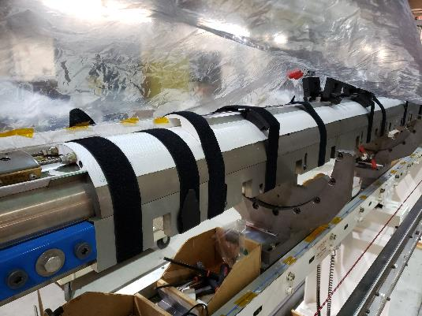
WBS 302.2.06 – COVID Impacts
Charge #1
Four coils were in progress at time of shutdown:
  QXFA214 – Inner layer wound and cured. Coil stored on mandrel in winding machine, inner layer pushers bolted in place supporting midplane, numerous Velcro straps securing coil OD and coil ends, coil covered in plastic.
    Unusual for coil to be stored longer than a few days in this state.

Slide 9
WBS 302.2.06 – COVID BCRs
Charge #1
Contingency consumption:
COVID BCRs – total $620k:
  BCR 0144, 0149, 0154, 0160, 0163 – COVID Shutdown – Cost $189k
  BCR 0168, 0188, 0199, 0216, 0246 – COVID Inefficiencies – Cost $233k
    Originally assumed efficiency to be 87.5%, later stopped based on observations.
  BCR 0279 – one additional coil at BNL – Cost $186k (COVID Portion)

Slide 10
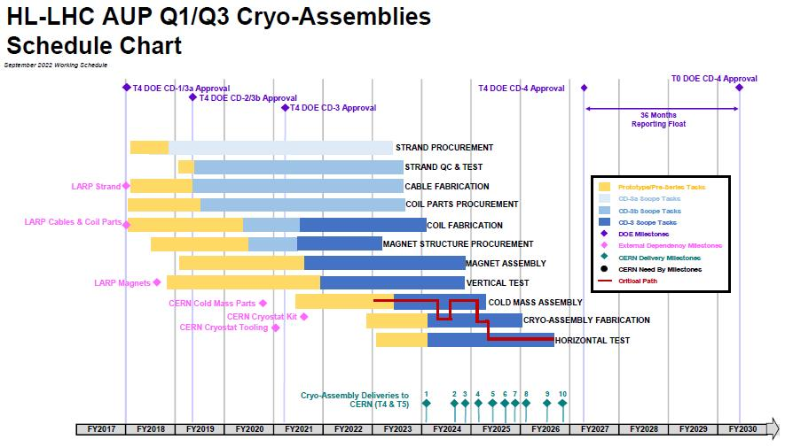
WBS 302.2.06 - Schedule
Charge #2
Coil fab not on or close to critical path, continuing at peak production to stay ahead of magnet fab.

Slide 11

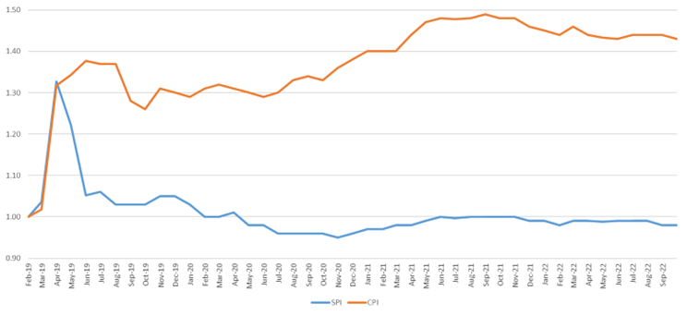
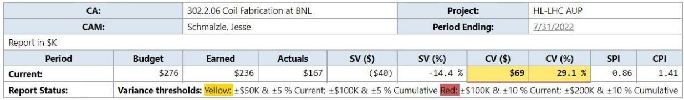
WBS 302.2.06 – Cost & Schedule Performance
Charge #2
Early coil fab labor under budget.
  Did not require the full learning curve multiplier.
  Coils no longer include multiplier.
Coil fab continued to run under budget.
  Labor estimates were updated (reduced) in 2020 & 2021.
Tooling fabrication was completed early and under budget.
CPI = 1.43
SPI = .98
Variance reports completed monthly:

Slide 12

WBS 302.2.06 – Estimate at Completion
Charge #2
  Estimate at Completion (EAC) = $12.5M
  Actual Cost to Date (CTD) = $9.1M
  Estimate to complete – $12.5 - $9.1 = $3.4M (EAC-Actual CTD)

Slide 13
WBS 302.2.06 - QA / QC
Charge #4
AUP Quality Assurance Plan (US-HiLumi-doc-80).
Coil Fabrication quality assurance plans include:
  Manufacturing & Inspection Plan (MIP) - approved by CERN.
  Electrical checks – in process and final checks before shipping coils.
  Mechanical measurements (coil azimuthal size, length).
  Reaction witness samples for each coil.
  Coil data is saved to CERN Manufacturing & Test Folders (MTFs).
Detailed travelers (work control procedures) for all fabrication steps.
  QA representatives review and approve all travelers.
Interface traveler captures data from cable fabrication thru coil fabrication and coil receiving inspection at LBL.
QA Plan in QXFA Series Coil Production Specification (US-HiLumi-doc-2986).
Electrical QA for QXFA Coil Fabrication (US-HiLumi-doc-521).

Slide 14
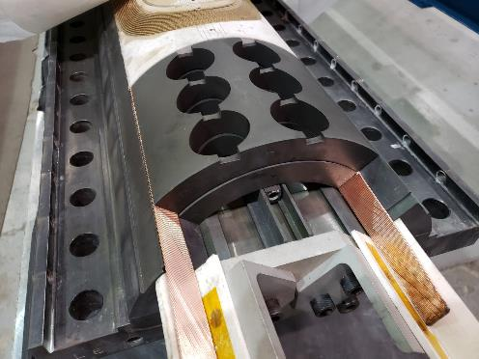
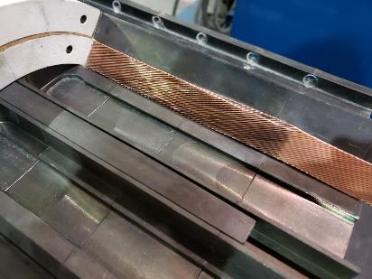
WBS 302.2.06 - QA / QC
Charge #4
Cause and corrective actions for rejected coils (205, 208, 232):
  Coil 205 – cable damaged during winding.
    Cause: slack in cable, cable dropped off guide pulley when resume after pause.
    Corrective action: improved tooling – added guard, revised procedure – incorporated interlock.
    Partially wound coil was unwound, coil parts were recovered.
  Coil 208 – cable damaged during curing.
    Cause: cable out of position during curing
    Corrective action: improved tooling – added clamps, revised procedure – inspect / verify.
    Coil was dismantled, coil parts recovered.
  Coil 232 – cable strands damaged during prep for reaction.
    Cause: coil lead pinched between tooling pieces as fixture was closed.
    Corrective action: revised tooling – additional clearance for lead & added lead support spacers, revised procedure – added inspection / signoff.
    Coil was dismantled, coil parts recovered.

Slide 15
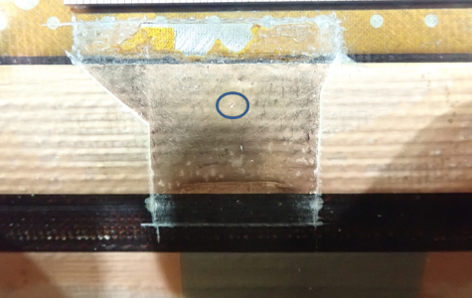
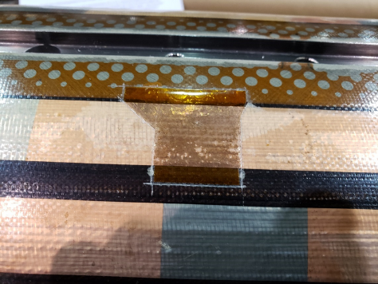
WBS 302.2.06 - QA / QC
Charge #4
Cause and corrective actions for on hold coils (210, 226, 228):
  Coil 210 – cable strands damaged during prep for impregnation.
    Cause: damage occurred while scraping away excess solder after lead splicing.
    Corrective action: revised procedure – eliminated use of scraper, added silicone pad to help prevent buildup of excess solder, brush away excess liquid solder while hot, use soldering iron to remove excess hardened solder if needed.
    Repair: solder fill damage area, impregnate coil.
  Coil 226 – heater to coil short.
    Cause: glass bead from laser cut impregnation fiberglass cloth.
    Corrective actions: switch to hand cut fiberglass cloth.
    Repair: remove glass bead, add Kapton insulation and re-impregnate coil.
  Coil 228 – coil to pole resistance below spec.
    Non-conformance report awaiting CERN review / approval.

Slide 16
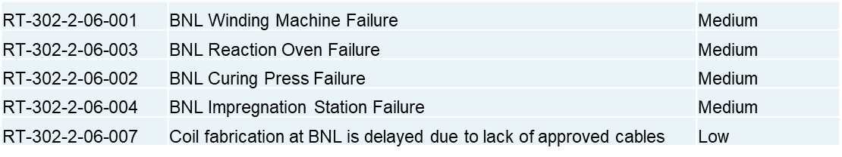
WBS 302.2.06 – Risks
Charge #3
Coil fab risks included in risk register (US-HiLumi-doc-79).
  Equipment / Machines have been historically reliable.
  Have some critical spare components on hand.
  Risk of coil failure above assumption is addressed in WBS 302.2.01 (RT-302-2-01-005).

Slide 17
WBS 302.2.06 – ES&H
Charge #10
AUP Hazard Analysis (US-HiLumi-doc-1121).
  Coil fabrication ES&H considerations:
    Chemicals (Boron Nitride, Mold release, Epoxy, Soldering flux).
    Electrical Hazards (Hipot checks, Impulse checks).
    Liquid Argon (cryogen).
    Lifting/Handling.
  Precautions taken include:
    Training, PPE, ventilation, etc.
    Dedicated fixtures for lifting coil, react / impreg fixtures. Reviewed, load tested and approved.
ES&H representatives review and approve all travelers.
COVID – working under guidelines.
  Avoid working in close proximity wherever possible.
  Face mask as required (based on local COVID levels).
Coil fabrication has excellent record – no issues / injuries.

Slide 18
Summary
Coil fabrication underway since end of 2018 and will finish in 2023.
Interfaces are flowing smoothly.
Coil yield addressed with BCRs and by implementing lessons learned.
COVID impact:
  Lockdown may have impacted coil 214 performance.
  Efficiencies resumed at ~100% after short time.
ESH&Q remains a priority.
Thank you. Questions?

Slide 19
-
Back Up Slides…

Slide 20
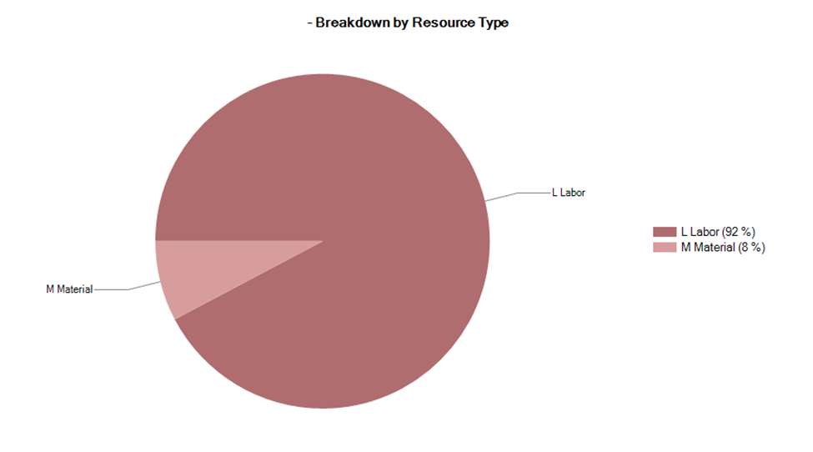
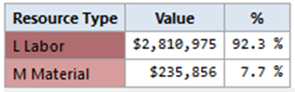
Resource Type Breakdown
Fully burdened values.

Slide 21
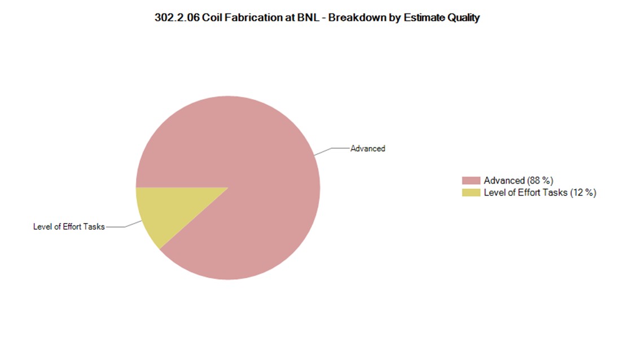
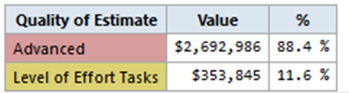
Estimate Quality
.

Slide 22
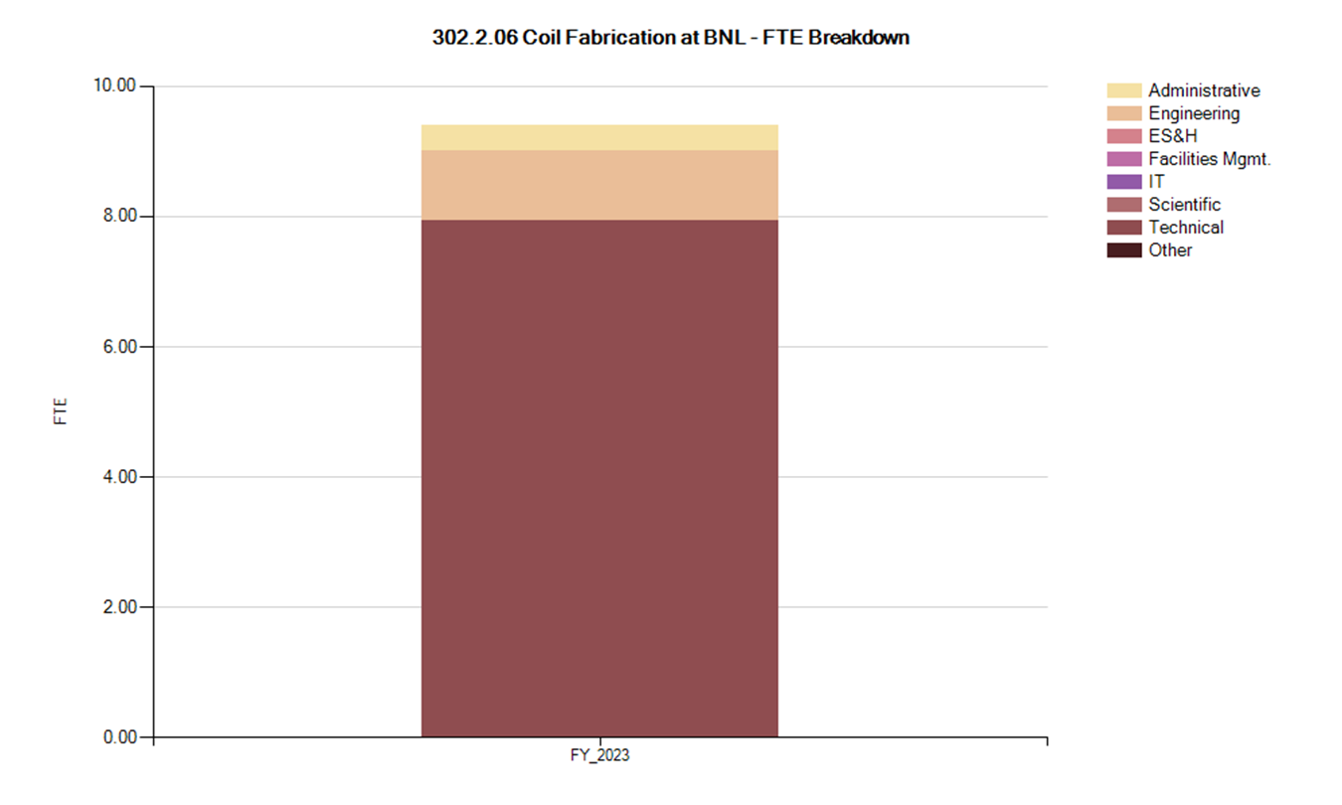
FTE Breakdown
.

Slide 23
WBS 302.2.06 – Other BCRs / CVs
Top-10 non-COVID BCRs & cost variance:

Slide 24
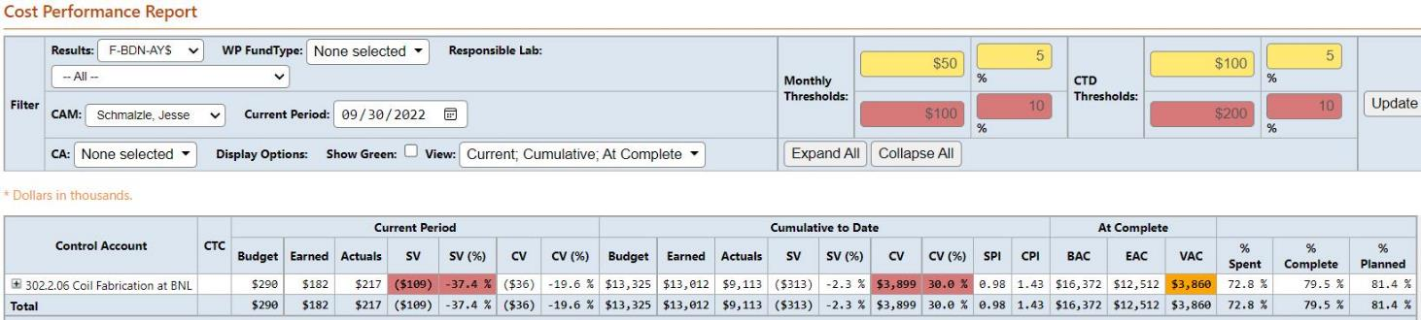
Cost Performance Report
BAC = $16.4M
Cumulative SPI = .98, CPI = 1.43

