Slide 1


Magnets 302.2.03
Cable Fabrication
Ian Pong – LBNL (L3 and CAM)
Elizabeth Lee – LBNL (L3 deputy)
Mike Naus – LBNL (CAM deputy)
HL-LHC AUP Rebaseline DOE Rev. – Dec. 13th–15th 2022

Slide 2
General Outline
Scope, Interfaces, Dependencies & Team
Achievements since CD-3
Contingency Consumption
COVID and Abnormal Escalation Impacts
Schedule
Cost and Schedule Performance
Estimate at Completion
QA/QC
Risks
ES&H
Summary

Slide 3
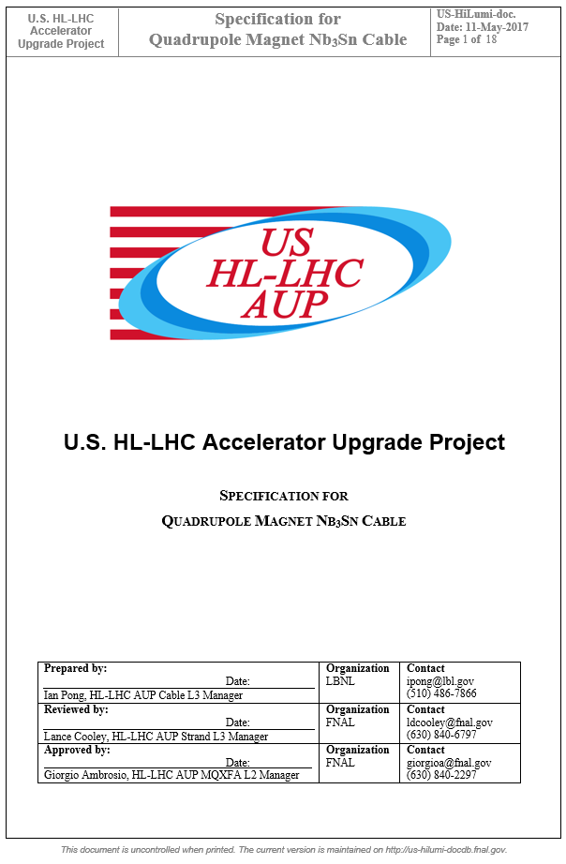
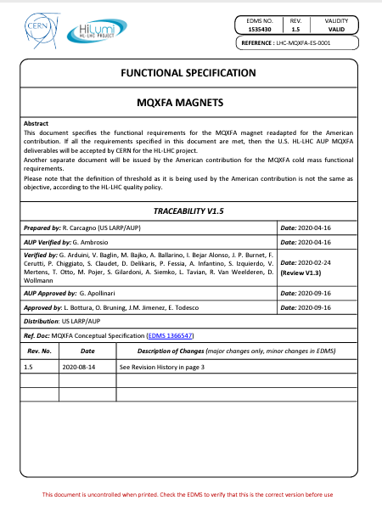
Functional Requirement Specifications
Charges #2, #9
Specification for Conductor (US-HiLumi-doc-40)
Specification for Cable (US-HiLumi-doc-74)
  Define performance and length of conductor
  Address FRS R-T-03
Specification for Cable Insulation (US-HiLumi-doc-75)
  Defines glass fiber braiding for cable insulation
  Addresses R-T-16
FRS (US-HiLumi-doc-36)
ID | Description
R-T-03 | The MQXFA magnet must be capable of operating at steady state providing an integrated gradient of 556.9 T in superfluid helium at (HeII) bath at 1.3 bar and at a temperature of 1.9 K
R-T-16 | The MQXFA magnet coils and quench protection heaters shall pass the hi-pot tests specified in Table 2.

Slide 4
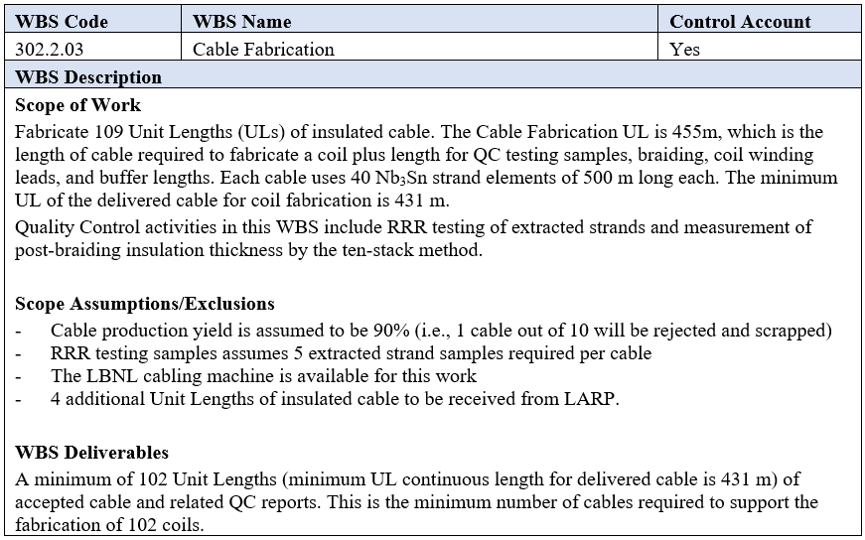
WBS 302.2.03: Scope
Charges #2, #9
Hitherto 96 AUP QXFA cables completed, 10 failed/on hold cable
US-HiLumi-doc-39

Slide 5
WBS 302.2.03: Scope
Charges #2, #9
Scope: fabricate 109 under AUP
Assumed yield 90% → 98 delivered AUP cables
4 from LARP → total cables for coils = 102
Scope includes:
  Fabricate bare cables at LBNL
  Insulation (braiding)
  Extracted strand RRR QC
This task is near completion: its EV/BAC is >86% as of September 31st EVMS data.

Slide 6
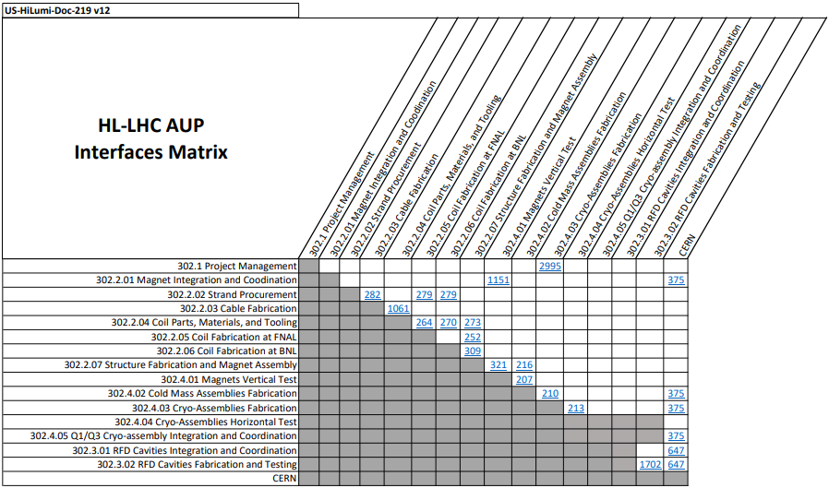
WBS 302.2.03: Interfaces
Charge #9
Not changed since CD-3
US-HiLumi-doc-219

Slide 7
WBS 302.2.03: Team
Charge #4
302.2
MQXFA Magnets Fabrication
L2: G. Ambrosio
(M. Baldini, P. Ferracin)
302.2.01
Magnets Integration and Coordination
L3/CAM: G. Ambrosio
(M. Baldini)
302.2.04
Coil Parts, Materials and Tooling Procurement
L3/CAM: M. Yu (A. Nobrega)
302.2.05
Coil Fabrication at FNAL
L3/CAM: A. Nobrega (M. Yu)
302.2.06
Coil Fabrication at BNL
L3/CAM: J. Schmalzle
(M. Anerella)
302.2.07
Structure Fabrication and Magnets Assembly
L3/CAM: S. Prestemon
(D. Cheng)
302.2.03
Cable Fabrication
L3/CAM: I. Pong (E. Lee)
CAM Dep: I. Pong (M. Naus)
302.2.02
Strand Procurement
L3: L. Cooley (V. Lombardo)
CAM: V. Lombardo
Control Account
Core Members:
Ian Pong
Elizabeth Lee (new L3 deputy)
Mike Naus (new CAM deputy)
Andy Lin
Al Baskys (new research scientist)
Assisting Members:
Li Wang (cryo)
Hugh Higley (Retiree)
Dan Dietderich (Retiree)
US HL-LHC Accelerator Upgrade Project: 302.2 MQXFA Magnets Fabrication
US-HiLumi-doc-104

Slide 8
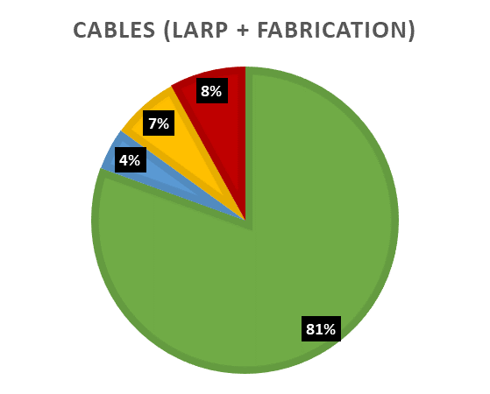
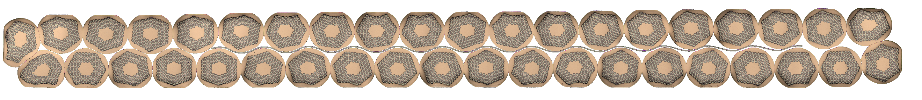
WBS 302.2.03: Achievements since CD-3b
Charges #5, #11
CD-3b approval for full production
CDR, PDR, FDR, ICDR, PRR all completed
No Action Items from previous Reviews
Yield in line with assumption
>86% complete (as of September 2022 by EV)
We have been making technical progress despite all the challenges

Slide 9
WBS 302.2.03: WBS Contingency Consumption by COVID Causes
Charge #1
Limited COVID impact on this task (total $400k). Major items:
  Efficiencies remained high: 87.5% for 302.2.03.1040, 100% for other activities ($257k)
  COVID Attribution portion of Addition of 5 Cables ($94k)

Slide 10
WBS 302.2.03: COVID, Abnormal Escalation, and Other Impacts
Charge #1
Limited COVID impact (total $400k). Major items:
  Inefficiencies ($257k)
  COVID Attribution portion of Addition of 5 Cables ($94k)
  Lockdown in 2020 LOE adjustment ($31k)
  A current period BCR #267 ($11k), due to COVID sickness and close contact isolation requirements
No Abnormal Escalation attributable
Other BCR / Adjustment (total $417k).

Slide 11
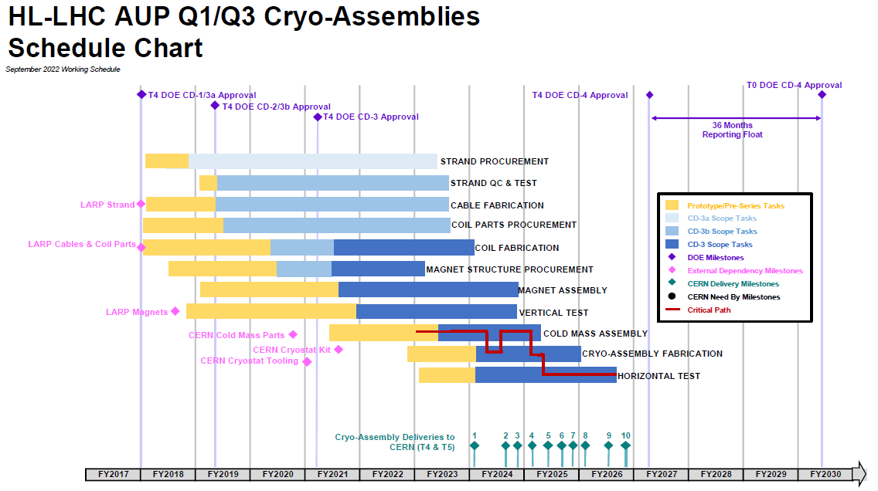
WBS 302.2.03: Schedule
Charge #2
302.2.03 is not on but will be close to the critical path in Jan 2023 due to staff shortage half a year ago

Slide 12
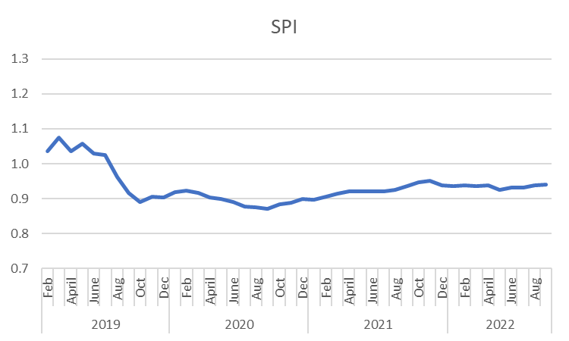
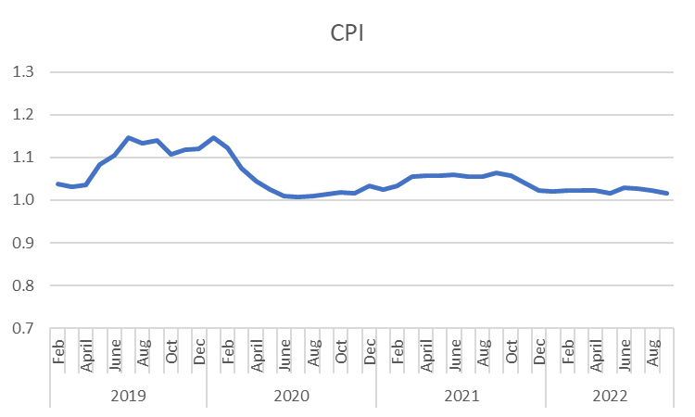
WBS 302.2.03: Cost and Schedule Performance
Charges #2, 7
Cumulative to Date
Budget | Earned | Actuals | SV | SV (%) | CV | CV (%) | SPI | CPI
$ 5,655,479 | $ 5,322,748 | $ 5,243,512 | $ (322,731) | -5.9% | $ 79,236 | 1.5% | 0.94 | 1.02
Deputy resigned
New members joined
COVID
COVID
BCR #145
(ETC 2020)
BCR #120
(CA PSPS)
Control Account cost and schedule historical performance
is reasonable and has been stable during COVID;
variances well understood and documented

Slide 13
WBS 302.2.03: Estimate at Completion
Charges #2, 7
At Complete
BAC | EAC | VAC | % Spent | EV/BAC | PV/BAC | AC/BAC
$ 6,133,110 | $ 6,078,207 | $ 54,904 | 86.3% | 86.8% | 92.2% | 85.5%
  CPI = 1.02 → Positive VAC, AC < EV
  EV/BAC >86% -- nearly complete
  SPI < 1 → EV < PV

Slide 14
WBS 302.2.03: QA/QC
MIP approved by CERN (EDMS 1866230)
AUP Quality Plan (Doc 903)
Three failed cables at time of manufacture
  Wire crossover (DR 11712)
  Mid-run bay brake activation (Traveler 464234)
  Roller bearing failure (Traveler 464234)
Six impacted cables at time of coil winding
  3 on-hold cables (DRs 12321,12323, 12799, 12822)
  3 failures (DRs 12194, 12412, 12413, 12414, 12863, 12867)
  Related to wire excess lubricant causing mechanical instability during coil winding. See also: US-HiLumi Docs. 4172, 4318
One cable on hold due to braiding issue

Slide 15
WBS 302.2.03: Risks
Charge #3
Three threats
One opportunity
One relevant project-wide threat
Risk-ID | Title | Risk Rank
RT-302-2-03-001* | Number of cables fails to meet specifications | Medium
RT-302-2-03-004* | Failure of insulation contractor to deliver on time | Low
RT-302-2-03-003 | Significant breakdown of cabling machine | Low
* These risks have a separate COVID component in the risk register to account for additional probability/impact due to COVID pandemic.
Opportunity-ID | Title | Risk Rank
RO-302-2-03-001 | Mapping optimization allows leftover from wire spools to be converted to a cable UL | Medium
Risk-ID | Title | Risk Rank
RT-302-1-005 | Need to replace key personnel | Low

Slide 16
WBS 302.2.03: ES&H
Charge #10
Regular meetings at LBNL, minutes & roster kept in Google Drive with access control
WPC, Procedures, HAR (§9.1), etc. are in place
No injury-causing accident for >25,000 labor-hr!
Fire sprinkler leak in 2019
  Causal Analysis Report made by the LBNL PIMD, EHS, and IA&I.
COVID control effective: no onsite transmission
Lab protocols and guidelines continually updated per DOE and CDC guidance

Slide 17
WBS 302.2.03: Summary
302.2.03 is nearing completion (EV >86%)
Technical work is proceeding according to the baseline plan
Cost is under control
Schedule performance has been stable since 2020
Hiring and retention have been the biggest challenge
Quality, Risk, and ES&H are well managed

Slide 18
Back up slides

Slide 19
WBS 302.2.03: WBS Contingency Consumption by COVID Causes

Slide 20
WBS 302.2.03: WBS Contingency Consumption by Other Causes

Slide 21
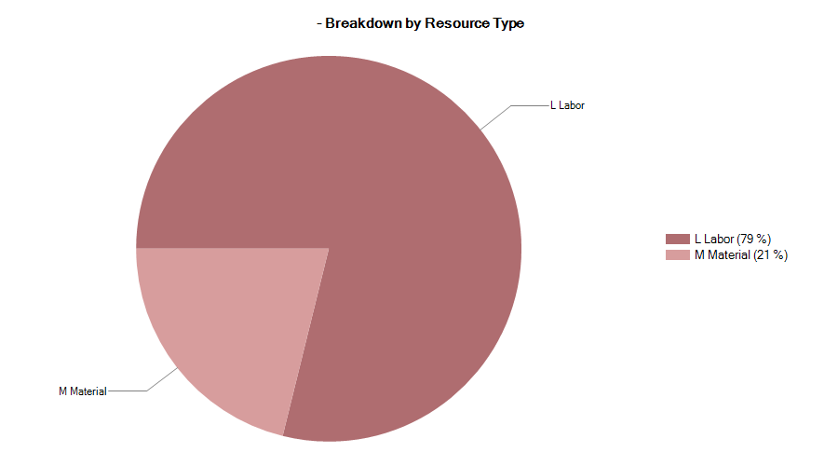

302.2.03 Resource Type Breakdown
Charge #4
77% Labor, 23% M&S
M&S Includes contractors (braiding vendor), travel, shipment, etc.

Slide 22
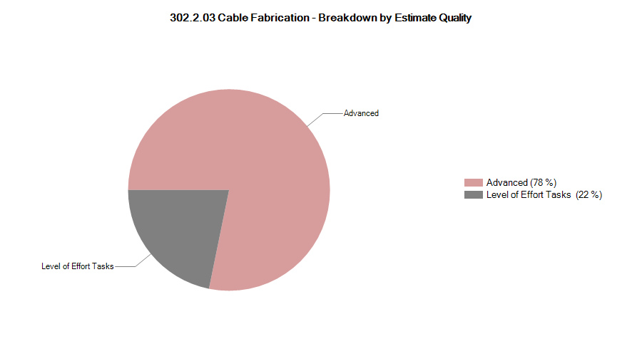
302.2.03 Estimate Quality
Charge #4

Slide 23
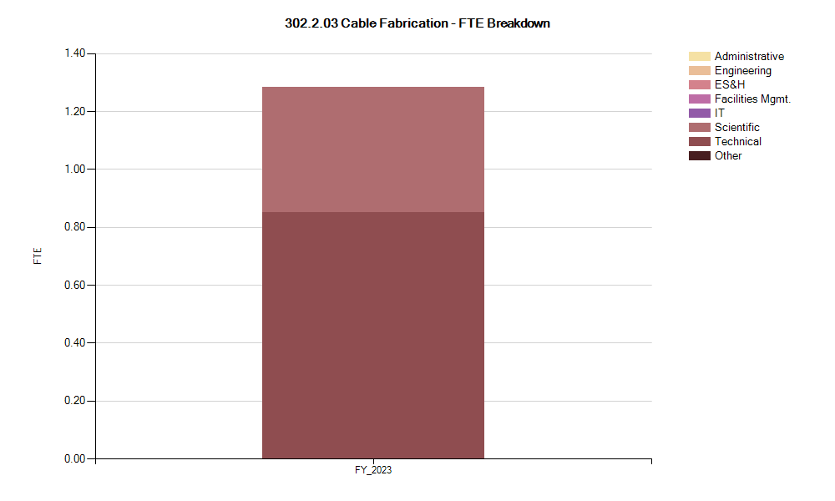
302.2.03 FTE Breakdown
Charge #4

Slide 24

302.2.03 Cost Performance Report
Charge #4
BAC = $6.133M
Cumulative SPI = 0.94, CPI = 1.02

