Slide 1
Magnets 302.2 – Charge Summary & Previous Reviews Recommendations
G. Ambrosio
MQXFA Magnets L2 manager, Fermilab
HL-LHC AUP Rebaseline DOE Rev. – Dec. 13–15 2022

Slide 2
Charge Question 1
Has a Root Cause Analysis (RCA) been conducted that explains the reasons for performance deviation from the original project baseline? Has the RCA been independently reviewed? Does the BCP plan credibly address mitigations for the root causes of the performance deviations, going forward?
The root cause analysis is presented in “Root Cause Analysis of Cost Overruns and Schedule Delays” (US-HiLumi-doc-4319)
It was independently reviewed in November
Issues were identified and corrective actions have been documented in the “Baseline Change Proposal” (BCP), (US-HiLumi-Doc-4356).
For MQXFA magnets, corrective actions have been implemented starting from MQXFA10 (partially) and in all future magnets and re-assemblies (completely).

Slide 3
Charge Question 2
Is the new resource-loaded schedule sufficiently complete, consistent, and credible so that it can serve as the Total Project Cost (TPC) and schedule part of the project’s new performance baseline? Are the TPC and schedule in the BCP compatible with the project funding guidance provided?
The resource-loaded schedule for 302.2 is complete and credible since magnet scope is 83.4% complete, and it is within budget and schedule
For MQXFA magnet fabrication (302.2) this rebaseline is due to COVID only:
The overall COVID impact on 302.2 BCRs is $3,934k
The largest COVID impact on 302.2 BCRs is $2,789k due to MQXFA07/08 non-conformity
The technical report “Analysis of MQXFA07 Test Non-Conformity” presents the investigation and analysis done to understand degradation mechanism and root causes.
The document “Root Cause Analysis of Cost Overruns and Schedule Delays” explains the 67% COVID attribution for MQXFA07/08 and lists all COVID BCRs
COVID BCRs not due to MQXFA07/08 have been presented by L3s
COVID risks have been presented by L3s and explained by Vito Lombardo in talk “Management 302.1 - AUP Risks (with and w/o COVID, inflation & escalation, etc.)”

Slide 4
Charge Question 3
Have the project’s current risks been fully analyzed and will the BCP provide adequate schedule contingency to complete the defined scope and achieve the Key Performance Parameters?
The major open risk for 302.2 is coil yield lower than in BL (risks RT-302-2-01-004/5). Mitigation plan includes:
We are procuring additional strand and coil parts. They will be available for additional coils (up to ~6) at the end of coil fabrication
Labor for additional coils is covered by risks RT-302-2-01-004/5
There is float at the end of coil fabrication for adding a few coils without project delay
Magnet scope (302.2) is 83.4% complete, so there is high confidence about understanding of other risks
All risks have been presented by L3s , and Vito Lombardo, AUP risk manager, explained risk strategy in his talk “Management 302.1 - AUP Risks (with and w/o COVID, inflation & escalation, etc.)”
We are very confident that magnet scope (302.2) will be completed within the rebaselined schedule.

Slide 5
Charge Question 4
Is the project team staffed properly with the required skills to deliver the proposed technical scope within the baseline budget and schedule?
We have an excellent team of very experienced scientists, engineers and technicians.
All L3s, CAMs and Deputies have been in AUP for a long time, most of them since LARP.
Magnet scope (302.2) is 83.4% complete, and it is within budget and schedule
We are very confident that magnet scope will be completed within the rebaselined cost and schedule

Slide 6
Charge Question 5
Is the project being managed well and supported properly by the laboratories?
All project tools: EVMS, Variance analysis, BCRs, DCRs, Travelers DRs, NCRs and Risk Register are being used properly and with great care
MQXFA EVMS performance is good
The CAs that experience delays are implemented corrective actions (for instance hiring new technicians)
We have an excellent team of very experienced scientists, engineers and technicians
Fermilab is supporting well AUP effort. For instance, FNAL CAM eToolbox is extremely useful.
All labs are supporting strongly their MQXFA effort

Slide 7
Charge Question 6
Does the project understand its dependencies on outside resources such as international collaborators and participation by researchers with other funding sources?
Magnet scope (302.2) does not need outside resources nor other funding sources.
There is only one external dependence left: material for CLIQ leads to be delivered by CERN
We have received material for ~18 CLIQ leads, and the remaining material is being shipped

Slide 8
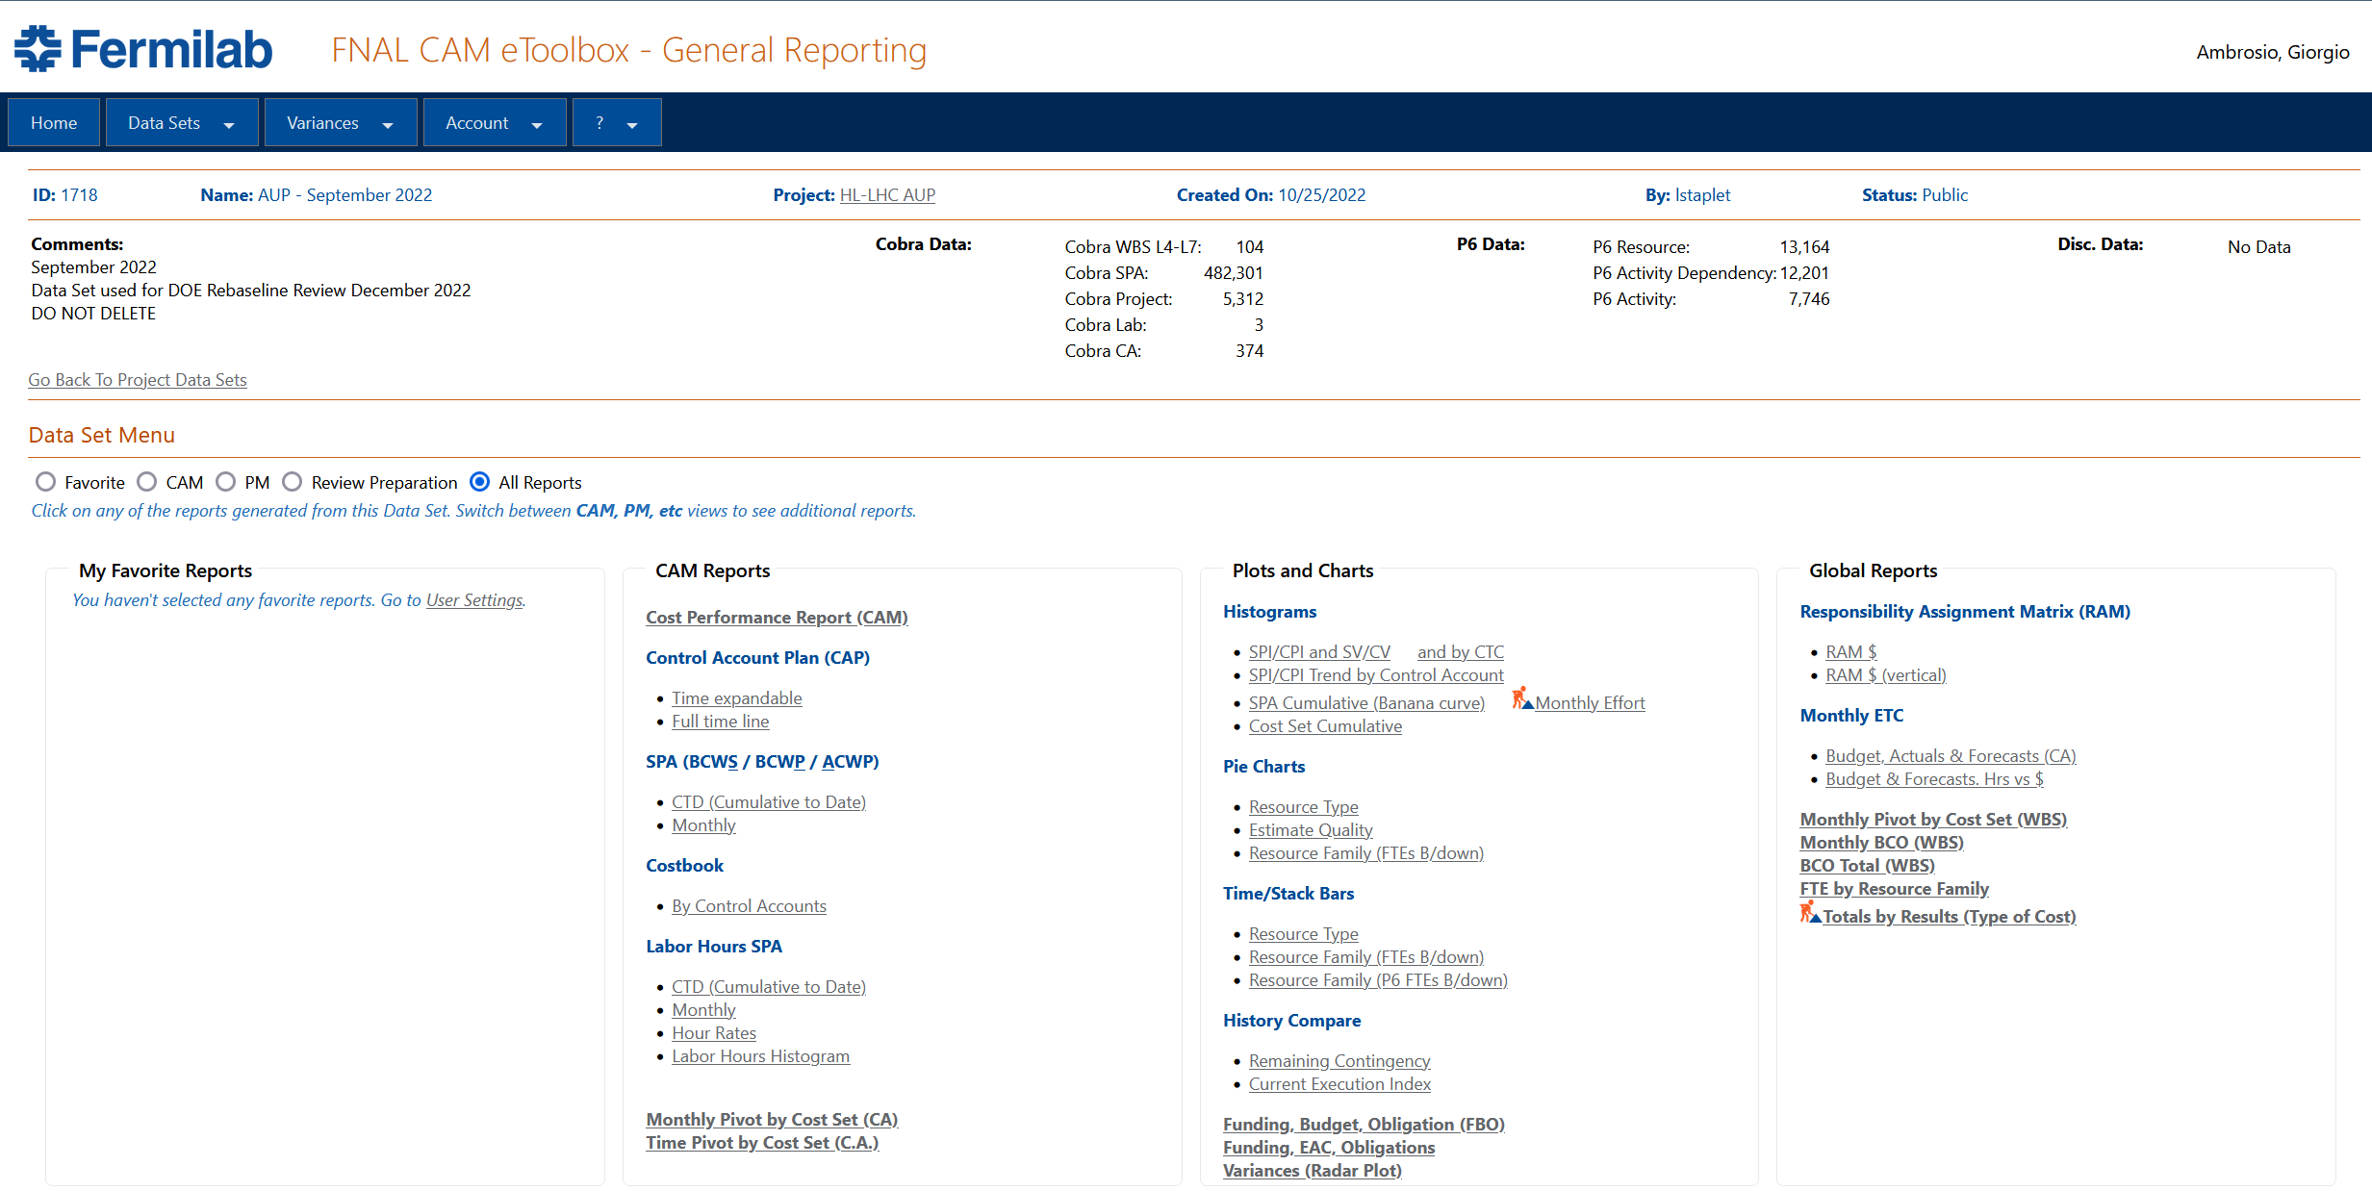
Charge Question 7
Does the project have a certified Earned Value Management System and has the project demonstrated an effective implementation?
AUP is using FNAL Earned Value Management System.
All MQXFA CAMs are using it properly and timely, and FNAL CAM eToolbox is extremely useful.

Slide 9
Charge Question 8
Is the BCP documentation complete and in good order?
All documentation is complete and approved
Project Management Plan (US-HiLumi-doc-437)
WBS dictionary (US-HiLumi-doc-36)
MQXFA Functional Requirements Specification (US-HiLumi-doc-36)
Acceptance Criteria Part A: MQXFA Magnet (US-HiLumi-doc-1103)
MQXFA Magnet Final Design Report (US-HiLumi-doc-948)
Magnet Interface Specification (US-HiLumi-doc-1674)
Interface Control Documents
Documentation for rebaseline analysis:
Root Cause Analysis of Cost Overruns and Schedule Delays (US-HiLumi-doc-4319)
Analysis of MQXFA07 Test Non-Conformity (US-HiLumi-doc-4293)
Baseline Change Proposal (BCP) in (US-HiLumi-Doc-4356).

Slide 10
Charge Question 9
Is the planning for major procurements, interfaces between subsystems, and integration of the project adequate to proceed with the new baseline?
All major components (strand, coil parts, structure parts) for magnet scope (302.2) have been ordered, and major procurements are close to completion
All magnet interfaces have been exercised several times and finalized
There was a magnet integration issue (two MQXFA09 coils rejected because of folded midplane insulation). Preventive actions have been implemented in order to avoid reoccurrence.

Slide 11
Charge Question 10
Are Environment Safety and Health aspects being addressed properly at this stage of the project?
The AUP Hazard Analysis Report is complete (US-HiLumi-doc-1121)
Typical hazards: Material Handling, Hazardous Materials, Mechanical Hazards, Fire Hazards, Pressure Hazards, Electrical Hazards, Cryogenic Hazards, …
The HAR includes the use of COVID provisions
There is an AUP ES&H Coordinator (Amy Pavnica), and we are working in close communication with her.
All L3s have performed hazard analyses and implemented policies and procedures of their laboratory, including COVID provisions
Details were presented in L3 talks
With 83.4% scope complete (EVMS), MQXFA ES&H record looks good

Slide 12
Charge Question 11
Did the project respond satisfactorily to the recommendations from the previous IPR?
All recommendations from project reviews are being tracked
AUP reviews tracking is in US-HiLumi-doc-1322
All recommendations in AUP reviews regarding MQXFA Magnets are closed
All recommendation in Magnets Production Readiness Reviews are closed

