Slide 1


Magnets 302.2.01 – Magnet Integration and Coordination
G. Ambrosio - FNAL
HL-LHC AUP Rebaseline DOE Rev. – Dec. 13–15, 2022

Slide 2
Outline
Scope, Interfaces, Dependencies & Team
Achievements & Technical Status
Contingency Consumption and COVID Impact
Schedule
Cost and Schedule Performance & VAR Reports
QA/QC
Risks
ES&H
Summary

Slide 3
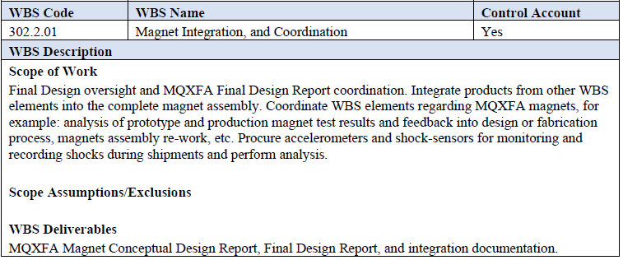
Scope and WBS Deliverables
Charge #2
WBS Dictionary: US-HiLumi-doc-39
Dedicated talks:
  MQXF Results and Plans
  MQXFA Shipping Requirements and Execution

Slide 4
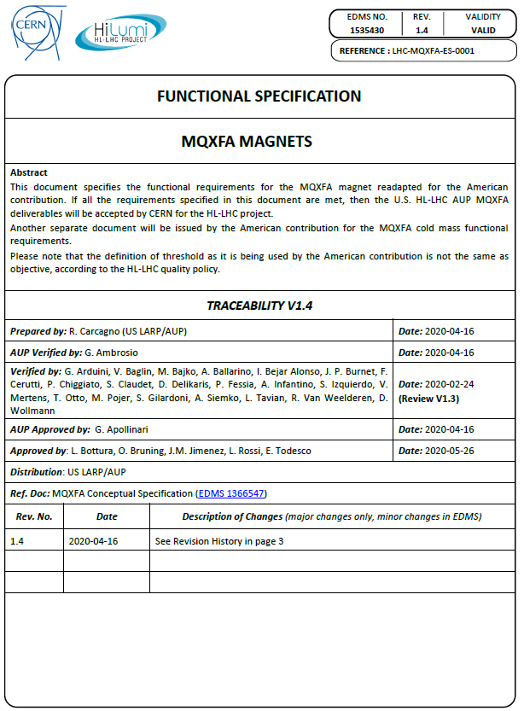
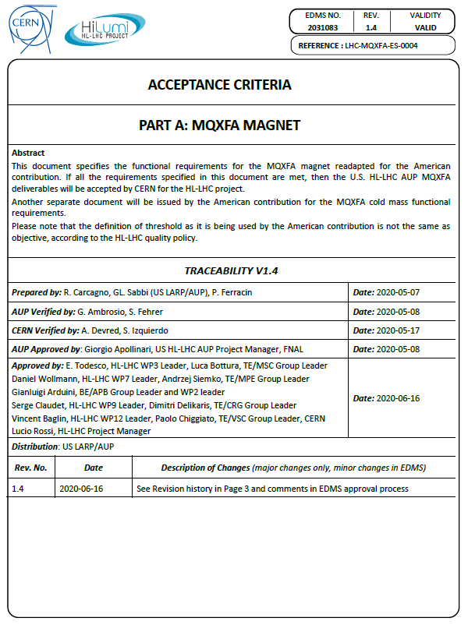
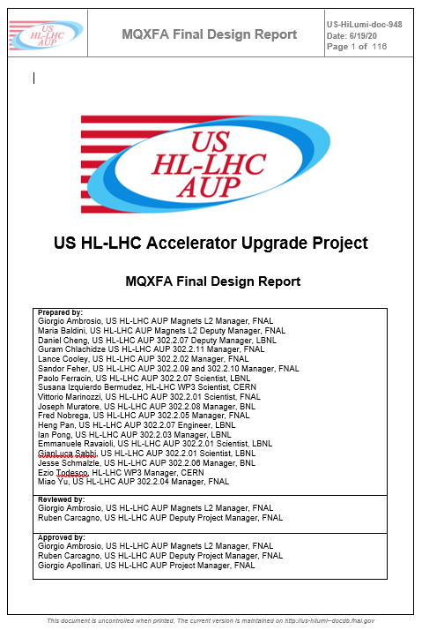
Requirements, Acceptance Criteria, FDR
Charge #2
All complete, updated and approved
US-HiLumi-doc-36
US-HiLumi-doc-1103
US-HiLumi-doc-948

Slide 5
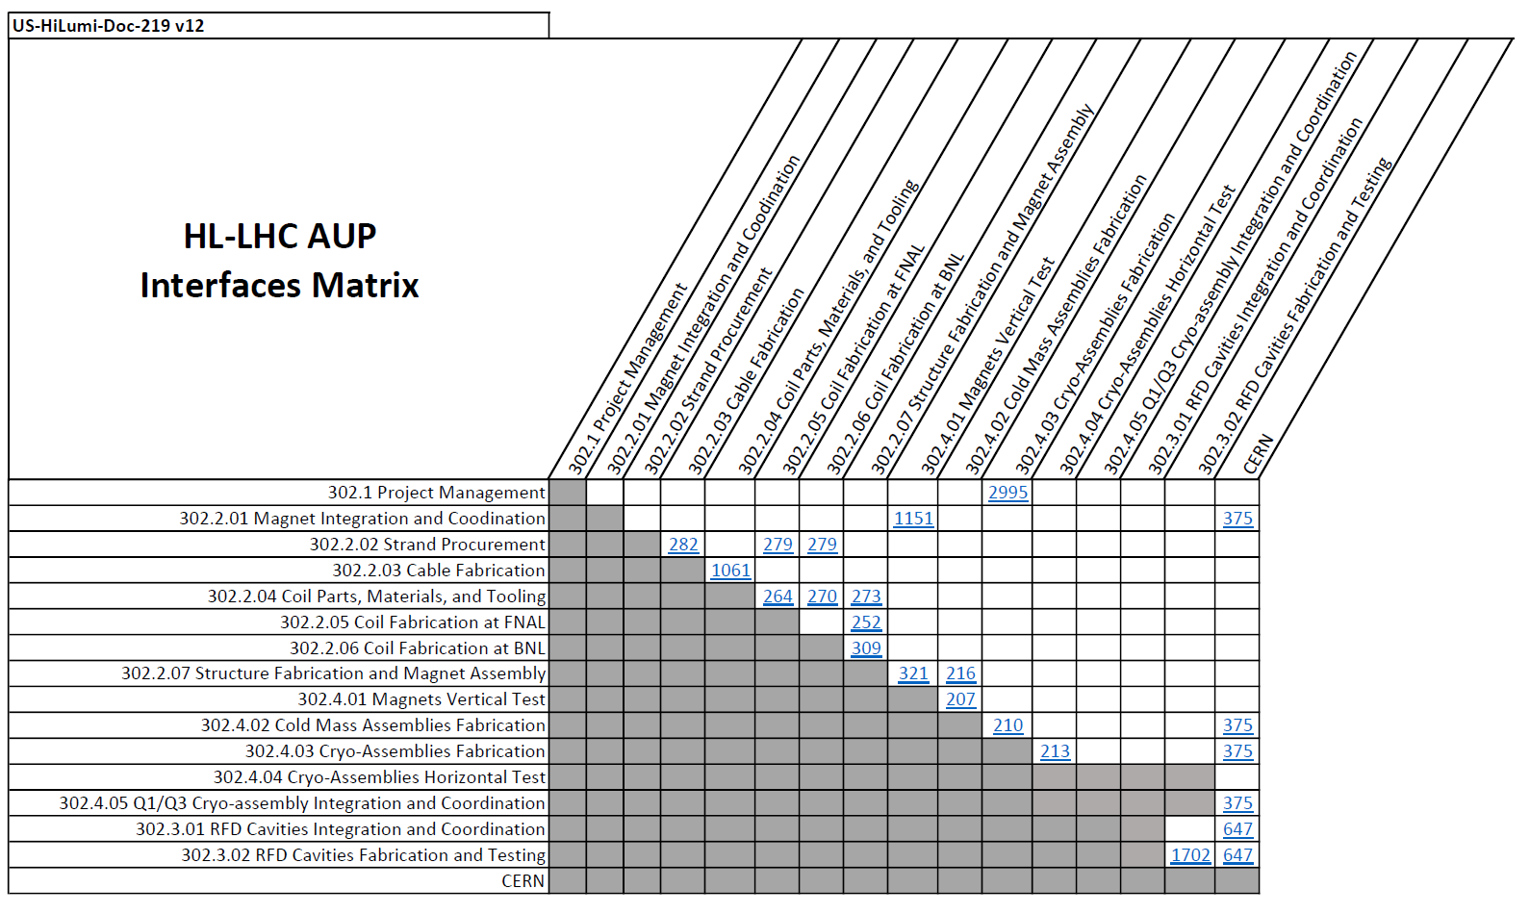
Interfaces
Charge #9
  Two Interface Control Document for this WBS element
    With CERN
    With 302.4.01 Magnet Vertical Tests

Slide 6
Magnet Interface Specification
Charge #9
Interfaces between Magnet and Cold-mass
  Mechanical (including Cold-mass welding and cooling)
  Electrical
Interfaces with CERN systems through the Cold-mass
  Quench protection
  Instrumentation
US-HiLumi-doc-1674
CERN-EDMS-2031177

Slide 7
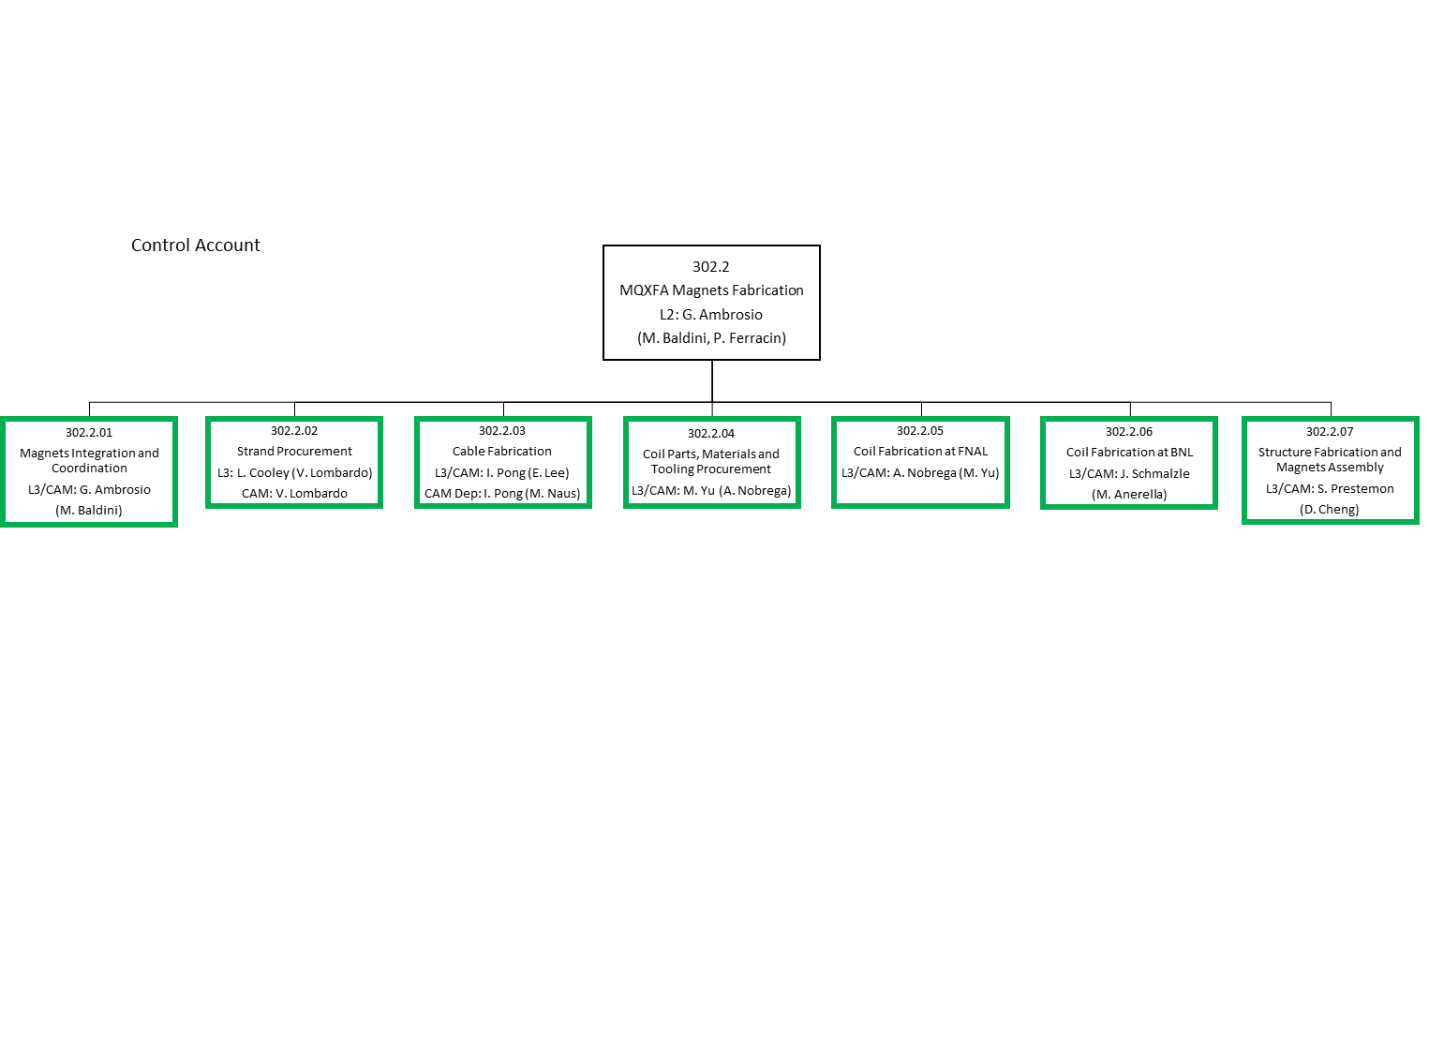
Organizational Chart
Charge #4
US-HiLumi-doc-104
  This WBS element is in charge of integration and coordination of all other WBS elements
    Includes arranging Production Readiness Reviews and Interface Control Document Reviews (done together with or prior to PRRs)

Slide 8
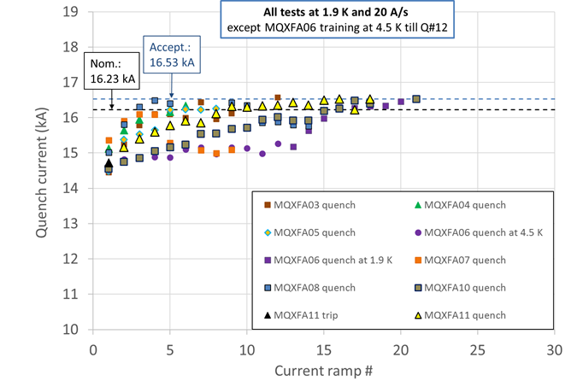
Technical Status in next talks
Charge #5
Talk “Magnets 302.2 - MQXFA Shipping Requirements and Execution” in magnet session
Coil and Magnet shipments:
  Accelerometer data analysis for all shipments
Magnet Post-Test Analysis:
  Magnets MQXFA03, MQXFA04, MQXFA05, MQXFA06, MQXFA10 and MQXFA11 met all requirements tested at BNL
  Magnets MQXFA07 and MQXFA08 did not meet requirements and have been dis-assembled
    Present Magnet yield is 75%, lower than 83.3% assumed in baseline
    Root causes of MQXFA07 & MQXFA08 NC have been understood and addressed
Talk “MQXF Results and Plans” in magnet session
  MQXFA03 and MQXFA04 are in the 1st Coldmass
  MQXFA05 and MQXFA06 are being used for 2nd Coldmass

Slide 9
302.2.01: Contingency consumption
& COVID Impact
Charge #1
WBS Estimate at Completion (EAC) | CD-2 | Contingency Consumption |  |  | Sep 2022
 | EAC | COVID | Ab. Esc. | Other | EAC
302.2.01 Magnet Integration & Coordination | $4,067,707 | $671,277 | $0.00 | $1,455,899 | $6,194,883
COVID impact on 302.2.01 is mostly through LOE
COVID BCRs:
COVID BCRs | Title | WBS Cost Impact
302.2.01 Magnet Integration & Coordination |  | $671,277
HL-LHC AUP_0160 | COVID-19 LOE Adjustments July 2020 | $191,507
HL-LHC AUP_0246 | COVID-19 Inefficiency Planning for future work for Oct-Dec 2021 | $179,898
HL-LHC AUP_0265 | COVID-19 Attribution portion of Magnet Assembly and Vertical Testing Schedule Revisions | $103,680
HL-LHC AUP_0211 | COVID-19 Impacts to BNL Vertical Testing Activities | $73,647
HL-LHC AUP_0274 | COVID-19 Inefficiency Planning for April 2022 through December 2022 | $67,779
HL-LHC AUP_0188 | COVID-19 Inefficiency Planning for future work for Nov-Dec 20 | $65,076
HL-LHC AUP_0216 | COVID-19 Inefficiency Planning for future work for Apr-Jun 2021 | ($3,136)
HL-LHC AUP_0199 | COVID-19 Inefficiency Planning for future work for Jan-Mar 21 | ($3,445)
HL-LHC AUP_0149 | COVID-19 Schedule Delay April 2020 | ($3,729)

Slide 10
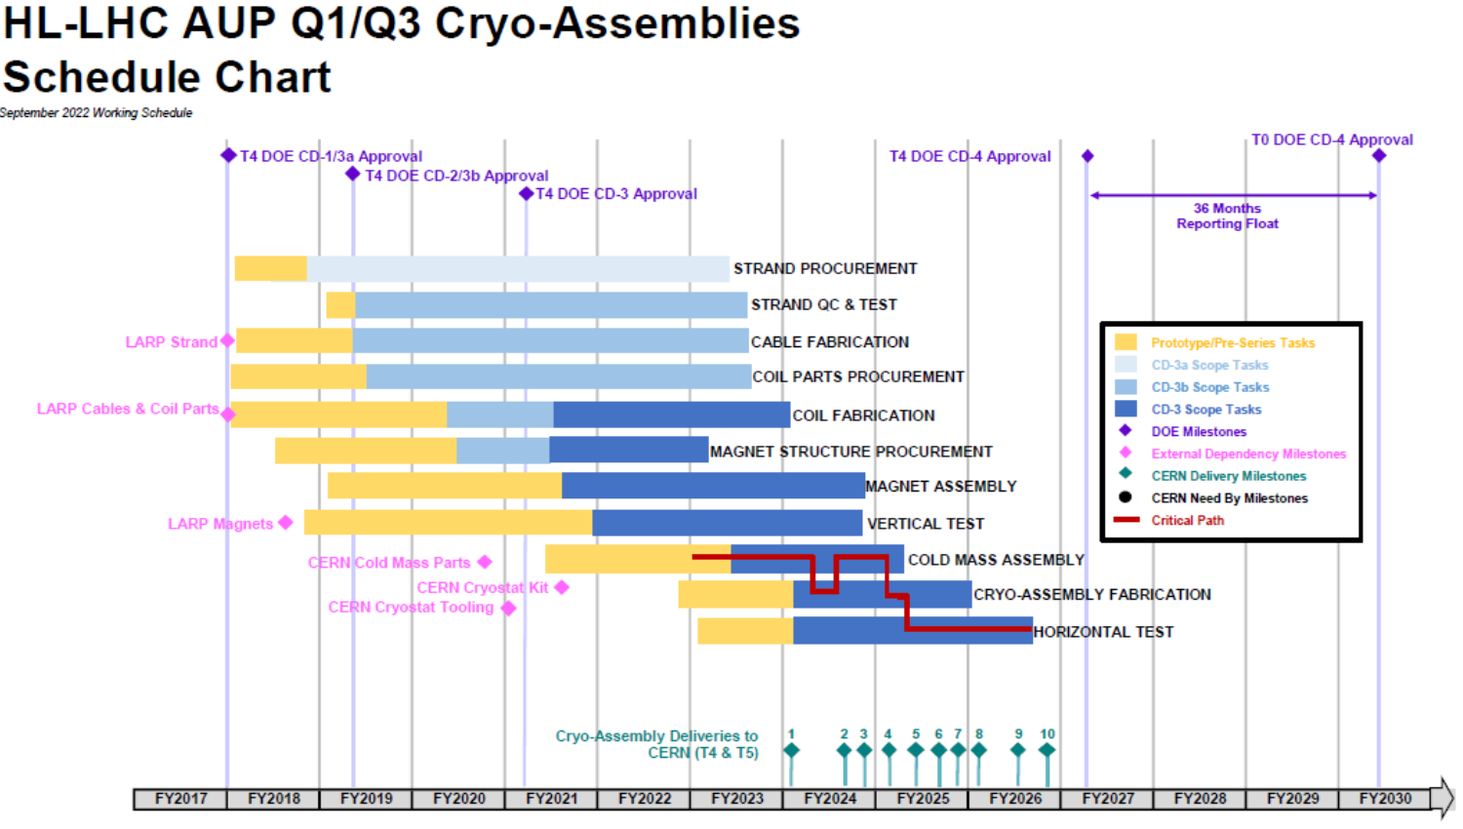
WBS 302.2.01 Schedule
Charge #2

Slide 11

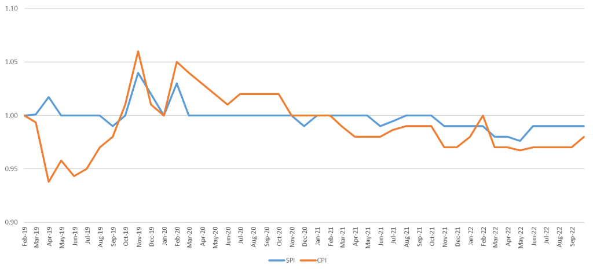
WBS 302.2.01: Cost and Schedule
Performance
Charge #7
* Dollars in thousands
Schedule Performance Index
Cost Performance Index
On schedule and ~on budget

Slide 12

WBS 302.2.01: Estimate at Completion
Charge #7
* Dollars in thousands
Estimate at Complete (EAC) is $6,195k
Variance at Complete (VAC) is -$288k
  Mostly due to effort for MQXFA07/08 analysis

Slide 13
WBS 302.2.01: Risks
Charge #3
This WBS element owns all risks affecting integration of magnet components
  For instance, coil/magnet fabrication yield
RT-302-2-01-008 | Magnet integration issue causes component rework and schedule delay | High
RT-302-2-01-004 (*) | Coils fail to meet specification and are rejected at FNAL | High
RT-302-2-01-005 (*) | Coils fail to meet specification and are rejected at BNL | High
RT-302-2-01-003 (*) | Series magnets fail to meet yield assumption in baseline | Medium
RT-302-2-01-012 | Coil/Magnet shipping or handling damage | Medium
RT-302-2-01-017 | Addition of new hipot test in helium gas reduces the coil yield | Medium
(*) These risks have a separate COVID component in the risk register to account for additional probability/impact due to COVID pandemic.
There is high probability we will need to add a few coils to the Baseline.
This is no problem because components (strand and coil parts) are available, and there is enough money in the risk contingency for this risk

Slide 14
WBS 302.2.01: ES&H and QA
Charge #10
No special hazards for this WBS element, which involves mostly office work.
  A few discrete activities (for instance coil autopsy) require use of PPE and following ES&H procedures including COVID-restrictions
  AUP Hazard Analysis Report (HAR) in US-HiLumi-doc-1121
  Very small COVID impact
Together with QA manager supervise that:
  AUP QA plan is applied by all labs
    AUP Quality Assurance Plan in US-HiLumi-doc-80
  Relevant documents are complete and under version control
  Required documentation (MIPs), data (in MTF folders), and drawings (in CDD) are sent to CERN timely

Slide 15
WBS 302.2.01: Summary
This CA is proceeding according to the baseline plan.
It owns the largest MQXFA risks. They are monitored on monthly basis, and actions were taken to improve yield
  A few additional coils may be needed by end of project; strand and parts are available
This CA is confident to complete its scope within re-baselined cost and schedule

Slide 16
Backup Slides

Slide 17
WBS 302.2.01: WBS Contingency Consumption by Other Causes
WBS Estimate at Completion (EAC) | CD-2 | Contingency Consumption |  |  | Sep 2022
 | EAC | COVID | Ab. Esc. | Other | EAC
302.2.01 Magnet Integration & Coordination | $4,067,707 | $671,277 | $0.00 | $1,455,899 | $6,194,883
TOP-10 OTHER BCRs/EAC-MAs/CVs | Title | WBS Cost Impact
302.2.01 Magnet Integration & Coordination |  | $1,400,180
HL-LHC AUP_0265 | Magnet Assembly and Vertical Testing Schedule Revisions | $215,776
EAC-MA-SV-2-01 | Additional LOE to account for the difference in completion of work between the baseline schedule and the PMB (see LOE for diff between WS vs BL tab) | $199,000
HL-LHC AUP_0145 | ETC - Spring 2020 - Control Accounts in 302.2 | $197,528
HL-LHC AUP_0237 | ETC - Summer 2021 - Control Account 302.2 | $196,904
HL-LHC AUP_0088 | Disassembly and Assembly of Mirror Magnet for QH analysis | $163,622
HL-LHC AUP_0066 | Additional Hours for Quench Heater Investigation | $134,691
CV-302.2.01 | 302.2.01 Magnet Integration & Coordination Cost Variance | $87,095
HL-LHC AUP_0108 | Testing of Mirror Magnet | $73,318
HL-LHC AUP_0215 | Quality Engineering Effort for FY21 | $69,418
HL-LHC AUP_0110 | Additional Hours for QH Analysis | $62,828

Slide 18
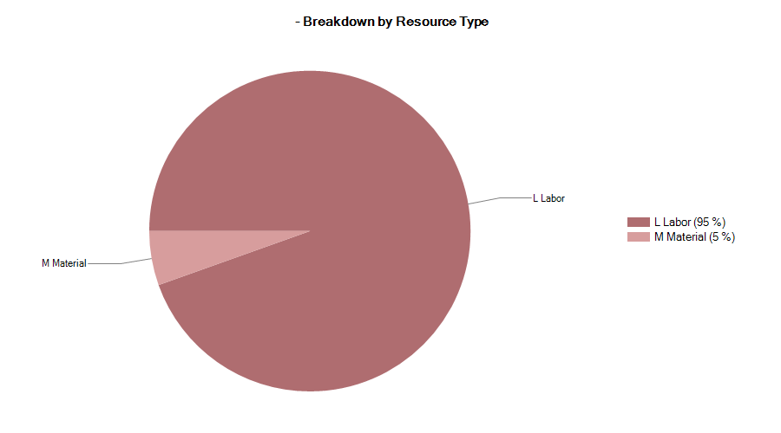


302.2.03 Resource Type Breakdown

Slide 19
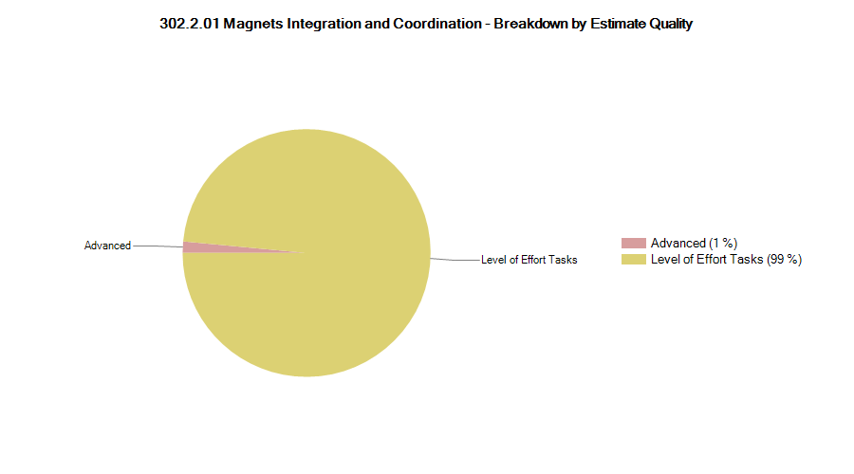

302.2.01 Estimate Quality

Slide 20
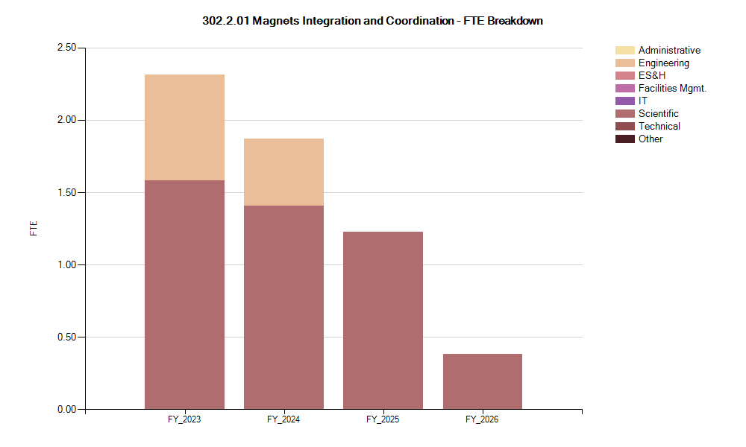
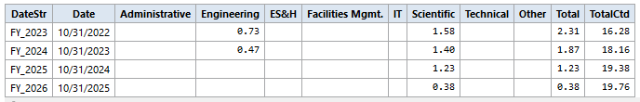
302.2.01 FTE Breakdown

