Slide 1
MQXF Results and Plans
Giorgio Ambrosio and MQXFA L3s/CAMs
HL-LHC AUP Rebaseline DOE Rev. – Dec. 13–15 2022

Slide 2
Outline
Vertical tests of MQXFA magnets
Analysis of magnets with limited performance
COVID impact
Lessons learned and corrective actions
MQXFA endurance and resilience
Conclusions

Slide 3
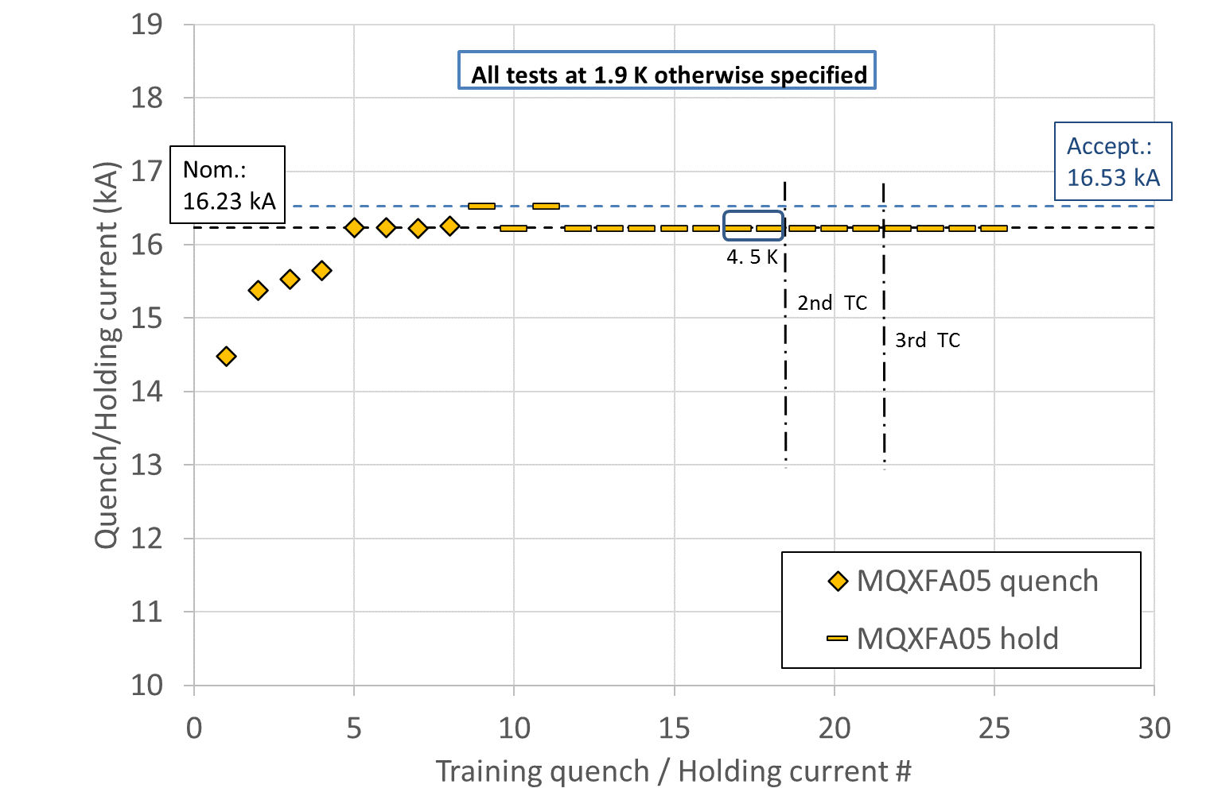
MQXFA Vertical Test
MQXFA magnets are vertically tested at BNL
Test plan demonstrates:
Holding at Acceptance Current: Nominal + 300 A
Temperature margin: Nominal curr. at 4.5 K
Memory after thermal cycle
Other requirements (next slide)
MQXFA @ BNL
3

Slide 4
Vertical Test Summary
Magnets are accepted for use in LMQXFA Cold Mass if they meet all Vertical Test Requirements
Hold current at nominal current + 300 A
Field Quality
Integrated gradient
Ramp to/from I_nom at ±30 A/s
100 A/s ramp down w/o quench (max for power supply)
Temperature margin
Training memory
Splice resistance (less than 1 nΩ)
All electrical requirements

Slide 5
Vertical Test: Training
MQXFA03-06 and MQXFA10-11 reached and held Acceptance Current and met all requirements tested at BNL
6 out of 8 magnets tested

Slide 6
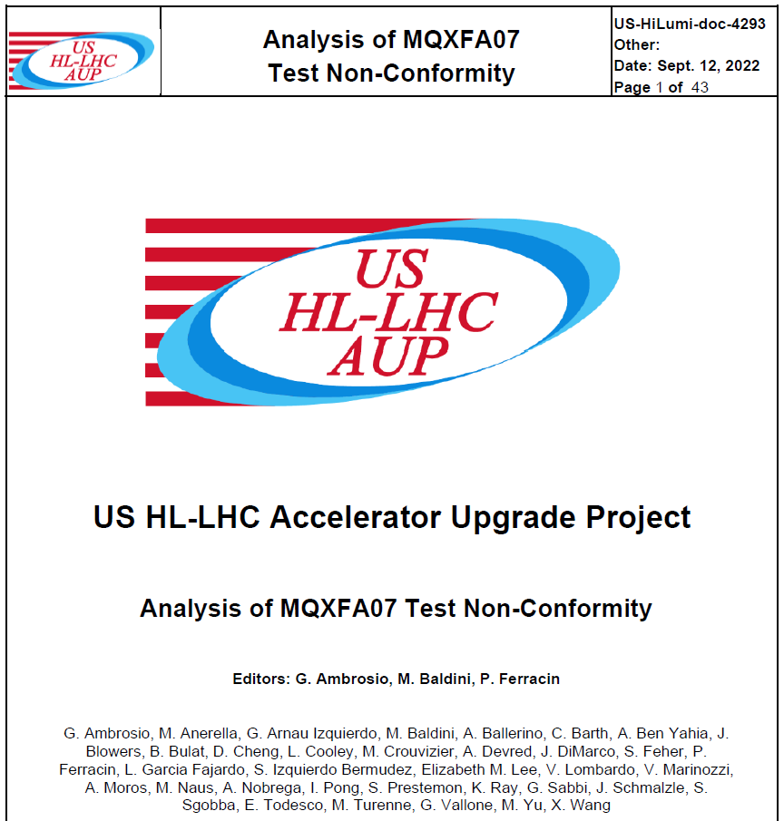
Outline
MQXFA07 & MQXFA08 investigation
COVID impact
Preventive Actions
US-HiLumi-doc-4293
CERN EDMS 2777612

Slide 7
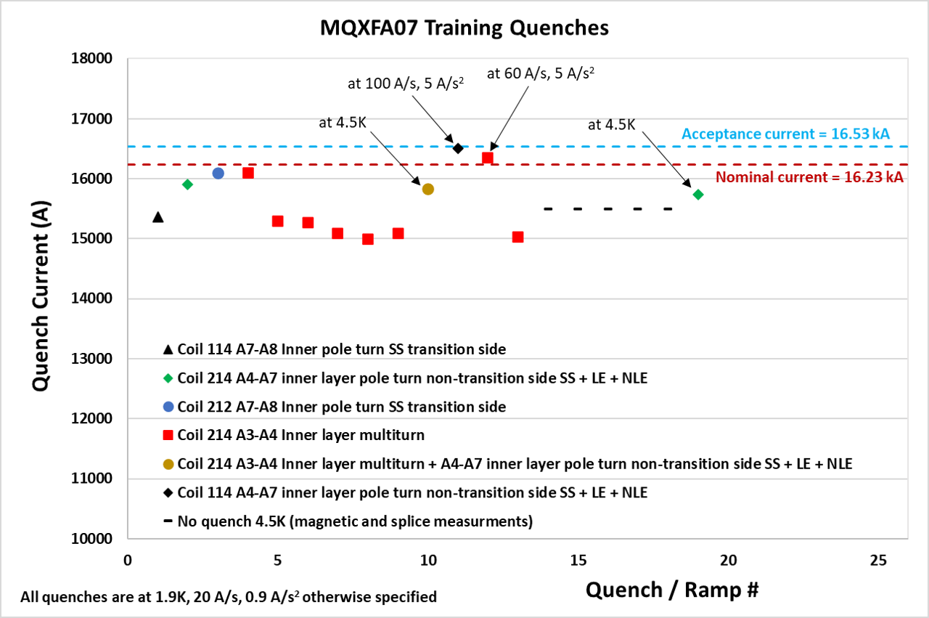
Location based on Quench Antenna and Voltage Taps
Courtesy of J. Muratore and A. Ben Yahia
Reverse temperature dependence
Reverse ramp-rate dependence
Same features and location in MQXFA08

Slide 8
Initial Diagnosis for Limitation Mechanism
Self-field instability triggered by a local issue, likely affecting only some strands, that pushes more current in adjacent strand(s)
Field in quenching segment is between 5 and 9.2 T
Similar mechanism in other magnets:
MQXFS03 showed a reversible component
LARP Long Quadrupole #2 showed “enhanced thermo-magnetic instability” in mid-plane block
With flux jumps
B. Bordini, et al., IEEE Trans. Appl. Superc., vol. 22, 2012, # 4705804
A. K. Ghosh, IEEE Trans. Appl. Superc., vol. 23, 2013, # 7100407
H. Bajas et al., “Test Results of the Short Models MQXFS3 and MQXFS5 for the HL-LHC Upgrade”, IEEE Trans. Appl. Superc. Vol 28, # 4007006 (2018)
Ref: G. Ambrosio et al., “Progress in the Long Nb₃Sn Quadrupole R&D by LARP”, IEEE Trans Appl, Superc. Vol 22, # 4003804 (2012)

Slide 9
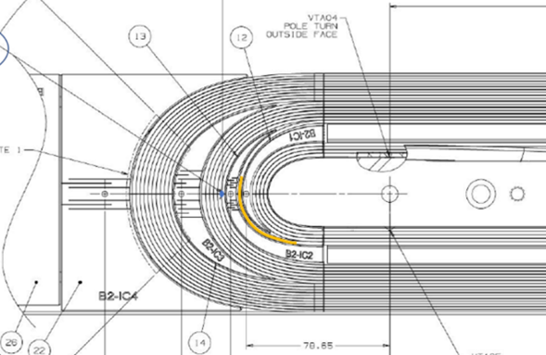
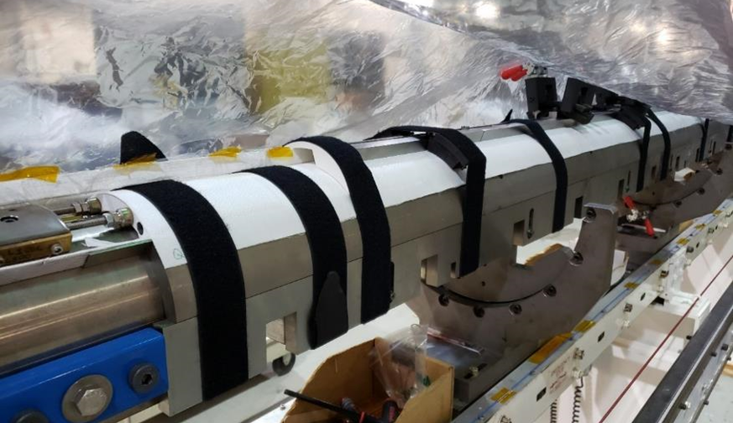
Discrepancies and Non-conformities
Possible causes of local issue:
Some strands popped out during winding, were fixed, popped out overnight and were fixed a second time (BNL DR AM-164)
Limiting coil was affected by COVID lockdown
14 weeks stop after winding & curing of inner layer
Axial preload had to be removed in order to fix position of end plate (LBNL MQXFA-NCR-0220)
Inner layer coil showing in yellow the position of coil-214 cable affected by DR AM-164
coil 214 as it was setup for the lab shutdown

Slide 10
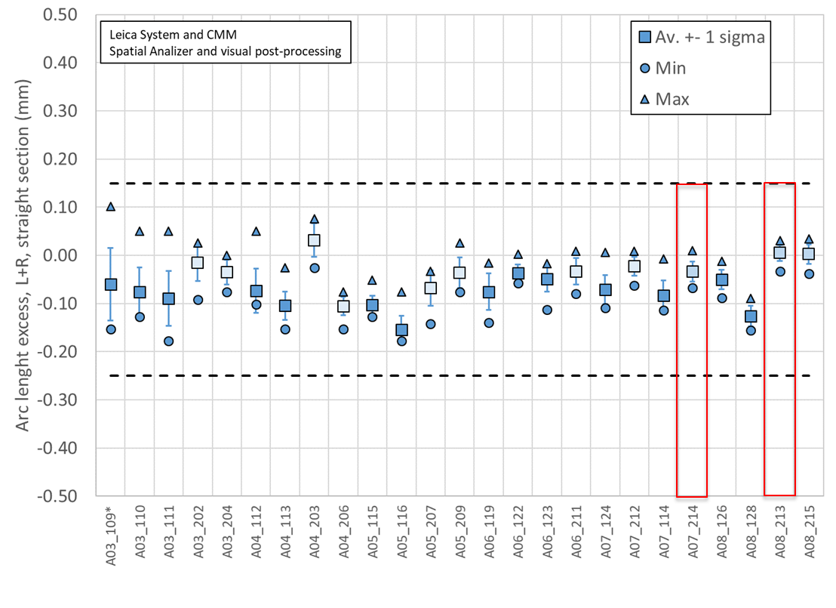
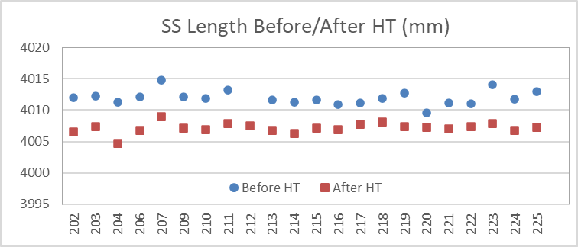
Assessment of MQXFA Data & Travelers
Completed assessment of travelers for Coil Fabrication at BNL, and Magnet Assembly at LBNL:
Assessment of coil parameters, which are being tracked, did not show any anomaly
Coil traveler assessment did not show any issue in addition to known DRs
Assessment of magnet assembly & preload data in next slides

Slide 11
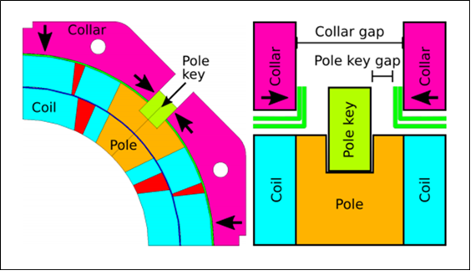
Structure Analysis & MQXFA07 Disassembly
Master
keys
Bladder
location
Yoke
Gap key
Pad
Pole key
Cooling
holes
Collar
Axial rod
location
Load
key
Al shell
A pole-key gap asymmetry was found during MQXFA07 and MQXFA08 disassembly:
- Gaps closed in quadrant 3
- Gaps open in other quadrants
Courtesy of P. Ferracin and D. Cheng

Slide 12
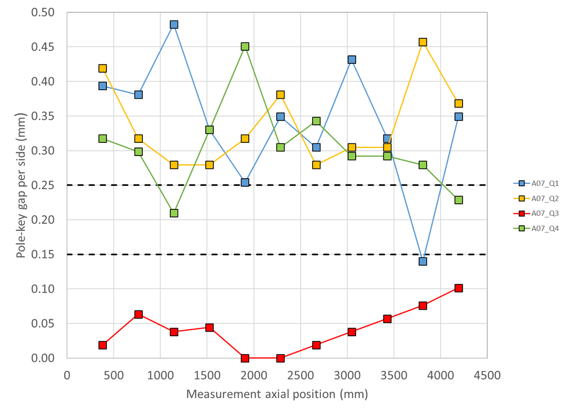
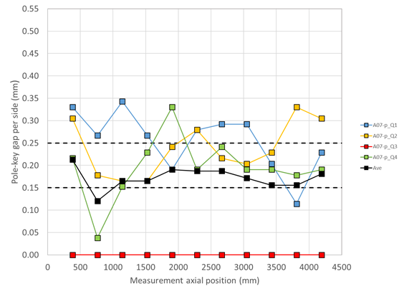
Pole-key gaps in MQXFA07
The measured pole-key gaps were not as uniform in MQXFA07 and MQXFA08 as in past magnets; this is particularly apparent on the limiting coils (Q3 for both magnets)
Only the total average (on the 4 keys) was targeted in the specification. The underlying assumption was that the gaps would be redistributed across coils during loading.
Investigation of the effect of this non-uniformity on the mechanical performances with 2D and 3D FE models
2D effect: preload variation within acceptable range
LL1
Courtesy of P. Ferracin and D. Cheng

Slide 13
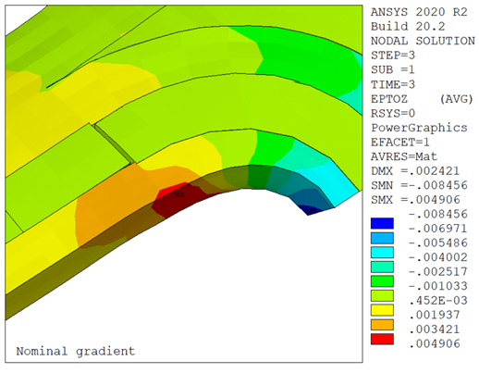
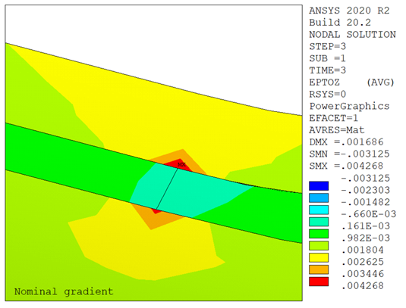
Possible Damage at Wedge-Spacer Interface
At cold the coil with less azimuthal preload ends up with less longitudinal preload
At nominal current tension develops between the inner wedge and the end spacer, and a (small) gap may open
This may result in high longitudinal strain (up to 0.4%) in that location
This location is consistent with quench data
Effect is larger on the pole block, but also visible on the mid plane block
LL2
Courtesy of G. Vallone and P. Ferracin

Slide 14
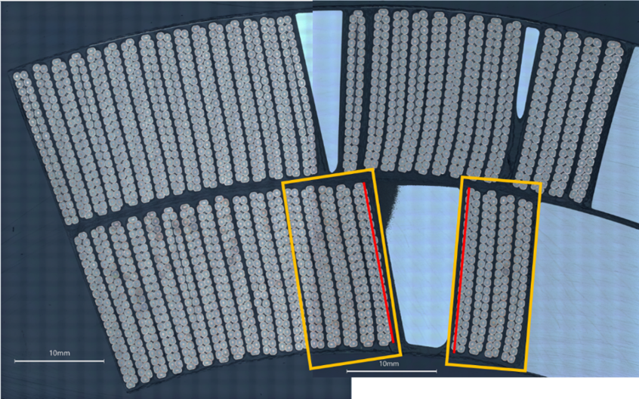
Micrographic Analysis of Coil 214 Lead End
CT-scan, dye-penetrant test and metallurgical analysis by CERN teams
OUTSTANDING!
S. Sgobba et al., “Advanced Examination of Nb₃Sn Coils and Conductors for the LHC luminosity upgrade: Computed Tomography and Materialographic Analyses”, ASC22 paper
Analysis started with sample #1: wedge-spacer interface
By B. Bulat, CERN
No anomalies found in cross-section #1.
Therefore, we did longitudinal sections
By M. Crouvizier, A. Moros, S. Sgobba, CERN

Slide 15
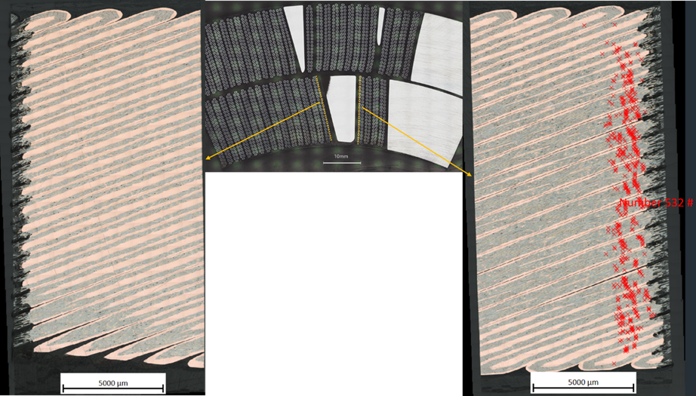
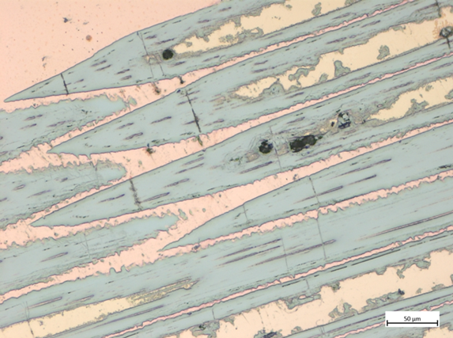
The Smoking Gun!
Each red marker is a broken Nb₃Sn filament

Slide 16
# | Samples adjacent to W-S transition from coil 214 Lead End | Number of cracked filaments
1 | Layer-jump side, cable in midplane block, side adjacent to W-S transition | 0
2 | Layer-jump side, cable in pole block, side adjacent to W-S transition | 532
3 | Non-layer-jump side, cable in midplane block, side adjacent to W-S transition | 54
4 | Non-layer-jump side, cable in pole block, side adjacent to W-S transition | 728
5 | Same cable of sample 4, side opposite to the W-S transition | 0

Slide 17
Copper wedge
Resin with S-2 glass
End spacer & ceramic coating
Left: coil section after samples were extracted for metallographic inspection.
Center: color scheme used to show the position of filament cracks with respect to the W-S transition in the following figure. A: End spacer + ceramic coating ≈ 0,5 mm; B: resin (filled with S-2 glass) between end spacer and wedge ≈ 1,5 mm; C: copper wedge.
Right: color scheme applied on sample with broken filaments.

Slide 18
MQXFA08 Analysis
Same features as in MQXFA07
Metallographic analysis of lead end completed on one side: broken filaments at wedge-spacer interface

Slide 19
Based on these findings, we understand that coil 214 pole-key gaps were closed at cold, whereas those of other coils were open. During magnet energization this difference caused tensile strain at wedge-spacer interfaces in coil 214 ends. In early ramps to quench (possibly before or during ramp #4) the bonding between the copper wedge and the resin (filled with S-e glass) gave away in the lead end increasing the strain on the strands closest to that interface. The “increased” strain degraded some strands and triggered the enhanced self-field instability behavior. This mechanism caused quench #4 and all subsequent quenches at 1.9 K and 20 A/s.
These quenches with hot-spot close to the wedge-spacer interface may have exacerbated this mechanism increasing the local strain and strand damage, and therefore causing the current drop (~1 kA) from quench #4 to #8.

Slide 20
COVID Lockdown Impact on Coil 214
Table: MQXFA coils whose fabrication was interrupted by COVID lockdown. Test status is green if magnet met requirements during vertical test; it is red if it did not meet requirements.
Coil # | Idle time | Status during lockdown | Test status
122 | ~9 weeks | OL impregnation prep, no lead soldering. | Tested in MQXFA06
123 | 11 weeks | Reaction was stopped during first ramp at 76 C. Coil in reaction fixture inside oven. | Tested in MQXFA06
124 | 8 weeks | Coil winding prep mostly complete. 1st turn not wound. | Tested in MQXFA07, will be used in MQXFA07b
211 | ~14 weeks | Impregnated coil. Coil remained closed in the impregnation fixture, hanging in the impregnation tank. | Tested in MQXFA06
212 | ~14 weeks | Reacted coil with leads soldered. Coil stored in the lower half of the reaction fixture, clamped with several form blocks and covered in plastic. | Tested in MQXFA07, will be used in MQXFA07b
213 | ~14 weeks | Reacted coil. Coil remained closed in the reaction fixture, in the oven. | Limiting coil in MQXFA08
214 | ~14 weeks | Inner layer wound and cured. Coil stored on mandrel in winding machine, inner layer pushers bolted in place supporting midplane, numerous Velcro straps securing coil OD and coil ends, coil covered in plastic. | Limiting coil in MQXFA07
Unique condition,
may have weakened wedge-spacer bonding

Slide 21
COVID impact on Magnet Assembly
Changes to magnet assembly procedures due to COVID requirements:
#1: change in bolting procedure for increasing tech distance
#2: the technician who had been leading the coil-pack assembly operations up to magnet MQXFA05 was removed from that task (starting from MQXFA06) because not vaccinated.
Before change #1
After change #1

Slide 22
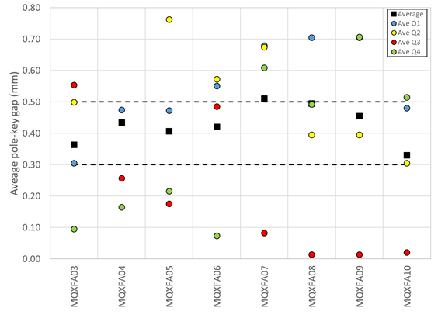
COVID Impact on pole-key gaps
Change #2
COVID lockdown
Change #1
With COVID change #2:
Smaller minimum
“Negative” trends
Fixed after MQXFA08 test
Coil 214 affected by COVID lockdown

Slide 23
Contributing factors
Specs for pole-key gaps
➔ Allowed non-uniform pole-key gaps
Changes to assembly procedures caused by COVID requirements
➔increased probability of non-uniform pole-key gaps, and possibly other magnet-magnet differences
COVID lockdown
➔ Stop in fabrication of coil 214 after Inner-Layer was cured may have weakened wedge-spacer bond
Less supervision caused by COVID
➔ increased probability of non-uniform pole-key gaps and other differences.
1/3
1/3
1/6
1/6
COVID share = 67%

Slide 24
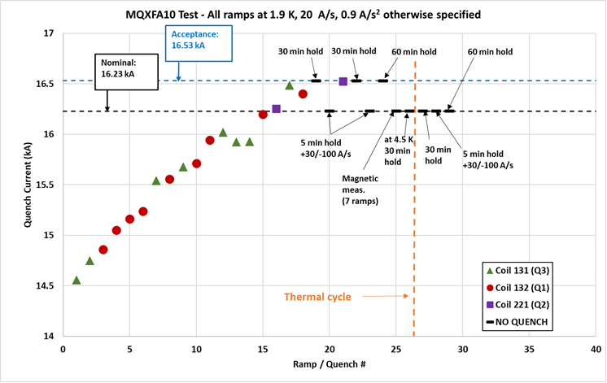
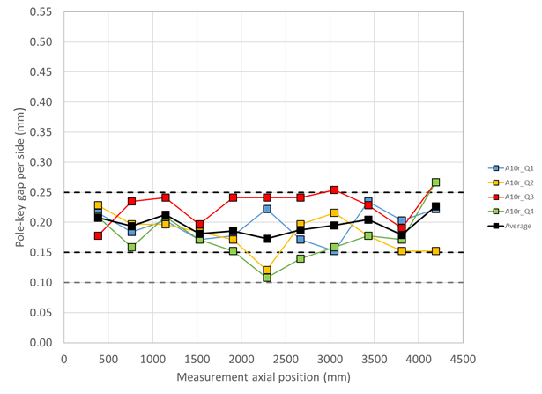
Preventive Actions
In order to prevent reoccurrence of this issue,
Design change for larger pole-key gaps (doc-4304):
From 200 μm to 400 μm - average pole key gap per side
Revised MQXFA Series Magnet Production Spec. (doc-4009):
Added spec for minimum gap on each coil at each longitudinal location: 300 μm per side
D. Cheng et al., “The challenges and solutions of meeting the assembly specifications for the 4.5 m long MQXFA magnets for the Hi-Luminosity LHC” ASC22 paper
MQXFA10 Pole-key gaps
MQXFA10 Quench History
Courtesy of P. Ferracin
Courtesy of A. Ben Yahia

Slide 25
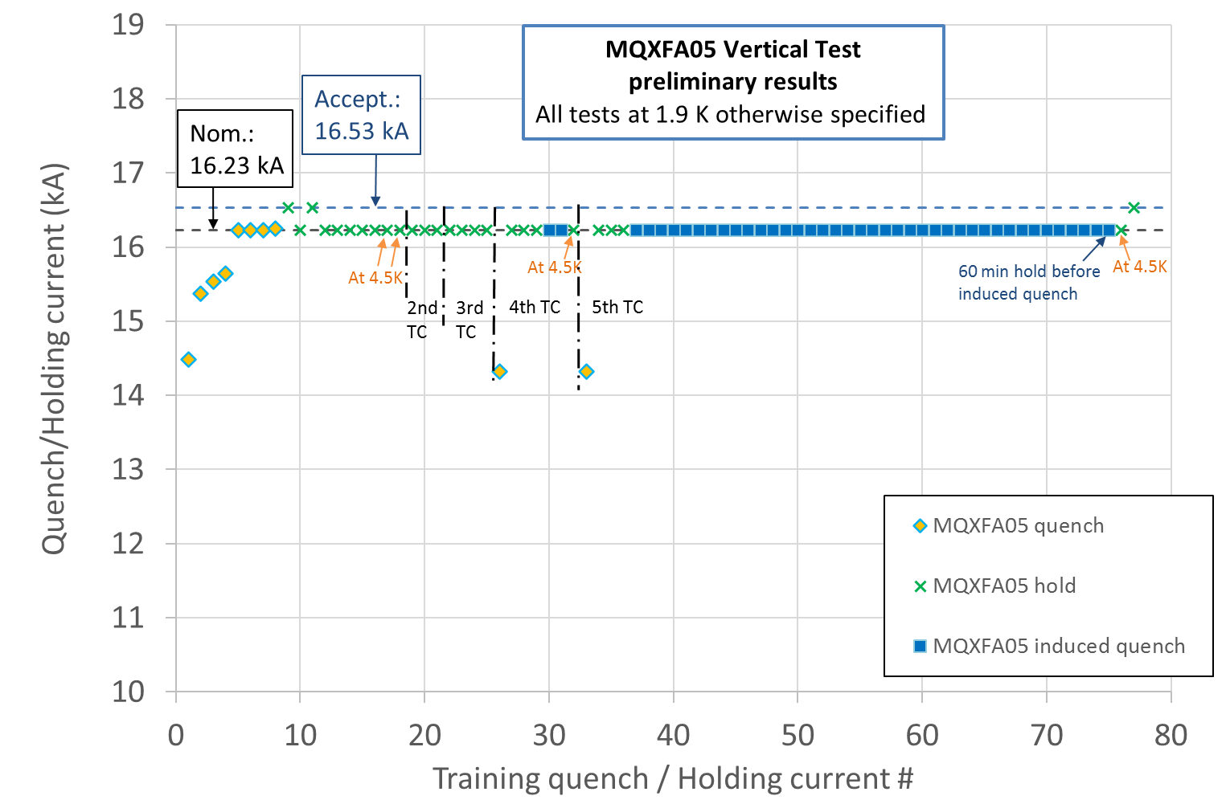
Endurance Tests
Previous endurance tests were successfully performed on short models
MQXFA05 met requirements after 5 thermal cycles, 52 quenches and 79 powering cycles
5 Thermal cycles
52 quenches (10 spontaneous + 42 induced)
79 power cycles (52 quenches + 27 cycles w/o quench) above 10 kA.

Slide 26
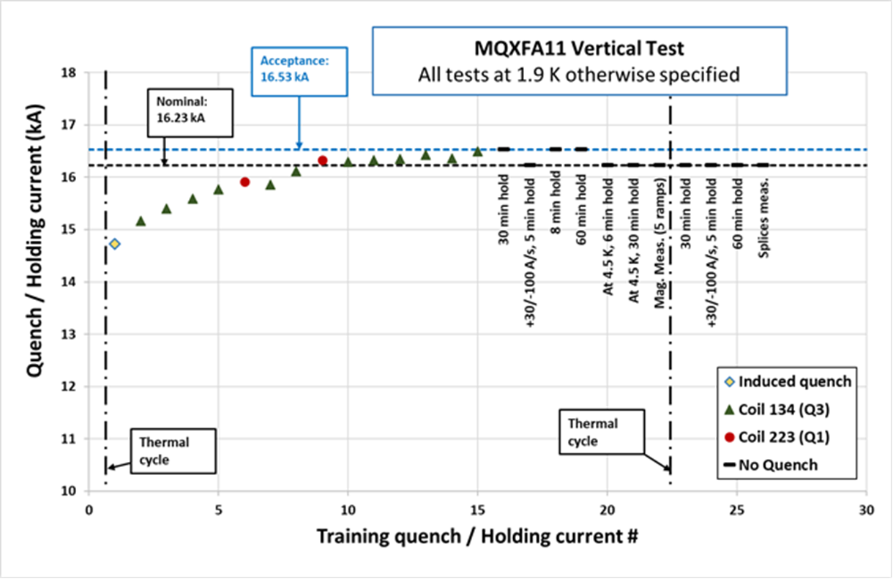
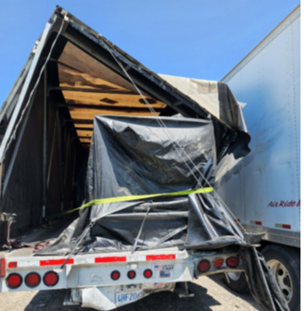
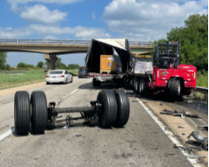
MQXFA11 “Resilience Test”
The truck transporting the MQXFA11 magnet from LBNL to BNL was rear ended by another truck.
The main hit took place on the right back corner. During the incident the truck rear axle disengaged as displayed below. Nobody was injured.
The magnet was moved to FNAL. Upon arrival a visual inspection was performed followed by electrical checkout, metrology survey, analysis of the fiber optic sensors and accelerometer data analysis
Max shock: 6 or 10 g vertical (depending on the device in the same accelerometer unit)
Duration: 5 ms
All tests and analyses were OK. Magnet was shipped to BNL
Courtesy of T. Cruise
Courtesy of A. Ben Yahia
Nobody was injured
Courtesy of J. Blowers

Slide 27
Conclusions
6 out 8 magnets met vertical test requirements
MQXFA07/08 “smoking gun” was found
Mechanism is understood
COVID restrictions and lockdown contributed to the degradation mechanism
Design change (larger gaps) and Specification revision (minimum gaps spec.) are going to prevent reoccurrence in future magnets
MQXFA10 & MQXFA11 demonstrated that this issue is over
MQXFA05 demonstrated Endurance
MQXFA11 demonstrated Resilience

Slide 28
Backup Slides

Slide 29
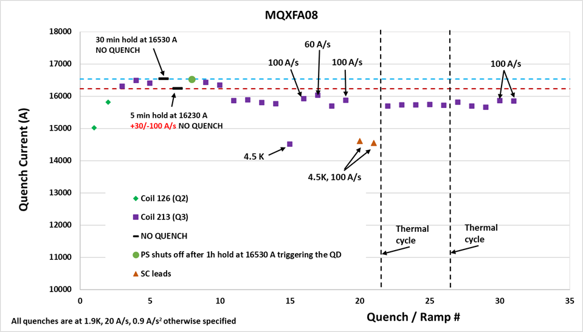
MQXFA08 Quench History
Fixed 42-nohm splice to test facility
Connected voltage taps to coil 213 LE

Slide 30
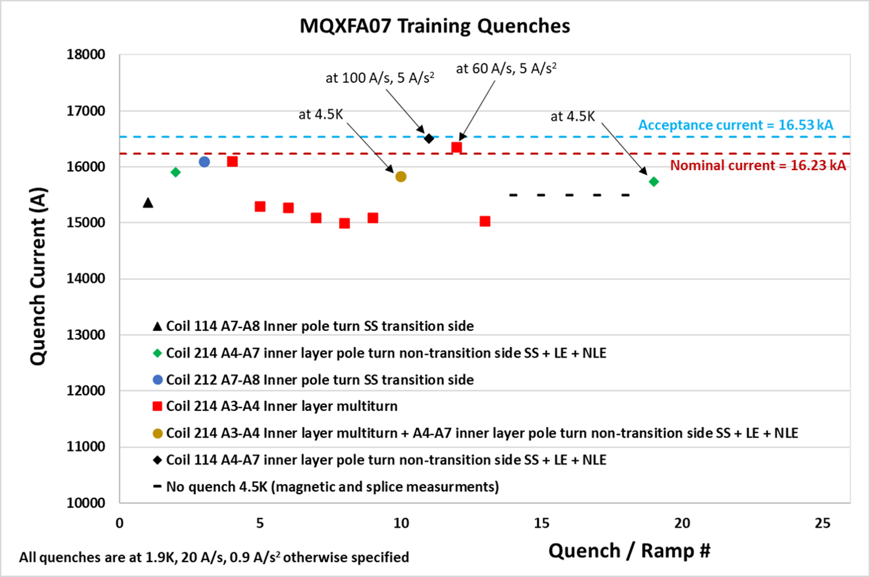
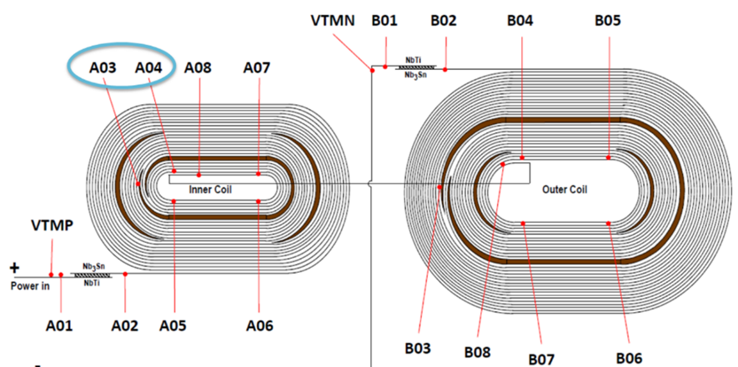
Main Features
All limiting quenches started in a single coil (Coil 214) and in the same voltage-tap segment (A3-A4), in the Lead End (quench antenna data)
Reverse temperature dependence:
higher quench current at 4.5 K than at 1.9 K, with standard 20 A/s ramp rate,
with about 800 A increase at 4.5 K
Reverse ramp-rate dependence:
higher quench current at ramp rate > 20 A/s, at 1.9 K
with 1486 A and 1332 A increase at 100 and 60 A/s respectively, using the last quench at 20 A/s as reference.

Slide 31
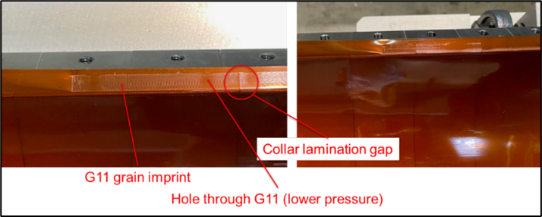
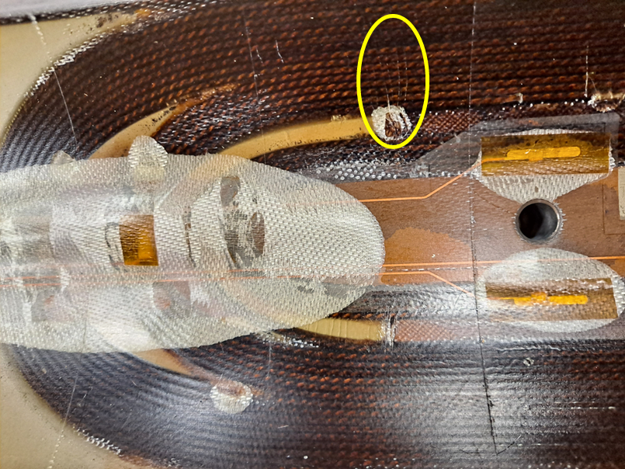
Magnet Dis-assembly
Pressure imprint in Q3 pole-key gaps
Unusual marks at wedge-spacer interface in lead end

Slide 32
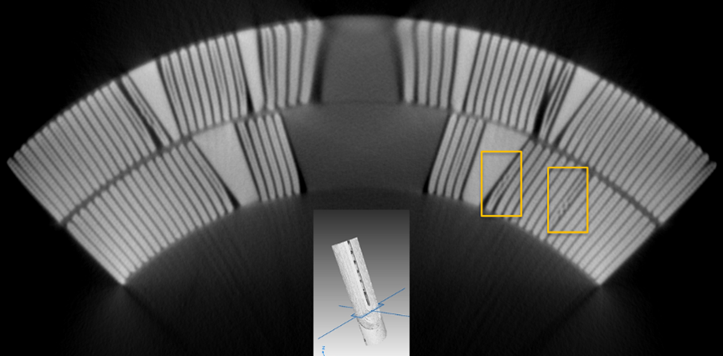
CT-scan of Coil 214 ends
CT-scanning performed at Diondo GmbH (Germany) with a 6 MeV Linac [12].
Lead by Bartosz Bulat (CERN) who did also image reconstruction.
Number of popped strands in coil 214 ends
Coil 214 section | # in Outer Layer | # in Inner Layer inside A3-A4 | # in Inner Layer outside A3-A4
Lead End | 3 | 1 | 1
Return End | 5 | 0 | 2
Image reconstruction of CT-scan through the Inner Layer of coil 214 Lead End. The yellow boxes highlight the location of two popped strands. The innermost one is within A3-A4 segment.

Slide 33
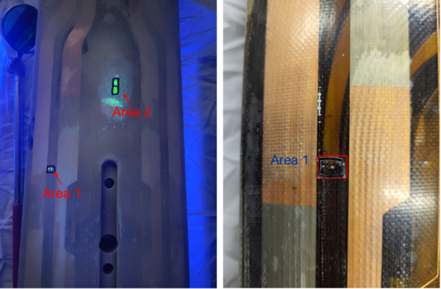
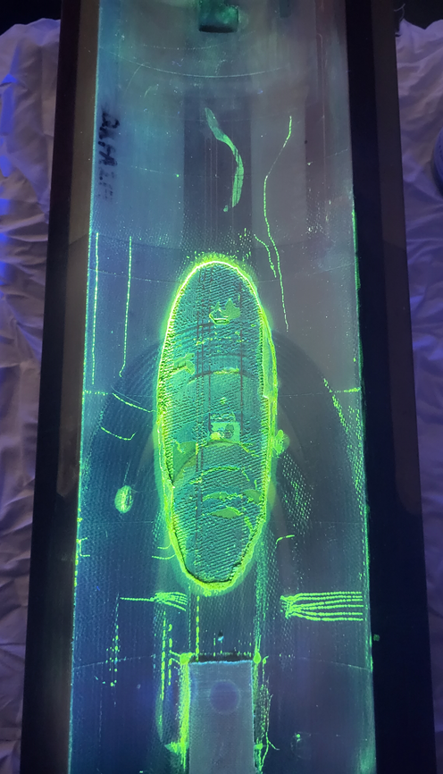
Dye-penetrant test of Coil 214 Lead End
Dye penetrant test performed by CERN team
Dye appeared on coil outer surface only in 2 points
On Inner Layer:
“tension marks” at wedge-spacer interface

