Slide 1


Magnets 302.2 - MQXFA Shipping Requirements and Execution
Maria Baldini – FNAL
302.2 Deputy L2
HL-LHC AUP Rebaseline DOE Rev. – Dec. 13th–15th 2020

Slide 2
Outline
Requirements and travelers
Shock measurements: devices and settings
QXFA coils and MQXFA magnets shipping summary: Non-conformity and lessons learned
MQXFA11 truck incident
Conclusion

Slide 3
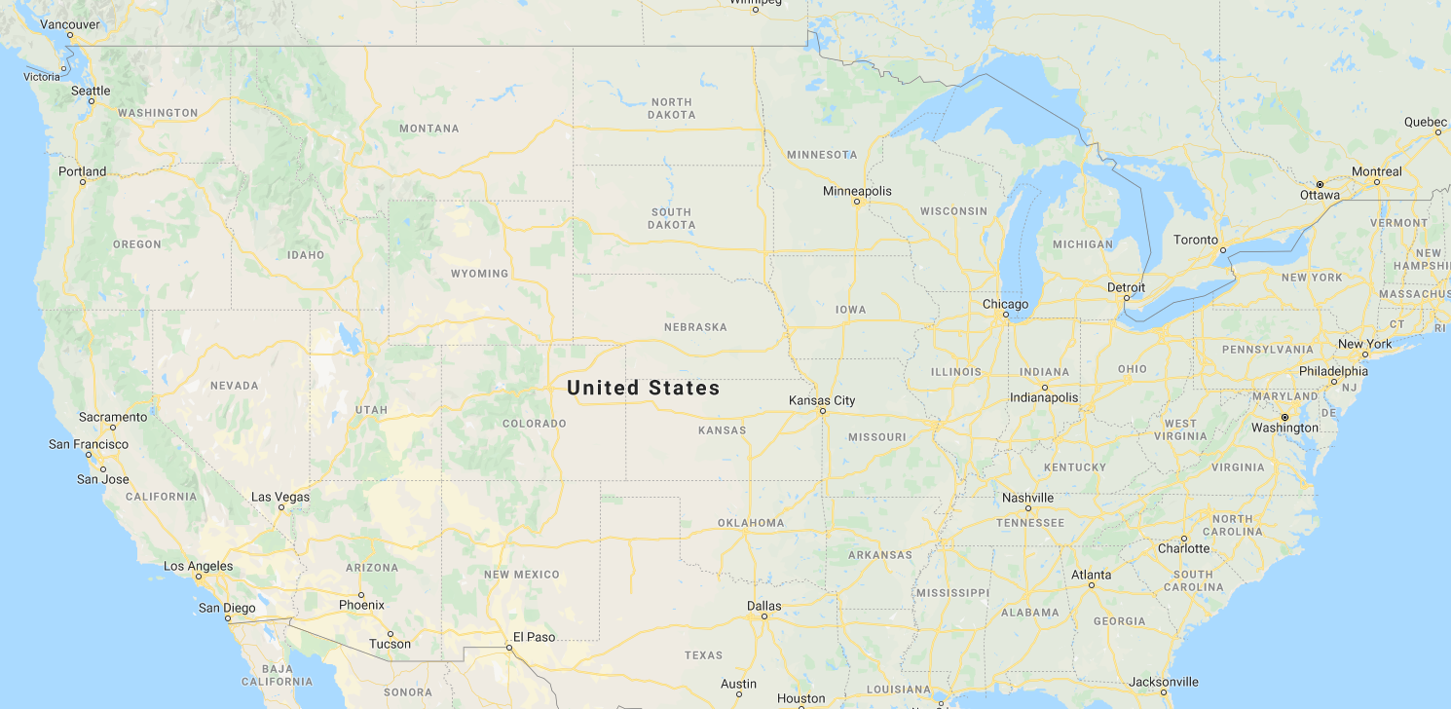
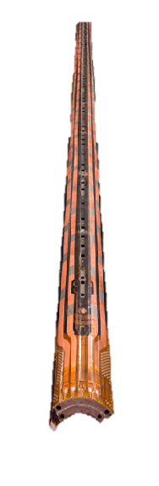
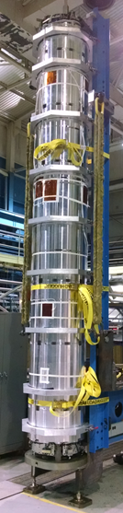
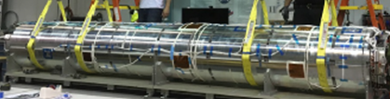
HL-LHC AUP domestic shipments
AUP project: around 150 domestic shipments (coils + magnets)

Slide 4
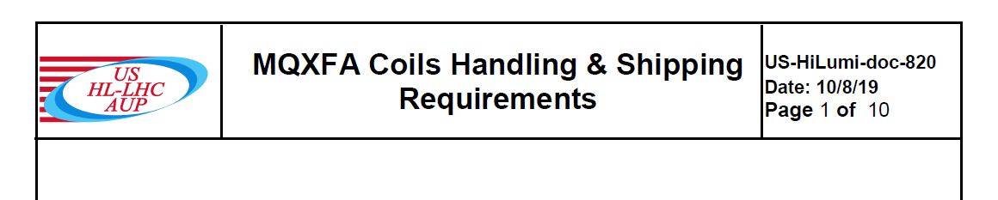
Coil shipping Requirements
Coils
The conductor strain shall never exceed 500 microstrain in any part of the coils during any handling or shipping operation.
  This requirement uses a safety margin of 4 and it implies that coil lifting, and shipping shall be performed using rigid fixture
  FEM analysis was performed on coil + fixture and threshold was set at 10g (US-HiLumi-doc- 2478)

Slide 5
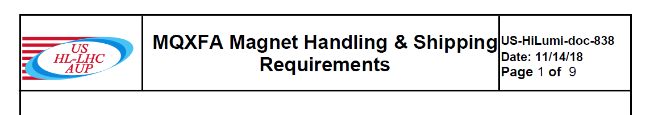
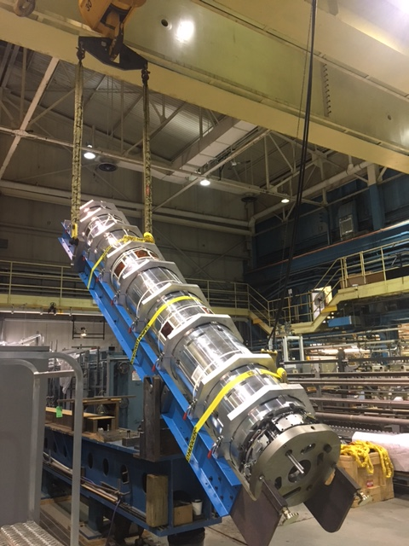
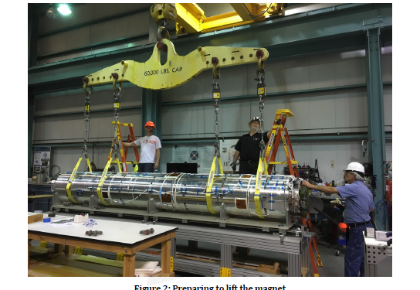
Magnet shipping Requirements
Magnets
The conductor strain shall never exceed 500 microstrain in any part of the coils during any MQXFA handling (for instance lifting, lowering, rotation and up-righting) and shipping operation.
  dedicated handling and shipping fixtures
Where the tie-rods go through the iron laminations, the laminations shall always remain in contact during any MQXFA handling and shipping operation.
  MQXFA deflection is kept below 0.26mm:
    4 points lifting
    shocks < 5 g (FEM analysis in US-HiLumi-doc-838)
NOTE: Deflection can be up to 0.48 after coldmass assembly
Notes:
Add deflection can be larger when magnet is in the cold mass 0.5 mm deflection for cold mass (add a backup slide)

Slide 6
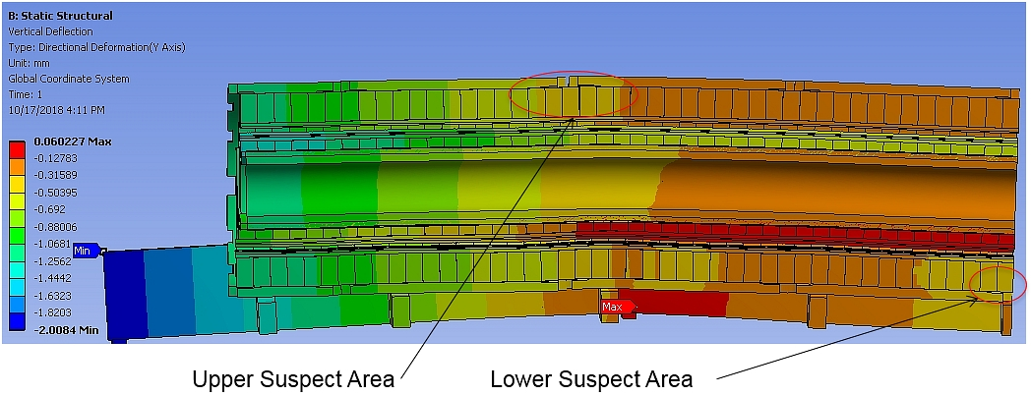
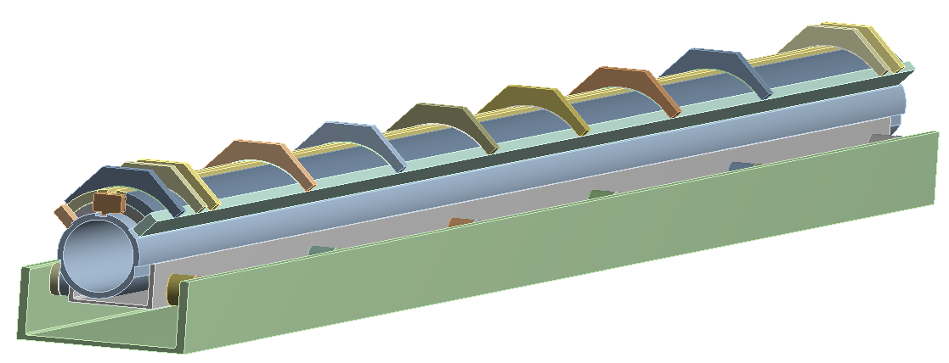
Shock FEM analysis
(by Heng Pan LBNL and John P. Cozzolino BNL)
Rubber Isolator
End Stopper
Coil Clamp
Side Rail
Base Channel
Support Tube
Support Channel
Coil+ fixture(US-HiLumi-doc-2478):
  strain is way below the limit of 500 µε with the current fixture design under 10g loads
  Magnet + fixture (US-HiLumi-doc-838, US-HiLumi-doc-3259) :
  Axial compressive strain at coil ends remains unchanged at 10g
  Separation of the outer yoke blocks is predicted to start at 10g
  Structure separation is the driver of shock requirements (5g)
.
6

Slide 7
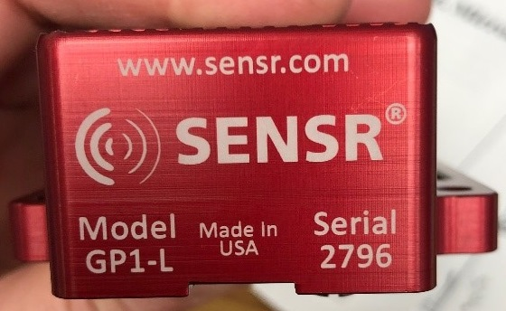
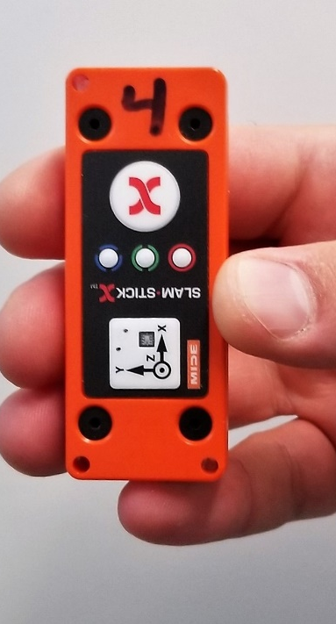
Shock measurements: accelerometers
GP1L Senseware
g range up to 6.7 g
Sample rate 100 Hz
Frequency response 50 Hz
Event recorded if > 3g. event is 1 sec long (0.3 sec before and 0.7 sec after)
SLAMSTICK E, X and C
Piezoelectric and a Digital capacitive (DC-MEMS)
g range up to 40 g and 25 g
Sample rate up 20 kHz or 3.2 kHz
Frequency response up to 2000 Hz or 500 Hz
From FNAL coil 115
From BNL coil 206
From magnet MQXFA03

Slide 8
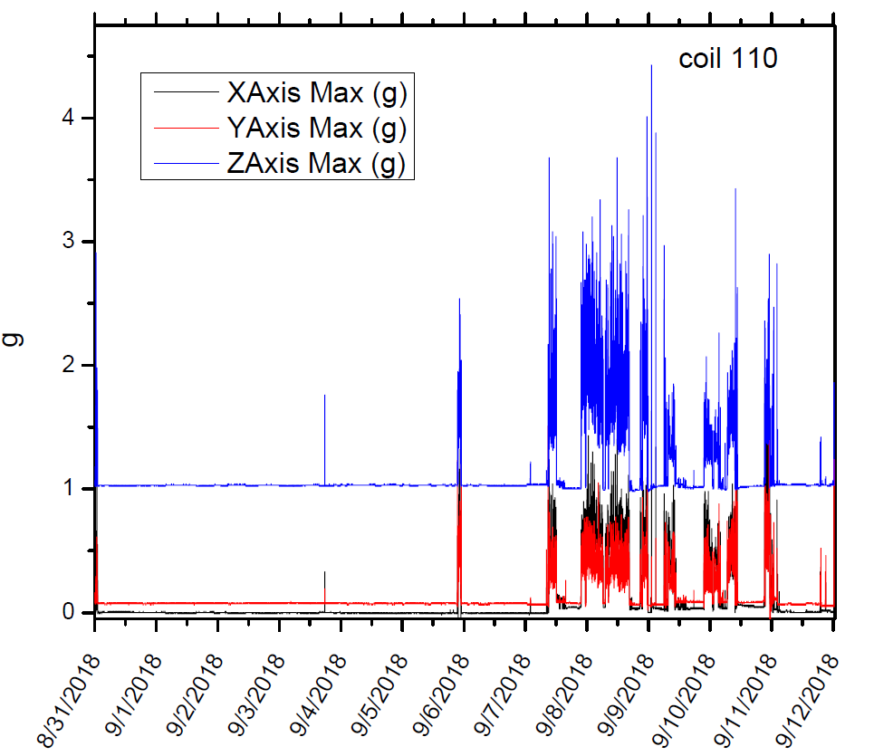
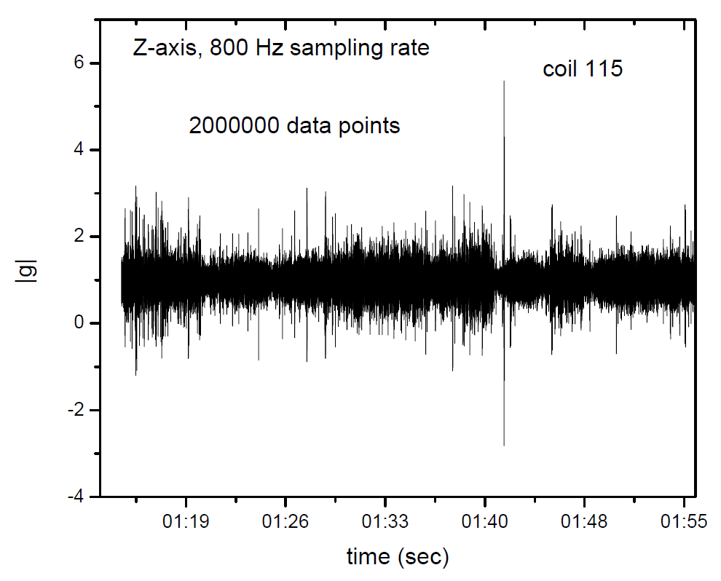
Shock measurements: accelerometers
GP1L device
SLAMSTICK device
Entire trip in a snapshot
21 days lifetime
Probe high frequency shocks, vibration analysis
2 days lifetime
7 days with external battery depending on the settings

Slide 9
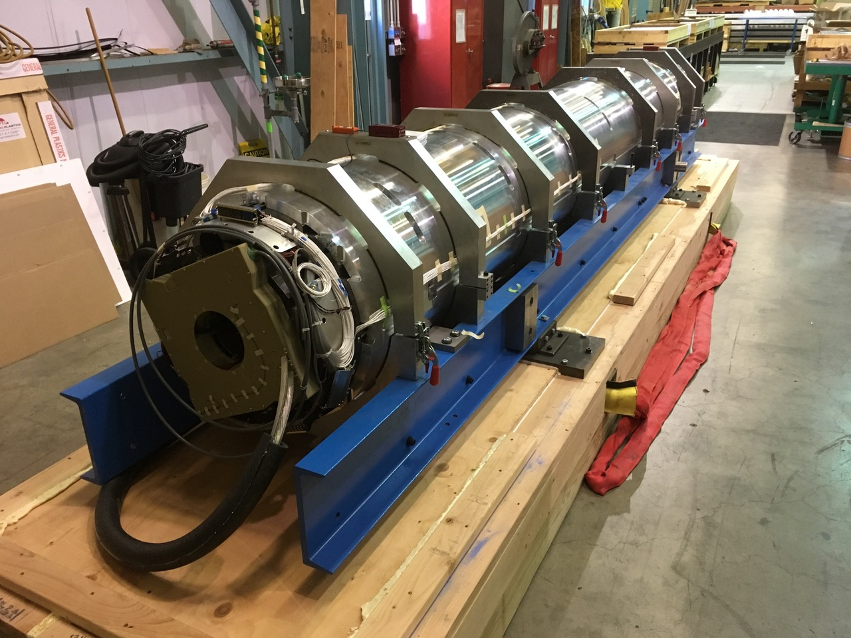
AUP coil and magnet shipment mitigations
Air ride truck
Dedicated full truck load
5g and 10g shock watches on the crate
Dedicated handling and shipping rigid fixtures
Shock measuring devices: a minimum of 2 devices per shipment
  4 accelerometers per coil: 2 GP1L + 2 slamstick on fixture clamps
  4/5 accelerometers per magnets: 2 GP1L + 2 slamstick on fixture clamps + 1 slamstick on magnet end plate
All those procedures are implemented in the FNAL, BNL and LBNL travelers
  - shock thresholds defined in the requirements have large margins
  - If shocks above requirements are observed on coil (10g) or magnet (5g)
      Coil/magnet is quarantined
      An investigation is performed
Notes:
Non possono muovere crate

Slide 10
AUP shipments: FNAL coil summary
Coil 119 above req.
Discussion in later slides

Slide 11
AUP shipments: BNL coil summary
Coil 206 above req.
Discussion in later slides

Slide 12
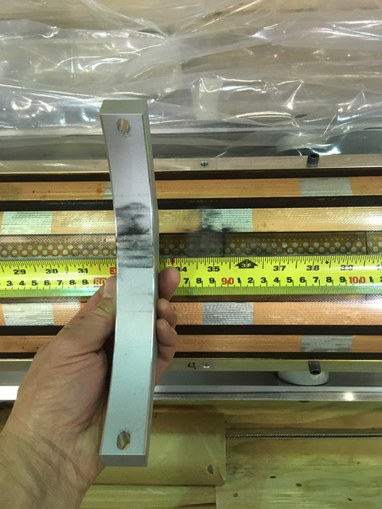
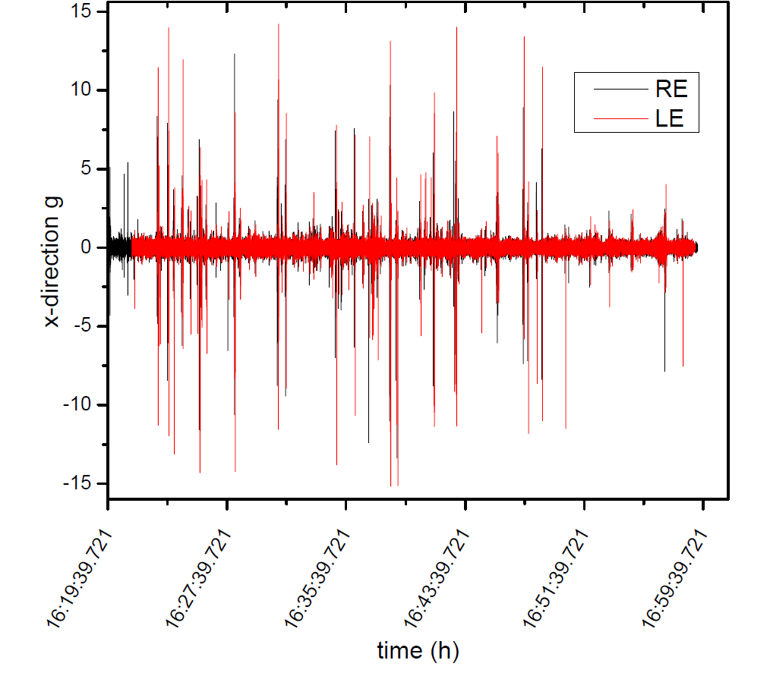
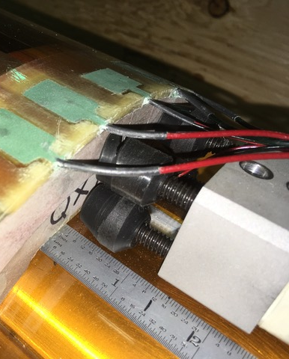
Lesson Learned: coil 206 shipment summary
  marks under Clamping Rib 4 were found
  Axial restrain not engaged
GP1L data: <5. 5g
No shock watches activated
Several 2 ms shock > 10g along x and y axis over the entire trip

Slide 13
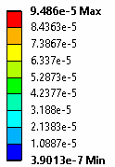
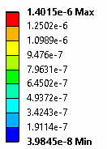
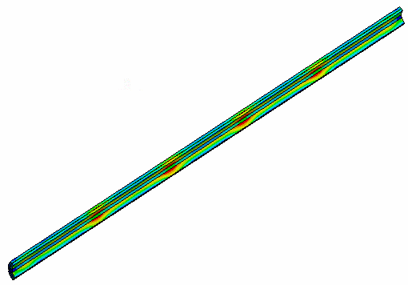
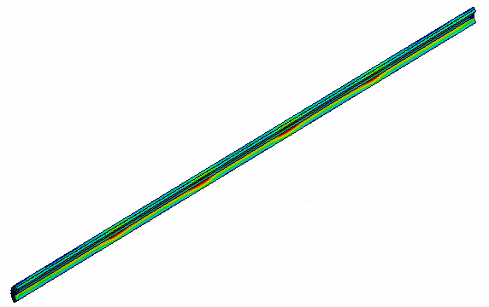
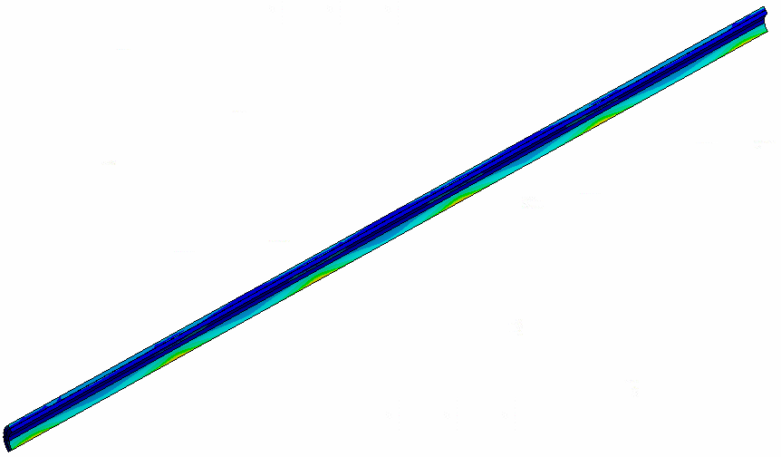
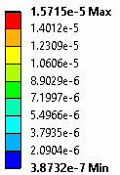
10g Inertial Load---Lateral (All parts)
US-HiLumi-doc-2478
FEM: 1g Vertical Inertial Load---upward on Coil Only
FEM: 10g Vertical Inertial Load---upward (all parts)
Coil Equivalent Strain,
Maximum strain is ~1.4 µε
Coil Equivalent Strain,
Maximum strain is ~95 µε
Coil Equivalent Strain,
Maximum strain is ~16 µε
Based on results and FEM analysis, strain is well below requirements: Coil 206 was accepted and successfully tested in MQXFA04
  Coil FEM analysis demonstrated large margin and can been used to dispose DR’s of future coils with shocks slightly above 10g (example coil 119; also successfully tested in MQXFA06).
  Shipping procedure were implemented in the traveler (ex. Add rubber underneath clamps)

Slide 14
AUP Magnet shipments summary

Slide 15
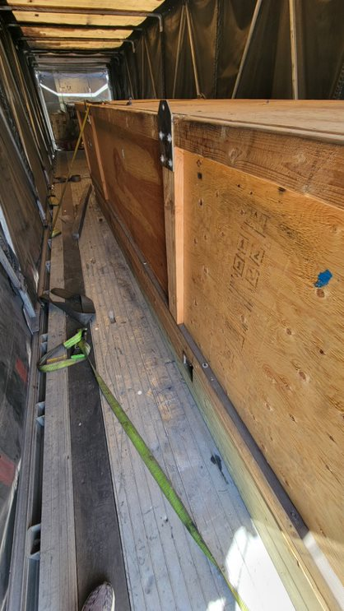
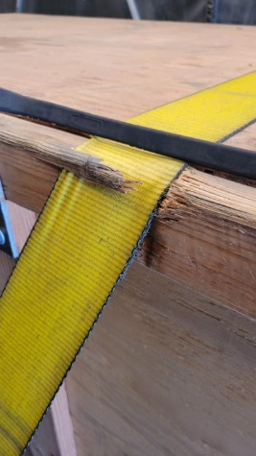
MQXFA11 incident
On July 20th the truck carrying MQXFA11 from LBNL to BNL was rear ended by another truck
Crate moved 6’ backward and the non-lead end of the crate shifted towards the passenger side
The shock watches installed on the non-lead end passenger side tripped
Magnet was brought to a tow yard and then to FNAL where an initial inspection was performed
[driver side]
[rear of trailer]

Slide 16
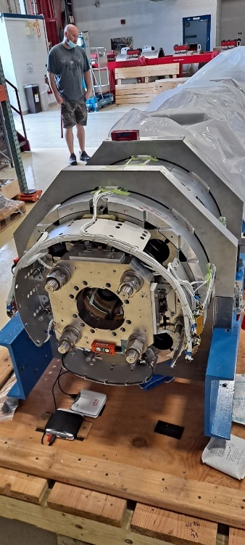
MQXFA11 accelerometers analysis
axial direction
vertical direction
Transverse direction
No shocks above requirements observed with the GP1L devices
Shocks above 3.5g coincides with the incident
Frequency response is 50 Hz/20 ms

Slide 17
MQXFA11 accelerometers analysis
1.5 second event
High shock events are 15 ms long
5 ms long shocks above requirements:10g DC MEMS and 6g Piezo
Based on vendor feedback, the amplitude values observed by the piezo are more reliable

Slide 18
MQXFA11 inspection at FNAL
US-HiLumi- Doc: 4341
Visual inspection: No issues
  no evident sign of damage on the magnet
High voltage tests: No issues
measurements were performed for
  Straightness of the magnet: consistent with LBNL data, No issues
  Axial restrain plate to load keys gaps: consistent with LBNL data, No Issues
Accelerometers analysis: some shock events above requirements: FEM analysis
Strain measurement using the FBG sensors: data consistent with LBNL measurements; No issues

Slide 19
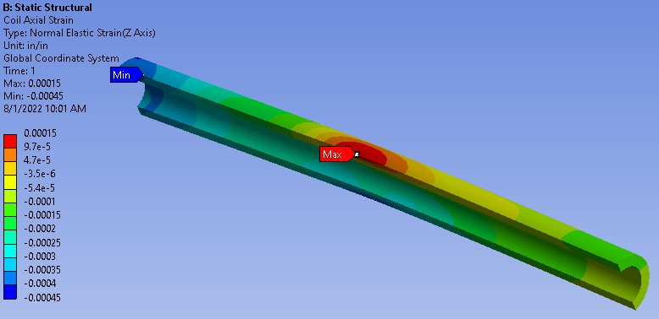
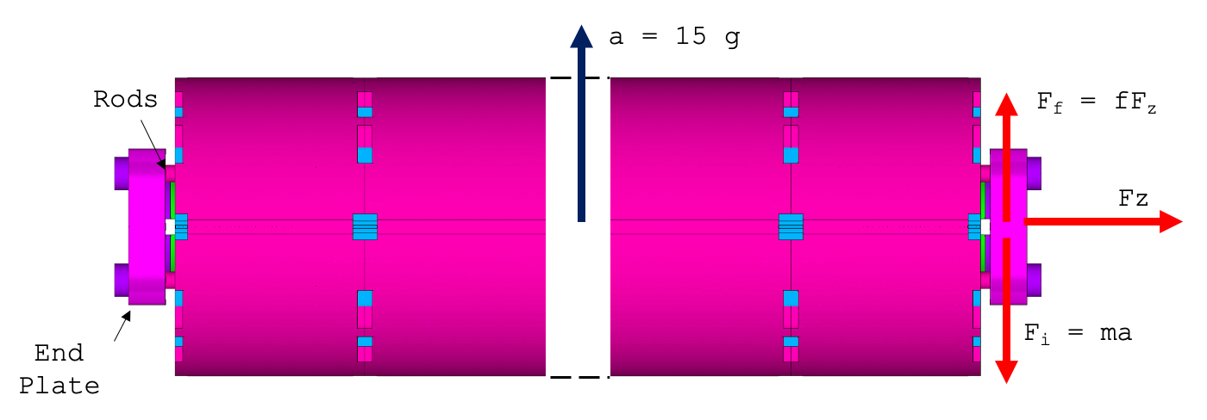
Computational analysis on MQXFA11
Static FEM analysis 15g (1.5X higher shock value) vertical load
The maximum tensile strain in the coil is 150 um/m in the area where the yoke lamination separated. This is below requirements
Relative movement between magnet and end plate is assured by friction
15 g of vertical acceleration
Safety factor of 2.34: F_{friction}/F_{i}
F_{i}= end plate inertia force with 15g vertical shock
Inspection results at FNAL + very conservative computational analysis suggests that we have margins : MQXFA11 was sent to BNL for vertical test
Test was successfully completed on October 24

Slide 20
Shipment risks (RT-302-2-01-012)
AUP is performing 100 coil and 50 magnet shipments for the duration of the project.
The risk of “Coils/Magnet Handling or Shipment damage” was considered after CD1 and mitigation was added in baseline:
  One magnet assumed irreversibly damaged during handling or shipment ➔ additional magnet in baseline
Considering the total number of LARP/AUP shipments: 84
  Only one incident has been recorded resulting in 1/84= 1.2% probability
Risk for magnet failure was computed considering the remaining coil (42) and magnet (31) shipments. The maximum number of failure is 1 magnet and 1 coil with 10% probability
Maximum cost impact is 3934k: full magnet damaged and single coil damaged in a separate shipment
  Coil cost ~ $ 583kX5
  Magnet cost (dis-assembly, re-assembly and re-test )~ $1019k

Slide 21
Conclusions
Requirements for QXFA coils and MQXFA magnets shipping, and handling are established and well defined.
Lesson learned: Very short shocks above 10g were observed for coil 206 and 119. FEM analysis demonstrated large margins with respect to max strain requirements and coils were accepted and successfully tested in MQXFA04 and MQXFA06 magnets.
A truck accident occurred during MQXFA11 shipment to BNL.
  5 ms shock above requirements
  Based on Visual inspection/measurements and computational analysis MQXFA11 was sent for vertical test
MQXFA11 successfully completed the vertical test confirming the resilience of this Nb3Sn magnets
Shipment Risks are up to date and mitigation procedures are well defined and in place for QXFA coil and MQXFA magnet shipments

Slide 22
Extra slides

Slide 23
Coil 206: lesson learned
Based on results and FEM analysis, strain is well below requirements: Coil 206 was accepted
  Mitigations:
    Add rubber material under the fixture clamps
    Install locking nuts on axial restraints to prevent screws from backing out
    Wrap coil in Kapton/Mylar around fixture
  Lesson learned:
  All those procedures have been specified in the coils shipping and handling requirements (US-HiLumi-doc 820)
  Coil FEM analysis demonstrated large margin and can been used to dispose DR’s of future coils with shocks slightly above 10g (example coil 119).
  Travelers have been updated and modified accordingly

Slide 24
Lesson learned for slamstick devices
Very sharp (1-2 ms) high shocks were observed on the DC-MEMS.during magnet shipment. No sign of those high shocks in the piezo contained in the same device.
Antialiasing filter is not reliable in the DC-MEMS: high frequency shocks can be distorted
Antialiasing filter cut off everything higher than 1/5 sample rate for the piezo (200 Hz).
DC: 800 Hz sample rate
Investigation conclusion
  Older devices have a bad low pass antialiasing filter
  The antialiasing cut-off of the DC-MEMS is currently not known.
  Antialiasing filter cut off everything higher than 1/5 sample rate for the piezo (200 Hz).
  Those data were discharged
PIEZO: 500 Hz sample rate

Slide 25
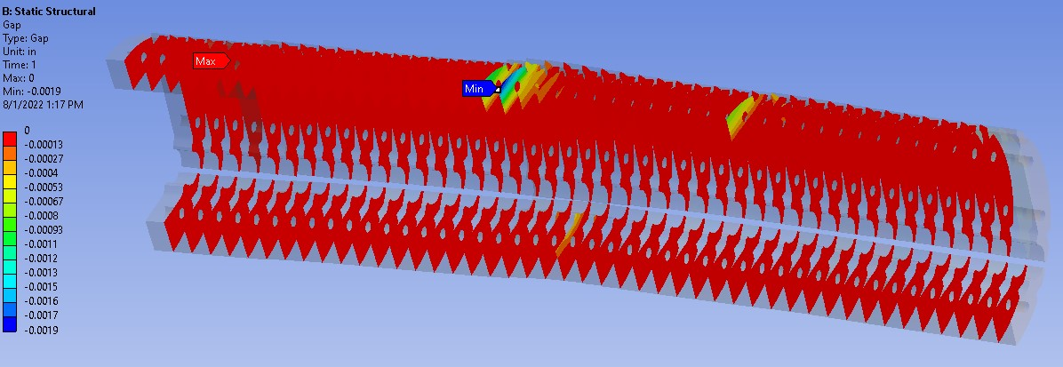
Magnet 11 Gap between yoke blocks at 15 g vertical

Slide 26
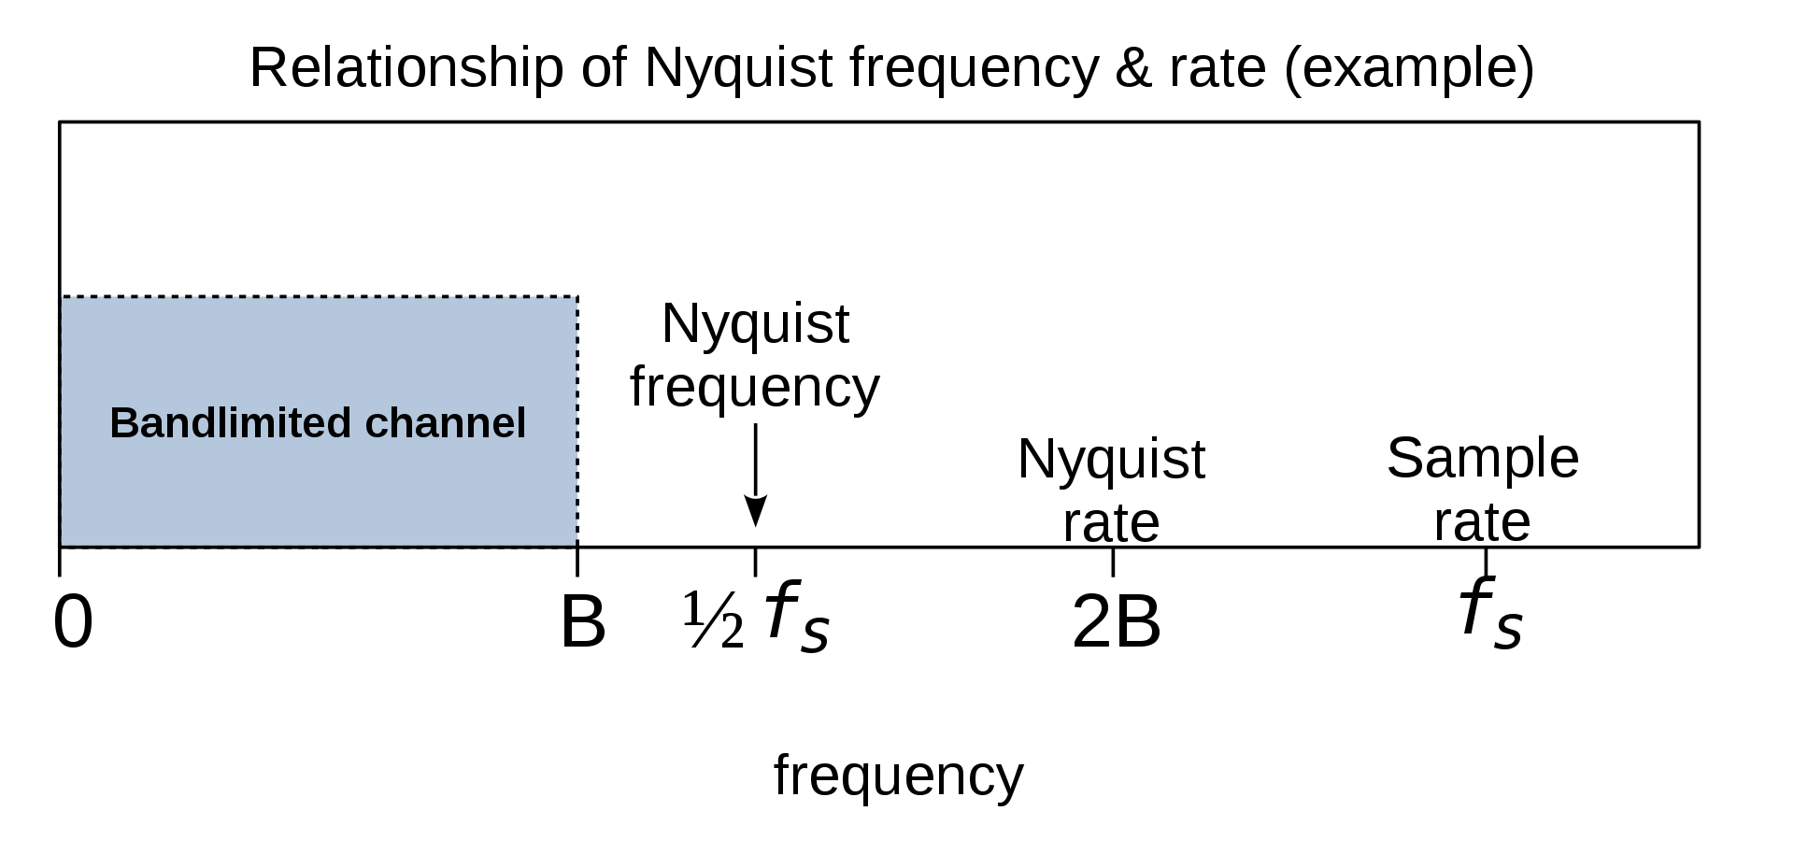
Aliasing
A discussion was initiated with the vendor. Below you find the outcome of such discussion
The slamstick devices have an anti-aliasing filter.
However, old DC-MEMS devices have a bad low pass antialiasing filter. Cutoff is ½ sample rate
PIEZO cut off is 1/5 of the sample rate
The workaround for this issue is to set the sample rate to be greater than twice the highest frequency we want to measure.
  If the highest frequency of the signal is less than the Nyquist frequency (which is ½ the sampling rate), we are sure that we do not have data with distortions (aliasing).
The sudden rise of very high frequencies oscillations can be related to a failure of the anti-aliasing filter

Slide 27
Q1 coil
Strain data by FBG fibers
Some differences are observed in the azimuthal direction at the 1900 m position
Q2 coil

