Slide 1
Magnets 302.2.04 - Coil Parts, Materials and Tooling
Miao Yu - FNAL
HL-LHC AUP Rebaseline DOE Rev. – Dec. 13th–15th 2022

Slide 2
Outline
Scope, Interfaces, Dependencies & Team
Achievements since CD-3
Contingency Consumption
COVID and Abnormal Escalation Impacts
Procurement Status
Schedule
Cost and Schedule Performance & VAR Reports
Estimate at Completion
Risks
QA/QC
ES&H
Summary

Slide 3
WBS 302.2.04: Scope
WBS Code | WBS Name | Control Account
302.2.04 | Coil Parts, Materials, and Tooling | Yes
WBS Description
Scope of Work Procure coil parts (excluding insulated cable) for the fabrication of 102 coils. Major parts include poles, wedges, end parts, traces, and consumable materials. A total number of 19 coil part sets are assumed to be available from LARP and the balance (83) are procured with project funds. Procure additional tooling required to increase coil production throughput at both FNAL and BNL locations. Additional tooling includes 4 reaction fixtures, 2 impregnation fixtures, 10 storage fixtures and a FNAL second winding mandrel. Ship corresponding parts and additional tooling to BNL for coils to be fabricated at the BNL location as part of 302.2.06 “Coil Fabrication at BNL”. FNAL equipment maintenance for coil fabrication, including cable length counter, SELVA winder, the rotating winding table and its tensioner, curing press, rollover fixtures, reaction oven, impregnation vacuum oven, and etc. Scope Assumptions/Exclusions 19 coil part sets are available from LARP One set of coil production tooling is available from LARP at both FNAL and BNL location BNL also requires a second winding mandrel, but it will be procured at BNL as part of 302.2.06 “Coil Fabrication at BNL” because this mandrel is specific to the BNL winding machine. WBS Deliverables Parts for the fabrication of 102 coils (52 sets for FNAL, 50 sets for BNL) 1 winding machine mandrel for FNAL 4 reaction fixtures (2 for FNAL, 2 for BNL) 2 impregnation fixtures (1 for FNAL, 1 for BNL) 10 storage fixtures (5 for FNAL, 5 for BNL)

Slide 4
WBS 302.2.04: Interfaces
Charge #9
Receive
US-HiLumi-Doc-1061: (from LBNL)
Insulated cable
US-HiLumi-Doc-375: (from CERN)
Quench heater trace
NbTi cable
Deliver
US-HiLumi-Doc-264: (to FNAL)
Drawings
Insulated cable
Coil parts and materials
Part kit list for each coil
US-HiLumi-Doc 270: (to BNL)
Drawings
Insulated cable
Coil parts and materials
Part kit list for each coil
US-HiLumi-Doc-273: (to LBNL)
Ti-alloy block for strain compensator
464441-HL-LHC AUP Coil Interface Traveler
US-HiLumi-doc-219

Slide 5
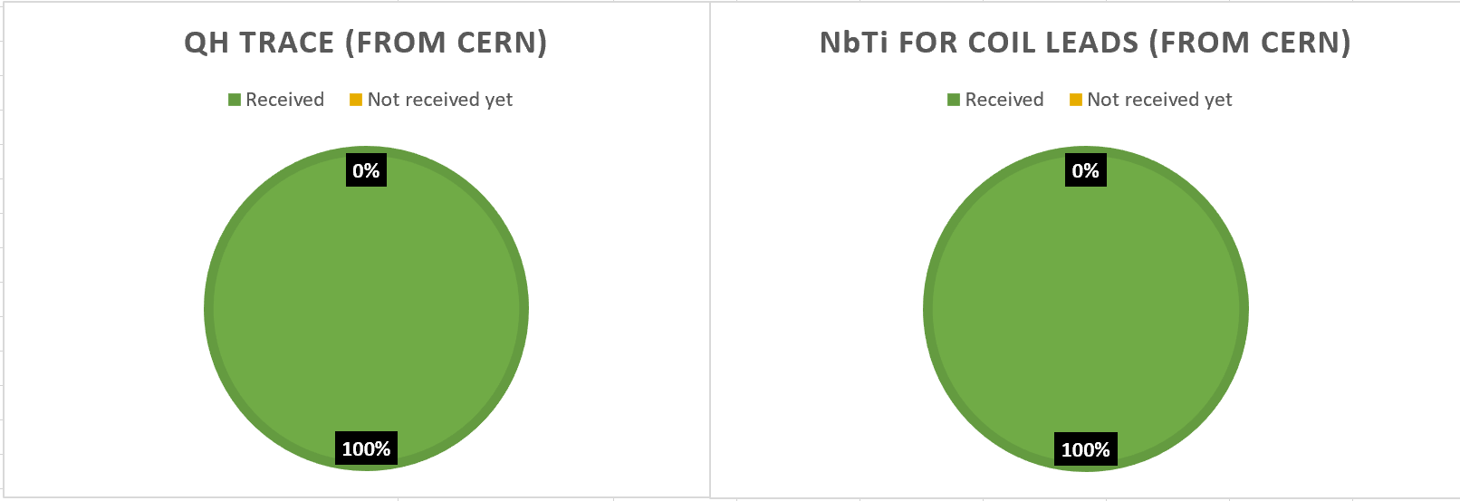
WBS 302.2.04: External Dependencies
Charge #6
US-HiLumi-Doc-375: (from CERN)
Quench heater trace: 100% Received
NbTi cable: 100% Received

Slide 6
WBS 302.2.04: Team
Charge #5
MQXFA Magnets
Fabrication
302.2
L2: G. Ambrosio
(M. Baldini)
Control Account
Magnet Design, Integration and Coordination
302.2.01
L3/CAM: G. Ambrosio
(M. Baldini)
Strand Procurement and Testing
302.2.02
L3: L. Cooley
(V. Lombardo)
CAM: V. Lombardo
Cable Fabrication
302.2.03
L3: I. Pong (M. Naus) CAM: I. Pong (E. Lee)
Coil Parts, Materials, and
Tooling Procurement
302.2.04
L3/CAM: M. Yu
(A. Nobrega)
Coil Fabrication at FNAL
302.2.05
L3/CAM:
A. Nobrega
(M. Yu)
Coil Fabrication at BNL
302.2.06
L3/CAM: J. Schmalzle
(M. Anerella)
Structure Fabrication and
Magnets Assembly
302.2.07
L3/CAM: S. Prestemon
(D. Cheng)
FNAL Quality & Materials Dept., with high priority on AUP

Slide 7
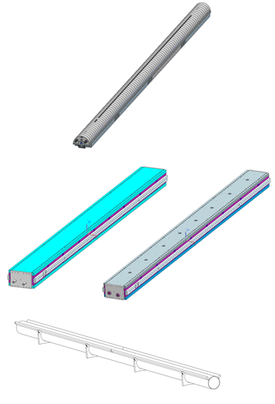
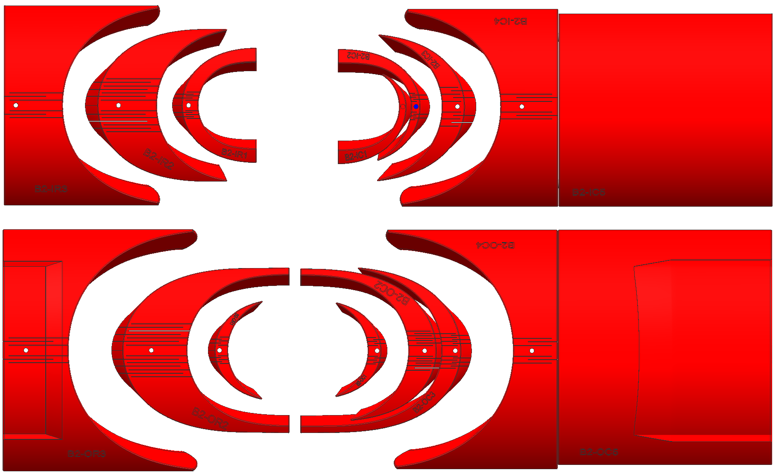
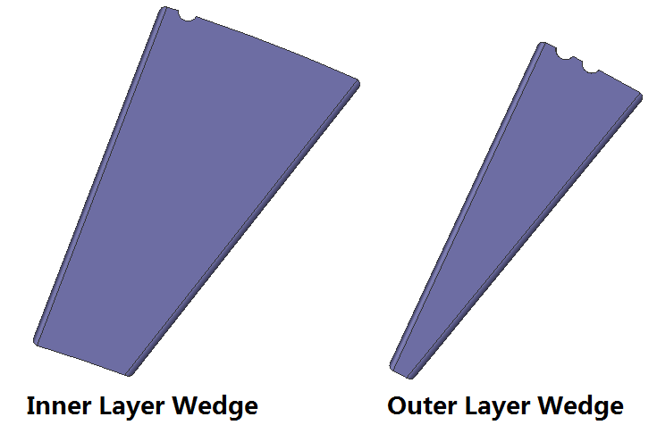
WBS 302.2.04: Achievements
Coil Parts
Tooling
Tooling is in place to support the series coil production.
90 sets were delivered
12 sets to be delivered
Pole
1 x Winding Mandrel
2 x Impregnation Fixture
10 x Storage Fixture

Slide 8
WBS 302.2.04: WBS Contingency Consumption by COVID
Charge #1
WBS Estimate at Completion (EAC) | CD-2 | Contingency Consumption |  |  | Sep 2022
 | EAC | COVID | Ab. Esc. | Other | EAC
302.2.04 Coil Parts, Material and Tooling | $7,740,720 | $200,379 | $0.00 | $797,923 | $8,739,022
BCR # | Brief Description | Cost Impact
0256 | Increase Cost of Coil Parts Order for FY22 | $74,863
0244 | Additional Coil Parts Orders | $31,008
0199 | COVID-19 Inefficiency Planning for future work for Jan-Mar 21 | $7,960
0188 | COVID-19 Inefficiency Planning for future work for Nov-Dec 20 | $25,618
0168 | COVID-19 Inefficiency Planning for future work for Aug-Oct 20 | $4,128
0160 | COVID-19 LOE Adjustments July 2020 | $59,734
0154 | COVID-19 Schedule Adjustment May 2020 | $137
0149 | COVID-19 Schedule Delay April 2020 | -$3,107
0144 | COVID-19 Schedule Delay March 2020 | $38
Purchase of additional coil parts in FY22 to account for currently observed coil and magnet yields (coil/magnet failure was partially due to COVID)

Slide 9
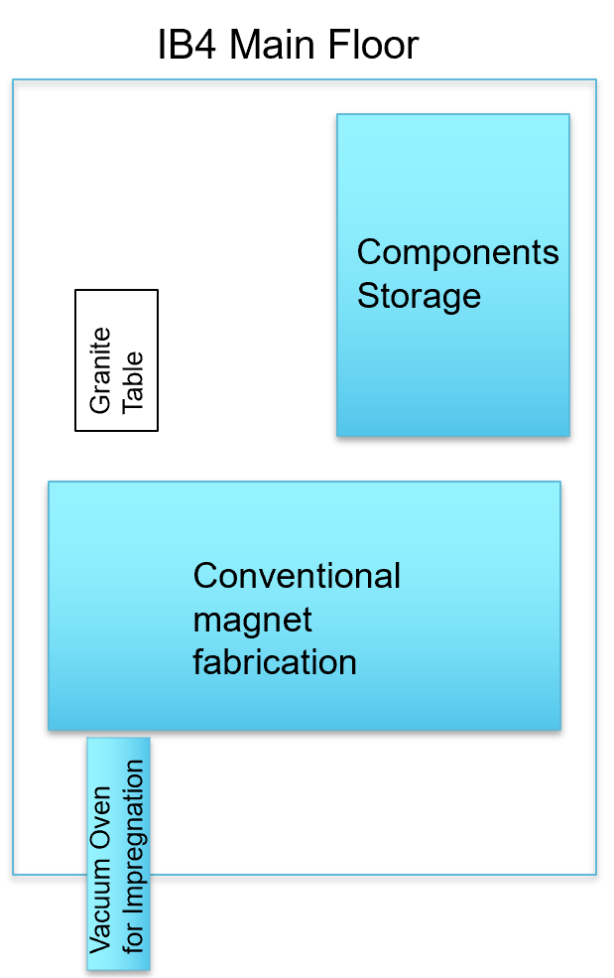
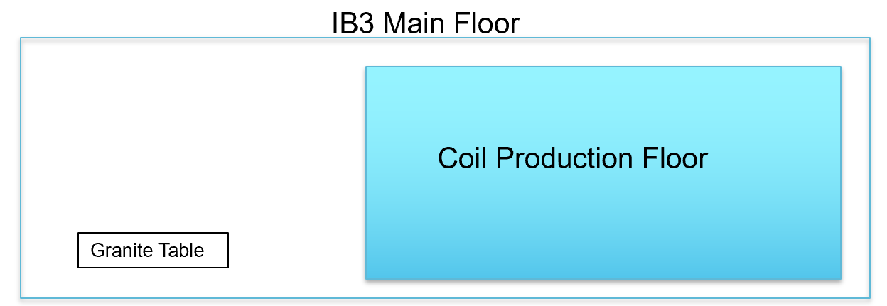
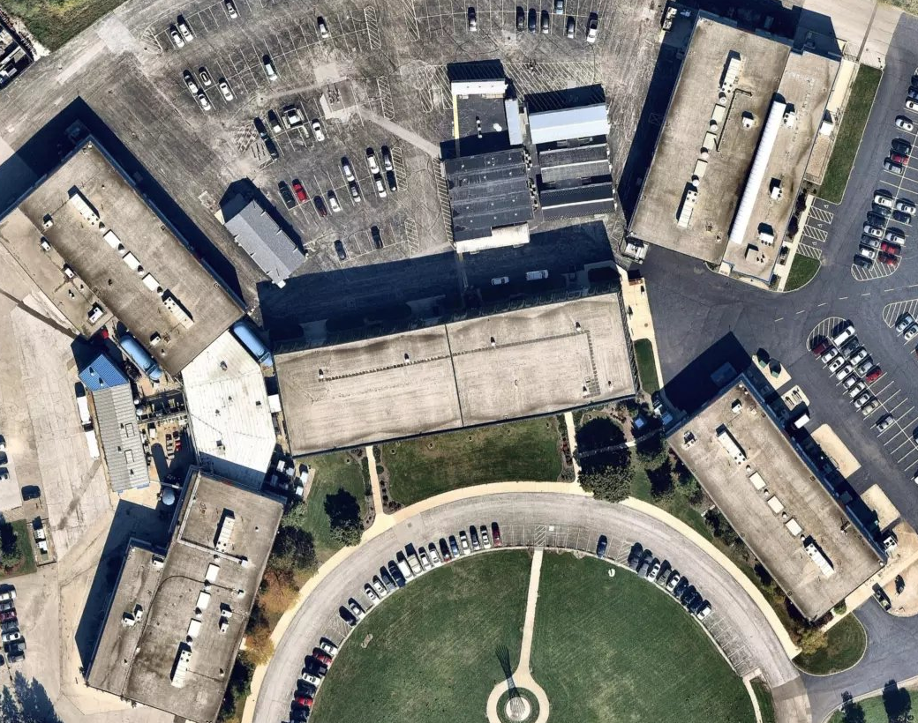
WBS 302.2.04: COVID & Abnormal Escalation Impacts
1 person job
Plasma coating QC
Parts kit prep.
1 person job
QH trace QC
Work was well managed during COVID pandemic period to minimize the impact.
The overall cost impact is $200,379 due to COVID.
Coil parts QC

Slide 10
WBS 302.2.04: Procurement Status
Charge #9
Pole Parts and End Parts
Received 96 sets.
PO was placed to procure 6 + 4 spare sets.
Wedges: Procurement is finished.
POs for coil parts have all been placed, so no cost escalation is expected in M&S for 302.2.04 coil parts.

Slide 11
WBS 302.2.04: Schedule
Charge #2
302.2.04

Slide 12
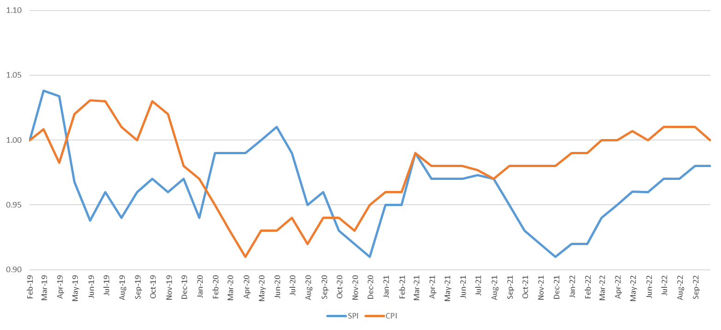
WBS 302.2.04: Cost and Schedule Performance & VAR Reports
Charge #7
The cost and schedule performance is well under control.
Some delay in the procurement of the coil parts, and once receive the parts, -$207k SV will be recovered.

Slide 13
WBS 302.2.04: Estimate at Completion
Charge #7
The CA Variance at Completion (BAC- EAC) = $21k
The CA estimate to complete (ETC) is $673k (EAC – ACWP).

Slide 14
WBS 302.2.04: Risks
Charge #3
RI-ID | Title | Risk Rank
Threats
RT-302-2-04-001 | Vendor delivery delay | 5%+25%(due to COVID)
RT-302-2-04-002 | Laser cutting machine failure | 1 (Low)
RT-302-2-04-003 | Shipping and Handling Damage | 1 (Low)
Mitigation plan: keep minimum 10 sets coil parts and materials in stock and monitor the inventory carefully.

Slide 15
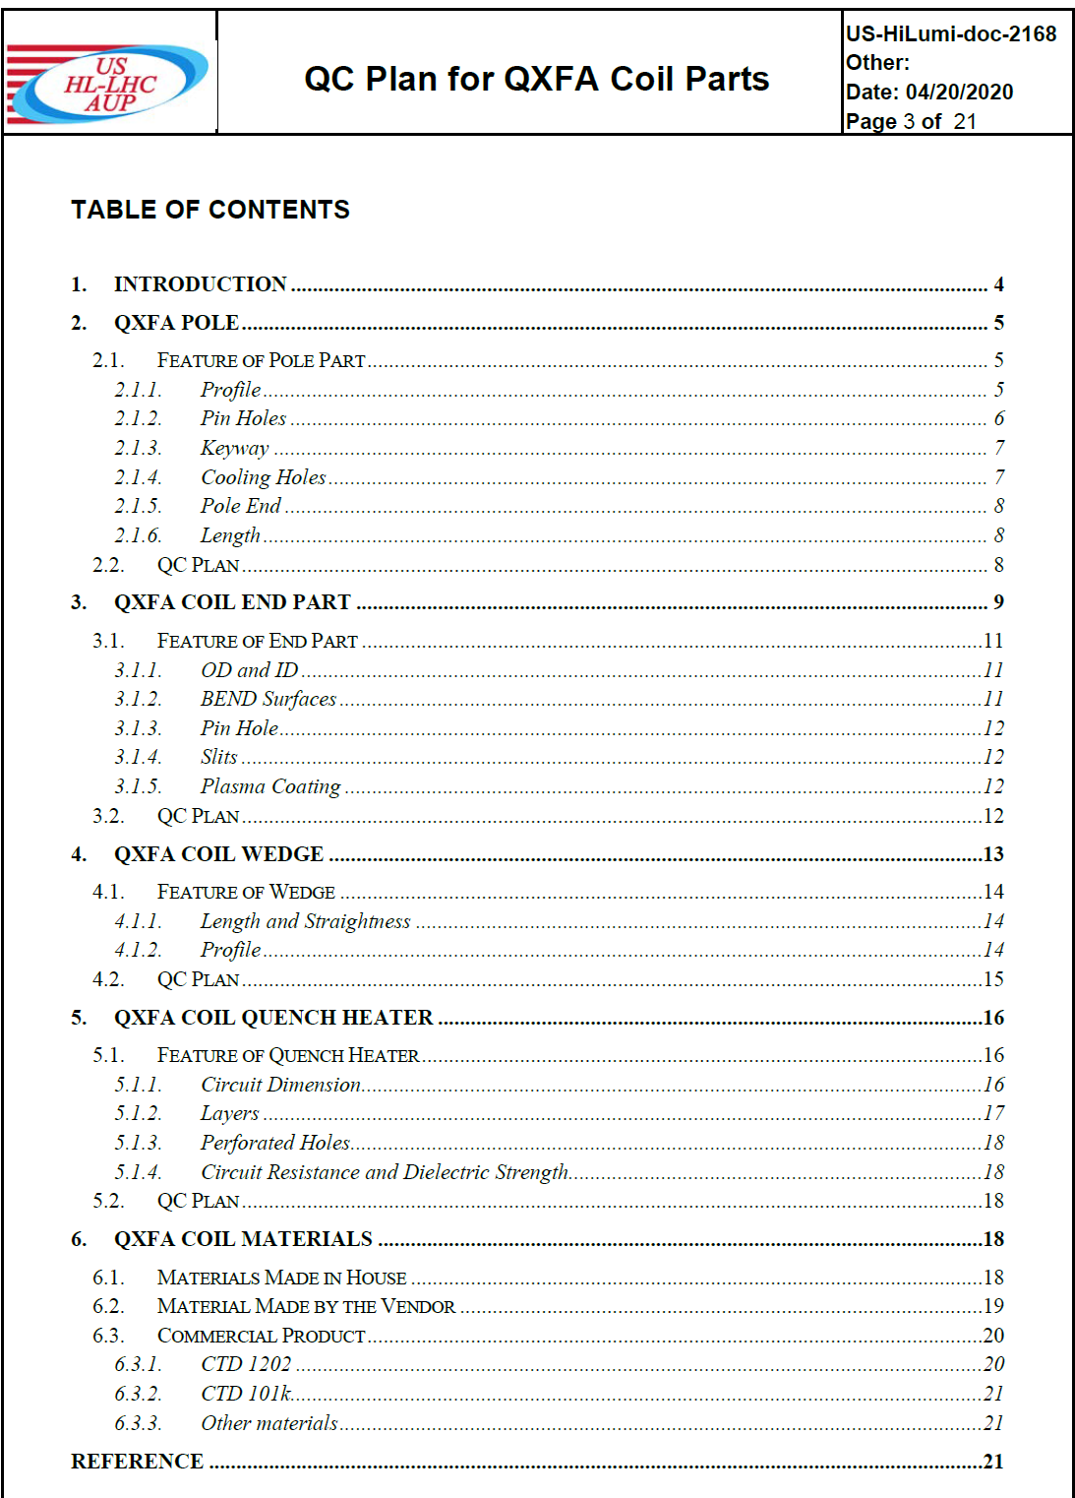
WBS 302.2.04: QA/QC
Charge #4
Pole
100% straightness inspection on granite table
CMM on random samples
End parts
Solid parts – CMM on random samples
Slits – 100% visual inspection
Plasma coating – 100% visual inspection and thickness measurement on samples. Disposition of non-conforming parts in US-HiLumi-doc-2140
Wedges
CMM on random samples
100% straightness inspection on granite table
QH trace
464423-HL-LHC Magnet QXFA QA/QC QH Trace Inspection Traveler
Dimension (length, width and thickness of the trace, perforated holes size and distance)
Resistance of the circuits and HiPot at 3.7kV
Disposition of non-conforming QH trace in US-HiLumi-doc-xxxx
Coil materials
Made in house (laser cut and hand cut materials)
Made by vendor (G11 shims, G11 fillers, etc.)
Commercial product (CTD 1202, CTD 101k, etc.)
CMM data and QC reports are stored in FNAL server Q:\QCR_Data\, and can be retrieved upon request

Slide 16
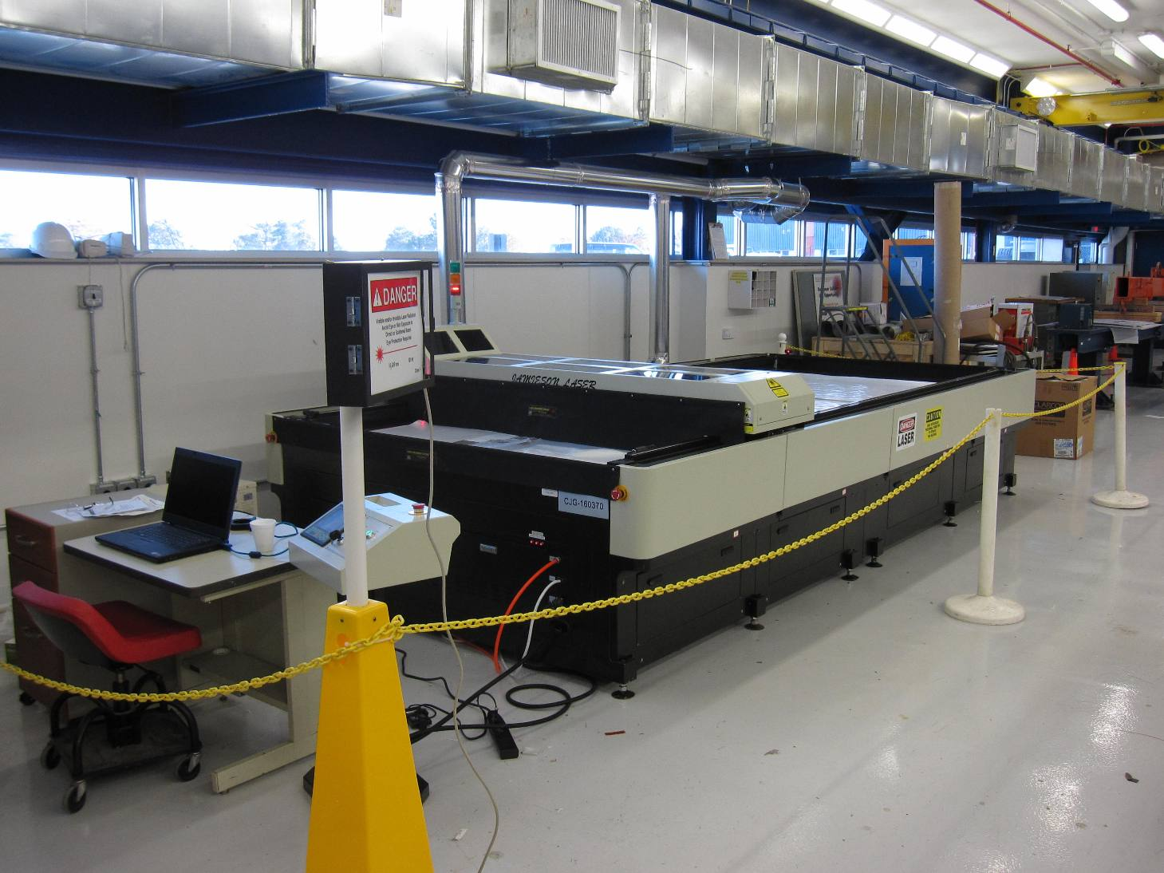
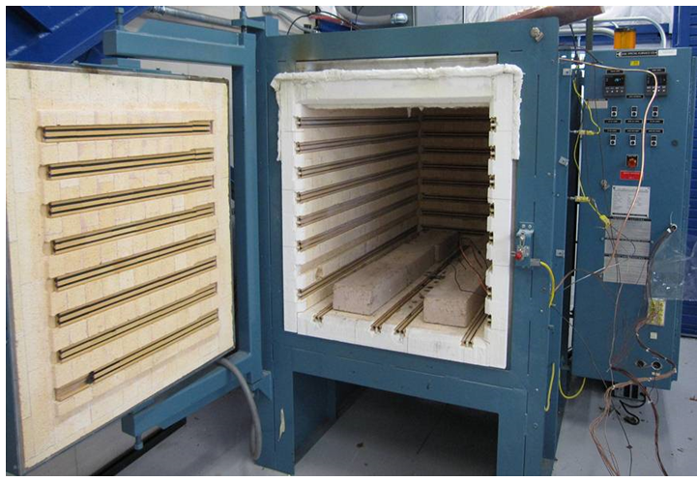
WBS 302.2.04: ES&H
Charge #10
Hazards and safety procedure for the work in 302.2.04:
Laser cutter (OP-464061)
Only Trained and Authorized personnel are allowed
Wear proper PPE (Face shield to protect eyes)
The machine is roped around when in operation with waring light on
2m furnace (OP-333916)
Wear proper PPE
Operated only by trained personnel and the area is roped out with signs in place during operation.
Open the furnace when the furnace temperature is below 100 °C
CTD product (following SDS)
Wear safety glasses and gloves to avoid contact with eyes and skin
S2 glass powder (following SDS)
Wear safety glasses and gloves to avoid contact with eyes and skin and wear N95 mask as respiratory protection

Slide 17
WBS 302.2.04: Summary
The work scope is clearly defined, which was approved in CD2/3b ESAAB.
Additional sets of coil parts are in the procurement process after the approval of the related BCRs due to COVID.
The interface documents are well described.
QA/QC plan is fully developed to ensure the good quality.
Cost and schedule estimates are well defined and mature and monthly status is reported.
ES&H and Risks are well specified and managed.
The inventory of the components is being monitored. Continue providing the coil fabrication parts.

Slide 18
Backup Slides

Slide 19
WBS 302.2.04: WBS Contingency Consumption by Other Causes
TOP-10 OTHER BCRs/EAC-MAs/CVs | Title | WBS Cost Impact
302.2.04 Coil Parts, Material and Tooling |  | $728,923
HL-LHC AUP_0145 | ETC - Spring 2020 - Control Accounts in 302.2 | $283,550
HL-LHC AUP_0244 | Additional Coil Parts Orders | $223,532
HL-LHC AUP_0109 | Plasma Coating for CERN | $212,579
HL-LHC AUP_0204 | Fabrication of 2 Additional Coils due to Lower than Expected Yield | $98,737
HL-LHC AUP_0139 | Addition of 2 Coils to the Project | $98,266
HL-LHC AUP_0208 | Plasma Coating End Parts for Parts Exchange Agreement | $89,530
HL-LHC AUP_0067 | QA/QC labor on coil part kit | $61,611
HL-LHC AUP_0054 | Extra QXFA coil curing tooling | $48,836
HL-LHC AUP_0183 | Coil Winding Back Up System for FNAL Rotating Table | $44,112
. . . | . . . | . . .
HL-LHC AUP_0095 | 302-4-1180 Q2 Bus Bar Production Parts and CERN Exchange Adjustment | -$431,830

Slide 20
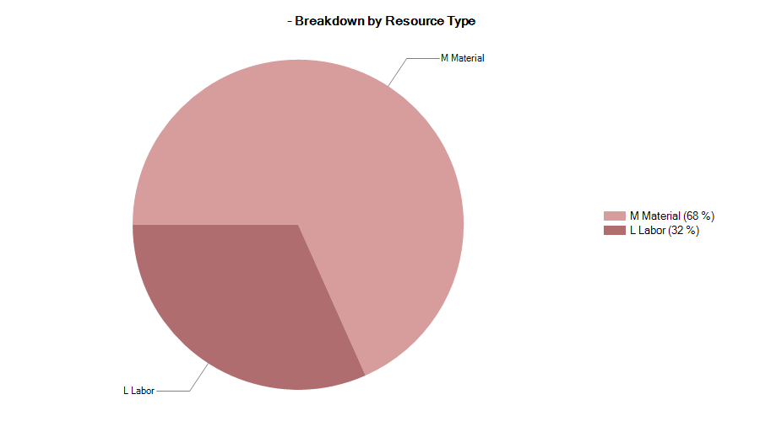
302.2.04 Resource Type Breakdown
32% Labor, 68% M&S

Slide 21
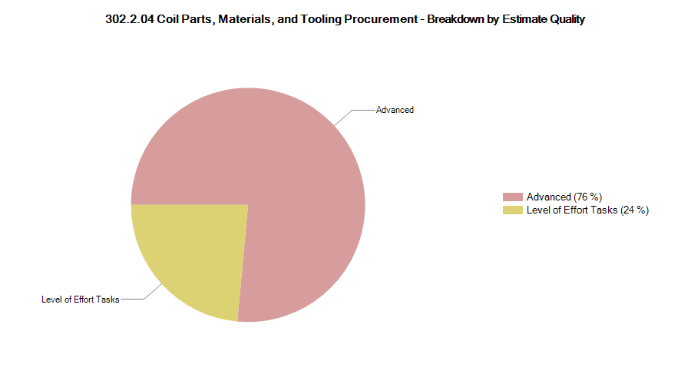
302.2.04 Estimate Quality
The quality of estimate has been updated for CD-2/3b

Slide 22
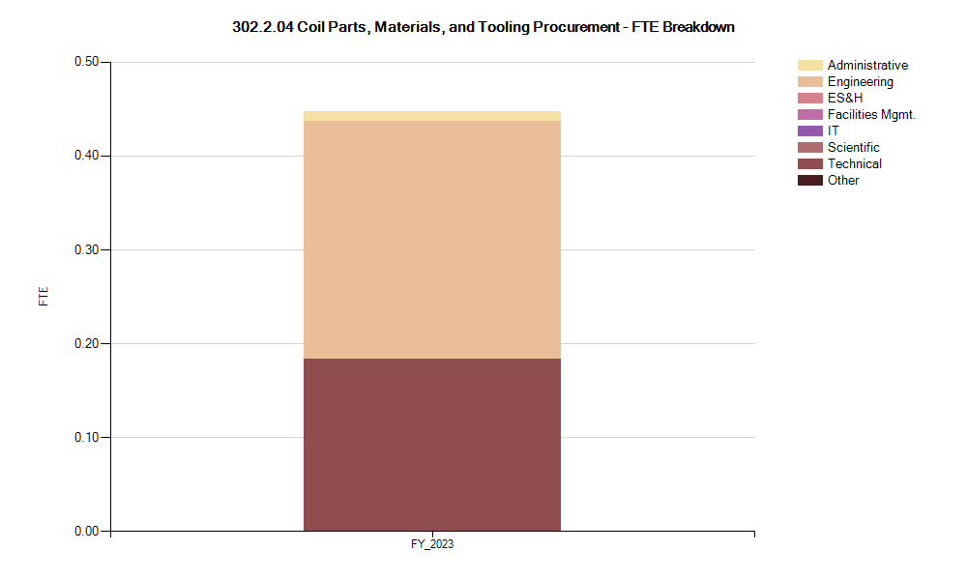
302.2.04 FTE Breakdown

Slide 23
302.2.04 Cost Performance Report
BAC = $8.760M
No thresholds crossed in Current Period Cost
No thresholds crossed in Cumulative to Date
Cumulative SPI = 0.97, CPI = 1.01

