Slide 1


Magnets 302.2.07 - Structure Fabrications and Magnet Assembly at LBNL
Soren Prestemon – LBNL (L3/CAM)
Dan Cheng– LBNL (Deputy L3/CAM)
HL-LHC AUP Rebaseline DOE Rev. – Dec. 13th–15th 2020

Slide 2
General Outline
Scope, Interfaces, Dependencies & Team
Achievements since CD-3
Contingency Consumption
COVID and Abnormal Escalation Impacts
Procurement Status
Schedule
Cost and Schedule Performance & VAR Reports
Estimate at Completion
Risks
QA/QC
ES&H
Summary

Slide 3
WBS 302.2.07: Scope and Interfaces
Charge #9
Scope of Work
Re-assemble magnet prototype MQXFAP-1b, fabricate 5 pre-series magnets (from MQXFA-03 to MQXFA-07), and fabricate 20 MQXFA series production magnets. Scope includes:
  Parts procurement for 21 magnet structures (shell, Yoke, masters, pads, collars, axial support components, keys, strain gauges and wires)
  26 magnet assemblies (1 prototype re-assembly, 5 pre-series, 16 series production, and 4 re-assemblies).
    Assembly includes install strain gauges on shells, Fabricate Yoke/Shell subassemblies. Receive and check coils, perform CMM measurements and prepare coils for magnet assembly. Assemble collar packs and coil packs. Insert coil packs, setup bladders, and perform azimuthal and axial preload, and conduct electrical QC
  Prepare for shipment and ship the magnet assembly to BNL for vertical testing.

Slide 4
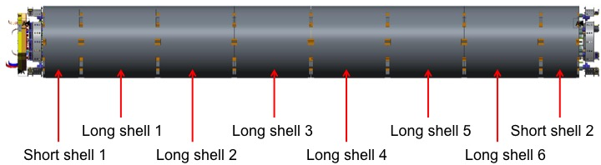
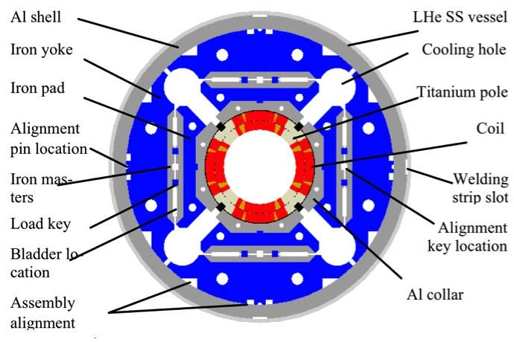
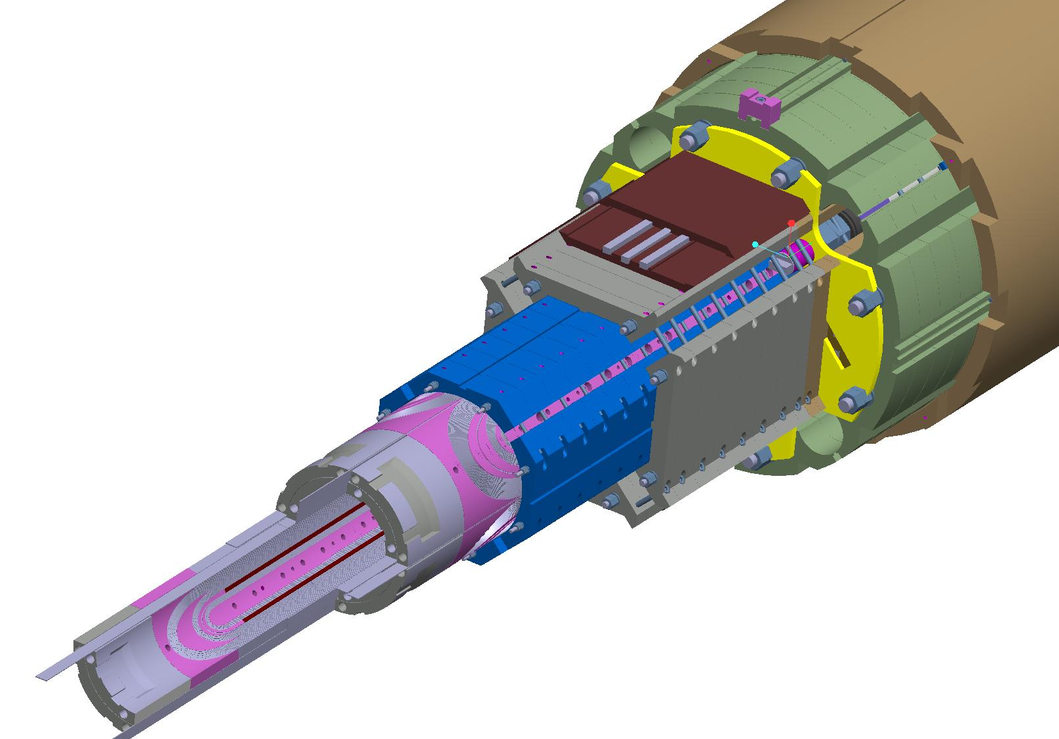
WBS 302.2.07: Overview of deliverables

Slide 5
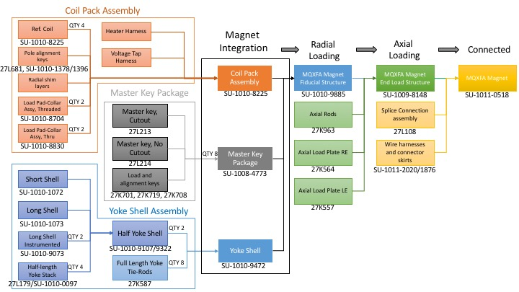
WBS 302.2.07: Work Flow and Interfaces
Coils from FNAL
302.2.05
Coils from BNL
302.2.06
Coil components
302.2.04
Magnet shipped to BNL
302.4.1
US-HiLumi-doc-252
US-HiLumi-doc-309
US-HiLumi-doc-273
US-HiLumi-doc-321
Fiducialization Data to FNAL
302.4.02
US-HiLumi-doc-216
5

Slide 6
WBS Deliverables & Yield Assumptions
WBS Deliverables
  Re-assembled prototype magnet MQXFA-1b, 4 accepted pre-series magnets, and a minimum of 17 accepted production MQXFA magnets with their corresponding QC reports.
Yield Assumptions:
  3 of the 16 series magnets and one of the 5 pre-series magnets are assumed to be re-worked before passing acceptance test. Parts are assumed to be re-used for this re-work.
  1 Magnet structure is assumed to be irreversibly damaged, due to shipping and handling, and therefore assumed lost.

Slide 7
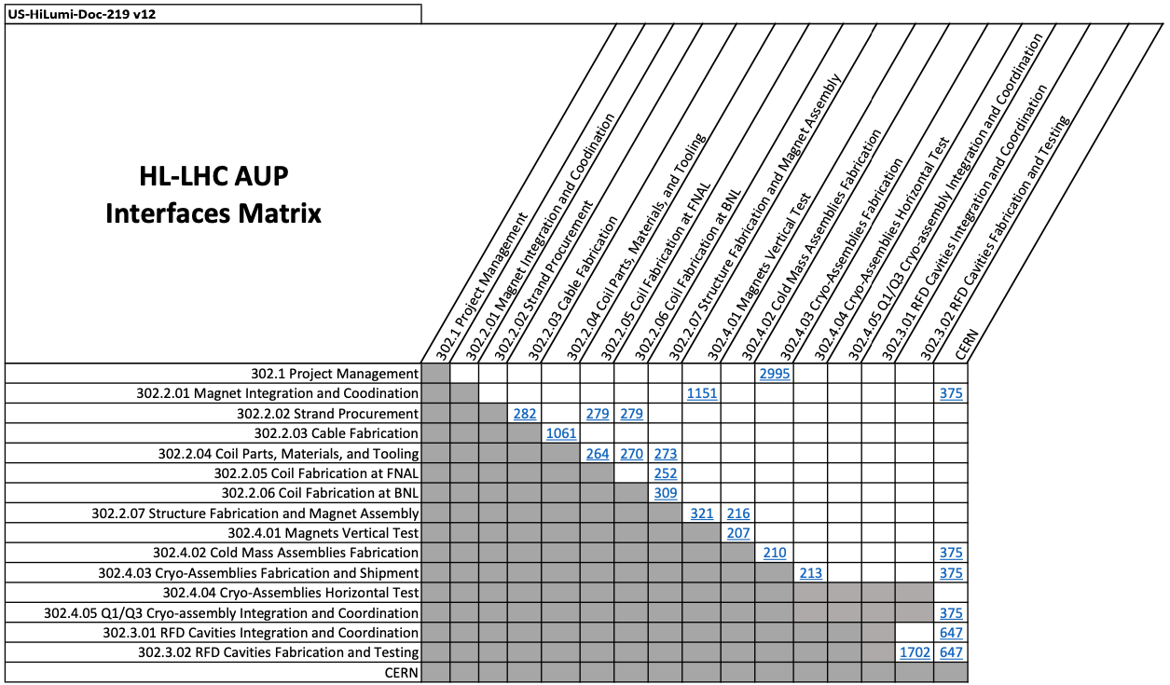
Interfaces with incoming coils and with magnet testing

Slide 8
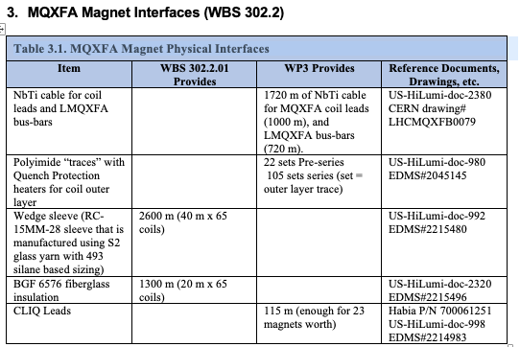
WBS 302.2.07: External Dependencies
Charge #8 & #6
Original CLIQ leads were provided by CERN (see interface control document US-HiLumi-doc-375); described in US-HiLumi-doc-998 (now obsolete)
Recently a modified procedure has been defined
  Described in US-HiLumi-doc-4328
  Update to ICD US-HiLumi-doc-998 is underway
All CLIQ lead material had been received from CERN in Feb 2020
New material will be needed per doc-4328

Slide 9
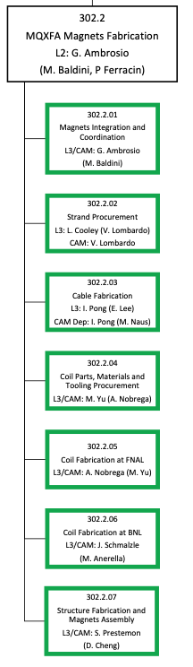
WBS 302.2.07: Team
Very established team
  Additional technicians planned
Target staffing & training level:
At least one additional technician to minimize disruption from vacation, illness, etc.
Cross-train to avoid potential bottlenecks or single-point failures
  Ex.: recent training of 2 junior techs on instrumentation
Soren Prestemon, L3 Manager
Dan Cheng, Deputy L3 Manager
Paolo Ferracin, Deputy L2 Manager
Laura Garcia Fajardo
QA:
Katherine Ray
Jennifer Doyle
Mike Solis (also procurements)
Technicians:
Joshua Herrera, lead
Juan Rodriguez
Jonathan Hekmat
Matt Reynolds
Bob Memmo (Electrical)

Slide 10
WBS 302.2.07: Achievements since CD-3
Charge #8
Facility improvements (lab-supplied):
- HVAC and roofing of assembly building
Completed tooling for full parallel assembly capability needed for production magnets
Completed assembly of all pre-series scope (MQXFA03-A07)
Assembled MQXFA08-12 and reassembled MQXFA08b
Key technical milestones since DOE CD-3 review
  PRR (4005 Feb. 2021)
  MQXFA Series Magnet Specifications updated (DocDb 4009-v6)
  Coil selection, Structure & Shim reviews; Handoff meeting for each magnet delivered to BNL

Slide 11
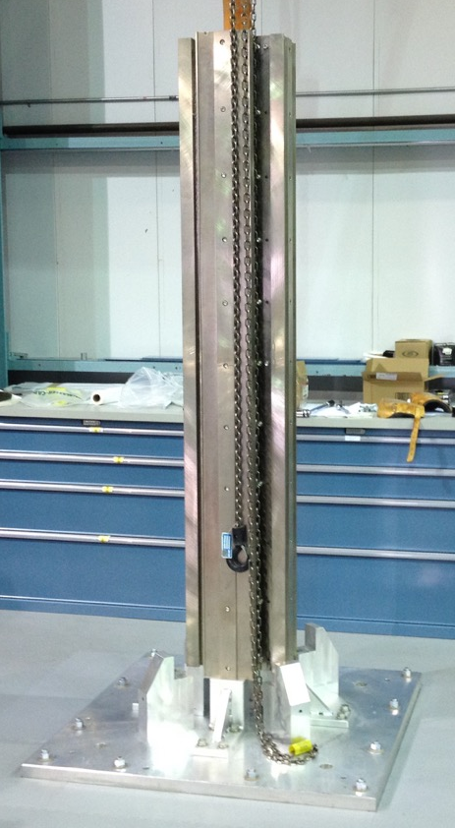
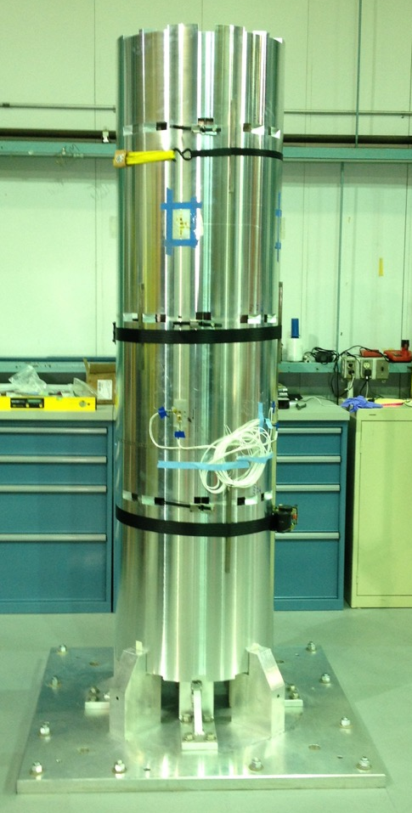
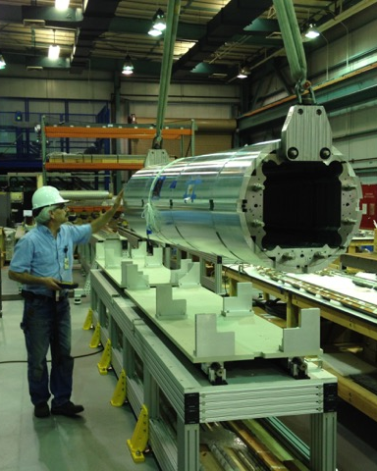
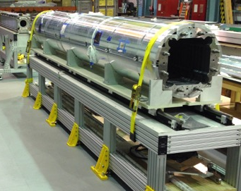
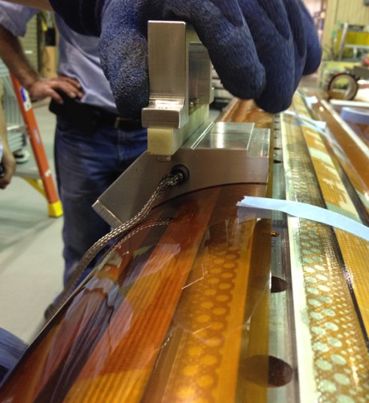
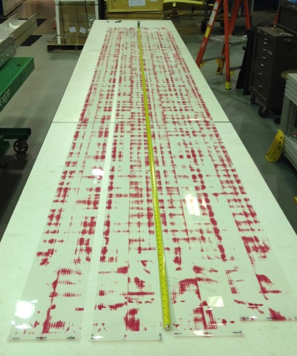
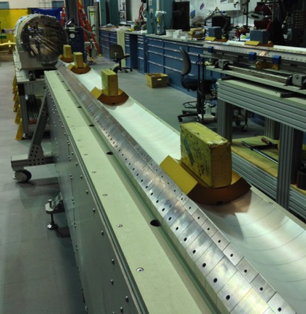
Magnet fabrication process – a pictorial view
Shell-Yoke Assembly
Coil Prep
Fuji Paper Exposure
Radial Shim Prep
11

Slide 12
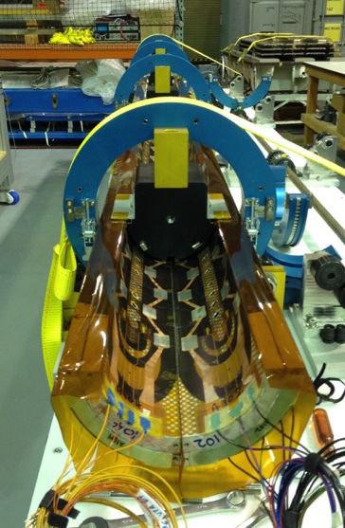
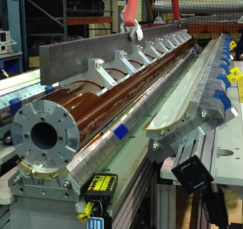
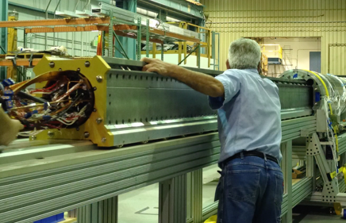
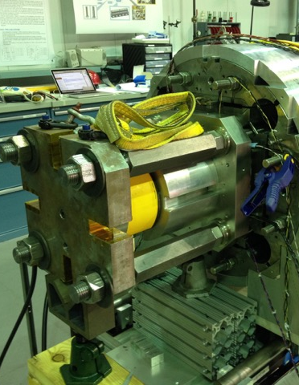
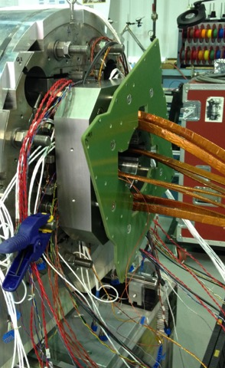
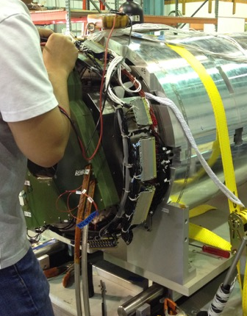
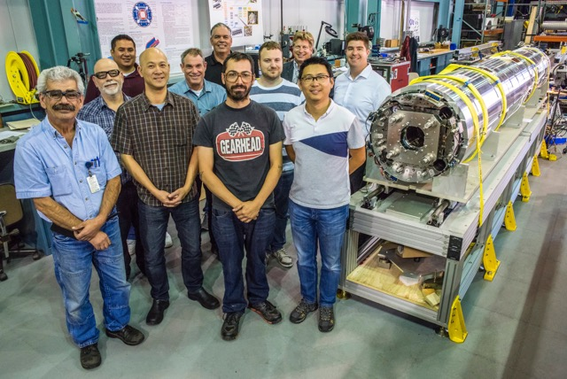
Magnet fabrication process – a pictorial view
Final Coil pack assembly
Coilpack Insertion
Preloading
Splicing and Connectorization
Fully assembled magnet

Slide 13
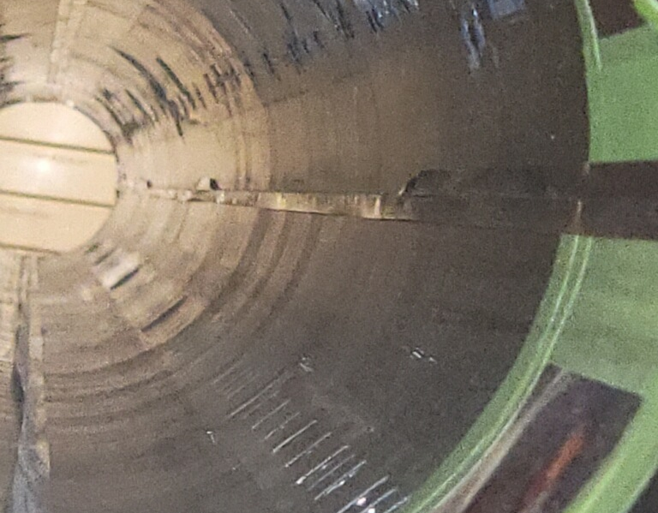
Examples of issues and resolutions
Cooling hole bore clearance – ECN-0233
GPI fold issue in MQXFA09 – NCR-0313 (critical)
Fiberoptics installed (upper coils only) – DCR-4190
Increase in pole-key gaps – DCR-4304

Slide 14
Lesson’s learned resulted in improved process of assembly, demonstrated with MQXFA10
Identified during MQXFA07 disassembly
Lessons learned and preventive actions are being implemented on all magnets going forward

Slide 15
WBS 302.2.07: WBS Contingency Consumption by COVID
Charge #1
WBS Estimate at Completion (EAC) | CD-2 | Contingency Consumption |  |  | Sep 2022
 | EAC | COVID | Ab. Esc. | Other | EAC
302.2.07 Structure Fabrication and Magnets Assembly | $30,887,825 | $1,111,395 | $0.00 | $1,732,092 | $33,731,312
COVID BCRs/EAC-Mas | Title | WBS Cost Impact
302.2.07 Structure Fabrication and Magnets Assembly |  | $1,111,395
EAC-MA-15 | COVID-19 Attr. of add. magnet disassbly & reassbly (07/08 assigned to existing PMB rework activities) | $264,200
HL-LHC AUP_0160 | COVID-19 LOE Adjustments July 2020 | $218,828
HL-LHC AUP_0274 | COVID-19 Inefficiency Planning for April 2022 through December 2022 | $180,244
HL-LHC AUP_0188 | COVID-19 Inefficiency Planning for future work for Nov-Dec 20 | $121,782
HL-LHC AUP_0168 | COVID-19 Inefficiency Planning for future work for Aug-Oct 20 | $57,390
HL-LHC AUP_0235 | COVID-19 Inefficiency Planning for future work for Jul-Sep 2021 | $55,371
HL-LHC AUP_0265 | COVID-19 Attribution portion of Magnet Assembly and Vertical Testing Schedule Revisions | $45,329
HL-LHC AUP_0199 | COVID-19 Inefficiency Planning for future work for Jan-Mar 21 | $36,733
HL-LHC AUP_0216 | COVID-19 Inefficiency Planning for future work for Apr-Jun 2021 | $30,029
HL-LHC AUP_0144 | COVID-19 Schedule Delay March 2020 | $25,958
HL-LHC AUP_0262 | COVID-19 Attribution portion of Magnets Rework and Test Replan Following MQXFA07/08 Performance Issues | $25,940
HL-LHC AUP_0266 | COVID-19 Inefficiency Planning for future work for Jan-Mar 2022 | $24,258
HL-LHC AUP_0248 | COVID-19 Attribution portion of Magnet MQXFA07 Rework | $14,315
HL-LHC AUP_0154 | COVID-19 Schedule Adjustments May 2020 | $7,309
HL-LHC AUP_0258 | COVID-19 Attribution portion of Delay to Coil and Magnet Work due to MQXFA08 preliminary test results | $5,604
HL-LHC AUP_0279 | COVID-19 Attribution portion of Addition of 5 Cables and 2 Coils Due to Present Cable and Coil Yield | $5,136
HL-LHC AUP_0163 | COVID-19 Schedule Adjustments June 2020 | $3,858
HL-LHC AUP_0246 | COVID-19 Inefficiency Planning for future work for Oct-Dec 2021 | -$353
HL-LHC AUP_0149 | COVID-19 Schedule Delay April 2020 | -$10,536

Slide 16
WBS 302.X.Y: WBS Contingency Consumption by Abnormal Escalation
Charge #1
New Slide for L3s (if applicable)
L3s: If applicable, expand Abnormal Escalation contingency consumption to BCRs/EAC-MAs/CVs (table to be provided). Example below for 302.4.01.
Include slide or bullets with description for major items
Ab. Esc. BCRs/EAC-MA/CVs | Title | Ab. Esc.
302.4.01 Magnets Vertical Test |  | $287,979
HL-LHC AUP_0284 | ETC - Summer 2022 - Control Account 302.4.01 | $263,686
HL-LHC AUP_0282 | Increased Cost of Helium for testing at BNL | $24,293
To be completed

Slide 17
WBS 302.X.YY: COVID & Abnormal Escalation Impacts
Charge #1
RCA will be major input source for this slide
Be knowledgeable about the impact of COVID and Abnormal Escalation on your L3:
  Lockdown
  Determination of inefficiencies
  COVID mitigation measures (Labor-workforce ramp-up, Social Distancing, Quarantine, etc.)
  Discuss Manual Adjustments if related to COVID/Abn. Esc.
  Message: WBS managed COVID and knows the impact from the pandemic
Lab
Logo

Slide 18
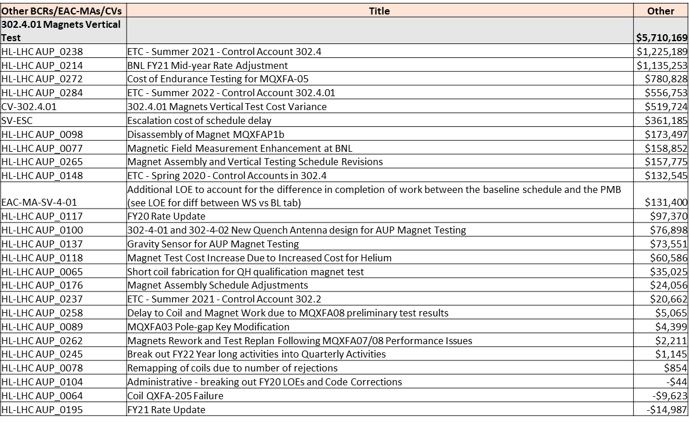
WBS 302.X.Y: WBS Contingency Consumption by Other Causes
New Slide for L3s – KEEP AS BACKUP SLIDE IN CASE OF QUESTIONS. This table shows contingency consumption IMPACT on the WBS.
L3s: Expand Other causes contingency consumption to BCRs/EAC-MAs/CVs. Example below for 302.4.01 (table for major items to be provided)
Include slide or bullets with description for major items, be prepared to speak to those if asked. This can also be useful to inform Slides #21 and #22.

Slide 19
WBS 302.2.07: Procurement Status
Charge #4
All major components have been ordered
  ”Master Agreements” proved valuable
    Enabled timely PO placements
    Likely avoided additional costs due to inflation
Majority have been received and are in-use or in storage
Remaining procurements may include:
  Magnetic shims, and other consumables
Additional exposure to inflation is minimal for Structures

Slide 20
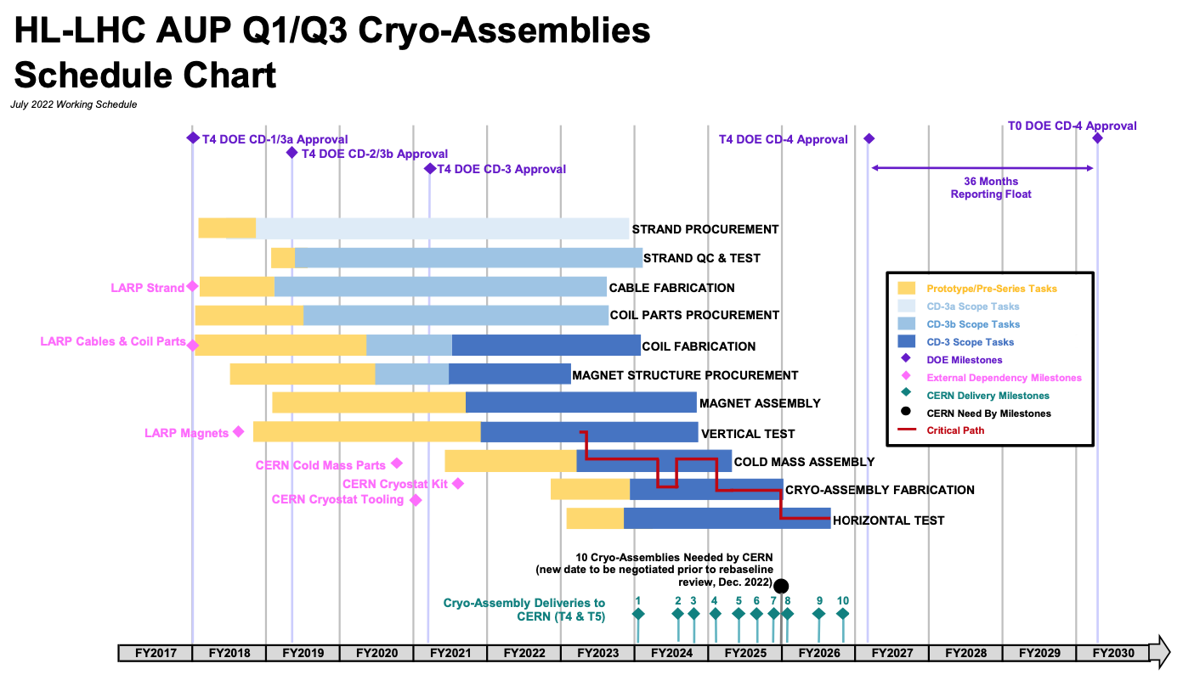
WBS 302.2.07: Schedule
Charge #4
Structures not on critical path, but…
  Need vigilance to meet P6 schedule
  Actions are being taken and remaining risks identified
Note: we have two fully functioning assembly lines to support meeting the schedule

Slide 21
WBS 302.2.07: Schedule considerations
Charge #4
Anticipated “full production” mode has been disrupted by:
  Disassembly of MQXFA07 for post-mortem
  Disassembly of MQXFA08 and re-use in MQXFA08b
  Disassembly of MQXFA09 and use of structure in MQXFA11
  Unloading and reloading of MQXFA10 to address “squareness” lessons-learned
Nevertheless:
  We are confident in our ability to deliver to the schedule
    Labor estimates and durations in BOEs demonstrated on each step of the Assembly Breakdown Structure
  Actions taken:
    Training staff for some level of redundancy
    Out-sourced some assembly steps to industry
  Remaining concern:
    Challenging market for tech expertise – hard to hire and to retain

Slide 22
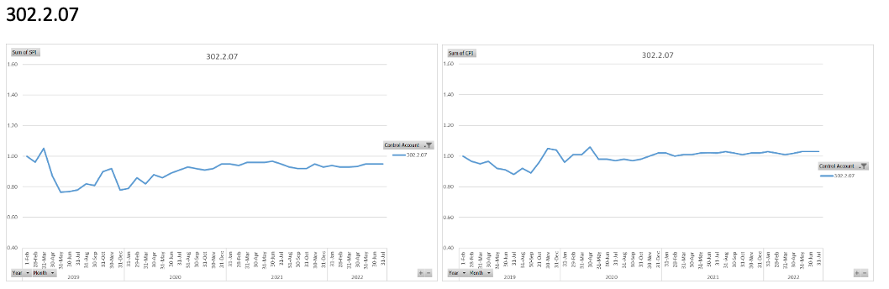
WBS 302.2.07: Cost and Schedule Performance & VAR Reports
Charge #4, #8
SPI
CPI
Major variances earlier in project stemmed from large procurements and various vendor issues in delivering on schedule
  Most significant example was ARMCO steel order
Recent variances typically associated with individual component delivery delays (e.g. due to vendor rework), mismatch of receipt and earning of article, and overruns/underruns on certain labor elements

Slide 23

WBS 302.2.07: Estimate at Completion
Charge #4
  Minor Variance at Completion (BAC- EAC) = $108K on $33.7M
    Balance between positive cumulative cost variance $693K and manual EAC adjustments ($554.6K)

Slide 24
WBS 302.2.07: Risks
Charge #3
RT-302-2-07-007 (*) | Magnet disassembly and reassembly needed to meet the requirements | Medium
RT-302-2-07-001 | Magnet assembly matrixed or shared resources unavailable when needed | Medium
RT-302-2-07-006 | Production is stopped because more QC testing/discussions need to be carried out | Medium
RT-302-2-07-004 (*) | Magnet structure vendor delivery delays | Low
RT-302-2-07-002 | Bladder pressurizing system failure | Low
(*) These risks have a separate COVID-19 component in the risk register to account for additional probability/impact due to COVID-19 pandemic.
Risks are monitored and reviewed regularly
  RT-302-2-07-002: “Bladder pressurizing system failure” was realized; spare had been procured as part of mitigation, resulting in negligeable delay
  RT-302-2-07-007: “Magnet disassembly and reassembly needed to meet the requirements” has been realized with the disassembly and reassembly of magnet 10
    Updated entry reflect residual risk of having to disassemble and reassemble between 0 and 2 magnets between now and the end of the project.

Slide 25
WBS 302.2.07: QA/QC
Area | QC / Work Instructions | QA – MIP element
Coil Selection and Shimming Plan Review | Coil Acceptance WI SU-1011-5294; Coil CMM WI SU-1012-3958 | 1.1
Incoming Shells and Yokes & inspection |  | 2.2
Assemble Yoke Half-Stacks | Yoke Pre-Stack SU-1008-8072; Yoke Half Stack SU-1009-7829 | 2.2
Put strain gauges on shells | Shell Instrumentation SU-1009-3745 | 2.3
Complete Shell-Yoke Assembly | Shell-Yoke Assembly SU-1008-2169 | 2.4
Incoming coil pack assembly parts inspection | Load Pad Pre-Stack SU-1008-8075 | 3.1
Dressed Coil | Dressed Coil SU-1008-8073 | 3.2
Pad Collar Assembly | Pad-Collar Assembly SU-1010-1610 | 3.3
Coil Pack Assembly | Coil Pack Subassembly SU-1008-8074 | 3.4
Coil Pack Electrical Tests | MQXF Magnet Electrical QA at LBNL SU-1010-1903 | 3.5
Coil Pack Magnetic Measurements | Magnetic Meas. SU-1010-2018 | 3.6
Area | QC / Work Instructions | QA – MIP element
Incoming parts inspection (Master Keys, etc.) |  | 4.1
Strain Gauges on Axial Rods | Axial Rods Instrumented SU-1008-8069 | 4.4
Magnet Integration and Loading | MQXFA Loading and Integration WI SU-1011-5637 | 4.5
Post-preload Electrical QC | MQXF Magnet Electrical QA at LBNL SU-1010-1903 | 4.6
Finish Wiring | Connectors and Finishing WI SU-101205517 | 4.7
Assemble Splice Box and verify Bore ID Clearance | Splice Box WI SU-1008-8067 | 4.8
Magnetic Measurements, Fiducial Structure | Magnetic Measurements SU-1010-2018 | 4.10
Final Electrical QC | MQXF Magnet Electrical QA at LBNL SU-1010-1903 | 4.11
Strain Gauge Reading |  | 4.12
Prepare for Shipment |  | 4.13
MIP has been approved by all parties
QC data for each magnet is uploaded to Vector and to the CERN MTF – all magnet data is then available to subsequent WBS elements

Slide 26
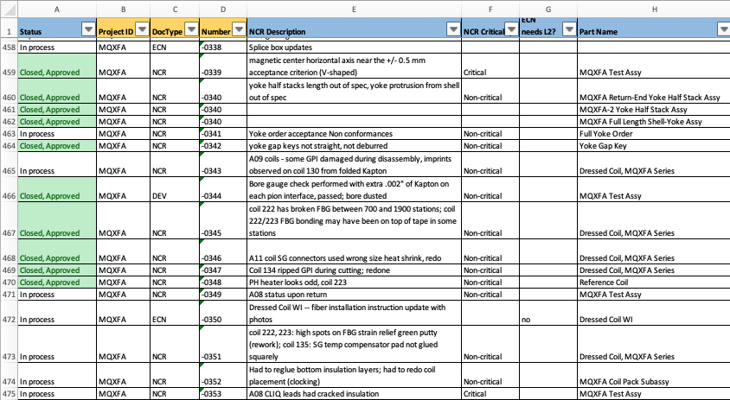
WBS 302.2.07 QA/QC process
Detailed tracking sheet is maintained
Monthly reports submitted to L2 and Project QA Manager, as well as regular meetings
  Clear process for informing L2 of an issue and for resolution
  Excellent relations within AUP and with CERN – strong team, very transparent

Slide 27
WBS 302.2.07: ES&H
Charge #5
We have regular LBNL HL-LHC AUP EH&S meetings
Meeting agenda’s and notes are shared regularly with FNAL Project EH&S Manager Amy Pavnica
Magnet Survey and Alignment has a Work Planning and Control (WPC) Activity (laser tracker has Hazard Level 2); staff are trained accordingly
Crane failed in assembly area:
  Resulted in halt of use until inspected and operation recovered
  Spare parts have been procured, maintenance will be planned when all parts are in-house and when AUP schedule is minimally impacted

Slide 28
WBS 302.2.07: Summary
The Magnet Assembly WBS is in full production mode, deep into production magnet assembly
Strong team, now well-versed in all technical, QC/QA, and EVMS aspects of the project
COVID has had a significant impact on multiple fronts – these are now understood and addressed
We have procured all major components for the magnet assemblies, alleviating a major concern with inflation and supply-chain
Risks are being managed and addressed – plenty to worry about… but plenty to be proud about!

Slide 29
Backup Slides
For L2s plenary only: QA/QC, ES&H slides (others should keep these slides in the main presentation)
Keep pie-charts and tables from the CAM e-Toolbox as backup slides in case someone asks questions

Slide 30
WBS 302.X.YY: QA/QC
Charge #3
List any approved CERN MIPs with links for your WBS (show an example)
List any NCRs, for major ones explain root causes and corrective actions
  Important topic for Coils Fabrication WBSs because of lower yield than assumed
DON’T MAKE THIS CHEESY !
DON’T REPEAT BOILERPLATE INFO
IT MIGHT APPLY ONLY TO SOME CA (ex: COILS)
  Message: WBS follows project QA/QC processes; NCRs corrective actions are effective (problems are not repeated); lessons learned shared; etc.

Slide 31
WBS 302.X.YY: ES&H
Charge #10
Any safety reviews? Any Safety incidents?
Take credit for great safety record. Mention number of worked hours. If truck accident is mentioned, remind that nobody was hurt.
For fabrication activities, include links to approved equipment ORCs, Hazard Analysis, etc.
For the ES&H breakout presentation, add more details and examples of implementation at the different sites (Work Planning and Control, Org Charts, Partner Lab summary of discussions and salient issues)
DON’T MAKE THIS CHEESY !
DON’T REPEAT BOILERPLATE INFO
SHOW SPECIFIC EXAMPLES (IF YOU HAVE ANY)
  Message: WBS ES&H is being handled appropriately

Slide 32
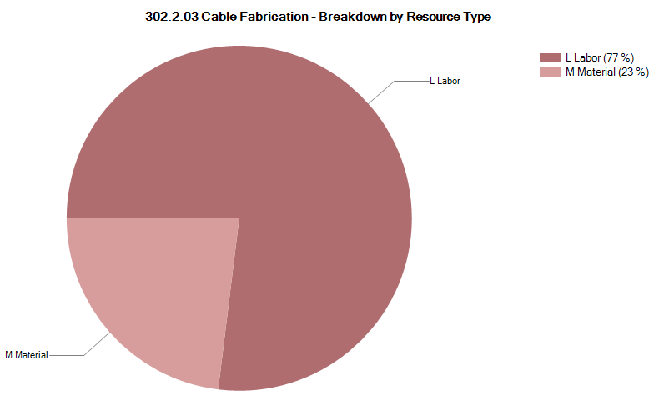

302.2.03 Resource Type Breakdown
Charge #4
77% Labor, 23% M&S
M&S Includes contractors (braiding vendor), travel, shipment, etc.
To be Updated
Example from 302.2.03
Plots to be provided by PO
Lab
Logo

Slide 33
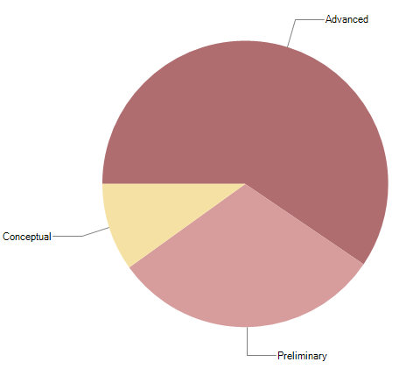

302.2.03 Estimate Quality
Charge #4
Conceptual is related to the RRR measurements
  FNAL has been measuring RRR up to earlier this year
  LBNL’s new system is undergoing benchmarking approval
Preliminary is mostly related to Insulation
  Master Agreement is being placed to lock down the price throughout AUP
The quality of estimate has been updated for CD-2/3b
To be Updated
Example from 302.2.03
Plots to be provided by PO
Lab
Logo

Slide 34
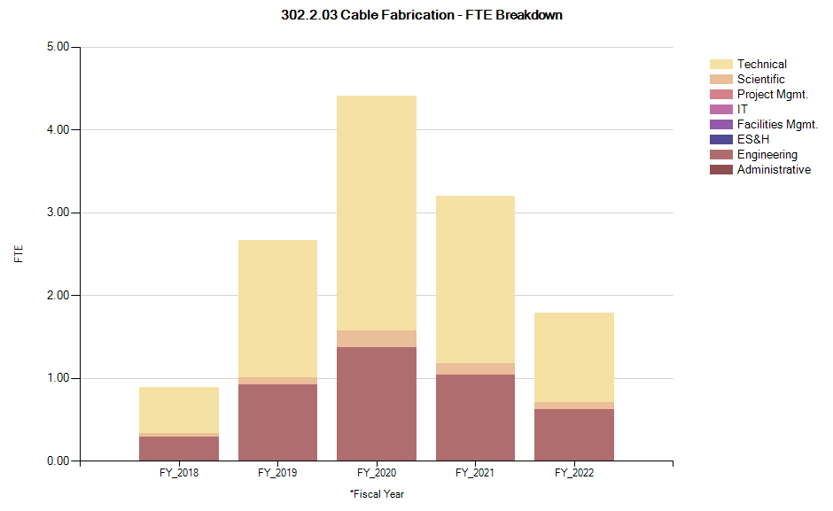
302.2.03 FTE Breakdown
Charge #4
From 5/31/18 forward
  Does not include FY18 Actuals
To be Updated
Example from 302.2.03
Plots to be provided by PO
Lab
Logo

Slide 35

302.2.03 Cost Performance Report
Charge #4
BAC = $5.658M
No thresholds crossed in Current Period Cost
No thresholds crossed in Cumulative to Date
Cumulative SPI = 0.9, CPI = 1.05
To be Updated
Example from 302.2.03
Plots to be provided by PO

