Slide 1
progress on cage design
Dismounting and mounting KLOE ECAL.
Summary
Progress on restoring the dismantling tooling.
Progress on support structure.
Some verification on the extraction simulation.
Conclusions.

Slide 2
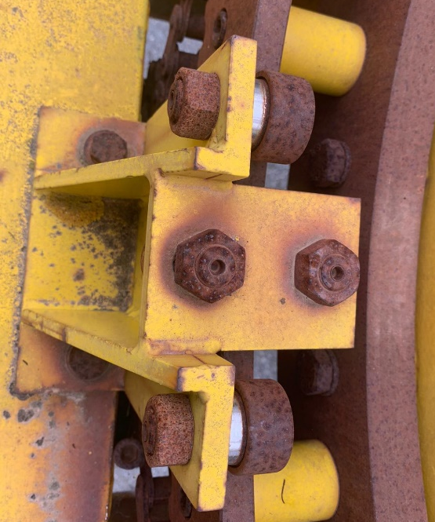
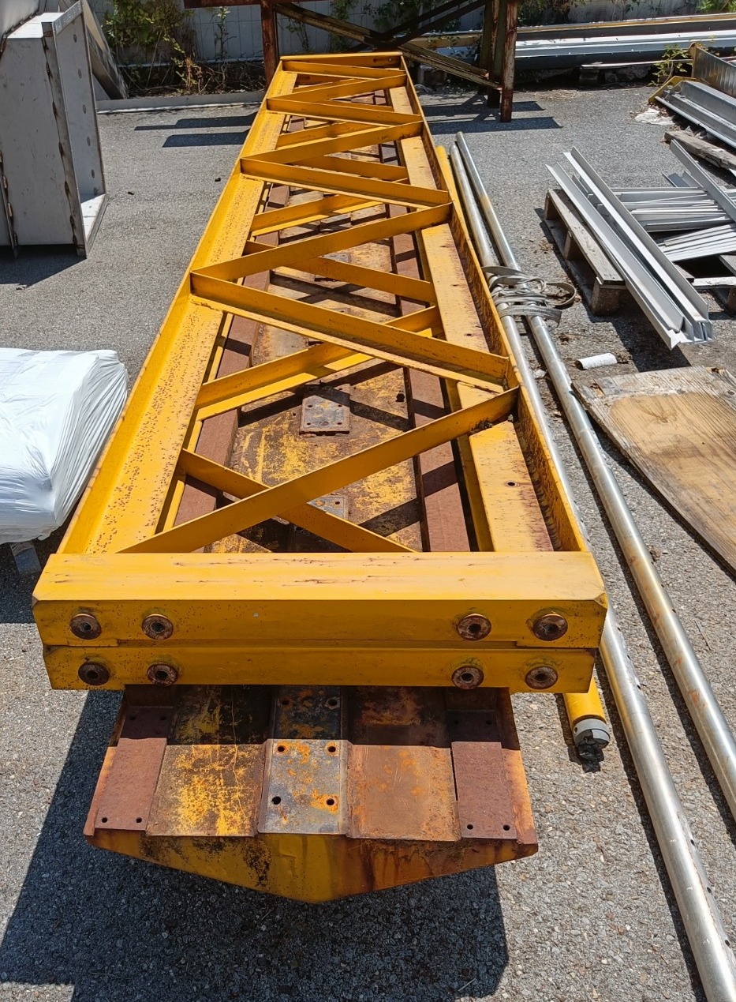
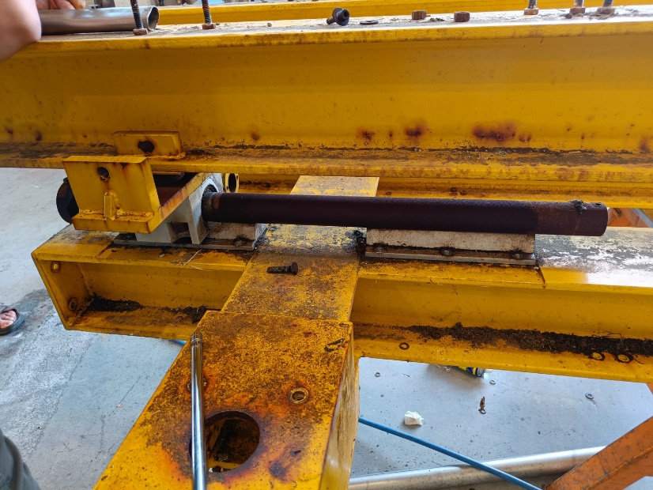
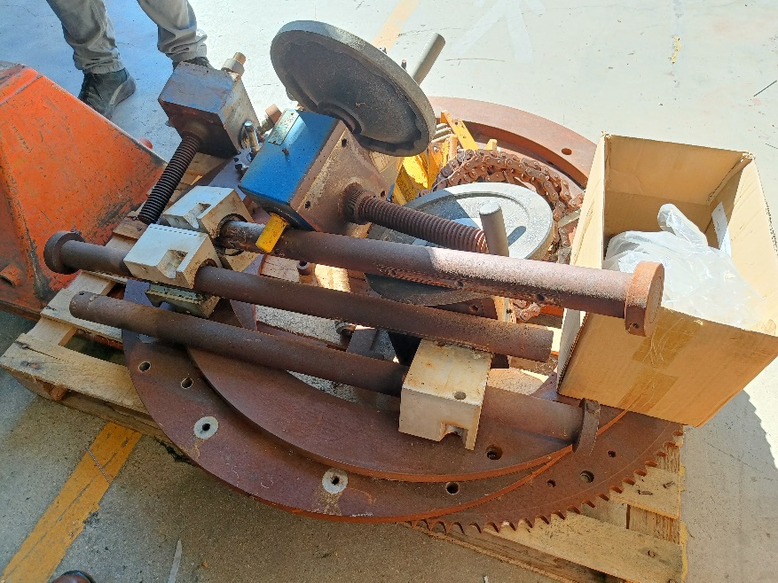
Progress on restoring the dismantling equipment.
The company has received the order to proceed with recovery of insertion tooling last week (Invoice data del 30-set-2022).
The equipment is completely disassembled. This week is going to sand blasted and painted.
We are proceeding to order a replacement components.

Slide 3
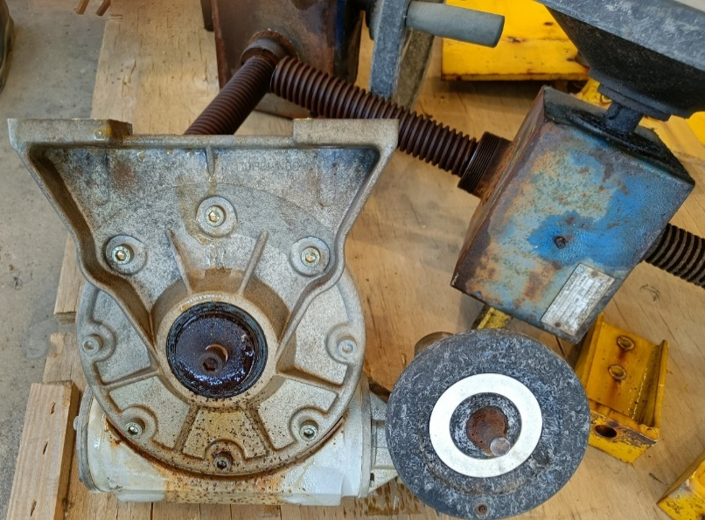
Progress on restoring the dismantling equipment.

Slide 4
Material on order

Slide 5
Material on order
Same Bushing calorimeter replacements 72 pieces
47 Keuro. May be we can save some money reused the
Aluminum housing.

Slide 6
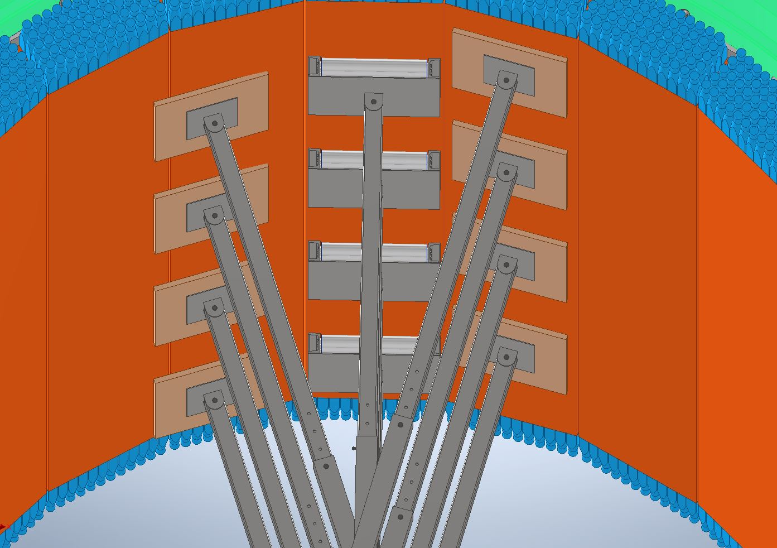
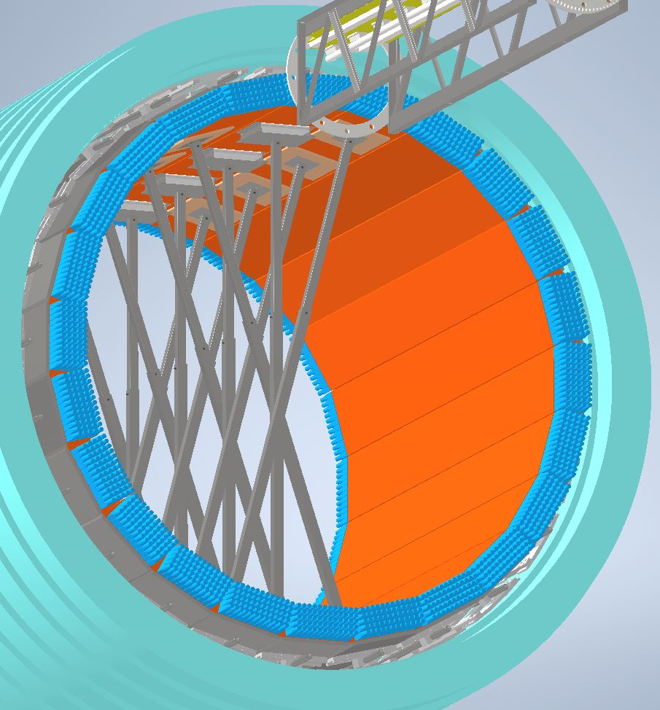
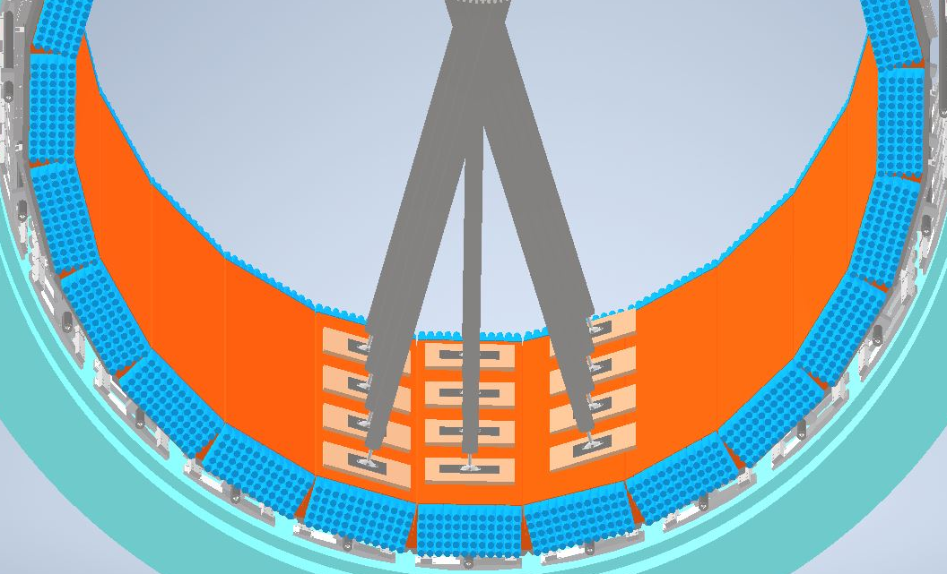
progress on cage design
Progress on support structure.
Support are necessary before extracting modules.

Slide 7
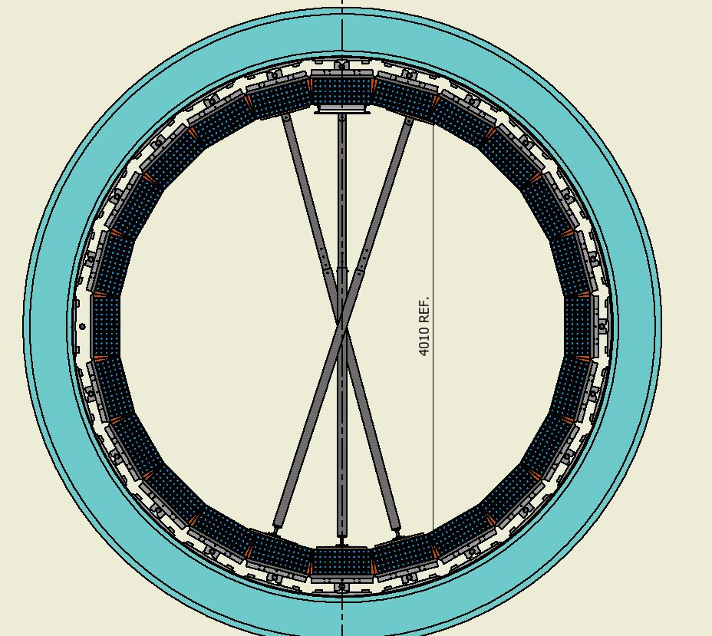
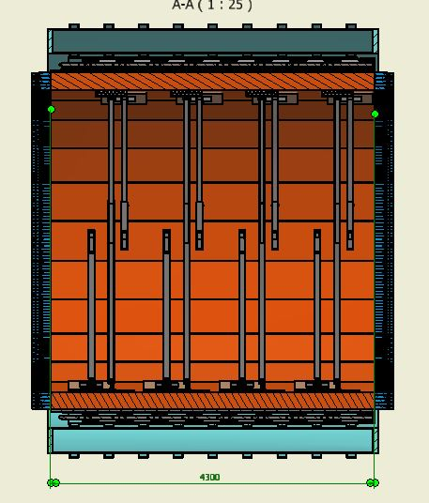
progress on cage design
Progress on support structure.

Slide 8
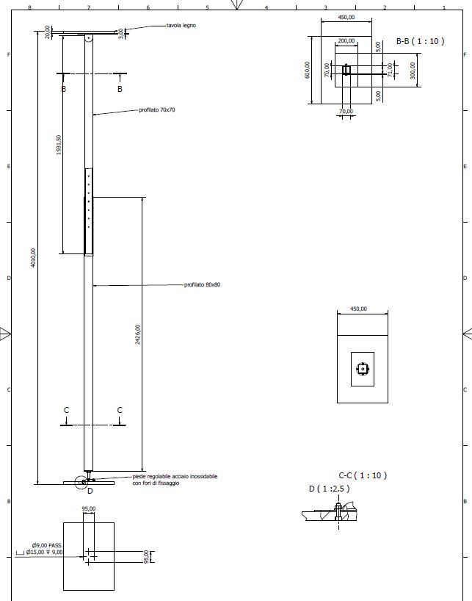
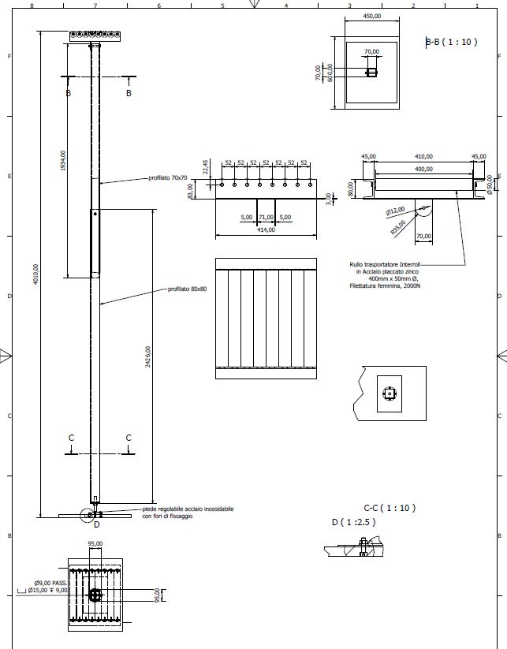
Progress on support structure.
Polacchi is going to arrange the support of the calorimeter module.

Slide 9
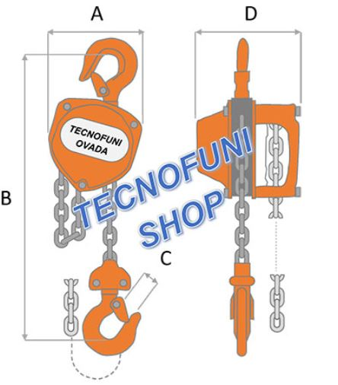
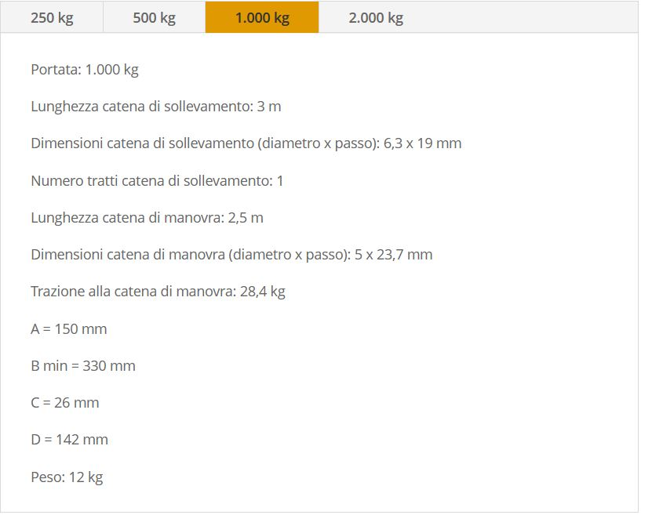
Progress on support structure.
Polacchi is also provide the pulling equipment.

Slide 10
Conclusions.
The equipment right now has been sand blasted and painted Yellow.
It is necessary to discuss the disassembly procedure with Polacchi that is going to make the calorimeter temporary supports and provide the pulling tooling.
Some additional simulation on the module extraction.

