Slide 1
ND Module Resonance Study
Lambert
12/16/2022

Slide 2
Outline
Resonance Study: Pixel Tile & Full Module
Introduction
Model Geometry
Model Mesh
Model Boundary Conditions
Results
Future Steps

Slide 3
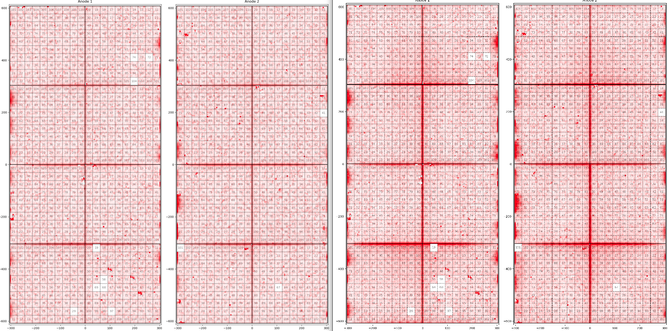
Introduction – Module 2 Noise
Mechanical Vibrations Applied

Slide 4
Introduction
Module 2 run showed that microphonics can contribute to overall system noise
Induced mechanical vibrations showed an increase in the noise level on the pixel system
  Tapping on cryostat
  Stomping on platform
  Etc.
Concluded that altered sleeve design introduced some type of resonance/motion; modification of this alleviated microphonics
  Additional filtering on the charge system through the periodic reset also helped to reduce overall noise
Next few slides examine resonant frequencies of the pixel tiles and ND-module

Slide 5
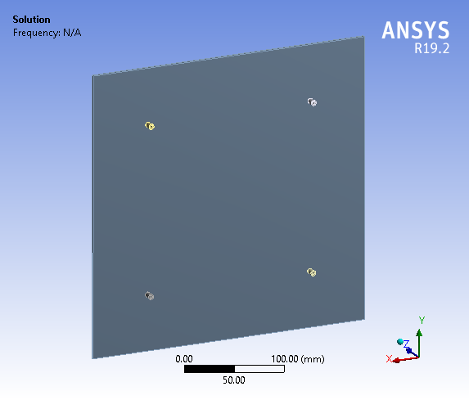
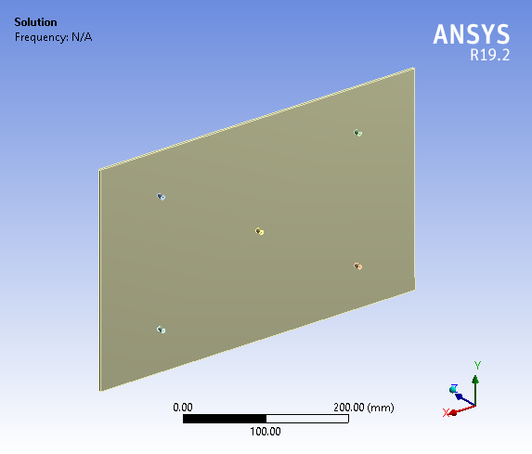
Model Geometry
2x2 Tile
ND Tile

Slide 6
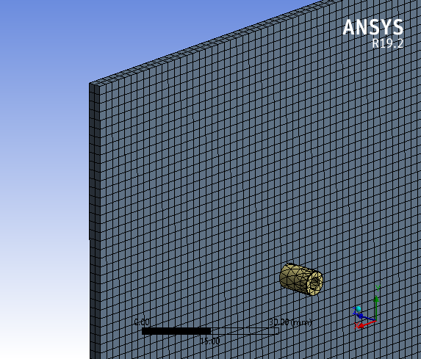
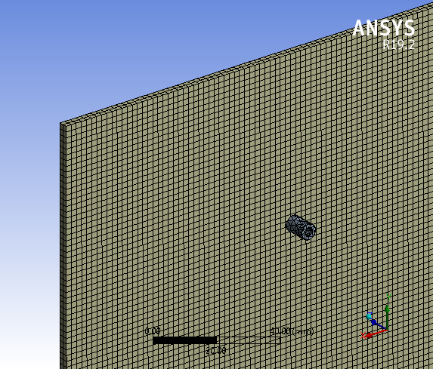
Model Mesh
2x2 Tile
ND Tile

Slide 7
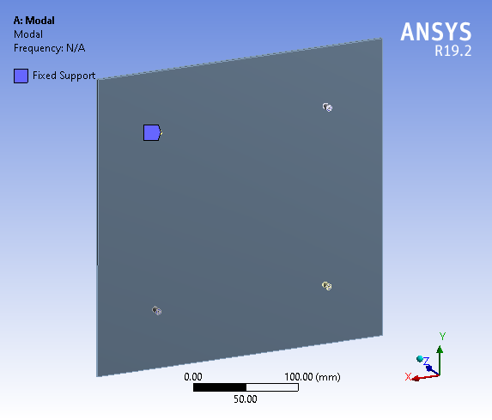
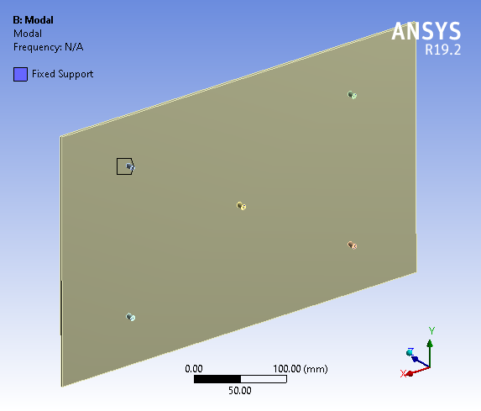
Model Boundary Conditions – damping of LAr not included
2x2 Tile
ND Tile
Attached LRO neglected

Slide 8
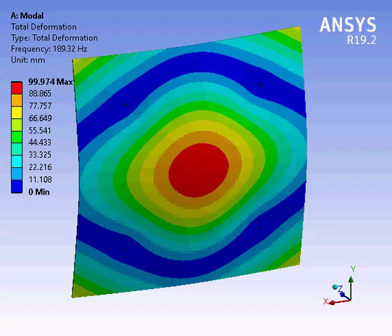
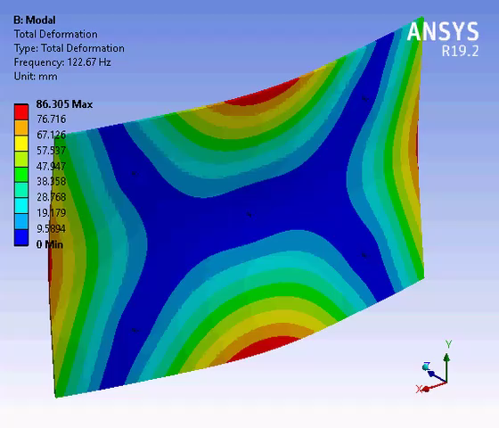
Results – note: deflections not real
2x2 Tile
ND Tile

Slide 9
Summary & Next Steps
Tiles are fairly stiff with the lowest modes being:
  2x2: 189 Hz
  ND: 123 Hz
Mode shapes are different between 2x2 and ND tile designs
  ND tile could be stiffened quite a bit by adding a 6th PEM stud and going to a 3x2 configuration
Frequencies shown and mode shapes seem unlikely to be culprit
Examine overall structure (ND only)

Slide 10
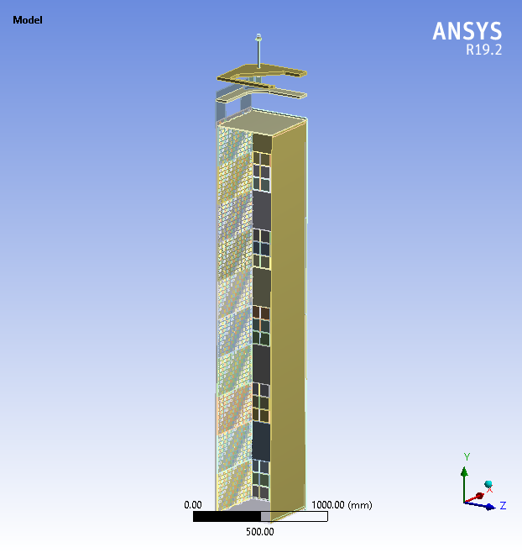
Model Geometry
¼ symmetry geometry
All elements included – simplified with best estimates of material properties
  LRO: fibers & WLS plastics
ND module only simulated -> unlikely that any modifications can or will be made to 2x2 modules
Meshed using brick elements

Slide 11
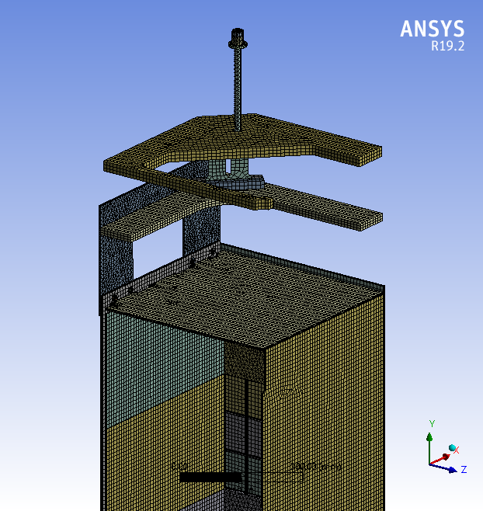
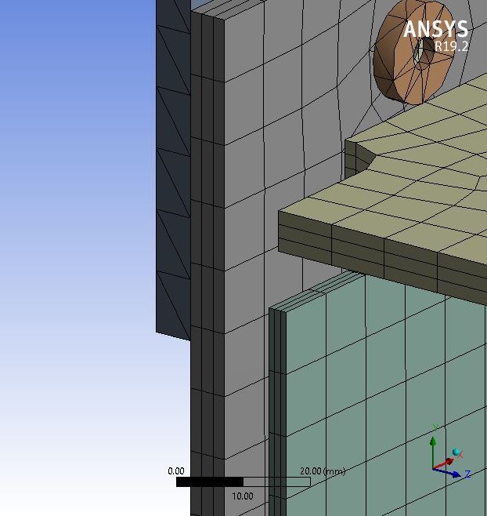
Mesh

Slide 12
Boundary Conditions
Zero Y-Displacement Applied here
Symmetry in X
Symmetry in Z
Zero Displacement in Y
Damping of LAr not included

Slide 13
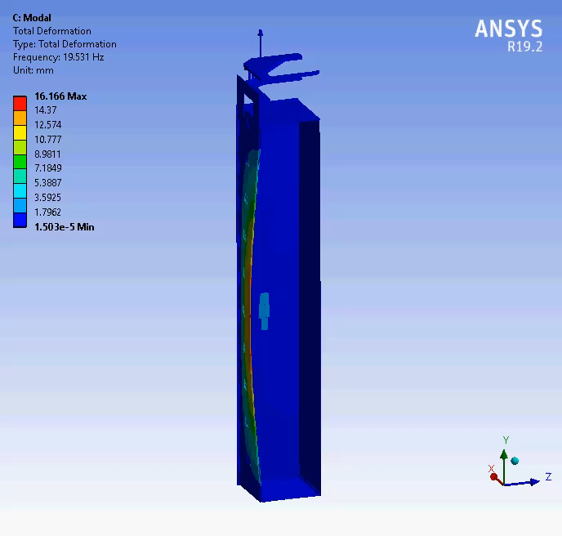
Results – Mode 1: 20 Hz, note: deflections not real
First mode @ 20 Hz
Motion of entire anode panel in-out of plane
2x2 would have a similar mode but at probably slightly higher frequency
Looking at the motion of the anode panel and the pattern of noise seen in Module 2 there is some correlation
Low frequency vibration of the sleeve in the LAr flow on Module 2 could have introduced a similar resonance to the anode panel

Slide 14
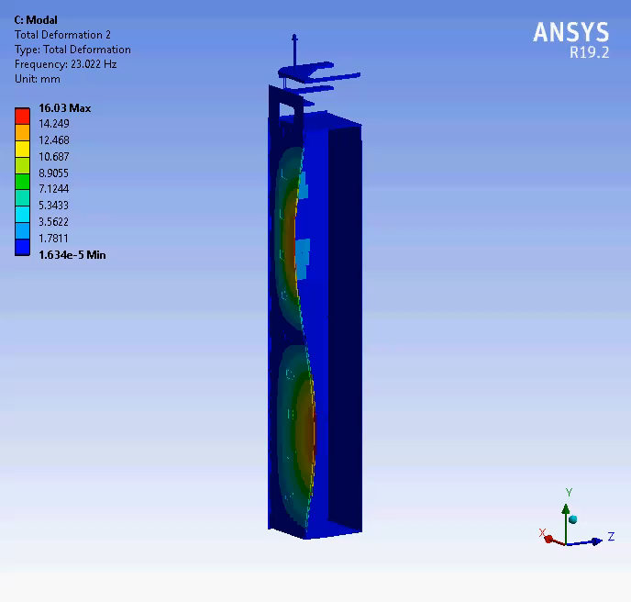
Results – Mode 2: 23 Hz, note: deflections not real
Second mode @ 23Hz

Slide 15
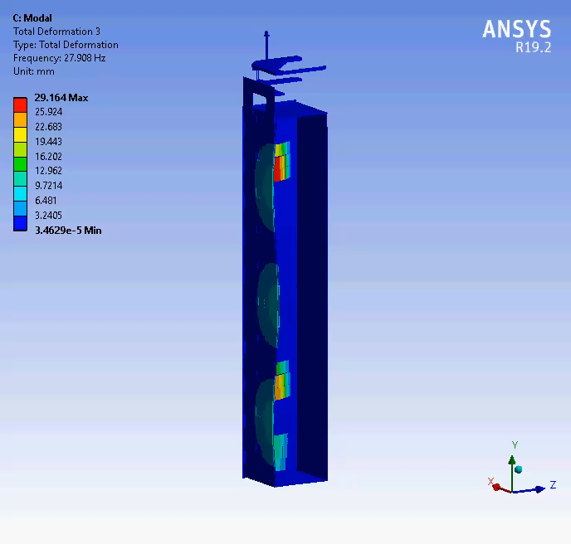
Results – Mode 3: 28 Hz, note: deflections not real
Third mode @ 28 Hz

Slide 16
Summary & Next Steps
Studies show some low frequency resonant modes that we should try to better understand & mitigate
Potential solutions:
  TPC mechanical mounting and isolation
  Stiffen anode support to increase frequency of minimum resonant mode
  Pixel Tile PEM stud mounting pattern

