Slide 1
PPD Department Heads Meeting
ESH
November 9, 2022
Katie Swanson

Slide 2
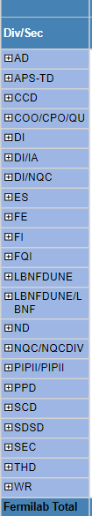
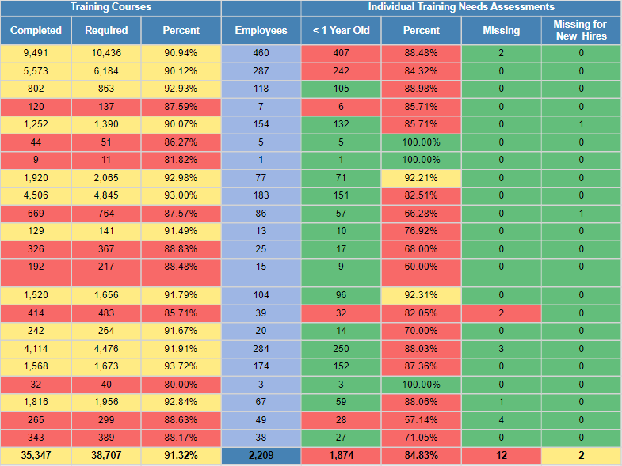
ESH Training and ITNA Status for employees – as of 11/10/2022
Last month:

Slide 3
FESHM updates in October
FESHM Chapter 3010 – Occurrence Reporting
Added references to QAM 12140 – Event Response Program (ERP), updated chapter to point to new roles in ERP.
Revamped chapter to include Centralized Facility Management program administered by FESS.
Added 5A(5) reporting criteria to Technical Appendix 7.2.
FESHM Chapter 3020 – Workplace Injury and Illness Management Program
Revision of chapter to incorporate references to new QAM 12140: Event Response Program.
FESHM Chapter 3030 – Noncompliance Tracking System (NTS)
Removed SEAB reference as it is no longer applicable. Minor editorial changes from PAAA to Enforcement.
Updated Enforcement Coordinator Responsibilities.
Added references to QAM 12140 - Event Response Program.

Slide 4
FESHM updates in October continued
FESHM Chapter 7080 – Concrete Anchor Devices
General update and clarifications to provisions to meet requirements of ACI 318-19.
Certified inspector requirements per IBC/ACI.
Provided additional guidance for drop-in anchors.
Addressed abandoned drill holes.
Hazard analysis requirements.
Updating testing requirements which allows the engineering note preparer more discretion.
Removed fall protection anchorage testing and inspections provisions and referenced FESHM 7060 for those requirements.
Reorganized to comply with FESHM chapter template.
FESHM Chapter 8041 – Polychlorinated Biphenyls
Added Program Description and elements
Edited responsibilities
Reviewed chapter for accuracy.
Removed references to ESH&Q.

Slide 5
New chapter--Last day to comment!
FESHM Chapter 1071 – Codes and Standards has been posted for (lab-wide) comments until November 11, 2022.
***Initial Release
Link to the draft chapter: https://esh-docdb.fnal.gov/cgi-bin/sso/ShowDocument?docid=7122
Chapter comments are required to be entered here: https://www-esh.fnal.gov/pls/cert/esh_drafts.html

Slide 6
Injuries/Illnesses in October
Oct 20th – Recordable, FESS
  The employee was performing repairs on a UTV/ATV at vehicle maintenance. The employee was trying to replace a spring on the tilt bed when the vise grips slipped off the spring causing their hand to jerk and come in contact with the sharp edge of the heat shield for the exhaust, cutting the index finger on their right hand. The employee reported to medical and received 7 sutures to close the wound.
Tendon injury surgeries
  Has the toolbox talk been shared with workers? Email from Rick Ford Oct. 26

Slide 7
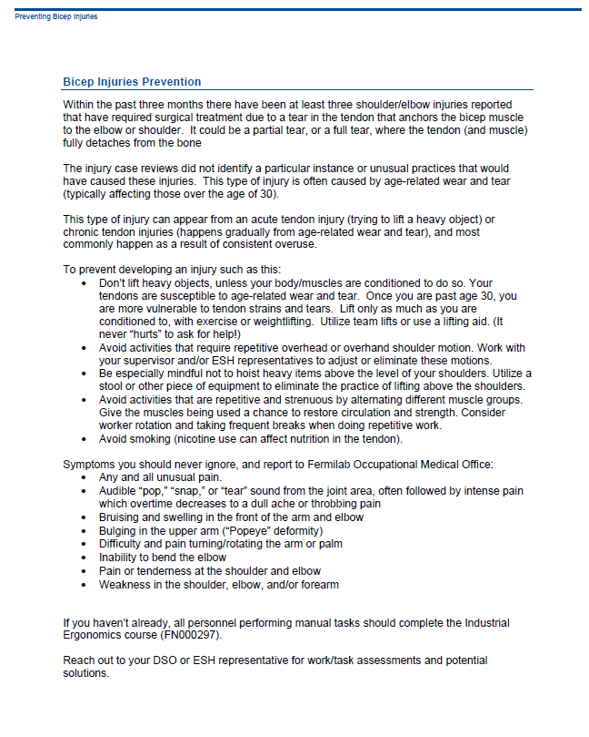

Slide 8
ORPS/NTS in October
LBNF Far Site Quarterly NO2 report (07/01/22-09/30/22) - Low
LBNF Far Site Explosive Delivery Concern – Informational
  On the afternoon of October 7th, a subcontractor crew was observed transporting explosives into the magazines located on the 4850L. The explosives were successfully delivered to the magazine using a skid steer with fork attachment. When the operator was maneuvering the skid steer to exit the drift, they backed the skid steer into the open powder magazine to make the turn. The back end of the skid steer, which houses the hot engine and exhaust system, came within approximately 4 inches of the 1.1 placarded high explosives powder inventory. The subcontractor has paused access of material transport equipment into the magazines until their investigation is complete.
LBNF Winch Rope Failure – Informational
  TMI employees were utilizing a 15,000-pound synthetic rope winch to lift CT bolts from a Zimmerman transport frame at the 4850 Ross station. The rope was configured to run out from the winch’s fairlead, over a sheave block directly above the load, and straight down to the load. The bolts were to be lifted from the transport frame, the frame withdrawn from below the bolts, a skid slid under the bolts, and then the bolts lowered onto the skid. The skid would be used to transport the bolts out onto the 4850-level proper. As the batch of bolts was lifted from the Zimmerman transport frame, the bolts were raised approximately 2 inches from the frame when the synthetic rope failed, and the load fell back onto the transport frame. No personnel were in the “line of fire,” and no other damage was caused other than to the synthetic rope itself.

Slide 9
Other news…
A brand new SDS database is here! It is called Velocity. It will be rolled out soon to Directorates. This is an improvement to our existing in-house system because with Velocity, we have access to millions of SDS that make searching for and obtaining the correct SDS easier than before. The system provides us with a modernized portal and simplifies management of our in-house SDS.
Stay tuned.

Slide 10
Material Survey & Release Process Updates
M. Schoell – ES&H RPO Dept. Head
11/9/2022 PPD Dept. Head Meeting

Slide 11
Material Survey & Release Process
New interim method for radiological workers removing & surveying material exiting enclosures
  Same process of performing the survey
  Introduce new Class 0 sticker for material < Class 1
  Introduce new Restricted Release Form for documentation
New disposal process for used PPE
Just-In-Time Training will be rolled out to Radiological Workers end of October describing the updated process
  Training available throughout November and December
  Scheduling Q&A Sessions throughout November and December (schedule on the next slide)
  Be on the lookout for All-Hands email
New process will “go live” starting in January
Long term – develop strategy for RCTs to perform material surveys

Slide 12
Material Survey & Release Process – Q&A Sessions
https://fnal.zoom.us/j/93006521213?pwd=UFJwSlh3UEp4N2Z2VFJ4RWFtRUdEQT09
Meeting ID: 930 0652 1213
Passcode: 679157
Living Frequently Asked Question (FAQ) Document (ESH DocDB 7042)
Monday 10/31 1-1:30pm Zoom Only
Thursday 11/3 2-2:30pm Zoom Only
Tuesday 11/8 10-10:30am Zoom Only
Wednesday 11/9 2-2:30pm Zoom & Huddle
Wednesday 11/16 3-3:30pm Zoom Only
Friday 11/18 1-1:30pm Zoom & Huddle
Monday 11/21 11:30-noon Zoom & Huddle
Wednesday 11/23 2-2:30pm Zoom Only
Tuesday 11/19 10-10:30am Zoom Only
Thursday 12/1 9:30-10am Zoom & Huddle
Wednesday 12/7 11:30-noon Zoom Only
Friday 12/9 2:30-3pm Zoom & Huddle
Tuesday 12/13 1:30-2pm Zoom & Huddle
Thursday 12/15 10-10:30am Zoom Only
Tuesday 12/20 3:30-4pm Zoom & Huddle
Thursday 12/22 10-10:30am Zoom Only

