Slide 1

Ultralight Dark Matter Searches in Gravity Gradient Noise Background
Jeremiah Mitchell
9 November 2022

Slide 2
Outline
Atom multi-gradiometry
Ultralight dark matter phase shift
Gravity gradient noise phase shift
Analysis method
Results on dark matter sensitivity
arXiv:2211.01854v1

Slide 3
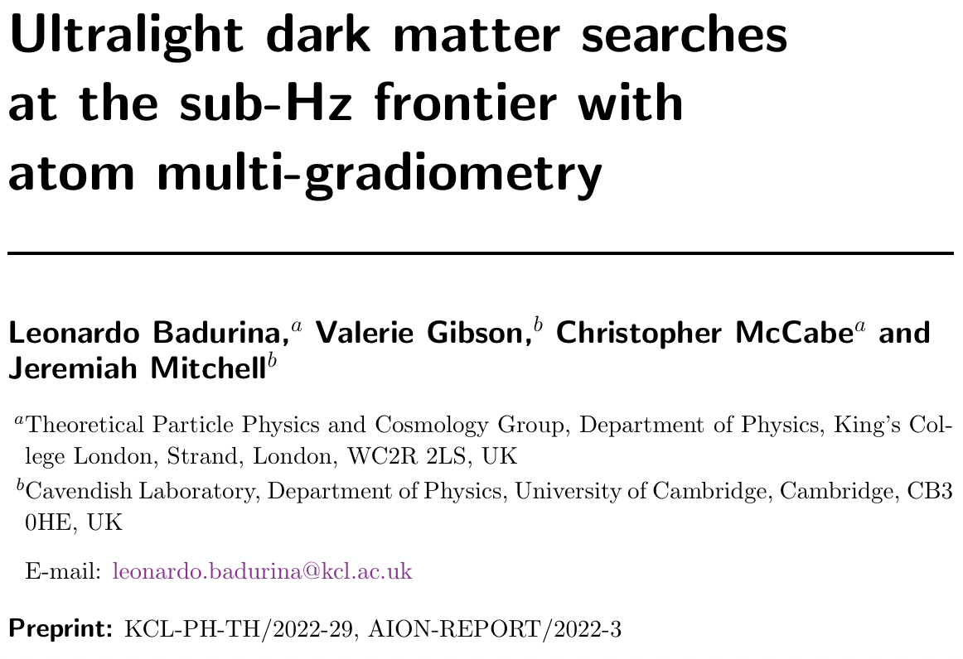
Background
arXiv:2211.01854v1

Slide 4
Atom multi-gradiometry

Slide 5
Signals and noise
Signals
  Ultralight scalar dark matter (ULDM) parameterized by mass and velocity distribution
Noise
  Atom shot noise
  Gravity gradient noise (GGN) parameterized by Rayleigh wave modes and vertical surface displacement

Slide 6
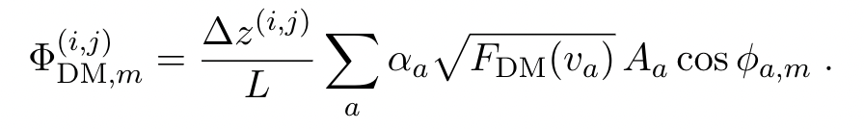
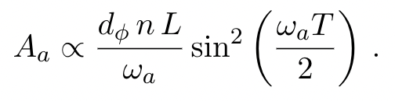
ULDM signal and statistics
Gradiometer phase shift parameterization for dark matter signal
Important scaling factors are the experiment specific n, L, T as well as the ULDM-Standard Model coupling d_{𝜙}

Slide 7
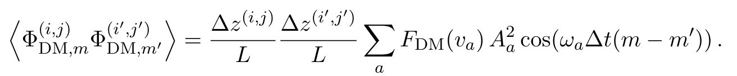
ULDM signal and statistics
Over long timescales signal characterized by vanishing expectation value
Covariance can then be expressed as

Slide 8
GGN
Vertical displacement amplitude spectral density
Rayleigh surface waves

Slide 9
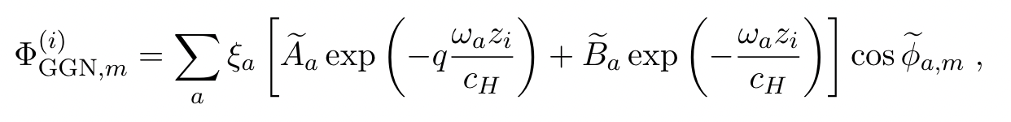
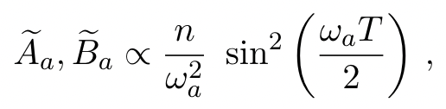
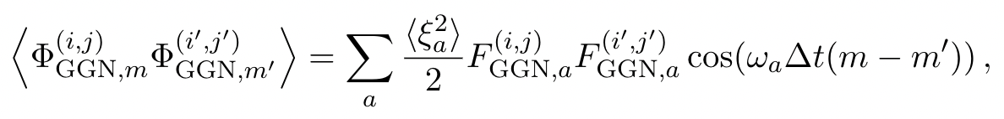
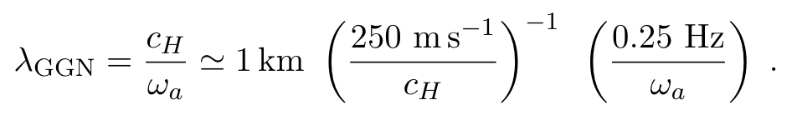
GGN statistics
Calculated via semi-classical perturbative analysis
Characteristic length scale

Slide 10
Test statistic
Data vectors for the signal are composed of the Real and Imaginary components of the Discrete Fourier Transform of the sequence of measurements over some integration time
Log-likelihood method for finding the best fit parameters to our model via a test statistic
Asimov approach instead of Monte Carlo, i.e. finding the asymptotic behavior
Model is built up from the covariance matrices for the signal and noise assuming a Gaussian likelihood function

Slide 11
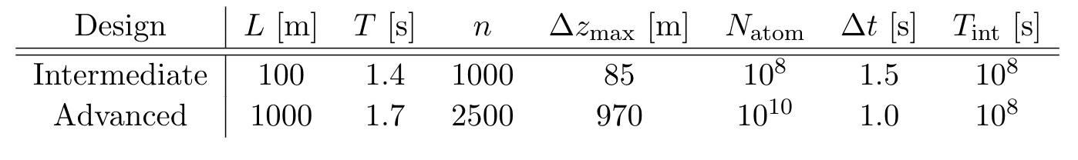
Configuration parameters
For 10m detectors no impact on ULDM sensitivities

Slide 12
DM sensitivity and exclusion limits

Slide 13
Configurations and site dependence

Slide 14
Summary
GGN impacts ULDM searches below 1Hz for 100m and longer baselines
Sensitivity can be regained by adding more atom interferometers along the baseline giving more gradiometer measurements as well as optimizing the positions underground
The test statistic formalism developed can be extended to other signals such as gravitational wave searches and used for comparing other background sources

