Slide 1
POWER SUPPLY SPECIFICATION
Xingchen Alex Yuan
Workshop on User Interface, SC Cable Test Facility at Fermilab
11/21/2022

Slide 2
Basic Requirements
Two independent power systems, 24kA and 16kA each
Output voltage is no less than 20V at PS terminals
Decided by ramp rate, estimated bus resistance, and voltage drops at dump system
To be installed by the HFVMTF pit in the Industrial Building #1, FNAL
Loads range from 20µH to 120mH
Does NOT operate continuously
Switch mode, modularized power supplies
Higher efficiency, smaller size
Interchangeable; less down time

Slide 3
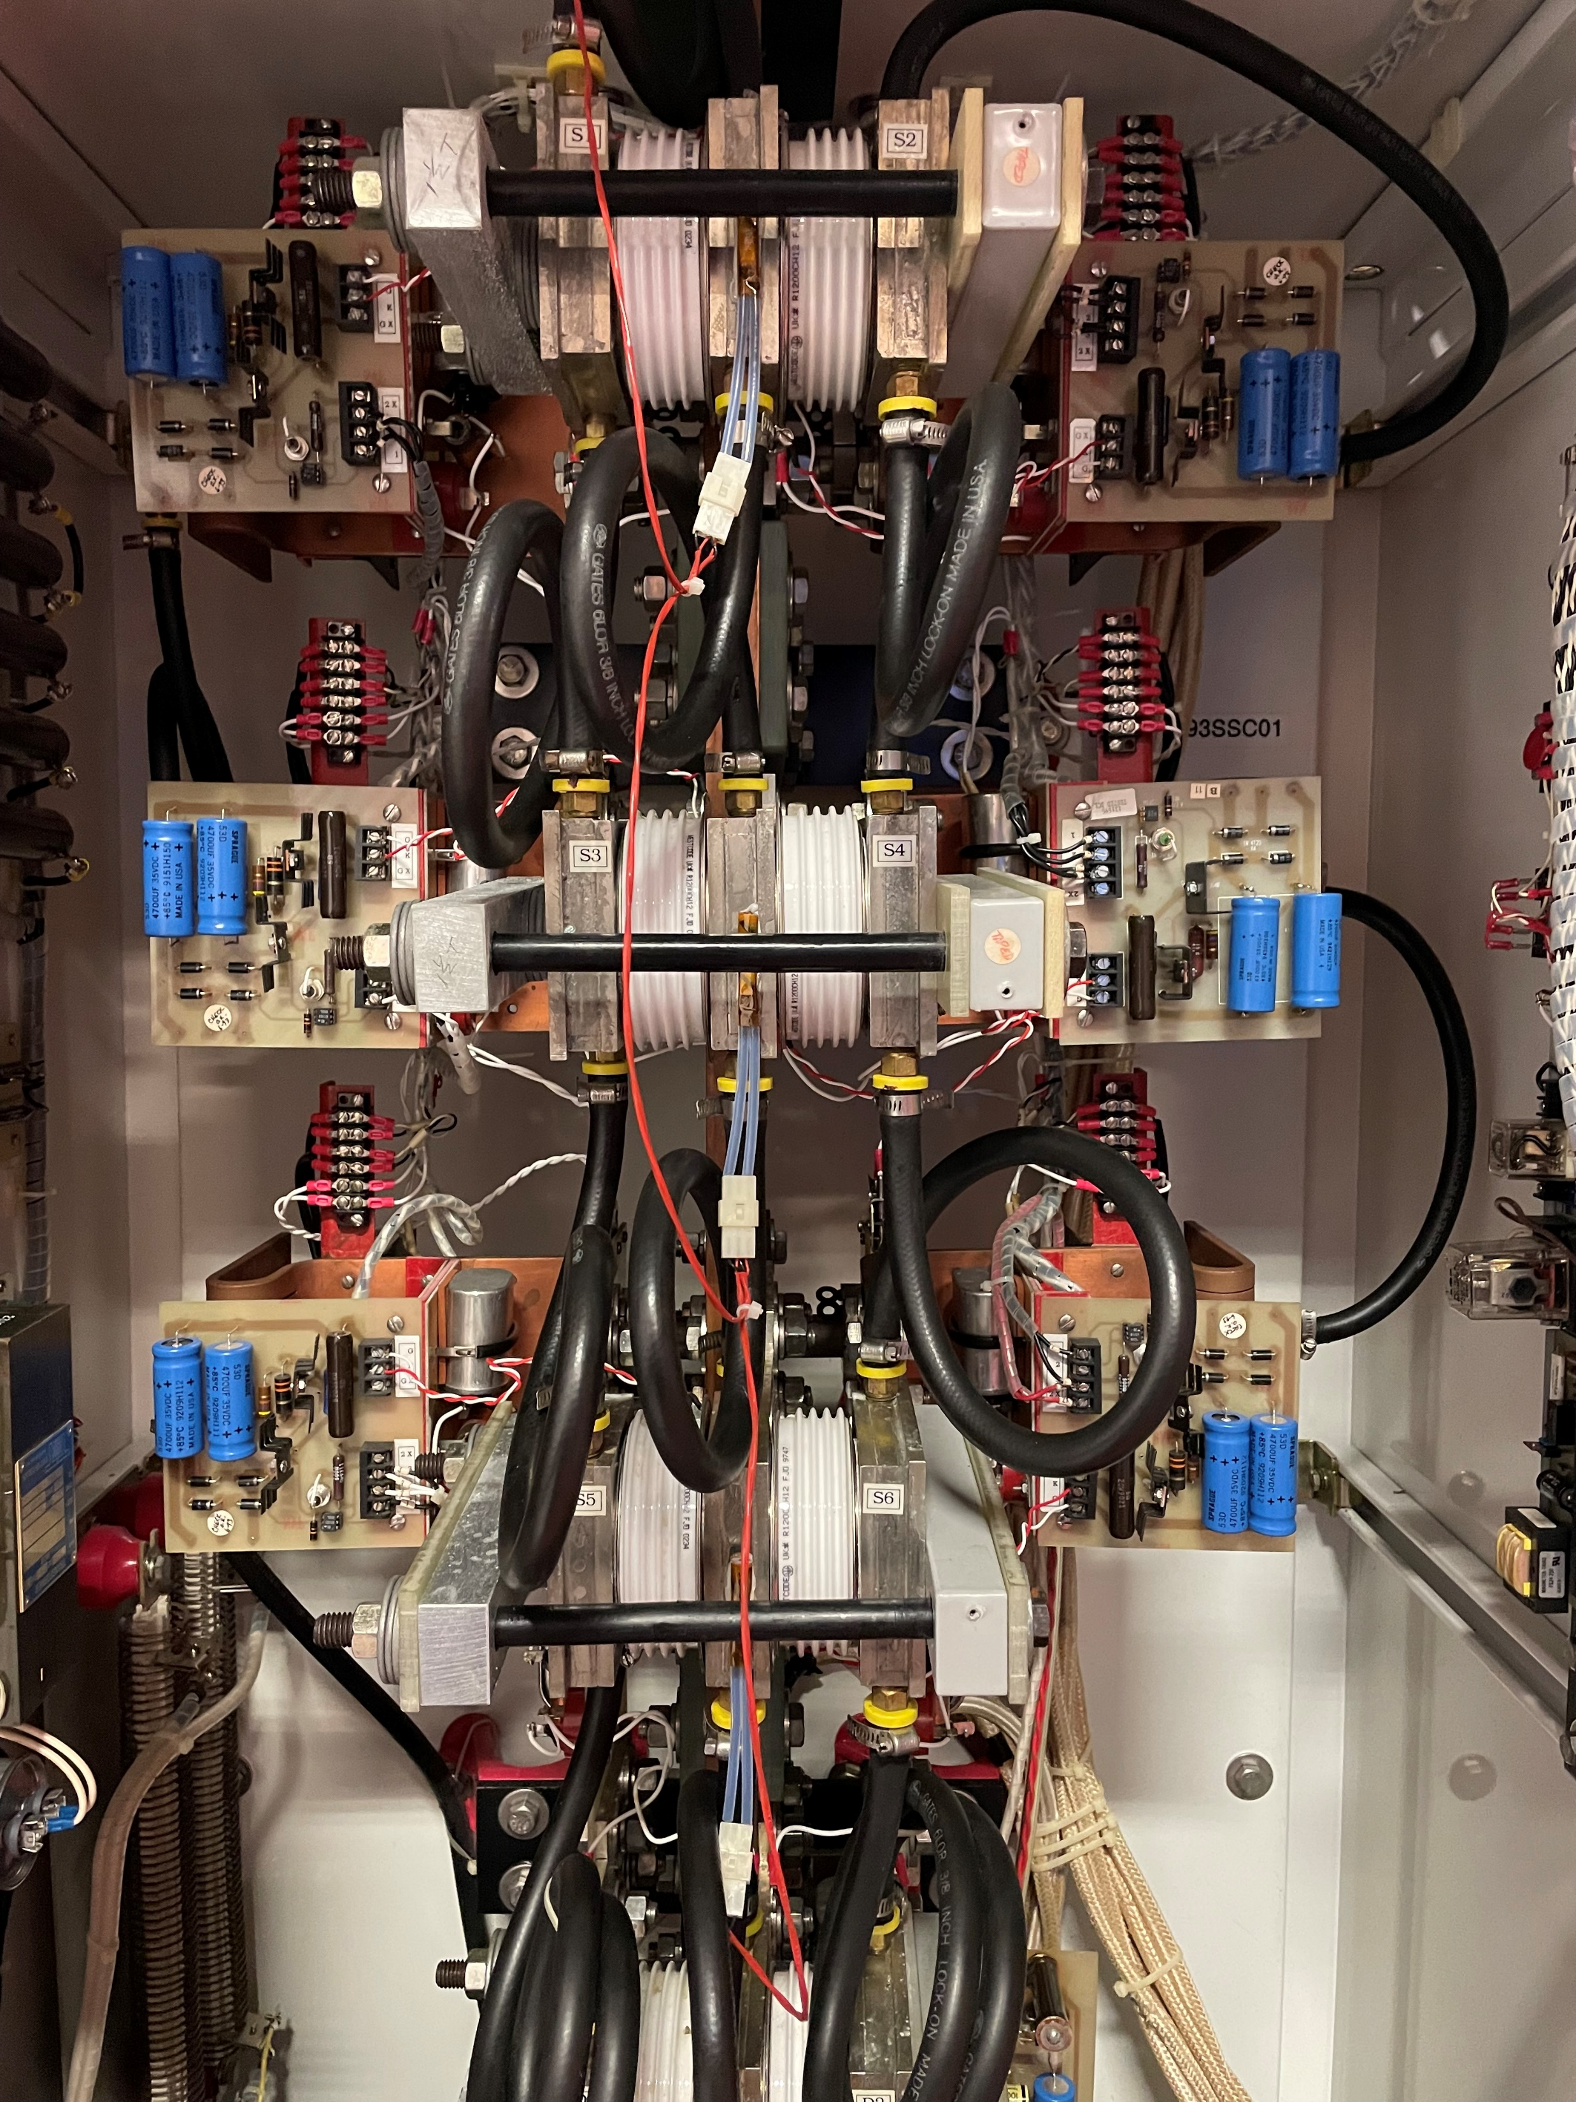
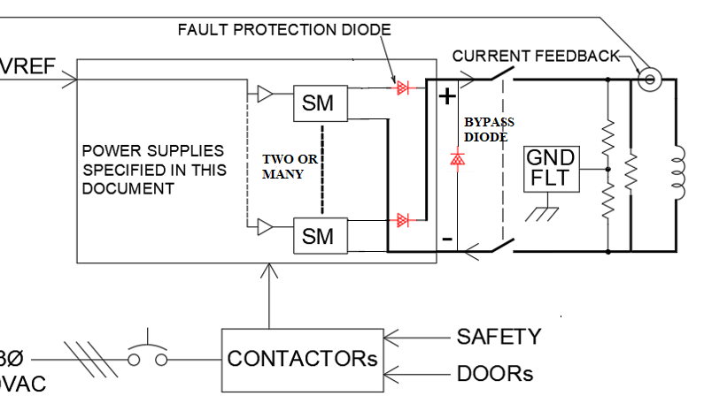
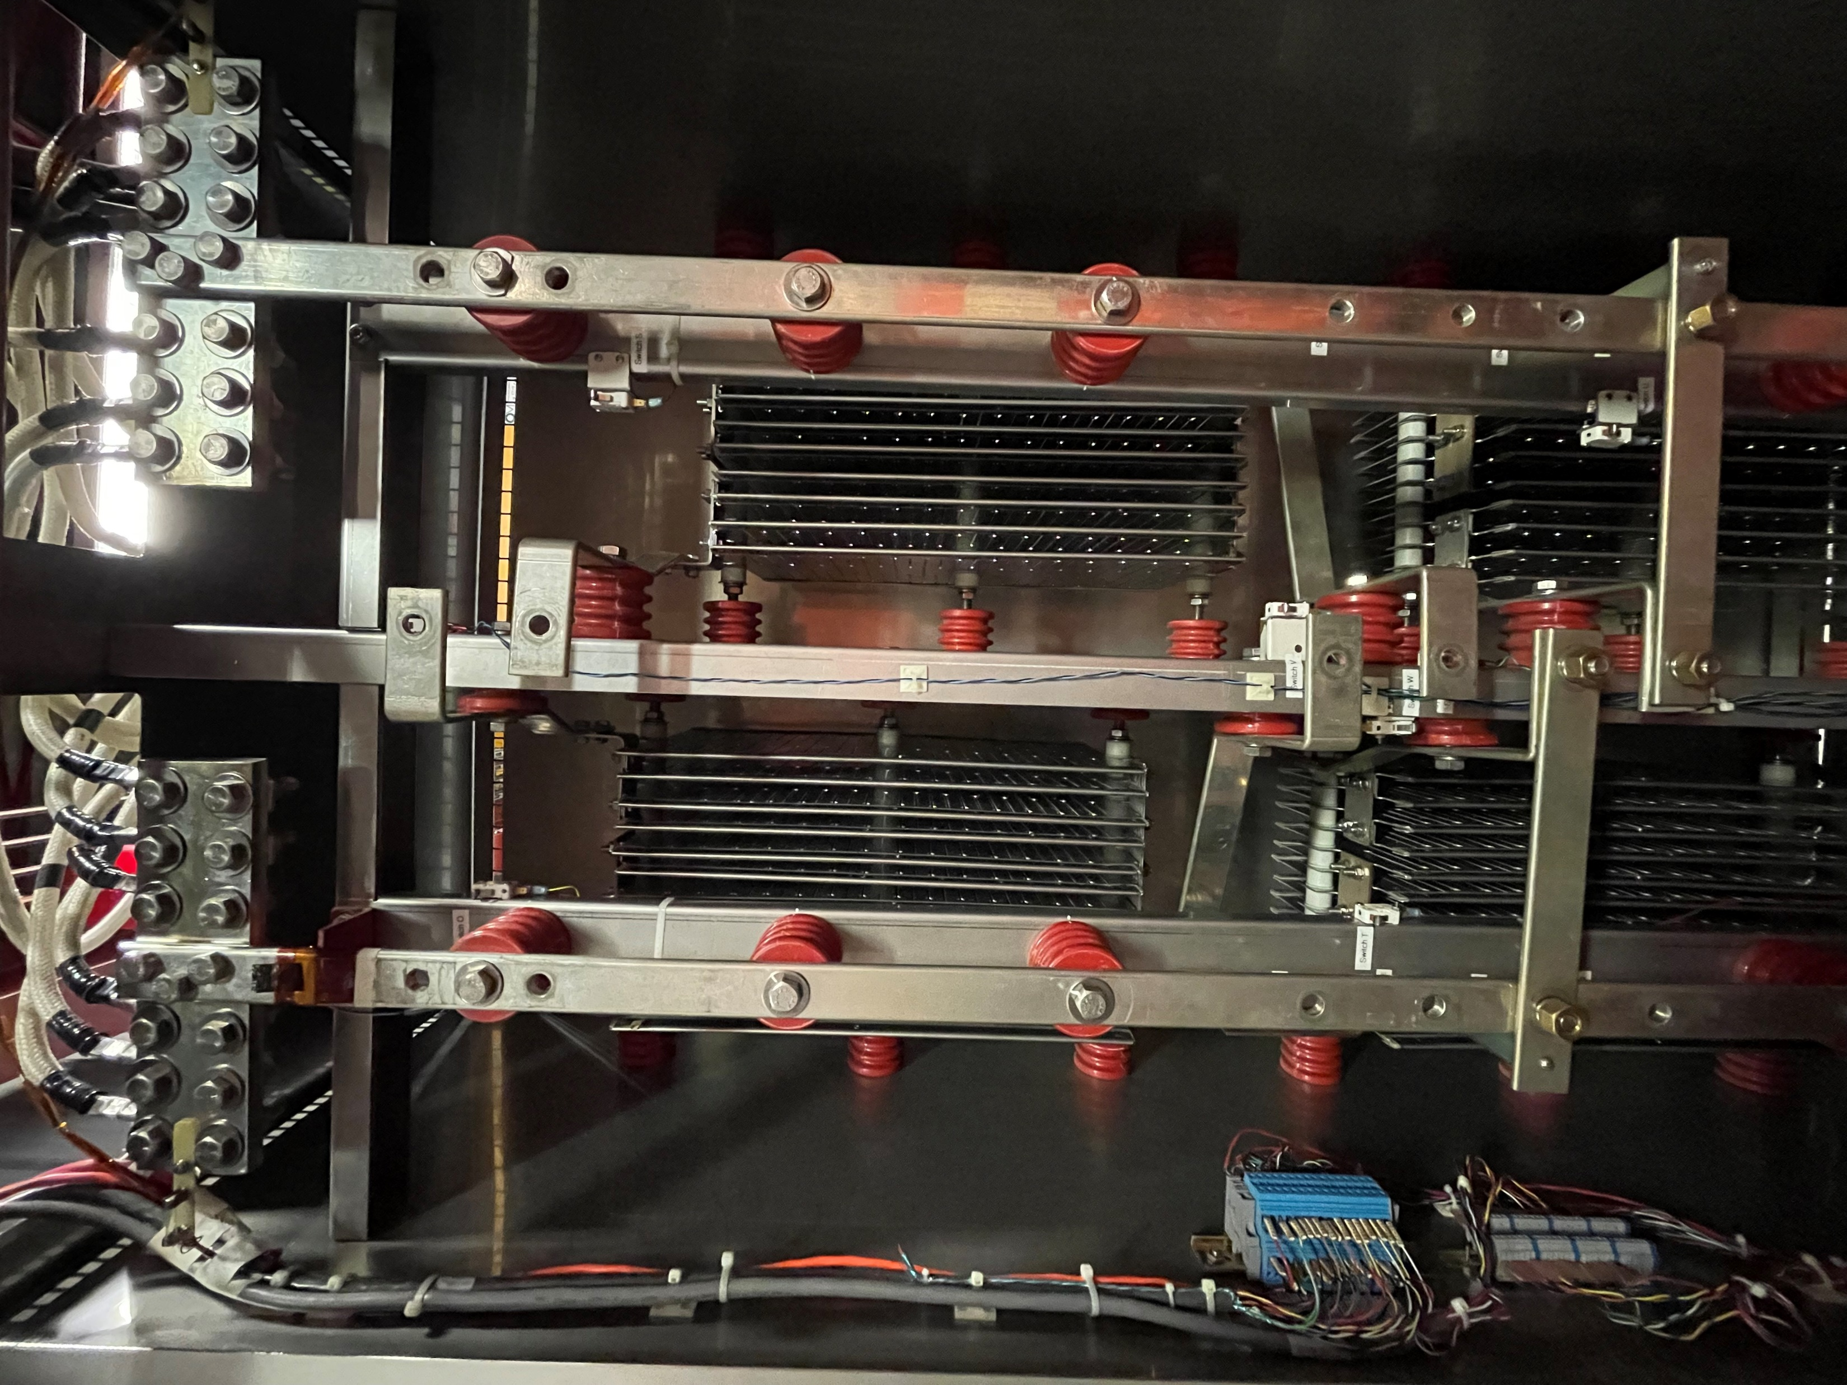
System Diagram

Slide 4
System Diagram

Slide 5
System Diagram

Slide 6
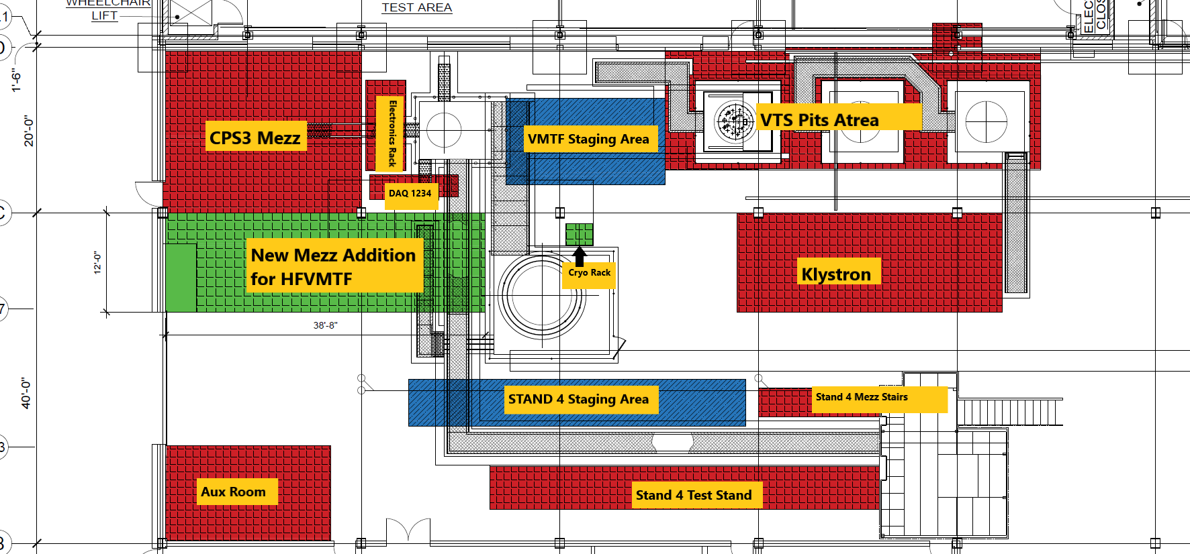
System Diagram

Slide 7
More Detailed Specification
Specification | Value
Input Voltage |  | 480 VAC, 3P, 60 Hz
Output Voltage |  | >20 V
Output Currents Power Supply Units Cooling Efficiency for 50 plus % Load Voltage Regulation Voltage Regulation Bandwidth Voltage Ripple (from 20Hz to 300kHz) Current imbalance among PS units Control Footprint Safety components |  | 24 and 16 kA Water Cooling >80% <±0.5% >50 Hz 0.2% <10% Local/Remote <200 sft Fail safe; NTRL rated

Slide 8
Current Status
We are in the third-round bid
Currently 3 leading bidders
Technical review on-going
Vendor selection in a month or so
Average delivery time ~50 weeks

Slide 9
SUMMARY
We specified a 24kA and a 16kA power systems for bids, with detailed electrical and mechanical requirements.
Switch mode power supplies to be installed by the HFVMTF at Fermilab Test Facility
The bid process is on-going.
Expect to have power supplies built and shipped in 12-15 months.
We had experience commissioning similar power systems at the Magnet Test Facility in Fermilab.

