Slide 1
Building Infrastructure
Maurice Ball
PIP-II Beam Transfer Line Workshop
November 30, 2022 – December 1, 2022

Slide 2
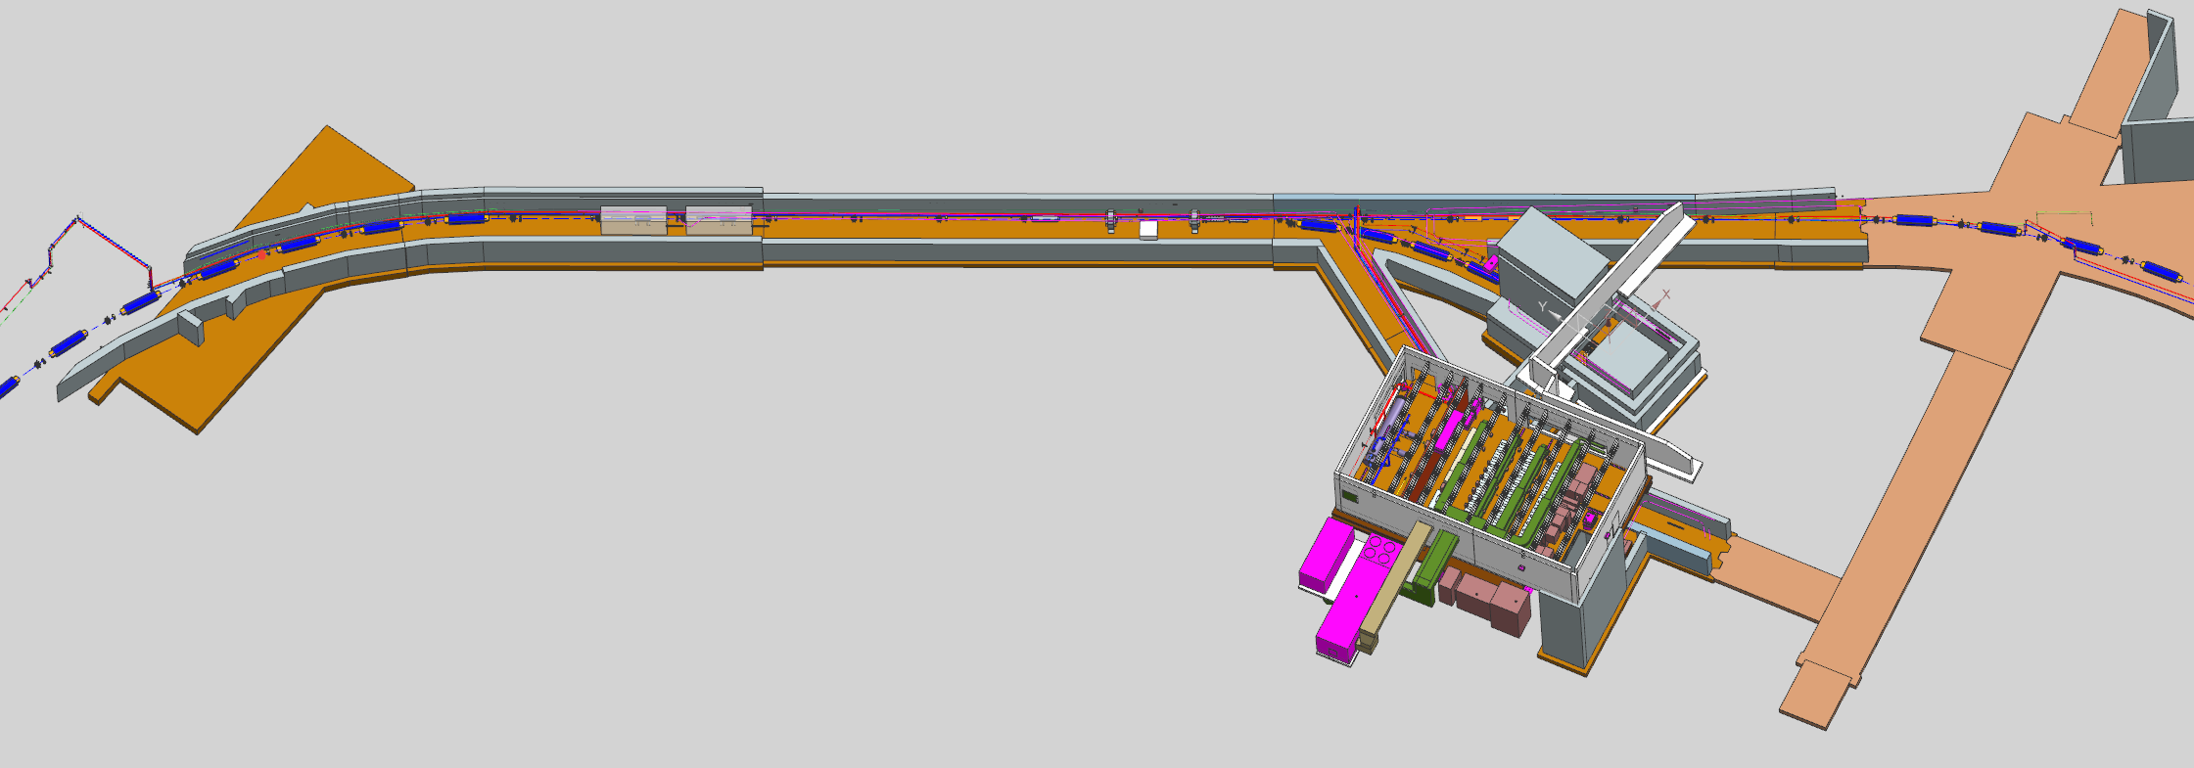
BldgI Mechanical - Scope
PIP-II Primary LCW System, Compressed Air, Utility Nitrogen
Technical Requirements
System highlights/flow summary
Key Concern Points
3D Model Screenshots
Absorber RAW Skid
Technical Requirements
System highlights/flow summary
Key Concern Points
3D Model Screenshots

Slide 3
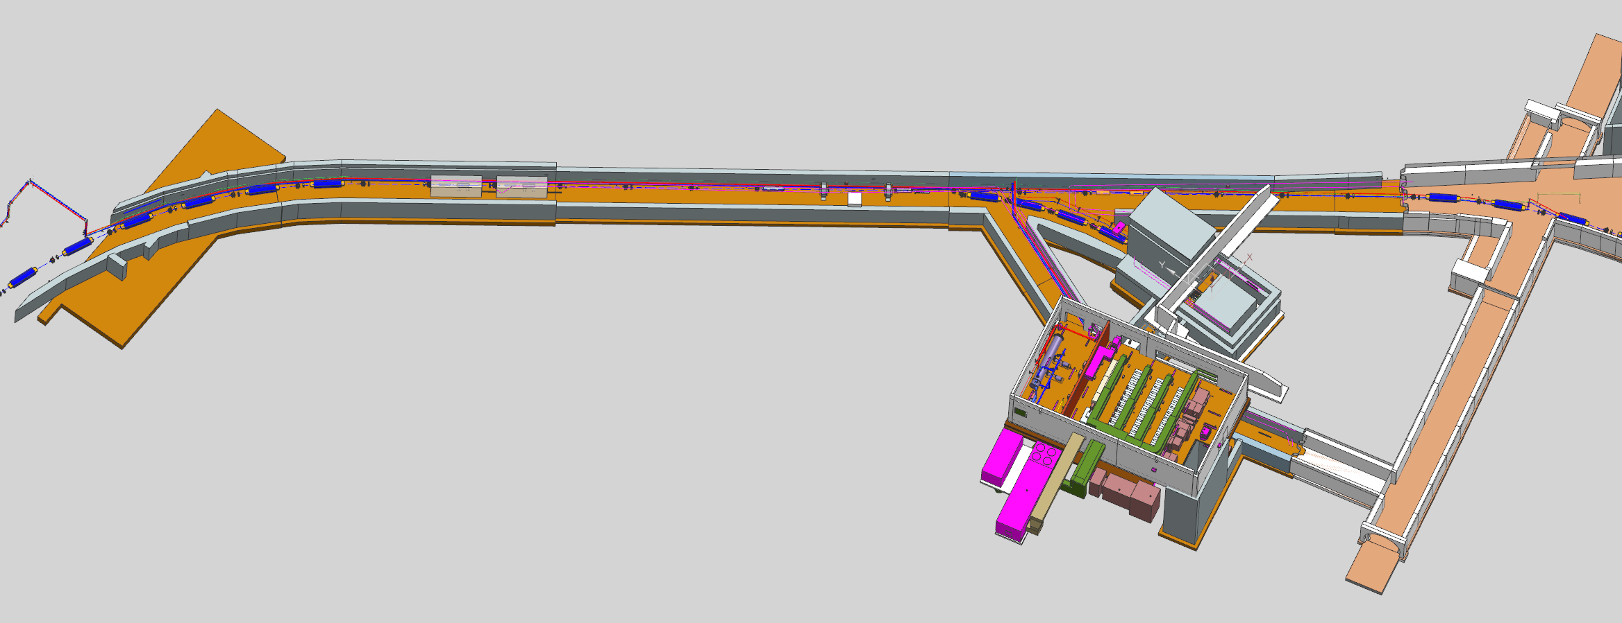
BldgI Mechanical – Scope (Continued)
Helicopter view of BTL showing layout, routing of LCW/CA/N

Slide 4
PIP-II Primary LCW System – Technical Requirements/System Highlights
ASME Category D Piping System
304 Stainless Steel Schedule 10 piping material and weld pipe fittings
Centrifugal Pumps
Electro-deionization Skid
Dissolved Oxygen Removal Skid
Particulate filtration
Expansion Reservoir Tank – 250 Gallon
Pump room located in F37 Service Building
Tube and shell heat exchanger
Heat exchange with ICW, discharge to F-Sector ponds
Make up water via – Deionized water from 50 Gallon portable drums
Nitrogen gas supplied from Utility Nitrogen gas line piping installation from BTL
Requirement # | PARAMETER DESCRIPTION | VALUE
T- ED0012655-A002 | Design Pressure | 150 psig
T- ED0012655-A003 | Discharge Pressure | 105 psig
T- ED0012655-A004 | Suction Pressure | 15 psig
T- ED0012655-A005 | Supply Temperature | 95⁰F +/- 1⁰F
T- ED0012655-A006 | Delta T (ΔT) | 17 F⁰
T- ED0012655-A007 | Total Heat Load | 200 kW
T- ED0012655-A008 | Available Flow | 400 GPM
T- ED0012655-A009 | Side Stream Particulate Filtration | 5 micron
T- ED0012655-A010 | Resistivity | 4 MOhm*cm
T- ED0012655-A011 | Oxygen Removal Levels | ≥ 20 PPB

Slide 5
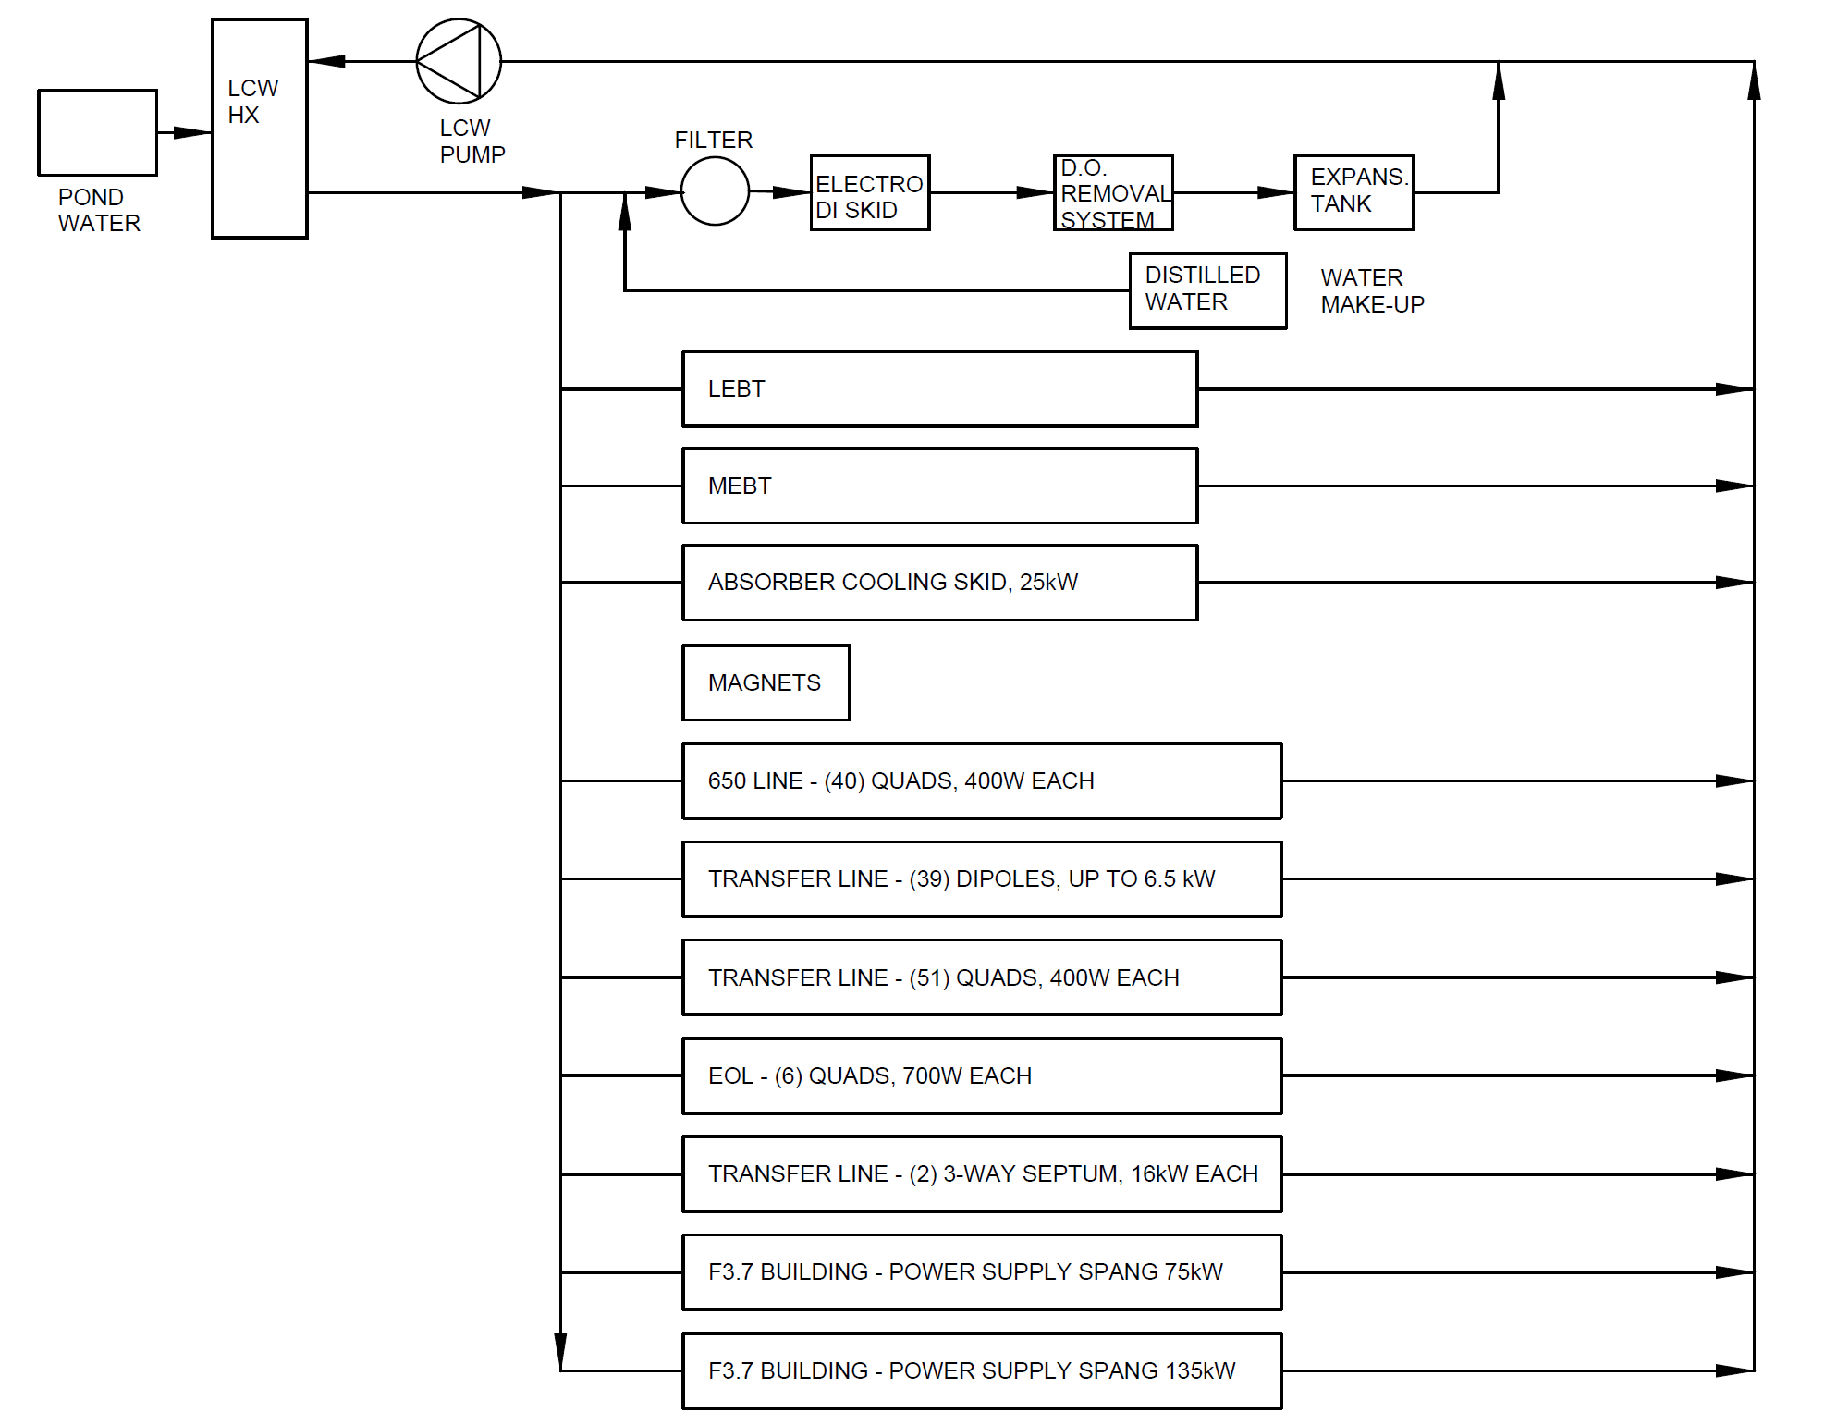
PIP-II Primary LCW System – Flow Summary Sheet
Component | Quantity | Unit Consumption | Total Consumption
 | [#] | [GPM] | [GPM]
LEBT
Solenoid #1 - LEBT | 1 | 1.2 | 1.2
Chopper - LEBT | 1 | 1.4 | 1.4
Collectors in 30 Magnet chamber - LEBT | 1 | 1.2 | 1.2
Scraper - LEBT | 1 | 1 | 1
Solenoid #2 - LEBT | 1 | 1 | 1
Solenoid #3 - LEBT | 1 | 1 | 1
Solenoid #4 - LEBT | 1 | 1 | 1
Electrically isolated diaphragm (EID) #1 - LEBT | 1 | 0.5 | 0.5
Electrically isolated diaphragm (EID) #2 - LEBT | 1 | 0.5 | 0.5
Electrically isolated diaphragm (EID) #3 - LEBT | 1 | 0.5 | 0.5
Electrically isolated diaphragm (EID) #4 - LEBT | 1 | 0.5 | 0.5
Electrically isolated diaphragm (EID) #5 - LEBT | 1 | 0.5 | 0.5
MEBT
Scraper #1 - MEBT | 1 | 0.5 | 0.5
Bunching Cavity #1 - MEBT | 1 | 3.5 | 3.5
Scraper #2 - MEBT | 1 | 0.5 | 0.5
Emittance scanners #1 - MEBT | 1 | 2 | 2
Emittance Scanner #2 - MEBT | 1 | 2 | 2
Kicker #1 - MEBT | 1 | 0.5 | 0.5
Bunching Cavity #2 - MEBT | 1 | 3.5 | 3.5
Kicker #2 - MEBT | 1 | 0.5 | 0.5
Absorber #1 - MEBT | 1 | 8 | 8
Absorber #2 - MEBT | 1 | 8 | 8
Water jacket (Around beam tube) - MEBT | 1 | 1 | 1
Scraper #3 - MEBT | 1 | 0.5 | 0.5
Bunching Cavity#3 - MEBT | 1 | 3.5 | 3.5
Scraper #4 - MEBT | 1 | 0.5 | 0.5
Bunching Cavity#4 (in the Linac tunnel) - MEBT | 1 | 3.5 | 3.5
Linac
650 Line 400 W Quadrupoles | 40 | 1.3 | 50.8
BTL
Absorber Cooling Skid (25 kW) | 1 | 16 | 16
Transfer Line 6.5 kW Dipoles (37 + 2 EOL) | 39 | 2 | 78
Transfer line 400 W Quadrupoles | 51 | 1.3 | 64.8
EOL 700 W Quadrupoles | 6 | 1.3 | 7.6
Transfer Line 16 kW 3-Way Septum | 2 | 1.7 | 3.4
F37 Building
F3.7 Building 75 kW Power Supply Spang (for beamline abort dipole) | 1 | 1.5 | 1.5
F3.7 Building 135 kW Power Supply Spang (for Septum) | 1 | 3 | 3
Total Flow Required (GPM) = |  |  | 273.4
PIP-II Building Infrastructure – Low Conductivity Water (LCW) System TRS – TC# ED0012655

Slide 6
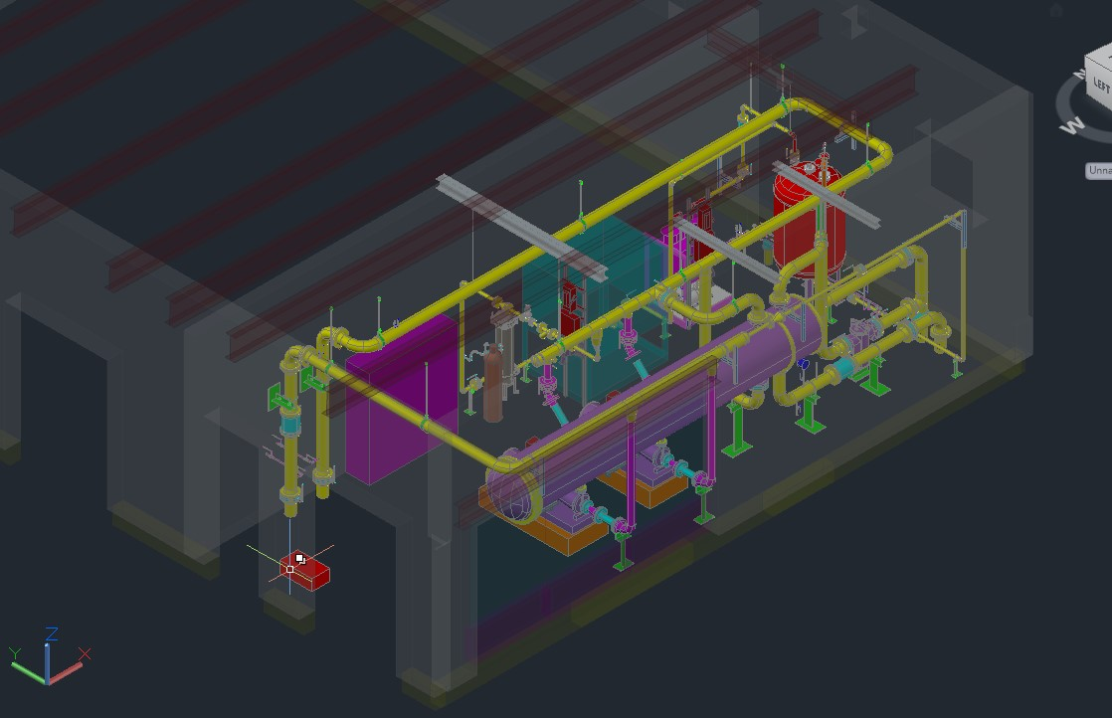
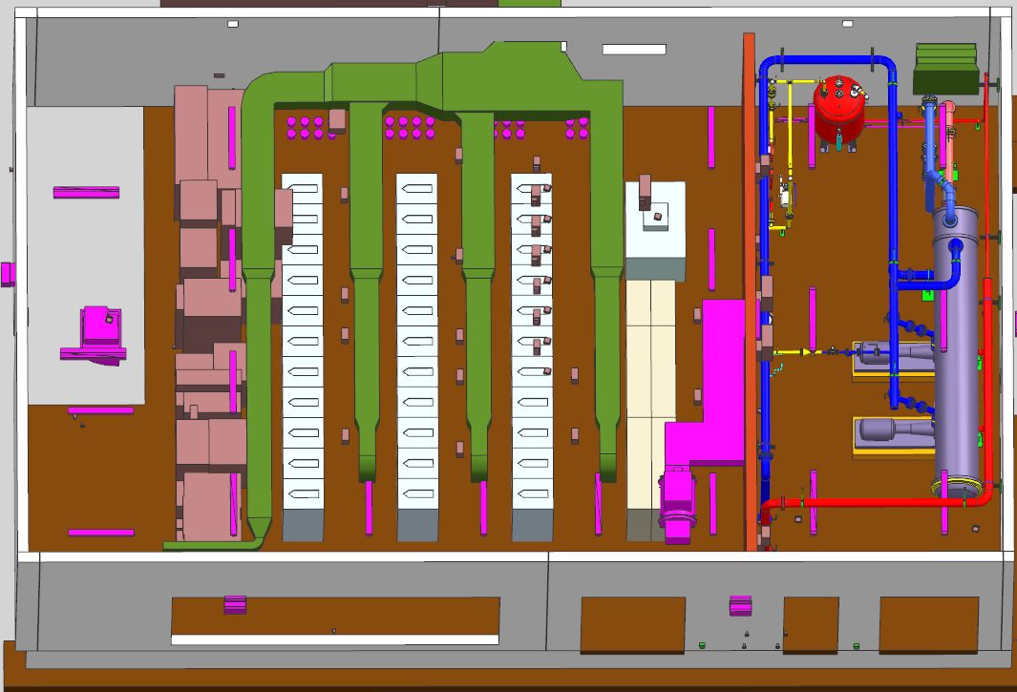
PIP-II Primary LCW System – Key Concern Points – F37 Pump Room
No direct access to LCW pump room from power supply room
LCW cooling provided to power supply room
PLC/Rittal cabinets enclosures located in pump room and power supply room
LCW provides cooling to Absorber RAW skid heat exchanger
LCW Pump Room in F37 Service Building
F37 Service Building showing power supply room adjacent to LCW pump room

Slide 7
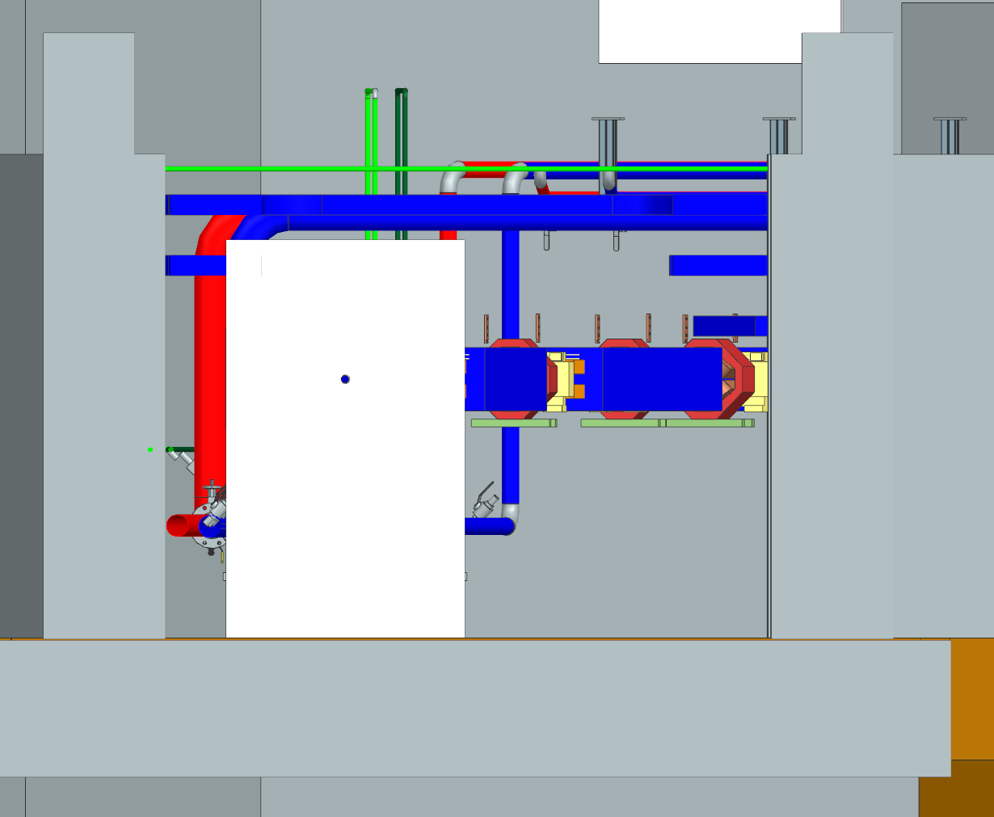
PIP-II Primary LCW System – Routing around collimator
LCW piping positioned low along the wall for equipment clearance
Valve taps at collimator locations abandoned/replaced with strategic ALARA locations
“Goldilocks” valve manifold arrangement at strategic locations
BTL cross-section view at Collimator
BTL elevation view at Collimator footprint showing LCW valve taps at each warm magnet

Slide 8
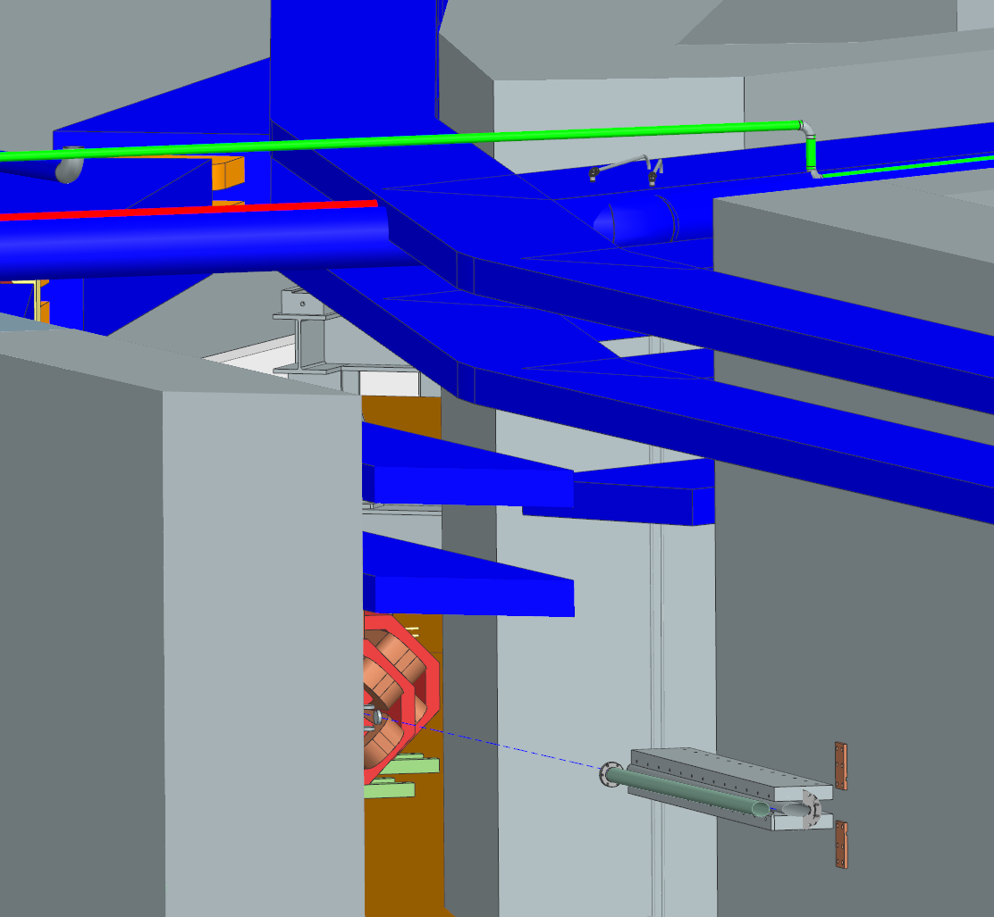
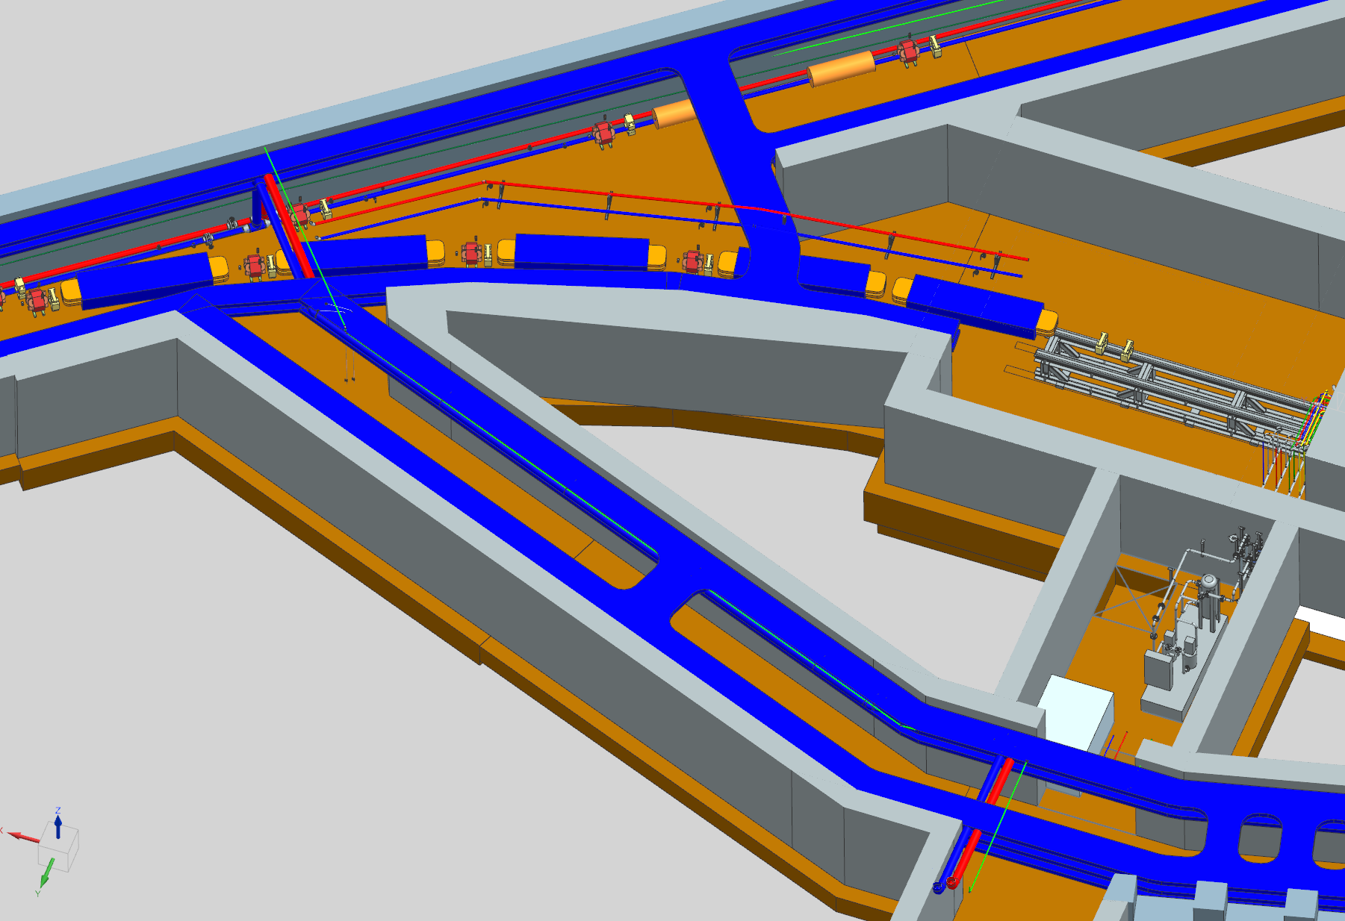
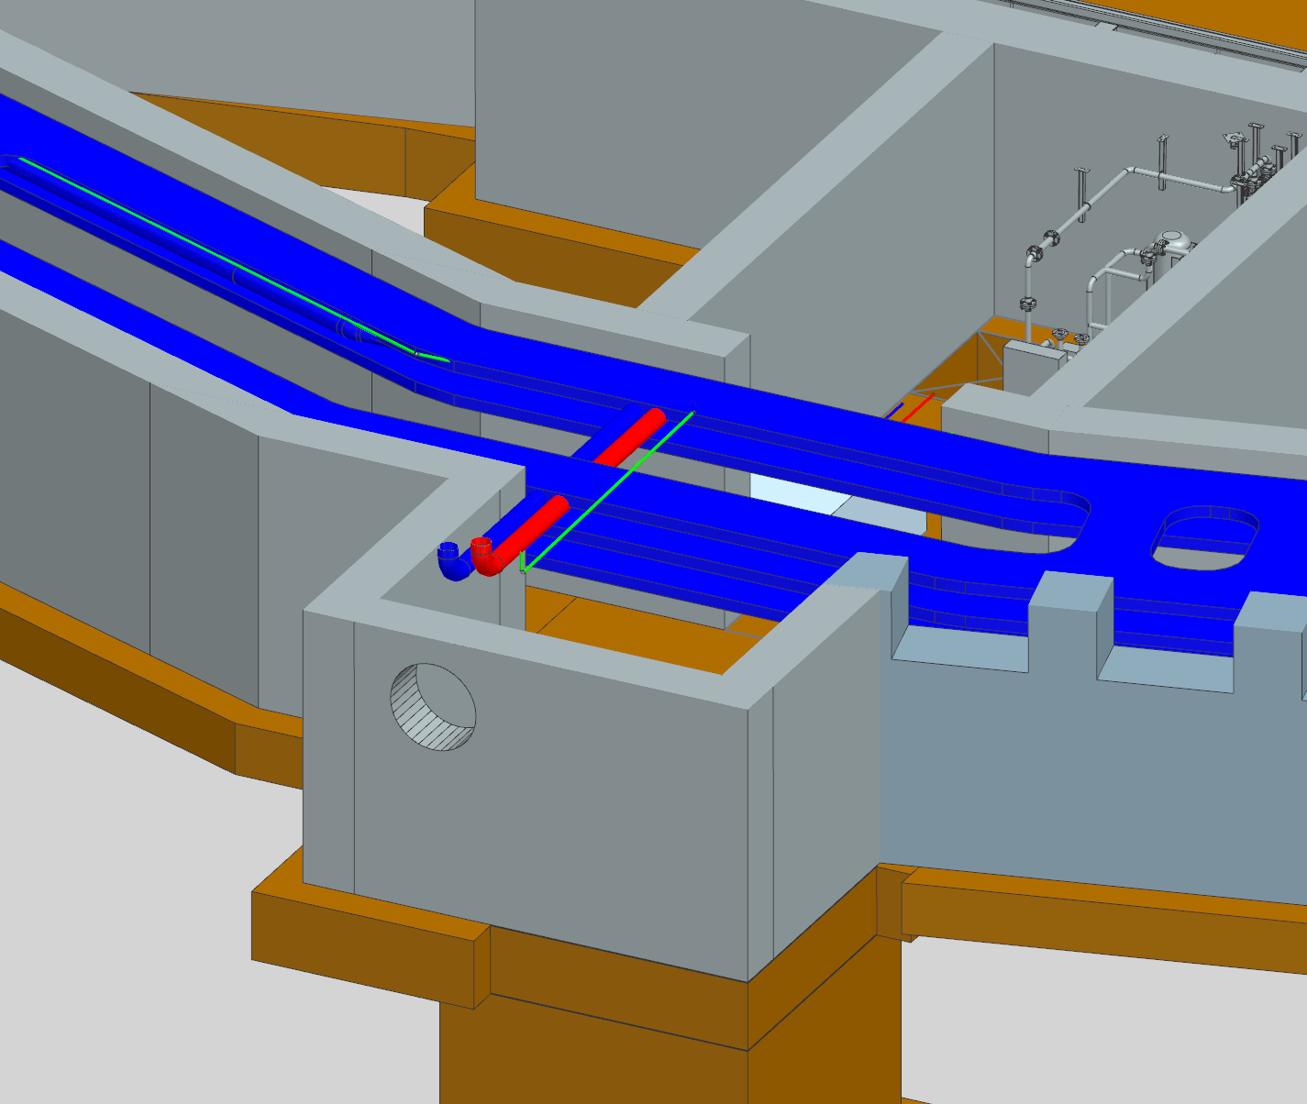
PIP-II Primary LCW System – BTL/F37 Labyrinth Intersection
LCW piping positioned low along the wall for equipment clearance
Interferences with cable tray at BTL/F37 Labyrinth cleared
Separate “custom” LCW manifold created for Absorber beamline
Above - Helicopter view looking south
Upper Right – BTL/F37 Labyrinth intersection
Lower Right – F37 Labyrinth near Absorber RAW Room

Slide 9
Compressed Air - Technical Requirements/System Highlights
PIP-II Building Infrastructure – Compressed Gas Systems TRS – TC# ED0012529
Actuation of accelerator beam valves for vacuum system in BTL
2 - 200 HP Rotary screw air compressors in UPB
Redundant operation Air compressor arrangement
Redundant operation desiccant air dryers and particulate filters
1500 Gallon reservoir tank
Water/oil separator
Electric operated automatic condensate drains
Requirement # | PARAMETER DESCRIPTION | VALUE
T- ED0012529-A002 | Design Pressure | 150 psig
T- ED0012529-A003 | Discharge Pressure | 100 psig
T- ED0012529-A004 | Total Discharge Flow | 1060 SCFM
T- ED0012529-A005 | Dewpoint | -40⁰C/F
T- ED0012529-A006 | Particulate Filtration | 0.1 micron with .01 ppmw oil allowance

Slide 10
Compressed Air – Flow Summary Sheet
Component | Quantity | Unit Consumption | Total Consumption
 | [#] | [SCFM] | [SCFM]
RFQ Couplers | 4 | 4 | 16
HWR Couplers | 8 | 1.67 | 13.4
SSR1 Couplers | 16 | 3.5 | 56
SSR2 Couplers | 35 | 6.17 | 216
LB650 Couplers | 36 | 6.17 | 222.1
HB650 Couplers | 36 | 7.03 | 253.2
Cryomodule JT Control Valves | 25 | 0.141 | 3.5
Cryomodule CD Control Valves | 25 | 0.066 | 1.7
Beam and Vacuum Valves | All | 0** | 0**
CDS
Tunnel Control Valves | All | - | 28.3
Distribution Box Control Valves | All | - | 1.4
Cryoplant
Coldbox Control Valves | All | - | 64.9
Warm Compressor System Control Valves | All | - | 14.8
Warm Header Control Valves | 2 | 0.2 | 0.4
Cryoplant ORS and GMP Control Valves | All | - | 11.8
Recovery Compressor Control Valves | All | - | 0.2
Liquid Helium Dewar Control Valve | 1 | 0.1 | 0.1
Total = |  |  | 903.8

Slide 11
Compressed Air – Key Concern Points
Routing follows LCW piping
Usage in BTL footprint only
No taps to Absorber RAW room or F37 pump room
Valve taps located at beam valve locations (locations need confirmation)
Addition miscellaneous valve taps currently not planned (confirmation needed)

Slide 12
Utility Nitrogen – Technical Requirements/System Highlights
PIP-II Building Infrastructure – Compressed Gas Systems TRS – TC# ED0012529
Source is boiloff from Nitrogen Dewar located near Cryo Plant Building
Routing follows LCW piping in BTL
Usage in Absorber RAW room and F37 pump room only
Requirement # | PARAMETER DESCRIPTION | VALUE
T- ED0012529-A008 | Design Pressure | 150 PSIG
T- ED0012529-A009 | Discharge Pressure | 100 PSIG
T- ED0012529-A010 | Total Discharge Flow | 35.5 SCFM
Technical Requirements
System | Frequency | Pressure | Flow Rate
 |  | [PSIG] | [-] | [G/S]
LCW – oxygen removal | Continuous | 50 | 10 cfm | 5.43
LCW – vessel blanket flow | Continuous | 50 | 2 cfh | 0.02
Clean nitrogen for portable cleanroom and vacuum use | Infrequent | 100 | 2000 cf/day (10 cfm instantaneous) | 0.75
Cryoplant purifier charcoal bed regeneration | Infrequent | 50 |  | 10**
Total = |  |  |  | 16.2
Process Flow Summary

Slide 13
Utility Nitrogen – Key Concern Points
No usage in the BTL
No taps along entire BTL length, Welded stainless steel tubing only
ODH conducted by CDS to insure ODH 0 conditions

Slide 14
Absorber RAW – Technical Requirements/System Highlights
Radioactive Water (RAW) system
Cools the Beam Absorber located in the Beam Transfer Line (BTL)
Normal Fluid Service
Nitrogen gas used as tank blanket and to purge Hydrogen gas from system
Magnetically driven circulating pump, no leaky seals
Containment basin located under RAW skid, sized to contain entire RAW system volume
Requirement # | PARAMETER DESCRIPTION | VALUE
T- ED0015435-A049 | Design Pressure | 150 PSIG
T- ED0015435-A050 | Discharge Pressure | 100 PSIG
T- ED0015435-A051 | Suction Pressure | 15 PSIG
T- ED0015435-A052 | Supply Temperature | 100⁰F +/- 1⁰F
T- ED0015435-A053 | Delta T (ΔT) | 8.5⁰F
T- ED0015435-A054 | Total Heat Load @ΔT 23.5° F | 25 kW
T- ED0015435-A055 | Nominal Flow Required | 20 GPM
T- ED0015435-A057 | Side Stream Particulate Filtration | 5 micron
T- ED0015435-A057 | Resistivity | Not a requirement for PCW
Technical Requirements
Component | Quantity | Unit Consumption | Total Consumption
 | [#] | [GPM] | [GPM]
Absorber | 1 | 20 | 20
 |  | Total = | 20
Process Flow Summary

Slide 15
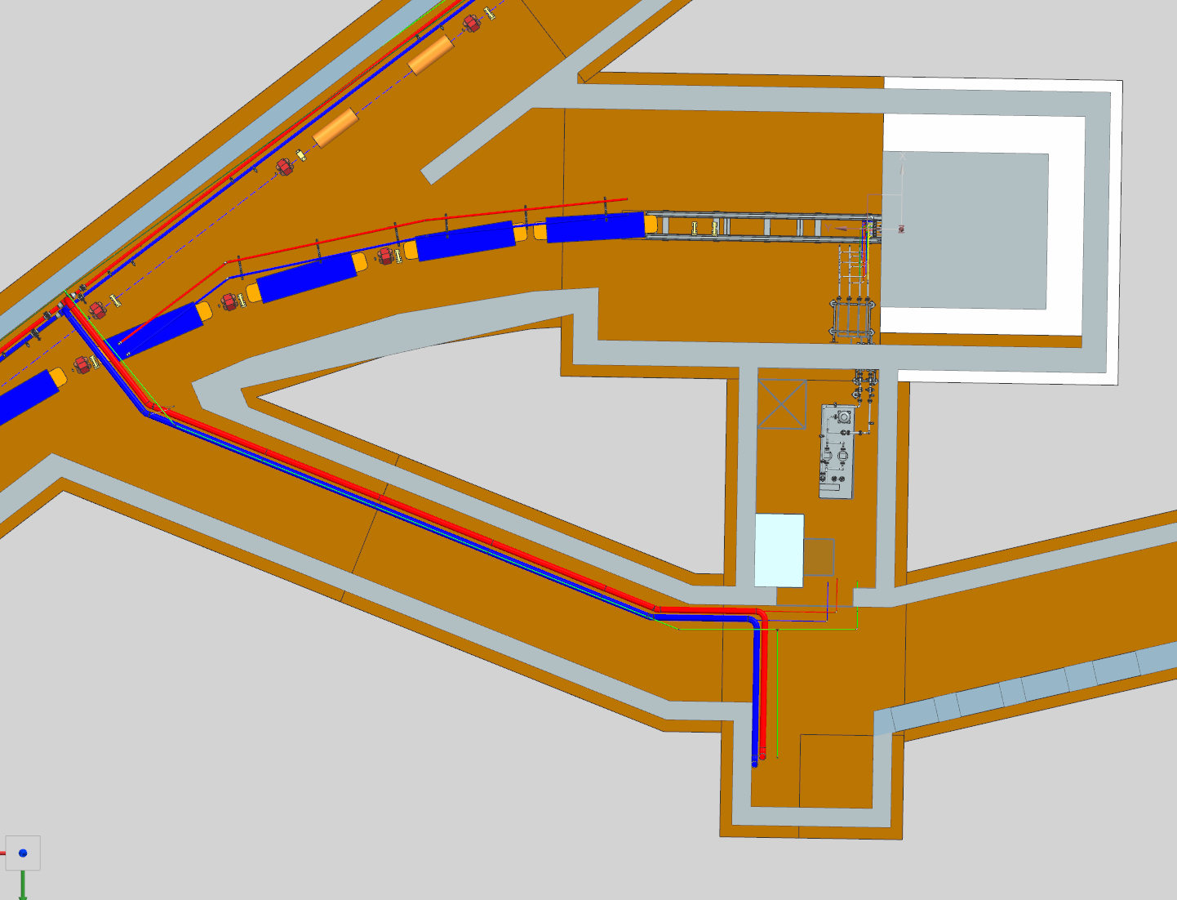
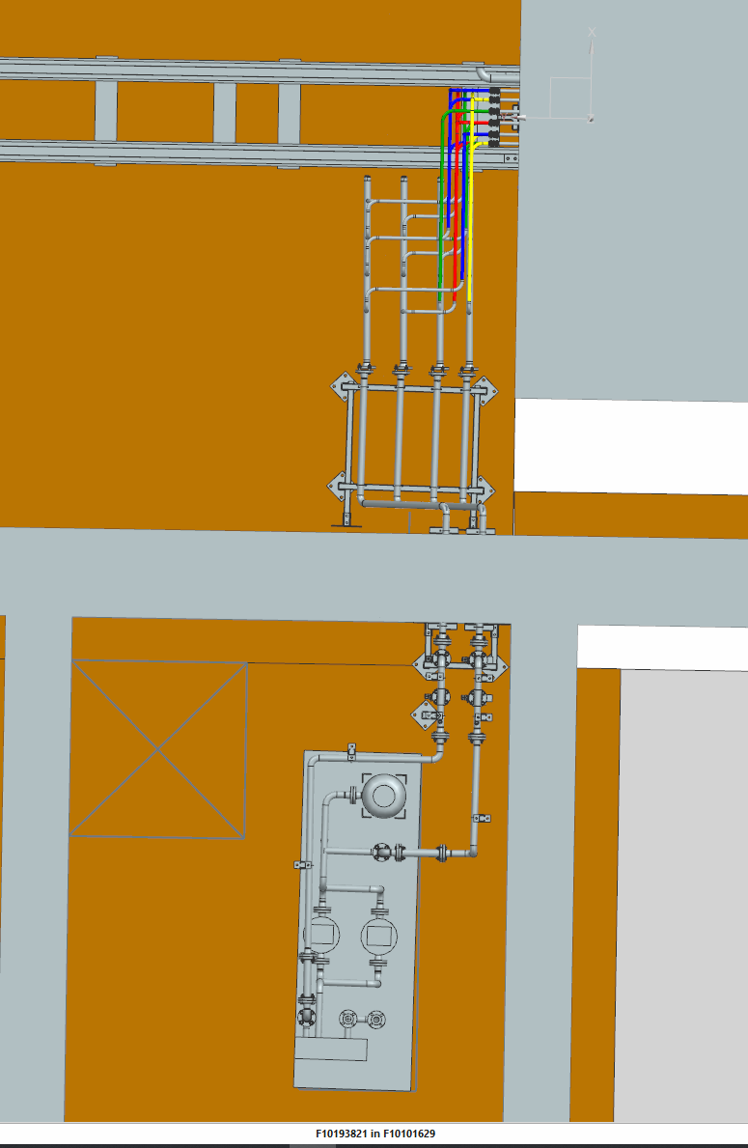
Absorber RAW – Key Concern Points
Interface between the Absorber and Absorber RAW piping
Absorber RAW Room Furniture arrangement, includes
Floor space for Absorber Air Cooling Skid
Wall space for power/controls boxes
Nitrogen gas supplied from Utility Nitrogen gas line piping installation from BTL
Ventilation for RAW Room
Design is complete
Installation not under BldgI scope
Plan view showing the BTL intersection with the F37 labyrinth and the Absorber beamline footprint
Plan view close up showing the Absorber RAW skid interface with the Absorber RAW piping configuration

Slide 16
BldgI Electrical- Scope
Design electrical, cable tray and grounding system
Installation performed by CF or BTLI
Relay Racks

Slide 17
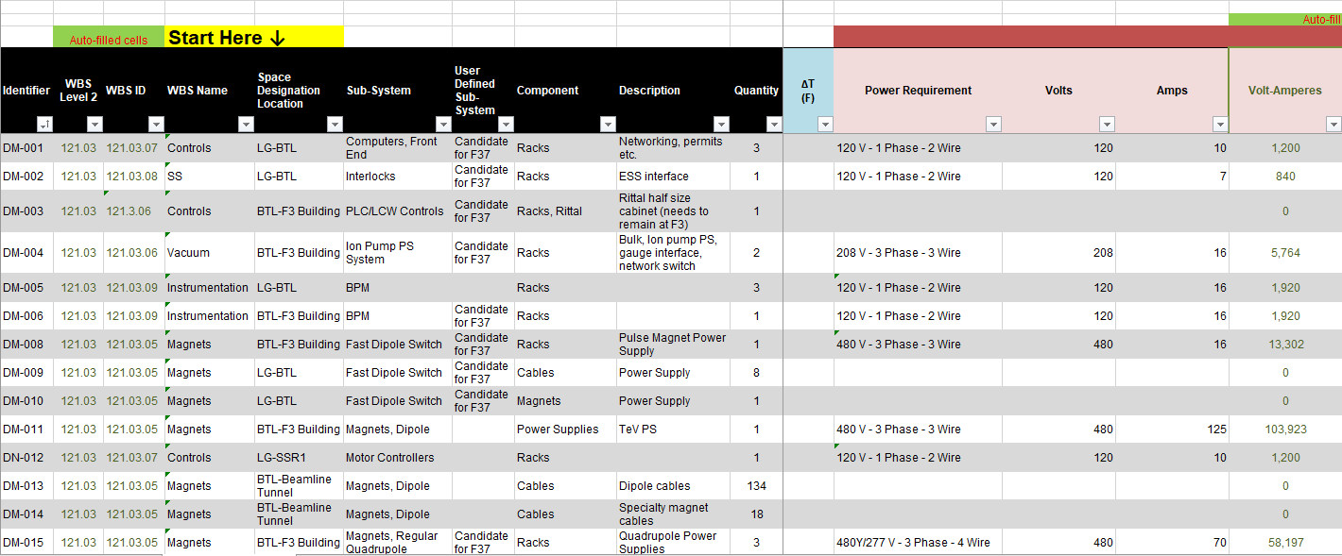
BldgI Electrical- Requirements/Drivers
RDS used for all requirements

Slide 18
Equipment Location
Rack equipment will be located as close as reasonably possible to tunnel loads
If equipment is located near the start of BTL, the gallery will be used for rack space
Instrumentation is given priority due to strict requirements
Systems that have strict maximum length requirements should make their needs known as soon as possible
F37 service building, penetrations, and cable tray are maxed out currently
RDS shows what equipment is located at F37, please review this information and make BldgI personnel aware if any issues exist

Slide 19
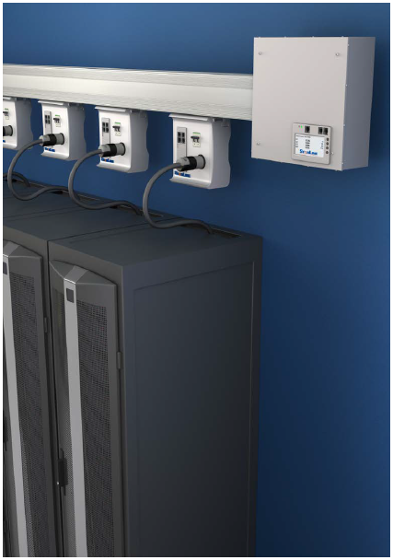
Electrical Systems
Electrical design based on LINAC gallery
Busway used extensively
PDUs integrated in racks
Plug and Cord design where feasible
Utility outlets provided throughout the tunnel
Every 50ft. at a minimum
Includes 4x 120V receptacles
Includes 1x 208Y receptacle
480V welding outlet every 100 ft.
Can be used for temporary distribution at the 208Y/120V level using distribution carts

Slide 20
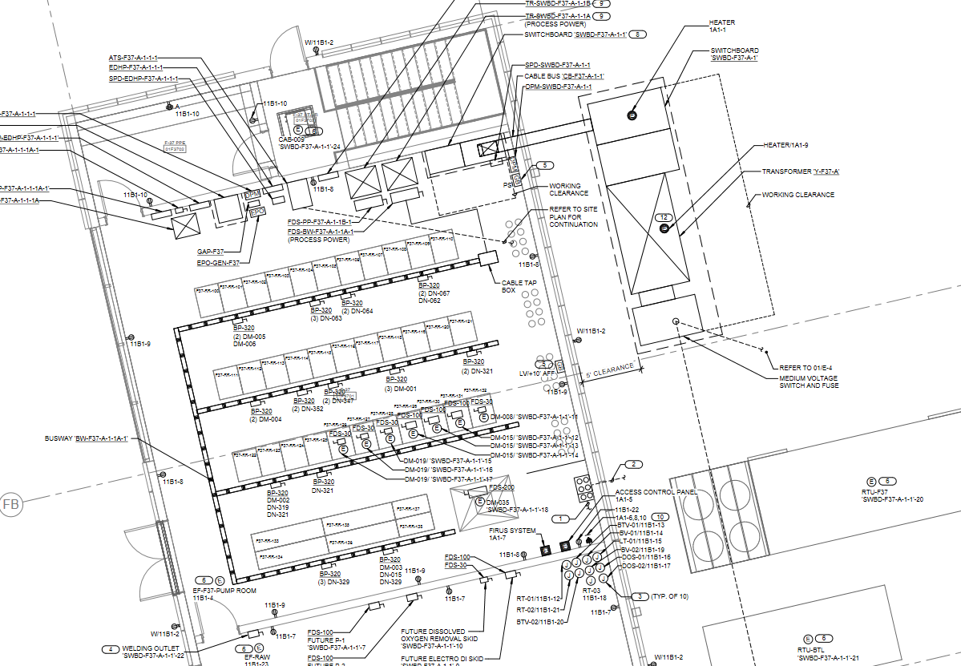
F37

Slide 21
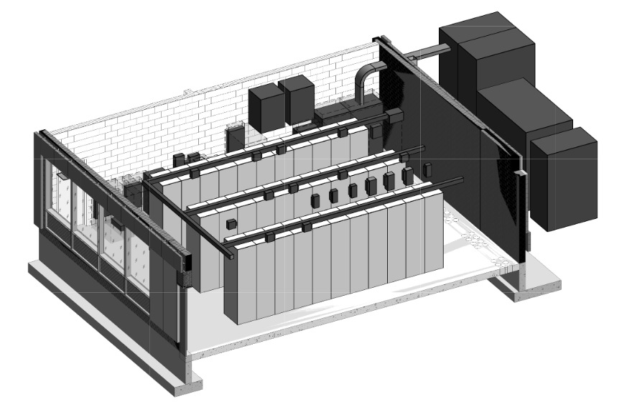
F37

Slide 22
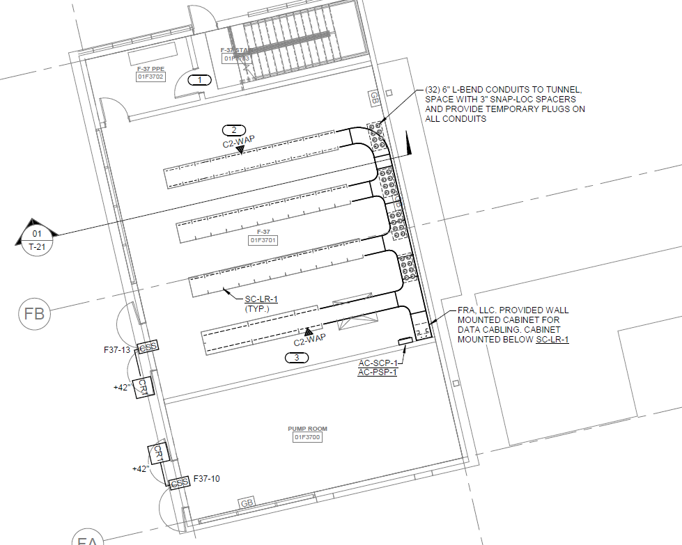
F37

Slide 23
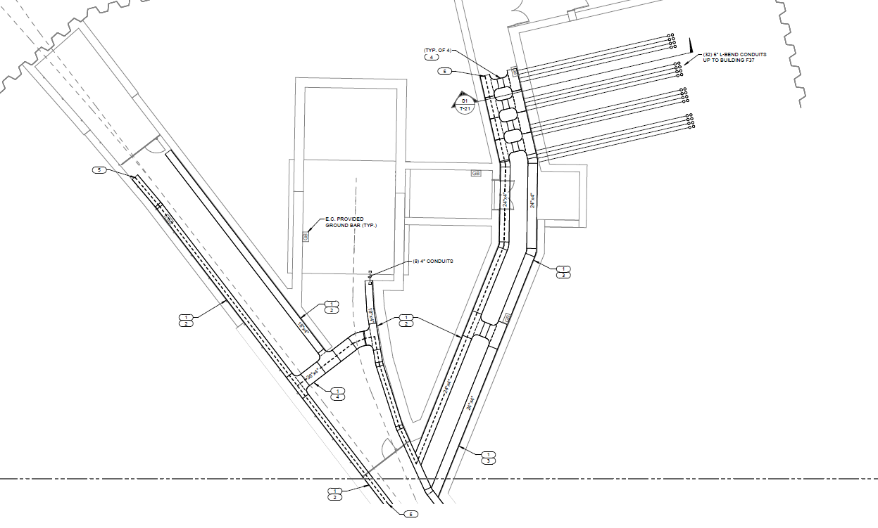
Cable Trays
Part of CF Scope
At AUP we are ready to pull cables
4 sets of 18” tray
2 on each side of the wall with crossovers
Crossovers are 36” wide tray with dividers
Crossovers will have a gap, so cable can be installed easily
F37 section as mentioned previously is “busy”

Slide 24
Grounding
Grounding design based on LINAC gallery
Ground bars located every 100 ft.
Each ground bar is tied directly to building ground
Ground trunk line runs with cable tray system
Tie-ins to trunk lines will occur during installation

Slide 25
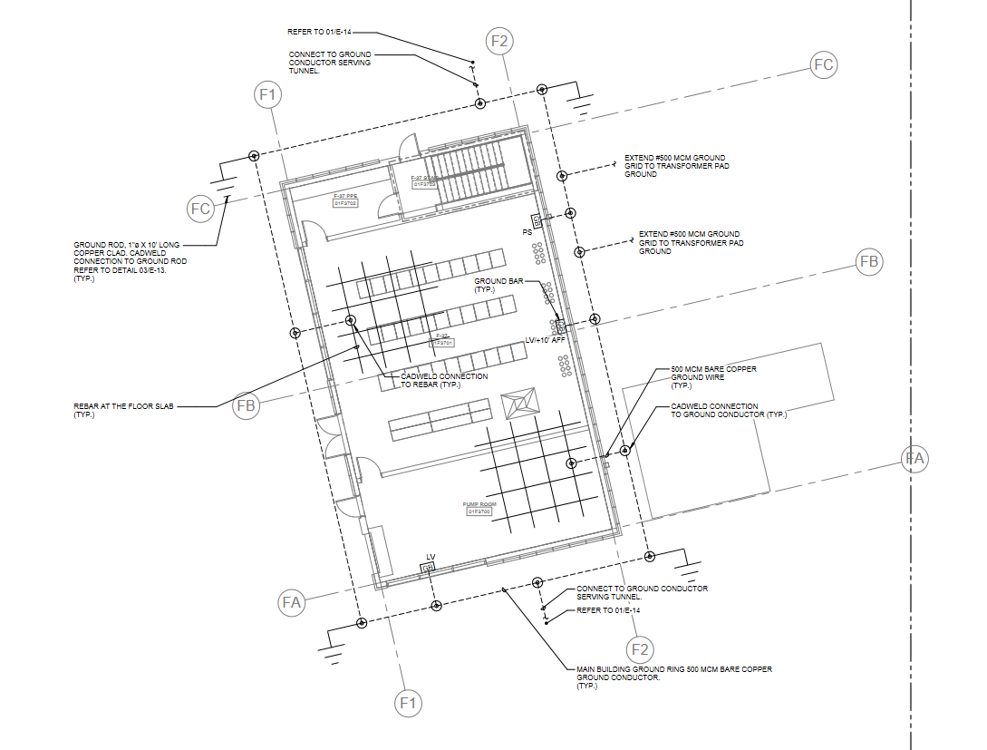
F37

Slide 26
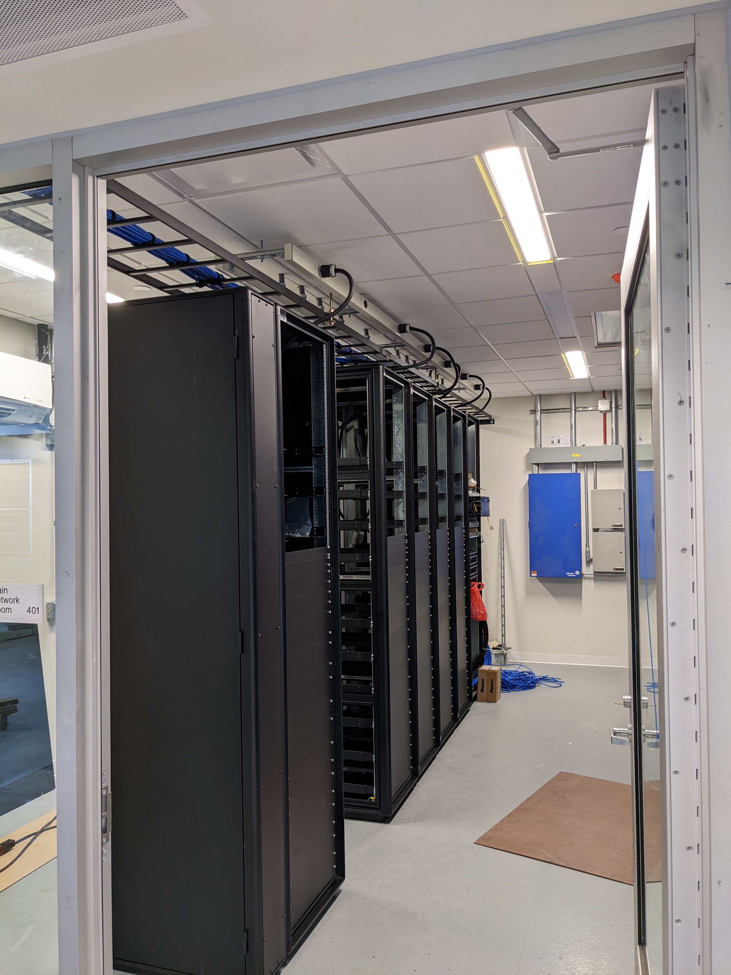
Relay Racks
Relay racks will be built according to the same specifications used for the gallery
Based on system
If special needs exist, please make BldgI aware as soon as possible

Slide 27
Questions/Comments

