Slide 1
PIP-II BTL Vacuum Systems
BTL Workshop
Raul Campos and Alex Chen
1 December 2022

Slide 2
Outline
Vacuum Systems Scope
Vacuum Systems Performance Requirements
Current BTL Vacuum Design Status
Vacuum System Interfaces
Summary and Path Forward

Slide 3
Vacuum Scope
Management, design, procurement, fabrication, and testing of all vacuum systems in all sections of the linac, transfer line, absorber line, and in PIP2IT including its transition to the cryomodule test stand.
Preliminary design BTL Deliverables (includes BAL, and Booster injection):
Material Requirements: | Beam Transfer Line | Beam Absorber Line
Ion Pump | 53 (45 l/s) | 11 (200 l/s)
Ion pump controller | 53 | 11
Connectors & 100m cable | 106 | 22
Ion gauge | 14 | 8
Pirani gauge | 7 | 4
Gauge controller | 4 | 3
Pirani gauge cables (50-200m) | 7 | 4
Ion gauge cables(50-200m) | 7 | 4
SS beam tube, 2" dia, | 250 | 40
Cutting, welding | 1 | -
SS beam tube, 6" dia | - | 5
2" Tee's | 53 | -
6" Tee | - | 11
2" Crosses | 7 | -
Hardware + adaptor w/ cover, clamp, bellows | - | -
Inline valve for isolation | 5 | -
Pumpout port w AMV | 7 | 3
Portable pumping cart | 2 | -
Titanium Windows | - | 2
Ion pumps are located at each quadrupole:
49 regular quads
+2 (large aperture)
+6 (end of line quads)
57 TOTAL
-4 (in Absorber line)
53 (in BTL)

Slide 4
Critical Requirements - Performance Requirements Physics Requirements Document is the basis; Team Center #ED0010228
 | Ion Source | LEBT | RFQ | MEBT | MEBT-DS | CMs* | Warm Units** | Trans. Section | BTL
Pressure (torr) | <10^{-2***} | <5x10⁻⁷ | <5x10⁻⁷ | <5x10⁻⁷ | <1x10⁻⁹ | <10⁻¹⁰ | <1x10⁻⁹ | <5x10⁻⁸ | <5x10⁻⁸
Leak check sensitivity (mbar-l/s) | 2x10⁻⁹ | 2x10⁻⁹ | 2x10⁻⁹ | 2x10⁻⁹ | 2x10⁻¹⁰ | 2x10⁻¹⁰ | 2x10⁻¹⁰ | 2x10⁻¹⁰ | 2x10⁻¹⁰
Vacuum seals joints | Metal gasket or elastomer, CF or KF |  |  |  | CF only: metal gasket only | CF only: metal gasket only |  | Weld or Metal gasket | Weld or Metal gasket
Parts cleaning | UHV procedure
Gauging | Ion gauge |  |  |  |  | CC gauge |  | Ion gauge
Low Particulate practice | No | No | No | No | Yes | Yes | Yes | Yes | No
Controllers | Equipped with RS485 to communicate with control system via a PLC
Metal gaskets for instrumentation or serviceable devices, or welded joints (between magnets, less risk of leak)
* Anticipated pressure value when CM is cold
**Warm units adjacent to CMs
***Operational pressure
Interface with Booster
Booster-style vacuum joins (O-rings)

Slide 5
Current Design Status
Final design of Vacuum subsystems in progress, PDR completed in Oct 2021
Developed P&ID for Vacuum system with pumps and gauges, with input from ED0010216 PIP-II Parameters PRD
Performed initial vacuum pressure calculations and defined pump capacity
Defined specifications for BTL magnets vacuum chambers
Developed vacuum physical interface between BTL and Booster injection

Slide 6
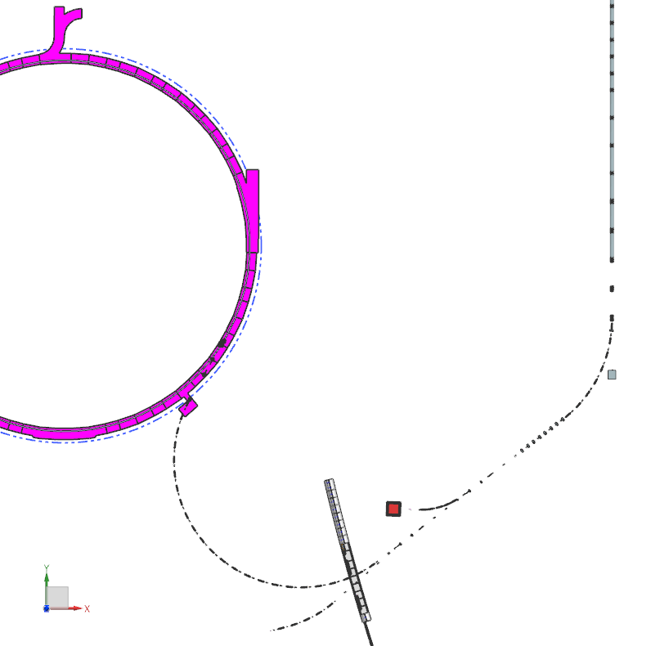
Vacuum Layout For Linac-BTL-BAL-Absorber-Booster
We understand basic configuration and segmentation based on ED0010216 PIP-II Parameters PRD and initial CAD model
Initial configuration and placement of gate valves and ion pumps has been defined roughly based on operation needs. Final locations need to be defined based on final lattice and CAD model
GV1
GV1: gate valve at down stream of fast close valve, as beginning of BTL
GV2: branch for straight ahead Dump(5kW)
GV3: branch for beam dump (50kW)
GV4: divides BTL into two vacuum segments for operation/maintenance
GV5: separate from Booster vacuum
GV2
Section1(GV1-GV4): 26 Ion pumps; 3 gauge/pump port
Section2(GV4-GV5: 27 ion pumps; 4 gauge/pump port
Section3(GV2-Dump): 2 Ion pumps; 1 gauge/pump port
Section4(GV3-Dump): 6 Ion pumps; 2 gauge/pump port
GV5
GV3
GV4

Slide 7
Ion Pump Capacity
Vacuum pumping uses typical ion pumps
Assuming 45 L/s Ion Pumps, distributed roughly 7m apart following quadrupoles
Assumed 2in beamtubes for typical sections. We need to update pumping and calculations where larger aperture is needed
Calculations based on 4 different outgassing assumptions
Blue line is the achieved pressure after a few weeks of pump down
Dash line assumes a loss of an ion pump – allows for reliable operation in case of failure
We will need to simulate non typical sections (i.e. near collimators) and verify initial assumptions to verify pump capacity selection
< 5E-8 Torr requirement

Slide 8
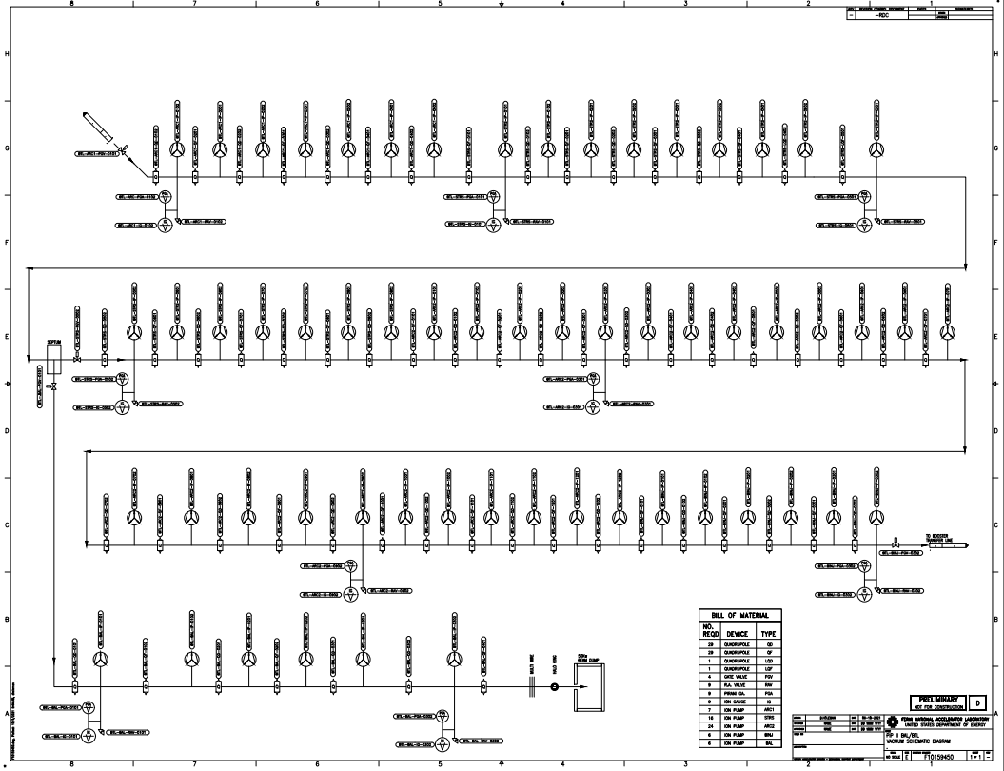
BTL/BAL P&ID
P&ID TC F10159450 developed with initial lattice, final P&ID will use latest lattice information
Valves are included in P&ID and need to be added to ED0010216 PIP-II Parameters PRD
We need to develop 3D model with detailed vacuum systems

Slide 9
BTL Vacuum Interfaces
BTL Vacuum Interfaces outlined in Vacuum ISD ED0016361. Interface details and reference drawings and documents need to be added to ISD for BTL interfaces
For other Vacuum subsystems, we have used Not-to-Exceed Envelopes and interface drawings to develop vacuum designs and CAD models
We need to work with interfacing systems to detail:
Vacuum spool sizes
Ion pump locations – until now we have followed quads locations to define spool size and ion pump locations
If there are locations of limited space, can ion pumps be installed on instrumentation vacuum chambers?

Slide 10
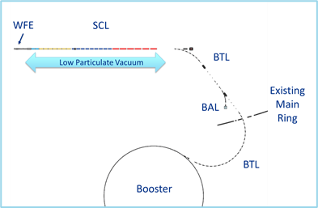
Transition from Linac to BTL
We have initial understanding of transition interface but need additional details on design and interface of systems such as
Downstream of CMs design and integration
RF Separators Interface
Conventional UHV
FAV
Low-particulate vacuum
field connections

Slide 11
BTL Magnets Interface
Charge #1b
Vacuum systems has worked with Magnets WBS to define magnets vacuum chambers materials and surface finish requirements
BTL magnets define beampipe size and shape
Working with Margents WBS as magnets designs advance, especially switcher magnets

Slide 12
Beam Instrumentation Interface
In general, we adapt the vacuum system spools to instrumentation physical interfaces (flange size)
In case there is space limitation, we need to work with instrumentation to see if ion pumps can be installed on wire scanners vacuum chambers

Slide 13
BTL Collimators Interface
We are working closely with Collimators team
Pump capacity and location to be verified based on vacuum calculations and proximity to collimators vacuum chamber

Slide 14
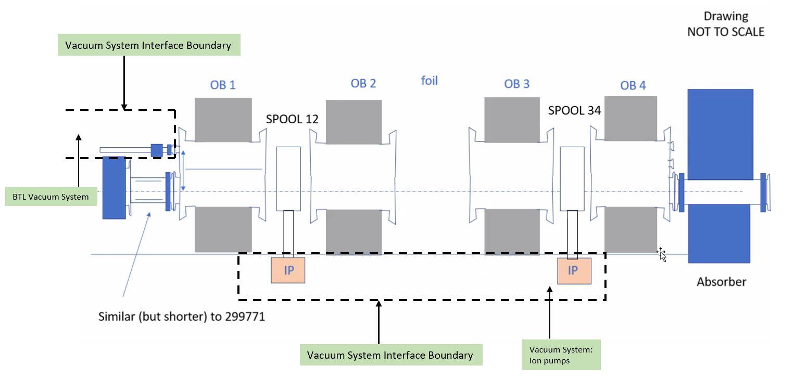
Booster Interface
Vacuum interfaces with Booster Injection:
BTL vacuum connection with Booster injection to use Booster-style flanges
Ion pumps capacity is 600 L/sec (same as Booster) and quantity is 2 or 3 (depending on outgassing)
We are working with booster injection team to verify outgassing increase due to increased temperature or beam loss
Vacuum interface with Booster:
Gate valve will separate BTL from Booster Vacuum

Slide 15
Beam Absorber Line
Beam Absorber line basic interfaces identified. Interface details need to be defined:
Vacuum windows
Who is designing the window
Physical interfaces
Operating conditions
Beampipe
Size requirement, 2in diameter or a different size

Slide 16
BTL/BAL Installation
We need location of devices and relative distances for final design of vacuum systems
NTE envelopes and interface drawings, Integrated CAD models
We are a stakeholder for the integration of the 3D model and NTE envelopes but need to understand who will lead the integration efforts
Design interfaces that we’ll need to work out:
Interfaces with structural supports for ion pumps and beamtubes
Vacuum Joints and Interconnections - Vacuum will define magnet vacuum chambers connections to beamtubes based on experience and review with stakeholders
Hand-off and deliverables requirements (to address installation issues)

Slide 17
Summary and Path Forward
Continue working with stakeholders to define interfaces with Vacuum
Verification of vacuum loads and pump capacity:
Booster ORBUMP magnets outgassing
BTL collimators vacuum calculations based on pump distances
BTL magnets vacuum chambers QC
Develop 3D CAD model of vacuum systems integrated with the Full CAD model
Need CAD model designs of all devices and their position on beamline. Preliminary designs from interfacing systems will help vacuum get started with CAD model
Need interface drawings/NTE envelopes for final design of vacuum systems

