Slide 1
Beam Instrumentation for the PIP-II Beam Transfer Line
Vic Scarpine
PIP-II Beam Transfer Line Workshop
Nov. 30, 2022 – Dec. 1, 2022

Slide 2
Beam Instrumentation for the BTL
Beam Current
ACCT, (DCCT and RWCM end of linac)
Is there an input to MPS?
Beam Losses
One ion chamber per quad magnet
Ion chambers for collimators
Beam Position and Phase
BPM measure position and phase
No phase reference line planned for these BPMs
Beam Profiles
Wire scanners in BTL for transverse profile
Longitudinal bunch shape monitor
Laser transverse emittance monitor
Requirements:
PRD
BI FRS
Instrument TRSs

Slide 3
BTL Questions and Issues
Are all required beam instruments identified?
Are quantity of instruments correct and final?
Are instrumentation locations correct and final?
Where does bunch length monitor go? Only at end of linac.
Where is new buncher cavity? Maybe just downstream of the collimators?
Location of laser emittance monitor?
Who (BTL or linac) is responsible for low-power dump line at end of linac? - BTL
Who is doing BTL CAD model and will instruments fit?
Dakota working on mechanical designs of BPM and wire scanners
Curtis controls CAD model. BTL mechanical design starts next year. Vacuum questions to Raul.
Do BPMs mount to quads? Talk to Bruce and Denton. BI prefer mounting to quads
How long are cable runs to penetrations? Where do electronics go?
How much space doe BI get in new F37 building? Talk to Ryan Crawford about F37 about space.
How do we shield ACCT electronics? Especially near beam dump(s).
Talk to Ryan for cable lengths in BTL
Talk to Salah about possible Booster penetration from ACCT
Laserwire emittance monitor– work with Denton and Bruce
Where is the definitive document with all beamline devices? ED0011224
Are the pictograms updated to reflect this document? No
Answers in Red?

Slide 4
Proposed PIP-II BTL Beam Instruments from Oct 2019 Accel Physics Meeting
End of linac
Feschenko monitors reduced to one due to cost
Where does it go?

Slide 5
Are the BTL Instrumentation quantities correct?
Instrument | WFE | SC Linac | Linac end | BTL | Total
BCM – DCCT | 3 | 0 | 1 | 0 | 4
BCM – ACCT | 3 | 2 | 1 | 2 | 8
BCM – RWCM | 1 | 0 | 1 | 0 | 2
BPM - Warm | 11 | 14 | 6 | 58? | 89
BPM – Cold | 0 | 37 | 0 | 0 | 37
BProM – Laserwire | 1 | 11 | 0 | 1 | 13
BProM - Wire Scanner | 2 | 0 | 2 | 22 | 26
BProM - Emittance scanner – Allison | 6 | 0 | 0 | 0 | 6
BCM - Scrapers – paddles | 16 | 0 | 0 | 0 | 16
BCM - EID - non-ring | 14 | 0 | 0 | 0 | 14
BCM - EID - ring pickups | 4 | 0 | 0 | 0 | 4
BProM - Longitudinal – Feschenko | 0 | 0 | 1? | 1? | 1
BProM - Longitudinal – Laser | 1 | 0 | 0 | 0 | 1
BLM - ion | 0 | 64 | 8 | 68 | 140
BLM - PMT | 0 | 26 | 0 | 0 | 26
BLM - neutron | 4 | 20 | 0 | 0 | 24
Totals

Slide 6
Are the beam instrumentation locations correct? BTL Arc 1, Straight Section and Dump Pictogram
26 BPMs
11 Wire Scanners
1 ACCT
Are pictograms up-to-date with ED0011224
Where is buncher cavity?

Slide 7
BTL Arc 2 into Booster
25 BPMs
7 Wire Scanners
1 ACCT

Slide 8
End of Linac
End of linac under BTL scope
Who is designing this line?
What beam instrumentation goes here?

Slide 9
BTL Beam Position Monitors
Four button BPM design
2” diameter aperture
Need to add large aperture BPM to project plan
Same design as linac warm unit BPMs
Downstream BPM end will bolt to quad magnets
Upstream BPM end will be welded to beam pipe
51 BPMs total → 204 3/8” Heliax cables
Which cables go to F37?
Which penetrations?
Can cables go into Booster?
Top-of-rack space limited for cable connections
Long cables runs are a problem
800’ of cable is 12 db of loss
Dakota Krokosz

Slide 10
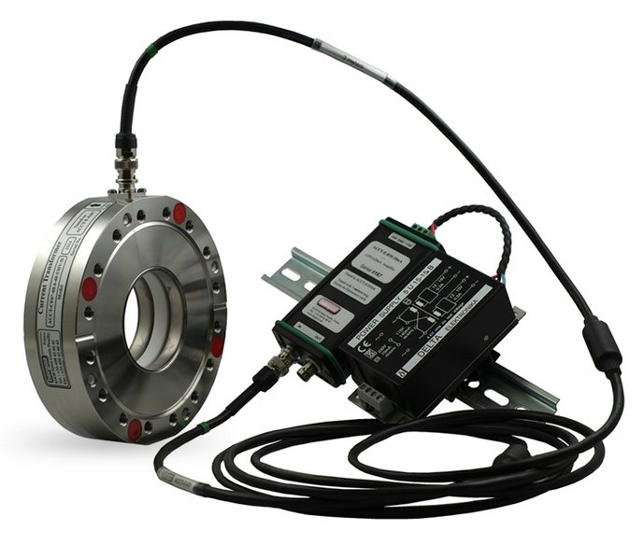
BTL Beam Current Monitors - ACCT Locations and Radiation
Electronics must be within 30m of ACCT
In front of BTL absorber
Place electronics in alcove near RAW room
Is there AC power?
At entrance to Booster
Where to place electronics?
Are there any penetrations into Booster?
Are alcoves possible?

Slide 11
Wire Scanner Design for BLT
Single wire scanner version
Vertical and horizontal profiles
Vacuum port on bottom
Long cables are a problem
Can we put preamps in tunnel → radiation damage?
Can we measure halo? Do we need halo monitoring
Dakota Krokosz
Dual wire scanner version
Vertical and horizontal profiles
Two additional 45º profiles
How many dual wire scanners needed in BTL?
Dakota Krokosz

Slide 12
Beam Loss Monitors
One ion chamber per quad.
No PMT or neutron detectors
~8 ion chambers near high-power dump
How many ion chambers needed around collimators?
Any other locations?
Long cable runs are okay
Two RG58 cables per ion chamber
Some extra cables pulled for new locations
Where to bring signals? F37? Linac gallery?

Slide 13
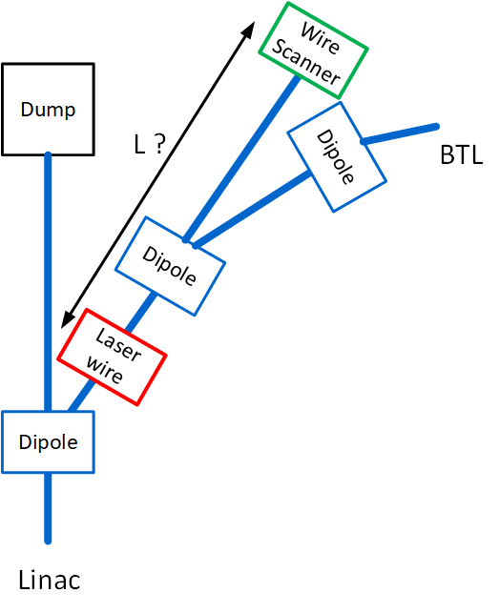
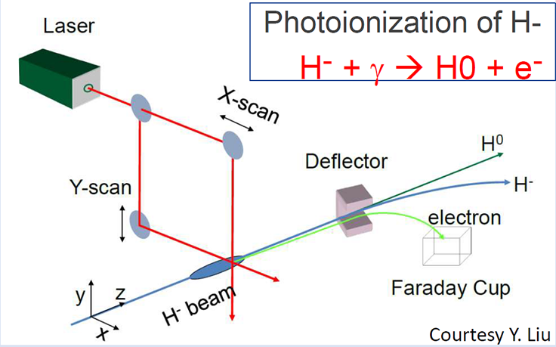
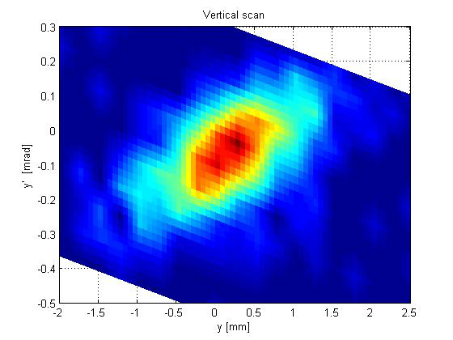
Laserwire Transverse Emittance Monitor
H0
H-
SNS Emittance Measurement
Place laserwire in BTL
Removes linac background H0
Place H0 detector after dipole
Need straight beam path through dipole

Slide 14
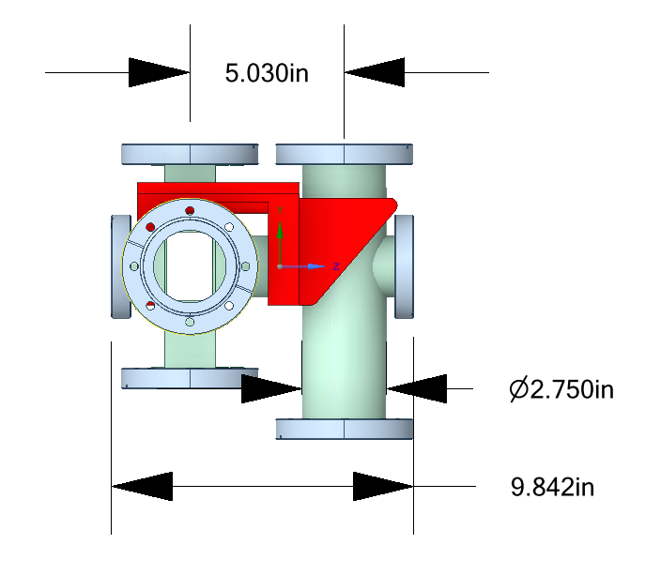
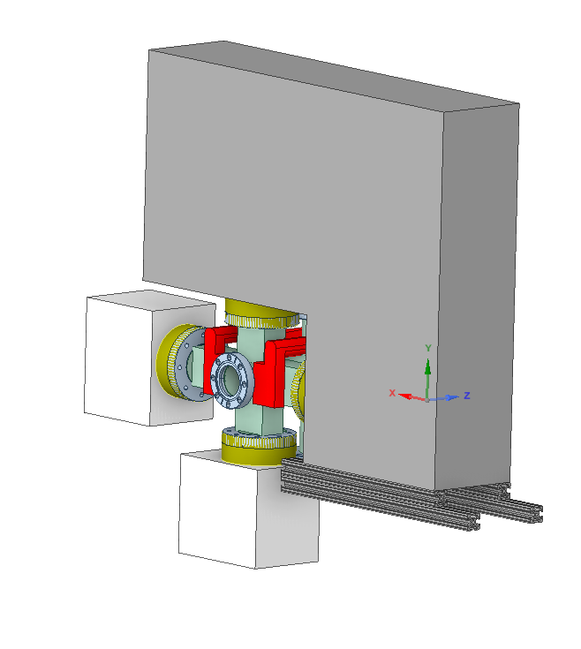
Preliminary Vacuum Chamber and Optics Box Design
Very tight fit!
Electron Port
Laser Ports
H-
With optics boxes
Collection Magnet
Laser Ports
Vacuum Port

Slide 15
Laserwire Emittance Monitor location
Where to place laserwire emittance monitor?
Laserwire after first BTL dipole in Arc 1, cell 1
Is space available?
Laserwire needs 250 mm
Second dipole would have straight path similar to first dipole
H0 detector after second dipole
Is there enough space for H0 detector?
Laserwire
H0 detector

Slide 16
Summary
2” BPM and wire scanner designs in progress
Beam instrumentation quantities and locations being finalized
Cable routing still needs to be determined
Radiation damage to electronics is a concern
Finding safe locations for ACCT
Building rad-hard preamps for wire scanners
Working with BTL team to determine if laserwire emittance monitor will fit after cell 1 dipole

