Slide 1
Booster DCCT (BDCCT) Overview

Slide 2
General Project Timeline
 | July | Aug | Sept | Oct | Nov | Dec | Jan | Feb | Mar | Apr | May | June
FW/SW Development (Complete data path from NPCT -> electronics->server-> ACNET)
Enter REQ for Rev3
Assembly Rev3 (May slide due to supply chain issues)
Install Rev3 (May slide due to supply chain issues)
Initial Commissioning (Combination of beam and no-beam studies to compare with B:CHG0)
Switch to Operations (Beam Studies on $10/$17)
Rev3 (Final) of the DCCT digitizing electronics (~$4k)
AWS
Miscellaneous connectors/cables/panels for installation into booster gallery (~$2K)
Provide FTP and SNP for B:DCCT devices (4)
Present architecture / benchmark measurements / initial comparison to B:CHG0 / current issues to PIP2 L3&4M and Booster Group
Start operational switch from B:CHG0 to B:DCCT, initially during dedicated study times
Start teting Console App

Slide 3
Bergoz NPCT-CF6"-96.0-120-UHV-VHR-316LN-H
Internal Design Review in January 2021
https://indico.fnal.gov/event/47392/
Installed in Long10 during February 2022
NPCT is meant to provide an average beam current.
Operations does not need turn-by-turn
NPCT core material will be able to handle expected peak currents.
NPCT can achieve 0.1% resolution after ~25 turns into order to track 1-2% changes.
At injection (2mA , 2.5e10 ), expect 2-3% error.

Slide 4
System Block Diagram
Dashed lines are optional and not yet implemented.
BSYNC
Extraction Sync (BES)
Booster LLRF Fanout
TCLK
Turn Marker
MFTU-016
Injection Sync
TTL
TTL
TTL
BPM Beam Valid
+/- 800mA
+/- 10V / 2A
NPCT Sensor
NPCT Electronics
PYNQ
REDIS
1000 samples
(ts=20us) @ 15Hz
Engineering/ Diagnostics Application
( Jupiter Notebook on SME’s laptop)
Web Portal
Instrumentation Server
ACNET
Controls Network
Client/ Console App

Slide 5
Primary Readouts
3 main ACNET devices that are plottable, in a correlated manner with other existing ACENT devices
Normalized Intensity Thru Cycle (E12), comparable to B:CHG0 & B:IRMCHG
Un-Normalized Current (mA) Thru Cycle
Calculated Booster Freq Curve (MHz), comparable to B:VXFREQ
Operationally Critical Device
Verification / Diagnostic Devices

Slide 6
Secondary Readouts
Current B:CHG0 System is fanout to multiple front-ends.
The sample & hold, time-averaging, efficiency/BEL calculations and BBM interface will all be handled within Instrumentation server.
In FY23, any interfacing systems requiring an analog signal will still rely on B:CHG0
An application accessible through the index page will be available to adjust parameters affecting these readouts

Slide 7
More devices calculated from IRMCHG
The ones at the top of the attached screenshot, the charge per hour, fall out of the loss monitor local application, handled as a special case (for the charge signal).
The ones at the bottom of the page are the devices we touched on for loss per pulse.
IRMCHG at 15 Hz on event $0C ($OC is all booster resets, including $11 and $12). The sample rate is 12.5 kHz. The initial value is at $0C + 26 samples, or 2.08 ms. The final value is at $OC + 443 samples, or 35.44 ms.

Slide 8
CHG0 Fanout Users Requiring Analog Signals
Still supplied by old CHG0 in the near term
 | User | Destination | Notes | Necessary @ that location
1 | B:CHG0 | MCR Booster $B0 MADC7 CH0 |  | No
2 | MCR CNS 2 | MCR Patch Panel |  | Yes
3 | MCR RR4 | MCR Patch Panel | CHG0 Scope display | Yes
4 | IRM BLML3 | BGW G02-RR1-3 | IRMCHG, BEFFxx, CHGBxx, HRSUM, + | Yes
5 | BRFICW | BGW RCC IRM | CHGBBM via S&H | Yes
6 | CHG1 & CHG2 | MCR Booster $B0 MADC7 CH1&2 | Via S&H | No (needs S&H though)
7 | CHGA & CHGB | MCR Booster $B0 N14 C185 | Via NIM modules to C185 | No (needs NIM & Camac modules though)
8 | IPM’s + Fast LM system | BTW local fanout | Cabling to BTW from MCR currently. | Yes
9 | BLLRFO | BLLRF room | Power Loss BPL5MA, BPL1HA, BELOST | Yes

Slide 9
Mechanical Specifications from IDR
 | Requirement | NPCT-CF6"-96.0-120-UHV-VHR-316LN-H
Beam pipe outer diameter | 3.25” | 4” (ID: 3.78”)
Flange-to-Flange physical length | <1m | 6.38” (DN100 NW100CF Mating Flange)
Vacuum | < 1e-7 Torr | UHV compatible to 7.6e-10 torr (1e-9mbar) Bergoz provides vacuum certificate, showing leak rate with He
Other |  | AISI 316LN steel for better rust prevention Radiation-resistant sensor 200ft cable with PP polypropylene dielectric; pre-terminated with DB15 connectors
Notes:
Toroid cores of the parametric transformer are made out of high permeability amorphous alloy thin ribbons. Bergoz developed a special manufacturing process to improve the magnetic characteristic stability of the parametric current transformer cores. In addition, these cores require a very careful packaging and a sophisticated annealing treatment, both thermal and magnetic, using a longitudinal field and a transverse field. A multilayer magnetic shield using amorphous alloys provides a good shielding factor from external magnetic fields.

Slide 10
Electrical Specifications from IDR
NPCT is meant to provide an average beam current.
Operations does not need turn-by-turn
10kHz bandwidth (53turns PIP2 // 45turns BSTR)
Rise time = 35us, typically (10%-90%)
NPCT core material will be able to handle expected peak currents.
Sensor can handle >100mC
NPCT can achieve 0.1% resolution into order to track 1-2% changes.
RMS noise of output is constant, and noise density depended on output bandwidth
With higher currents, expect better SNR and need less time to reach desired resolution
At injection (2mA , 2.5e10 ), expect 2-3% error. However, as increase current to 8e12, achieves 0.1% resolution after 25 turns during PIP2
 | SPECIFICATION
Amplifier settling time | <50 us
Bandwidth | 10 kHz
Resolution (VHR) | < 0.5 $μ\text{A}/\sqrt{\text{Hz}}$
Linearity error | < 0.1 %
Output Accuracy | 0.1%
Temperature Drift | Sensor: 5µA/K Electronics: 0.05uA/K
Magnetic Sensitivity | 10uA/mT (axial) 1mA/mT (radial)
Sensor Saturation Flux | 10mT (axial) 2mT (radial)
Notes:
Per discussion with Bergoz
( Tom Delaviere delaviere@bergoz.com
Hervé Bayle bayle@bergoz.com )

Slide 11
Booster Beam Parameters

Slide 12
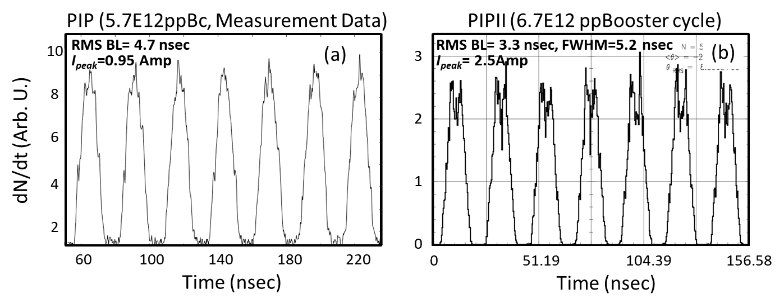
Booster Operations
In the current mode of Booster operation, PIP, the 400 MeV Linac beam with synchronized notches is injected up to about 17 turns with almost no RF voltage turned on. The beam is then adiabatically captured in about 250 us. By the end of the capture of this multi-turn beam, a notch of about 3 Booster RF buckets is created. Booster is then left with an almost equally populated 81 bunches. Figure 1(a) depicts the measured bunch pattern for seven bunches at the end of capture for 5.7e12 protons.
During the PIPII era, the injected beam will not be adiabatic capture. Instead, the beam will be injected either on-energy or off-energy inside pre-opened Booster RF buckets with a peak voltage of ~0.2 MV and 81 consecutive bunches. Three buckets are left unfilled to form a notch. Each bunch profile will have a local minimum at the center of the bunch in its distribution. Its purpose is to minimize the longitudinal space charge effects at injection. Therefore, the expected bunch structure will be quite different from PIP operations. Figure 1(b) shows the predicted bunch pattern at the end of injection during the PIPII era.

