Slide 1
Bergoz NPCT Hardware Update
Evan Milton
An Overview of the ‘Bergoz Buddy’
11/8/2022

Slide 2
Hardware Status
REVA2 currently installed at the Booster NPCT and in test stand.
Unit shares rack space with the Bergoz NPCT.
REVA3 is in production, entering testing phase.
Presently networked to a local computer.

Slide 3
Hardware Capabilities
Typical Readout
System Noise Floor
20Ksps standard sample rate, 100Ksps raw data rate.
Full system SNR of 60dB during beamline operation.
Resolves below 1 e9
15Hz/20Hz cycle capable
Note- LLRF in signal, present from
normalizing ambient noise.

Slide 4
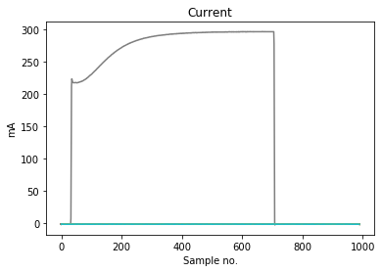
Big Change - Digital normalization
Booster LLRF Sweep
LLRF is measured by FPGA
e12 conversion is done by FPGA
i*dt = q -> q/e = e12
Higher repeatability than analog circuitry.
LLRF frequency sweep will be available in ACNET.
Current (mA) readout will be available in ACNET.
Allows for verification at console.
Raw current (mA) readout

Slide 5
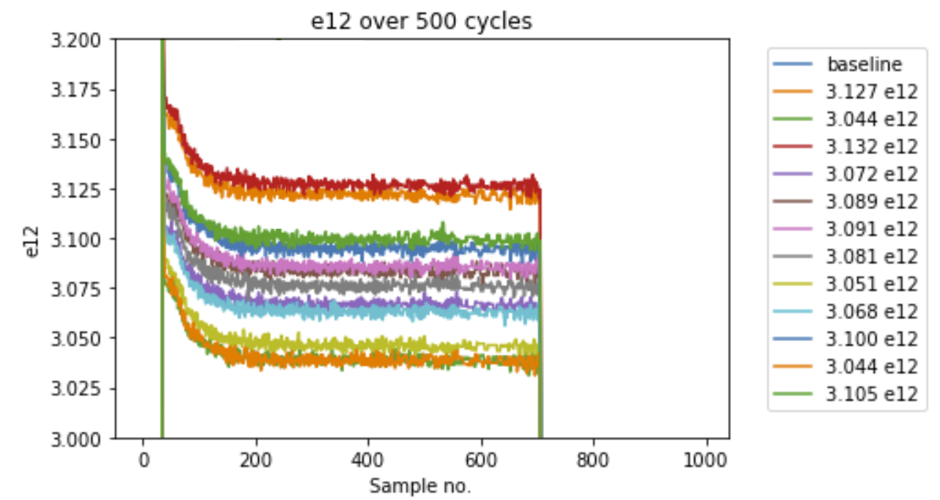
General Performance
Salah Sneezed Oct 25, 2022 11:43:56 am
System functions as expected
Calibration against current sources/ reference values return correct results.
Calibrates reliably over time~ Evan has been monitoring since startup, generally <0.1% change week-to-week.
System signal integrity in Booster on par with observations on scope/ at bench.

Slide 6
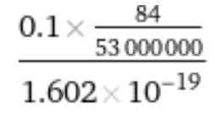
Technical Discussion
What operational metric we can use to compare results against?
BDCCT vs. …?
Notching (81 or 84 bunches) changes normalization readout by 3%.
Should notching impact intensity measurement?
Priority of this issue?
There is a persistent wiggle towards the end of the cycle. This was not present during testing.
Operationally, is there something that happens at this point in the cycle?
Priority of this issue?

