Slide 1
BDCCT Software Update
Presenter Name [16pt Regular]
Meeting Title
Day Month Year

Slide 2
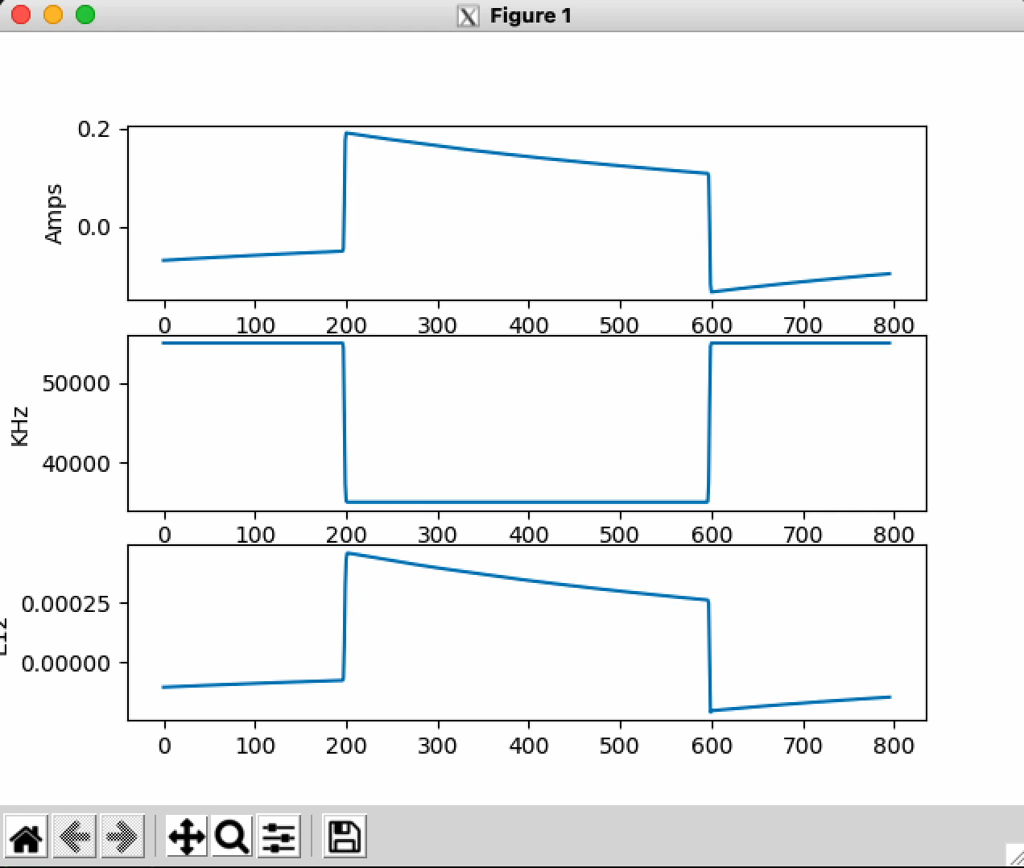
Proof of Concept: Board -> Redis -> Python client

Slide 3
Software Status Update
Z:BDCCT is the current test device (E12), and will be the first reading completed
  Frequency & Amps will be re-use same code and will come much quicker
Fast Time Plots
  Working on using similar data path for fast time plots in ACNet
  Board -> redis -> ACSys FE driver -> ACNet Fast Time Plot
  Documentation on ACNet FTP drivers in C++ leaves a bit to be desired
  Currently at 1000+ lines of code including tests
Snapshot Plots
  Based on conversations with Controls, support for Snapshot will be phased-out moving forward
  More conversations need to provide functionally equivalent plotting
    If main objective is to provide a correlated plot between multiple devices, FTP might be already sufficient for operators.

