Slide 1
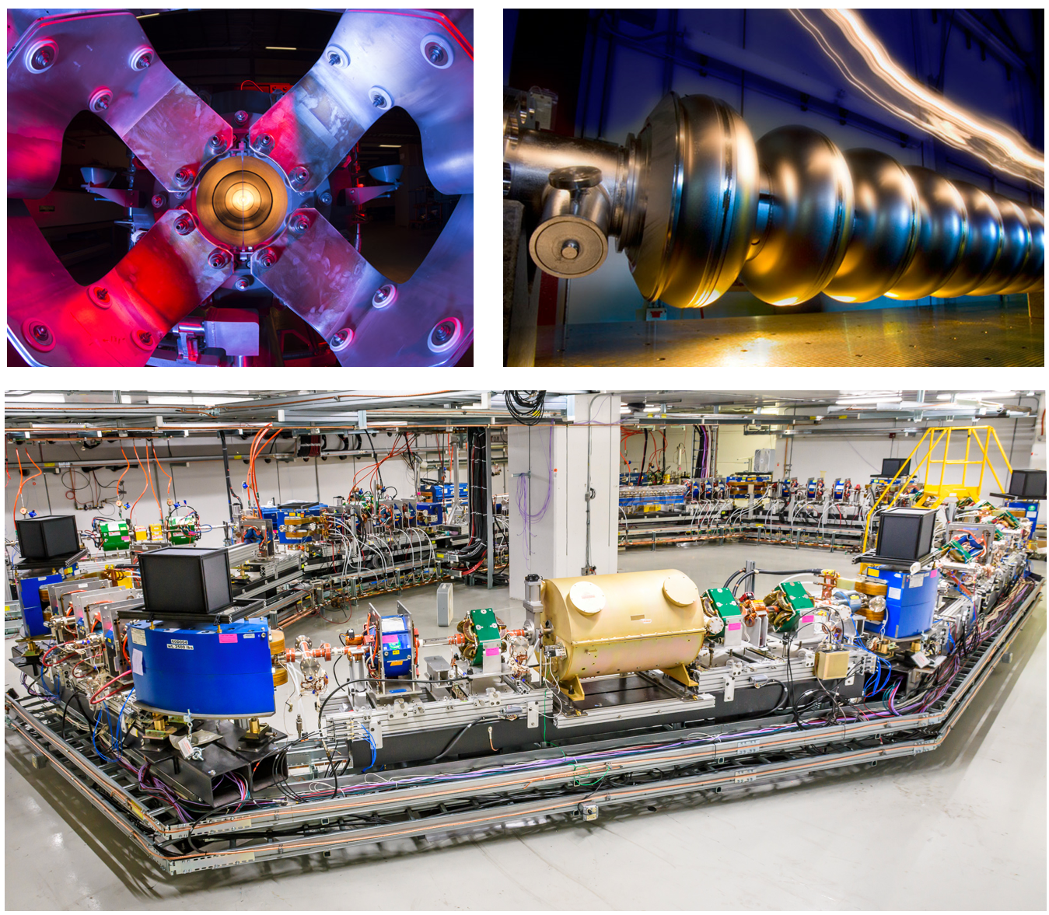
LTI: a unique experience in Accelerator Science and Technology
The Lee Teng Internship is a prestigious 10-week joint program by Fermilab and Argonne National Lab
2-week course in accelerator fundamentals at the US Particle Accelerator School with academic credit
8-week project in accelerator science and technology with a dedicated mentor at either Fermilab or Argonne
Joint tours of facilities at Fermilab, Argonne and University of Chicago
Mentorship on building graduate-school applications

Slide 2

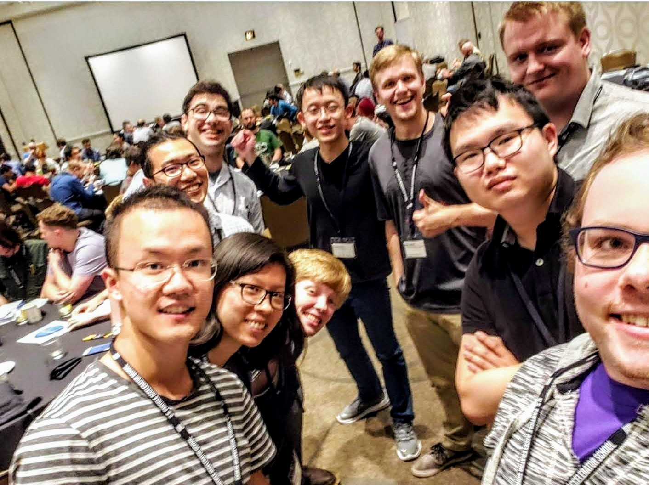
LTI: a unique experience in Accelerator Science and Technology
“Being able to work at Argonne National Lab introduced me to the idea of working at national labs, which is now my goal. Participating in USPAS was also a great experience as it gave me an option for research in graduate school that I pursued… Now I get to work at the Argonne Wakefield Accelerator facility as a graduate student performing research for structure-based wakefield acceleration.” - Cassandra Phillips: LTI’19
LTI is open to students enrolled in a US university
Application site should go live in November ’22
More details available here:
  https://internships.fnal.gov/lee-teng-undergraduate-internship/
  https://www.anl.gov/aai/lee-teng-internship
Join us for LTI in Summer of ‘23!
LTI’19 interns at USPAS

