Slide 1
MINIWORKSHOP
UNICAMP
14/11/2022

Slide 3
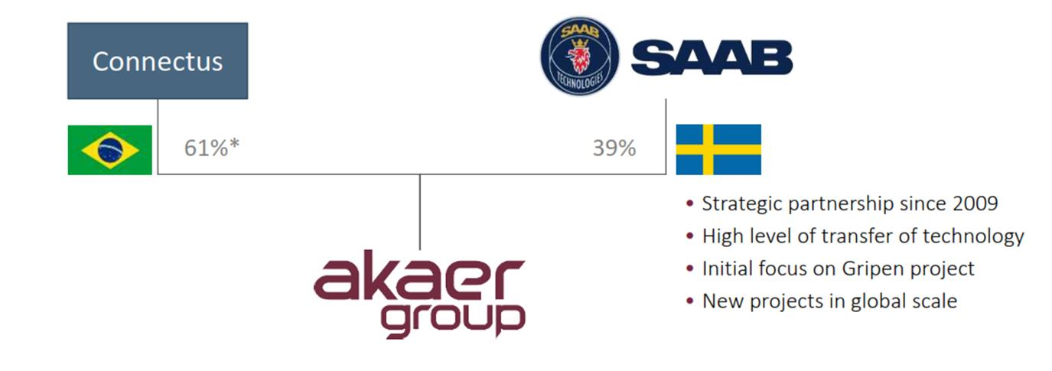
GRUPO AKAER
57,79%
42,21%

Slide 4
FIELDS
SPACE SYSTEMS:
SENSOR SYSTEMS:
ENERGY SYSTEMS:
SCIENTIFIC ENGINEERING:
AUTOMATIC TARGET RECOGNITION:

Slide 5
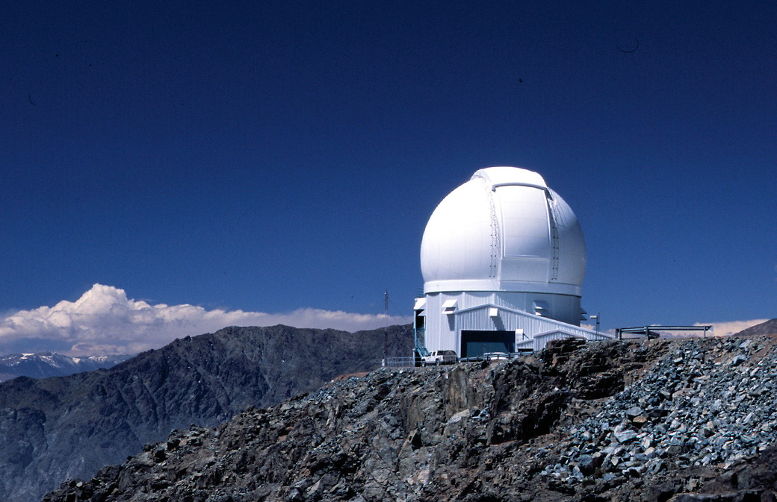
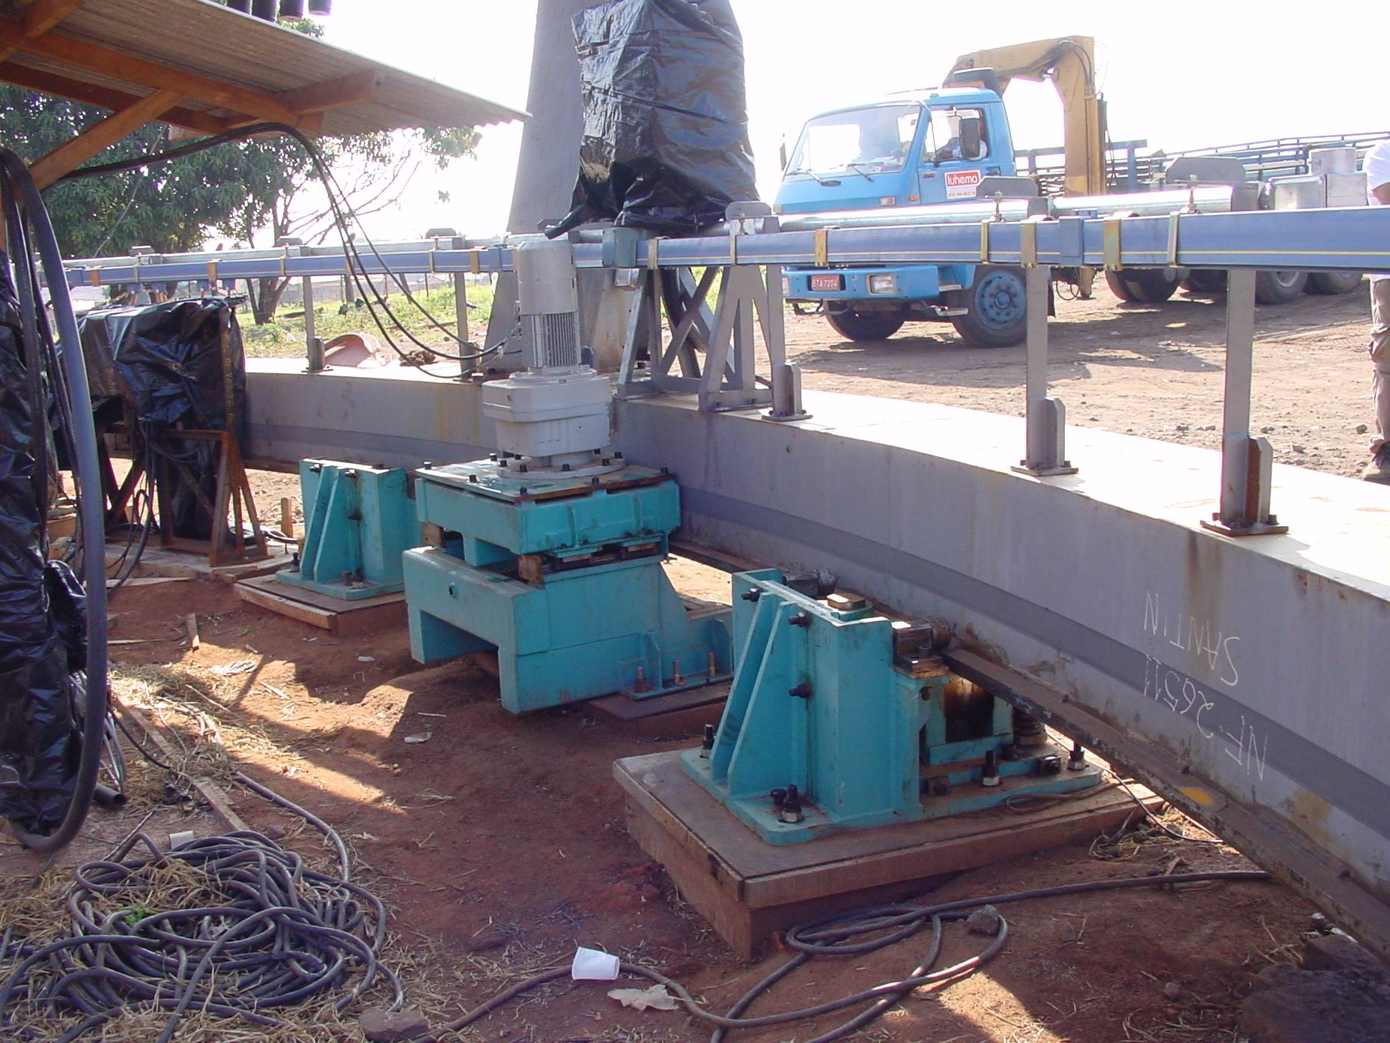
SOAR TELESCOPE (CHILE)

Slide 6
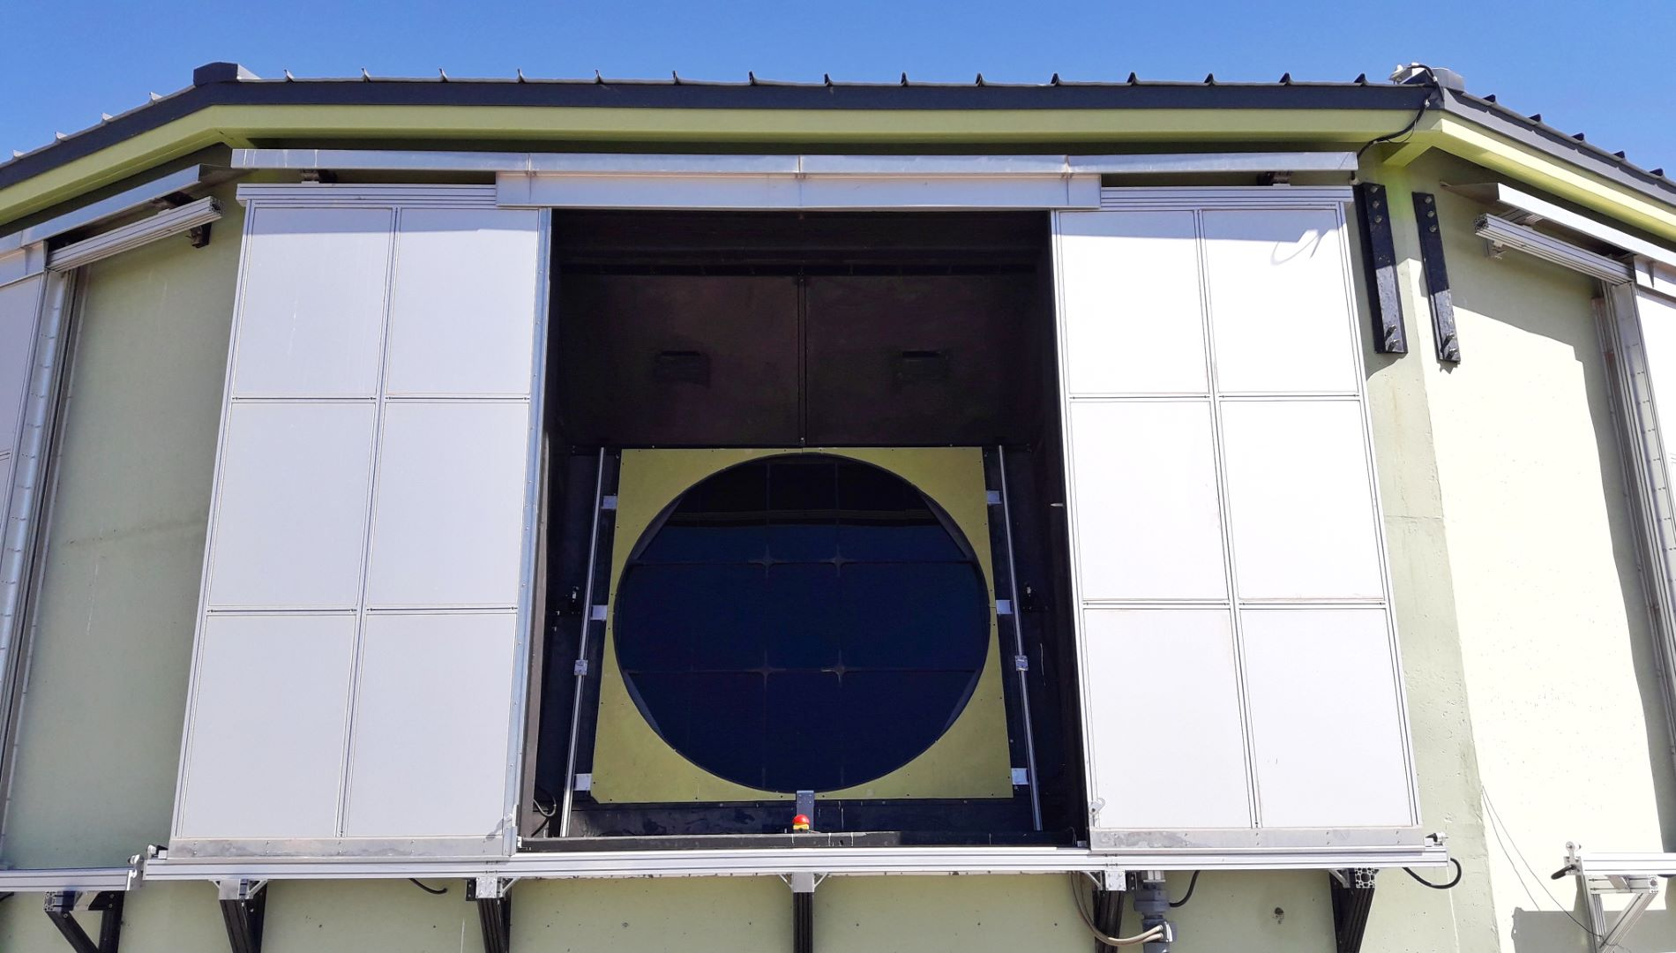
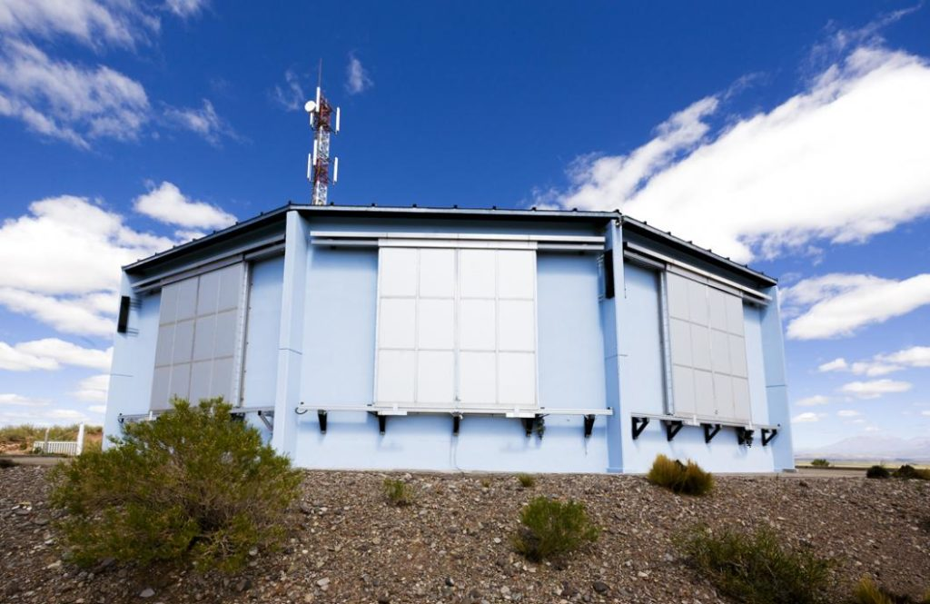
PIERRE AUGER OBSERVATORY (ARGENTINA)

Slide 7
SIRIUS (LNLS): ELECTRONS FLUORESCENT MONITOR

Slide 8
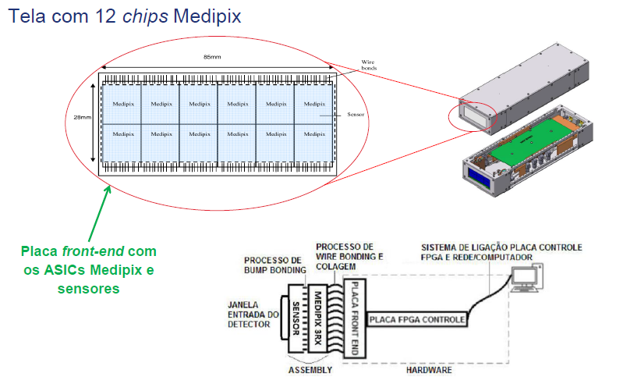
SIRIUS (LNLS): X RAYS DETECTOR

Slide 9
SIRIUS (LNLS): PHOTON SHUTTER

Slide 10
DUNE PROJECT
FAPESP
COMITÊ GESTOR
FERMILAB
UNICAMP (IFGW)
EQUATORIAL
CONVÊNIO INTERNACIONAL
FUNCAMP

Slide 11
PROJECT DUNE: CRYOGENIC ARGON PURIFICATION

Slide 12
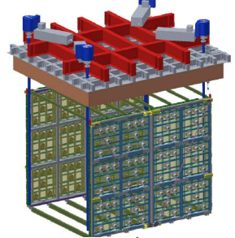
DUNE PROJECT: ARAPUCA

Slide 13

DETECTOR 2 (FAR DETECTOR): 34 TON LAr

Slide 14
AKAER HEADQUARTERS

Slide 15
AKAER GROUP
Workforce educational level
100%
2%
14%
50%
33%
1%
Total
PhD
MSc
BS
Technician
Basics

Slide 16
OPORTUNIDADES OFERECIDAS AO BRASIL

