Slide 1
QA/QC Planning
Kevin Fahey LBNF/DUNE QA Manager
Photon Detector Mini-Workshop
15 November 2022
v1 – posted 25 October

Slide 2
Outline
Overview of LBNF/DUNE Quality Assurance
QA/QC Review Deliverables
QA/QC Plan Outline
Procurement Plan Outline
Manufacturing Plan Outline
QA/QC Resources

Slide 3
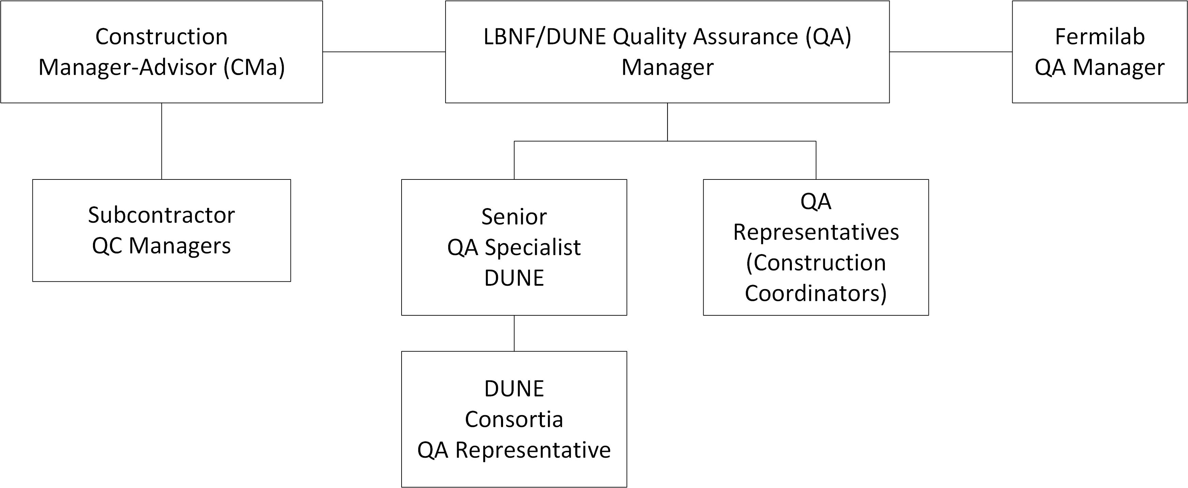
Overview of LBNF/DUNE Quality Assurance

Slide 4
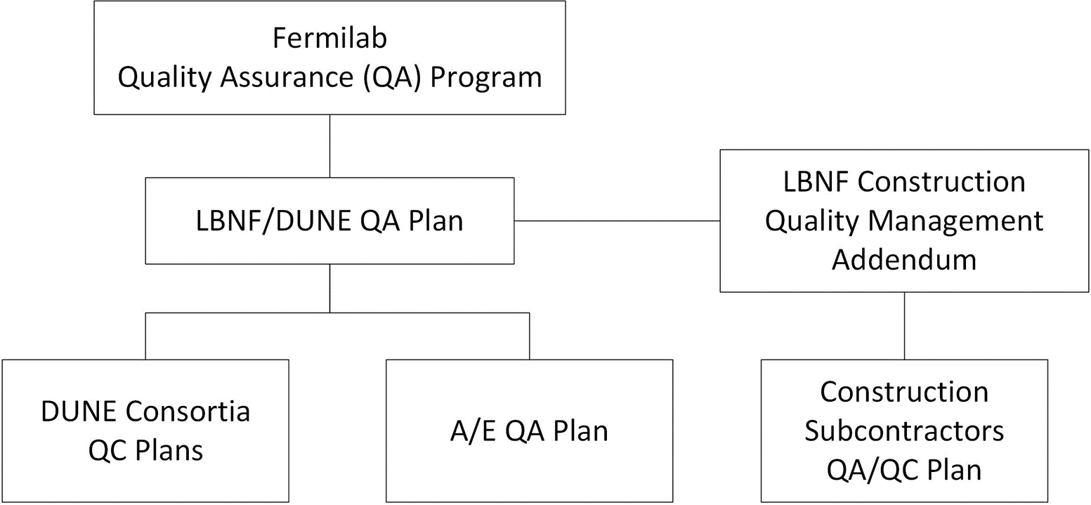
Overview of LBNF/DUNE Quality Assurance

Slide 5
Overview of LBNF/DUNE Quality Assurance
Quality Documentation Hierarchy:
Quality Assurance Plan
Specifications
Drawings
Procedures
QC Plan
Test Plans
Travelers
Test Reports
Inspection Reports

Slide 6
Overview of LBNF/DUNE Quality Assurance
Features of the LBNF/DUNE QA Plan:
Personnel training and qualification
Quality improvement programs
Document, records and configuration management
Work process control
Engineering design quality standards
Procurement quality processes
Inspection and acceptance testing
Management assessments
Independent assessments
Suspect/Counterfeit items prevention
Quality in scientific research

Slide 7
Overview of LBNF/DUNE Quality Assurance
Quality assurance and quality control (QA/QC) systems are designed, as part of the LBNF/DUNE Quality Assurance Plan, to ensure that the components of the DUNE Project meet the design specifications and operate within the parameters mandated by the requirements.
QA Plan outlines the QA requirements for all LBNF/DUNE collaborators and subcontractors, henceforth referred to as Project Partners, and describes how the requirements shall be met
Plan is implemented by the development of QC plans, procedures and guides to accommodate those specific quality requirements

Slide 8
QA/QC Review Deliverables
Preliminary Design Reviews
Draft QA/QC Plan
Draft Manufacturing Plan
Draft Procurement Plan
Preliminary Installation Plan
Final Design Reviews
Final versions of the above plans
Installation plans, schedules, procedures as understood at the time, to assess the adequacy of design related to installation.

Slide 9
QA/QC Review Deliverables
Production Readiness Reviews
Final QA Plan
Final QC plan (i.e., travellers, test plans and reports, software verification and validation documents, procedures, supplier documentation)
Specific Roles and Responsibilities of the production / manufacturing process
Complete evaluation of prototypes and module-0 production, completed review of production process and QC process and results
QA and ES&H requirements for purchasing

Slide 10
QA/QC Plan Outline
Purpose and Scope
Test/Inspection Requirements
Components to be inspected and/or tested
Description of QC Inspections and Tests
Location of inspections and tests
Receiving site
Production Site
Warehouse Site
Cavern Cleanroom
Cryostat Final Position
Technical Justification of Inspections and Tests

Slide 11
Procurement Plan Outline
Purpose and Scope
Key Items to be procured
Procurement Management
Vendor Management (Prototyping, vendor selection)

Slide 12
Manufacturing Plan Outline
Purpose and Scope
Roles and Responsibilities
Manufacturing Processes
Materials
Inspection Requirements
Shipping Method

Slide 13
QA/QC Resources
QA/QC Support:
Provide guidance in the development of fabrication, inspection and testing procedures
Assist in the development of QC Plans, Travelers, Inspection and Test Reports, as applicable
Assist in the resolution on quality issues
QA/QC Documentation Review
Perform assessments of the Consortia processes in coordination with Consortia Leaders to assess the effectiveness of the Consortia processes.
Contact: Kevin Fahey kfahey@fnal.gov
Jim Mateyack Mateyack@fnal.gov

Slide 14
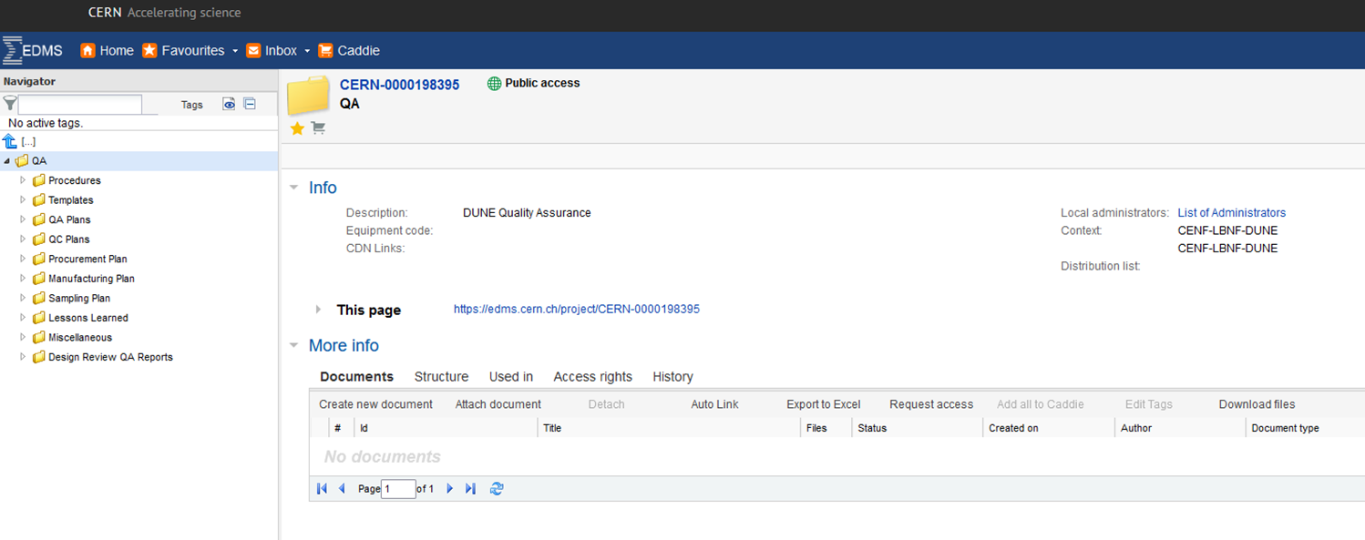
QA/QC Resources
URL:
https://edms.cern.ch/project/CERN-0000198395

Slide 15
QA/QC Resources
QC Workshops
Roles & Responsibilities for Quality
Document Management
Vendor Management
QC during Fabrication and Installation
Handling, Storage and Shipping
Nonconformance Management

