Slide 1
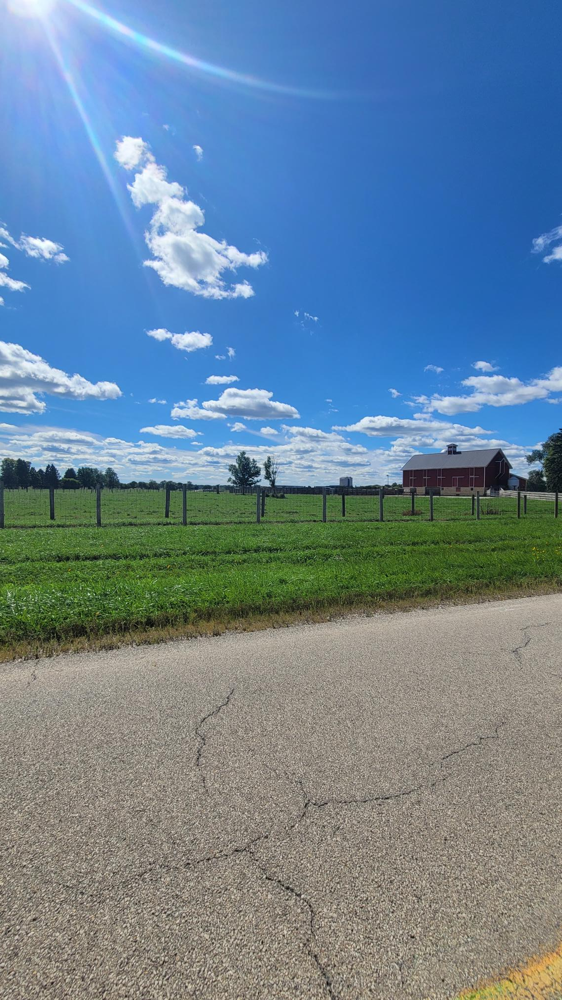
Neutrino Campus CFM Monthly Update 11-15-2022
Harry Ferguson III

Slide 2
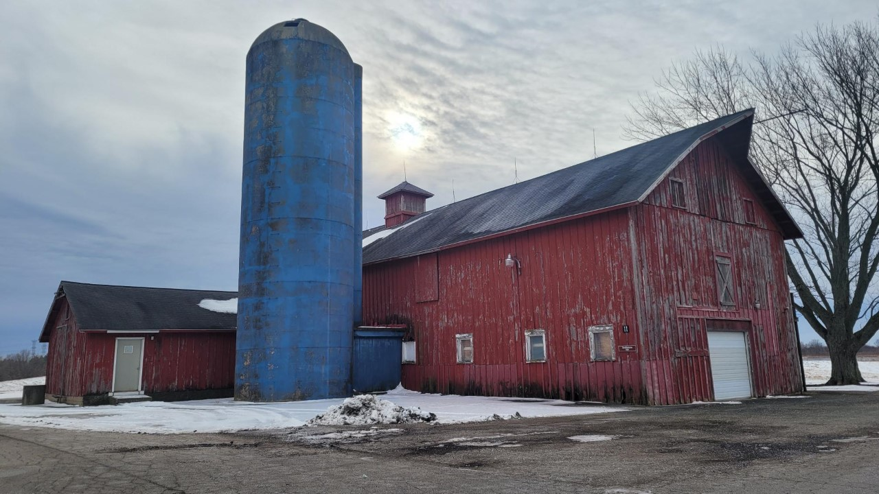
What is CFM? Centralized Facility Management
Future sustainability of the lab’s infrastructure relies heavily on our ability to develop and forecast our maintenance and replacement costs for our future needs.

Slide 3
If you see something report it email, text, photo or Phone call?
If you see something say something, Text, email or phone call.
If you see something say something

Slide 4
Priority Neutrino Campus Work Orders
NUMI Underground
Re-Lamp of all fixtures in the NUMI and NOVA underground areas(two locations that require articulating lift to service),NUMI area complete, NOvA Cavern scheduled for today
Repair of Elephant Door latch complete
Repair of the Lower-Level Elevator door cable complete
SBN ND
All Filters are to be replaced November 1st 11-01-2022 complete
Replace all belts on Folding overhead door complete
Scheduled door inspection on 11-28-2022 prior to detector move
LArTF
Re-lamp Light in West stair well scheduled
Replace damaged arm on personnel door on west side of stairwell parts ordered but wrong handed arm awaiting new parts

Slide 5
Priority Neutrino Campus Work Orders
SDN FD
Replacement of Fire Stressed sprinkler heads
Awaiting RWP for work
Plan is to use a pipe Freezing system on the main line just upstream of the fire stressed sprinkler heads
Schedule is to complete prior to Thanksgiving
MINOS
The MINOS roof is in process. The package is complete, and in Bidding process
The masonry wall at MINOS repair will be done T&M. This work is being scheduled by T&M.
MINOS and MI65 Fire Protection panel replacement is moving forward and there is a plan to try and get the engineering task complete this Fiscal year.
The Engineering Task Request for the Water Leak in MINOS is well underway.
Have received the quotation for the MINOS card reader access for the elevator entry and the shelter door ~$18K requisition is being completed.

Slide 6
Priority Neutrino Campus Work
PAB awaiting P.O.
Phase two of the exterior painting of PAB quotation has been received has being submitted.. This work will involve both north and south facades of PAB.
Request for northeast wall patch and ¾” plywood install quotation has been requested awaiting response from contractor.
A request for two additional card reader access control locations has been received and is awaiting quotation form Johnson Controls.
Revision of conference room for new TV mount. Quote has been received and is in process.
Gate in Mezzanine area
LED light replacement for the remaining areas at PAB will become one package that will include all the areas, mezzanine, office area, calibration shop and alcove area.

Slide 7
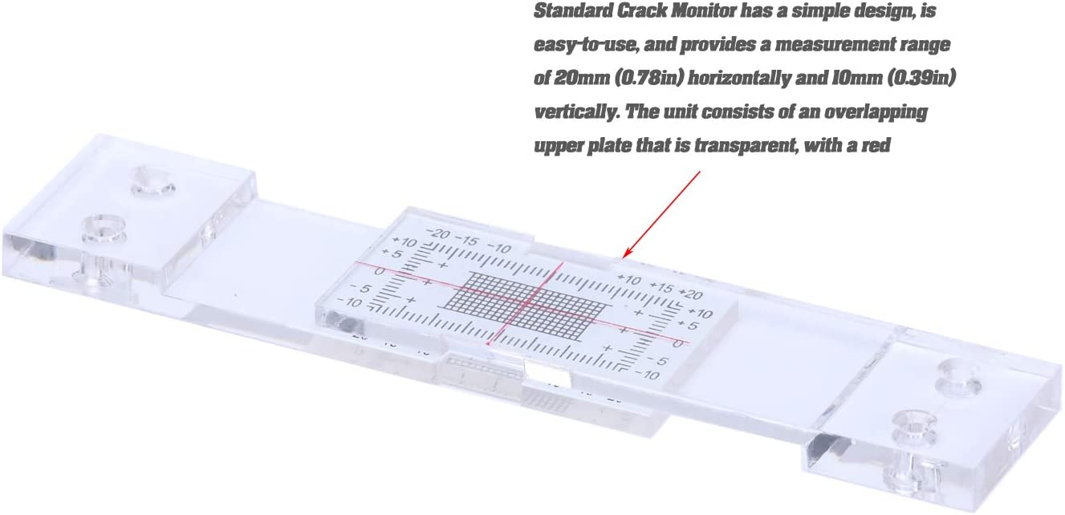
Priority Neutrino Campus Work
SBN Far Detector
The crack monitoring strips for the SBN Far Detector Mezzanine ceiling area have been received scheduling installation by carpentry shop.

Slide 8
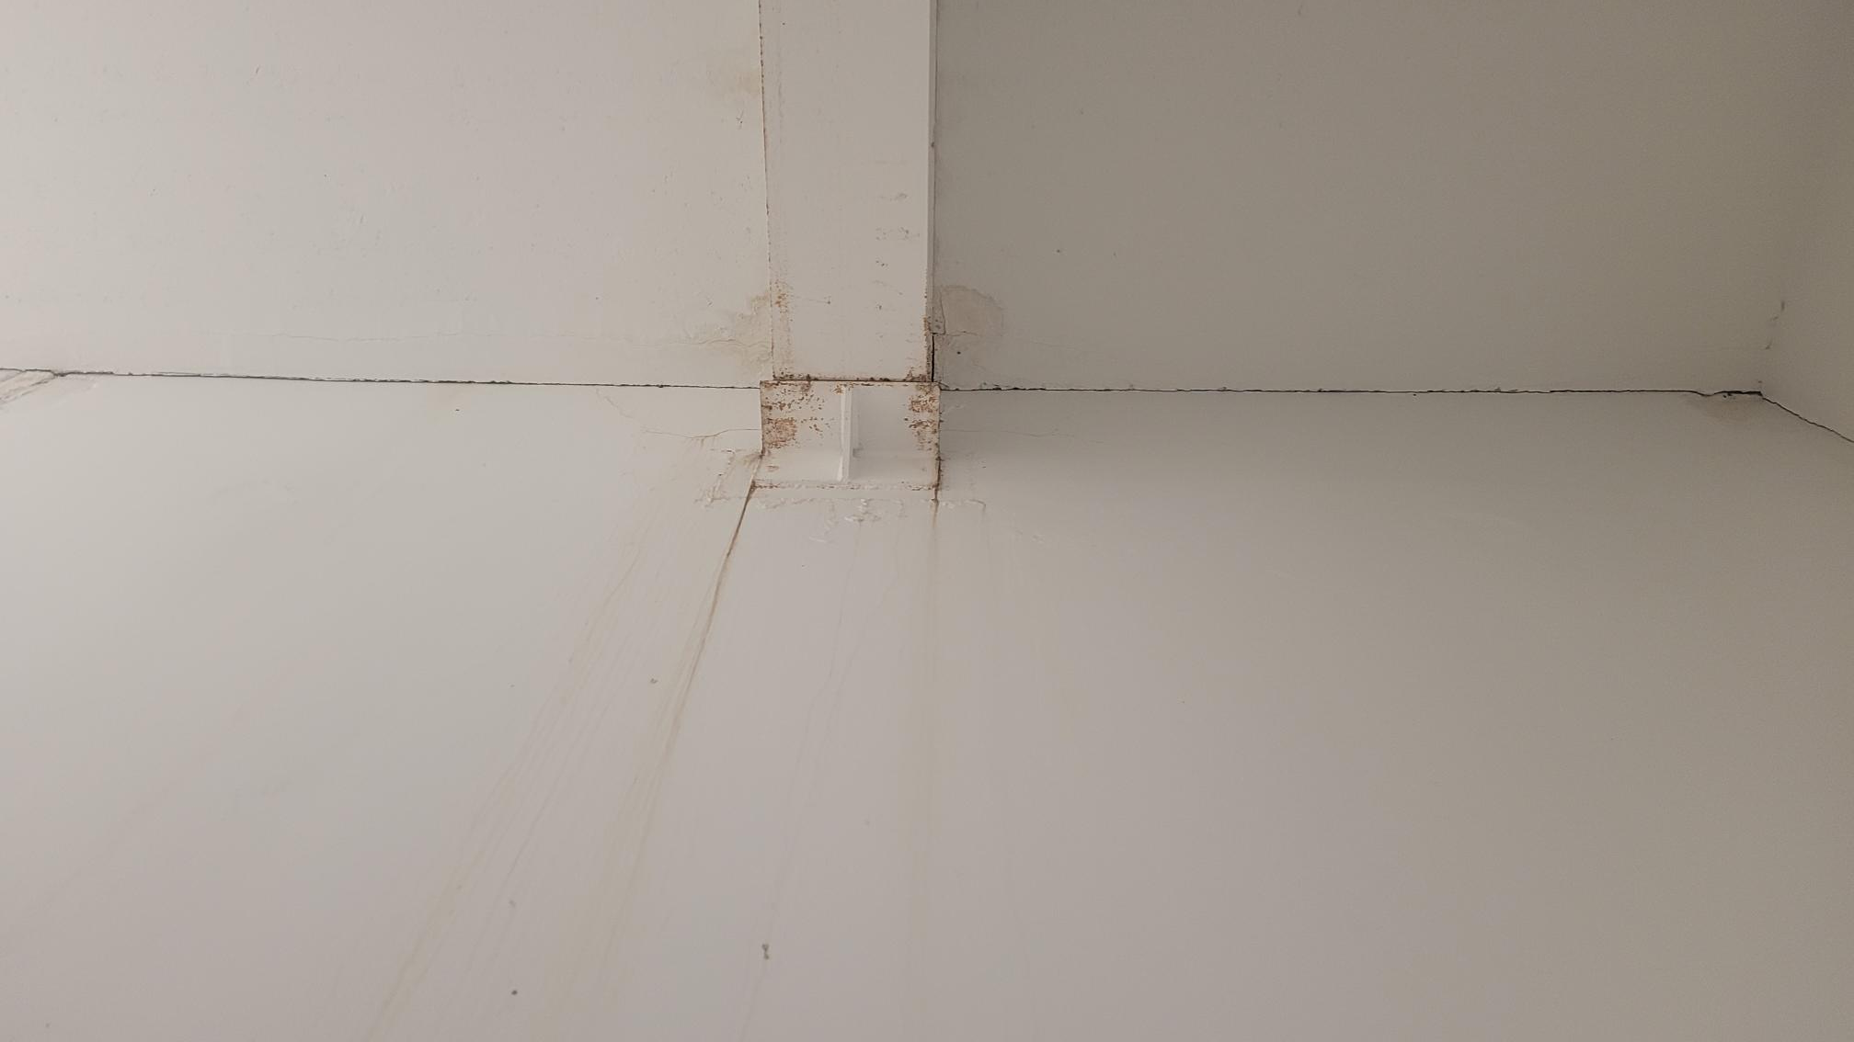
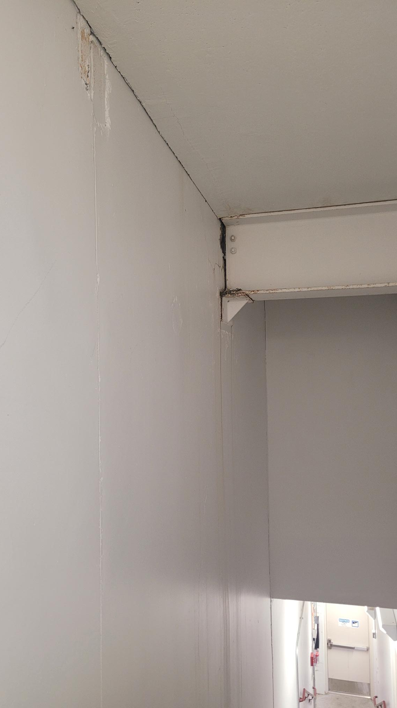
Current Status
Neutrino Campus
Roof Leaks have been reported at NDOS have been repaired

Slide 9
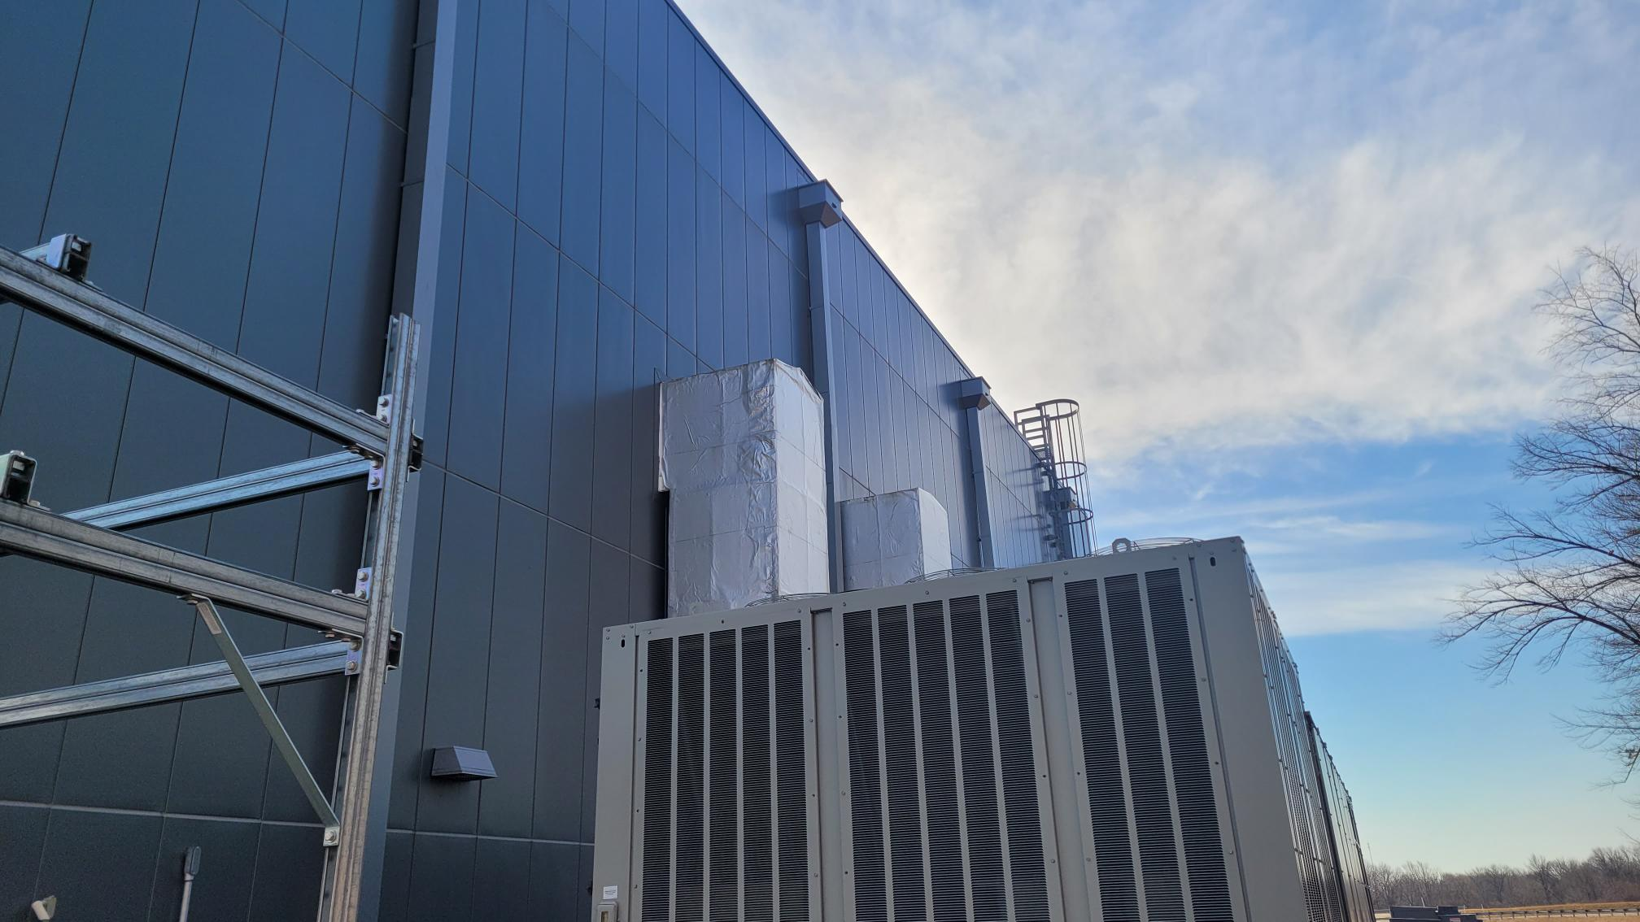
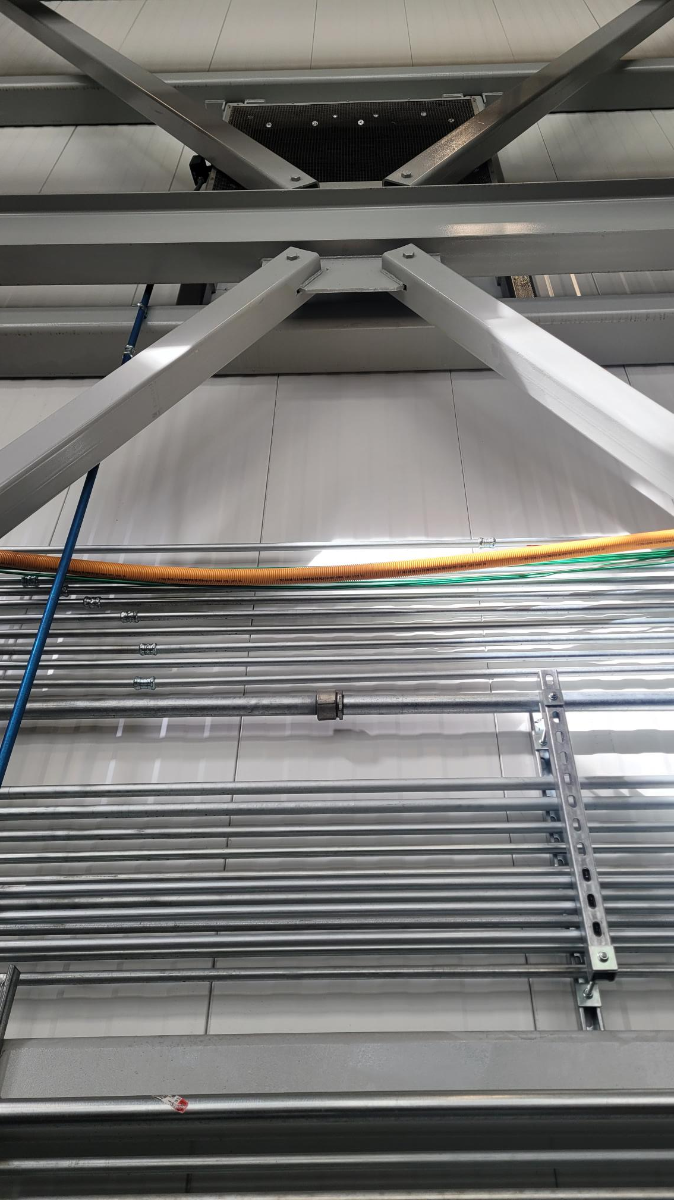
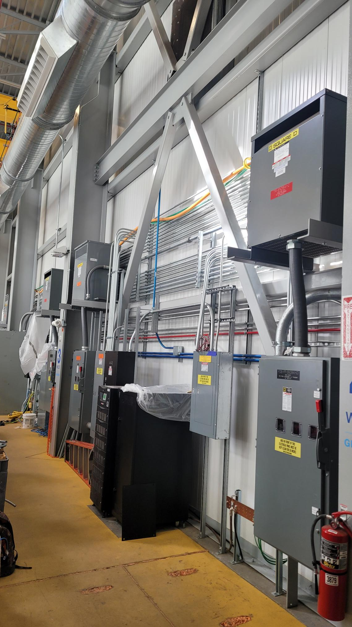
Current Status
Neutrino Campus
Roof Leaks have been reported at SBND and have been submitted and we are currently awaiting Schedule for repair. These shall be done T&M. some engineering questions are outstanding

Slide 10
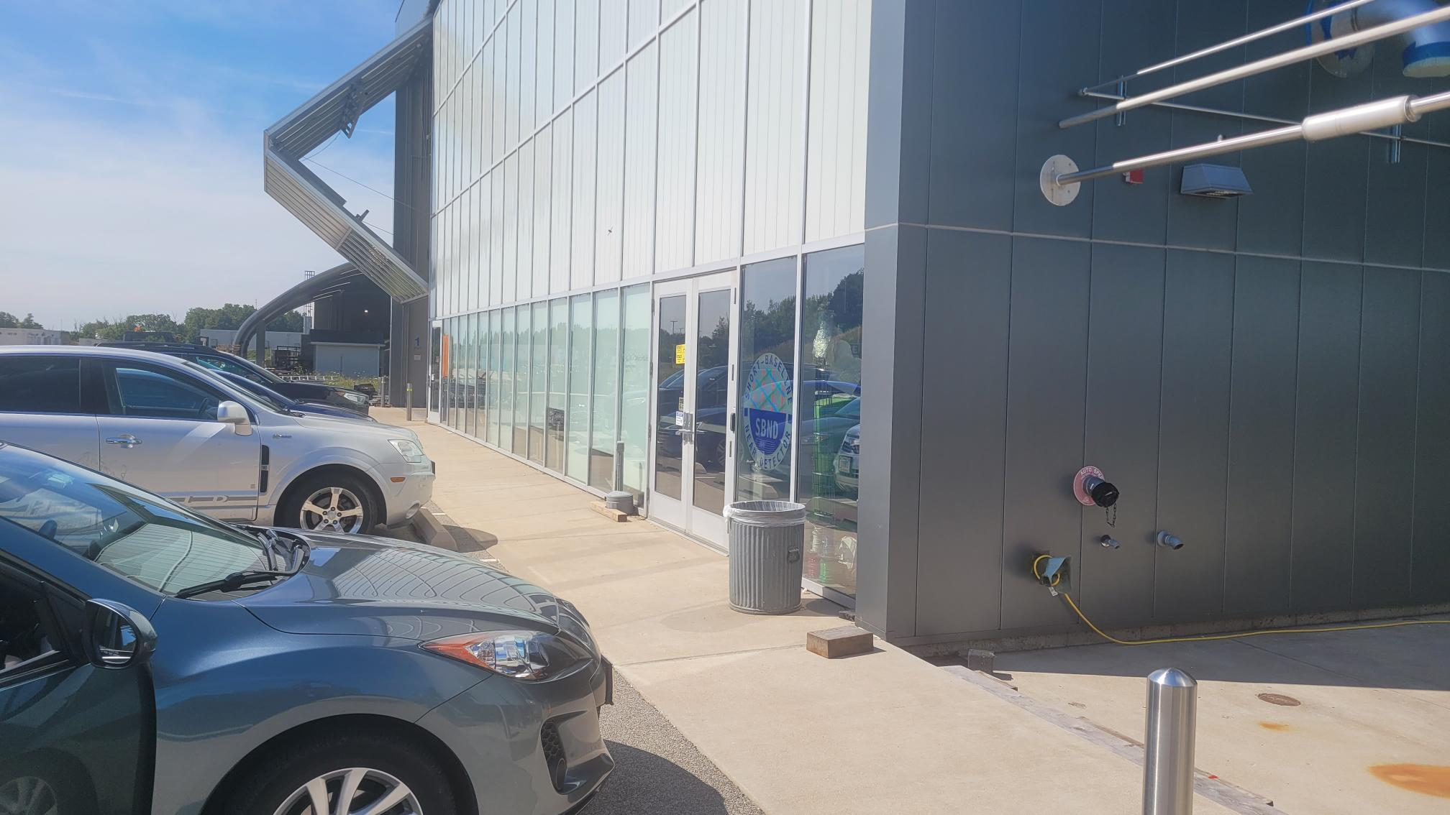
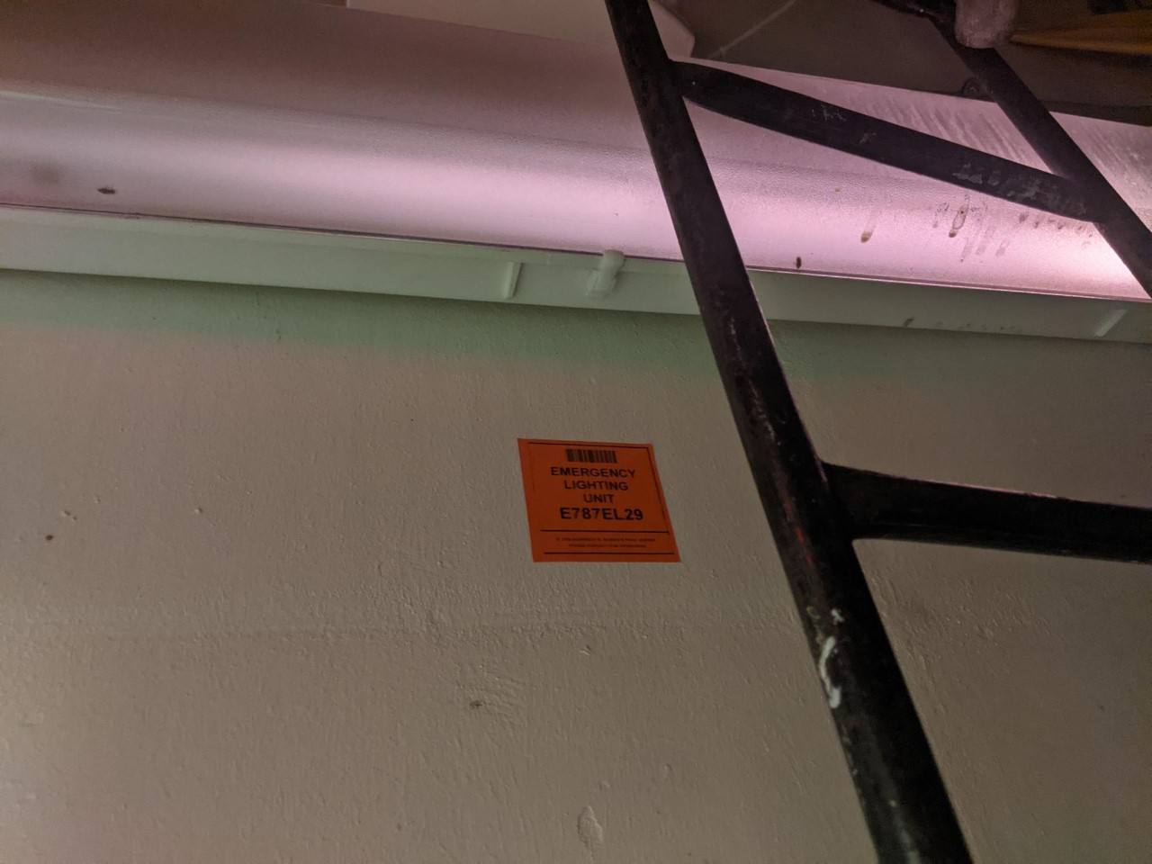
Neutrino Campus NEW Open Work Orders
6 work orders are in place for the repair of emergency lights at SBN Far Detector.
T&M Request to replace the existing Metal Halide light fixtures at MINOS service building in the 1st floor northwest and northeast corner of the building. Should have the quotation and schedule soon.

Slide 11
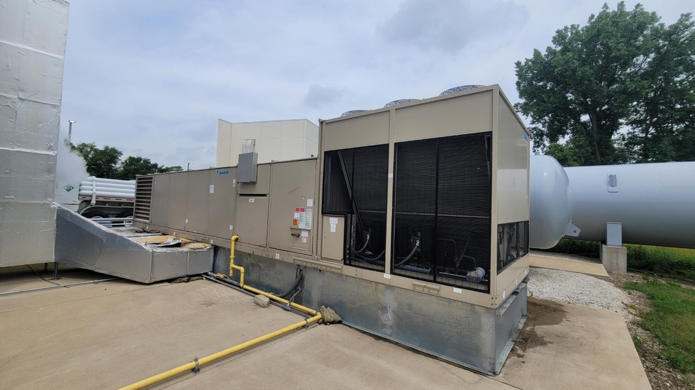
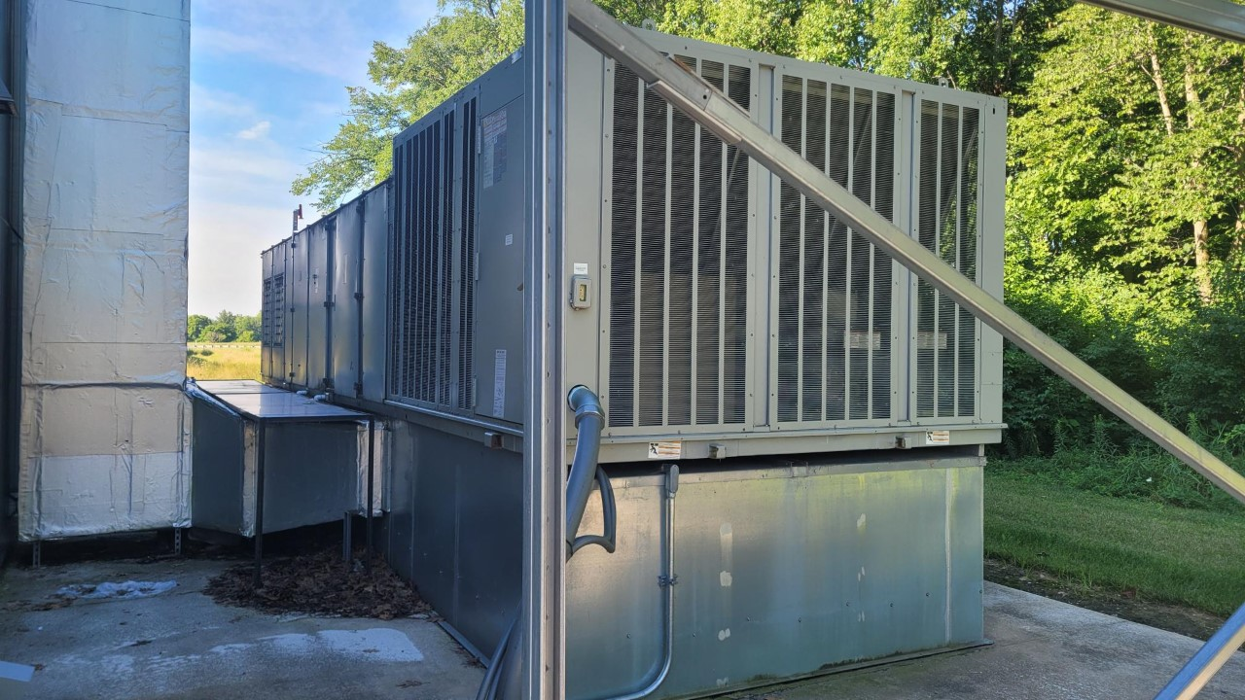
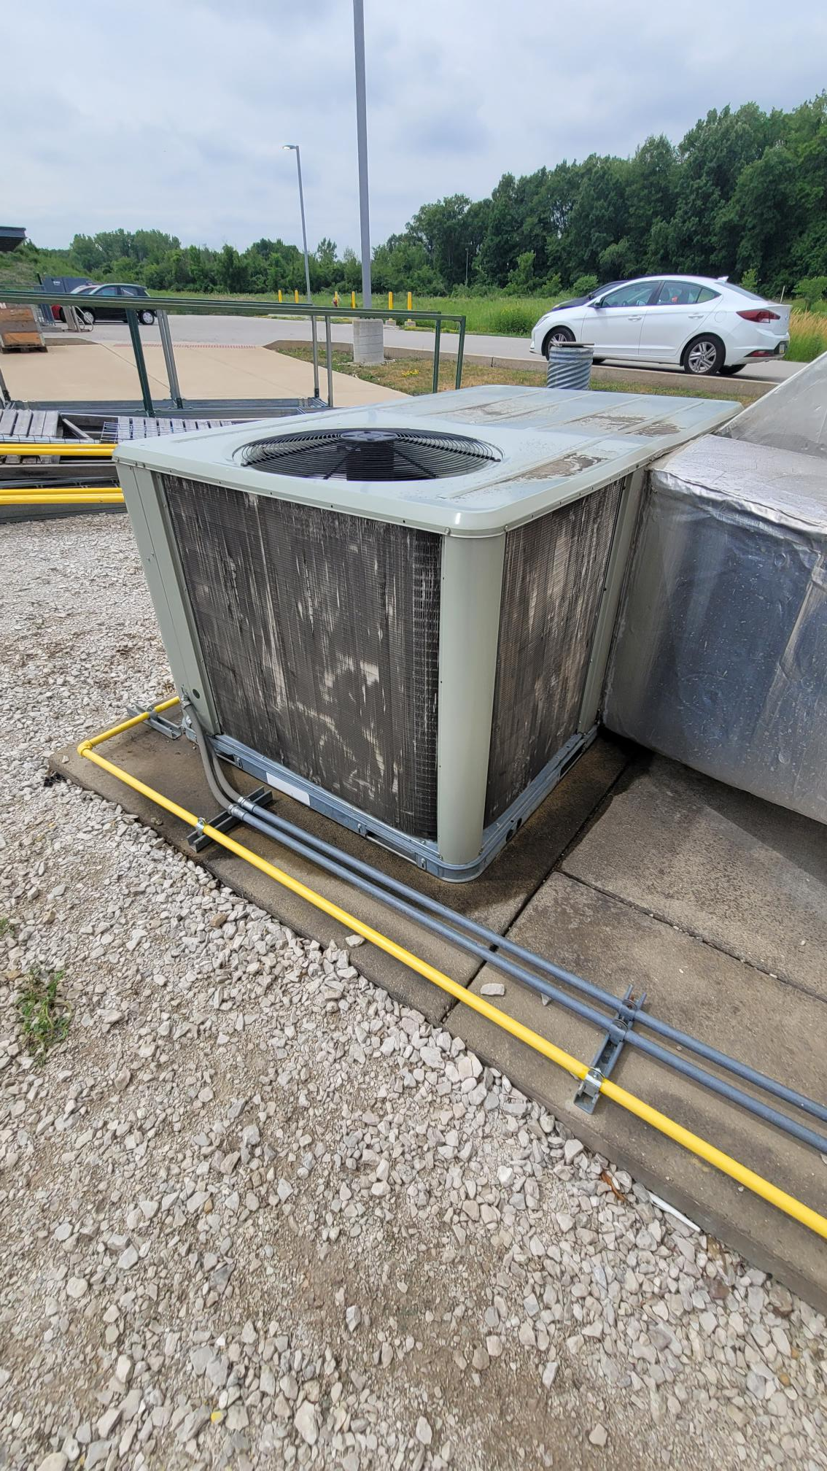
Neutrino Cotton Wood Screens for HVAC units should receive shipment this week
SBN Far Detector Unit
NOvA Near Detector Building
SBN Near Detector Building.

Slide 12
There was some Scintillator Oil in Mini BooNE that disappeared this month and I kinda need to no where it went. I have to report it as no longer requiring me to inspect its containment every month. Who ever knows its whereabouts could send me an email about it. thanks Questions? Request?

Slide 13
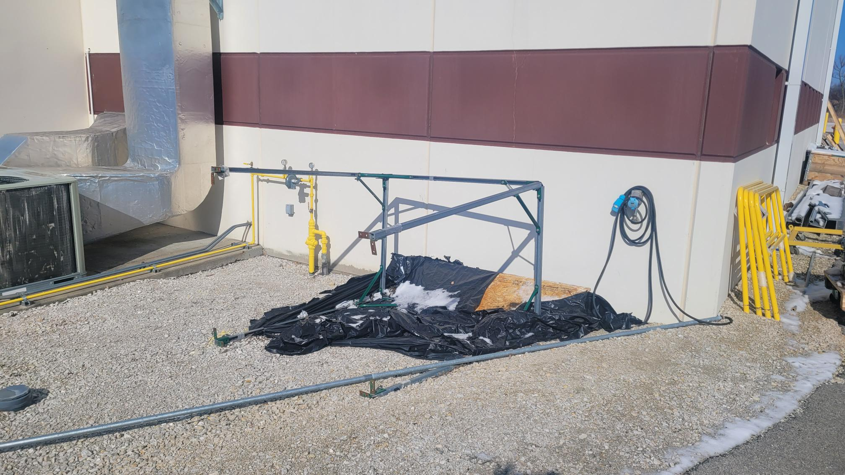
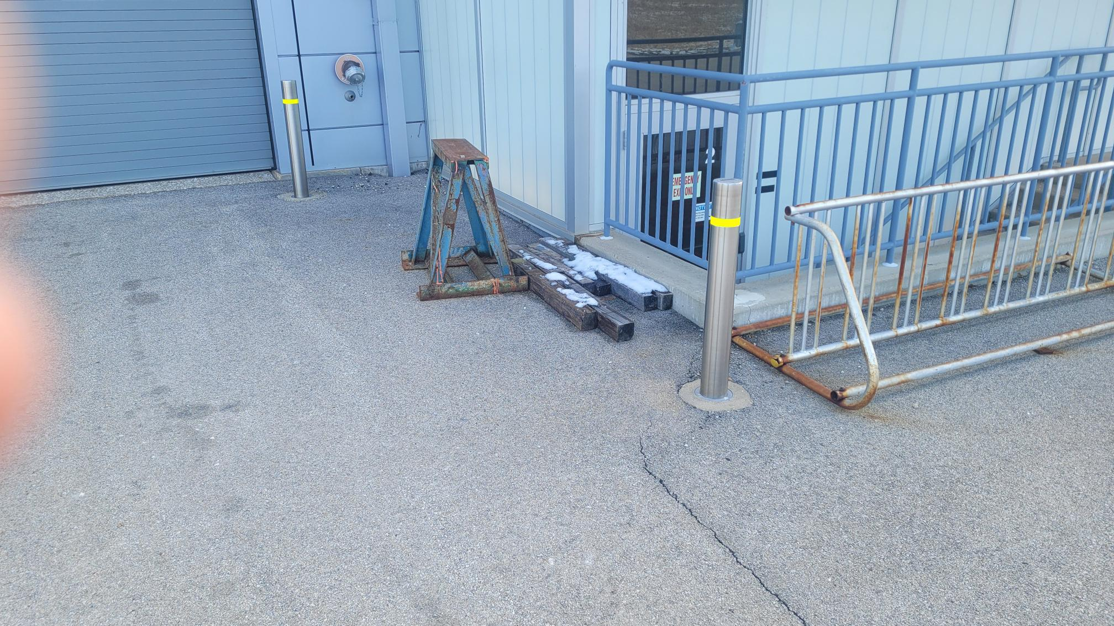
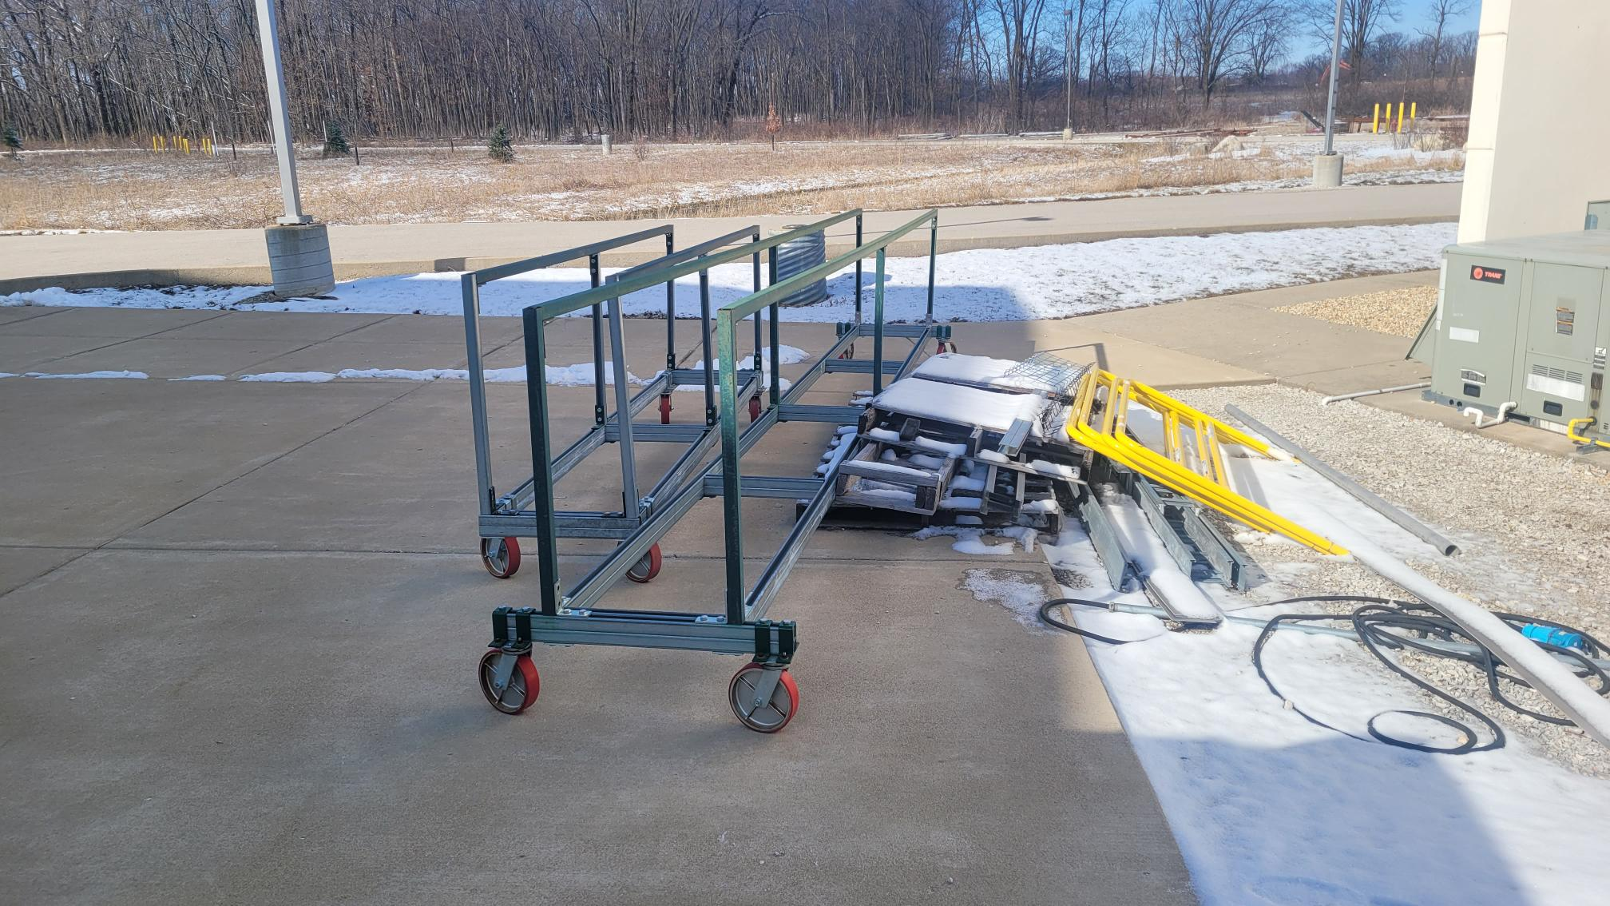
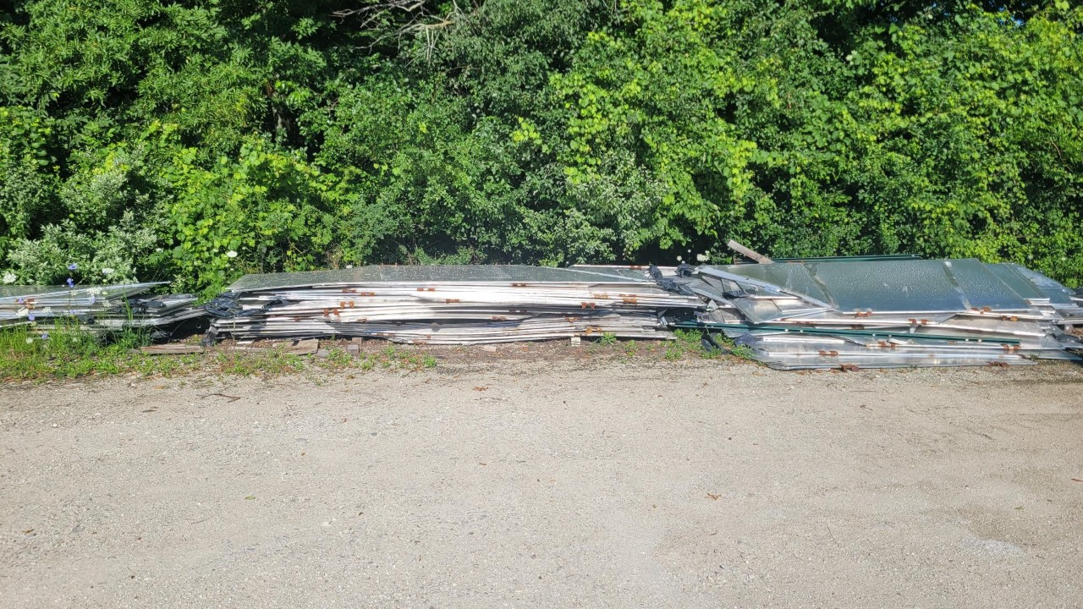
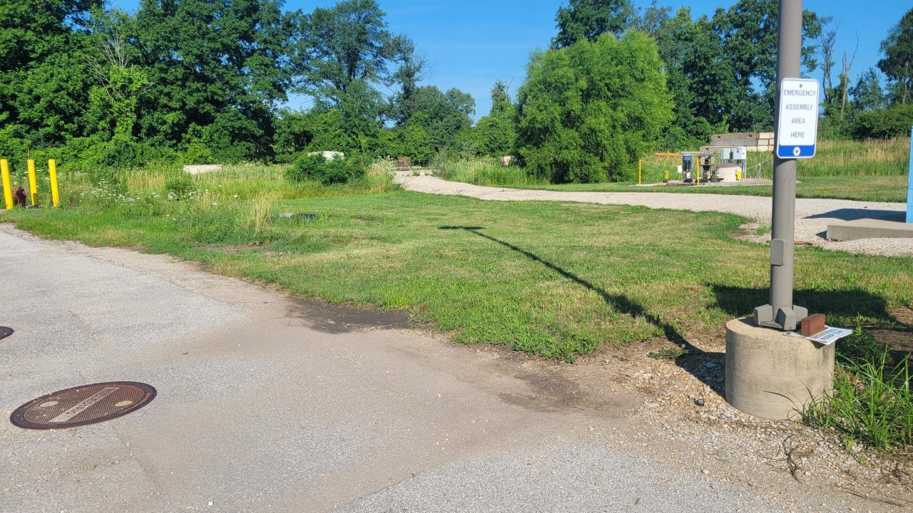
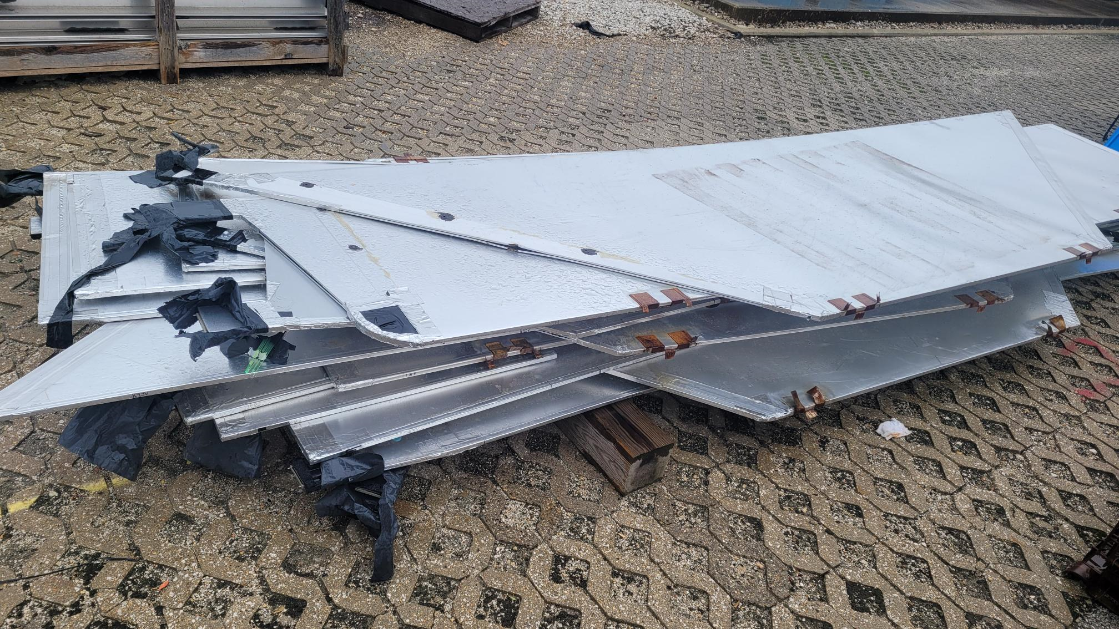
Thanks, Steve Hahn, for getting all the stuff in the yard removed.
If you have any equipment or materials that should be disposed, dismantled, stored or placed in surplus please don’t hesitate to do so.

