Slide 1
Status of the SQMS Center
Anna Grassellino, SQMS Center Director
Jens Koch, SQMS Deputy Director
Fermilab PAC Meeting, Jan. 2023 1/17/2023

Slide 2





Motivation
Quantum Information Science
Quantum
Sensing
& Metrology
Quantum
Cryptography
Quantum
Computing
Quantum
Simulation
Quantum
Communication
ħ
ħ
Foundations of
Quantum Mechanics
Physics beyond
Standard Model
Dark Matter
…
Leveraging quantum technologies
for studying fundamental physics

Slide 3





BILL
National Quantum Initiative Act (2018)
5 NQI DOE centers (2020)
10 yr plan to accelerate
the development of
quantum information science
& technology applications.
SUPERCONDUCTING QUANTUM
MATERIALS & SYSTEMS CENTER
“
”
DOE shall establish and operate
NQI Science Research Centers
to conduct basic research
to accelerate
scientific breakthroughs in
quantum information science
and technology.
Quantum
Systems
Accelerator

Slide 4
DOE NQI Center Requirements (excerpt)
Significant National Impact
advance basic research in QIS
improve competitiveness of the US
catalyze the wider scientific/technical communities
serve as national resources and leaders
Major Cross-Cutting Challenge
attack a major challenge that warrant a large,
multi-institutional, multi-disciplinary effort
S&T Innovation Chain
advance science & technology,
accelerate progress from discovery
to technology/applied research
co-design approach
QIS Ecosystem Stewardship:
complement existing DOE QIS research
leverage other DOE investments in research/facilities
create synergies between federal agencies,
private sector &academia
contribute to QIS workforce development in US
Multi-disciplinary Leadership
Collaborative Management Structure
Well-Structured Plan and Metrics
clearly defined near, intermediate, and long-term goals,
milestones, deliverables, and metrics of success

Slide 5
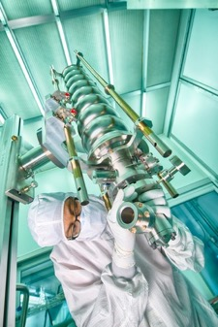
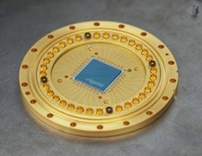
SQMS Mission
Leverage strengths of
national labs, industry & academia
to achieve
transformational advances
in quantum coherence of
superconducting devices.
GOALS
Enable construction and deployment
of superior quantum systems for
computing and sensing.
Create unique foundry capabilities
and quantum testbeds to
serve the national QIS ecosystem.
Train next-generation, diverse workforce of quantum scientists, engineers and technicians.

Slide 6











$115M Funding 2020-2025
Impact at a glance
26 SQMS Institutions
>200
External students engaged
(SQMS schools & internships)
420 SQMS headcount
15 New facilities & testbeds
131New hires
>210 Companies engaged
143
115 preprints & publications
Funded
students & postdocs

Slide 7
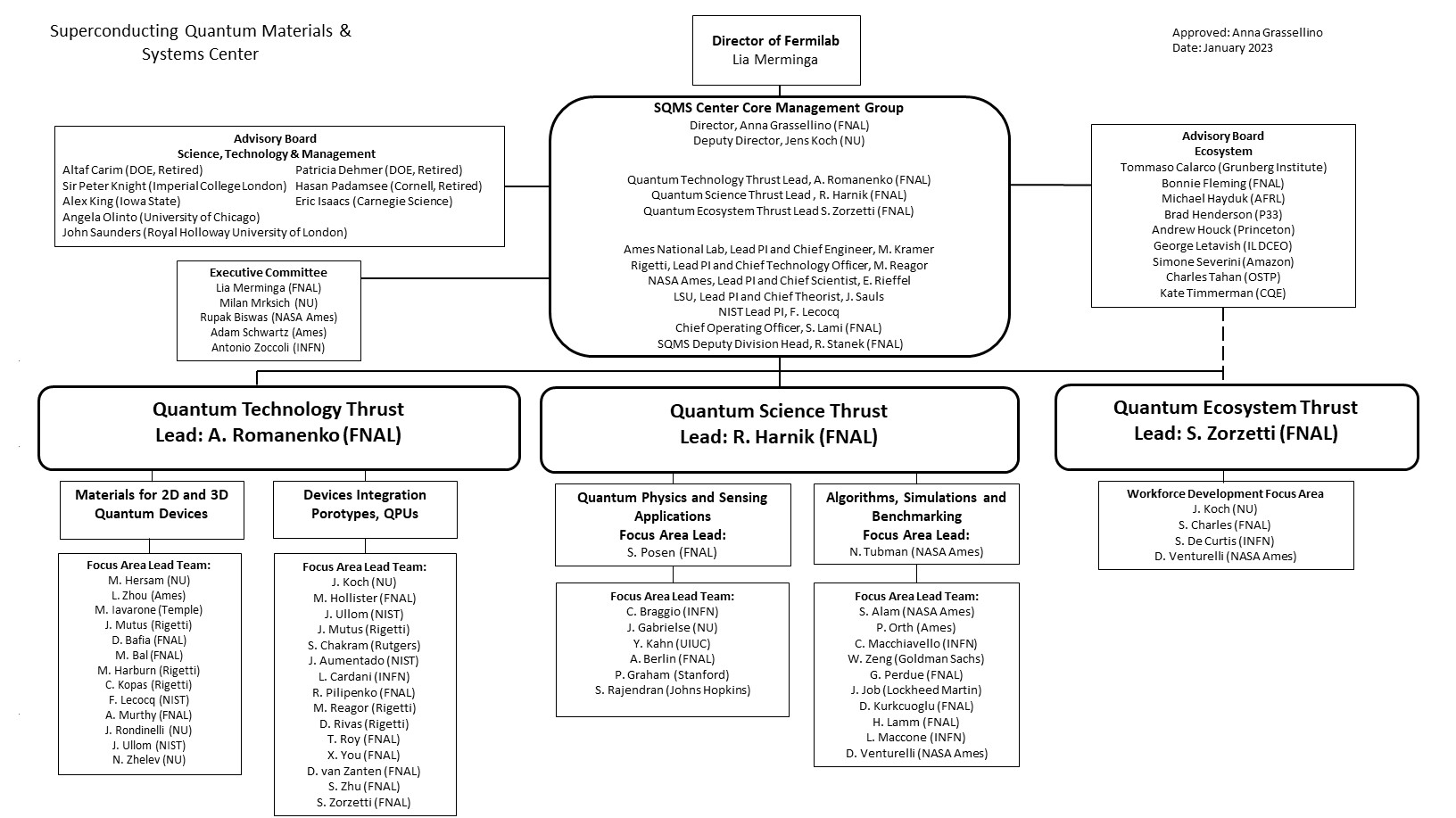
SQMS Center Organizational Chart

Slide 8
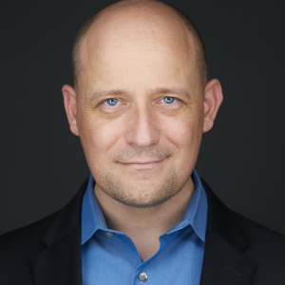
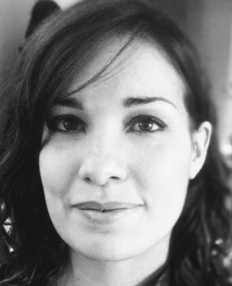
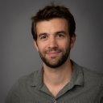
SQMS Leadership (core management group)
Dr. Anna Grassellino
(FNAL)
Center Director
Prof. Jens Koch (Northwestern)
Deputy Director
Dr. Alexander
Romanenko (FNAL)
Technology Thrust Leader
Dr. Silvia Zorzetti
(FNAL)
Ecosystem Leader
Dr. Roni Harnik (FNAL)
Science Thrust Leader
Dr. Matt Reagor
Rigetti PI, CTO
Dr. Matt Kramer
Ames Lab PI, Chief Engineer
Dr. Eleanor Rieffel
NASA Ames PI
Chief Computational Scientist
Prof. Jim Sauls,
LSU PI, Chief Theorist
Dr. Florent Lecocq
NIST Boulder PI

Slide 9



SQMS participants
SQMS
…

Slide 10
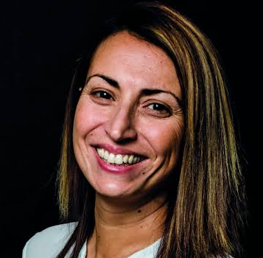
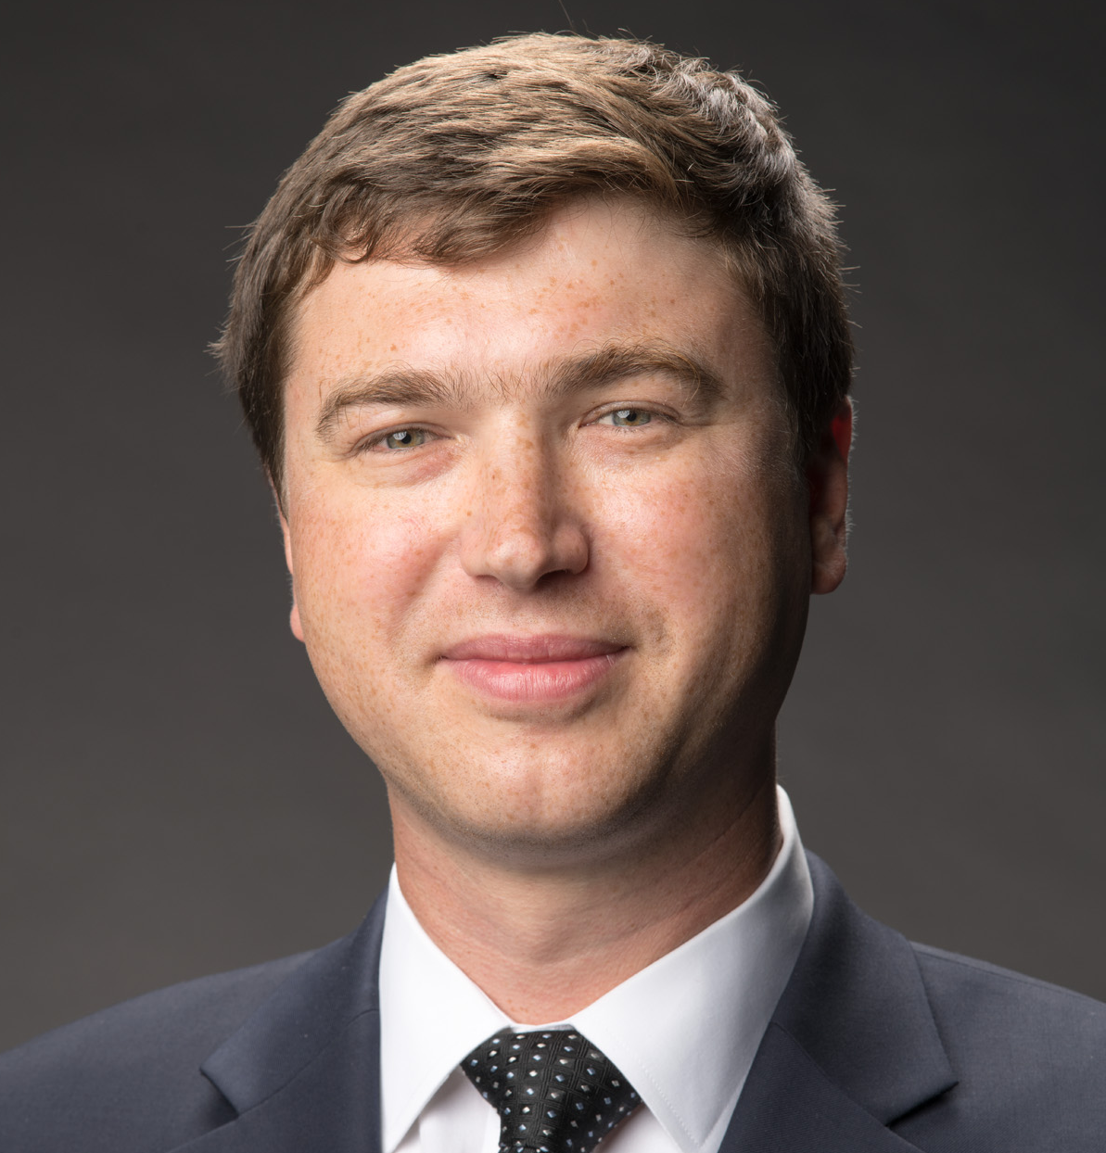
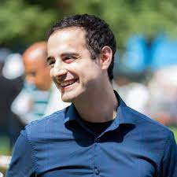
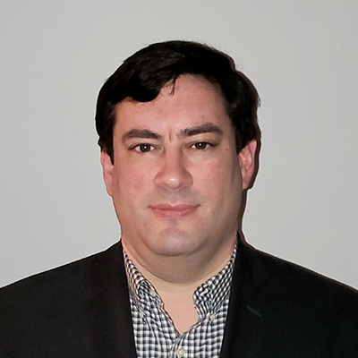

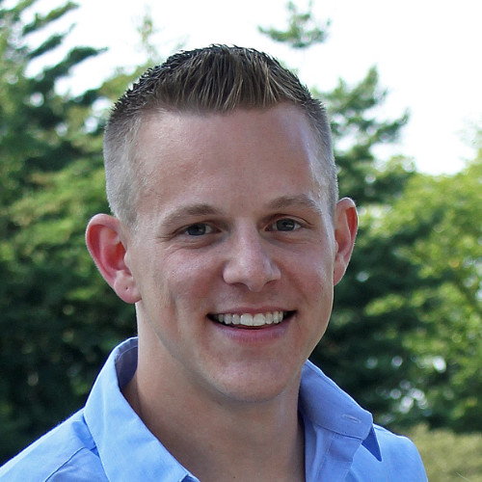
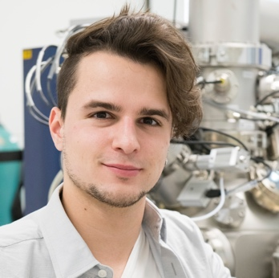
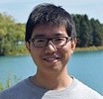
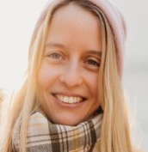
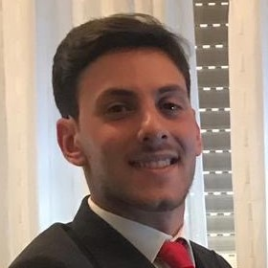
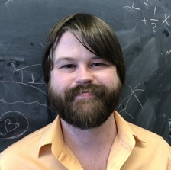
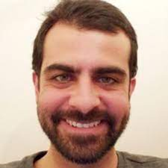
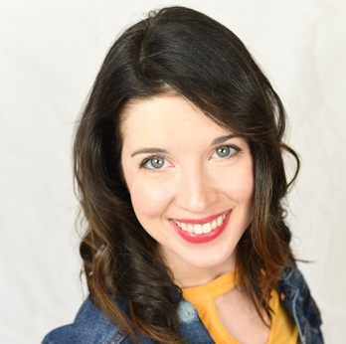
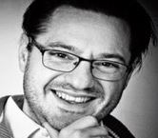
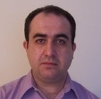

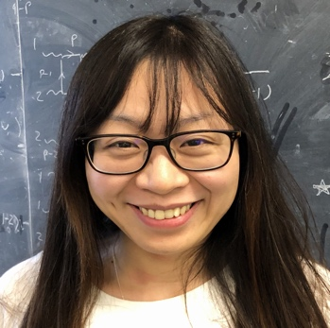
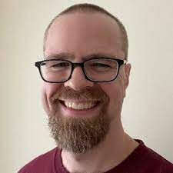
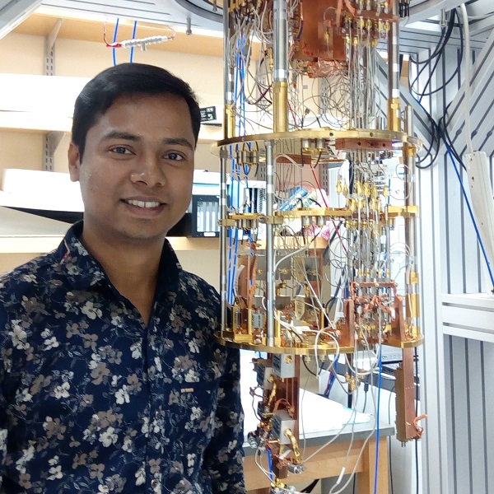
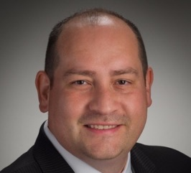
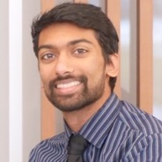
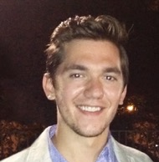
SQMS at Fermilab hired > 40 new employees supported by SQMS
SQMS Division (~50) + APSTD, Theory, FQI…

Slide 11
SQMS participants and research at NU
SQMS
…

Slide 12
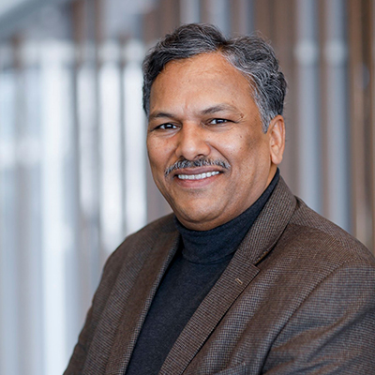
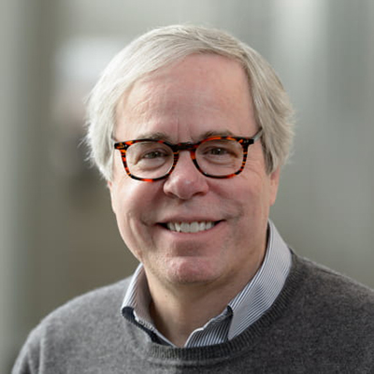
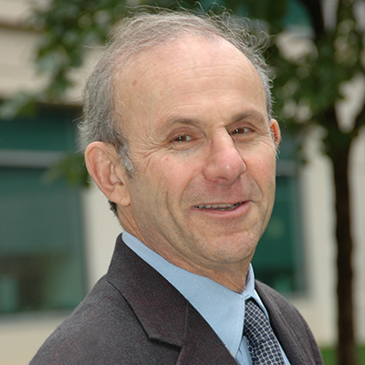
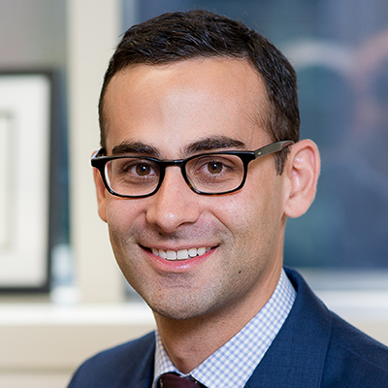
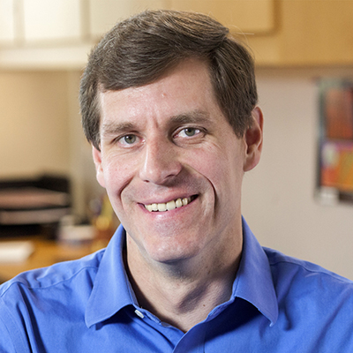
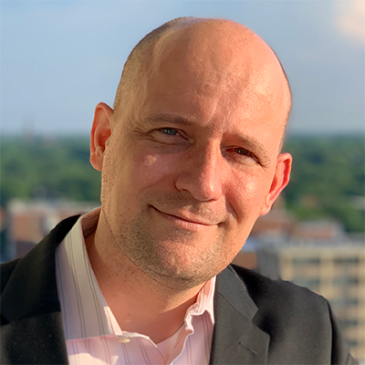
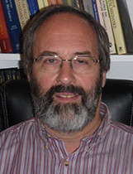
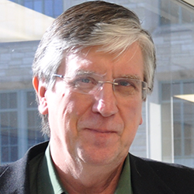
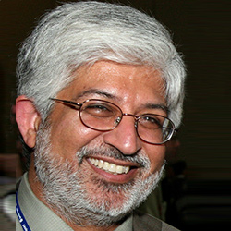
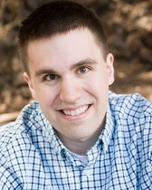
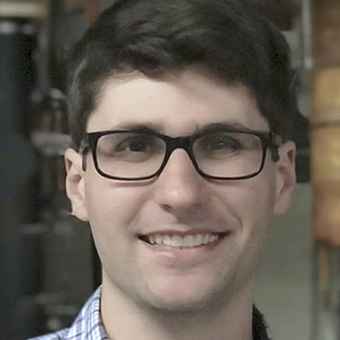
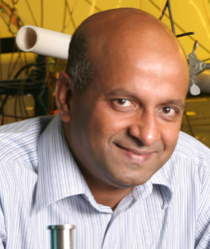
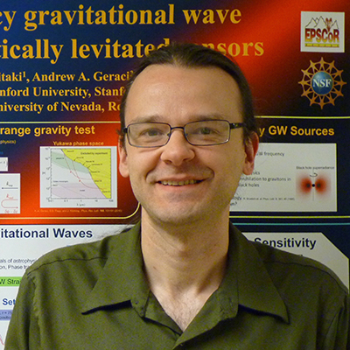
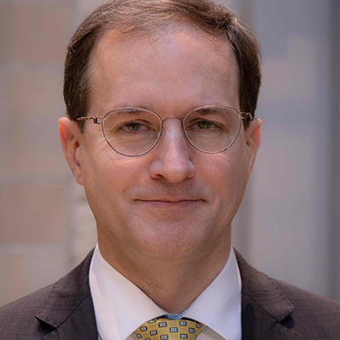
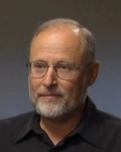
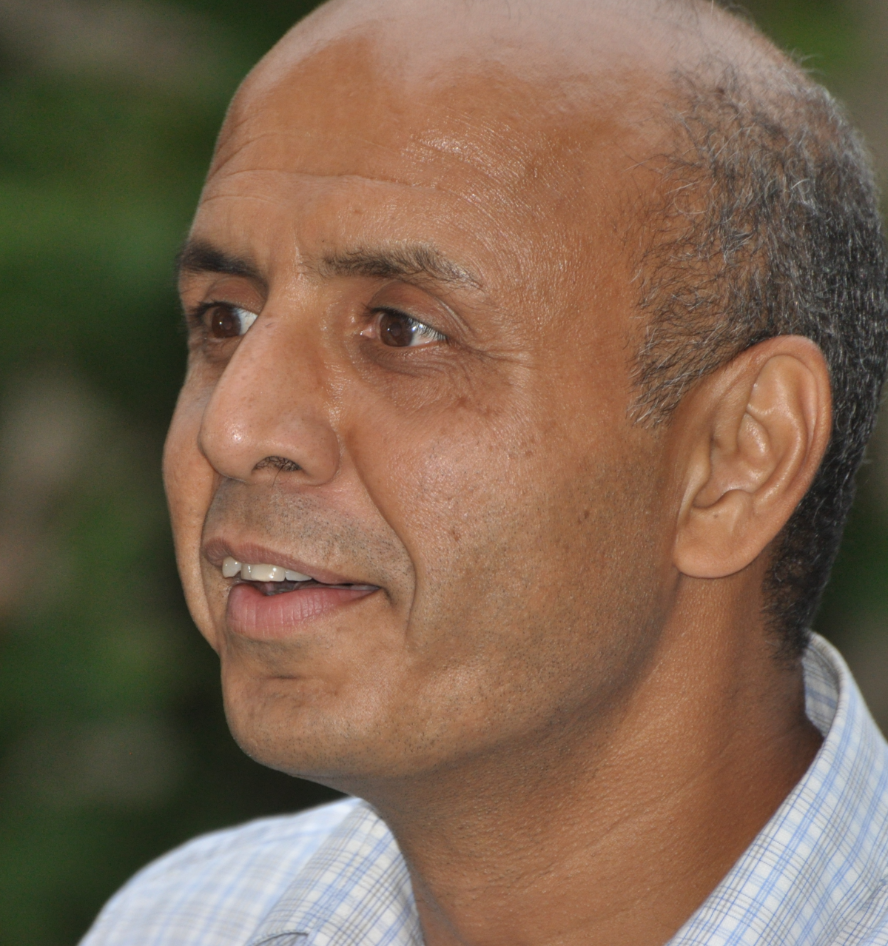
SQMS participants and research at NU
adjunct NU faculty
SQMS
- Anna Grassellino
- Alex Romanenko
- Roni Harnik
- Sam Posen
- Silvia Zorzetti
…
- Jens Koch
- Venkat Chandrasekhar
- Michael Bedzyk
- William Halperin
- Mark Hersam
- Peter Voorhees
- James Rondinelli
- Tim Kovachy
- Selim Shahriar
- Vinayak P. Dravid
- Nikolay Zhelev
- David N. Seidman
- Dieter Isheim
- Andrew Geraci
- Matthew Grayson
- Prem Kumar

Slide 13
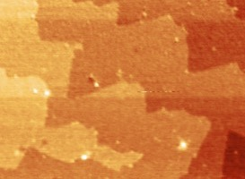
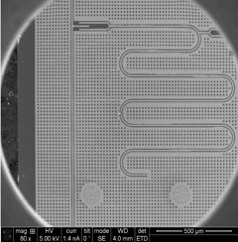
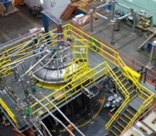
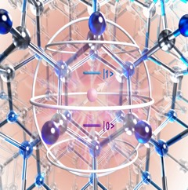
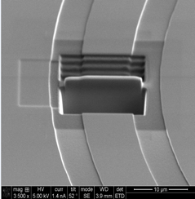
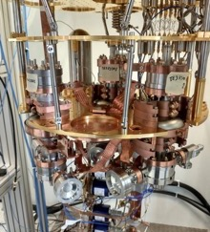
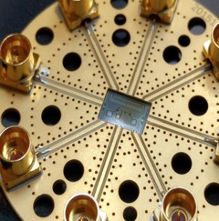
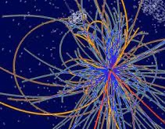
Science & Technology Innovation Chain
Materials
High-coherence devices
Systems integration
New platforms for
quantum computing & sensing
Quantum advantage
potential for scientific discovery
at every step of the chain

Slide 14


Center Mission and Co-Design
APPS
OPERATING
SYSTEM
INSTRUCTION
SET
HARDWARE
algorithms
high-level programming language
transpilation/compilation
quantum error correction/mitigation
control & measurement
design of devices … processor
fabrication of devices
materials for devices
vs.

Slide 15

Progress Assessment
Metrics
Meet/exceed milestones
Proposal appendix 13 - project timetable
  - quarterly updates/refinement JIRA/Confluence
  - boost promising research directions
Number, quality, impact of
peer-reviewed publications,
presentations
- ideally DOE/SQMS as lead funding source in acknowledgments
- report to FNAL for records
Internal and external evaluations via
- SQMS leadership
- Advisory Boards and DOE
PI participation
in center-wide activities
and meetings

Slide 16












Recent Highlights from SQMS Focus Areas
Comprehensive material characterization of commercial transmon qubits
MATERIALS
First quantum operation of the SRF-transmon system achieved
DEVICES
VQE for the square-octagonal Kitaev model
ALGORITHMS
PHYSICS & SENSING
Most sensitive search for dark matter-dark photons at specific frequencies
WORKFORCE DEVELOPMENT
2022 SQMS Summer Internship

Slide 17


SQMS Facilities Progress
Material Characterization Facilities
Advanced characterization techniques employed for first time and extended to qubit operational regimes
Foundries
New high-flexibility nanofabrication facility
at FNAL and NU
Materials testbeds
Qubits and materials measurements in the
most precise and sensitive environments
Physics Testbeds
Platforms enabling new particle searches
Computing Testbeds
2D and 3D-based quantum computer prototypes
Colossus
World’s largest dilution fridge at FNAL

Slide 18




Technology Thrust
Thrust Leader: Romanenko
Focus Area 1: Materials
Goal: Understand and mitigate the key mechanisms of decoherence in superconducting qubits and SRF cavities
Deliverables/metrics: achieve at least an order of magnitude improvement in coherence, SRF cavities > 10 seconds, 2D transmons > milliseconds with decrease in performance spread < 20%
Focus Area 2: Devices
Goal: Device performance test, integration and quantum controls development towards high coherence 2D and 3D SC architectures
Deliverables/metrics: develop quantum computer prototypes of 2D/3D architectures, deploy record sized dilution fridge to host the 3D/2D quantum processors

Slide 19




Science Thrust (focus for June PAC)
Thrust Leader: Harnik
Focus Area 3: Physics and Sensing
Goal: Exploit the center technological advancements for fundamental physics
Deliverables/metrics: develop and deploy search schemes with detection sensitivity orders of magnitude compared to state-of-the-art
Focus Area 4: Algorithms, Simulations
Goal: Investigate and develop quantum algorithms and simulations enabled by the groundbreaking SQMS 3D and 2D prototypes through co-design principles
Deliverables/metrics: simulations of the dynamics of theories approximating QCD, simulate LHC physics, plasma early universe conditions, quantum materials far from equilibrium, intermediate electron/phonon SC

Slide 20
Physics and Sensing 5-year Roadmap (focus for June PAC)
Year 1
Year 2
Year 3
Year 4
Year 5
DarkSRF
Multimode Cavity Axion Search
High B-Field Axion Search
Single Particle Penning Trap
Other Quantum Sensing Schemes
Tunable Dark Photon Search
Measure in LHe, 1st DarkSRF publication
Phase sensitive readout
Implement in DR, quantum regime!
Improve Q₀ towards 1e12
Nonlinearity studies
2-cavity multimode design
2-cavity 1st test
2- and 3- mode 1-cavity design
2- and 3- mode 1-cavity 1st test
Design and fabricate cavity
Trial runs, feedback
Study heterodyne vs photon counting
Data taking runs
Co-design w/ materials & devices
Searches w/ best cavities and qubits
Evaluate Nb₃Sn, NbTi Q₀ in high B
Evaluate search w/ AC B-field
Design high Q cavity geometry
Testing optimized cavities/squids
Prototype cavities & squids
1st next gen e- μ/μ_{B} measurements
Theory study of QIS for dark radiation detection, Quantum Sensor Network,
Evaluate SRF cavities for gravitational wave detection, DM with traps.
Notes:
Sam

Slide 21

Quantum control & measurement with SC qubits & cavities
transmon
circuit
SRF cavity

Slide 22





Quantum control & measurement with SC qubits & cavities
EM mode coupled
to transmon
Minimal description:
Jaynes-Cummings model
3d
oscillator
qubit
…
2d

Slide 23

Quantum control & measurement with SC qubits & cavities
Encode, manipulate and measure
quantum information
in the transmon,
using cavity for driving & readout
In the cavity mode
using transmon for control & readout
EM mode coupled
to transmon
…

Slide 24

Role of Materials Science
Slide from 2009:

Slide 25




Decoherence channels in 2D superconducting qubits: two-level systems, bulk substrate losses, quasiparticles
Other channels
(e.g. radiative decay)
Total decay rate ^{1,2,3}
Participation ratio E_{stored} /E_{total}
Each channel bounds T1:
Looking for changes channel-by-channel:
Lossy elements with known E_{stored} /E_{total}
Qubit frequency
Loss tangent
Al
1. Koch, J. et al. Physical Review A 76, 042319 (2007)
2. Wenner, J. et al. Applied Physics Letters 99, 113513 (2011)
3. Wang et al. Appl. Phys. Lett. 107, 162601 (2015)
4. Calusine, G. et al. Applied Physics Letters 112, 062601 (2018)
MS: Metal-Substrate | SA: Substrate-Air | MA: Metal-Air | MM: Metal-Metal

Slide 26







Pushing performance from materials to devices to quantum processors
NbO_{x}
10nm
Nb
Qubits/cavity devices microwave measurements
Material/superconducting analysis of qubits and cavities fragments
Qubits and cavities fabrication processes modifications guided by materials knowledge
Quantum processor of 2D and 3D architectures built with high coherence qubits

Slide 27















SQMS innovative approaches to QIS materials and devices characterization
PPMS- AFM/MFM
STM
Point-Contact Tunneling
Dissecting and studying fragments of microwave performance characterized devices
Leveraging DOE and SQMS partners user facilities
THz Spectroscopy
Magneto-optical
β-NMR/μSR

Slide 28









Electron Microscopy
XRR/XRD
APT
TOF-SIMS
XPS
AFM/MFM
Raman

Slide 29






Possible interface loss structures revealed by electron microscopy
Nb-Oxide interface
There is a ~4-6nm amorphous NbO_{x} layer on Nb metal surface both in the SRF cavity and the Rigetti transmon.
Si-air interface
A Thin amorphous Si-oxide layer (~2nm) is detected between Si/air interface.
(a)
cavity
Nb
O
side wall
NbO_{x}
Nb
Si
10nm
(b)
Transmon
NbO_{x}
Nb
10nm

Slide 30







Possible interface loss structures revealed by electron microscopy
Nb-Si interface
Nb-Si amorphous bi-layers at the Si/Nb interface formed during material deposition.
Josephson junction barrier
The Al/Al₂O₃/Al interface is wavy.
Existance of amorphous Al₂O₃ and amorphous SiO_{x} layer at Al/Si interface.
(b)
O
(a)
(b)
(a)
Si
Al
Nb
(c)
Al
(d)
Al
a-Al₂O₃
a-Al₂O₃
a-SiO₂
Si
2 nm
10 nm
Al
10 nm
Si

Slide 31

Discovery of niobium nano-hydride precipitates in superconducting transmon qubits
Scientific achievement
  First ever performed cryogenic microscopy studies of superconducting qubits lead to the discovery of the presence of hydride precipitates in the Rigetti Computing and other transmon qubit devices
Significance and Impact
  Niobium nano-hydrides are poorly superconducting phases that can cause qubit device performance limitations and degradation over time and with subsequent cooldowns
Details
  Cryogenic AFM, electron diffraction and high-resolution transmission electron microscopy (TEM) analyses are performed on the Nb films at room temperature and cryogenic temperature (106 K)
  The results suggest the existence of two possible types of Nb hydride domains in Nb grains: (i) ~5 nm-sized Nb hydride domain with irregular shapes; (ii) 10s~100 of nm-sized distinct Nb hydride domains
Lamellas of superconducting qubits from real Rigetti Computing processors are dissected via FIB-SEM at FNAL and studied for the first time via cryo-TEM
Cryogenic TEM, electron diffraction images of Rigetti 2D qubits , revealing the presence of hydrides precipitates in the niobium film at T=100K
J. Lee, Z. Sung, A. Murthy, M. Reagor, A. Grassellino, and A. Romanenko; https://arxiv.org/pdf/2108.10385.pdf
Work was performed at Fermi National Accelerator Laboratory material science lab and NUANCE user facility
Notes:
Notes: Include 200 word highlight summary….

Slide 32




3D record coherence cavities as sensitive probes for Nb₂O₅ (and other) loss tangents
340-450C treatments remove amorphous Nb₂O₅ hosting TLS
TOF-SIMS data on cavity cutouts
Very large TLS loss in Nb₂O₅
QIS record
Depth
A. Romanenko, R. Pilipenko, S. Zorzetti, D. Frolov, M. Awida, S. Belomestnykh, S. Posen, A. Grassellino, Phys. Rev. Appl. 13, 034032 (2020)

Slide 33


High Q cavities to characterize dielectrics loss tangents with very parts per billion accuracy
2.6 GHz materials test-bed has been commissioned to perform silicon loss studies with unprecedented accuracy of parts per billion
Also tunable cavity 5-8 GHz
M. Checchin et al Phys. Rev. Applied 18, 034013 – Published 7 September 2022

Slide 34


RF Characterization of MSE Sapphire Substrate
Achievement
Finished RF characterization of sapphire substrate used in previous round of qubit fabrication
  C-plane sapphire from MSE
Results:
Preliminary results suggest tanδ ≈ 5e-7
Limits 2-D transmon T₁ ~125 us
Next steps:
Making preparations to measure HEMEX sapphire with same setup
T = 100 mK
Notes:
Yale estimates: HEMEX limits T1 to 800 us, EFG limits T1 to 1000 us.

Slide 35



Silicon Sample Exchange with C²QA Collaborator Yale University
Collaborating with Yale University on sample measurement reproducibility (dielectric dipper)
Received previously measured high resistivity, DSP Si sample
Sample installed in new 6 GHz SRF characterization testbed
  Utilizing new, gold-plated O-free cooling setup to ensure adequate cooling to mK
RF Simulations:
  P_{Si, bulk} = 7.4e-4
  Expected Q_{0,empty} = 1E9
  Expected Q_{0,Si loaded} ~ ???
+
=
Notes:
DSP: double side polished
Yale has dipper method (in situ actuation of sample via piezo to enable measurements with and without sample). This is a quarter wave stub resonator

Slide 36














SQMS has launched a Nanofabrication Taskforce across four national qubit foundries
UChicago - Pritzker Nanofabrication Facility
Northwestern - NUFAB
FNAL/Uchicago, NIST, Rigetti, Northwestern foundries capabilities to work together in coordinated study to address material losses
Encapsulation strategies and bulk loss mitigation a priority
NIST - Boulder 2D Nanofabrication Facility
Mustafa Bal​
Associate Scientist​
Akshay Murthy
Associate Scientist
David Van Zanten​
Associate Scientist
Francesco Crisa’, PhD student
Shaojiang Zhu​​
Associate Scientist​
​
Rigetti - Fab-1 Integrated Circuit Foundry, Fremont CA
Ivan Nekrashevich​
Associate Scientist​
Pete Hopkins,
NIST
Florent Lecoq, NIST
Nick Zhelev, NU
Yuvraj Mohan
Rigetti Computing

Slide 37


2D SQMS R&D Qubit Chip and modeling/simulations work to estimate impact of subsystem losses
Standardized qubit chip
    8 fixed frequency uncoupled transmons ~ 4 – 5 GHz
      4 w/ double capacitive pads (for statistics)
      2 w/ interdigitated capacitive pads (most sensitive)
      2 w/ concentric capacitive pads (most insensitive)
    Anharmonicity ~ 220 MHz
    Readout resonators ~ 6 – 8 GHz
    Frequency multiplexing on single feedline
E-field distribution of different transmon geometries

Slide 38

First qubit results from FNAL group proving the importance of eliminating the pentoxide and take SQMS at the leading edge of coherence
Studies continue with more materials and passivation schemes under fabrication/evaluation
Goal is to reach world record coherence systematically above milliseconds
Manuscript in preparation

Slide 39








Round Robin experiment - Launched the first systematic cross-institutional benchmarking study of qubit performance
Fermilab
Rigetti
INFN/Gran Sasso
UColorado/NIST
Paper accepted

Slide 40




SQMS Devices Integration: research ongoing for 3D architecture

Slide 41





Progress in 3D architecture
Fermilab SRF group has demonstrated the world’s record photon lifetime in quantum regime with coherence up to 2 seconds
A. Romanenko et al, Phys. Rev. Applied 13, 034032, 2020
Single photon Fock state generation demonstrated
SQMS 3D QPU roadmap, courtesy of Tanay Roy

Slide 42


Large Cryogenics Facilities for quantum: Colossus
Ambient
80-K (Liquid Nitrogen)
4-K (Liquid Helium)
2-K (Superfluid Helium)
1-K (DR Still)
100-mK (MC 1)
20-mK (MC 2)
2m diameter volume x 1m high
Capitalizing on millions of dollars in previous investments in cryogenic infrastructure, we have launched the design of a record size dilution fridge, capable of hosting thousands of qubits, with the goal to host our first quantum computer prototype at Fermilab, or large networks of quantum sensors for physics experiments

Slide 43


Larger Cryogenic Facilities – a Concept for a “Quantum Data Center”
The Colossus developments have attracted substantial interest from industry sich as IBM, Rigetti, Form Factor, etc. The use of liquid helium rather than mechanical coolers makes the construction of large individual platforms possible but can also support multiple small cryostats from a central plant.
Image:
Fermilab
DISTRIBUTION SYSTEM
Central LHe plant
Courtesy of M. Hollister

Slide 44




Carolyn B. Parker
first African American woman
to earn a postgraduate degree
in physics
Postdoctoral Fellowship
increase
representation
and inclusion of
URM individuals
SQMS summer internships
SQMS summer schools

Slide 45






Ecosystem Advisory Board

Slide 46





Science, Technology and Management Advisory Board

Slide 47




Playing an important role in the national QIS ecosystem
The National Quantum Centers bridge the gap from blue sky ideas to prototypes to commercial platforms

Slide 48


