Slide 1
Long-Baseline Neutrino Experiment
Elaine McCluskey
Fermilab Annual Science and Technology Review
September 5-7, 2012

Slide 2

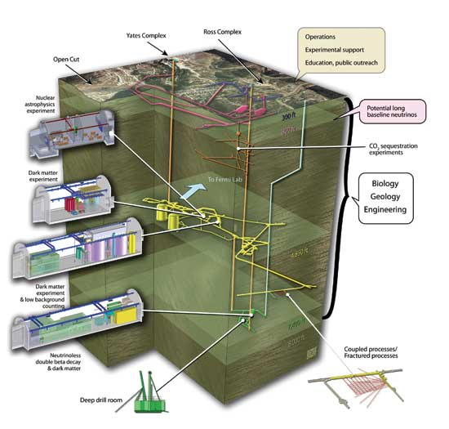
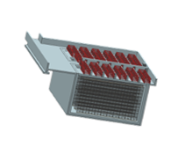
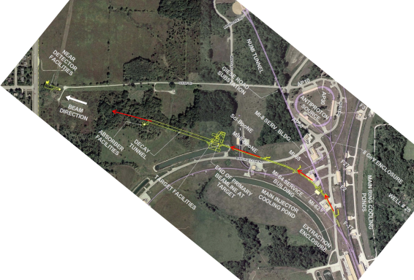
Long Baseline Neutrino Experiment
New Neutrino Beam at Fermilab…
Directed towards a distant detector at the
Sanford Underground Research Facility in Lead, SD
10 kton Liquid Argon TPC Far Detector
just below the surface

Slide 3
Outline
Scope
Overview of Project Organization
Developments since June 2011
Physics Goals and Sensitivity
Project Conceptual Design development
Plans for the coming year
Summary

Slide 4
The LBNE Project Scope for the 1st project of the LBNE program
A new neutrino beam at Fermilab
- Aimed at Homestake
- Spectrum optimized for this distance
- Upgradeable to ≥ 2.3 MW proton beam power
A 10 kt LAr TPC detector on the surface at Homestake
- In a pit just below the natural grade
- Shielded against hadronic and EM component of CR showers
Tertiary muon detectors to monitor the neutrino beam
- Ionization chambers
- Variable pressure gas Cherenkov detectors
- Stopped muon detectors
We have been strongly encouraged by OHEP to achieve CD-1 by the end of the calendar year 2012.

Slide 5
Long-Baseline Neutrino Experiment Collaboration
Alabama: S. Habib, I. Stancu
Argonne: M. D’Agostino, G. Drake. Z. Djurcic, M. Goodman, V. Guarino, S. Magill, J. Paley, H. Sahoo, R. Talaga, M. Wetstein
Boston: E. Hazen, E. Kearns, S. Linden
Brookhaven: M. Bishai, R. Brown, H. Chen, M. Diwan, J. Dolph, G. Geronimo, R. Gill, R. Hackenburg, R. Hahn, S. Hans, Z. Isvan, D. Jaffe, S. Junnarkar, S.H. Kettell, F. Lanni, Y. Li, L. Littenberg, J. Ling, D. Makowiecki, W. Marciano, W. Morse, Z. Parsa, V. Radeka, S. Rescia, N. Samios,R. Sharma, N. Simos, J. Sondericker, J. Stewart, H. Tanaka, H. Themann, C. Thorn, B. Viren, S. White, E. Worcester, M. Yeh, B. Yu, C. Zhang
Caltech: R. McKeown, X. Qian
Cambridge: A. Blake, M. Thomson
Catania/INFN: V. Bellini, F. La Zia, F. Mammoliti, R. Potenza,
Chicago: E. Blucher, M. Strait
Colorado: S. Coleman, R. Johnson, S. Johnson, A. Marino, E. Zimmerman
Colorado State: M. Bass, B.E. Berger, J. Brack, N. Buchanan, D. Cherdack, J. Harton, W. Johnston, W. Toki, T. Wachala, D. Warner, R.J.Wilson
Columbia: R. Carr, L. Camillieri, C.Y. Chi, G. Karagiorgi, C. Mariani, M. Shaevitz, W. Sippach, W. Willis
Crookston: D. Demuth
Dakota State: B. Szcerbinska
Davis: M. Bergevin, R. Breedon, D. Danielson, J. Felde, C. Maesano, M. Tripanthi, R. Svoboda, M. Szydagis
Drexel: C. Lane, S. Perasso
Duke: T. Akiri, J. Fowler, A. Himmel, Z. Li, K. Scholberg, C. Walter, R. Wendell
Duluth: R. Gran, A. Habig
Fermilab: D. Allspach, M. Andrews, B. Baller, E. Berman, R. Bernstein, V. Bocean, M. Campbell, A. Chen, S. Childress, A. Drozhdin, T. Dykhuis, C. Escobar, H. Greenlee, A. Hahn, S. Hays, A. Heavey, J. Howell, P. Huhr, J. Hylen, C. James, M. Johnson, J. Johnstone, H. Jostlein, T. Junk, B. Kayser, M. Kirby, G. Koizumi, T. Lackowski, P. Lucas, B. Lundberg, T. Lundin, P. Mantsch, A. Marchionni, E . McCluskey, S. Moed Sher, N. Mokhov, C. Moore, J. Morfin, B. Norris, V. Papadimitriou, R. Plunkett, C. Polly, S. Pordes, O. Prokofiev, J.L. Raaf, G. Rameika, B. Rebel, D. Reitzner, K. Riesselmann, R. Rucinski, R. Schmidt, D. Schmitz, P. Shanahan, M. Stancari, A. Stefanik, J. Strait, S. Striganov, K. Vaziri, G. Velev, T. Wyman, G. Zeller, R. Zwaska
Hawai’i: S. Dye, J. Kumar, J. Learned, J. Maricic, S. Matsuno, R. Milincic, S. Pakvasa, M. Rosen, G. Varner
Houston: L. Whitehead
Indian Universities: V. Singh (BHU); B. Choudhary, S. Mandal (DU); B. Bhuyan [IIT(G)]; V. Bhatnagar, A. Kumar, S. Sahijpal(PU)
Indiana: W. Fox, C. Johnson, M. Messier, S. Mufson, J. Musser, R. Tayloe, J. Urheim
Iowa State: I. Anghel, G.S. Davies, M. Sanchez, T. Xin
IPMU/Tokyo: M. Vagins
Irvine: G. Carminati, W. Kropp, M. Smy, H. Sobel
Kansas State: T. Bolton, G. Horton-Smith
LBL: B. Fujikawa, V.M. Gehman, R. Kadel, D. Taylor
Livermore: A. Bernstein, R. Bionta, S. Dazeley, S. Ouedraogo
London: A. Holin, J. Thomas
Los Alamos: M. Akashi-Ronquest, S. Elliott, A. Friedland, G. Garvey, E. Guardincerri, T. Haines, D. Lee, W. Louis, C. Mauger, G. Mills, Z. Pavlovic, J. Ramsey, G. Sinnis, W. Sondheim, R. Van de Water, H. White, K. Yarritu
Louisiana: J. Insler, T. Kutter, W. Metcalf, M. Tzanov
Maryland: E. Blaufuss, S. Eno, R. Hellauer, T. Straszheim, G. Sullivan
Michigan State: E. Arrieta-Diaz, C. Bromberg, D. Edmunds, J. Huston, B. Page
Minnesota: M. Marshak, W. Miller
MIT: W. Barletta, J. Conrad, B. Jones, T. Katori, R. Lanza, A. Prakash, L. Winslow
NGA: S. Malys, S. Usman
New Mexico: J. Mathews
Notre Dame: J. Losecco
Oxford: G. Barr, J. de Jong, A. Weber
Pennsylvania: S. Grullon, J. Klein, K. Lande, T. Latorre, A. Mann, M. Newcomer, S. Seibert, R. vanBerg
Pittsburgh: D. Naples, V. Paolone
Princeton: Q. He, K. McDonald
Rensselaer: D. Kaminski, J. Napolitano, S. Salon, P. Stoler
Rochester: L. Loiacono, K. McFarland, G. Perdue
Sheffield: V. Kudryavtsev, M. Richardson, M. Robinson, N. Spooner, L. Thompson
SDMST: X. Bai, C. Christofferson, R. Corey, D. Tiedt
SMU.: T. Coan, T. Liu, J. Ye
South Carolina: H. Duyang, B. Mercurio, S. Mishra, R. Petti, C. Rosenfeld, X Tian
South Dakota: D. Barker, J. Goon, D. Mei, W. Wei, C. Zhang
South Dakota State: B. Bleakley, K. McTaggert
Syracuse: M. Artuso, S. Blusk, T. Skwarnicki, M. Soderberg, S. Stone
Tennessee: W. Bugg, T. Handler, A. Hatzikoutelis, Y. Kamyshkov
Texas: S. Kopp, K. Lang, R. Mehdiyev
Tufts: H. Gallagher, T. Kafka, W. Mann, J. Schnepps
UCLA: K. Arisaka, D. Cline, K. Lee, Y. Meng, A. Teymourian, H. Wang
Virginia Tech.: E. Guarnaccia, J. Link, D. Mohapatra
Washington: H. Berns, S. Enomoto, J. Kaspar, N. Tolich, H.K. Tseung
Wisconsin: B. Balantekin, F. Feyzi, K. Heeger, A. Karle, R. Maruyama, B. Paulos, D. Webber, C. Wendt
Yale: E. Church, B. Fleming, R. Guenette, K. Partyka, A. Szelc
347 members
62 institutions
5 countries
Growing modestly since technology decision

Slide 6
LBNE Collaboration Groups
Physics Working Group
Long-Baseline Physics
Short-Baseline Physics
Supernovae
Proton Decay
Atmospheric ν
High Energy ν
Low Energy ν
GLoBES Coordinator
Physics Tools Group
LAr Electron/Photon & Transport
FD Simulation Group
FD Event Reconstruction
Cross Sections & Nuclear Model
Cosmic Rays & Cosmogenics
ND Simulation
ND Event Reconstruction
Radiological Backgrounds
Many people involved in many aspects.

Slide 7
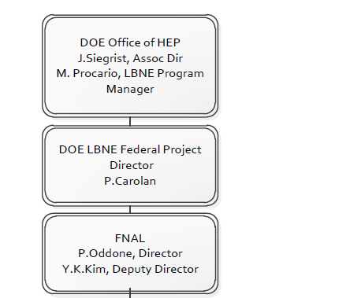
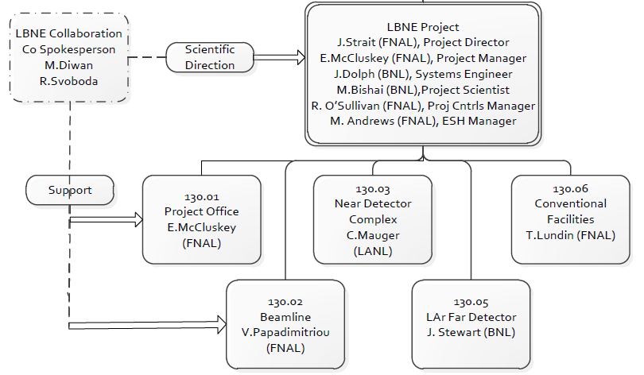
LBNE Project Organization
Fermilab is the lead laboratory.
The BNL/FNAL/LANL project leadership are well integrated.
Project and Collaboration integration:
Project leaders are Collaboration members.
Collaboration is heavily involved in Project planning and defining the physics
Project leadership are members of the Collaboration Executive Committee.
Spokespeople are members of the Project Management Board.

Slide 8
Project decisions since last S&T Review June 2011
Beamline configuration chosen in July 2011 as ‘MI-10 Shallow’ to move target, decay pipe, and absorber out of the aquifer to reduce tritium production and reduce cost.
Liquid Argon TPC was selected in January 2012 as the Far Detector technology with Directorate and DOE-OHEP concurrence after extensive reviews, reports, and discussions for its 3D position resolutions and particle identification in large volumes.

Slide 9
Actions since last S&T Review June 2011
March CD-1 Director’s review held for full LBNE scope with Total Project Cost ~ $1.9B
Fermilab simultaneously received direction from Dr. Brinkman to replan LBNE into a more affordable phased program that produces important science at each phase.
Project team first reworked March design to reduce cost to ~$1.5B, many ideas were already planned, but not executed in time for the review
Fermilab’s Reconfiguration team studied three -Phase 1 options in detail, based on LBNE costs
  10-kt surface detector at SURF with new beamline
  30-kt surface detector at Ash River reusing NuMI beam
  15-kt underground detector at Soudan reusing NuMI beam

Slide 10
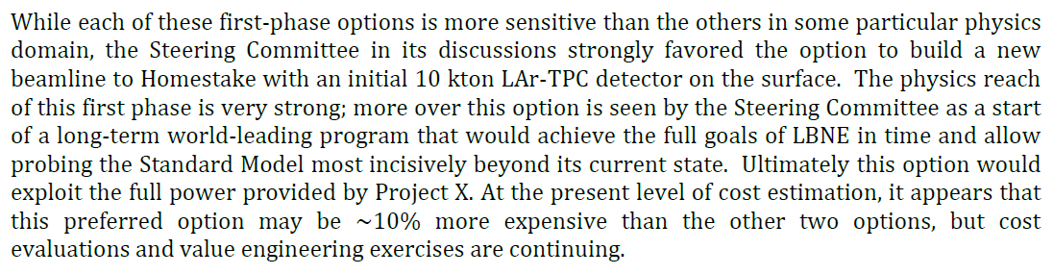
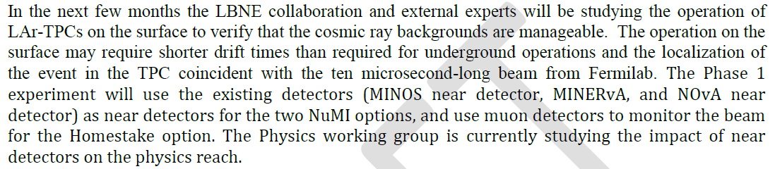
Reconfiguration Steering Committee Recommendations http://www.fnal.gov/directorate/lbne_reconfiguration/index.shtml
ctor.
But there are risks
First studies show these are reasonable, but work continues

Slide 11
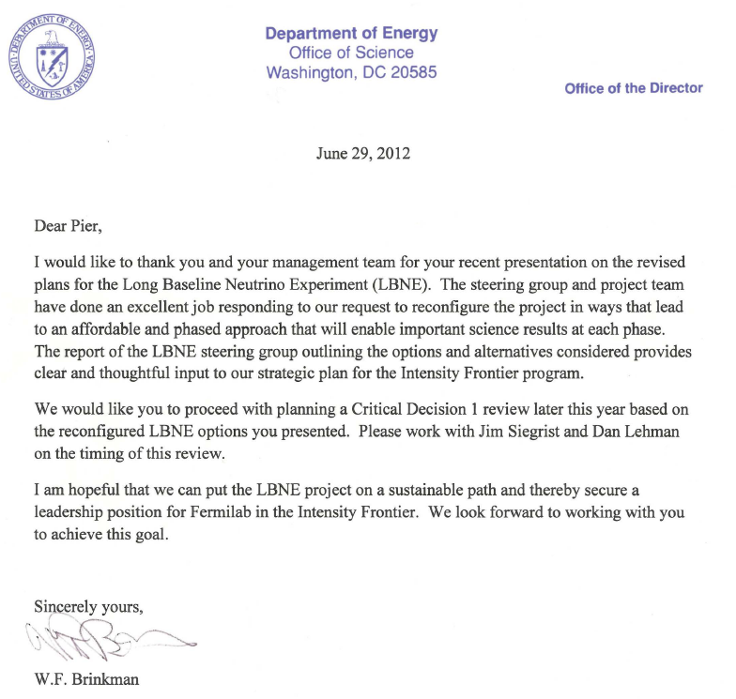
DOE Responds
NuFact 2012

Slide 12
Phased LBNE Program
The preferred (10 kt at SURF with new beamline) configuration would be the first step in a phased program.
1st Project: LBNE would determine the sign(Δm²₃₂) and measure δ_{CP}, as well as measuring other oscillation parameters: θ₁₃, θ₂₃, and |Δm²₃₂|.

Slide 13
Phased Program Possibilities
Subsequent phases would include:
  Build a highly capable near neutrino detector
  - reduce systematic errors on the oscillation measurements
  - enable a broad program of short-baseline neutrino physics.
  Increase far detector mass from 10 to 35 kt at 4850L (4300 mwe) at Homestake
  Staged increase in beam power from 700 kW to 2.3 MW with new proton source at Fermilab, Project X
Additional national or international collaborators could help accelerate the implementation of the full LBNE program.
  $135M to put 10 kt detector underground in lieu of surface
  $130M to add near neutrino detector

Slide 14
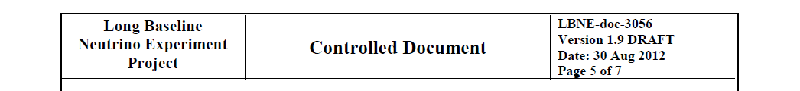
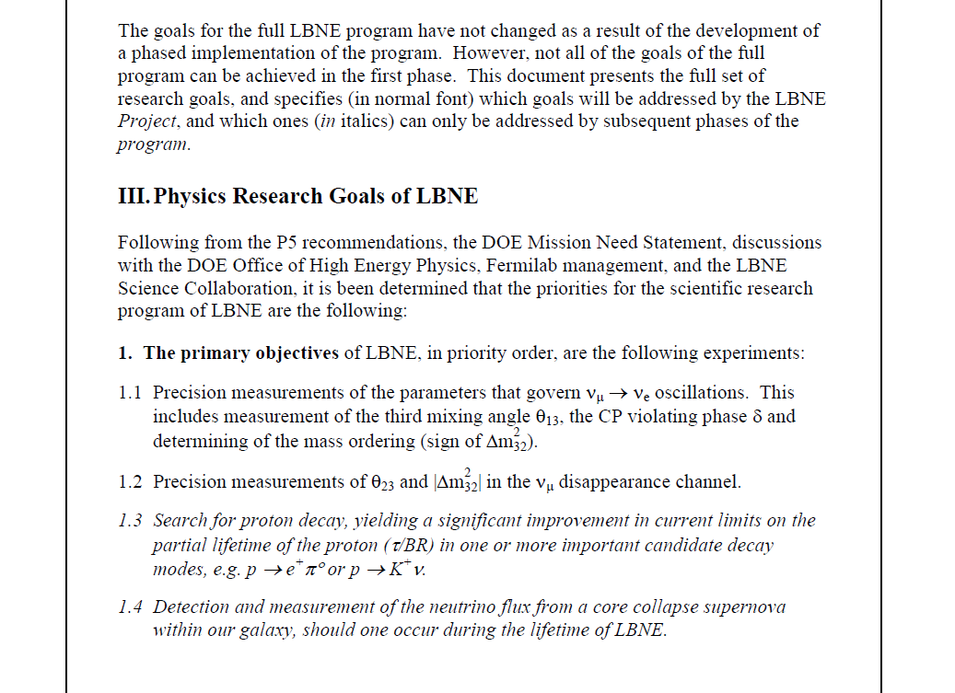
Outline
A
B
C
REVISION IN DRAFT FORM

Slide 15
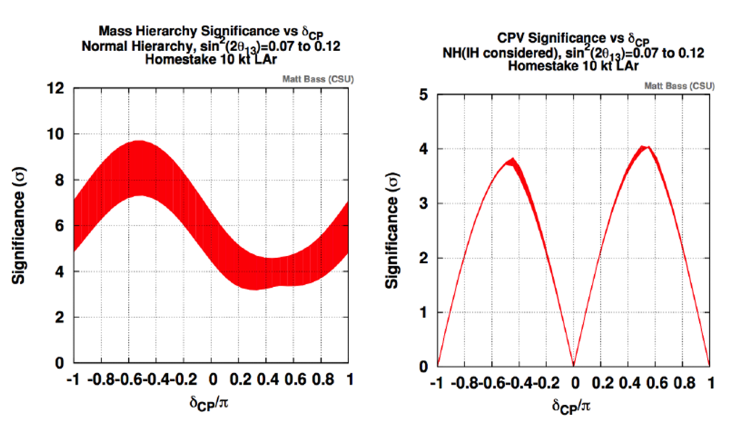
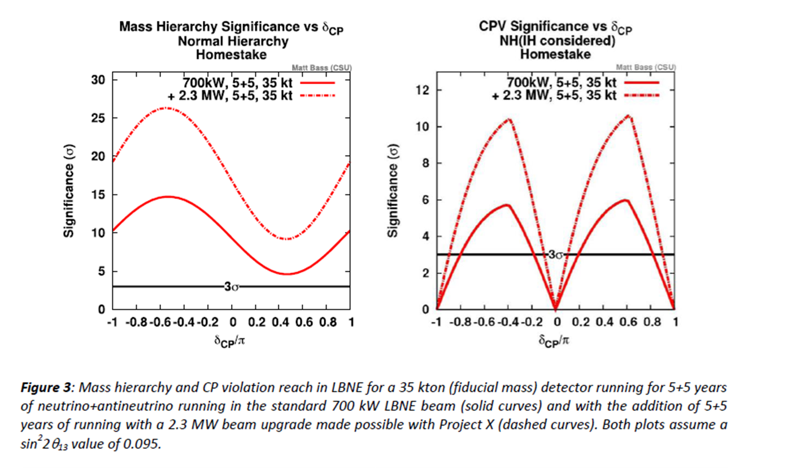
Performance of LBNE:
Long-Baseline ν_{μ} → ν_{e} Oscillations
10 kt far detector (1st phase of LBNE) leveraging NOvA & T2K
Mass hierarchy reach is significant
Value of sin²2θ₁₃ does not influence CPV
35 kt far detector,
with and without Project X
With 2.3 MW CPV reach is very significant

Slide 16
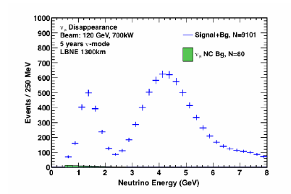
Performance of LBNE:
Long-Baseline ν_{μ} → ν_{e} Oscillations
Reach for 35 kt FD
Spectra for oscillated ν_{μ} events for 34 kt at 1300 km at sin²2θ₁₃= 0.1

Slide 17
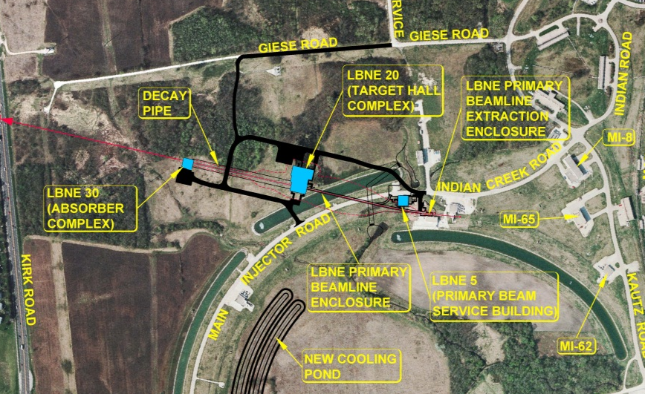
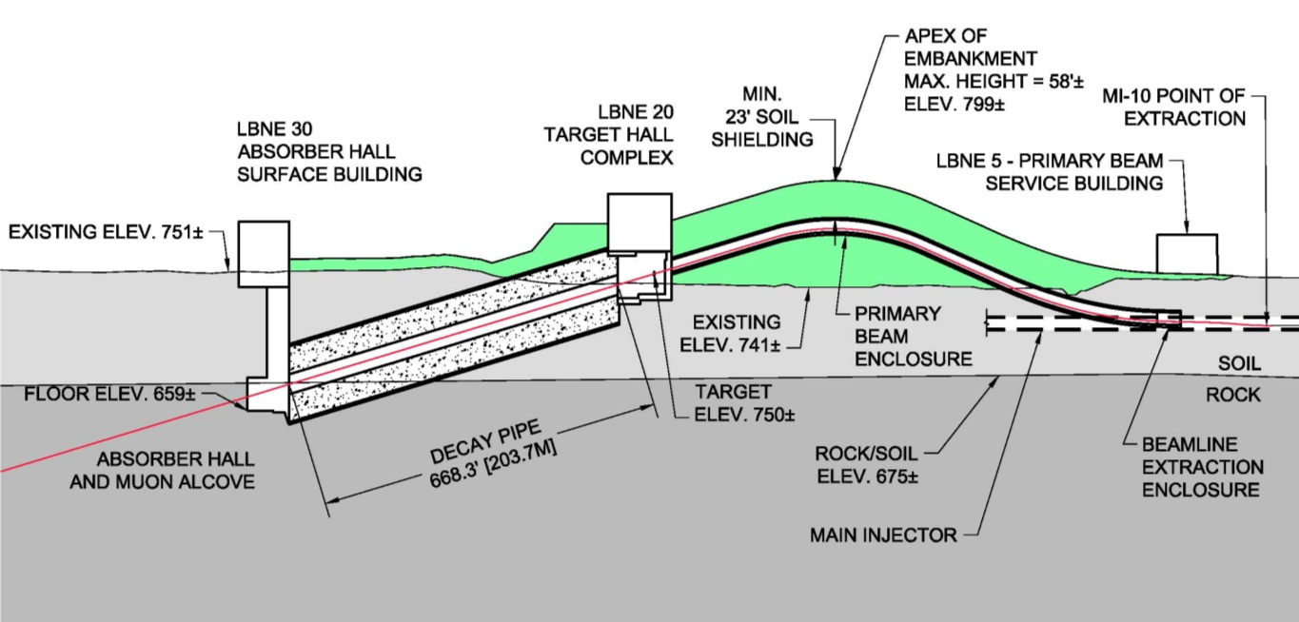
Beamline Scope

Slide 18
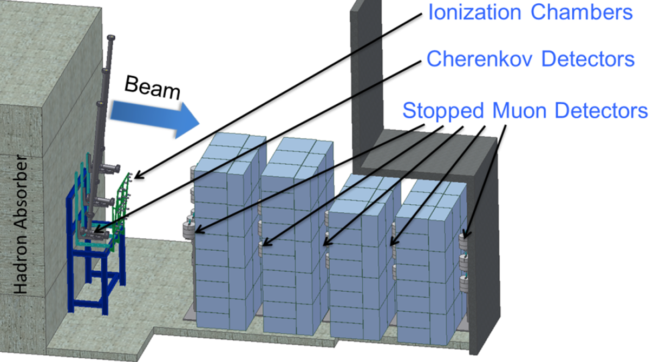

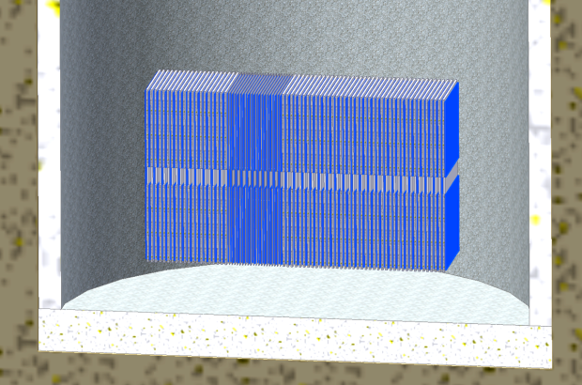

Muon Detectors Scope
Current Project does not include a near neutrino detector.
Tertiary muon detectors from the March Reference Design are retained.
Initial studies conclude there are viable strategies adequate for the initial period of LBNE running.
Possible backup plan: “Mini-Detector-in-a-Shaft”
Cost ~$30M, mainly conventional facilities
Non-DOE collaborators could eventually give us jointly the resources to build a near neutrino detector.

Slide 19
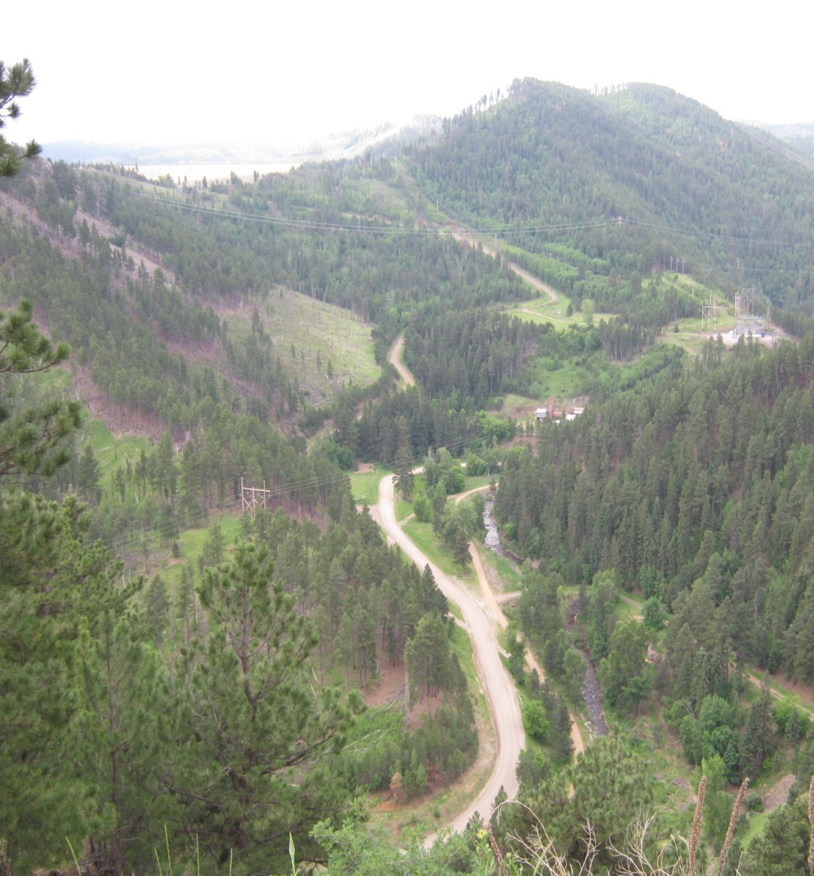
Far Detector Scope
Surface site off the main campus at SURF near the Oro Hondo substation and exhaust fan
10 kt LAr TPC at the “surface”
Close partnership with SURF, who will lead design and construction of LBNE conventional facilities at this site

Slide 20
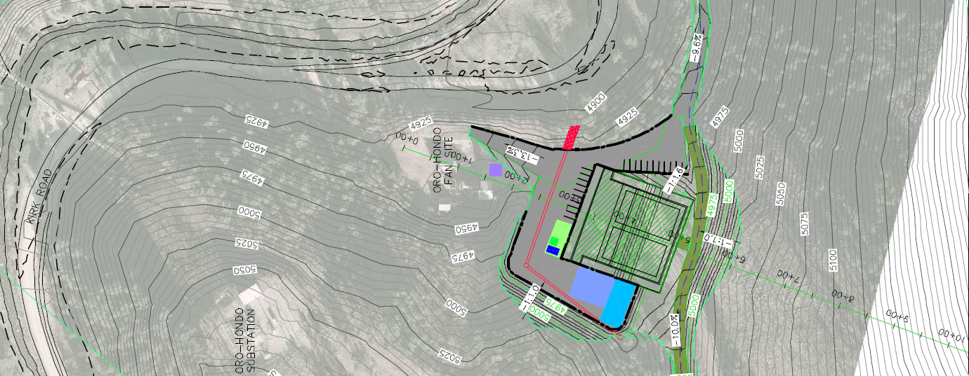
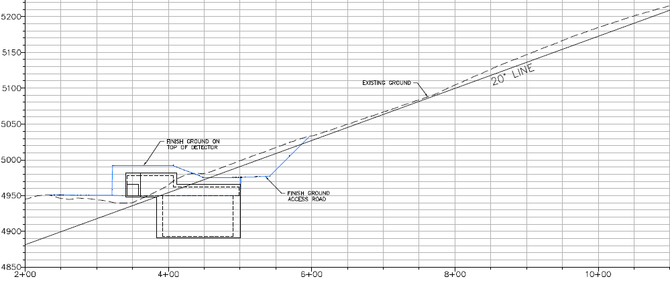
Far Detector Scope
ν beam
Siting against hill in direction of Fermilab provides shielding for cosmic ray muons
LAr TPC
ν beam

Slide 21
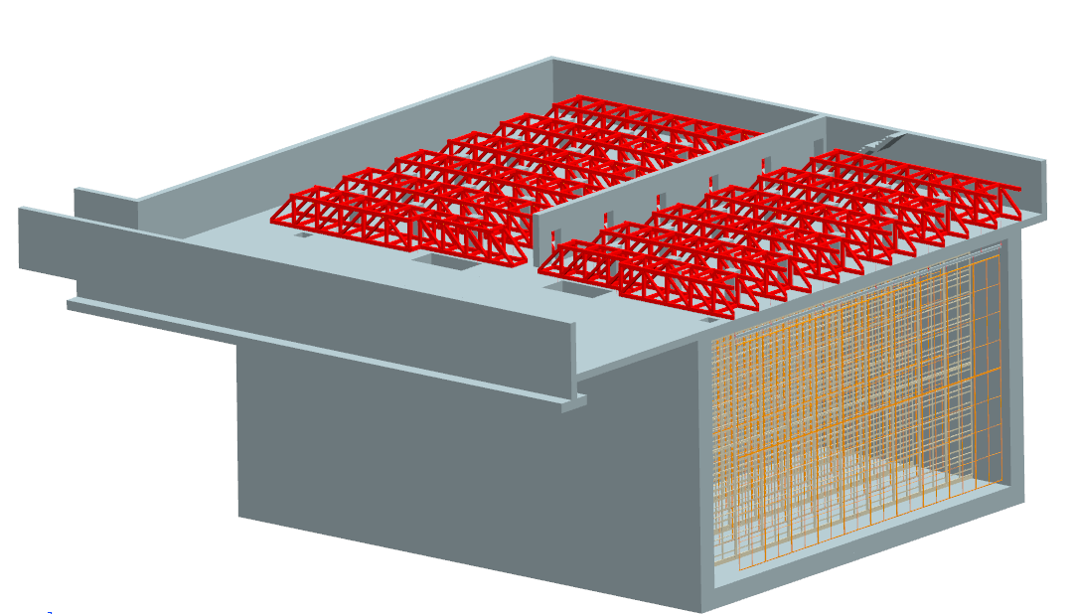
Far Detector Scope
INSIDE OF DETECTOR HALL
Beam
ASSEMBLY SPACE
Basic detector design is the same, only shrunk from 2 x 17 kt to 2 x 5 kt fiducial mass
Drift length reduced from 3.7 m to 2.3 m to reduce electric field distortions

Slide 22
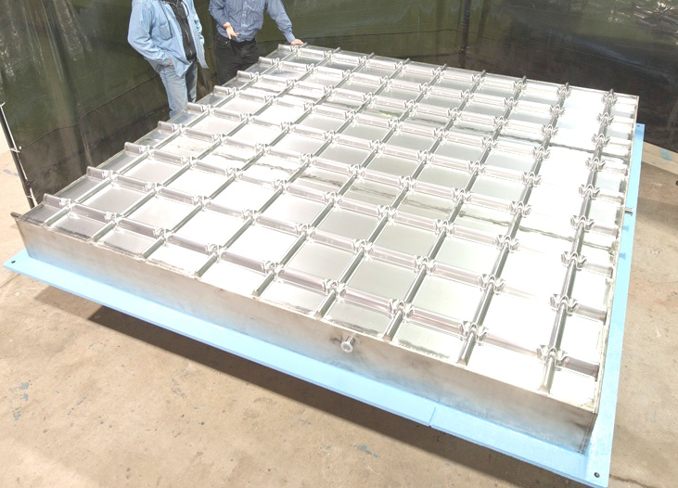
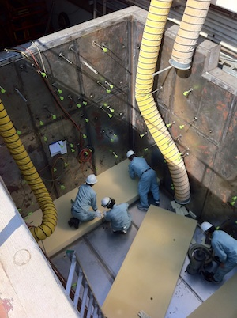
LAr-FD Prototyping
LAr-FD prototyping in LBNE Project is part of larger program.
Built 3mx3m membrane wall panel in 2011 to demonstrate technology
Currently constructing 35 ton membrane cryostat prototype in PC4, expect to be operational in 2013
Currently planning how to use it beyond cryo testing
  Subsystem components
  System test of scaled-down detector

Slide 23
Funding Profile from DOE ($M)
CD-0
CD-1
CD-2/3a
CD-3b
CD-4
 | FY10 | FY11 | FY12 | FY13 | FY14 | FY15 | FY16 | FY17 | FY18 | FY19 | FY20 | FY21
PED | - | - | 4 | 16 | 28 | 34 | 28 | - | - | - | - | - | 110
CON | - | - | - | - | - | - | 10 | 70 | 130 | 160 | 160 | 133 | 663
OPC | 17 | 17 | 17 | 10 | - | - | - | - | - | - | - | - | 61
TOTAL | 17 | 17 | 21 | 26 | 28 | 34 | 38 | 70 | 130 | 160 | 160 | 133 | 834

Slide 24
Cost Estimate Summary (AY$M)
37% contingency on $570M budget to go (FY13 and beyond)

Slide 25
Schedule

Slide 26
Plans for coming year
DIrector’s CD-1 Review: 25-27 September
DOE CD-1 Review: 30 Oct – 1 Nov
Achieve CD-1 approval by end of Dec 2012
Work on non-DOE contributions to enable near neutrino detector and far detector underground, in time to include in CD-2 baseline
Begin preliminary design
  Geotechnical work at both sites
  LAr prototyping
  Tertiary muon detector prototyping
  Target and horn design

Slide 27
Summary
LBNE is planning to achieve CD-1 in 2012 and has the strong support of DOE and Fermilab.
The present LBNE Project will achieve the primary long-baseline ν_{μ} → ν_{e} oscillation measurement goals.
A phased LBNE program provides a path for scope opportunities to the present LBNE Project with non-DOE contributions and collaborators, to increase scientific capabilities for proton decay searches and neutrino astrophysics.

