Slide 1
LBNF MI Extraction Area Bus & LCW Relocation Preliminary Design Review
Karlton E. Williams, II
13 December 2022
v3 – posted 12 December 2022

Slide 2
Who am I, a few highlights
Working in shops as machinist, mechanic, draftsman, since 1973
USN, 1975-1980, E-5 / Machinery Repairman 2nd Class Petty Officer
Northampton Community College, 1988, AS Engineering, AAS Design Technology
Hired in 1990 for the LINAC Upgrade, became the TM/CC for all of the piping for that project, as well as the initial start-up of the LCW systems
AD/MS Fluids Technician, 1993 - 1998
Northern Illinois University, 1996, BS Physics, Energy Emphasis
Lead or sole TM/CC for all of the Main Injector LCW and gas lines, 1993 – 1997
Project manager for the NuMI Upgrades, 2008 – 2013
Machine Engineer for Fluid Systems, 1998 – about 2016
Part of original crew for LBNE project, 2007 on, for all of LBNF LCW and RAW system development thru Preliminary Design Reviews

Slide 3
My Team
I’d like to thank my team, especially:
Scott Oplt
Dave Holeman
Dave Hixson
Dez Deshpande
Please note: This review package also serves as a turnover package, as Dave Hixson inherits the design after this review

Slide 4
Outline
Overview
Purpose
Scope
LCW
6” MI Global Headers
Quad Location Manifolds
MI-14 LCW and Fluorinert lines
LBNF PB Fill Line
Bus
1” x 4”, 2-5/8” Dipole bus
2-1/8” Quadrupole Bus
Fluorinert Systems
Enclosure Utilities
Cost & Schedule Estimates
Risks & Issues
Summary

Slide 5
Overview - Purpose
LBNF Extraction Beamline installation in the MI-10 Main Injector region requires rerouting of LCW main headers, manifolds, and bus runs, as well as kicker Fluorinert systems
This review presents the modifications and pathways considered as the best fit choice, and offers an opportunity for others to see and comment on the proposed modifications
This Preliminary Design Review focuses on the LCW and Bus modifications required
This represents the majority of the fluids relocation work required
The decision to change the WBS to include Fluorinert systems was made too late to cover fully in this review, rests currently with Power Supply Systems in those WBS’s

Slide 6
Overview - Scope
Modifications begin at the DS wall of the MI10 enclosure alcove
Extend from Q-103 thru Q-107 / Q-108 region
Major relocation of LCW headers
Extensions to LCW manifolds and MI-14 lines
Removal and reinstallation of LCW and Fluorinert from enclosure thru Gerardi boxes
Fluorinert systems are not included in this WBS, referenced only as needed
Addition of LBNF PBE fill line
Temporary removal & replacement of dipole bus
Major relocation of quadrupole bus
Requires relocation of some utilities
Fluorinert systems are referenced where necessary for the work involved, and in the References page, but are not included in this review

Slide 7
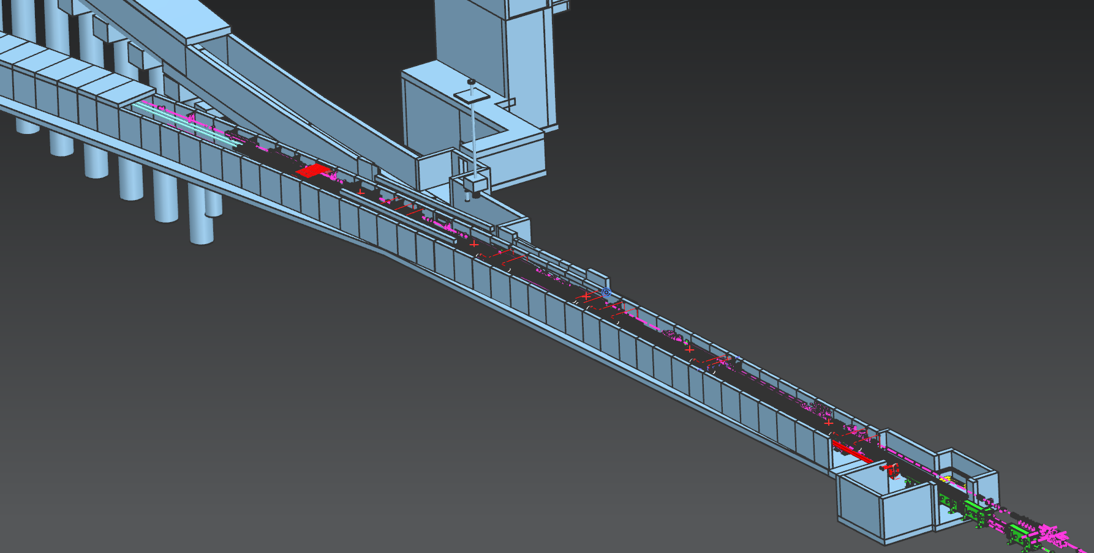
Affected Area Q-103 trhu Q-108
Q-108
Q-103

Slide 8
LCW – Global 6” Headers General Layout, Enclosure Run, Q-103 thru Q-108
Between Q-103 thru Q-108, the LCW headers are to be relocated from above magnets at chest height, to high up on aisle side, above current lighting fixtures
New location must avoid magnet mover and other equipment
Requires relocation of some utilities and lighting along upper aisle wall
Cell taps for manifolds can remain in the general Z axis location for each cell manifold connection
Isolation valves remain connected to header, move with it to the new path, and are located above aisle side for easy access
Same or similar hoses connect to the manifolds
Strategic cutting of pipe should result in all of it being reusable
If not reusable, add up to $25k and 80 hours labor

Slide 9
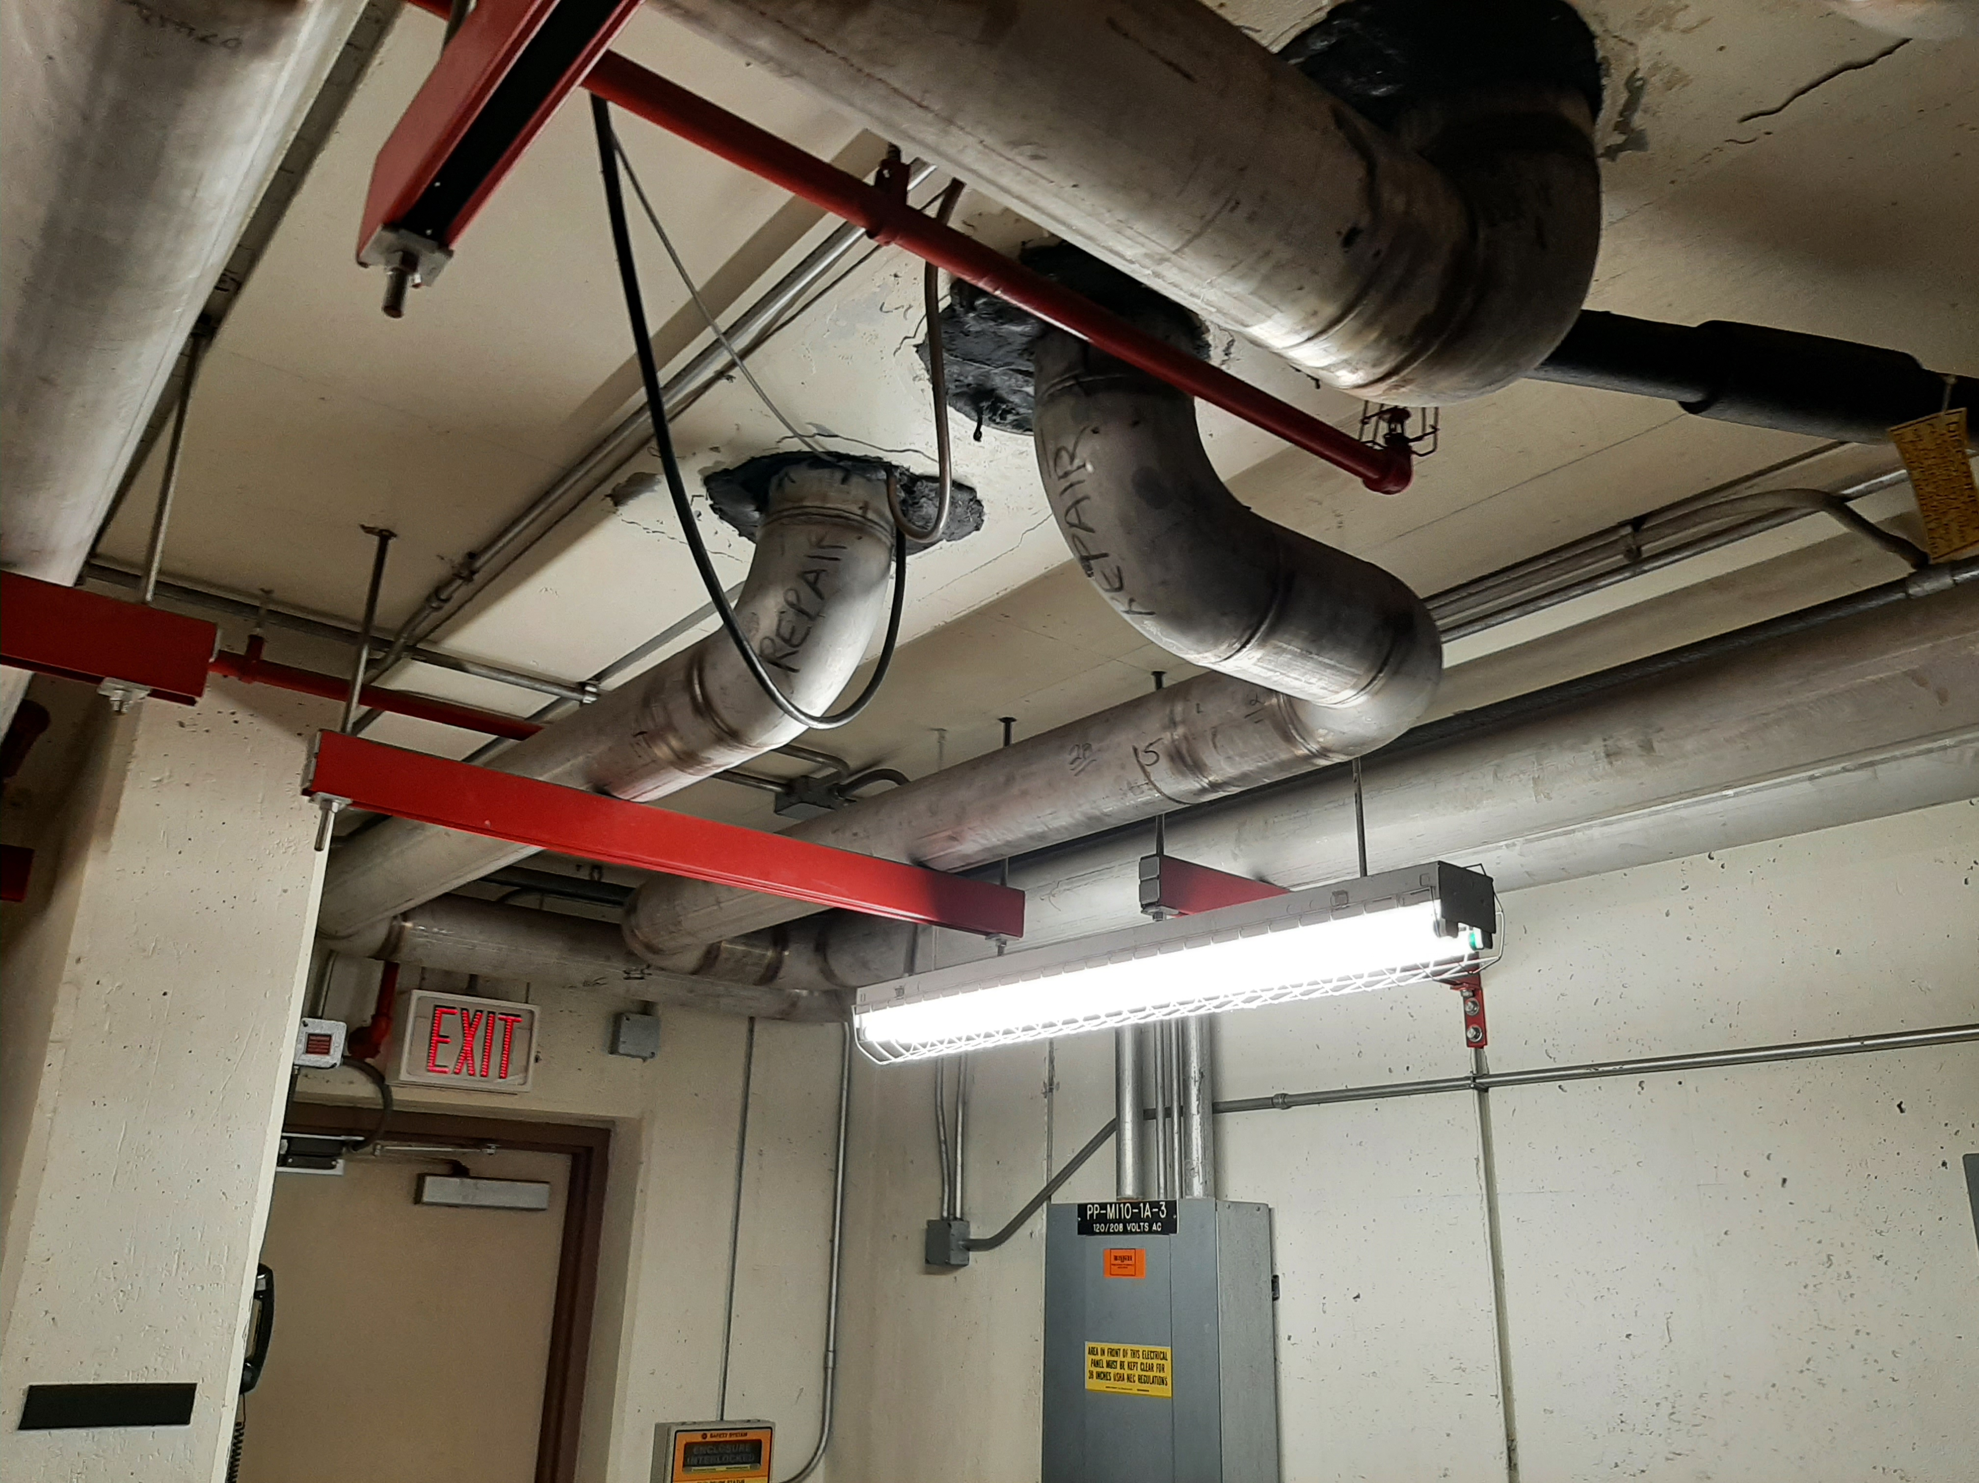
Affected Area MI-10 Alcove
6” HEADERS IN CEILING AT
Mi-10 ALCOVE IN ENCLOSURE

Slide 10
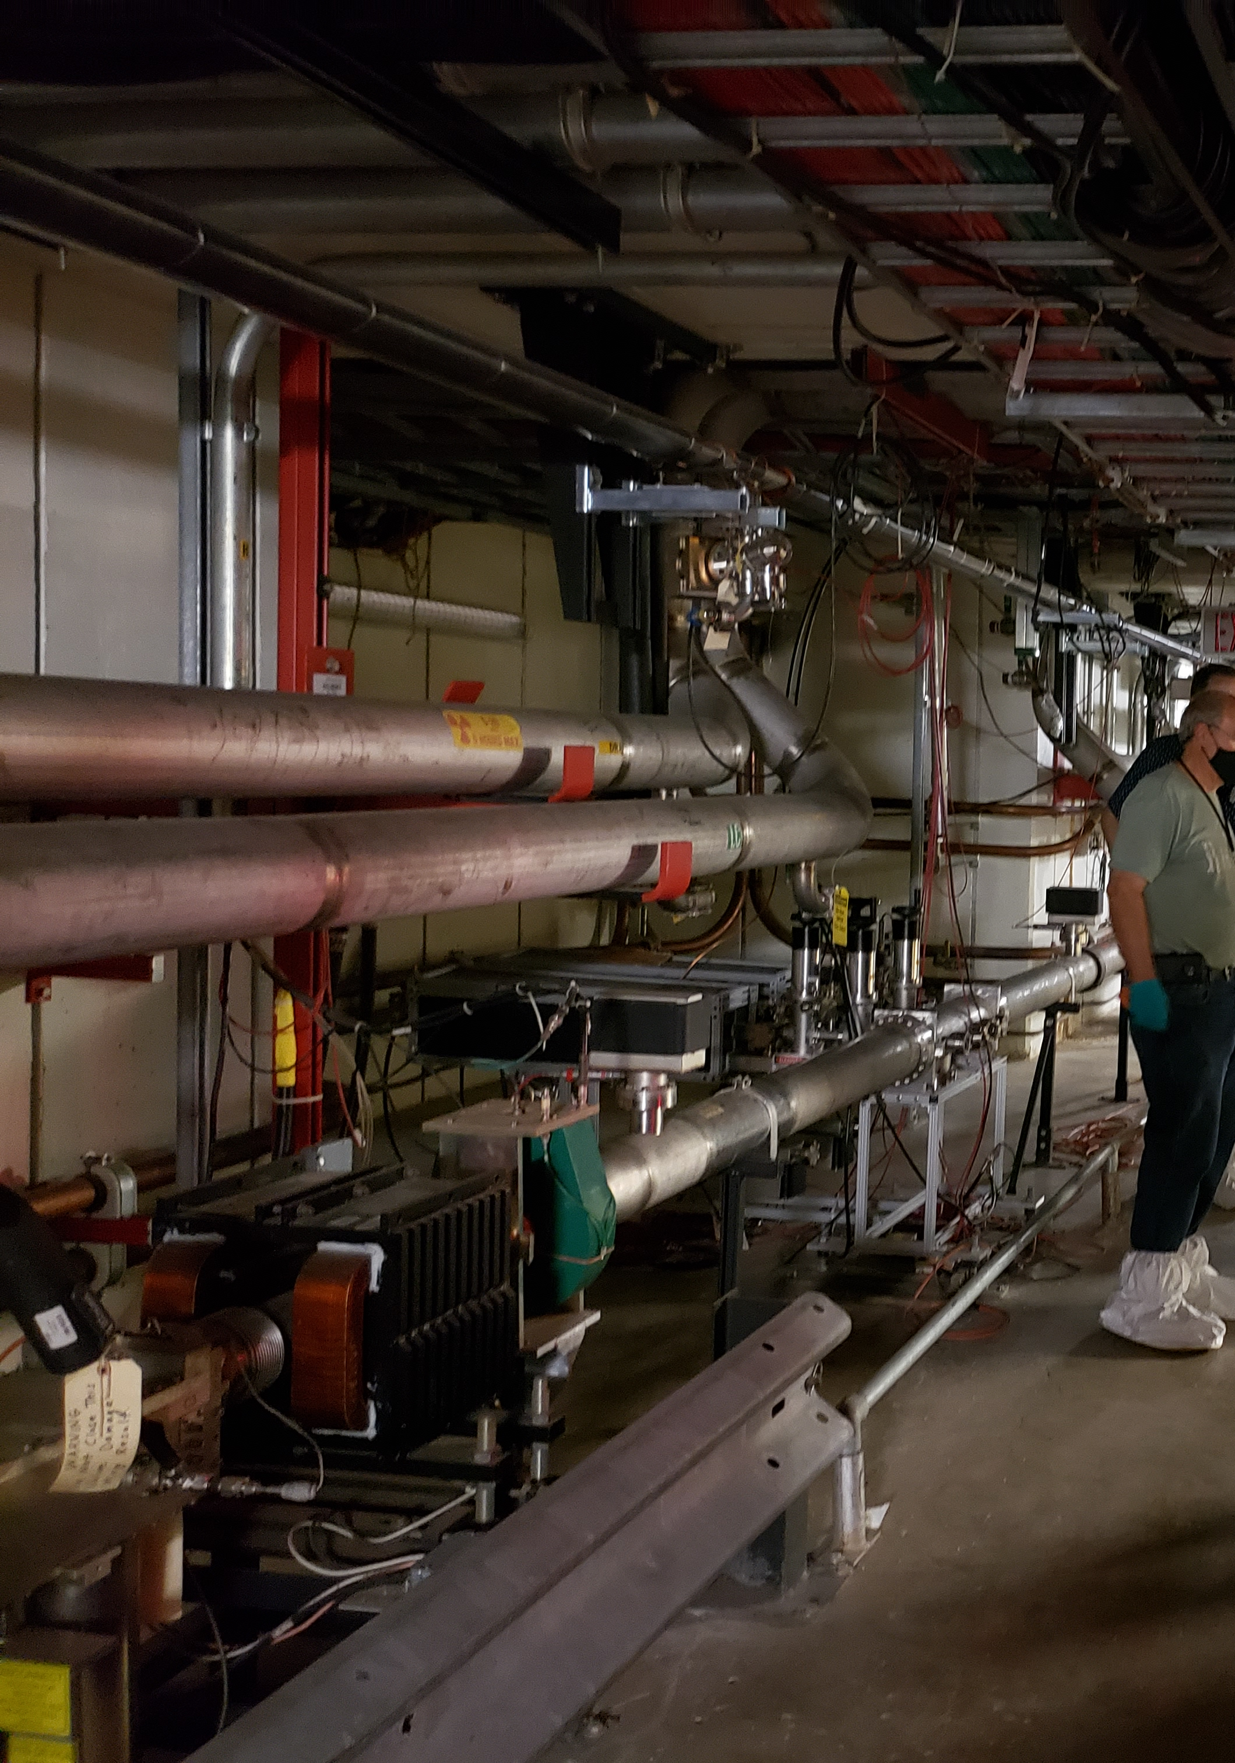
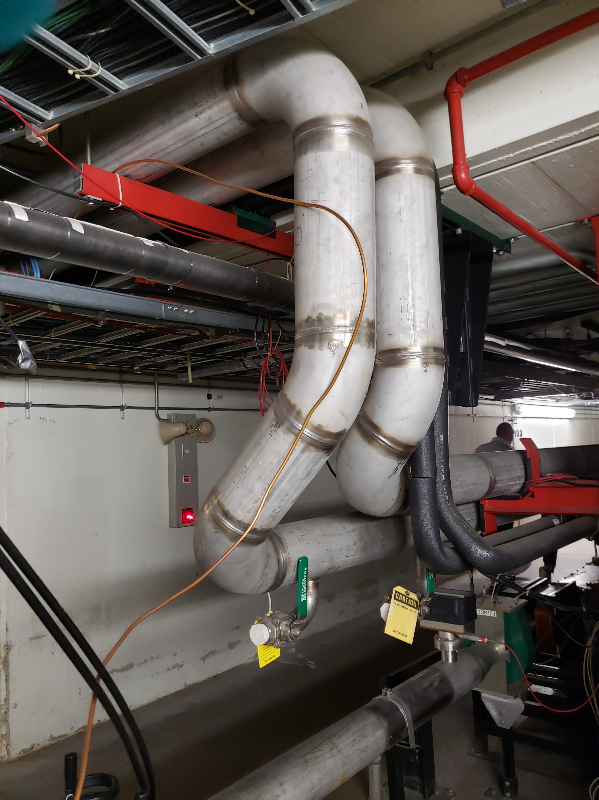
Affected Area MI-10 Alcove
6” HEADERSS FROM SURFACE, THRU OVERHEAD
LOOKING UPSTREAM
INTO ALCOVE
LOOKING DOWNSTREAM
FROM BEHIND ALCOVE
TOWARDS THE AISLE

Slide 11
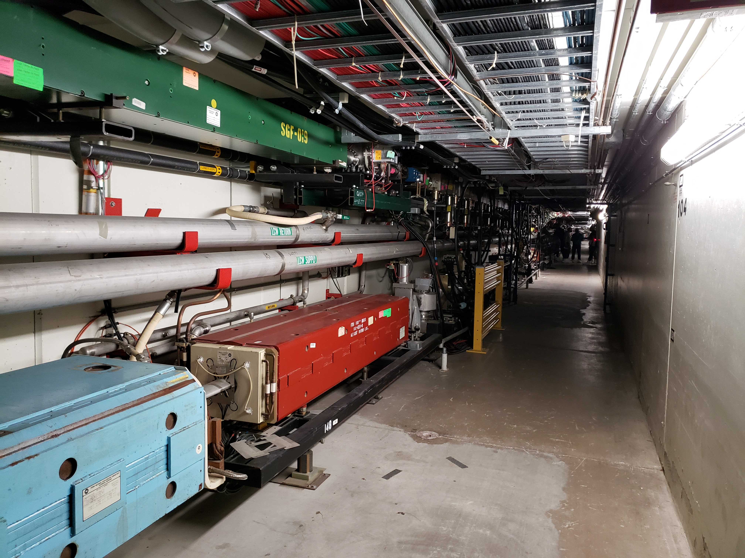
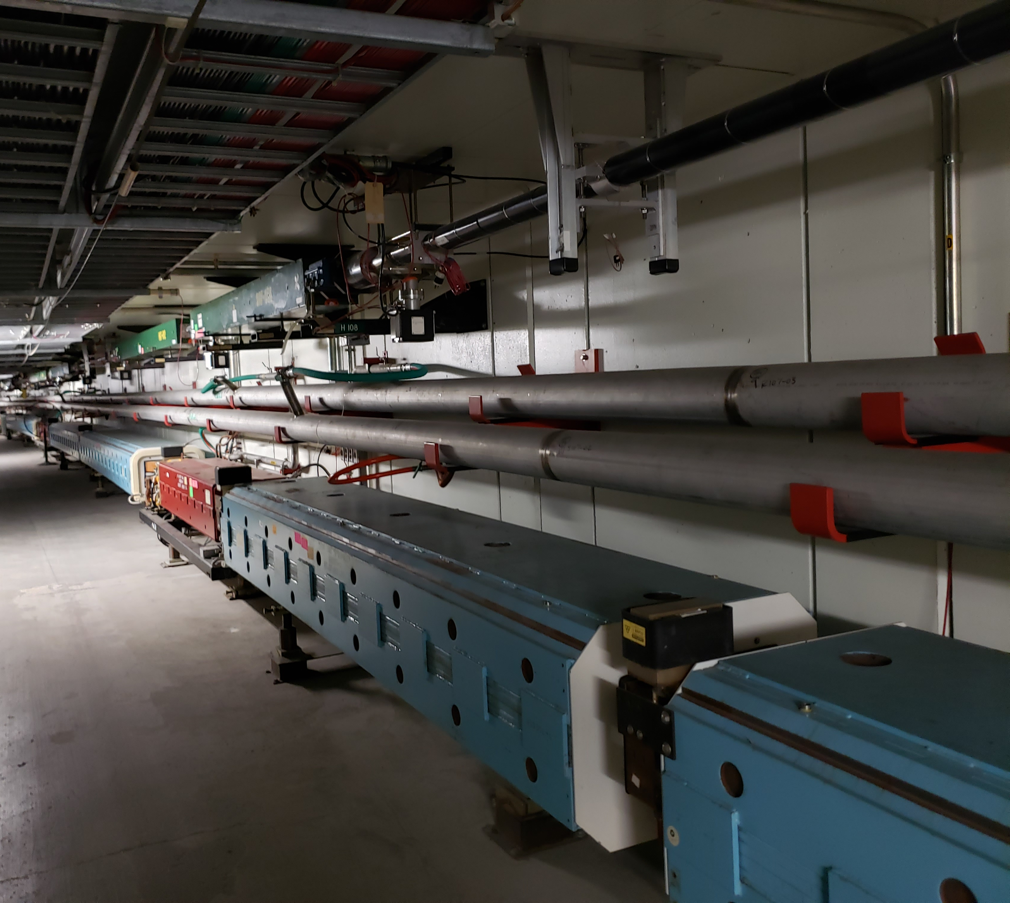
Affected Area Q-103 trhu Q-108
LOOKING UPSTREAM
AT Q-104
LOOKING DOWNSTREAM
AT Q-107

Slide 12
LCW – Global 6” Headers Upstream End at MI-10 Alcove
Path of current LCW headers come from overhead near stairwell in alcove, crosses overhead to the beamline, and to their current placement at chest-high over the magnet line
Modification will truncate that path to make a 90 degree bend downstream along inner aisle wall, near the top, just below utilities conduits
Little modification is required at this end

Slide 13
LCW – Global 6” Headers Upstream End at MI-10 Alcove

Slide 14
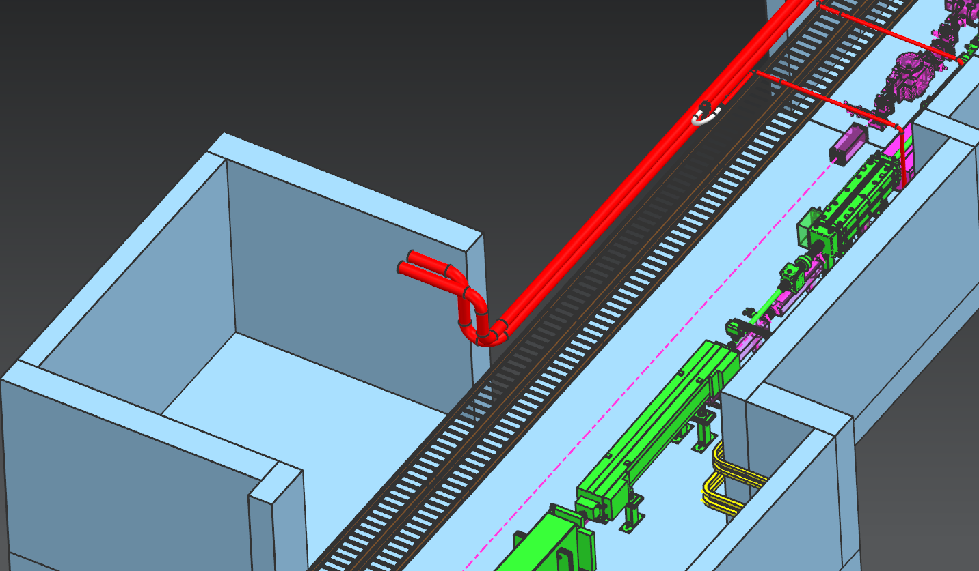
LCW – Global 6” Headers Upstream End at MI-10 Alcove

Slide 15
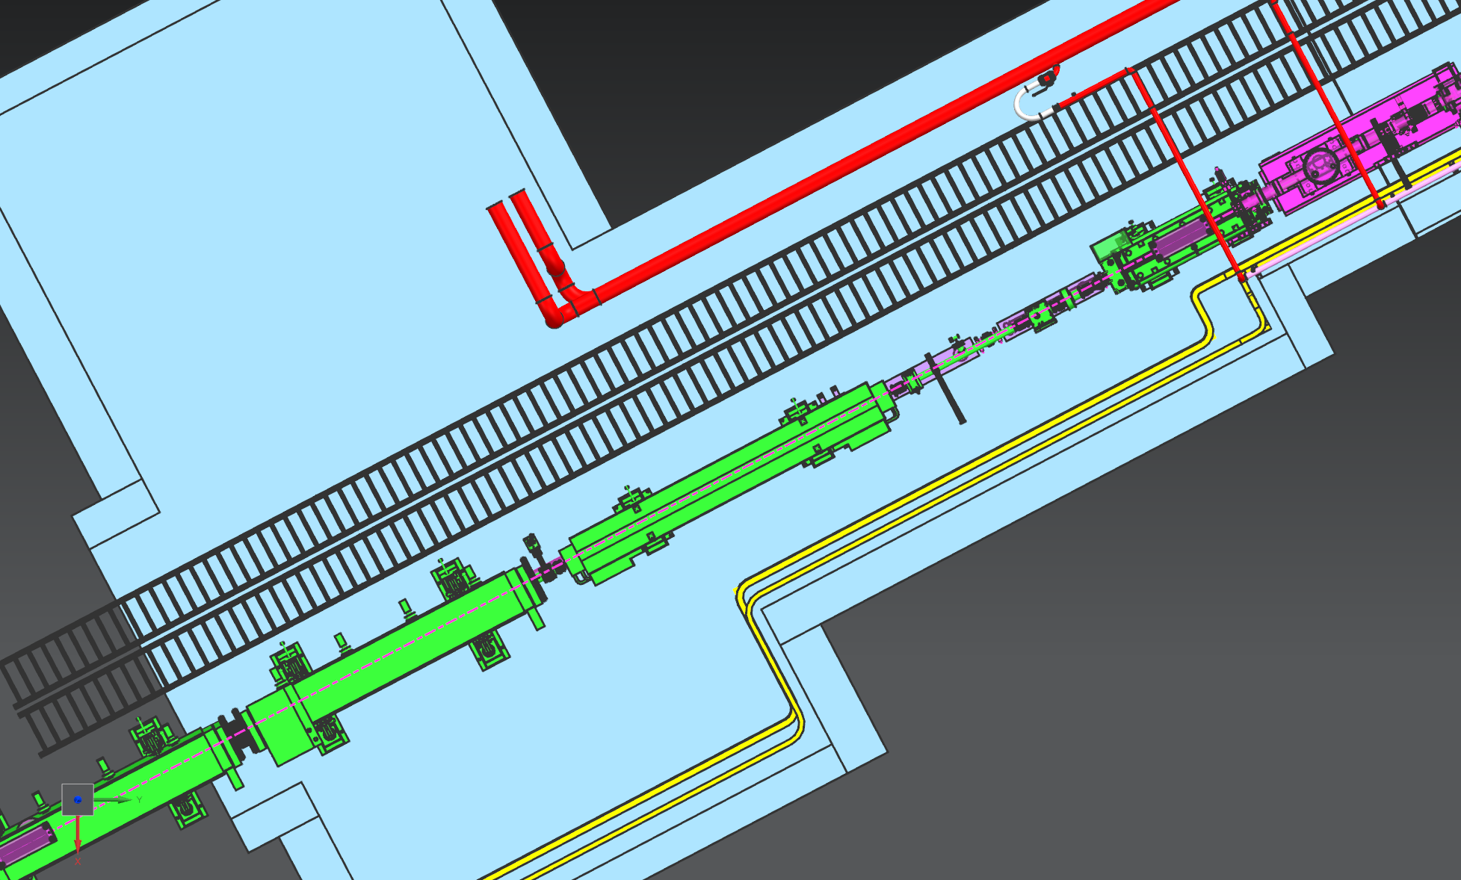
LCW – Global 6” Headers Upstream End at MI-10 Alcove

Slide 16
LCW – Global 6” Headers Downstream End at Q-107 / Q-108
At the downstream end, at D-107-2, the 6” LCW headers need to return from the aisle side, back to the magnet run and the original configuration
There is no room above the aisle cable trays for 6” IPS headers to fit without pushing the cable tray downward into harm’s way
2 choices for optional piping runs:
5 each of 3”IPS pipe runs per header, utilizing standard piping components
This “pipe organ” approach is only one presented herein
Complex, and requires more installation room & labor, but uses off-the-shelf components
1 each per header of a custom 3” x 25” rectangular pipe, custom fabricated
Simpler, requires less room, but would require engineering development
Both designs increase cross-sectional area by about 20% to allow for additional losses

Slide 17
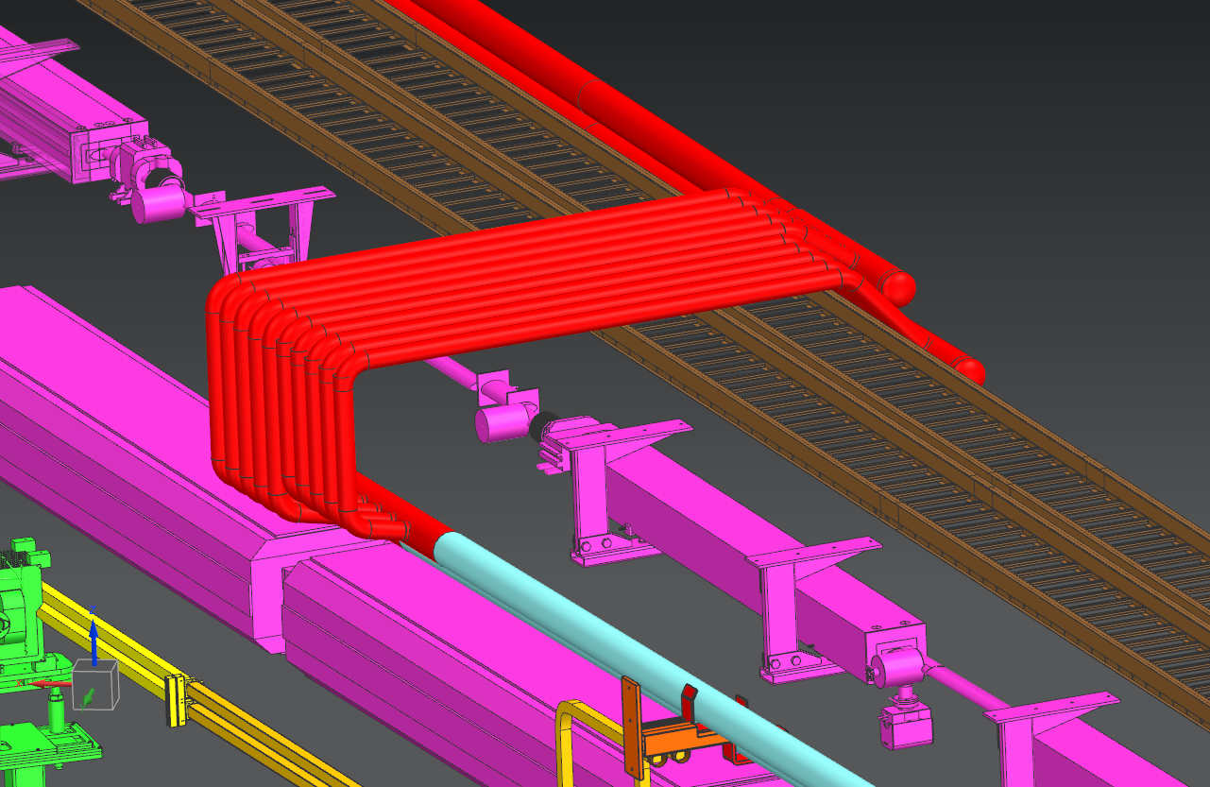
LCW – Global 6” Headers Downstream End at Q-107 / Q-108
3” IPS “PIPE ORGAN” APPROACH

Slide 18
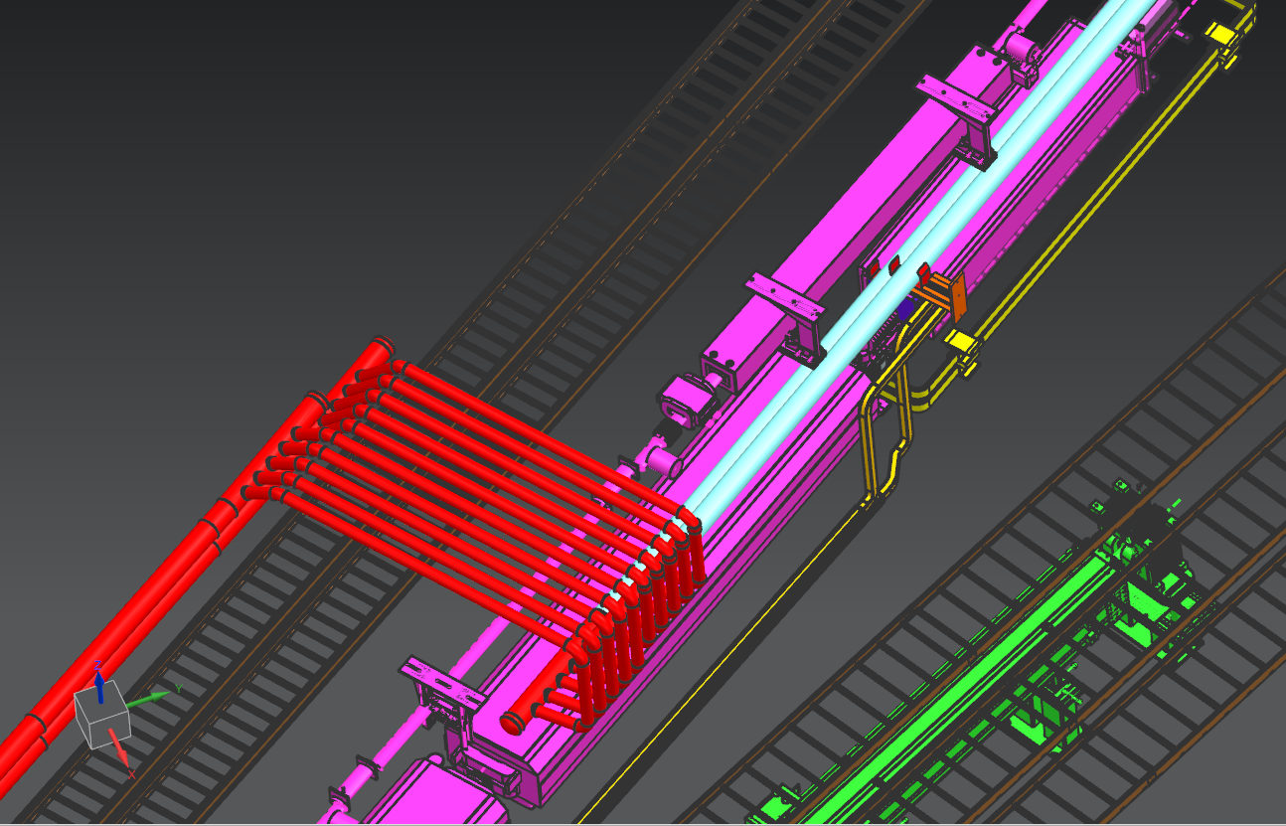
LCW – Global 6” Headers Downstream End at Q-107 / Q-108

Slide 19
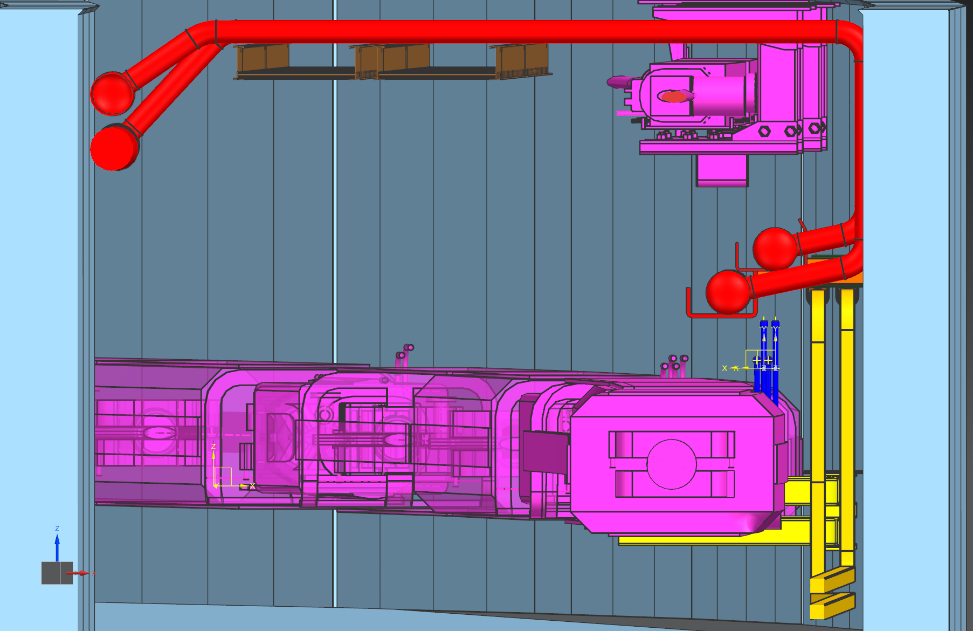
LCW – Global 6” Headers Downstream End at Q-107 / Q-108

Slide 20
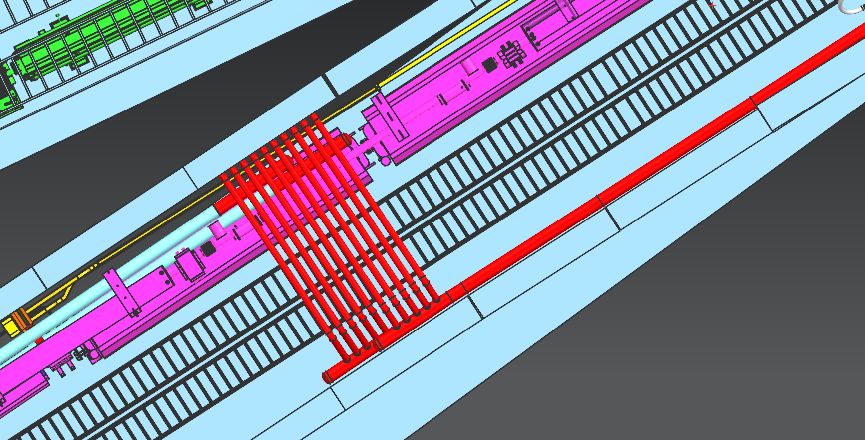
LCW – Global 6” Headers Downstream End at Q-107 / Q-108

Slide 21
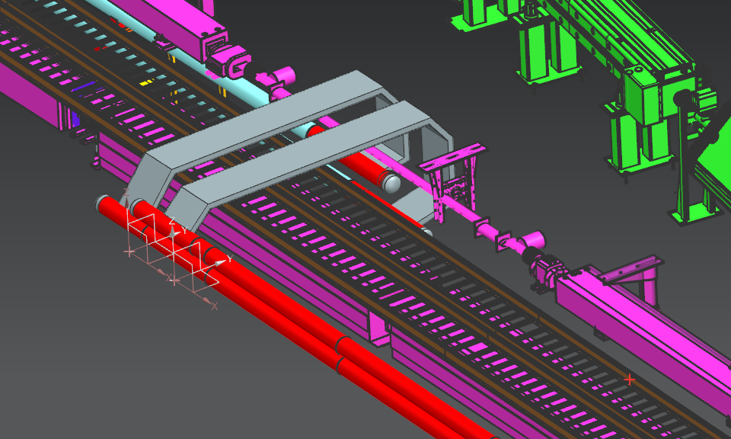
LCW – Global 6” Headers Downstream End at Q-107 / Q-108
3” X 25” RECTANGULAR
PIPE APPROACH

Slide 22
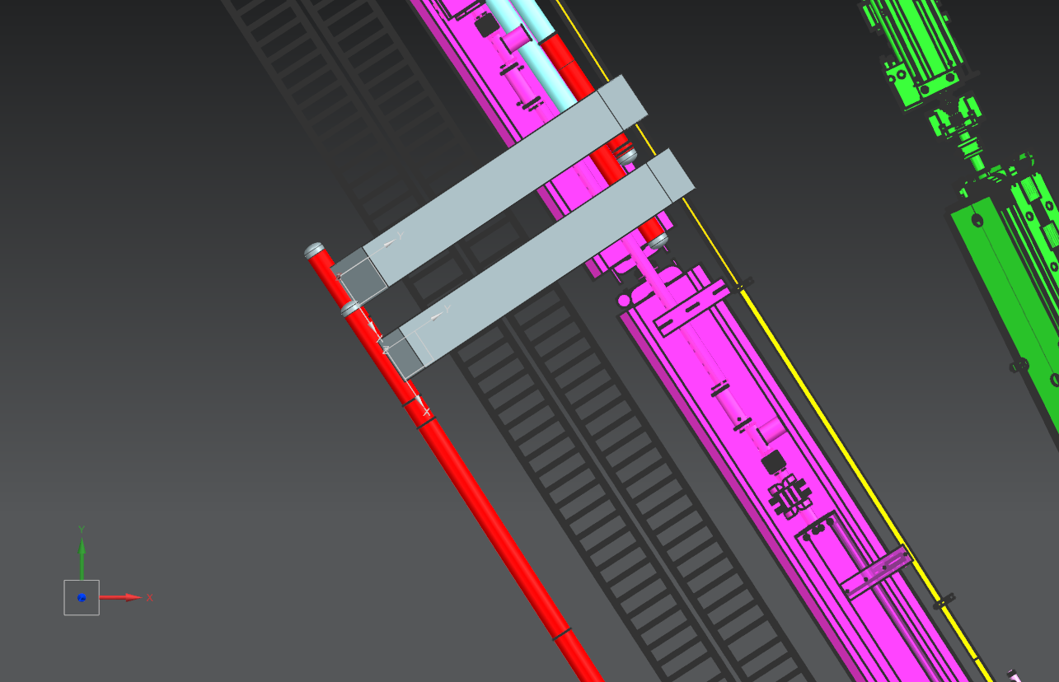
LCW – Global 6” Headers Downstream End at Q-107 / Q-108

Slide 23
LCW – Quad Cell Manifolds
8 components get removed from the current MI Q-641 to Q-106 area:
9 components get added into the PB Extraction beamline, Q-102 to Q-104:
SQA-851
SQA-852
LAMB AZERO
STOICH
Kicker 1
Kicker 2
STOICH
STOICH
LAM-10
LAM-11A
LAM-11B
V-100
Q-201A
Q-201B
HV-201
Q-202
Q-203

Slide 24
LCW – Quad Cell Manifolds
3 ways to add the taps for the 9 new magnets:
adding their own specific 2" manifold lines
adding taps from the existing manifolds
directly adding taps to the 6" headers
New components to be added are shown in P&ID # F10127805, LBNF Primary Beam Line LCW and Bus Flow Schematics, as fed from the addition of separate 2” MI manifolds, feeding just that string of LBNF components
Proposed here, due to space restrictions new components are shown in P&ID # F00305689-G as being fed from existing manifolds at Q-102, -103, &-104
Addition of individual taps directly to the 6” headers may be preferable upon study
All solutions are suitable from an LCW system standpoint, and components will receive the required cooling water flow
TBD during Final Design

Slide 25
LCW – Quad Cell Manifolds Modifying Existing Manifolds
All manifolds may stay where they are, minor adjustments may be required
Extensions added to follow up back wall, across overhead
Connection hoses to headers kept in similar arrangement, but relocated to aisle overhead space
Connections to current magnets may remain
Connections for new beamline elements added to existing manifolds
Some manifolds may require minor modifications due to new beamline components. The full extent of this is unknown at this time
The following chart summarizes the flow changes at each cell

Slide 26
LCW – Quad Cell Manifolds Change in quad cell LCW loads
 | COMPONENTS TO REMOVE |  |  |  | COMPONENTS TO ADD IN
# | Location | Component | Flow, gpm | @ Quad Cell | Location* | Component | Flow, gpm | @ Quad cell
1 | Q-641 | SQA-851 | 10 | -10 | Q-102 | LAM-10 | 16
2 | Q-100 | SQA-852 | 10 | -10 | Q-102 | LAM-11A | 16
3 | Q-101 | LAMB AZERO | 10 | -10 | Q-102 | LAM-11B | 16 | +48
4 | HDR-102 | STOICH* | 5 | -5 | Q-103 | V-100 | 9
5 | Q-103 | Kicker 1 | 2 |  | Q-103 | Q-201A | 8
6 |  | Kicker 2 | 2 | -4 | Q-103 | Q-201B | 8
7 | HDR-103 | STOICH* | 5 | -5 | Q-103 | HV-201 | 9 | +34
8 | HDR-106 | STOICH* | 5 | -5 | Q-104 | Q-202 | 8
9 |  |  |  |  | Q-104 | Q-203 | 6 | +14
 | Reduced Flow, ttl, gpm |  | 49 |  | Increased Flow, ttl, gpm |  |  | 96
 | NET TOTAL LCW LOAD CHANGE, gpm |  |  |  |  |  |  | +47
* denotes stoichastic cooling tanks which are fed directly from the header

Slide 27
LCW – Quad Cell Manifolds
EXISTING MANIFOLD
TAPS
EXISTING MANIFOLDS

Slide 28
LCW – Quad Cell Manifolds

Slide 29
LCW – Quad Cell Manifolds
MANIFOLDS EXTENSIONS
TO AISLE SIDE
CURRENT MANIFOLDS

Slide 30
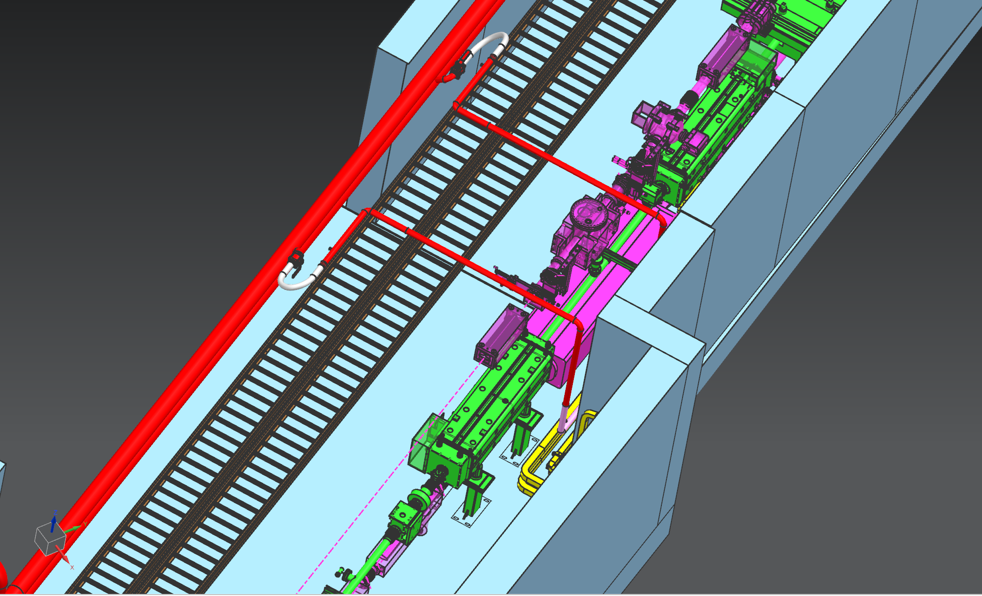
LCW – Quad Cell Manifolds

Slide 31
LCW – Quad Cell Manifolds
REUSE TAPS & HOSES FROM CURRENT MI
MANIFOLD EXTENSIONS PASS OVER CABLE TRAYS
MANIFOLDS EXTENSIONS
TO AISLE SIDE

Slide 32
LCW - MI-14 LCW and Fluorinert lines
Civil construction requires removal of the Gerardi Boxes behind MI-14 at grade, with penetrations to the enclosure overhead at about Q-105
Both boxes and penetrations packed with poly beads
Both LCW and Fluorinert lines in the Q-105 region require full removal from enclosure and penetrations to skid inside MI-14
Once Gerardi box replacements with penetrations are installed, LCW & Fluorinert lines may be reinstalled and reconnected as original
LCW lines require cross-over extensions similar to manifolds
Fluorinert lines appear not to need modification, only reinstallation
Fluorinert work for MI-14 needs to be combined into this WBS
Both require extra work if penetration arrangement is changed

Slide 33
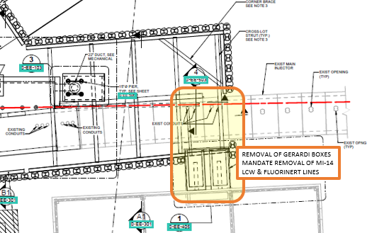
LCW - MI-14 LCW and Fluorinert lines
Extraction Stub
Construction,
Drawing Reference:
AECOM S-EE-102

Slide 34
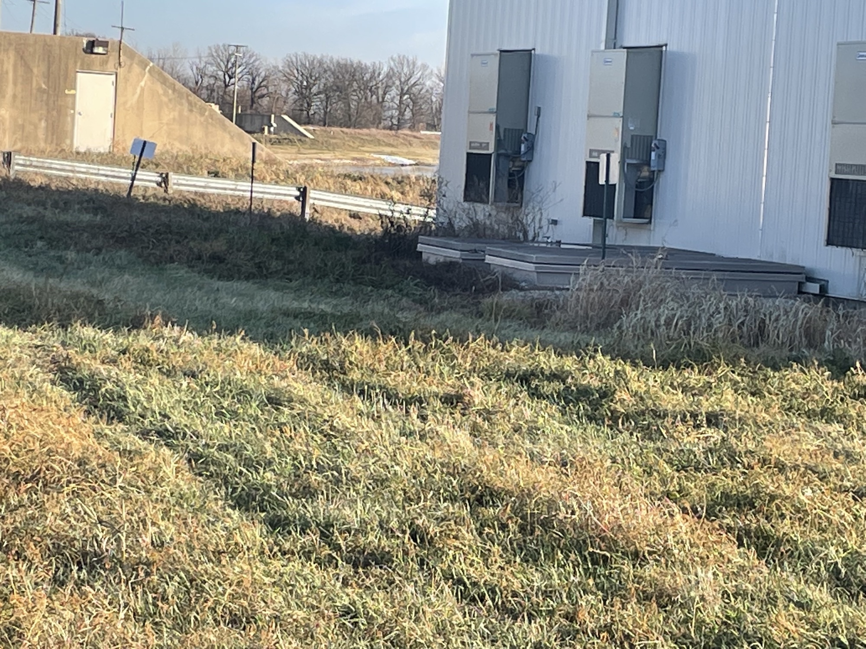
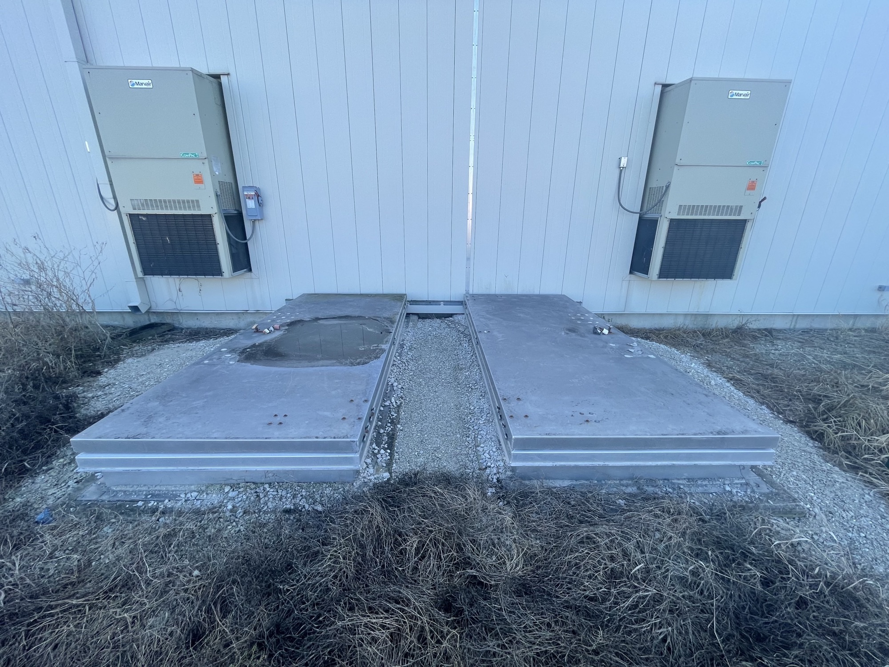
LCW - MI-14 LCW and Fluorinert lines Gerardi Boxes Outside of MI-14

Slide 35
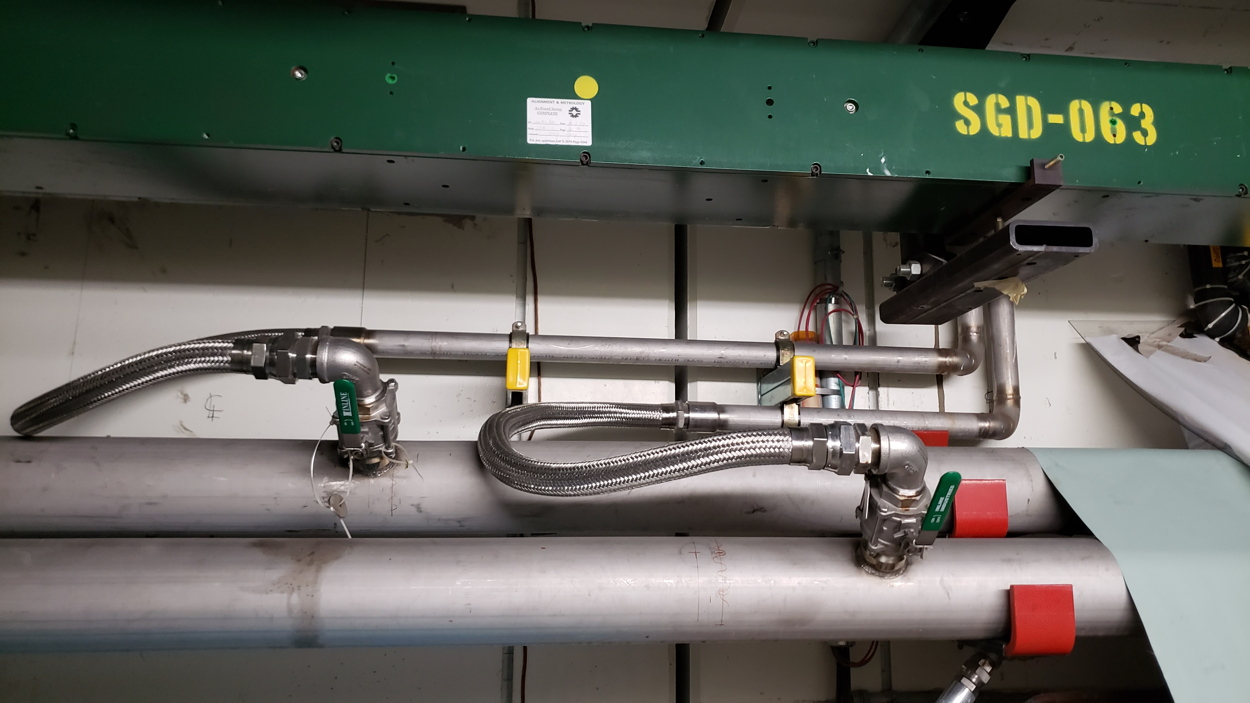
LCW - MI-14 LCW and Fluorinert lines Current Lines at Penetrations in Overhead at DS End of Q-105
LCW LINES TO MI-14

Slide 36
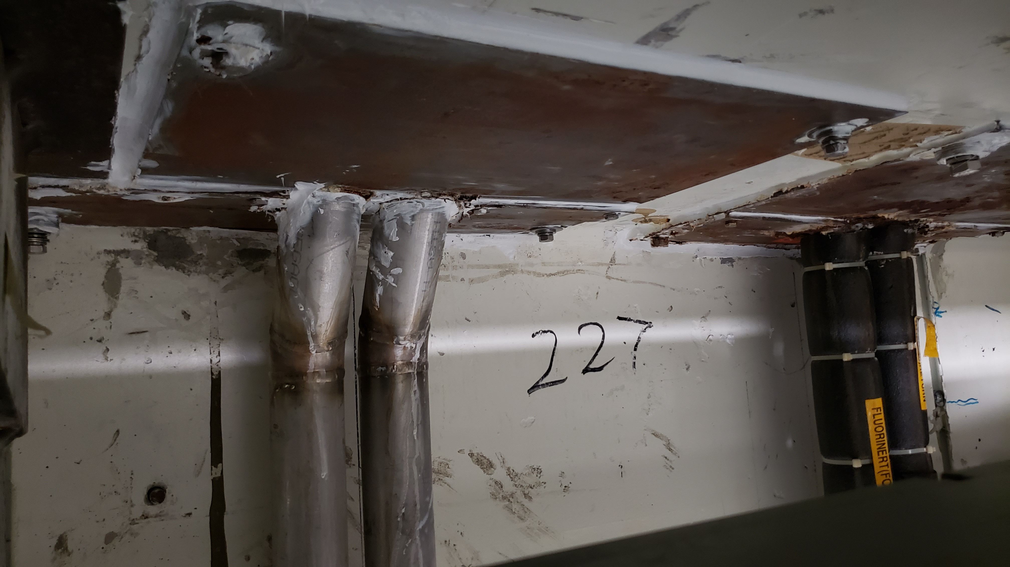
LCW - MI-14 LCW and Fluorinert lines Current Lines at Penetrations in Overhead at DS End of Q-105
LCW LINES TO MI-14
FLUORINERT LINES TO MI-14

Slide 37
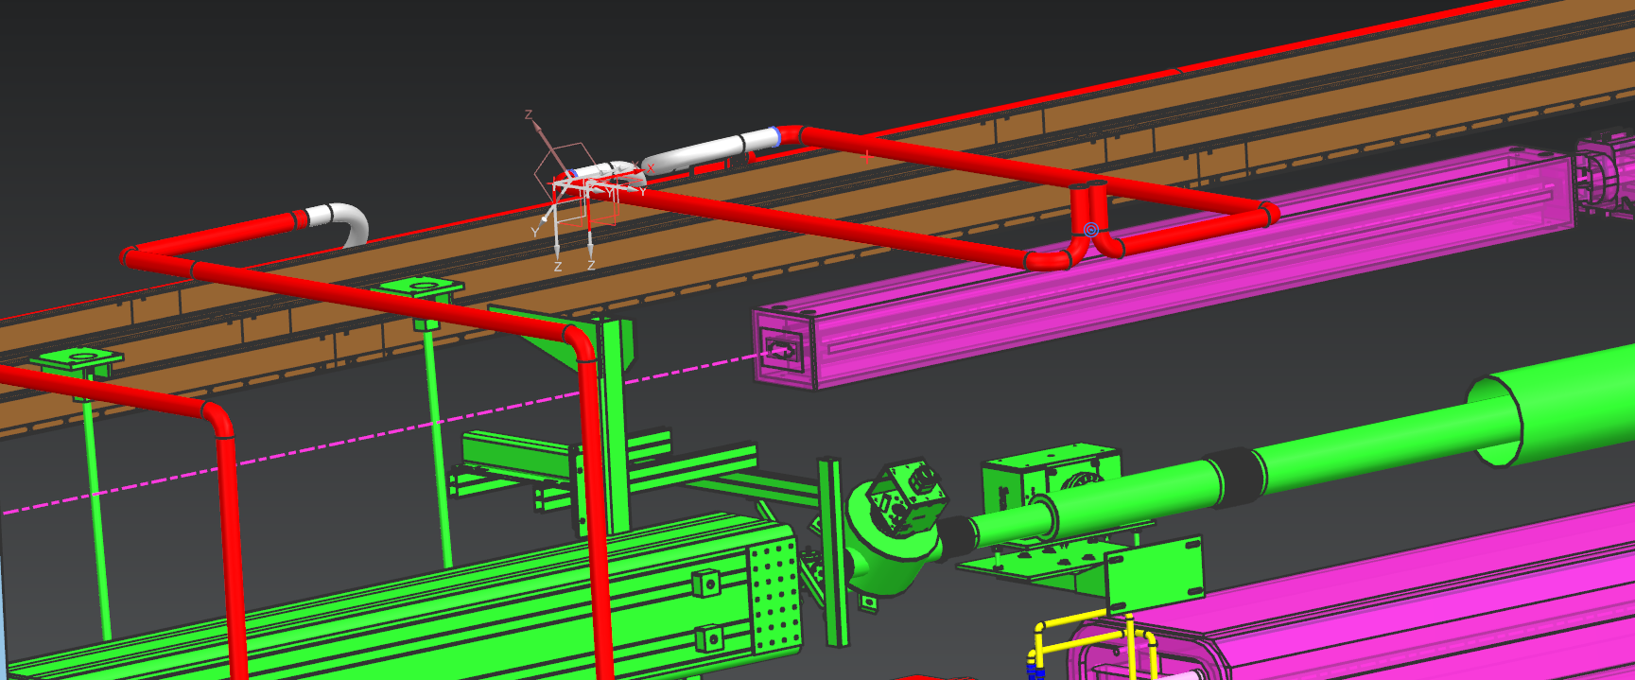
LCW - MI-14 LCW and Fluorinert lines Added Extensions to Aisle Side
LCW LINES TO MI-14

Slide 38
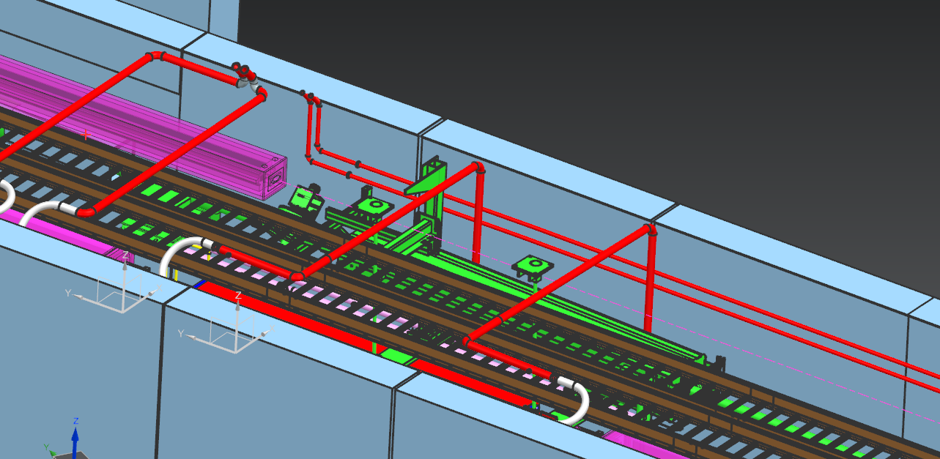
LCW - MI-14 LCW and Fluorinert lines Added Extensions to Aisle Side
LCW LINES TO MI-14
FLUORINERT LINES TO MI-14

Slide 39
LCW - LBNF PB Fill Line
Primary Beamline LCW requires a fill source line from global MI LCW
Located downstream of D-106-2
Penetration area is loosely defined in AECOM drawings S-EE-102 and S-EE-104
Fill line to be 2” Sch 10 SS, allows approx. 80 gpm max fill rate
Fill line flow is intermittent use, during system fill / make-up only
LCW line will require aisle cross-over path similar to manifolds
Line is to have isolation valves at each end, w/ remote actuator on one side TBD

Slide 40
LCW - LBNF PB Fill Line
Drawing Reference:
AECOM S-EE-104
Which penetration to use
is undeclared at this time

Slide 41
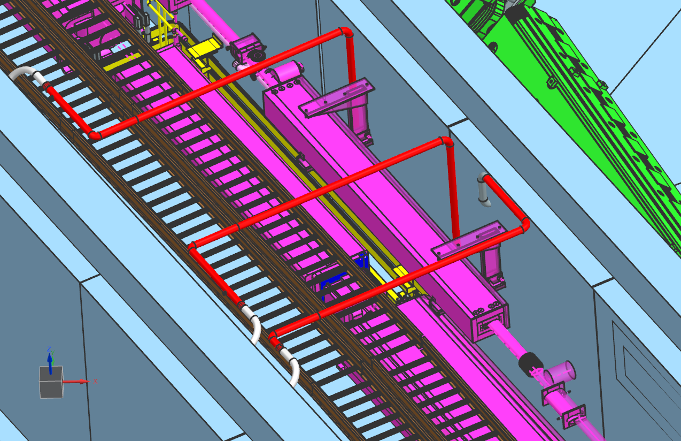
LCW - LBNF PB Fill Line
Q-107 MANIFOLD EXTENSIONS
FILL LINE
TO LBNF PB LCW
@ D-106-2

Slide 42
Fluorinert Piping - MI-10 to Q100 Adapt existing piping
131133.0202.A6400 Design/Adapt Fluorinert Piping, MI-10 to Q100
The LBNF kicker needs reconfigured lines in the tunnel, coming from MI-10, in place of the MI injection kicker
Fluorinert work for MI-10 needs to be combined into this WBS
This has not been investigated sufficiently, and not included in the work presented here
Needs further design work

Slide 43
Bus - General
Includes both Dipole and Quad Bus
Dipole Bus looks to require simple removal and reinstallation
Quad bus will require significant effort, and relocation

Slide 44
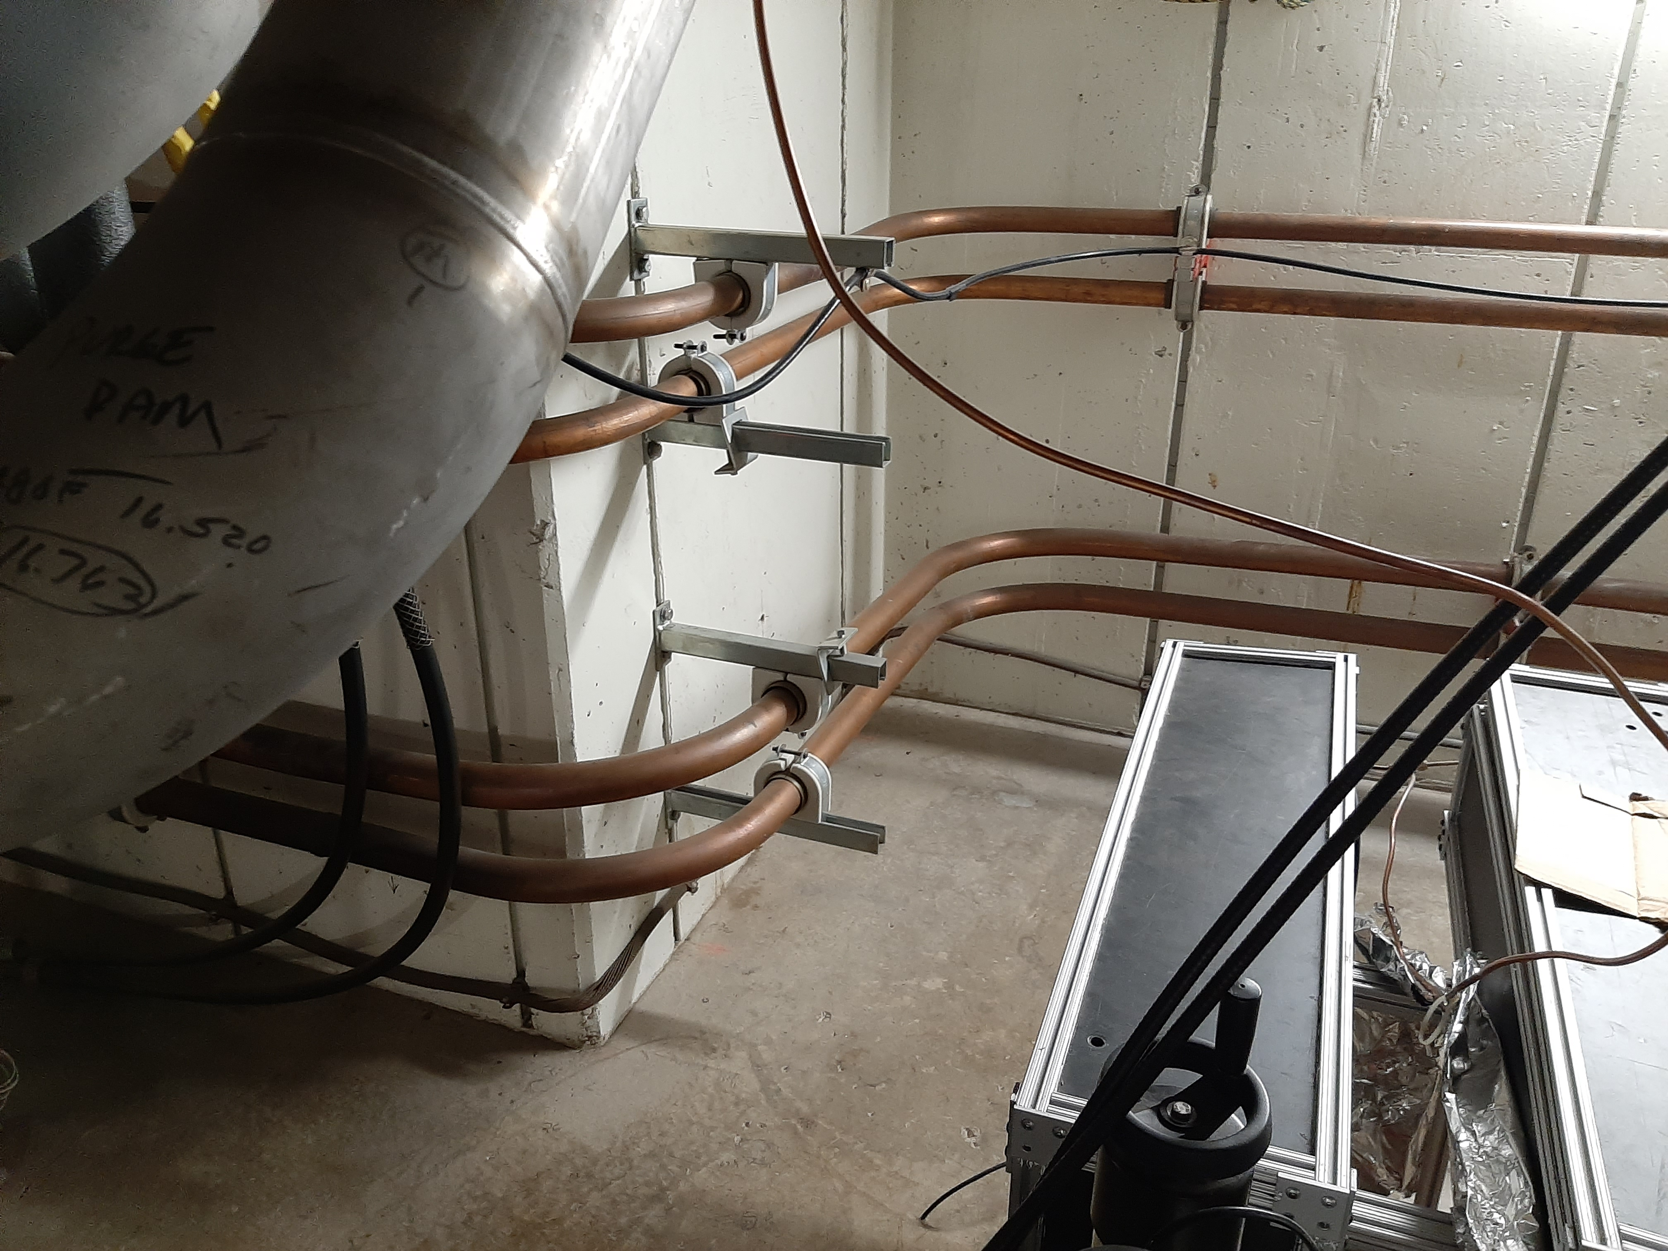
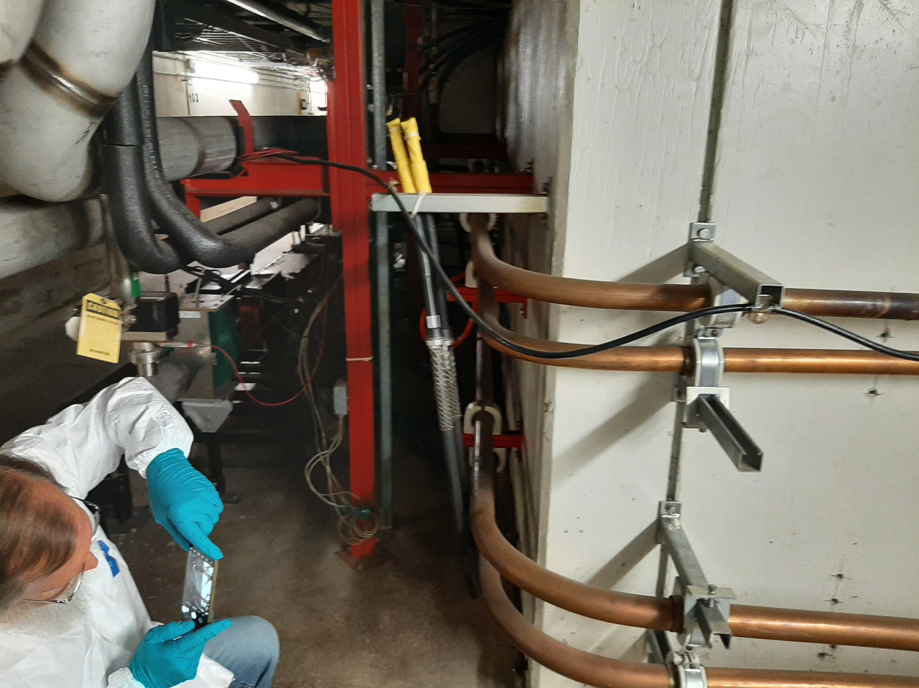
Bus - General Current Arrangement Upstream at Q-103 Alcove
QUADRUPOLE BUS
DIPOLE BUS
NEW LOCATION
QUADRUPOLE BUS
GROUNDING CABLE

Slide 45
Bus - General
DIPOLE BUS RETURNS
TO CURRENT POSITIONS
QUADRUPOLE BUS
MOVED TO LOWER
ON OUTSIDE WALL

Slide 46
Dipole Bus
At each quad magnet, 1” x 4” bus pair behind quads
Each has bus flags and SS flex hoses to each dipole
Require temporary removal and storage
To be reinstalled in same configuration
Minor alterations may be necessary, unknown at this time
Upstream 2-5/8” bus run from MI-10 does not require modification

Slide 47
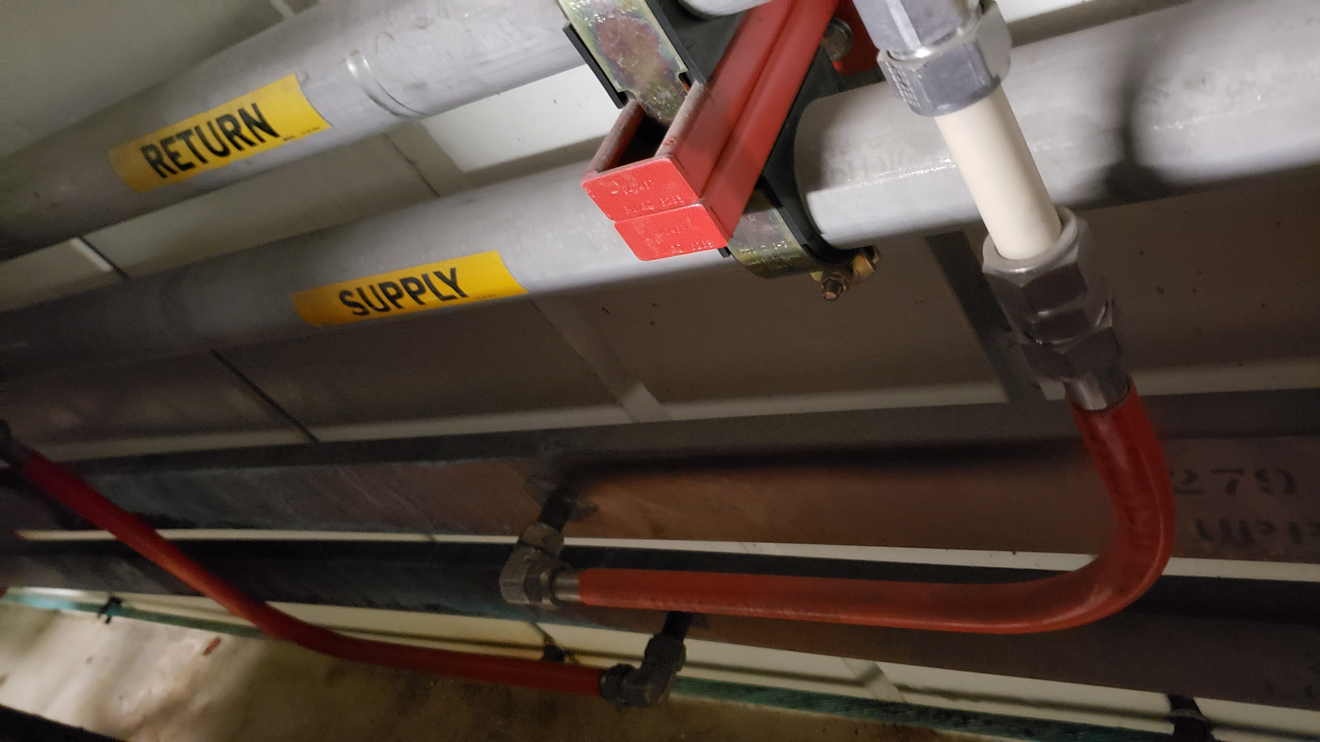
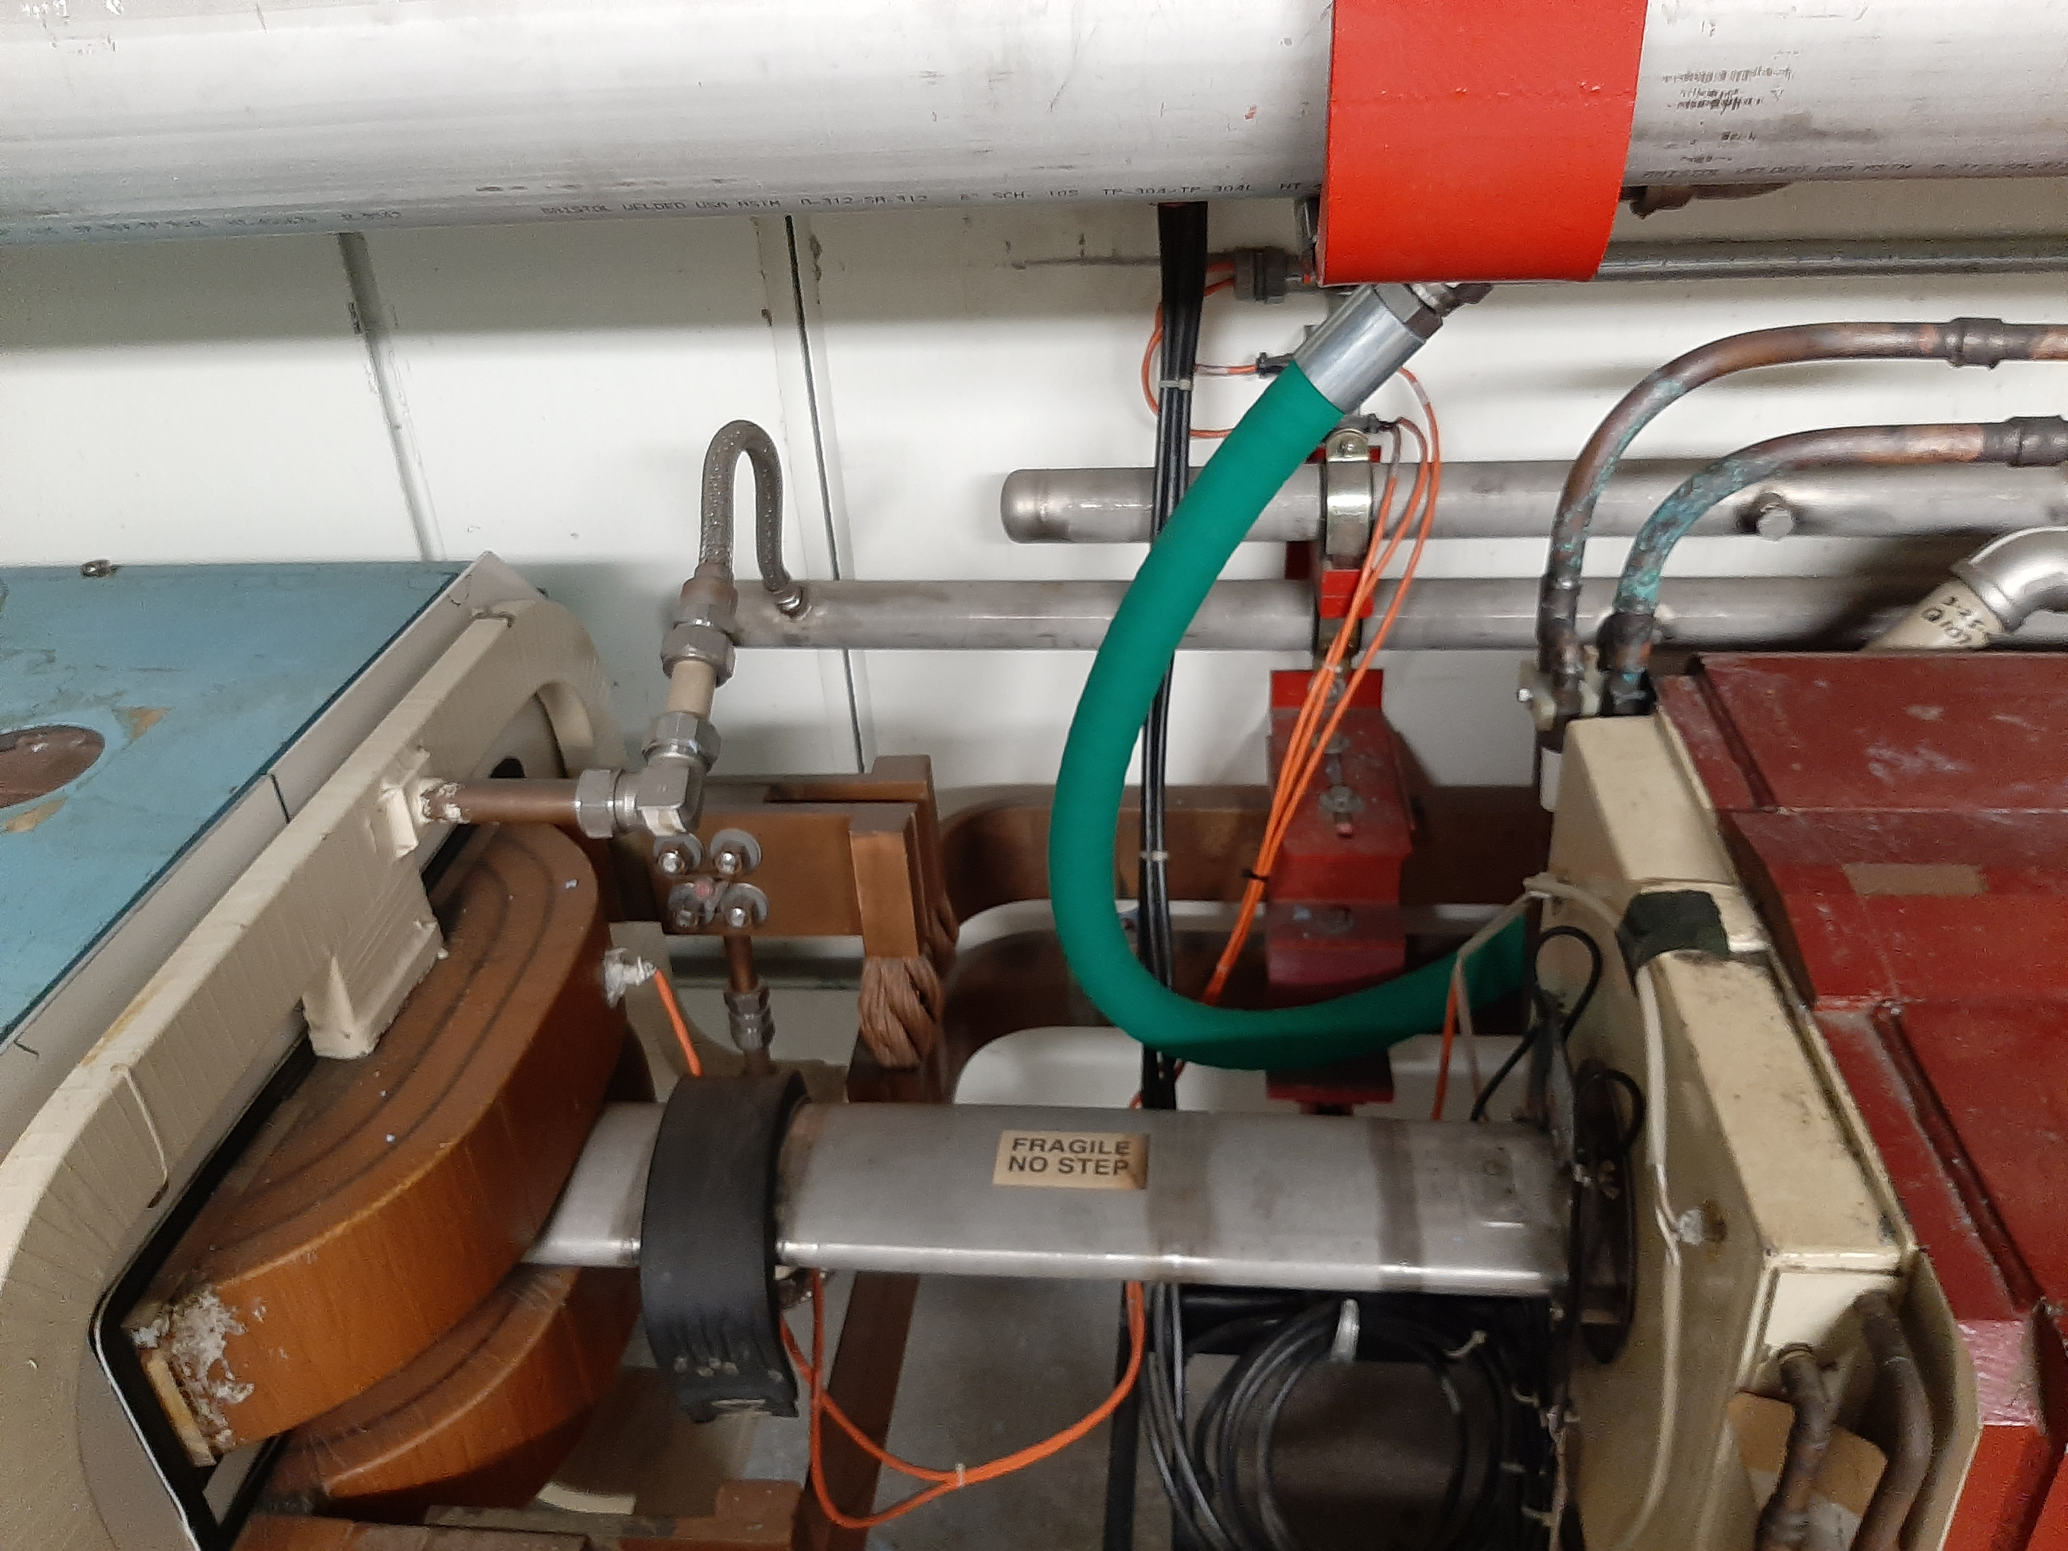
Dipole Bus
CURRENT CONFIGURATION: Dipole Bus as 1” x 4” behind Quadrupoles, gets removed for construction
and replaced into same positions

Slide 48
Quadrupole Bus
Mainly 2-1/8” diam bus currently mounted under LCW headers
Require temporary removal and storage
To be replaced in modified configuration
Remains on magnet side wall
Lowered on wall to just above enclosure floor and ground cable
New 7/8” bus runs from 2-1/8” quad bus to quadrupole connections
Any need for replacement bus stock material can use TeV 2” square bus
Mainly at Q-103 and Q-108 transitions
Quad bus expansion joints need studied for best placement

Slide 49
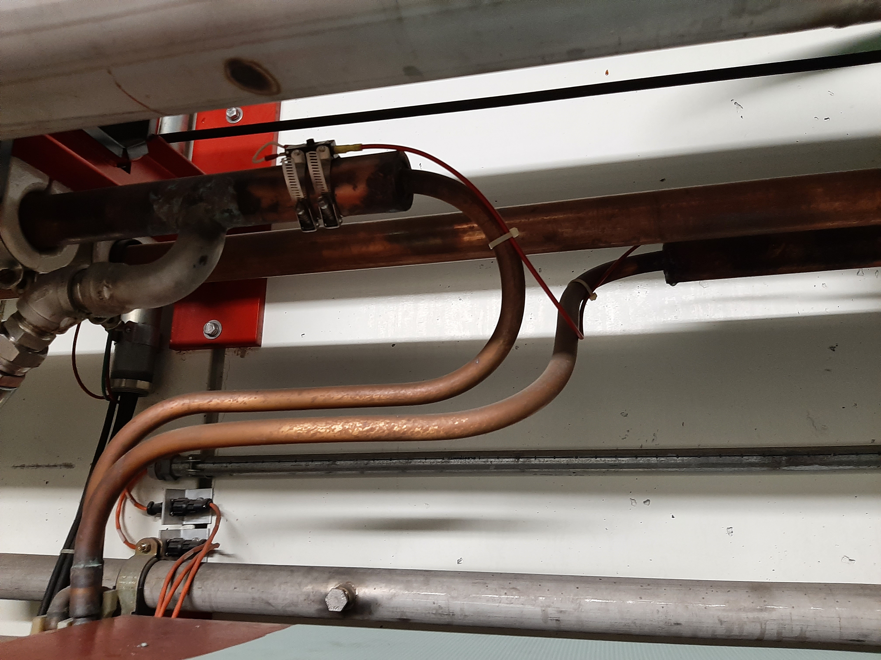
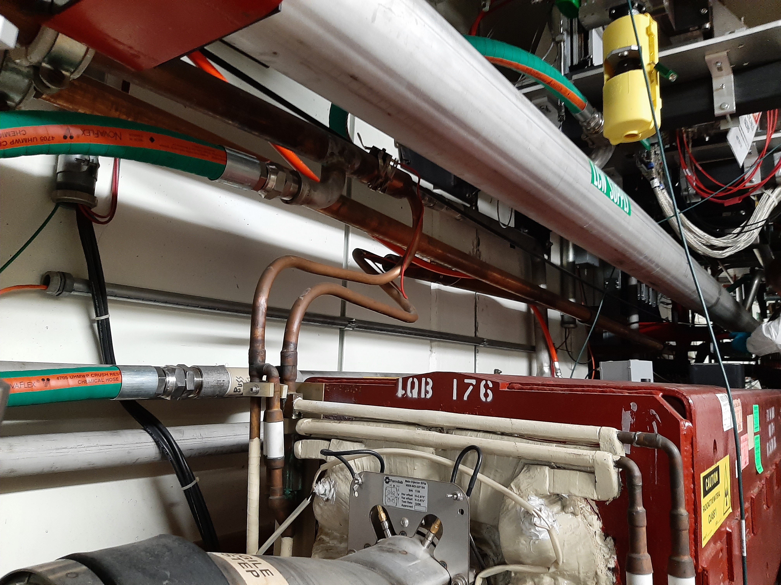
Quadrupole Bus
CURRENT CONFIGURATION: 2-1/8” Bus located behind LCW headers, 7/8” Bus connects to quads

Slide 50
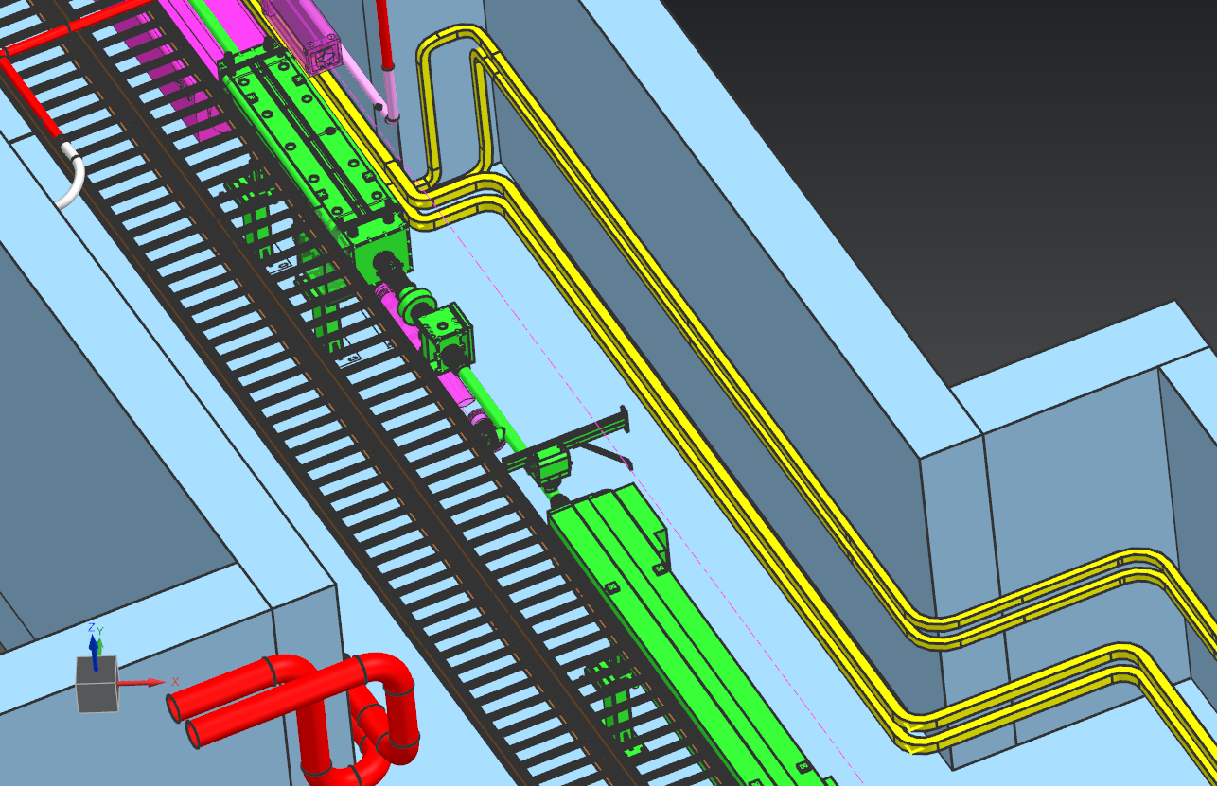
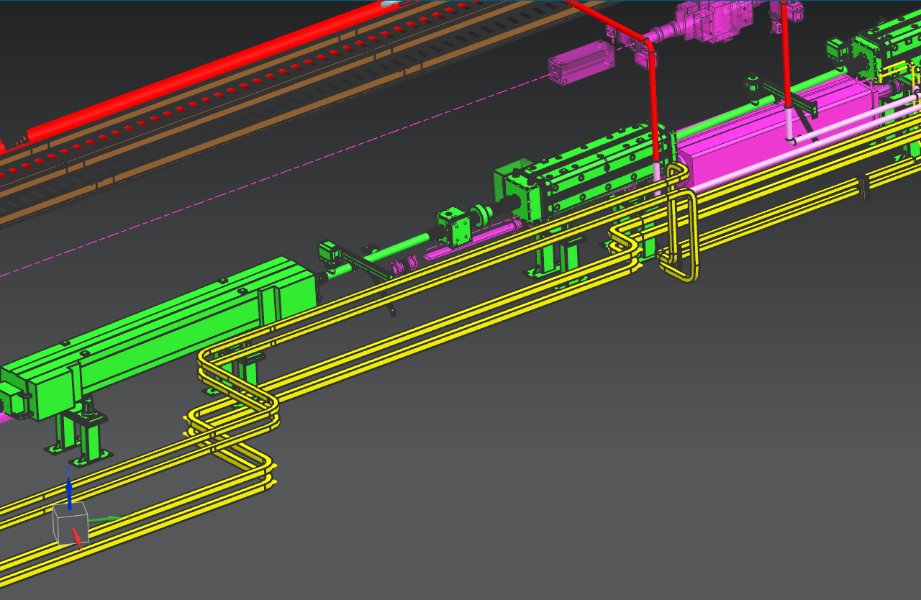
Quadrupole Bus 2-1/8” Bus Runs - Downstream
QUAD BUS MOVES TO LOW ON THE OUTER WALL,
JUST ABOVE GROUNDING CABLE SHOWN AT Q-103

Slide 51
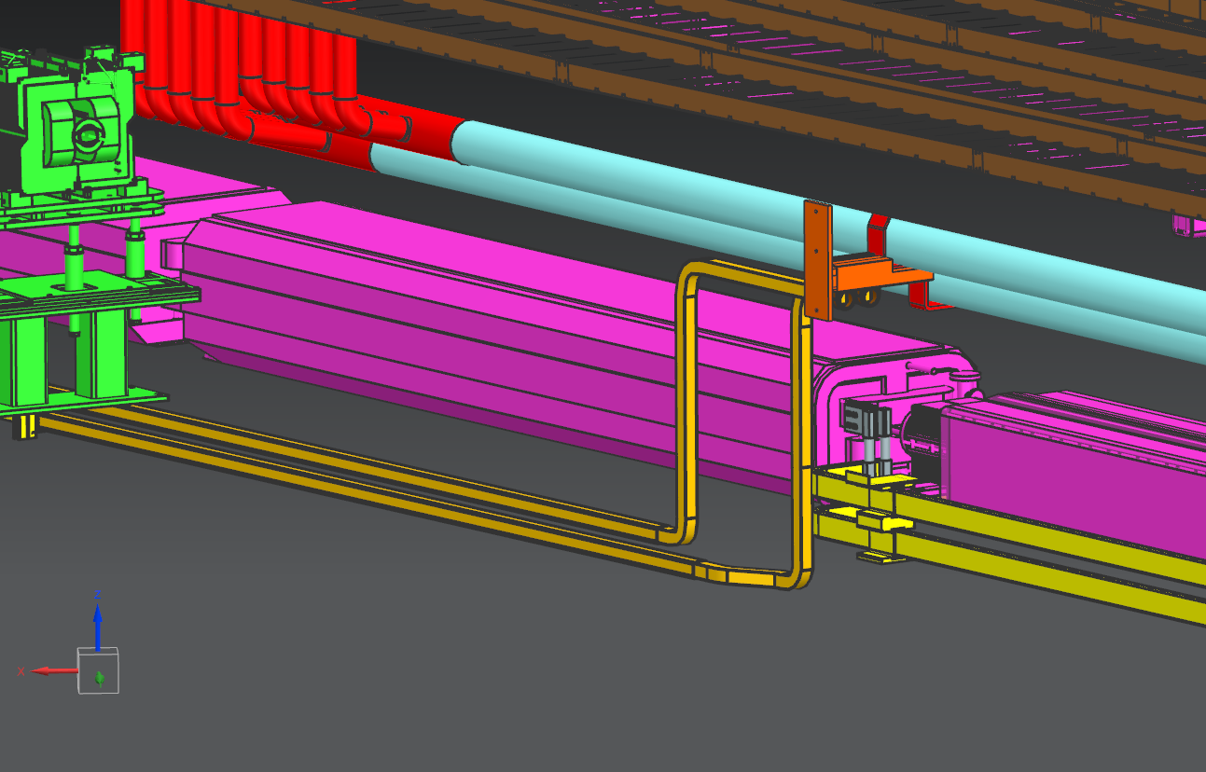
Quadrupole Bus 2-1/8” Bus Runs - Upstream
QUAD BUS RETURNS TO
ORIGINAL POSITION
BEHIND LCW HEADERS, SHOWN AT Q-107

Slide 52
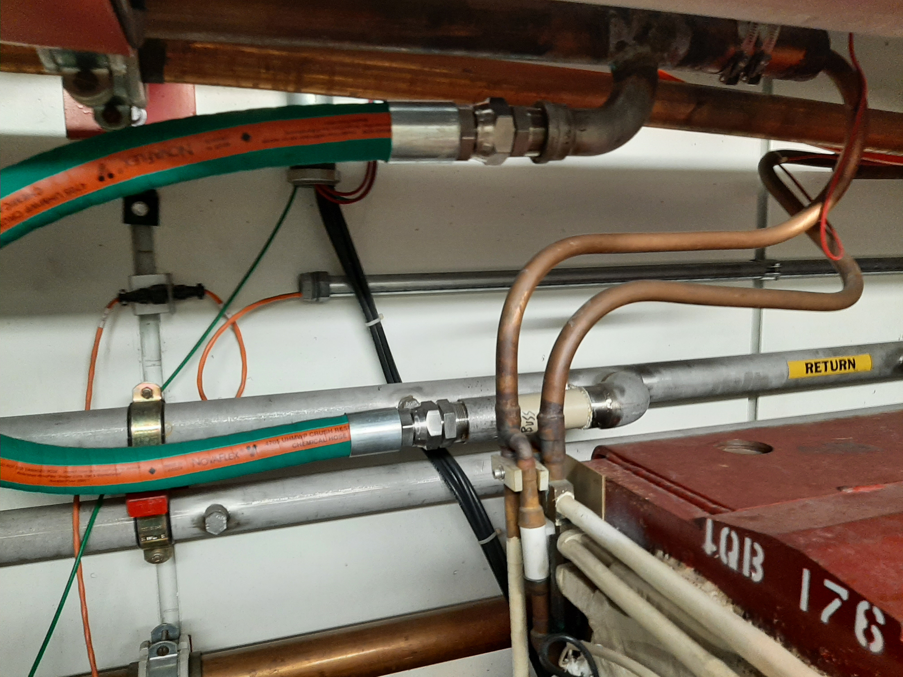
Quadrupole Bus 7/8” Quad Connections
CONNECTIONS FROM QUAD BUS TO MANIFOLDS AND
MAGNETS WILL MOVE WITH RELOCATED BUS
DOWN TO NEW LOCATIONS

Slide 53
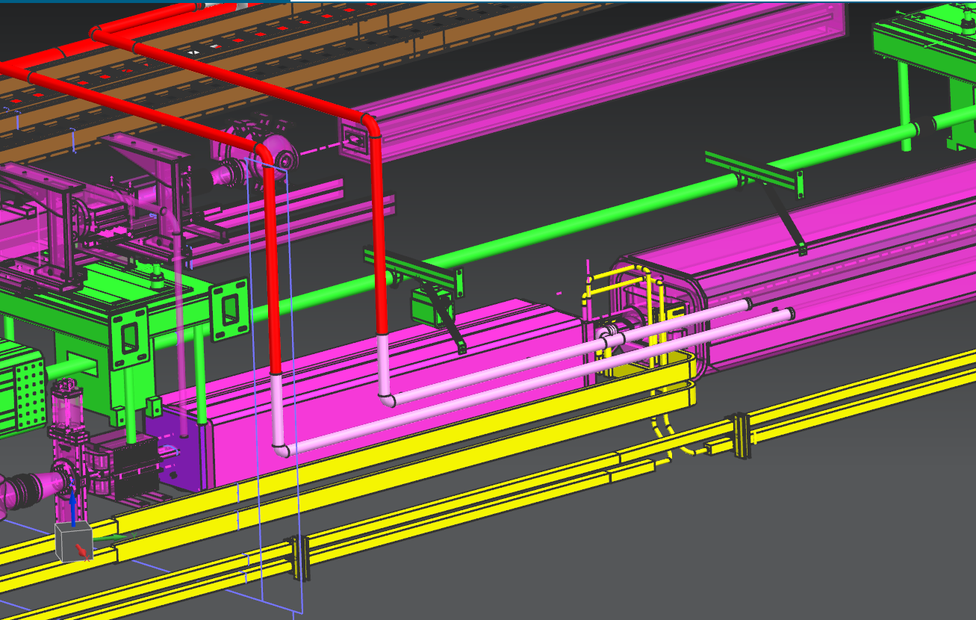
Quadrupole Bus 7/8” Quad Connections
7/8” QUAD BUS CONNECTIONS IN NEW LOCATION,
“CANDY CANE” CONNECTIONS BEHIND QUAD GIRDERS

Slide 54
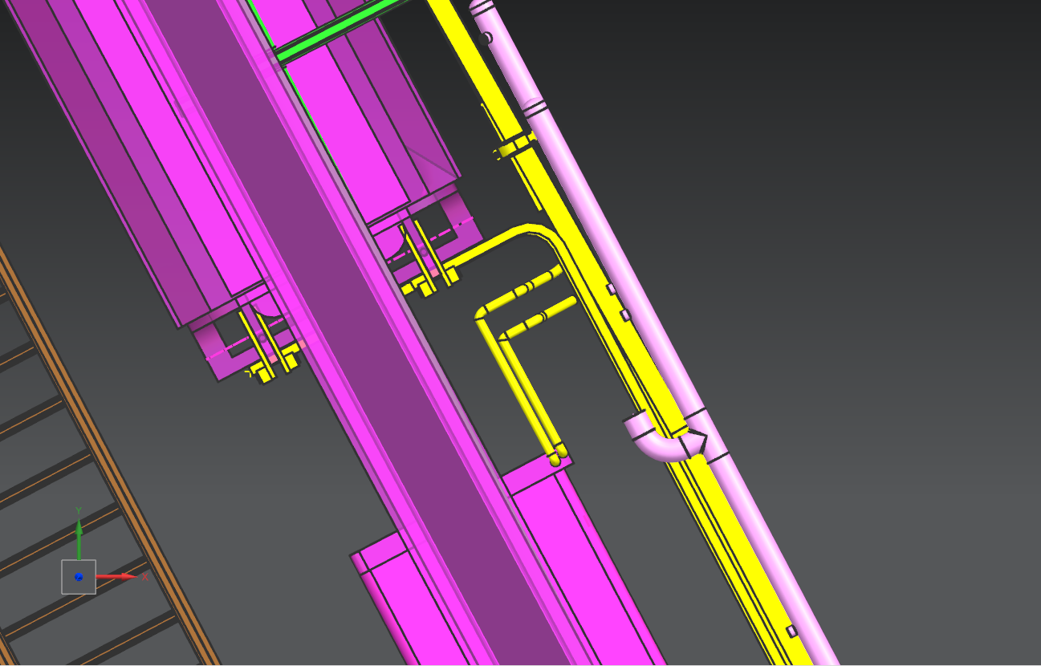
Quadrupole Bus 7/8” Quad Connections

Slide 55
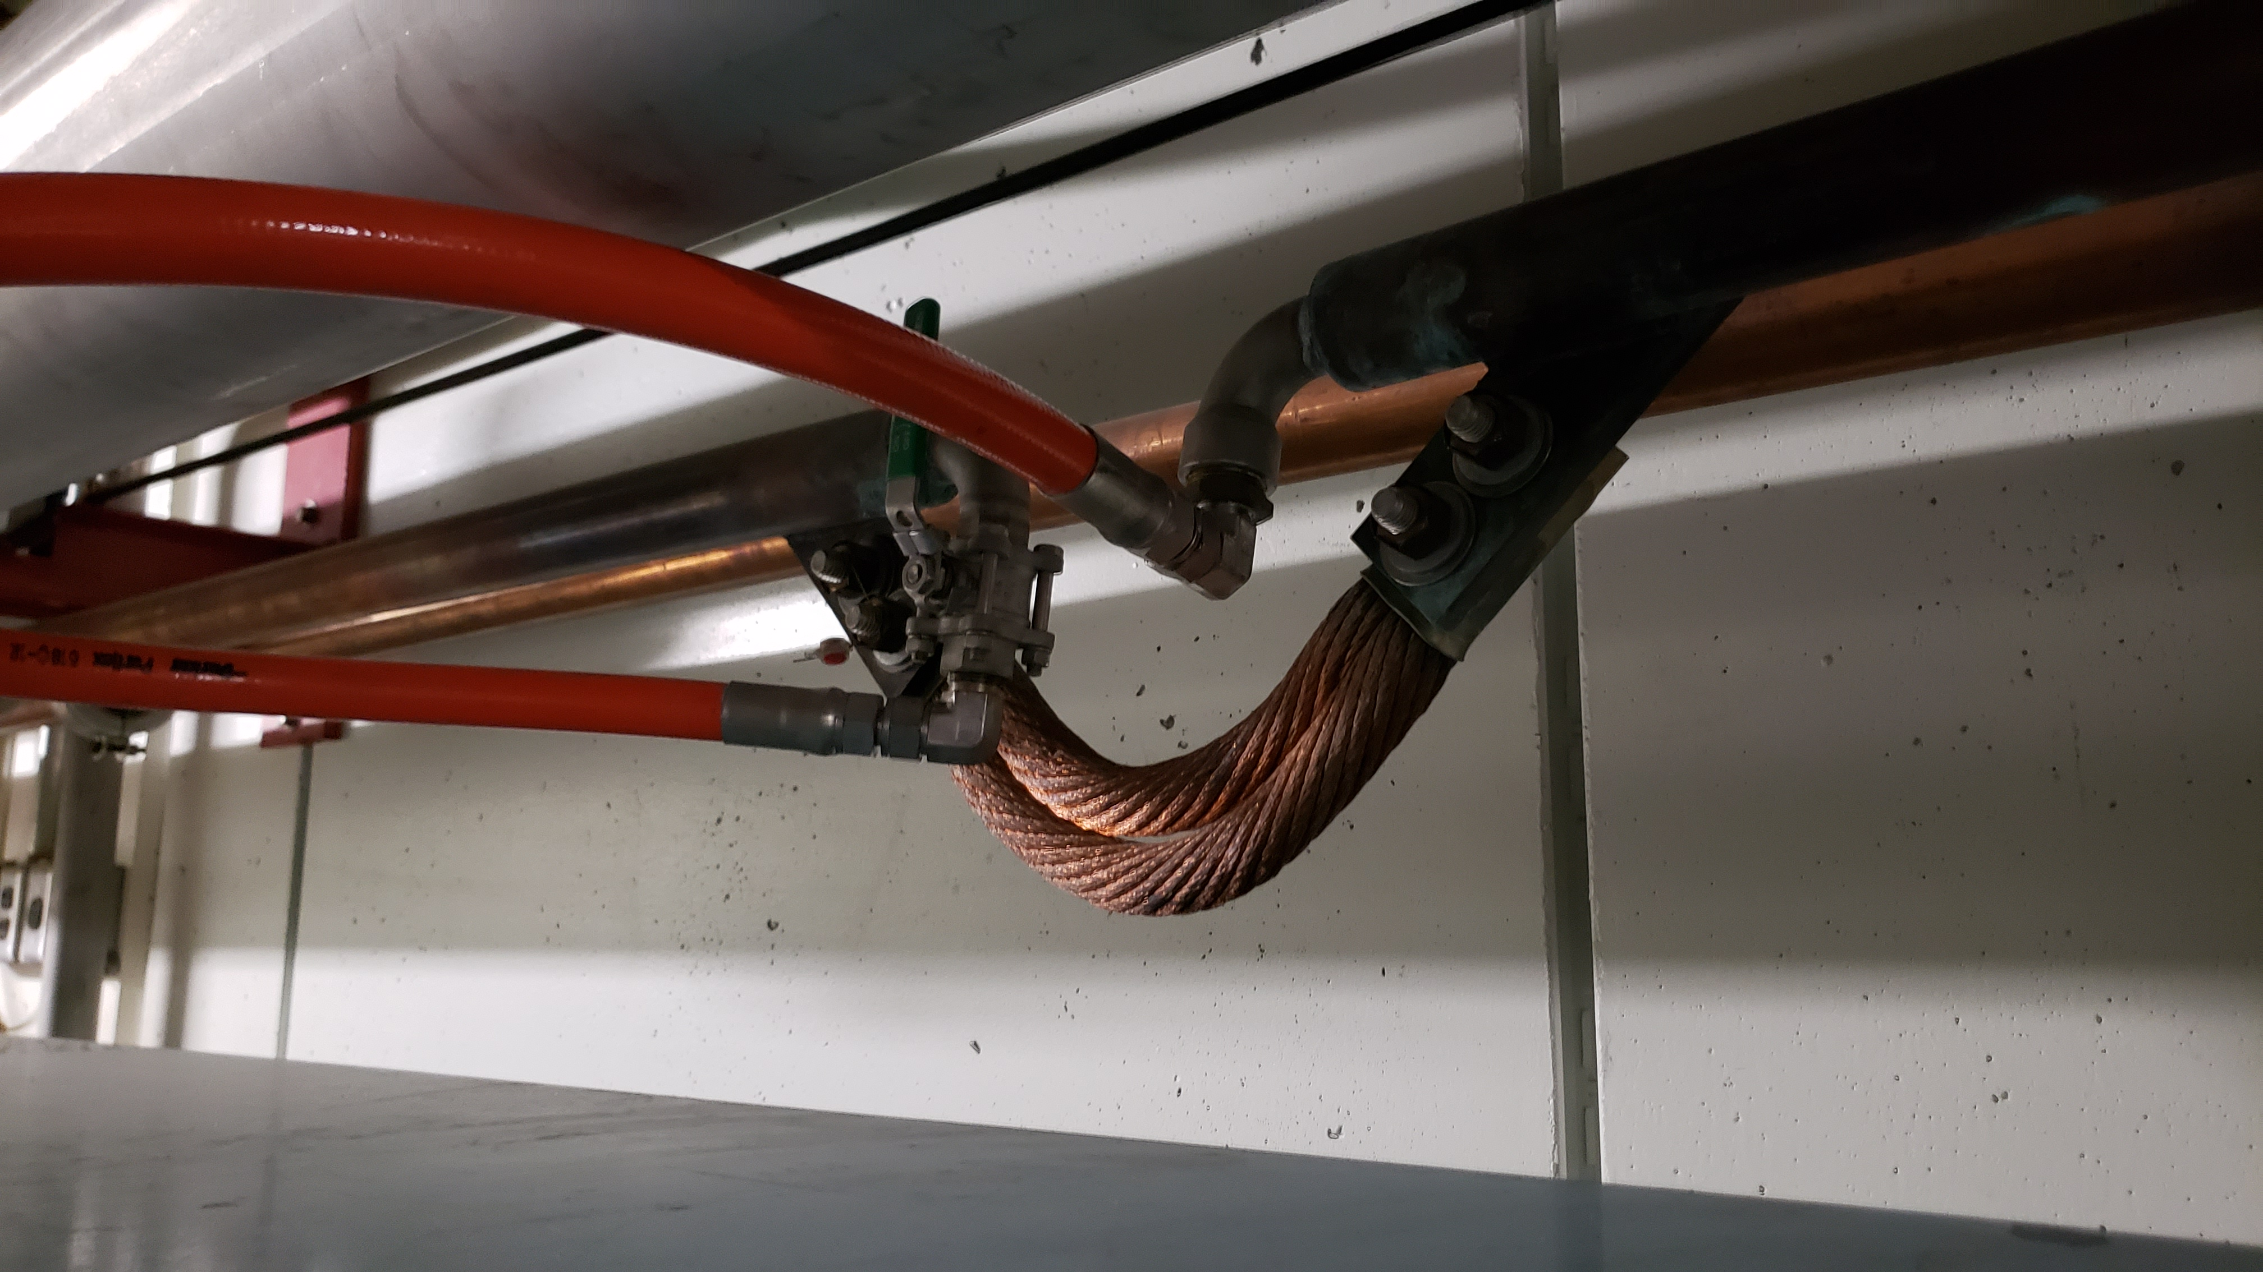
Quadrupole Bus Expansion Joints
Expansion joint arrangement and locations need studied

Slide 56
Enclosure Utilities
Outer “Magnet” wall will require relocation of grounding cable as low as possible to allow for quad bus to be installed below other wall-mounted features
Inner “Aisle” wall will require relocation of some lighting and conduits to allow for relocation of the LCW headers
May also require some relocation of loudspeakers etc.
Overhead cable trays will require temporary lowering for the installation of crossover piping
Transition range for lowering, up to 2 quad cells both US and DS of affected area

Slide 57
Enclosure Utilities
CABLE TRAYS OVERHEAD
ELECTRICAL CONDUIT
ENCLOSURE LIGHTING

Slide 58
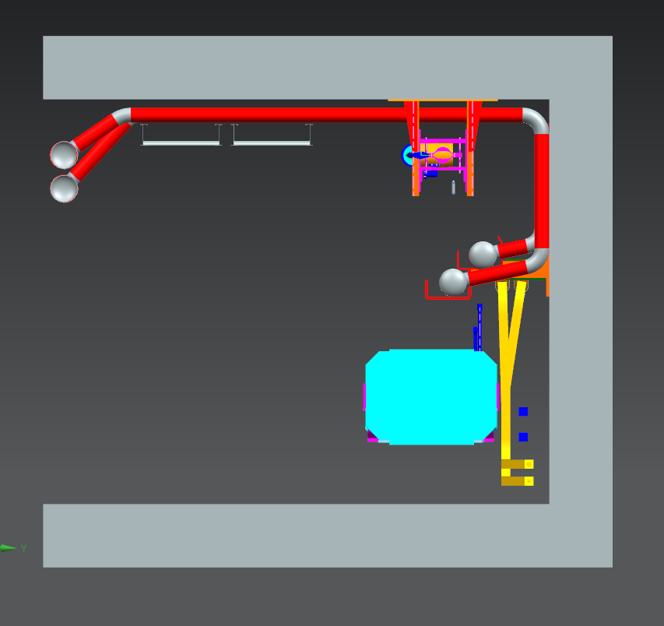
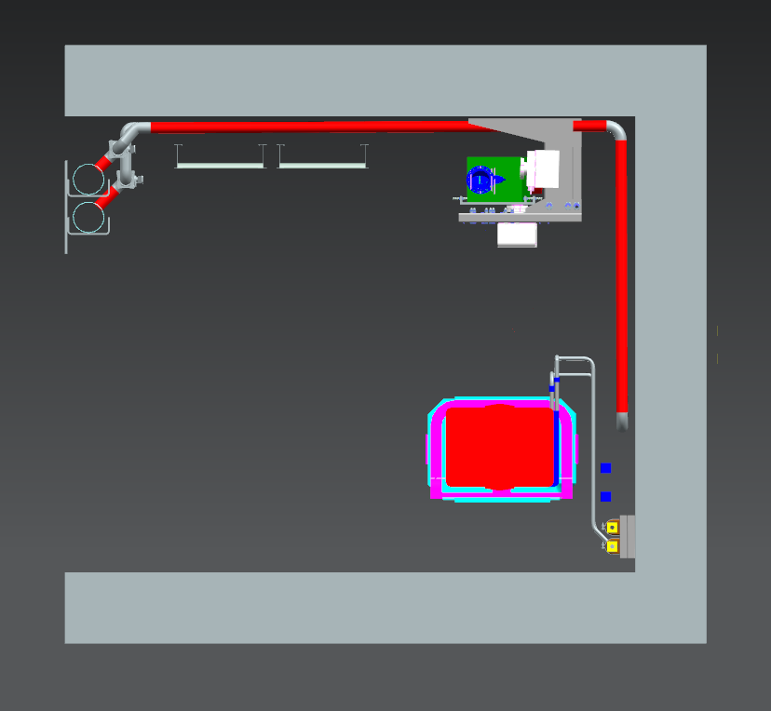
Enclosure Utilities
HEADER PIPES
MANIFOLD EXTENSIONS
CABLE TRAYS
UTILITIES IN THIS AREA

Slide 59
Cost & Schedule
Both Labor and Cost estimates are entirely new
From the ground-up
Independent of former estimates
As such, they do not meet the current documentation requirements, and will need to be reformatted to agree with current protocol and formatting

Slide 60
Cost Materials

Slide 61
Schedule Labor Hours - Fermilab

Slide 62
Schedule Labor Hours - Trades
NOTES ON TRADES: 1 – PIPEFITTER SOLO CREW is primarily pipe work 2 – ELECTRICIAN SOLO CREW is estimate for Utilities work, refer to C. Gatusso work for more accurate values
3 – COMBINED CREW is for the mixed crew for Buswork
4 – 3/5 of labor is for the bus work alone

Slide 63
Schedule Labor Hours – Task Duration
Duration Time expressed as FTE days

Slide 64
Risks and Issues
First risk is that of every retrofit: when we get to performing the tasks, there may be unforeseen issues with what is planned vs. what can be done
Labor force handling the bus may need to be mixed trades composite crew, requiring local union buy-in
6” headers may require all new pipe, rather than rework of current pipe, est. up to $25k additional materials, 80 Pipefitter hours
Needing additional bus not on hand, est. $7 - $10 per pound, 7 to 15 pound/foot
MI-14 penetration piping may require extensive rework, depending on planning and design ahead of time
Refilling the LCW into headers and components before the system is ready to come back on line would encourage a repeat of the Microbe Influence Corrosion (MIC) issues of the MI LCW start-up
Preliminary Design contingency of 40% is appropriate

Slide 65
Risks and Issues
WARNING
ABSOLUTELY NO REFILL OF ANY LCW UNTIL SYSTEM IS READY TO BE FILLED, TESTED, AND OPERATIONAL WITH FILTRATION LOOP ON LINE 24-7 !!!
This is non-negotiable.

Slide 66
Further Work To be Done
Format and upload documentation into proper LBNF project protocol
Combine Fluorinert work for MI-10 and MI-14 into this WBS
Receive buy-in approval from other vested parties
Initiate Final Design process
The following Standards and Codes shall be followed:
Fermilab Engineering Manual
ASME B31.3 - Process Piping
ASME BPVC.VIII.1 - Rules for Construction of Pressure Vessels
FESHM 5031.1 - Piping Systems
FESHM 5100 - Structural Safety
FRCM Chapter 4 - Radioactive Materials
FRCM Chapter 11 - Environmental Radiation Monitoring and Control

Slide 67
Summary
The installation of the LBNF Extraction Line in the Q-100 region requires relocation of main LCW headers and quadrupole bus, as well as numerous small modifications
Possible solutions have been discussed with many concerned parties over the last number of years
The paths for relocation of the piping and buswork have been well studied in the current enclosure, as well as with a CAD model
A reasonable plan for the retrofit work is presented herein
Cost and schedule have been re-evaluated from the ground up

Slide 68
Summary
NEW
HEADER
LOCATION
MANIFOL EXTENSIONS
PASSING OVER CABLE TRAYS
CABLE TRAYS
EXISTING QUAD
BUS LOCATION
NEW 7/8”
BUS LOCATION
NEW QUAD
BUS LOCATION
EXISTING
HEADER
LOCATION
UTILITIES AREA
3 sections from study drawing scotto_F10167487---dwg1-12-03-21-2.pdf

Slide 69
Summary Typical Quad Cell Layout, Viewed From Behind Magnet Towards Aisle
6” HEADERS,
AISLE SIDE (HIDDEN)
CABLE TRAYS
MANIFOLD VALVES,
AISLE SIDE
DIPOLE BUS
EXISTING
MANIFOLD
EXTENSIONS
7/8 QUAD BUS
NEW LOCATION
CURRENT
MANIFOLDS
MODIFIED
2-1/8” QUAD BUS
NEW LOCATION

Slide 70
References
Review Charge and Agenda: LBNF DocDB as DUNE-doc-27115-v1 https://docs.dunescience.org/cgi-bin/sso/ShowDocument?docid=27115
F10178761, LBNF FULL MODEL FOR LCW AND BUS REWORK
scotto_F10167487---dwg1-12-03-21-2.pdf
F00305689-G, Main Injector Hydraulic LCW and Bus Flow Schematic MI-10 Ser Bldg – Q108 to Q639 (Originally 9512.000-MF-305689) (updated to reflect current status with LBNF upgrades) (P&ID)
F10127805 thru 810, LBNF Primary Beam Line LCW and Bus Flow Schematic (proposed plan at this time) (P&ID)
ME-463356, MAIN INJECTOR/RECYCLER Q105 PENETRATION FLUORINERT LAYOUT
ME-463455, MAIN INJECTOR/RECYCLER MI-14 SERVICE BUILDING LCW AND FLUORINERT INSTALLATION
ME-463464, MAIN INJECTOR/RECYCLER Q104 KICKE`R COOLING MANIFOLD INSTALLATION
PBE Extraction LCW & Bus - Materials Estimate - PDR.xlsx
PBE Extraction LCW & Bus - Labor Estimate - PDR.xlsx
Return to title slide

