Slide 1
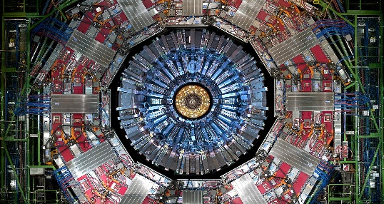
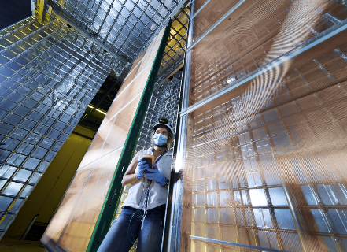


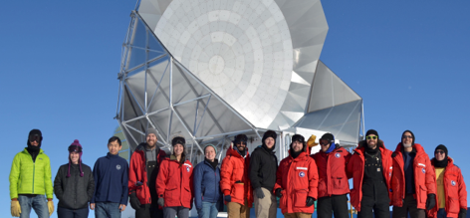
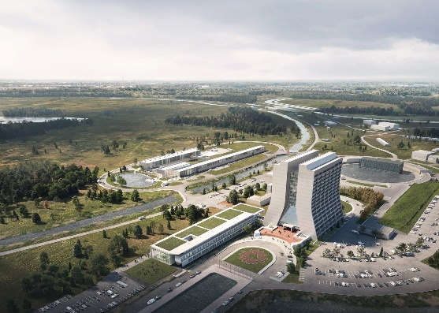
Strategic Thrusts: Pillars of our vision for Fermilab
Deliver groundbreaking science and technology innovation
Building for Discovery: Project Execution
Diversify and empower our workforce
Transform business systems & operations, execute sustainable campus strategy integrated with science vision
Forge strong alliances with UChicago, ANL, URA and other national/international institutions
Develop Strategic Plan for Fermilab’s next 20 Years

Slide 2
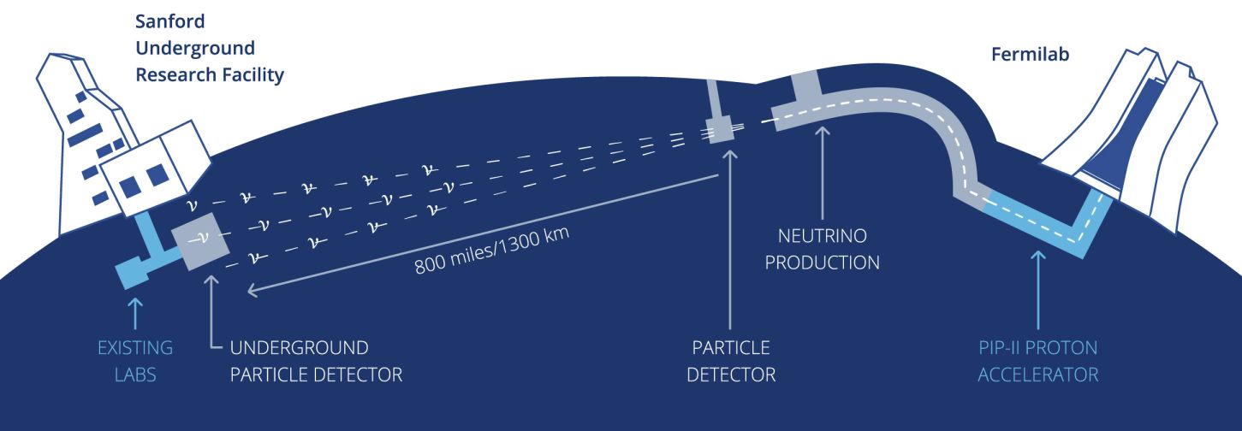
DUNE: The world’s most capable neutrino experiment, driven by LBNF and PIP-II
S&T
Delivering on LBNF/DUNE is Fermilab’s highest priority

Slide 3
LBNF/DUNE goals and plan for Accelerator Complex
The LBNF/DUNE strategy recently revisited by the lab
  Compressed timeline for LBNF construction and start of beam operations
  Push for more neutrinos, sooner
Proton Intensity Upgrade / Central Design Group reviewed beam intensity upgrade
  Options for replacing Booster with either a new RCS or a linac to achieve 2.4MW
  Booster has served for 50 years and will not serve for another 50!
In parallel, a scenario emerged for delivering beam intensity above PIP-II
    Referred to as ‘Option-0’
    Utilizes Fermilab Accelerator Complex with PIP-II but without major replacements
    Optimize for most production with least investment

Slide 4

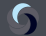
Major Decadal Goals
Neutrino Science
Vision: US/Fermilab is universally acknowledged as the world leader in neutrino science for decades to come
 | FY22 | FY23 | FY24 | FY25 | FY26 | FY27 | FY28 | FY29 | FY30 | FY31 | FY32
NOvA
SBN
PIP-II
LBNF/DUNE
Host Lab
BR
Operations
Operations
Construction
        2040
Construction
Plan
Execution
        2040
R&D

Slide 5
Path to higher number of neutrinos
The number of produced neutrinos will be determined by
  Maximum proton flux produced by the accelerator
  Overall efficiency of operations
  Ability of target station to convert protons to neutrinos

Slide 6
Path to higher number of neutrinos – proton flux
We evaluate the proton production by the Accelerator Complex after PIP-II upgrade
The proton flux to LBNF is a function of
Main Injector beam pulse intensity
  Upgrading beam intensity requires more particles per pulse out of Booster
Main Injector cycle time
  PIP-II increases particle flux from Booster by factor ~2 from present level to achieve 1.2MW with 1.2s MI cycle
  Shortening MI cycle would allow increasing LBNF proton flux without raising MI intensity

Slide 7
Path to higher number of neutrinos – operation efficiency
Reaching the LBNF/DUNE goals will be determined by the accelerator complex’ ability to deliver beam with maximum power reliably over long period of time. The overall operation efficiency is a function of
Average proton flux (beam power) during the operations
  Ability to quickly commission upgrades
  Ease of tuning and recovery after stops
  Lossless operation
Machine availability during scheduled run time
Length of scheduled operations
  Minimize the length and number of shutdowns

Slide 8
Motivation for this study
Upgrade of Main Injector power through shortening the accelerator cycle time is a promising path for increasing beam delivery to high-energy neutrino experiments.
  For DUNE/PIP-II, possibly increase power on day one.
  This approach is compatible with any Booster replacement scenario for future upgrades.
  Perform upgrades in stages as AIPs during regular accelerator shutdowns → minimum impact on beam delivery.
  Increasing proton flux through cycle rate is more forgiving for targets.
This report is a summary of a high-level feasibility study.
  What is the ultimate limit on MI cycle time?
  Identify key limiting factors.
  Produce a menu with options.

Slide 9
MI beam power in numbers
 |  | PIP-II Booster Intensity
Scenario | Present | PIP-II | A | B
MI 120 GeV ramp rate | 1.333 | 1.2 | 0.9 | 0.7
Booster I | 4.5 | 6.5 | 6.5 | 6.5
Booster ramp rate | 15 | 20 | 20 | 20
Number of batches | 12 | 12 | 12 | 12
MI power | 0.865 | 1.25 | 1.666 | 2.142
cycles for 8 GeV | 6 | 12 | 6 | 2
Available 8 GeV power | 29 | 83 | 56 | 24
J. Eldred
Minimum cycle is 0.65 s
  Slip-stacking in the RR requires 12 20 Hz booster ticks for 12 injections + 1 20 Hz booster tick for slipping
  13*0.05 = 0.65s
  Zero beam for other 8 GeV program

Slide 10
Goals of the workshop
Develop a self-consistent, staged plan that ensures most expeditious fulfillment of LBNF/DUNE Phase I and Phase II goals
The plan will utilize the accelerator complex after PIP-II upgrades and include modernization necessary to
  Increase MI proton flux through cycle time reduction
  LBNF target station to accept the increased particle flux
  Operate with efficiency at or above 50% (?)
The plan will include
  Key elements
  Timeline
  Cost ranges
  Risks and mitigation plans- come up with criteria / risk register

Slide 11
PIP-II and LBNF accelerator milestones – original

Slide 12
Accelerator ramp-up schedule – original PIP-II plan
 | FY29 |  |  |  | FY30 |  |  |  | FY31 |  |  |  | FY32 |  |  |  | FY33 |  |  |  | FY34
 | 1 | 2 | 3 | 4 | 1 | 2 | 3 | 4 | 1 | 2 | 3 | 4 | 1 | 2 | 3 | 4 | 1 | 2 | 3 | 4 | 1 | 2 | 3 | 4
startup and commission beam in Booster
establish beam to BNB and work on increasing Booster intensity
startup MI and commission beam in MI/RR
beam to Mu2e, increasing to 4E12 per Booster batch, 2 batches per 1.2s
beam to BNB, increasing to 6.25E12 per Booster batch (as beam dump if no user) |  |  |  |  |  |  |  |  |  |  |  |  | if requested |  |  |  | if requested
commission slipstacking with limited pulses to dump
establish beam to LBNF
beam to LBNF at 700 kW increase power to 900 kW
beam to LBNF increasing power to 1.2 MW

Slide 13
PIP-II and LBNF accelerator milestones – revised

