Slide 1
ACE
W Pellico
PIP-II Accumulator Ring (PAR)

Slide 2
Purpose of This Talk
To inform people of an opportunity that exists, for a modest cost and within this decade, a storage ring option that will utilize the PIP-II capabilities, help DUNE power ramp up, and jump start FNAL DS beam-based FNAL physics program.
  What is presented here is summarized in Snowmass paper …..
    arXiv paper: https://arxiv.org/abs/2203.07339

Slide 3
PAR People
Lattice:
John Johnstone, Meiqin Xiao, Cheng-Yang Tan, Jeff Eldred, Carol Johnstone, Dave Johnson
Students Supervisor: Jeff Eldred
Extraction Lines:
Meiqin Xiao
RF:
Chandra Bhat, Bill Pellico
Magnets:
Dave Harding, Bill Pellico
Civil:
Steve Dixon, Ernesto Alcaraz
Injection:
Dave Johnson
DS Physics Requirements:
Matt Toups
PIP-II
Curtis Baffes, Marina Simon

Slide 4
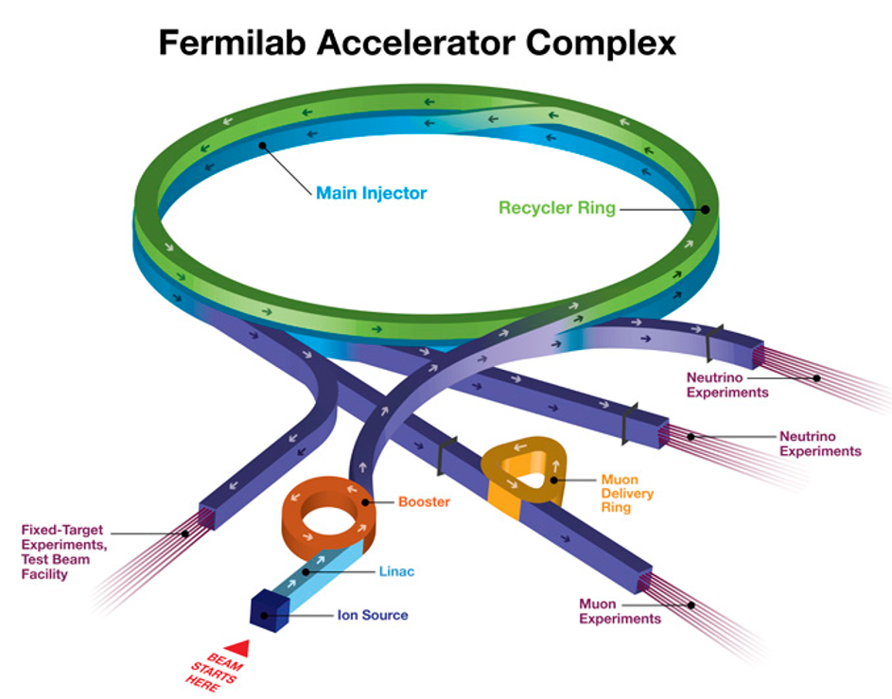
Present Complex
Linac:
15 Hz
30 ma
Booster:
8 GeV,
15 Hz
MI:
150,120, 60 GeV
1.2 sec cycle
Muon Campus, 8 GeV
Fixed Target (Test Beams), 120 GeV
Physics:
G-2
Neutrino –
NoVA:
Short Baseline: ICARUS and SBND
Long Baseline: NOvA
Fixed Target - Misc
Dark Matter & Dark Energy

Slide 5
PIP-II Complex & PAR
SRF PIPII: 800 MeV:
2.5 ma
High Cycle Rate
Upgradable
PAR:
100Hz (Upgradable)
800 MeV (Upgradable)
Booster:
8 GeV
20 Hz
MI: 150, 120, 60 GeV
Muon Campus, 8 GeV
Fixed Target, 120 GeV
Physics:
Mu2E
Neutrino - DUNE
Fixed Target - Test Beams
Dark Search
…….TBD…….
New
Transfer Line
PAR
PIP II Complex

Slide 6
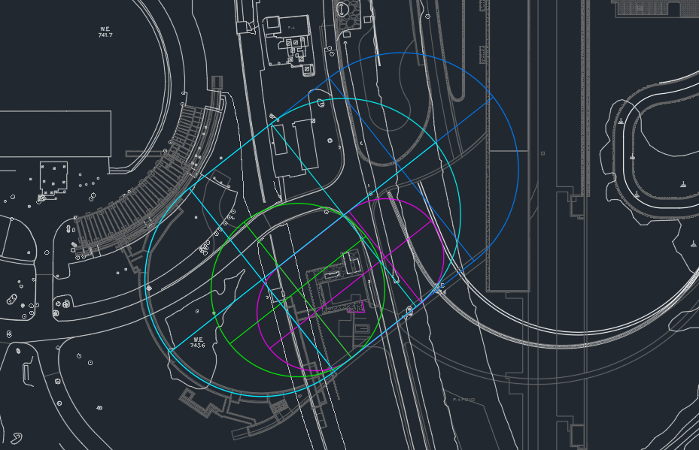
Early Effort to locate PAR
With PIP-II civil support
Priorities
Minimize impact to PIPII
Allow design flexibility
Meet timeline goals
HEP flexibility
Reduced cost
Too Big
Max Size
Half Booster Options

Slide 7
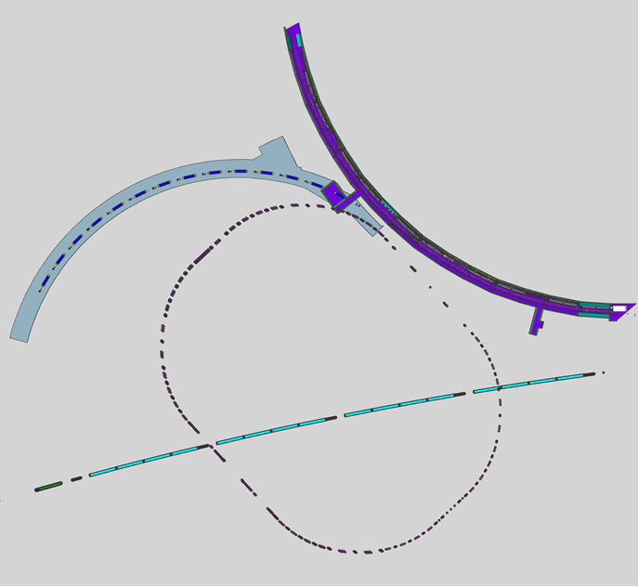
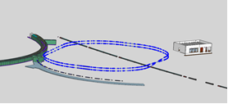
Present PAR Civil
PAR Civil Overview:
2 MI crossing – no interference
Injection Beam Dump – outside
Two rings: Top/Bottom Ring straights utilized
RF is located on one location
Extraction in one location
Rings are offset in both V & H for connivence
~ 10-meter injection region
PAR
Ext
DS
Target
PAR
Inj
DS
Det
PAR
BD
MI X2
MI X1

Slide 8
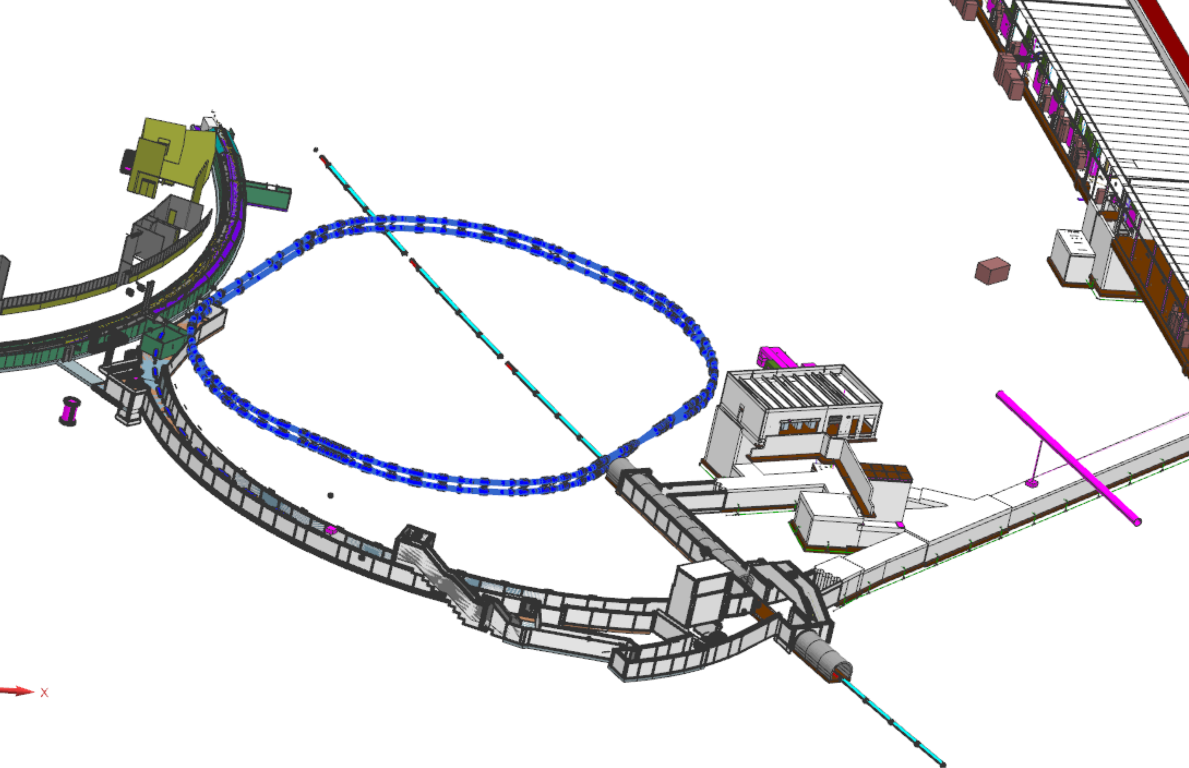
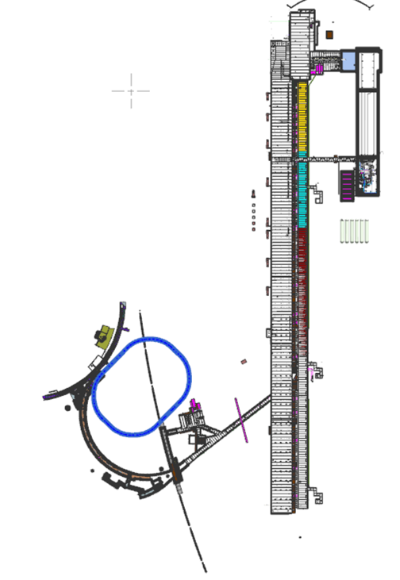
Civil Views – Looking to share with PIP-II

Slide 9
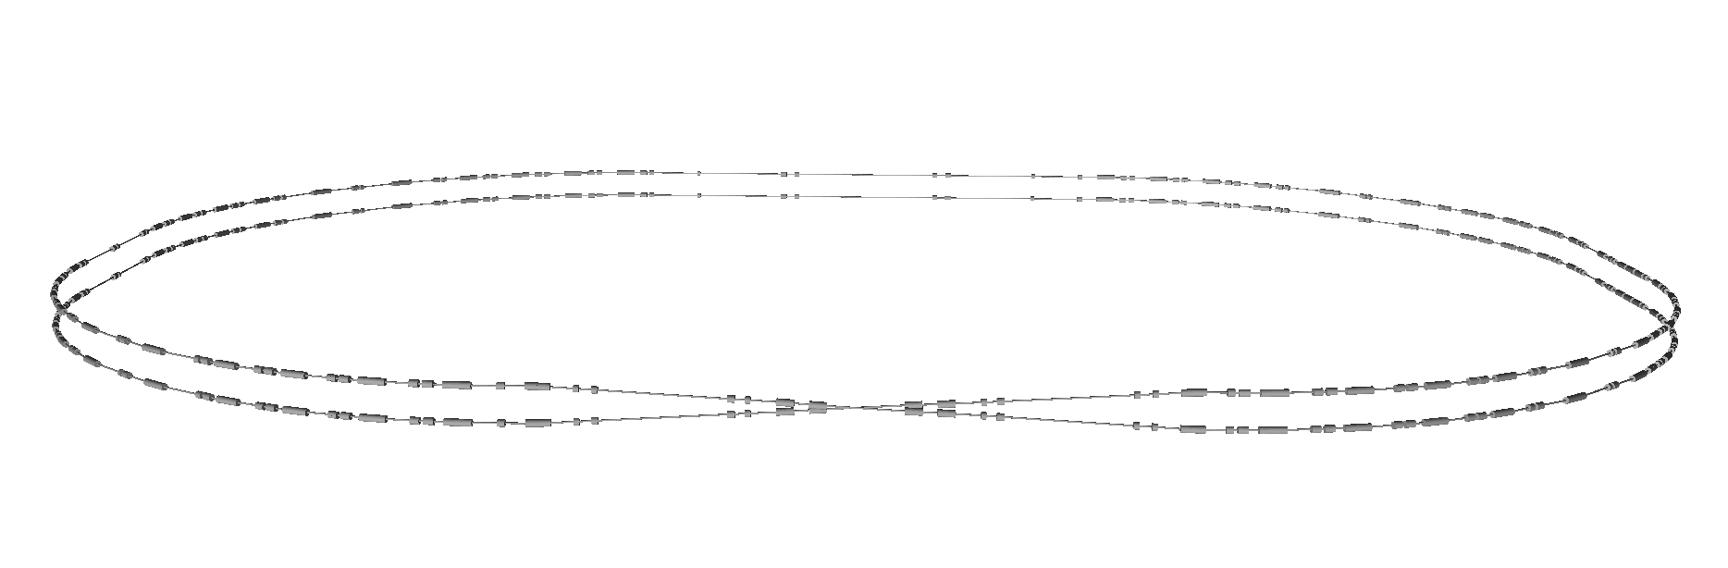
Folded Ring Design
Allow placement between BTL/Booster/PIP-II, Service Buildings
Fewer penetrations to power components – grouping
Reduced civil costs
Injection
Extraction
RF

Slide 10
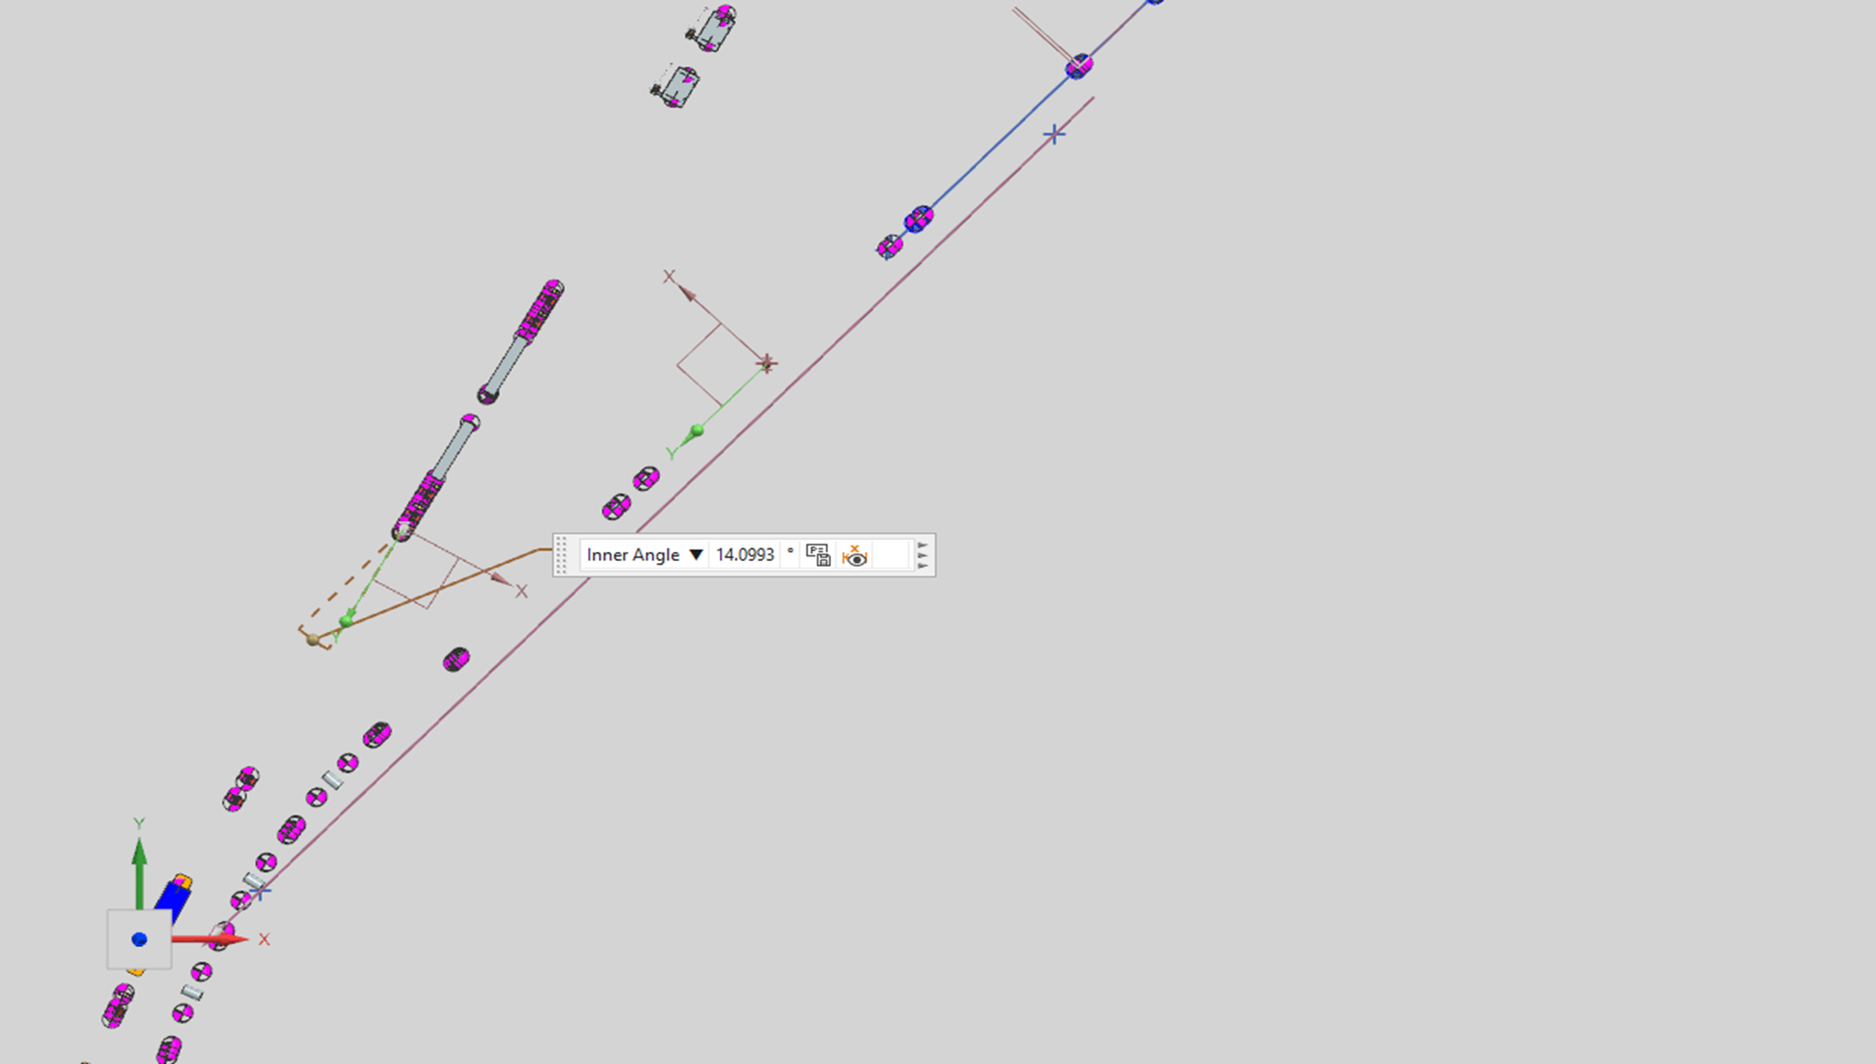
Not Used BTL magnets
When PAR is commissioned and ready to deliver to Booster
Two DC magnets in the BTL line will be used to divert beam:
Blue dipole magnet - Beam from BTL to PAR
Red dipole magnet - Beam from PAR to BTL

Slide 11
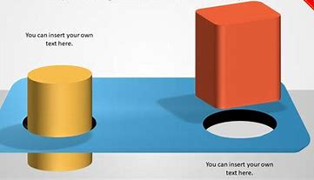
PAR – Design Parameter Considerations
Needed to start with a concept – to allow lattice work to start…….
Booster circumference ring ~478m so half Booster circumference ring ~239m
Beam will take the same time to fill the wrapped ring as it does the Booster: ~600us:
A bunch will pass the foil/injection girder in a similar number/time. ~7 (parasitic hits)
Harmonic number will be basically the same (fill about 81 buckets).
Aperture needed for Booster load is like Booster ~5.5125 cm
Aperture for DS program is constrained by cost – but ideally larger is better. ~7.62 cm
Accommodate a large injection region to handle the flux: ~10 meters
Accommodate two extraction areas:
Booster 20 Hz extraction rate
DS 100+ Hz extraction rate
Accommodate Two RF systems:
Booster designated beam needs 44 MHz capture
DS desires high intensity short bunches – Sub 10 MHz planned
Room for DS and waste beam dumps
Room for PAR injection from BTL line, extraction line to BTL, Extraction line to DS
Fit all of this inside an ‘open’ area that can match BTL, Booster and DS needs……
PAR- BTL
BTL- Booster

Slide 12
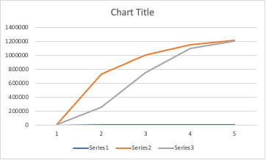
PAR Benefits for DUNE
The PAR concept offers significant improvements to planned PIPII Booster injection.
  PAR would allow for single turn injection – no flattening of Booter bend field
  PAR would remove from Booster RF needs of flat to ramp transition
PAR could reduce DUNE power ramp up times.
PAR offers a path to quickly utilize the capability of PIPII.
PAR will reduce Booster losses
  Can accommodate a robust injection and beam dump
  Easier beam painting
  Better injection capture and synchronization to Booster ramp and PIP-II
PAR could have an upgrade path to 1 GeV
PAR allows for a more direct method of RF transfer between PIP-II and Booster (Simpler Locking System)
PAR will allow accelerator scientist and engineers to test concepts needed for future storage rings/ RCS.
  A future RCS will require a storage ring to effectively collect high energy H- beams.
  Design and operation of Booster sized storage rings will be challenging at DUNE intensities.
DUNE Power Ramp UP
With PAR Present DUNE
Years

Slide 13
PAR Benefits for DUNE
Two categories: Ramp Up Flux & Viability/Reliability
Ramp Up Flux
  Reduces complexity of Injection
    Injection girder
    Injection beam dump
  Reduces complexity of RF capture
  Reduces complexity of Ramp process
  Reduces complexity of flat orbit
  Reduces complexity of orbit control/painting
  Reduces complexity of collimation
  (Higher injection opportunity)
  PAR lattice zero RF dispersion
Viability/Reliability
  Booster shielding is limited –
    TLM are tightly set to be safe
    Collimators are under towers
  Booster Injection Dump limited space
    Injection girder is under BWG
  Less stress on Booster correctors to flatten orbit
    Voltage gradient removed
  Loses at RF and Collimators reduced
  Booster RF systems – cogging, feedback are much simpler to maintain

Slide 14
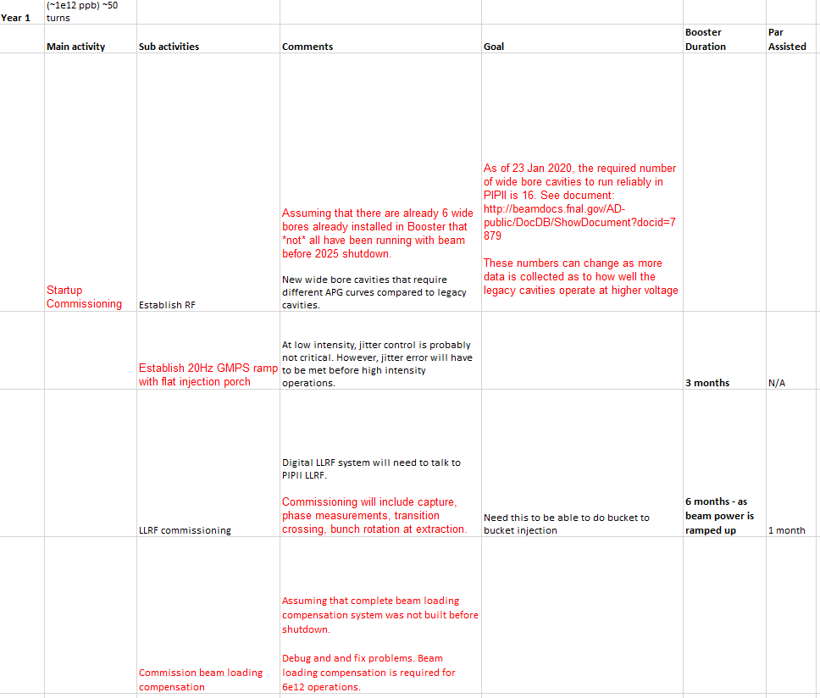
PAR TASK – Show in numbers PAR benefit
The PAR working group has started to go through each required task and quantity the savings. This is straight forward for initial effort/time. However, long term or to quantify viability is more challenging.
We are taking the same approach as we did with PIP and put a risk on items. Then will look at PAR impact on those risks as well as what risks PAR adds.

Slide 15
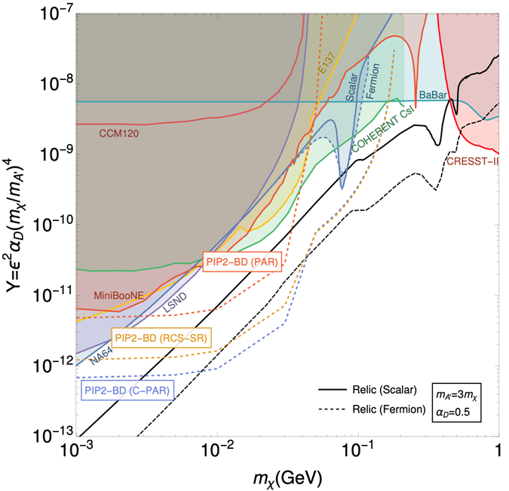
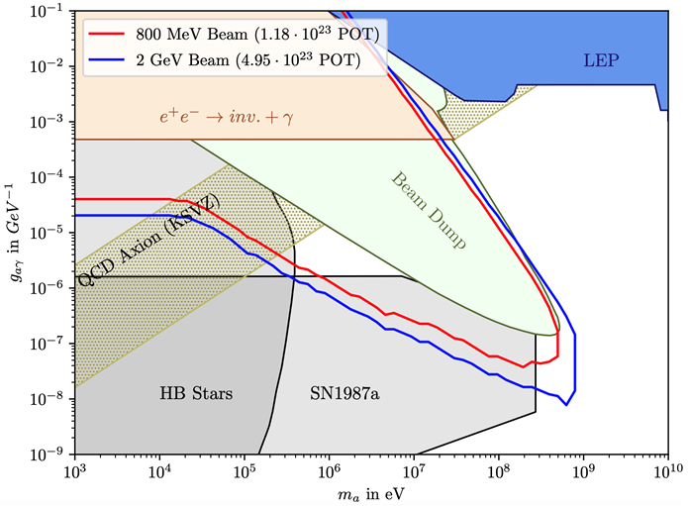
PAR Benefits – New Physics Options (Matt Toups Talk)
Sensitivity to benchmark vector portal dark matter scenario
(sensitivity also to hadrophilic models of dark matter, in which the dark matter prefers to couple to quarks over leptons)
Sensitivity to photon-coupled axion-like particles
(also motivated by the non-observation of charge-parity violation in the strong interaction)

Slide 16
PAR Status
The effort for PAR started almost two years ago
  Originally located in the Booster Tunnel was called BAR
Opted to move adjacent to the Booster near the PIP-II injection line BTL
  Civil cost higher
  Reduced impact to Booster
  No impact to present PIP-II Booster plan
Regular meetings
  Proton Source/Beam Physics Group
  Civil Construction – with PIP-II civil engineers
  Division Management
Finishing up lattice and beam physics in 2022 (About done – Jeff E. Talk)
Cost estimates will be provided in early 2023
Complete interface of PAR with BTL civil plans 2023
  Alternate options such as C-PAR listed in PIP2-BD physics paper
    C-PAR (compact PAR) option will be more fully explored following PAR

Slide 17
Original PAR Parameter Tables – Chandra Bhat
Still to be worked out
BAR – Accumulator for storage for DS Physics Search
Option 1
h - Harmonic Number (additional RF system) | 4
fRF | 2.079 | MHz
Bucket Length | 480.93 | ns
Number of Recycler type 2.05 MHz RF Cavities | 2
Peak RF Voltage/Cavity | 5 | kV
Peak RF Voltage | 0.01 | MV
Bucket Area | 1.66 | eVs
Synchrotron Oscillation Period | 6.10E+02 | Hz
Scaled Bunch Intensity | 1.82E+12 | p/bunch
Option 2
h (additional RF system) | 5
fRF | 2.599 | MHz
Bucket Length | 384.75 | ns
Number of Recycler type 2.5MHz RF Cavities | 2
Peak RF Voltage/Cavity | 5 | kV
Peak RF Voltage | 0.010 | MV
Bucket Area | 1.19 | eVs
Synchrotron Oscillation Period | 6.82E+02 | Hz
Average Bending Radius | 77.2682102 | m
Average Dipole B-Field | 0.063 | Tesla
Booster Accumulator Ring (BAR) Parameters - Booster Use
Parameter Name | Value | Units
Booster Synchrotron Circumference | 474.2 | m
Booster Synchrotron Radius | 75.47 | m
Booster Accumulator Circumference | 485.49 | m
Booster Accumulator Radius | 77.27 | m
BAR Injection Energy (kinetic) | 800 | MeV
BAR Injection Energy (Total) | 1738 | MeV
BAR Extraction Energy (kinetic) | 800 | MeV
Gamma Transition(for Booster=5.4783) | 6.36 | ???
Revolution Frequency | 519822 | Hz
Revolution Period | 1.924 | us
RF Properties
h (matching with Booster RF) | ~84 | Fundamental
fRF | 44.705 | MHz
Bucket Length | 22.37 | ns
Number of Booster type RF Cavities | 4
Peak RF Voltage/Cavity | 50 | kV
Total RF Voltage | 0.2 | MV
Bucket Area | 0.074 | eVs
Synchrotron Oscillation Period | 1.27E+04 | Hz
PIP2 beam Intensity | 6.70E+12 | ppCycle
PIP2 Bunch Intensity | 8.27E+10 | p/bunch

Slide 18
PAR Operations
Designed around some initial base numbers but with upgrades in mind:
Opportunity to minimize hardware rate and radiation limitations
Booster Delivery – 20 Hz @ 6.7E12 ppp 800 MeV (20 Hz 1 GEV being explored as part of design)
DS Delivery 100 Hz @ 800 MeV initial goal
Goal to be upgradable to 1 GeV
> 100 Hz options

Slide 19
PAR Operation
PIP-II - Booster – Recycler – MI cycles
v
T= .6 sec for 12 Booster cycles –> time to load of Recycler
MI Ramping
1.2 sec MI cycle
1 Sec
Beam to BNB
Additional Booster
cycles
T= 50msc
Load Recycler

Slide 20
Beam Cycles
.6 sec/12 Booster Cycles
Booster Beam
Booster
Beam
50 ms
Booster Cycles
20 Hz
PAR
Booster Load
PAR
Booster Load
100 Hz Option
PAR
DS Load
10ms
PAR
DS Cycles
Cycle rate for filling PAR will depend upon hardware limitations and injection region capability

Slide 21
PAR Beam to DS program
(Matt Toups Talk)
Assuming 100 Hz hardware limitations and Space Charge like PIP-II
100 Hz* 1E13 ppp*800 MeV*1.6E-19 = 128 kW
More pulses and or higher intensity may be possible
Future option: PIP-II increases injection beam energy to 1 GeV.
  The SC is reduced, and you can scale up the beam intensity:
100 Hz*1.5E13 ppp*1E9*1.6E-19 = 240 kW
Limitations for these intensities need to be examined – such as shielding, painting, injection foil, extraction, RF needs…..

Slide 22
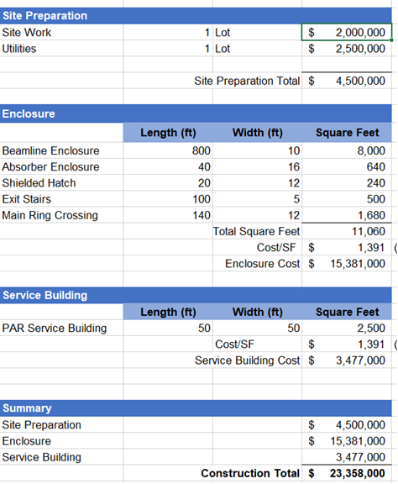
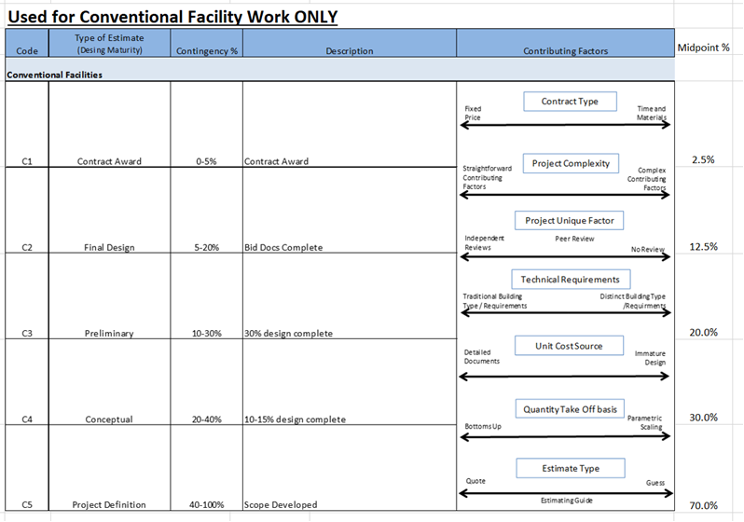
Why Not PAR - Funding Reality
Funding at an opportune time is the challenge. Meeting the timeline to help PIP-II/DUNE is important to PAR becoming reality. As PAR progresses – cost tables will be completed as shown for civil below.

Slide 23
PAR is path to a faster DUNE ramp up, use of the PIP-II capability and nearly a decade faster path to a DS physics program.
PAR
Build BTL Tie-In
The above timeline provides some idea of DUNE and DS power delivery. This may be overly optimistic or pessimistic – it all depends upon funding profile.
PAR is not an attempt to change the DUNE 2.4 MW timeline directly. However, it does offer a faster ramp-up. If one wants three years at full power before shutting down for 2.4 MW and the opportunity to examine some of the challenges of 2.4 MW delivery.
One may also consider 1 GeV PIP-II as a staged upgrade that will further improve staging of power upgrades. This also reduces the stress on the Booster magnets from reduced voltage radient 1 GeV injection from PIP-II into Booster is not possible without PAR.
PAR occurs before Booster replacement – This is the only option/talk on the next decade plus opportunities at FNAL.

Slide 24
Summary
PAR offers solutions an upgrade of PIP-II to Booster operations, an immediate extended use of the PIP-II capability, a stage to upgrade power, an opportunity for FNAL to make a significant contribution to DS HEP and an exciting area of accelerator development.
This option, by using the upgrades and facilities that exist or soon to exist, is cost effective and achievable on a short time scale. To achieve this capability before the end of this decade is possible but needs to start now.
Cost is the only reason not to proceed –
Therefore, if we can get the cost to a reasonable number – PAR will be done!
Had we started this earlier - I believe PAR would have been part of PIP-II plan.
  PIPII will work without PAR, but with PAR, PIPII operations is improved and simplified.

Slide 25
PAR Costs (Fill In Numbers Over the Next year)
Tunnel Enclosure 24 M
Permanent magnets (Two recent examples with labor) 7 M
Stands/supports 1.4 M
Correctors – reuse .1 M
Power Supplies
RF: Retro Fit Spare Booster Cavities Like PIP II (may power from upstairs: fixed freq) 4 M
Vacuum estimates: Pumps and plumbing (24 sector system). 2.5 M
  Can we share Booster Roughing system?
  Controls .8 M
Diagnostics – Use Booster BPM design (4 inch ID)
  BPM unit cost 24 k (with flanges) .65 M
  Use Booster or Linac fixed frequency BPM digitizer design ( 4k per board) .1 M
  Extraction Kickers – larger aperture, use SS PS – 2.2 M
  Toroids
Injection – similar to PIP II cost ??
Extraction Dump Magnets: (Unless we reuse 8 GeV magnets and PS) 1.2 M
Work In Progress

Slide 26
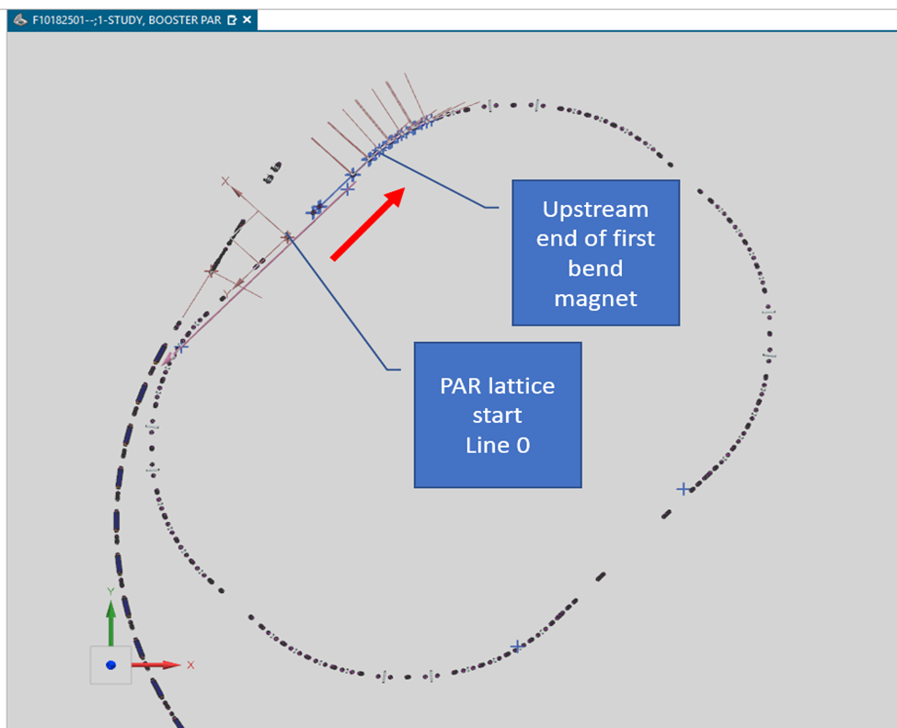
Planning DS placement is underway
Early thoughts each had pro/cons
Extract from PAR in the same region as extraction to Booster.
Have a switching magnet that switches between BTL/Booster and Booster Dump/DS region.
Benefits:
Use same kickers,
Use only one short straight
Issues:
Faster kickers 120 Hz vs 100/20 Hz
Potentially hotter area
Adding a fast pulser magnet
Separate
Using Btm ring for BTL, top for DS:
Separate operations
Easier of Pulsed systems
Det
DS RF section
>18 Meters
Tunable
Detector
Flux
Dump
Det B
Det C
PAR RF
Service
Building
PAR RF
BTL
Service
Building

Slide 27
PAR: Timeline of Development:
Lattice: (FNAL)
  Develop a list of constraints (use rough parameter boundaries)
    RF footprint (capture and maybe unique DS bunching needs)
    Injection Area
    Extraction (kickers, septa)
    Meet PIP-II injection and BTL physical and lattice constraints
    Comfortable tune and chromaticity for 600 us accumulation
    Minimize dispersion in RF area –
Hardware: (FNAL, BNL, US-Japan)
  Lattice will drive magnet design
    Edge Focusing
    Reasonable strength
      Permanent magnet
      Combined Function
  RF – reuse Booster cavities (shell)
  Use Booster style short kickers
Injection (FNAL)
  System to handle Booster needs but also DS needs -
  This is probably the most challenging aspect of a 100+ Hz capable machine –
Generate Rough Cost Estimate – In One Year

