Slide 1
Booster injection in the era of PIP-II & implications of PAR
Accelerator Capabilities Enhancement (ACE) Workshop
Presenter: David Johnson, Fermilab
Batavia, Illinois 60510
30 – Jan - 2023

Slide 2
Booster injection infrastructure challenges - Highlights
Booster throughput #protons/hr delivered is loss limited
Administrative lost power limited to 500W average over 5 minutes
Injected power is increased from 4.5 kW to 17.1 kW
Efficiency must increase from 94-95% to 98% to keep losses within Administrative Limit
Must have injection absorber in the injection straight and keep the waste beam (neutrals & H-) away from the aperture → takes up valuable beamline space
Limit of dipole fields for ORBUMP injection magnets to minimize losses due to Lorentz stripping of injected H0 → tends to increase required space for closed orbit bump
  Use plane with minimum offset from RCS centerline → implies Vertical injection
Current straight only has 5.68 meters free flange-flange in straight → NOT ENOUGH SPACE
  Requires the design and fabrication of TWO new flavors of the 50 yro CFM magnets
  We are establishing a 20 Hz girder test facility at E4R to test existing spare F&D’s and new flavor D’s
  This process will also allow the fabrication of spares
Requires transverse phase space painting
  The number of injected turns 20→ 386 and injection time from 44 us to 550 us → has implications for energy match during inj.
  New dedicated painting magnets around the injection straight
Change longitudinal injection process from adiabatic capture to micro-bunch to bucket injection
  Requires careful (energy & phase) matching and jitter control → de-buncher cavity
Booster excitation is resonant sin wave at 15 Hz to be increased to 20 Hz
  Must change resonant frequency of CFM power supply system i.e. GMPS), kickers, injection devices, extraction devices, instrumentation, clock system, and control system, etc.
Create a constant injection energy→ Effective injection field will be flattened using 48 corrector dipoles
    Simulation and hardware development efforts are on going

Slide 3
Current and PIP-II Operational Parameters
Parameter | Before PIP circa 2002-04 | Current circa 2017-now | PIP-II circa 2028 & beyond | Units
Injection Energy | 400 | 400 | 800 | MeV
Rep Rate | 7.5 | 15 | 20 | Hz
PPP Injected | 2 | 4.7 | 6.7 | E12
Protons/hr | 0.54 | 2.538 | 4.824 | E17
# turns | 1 to 12 | 1 to 19 | 292 | turns
Linac <current> | ~30-40 | ~22 - 25 | 2.5 | mA
injection time | 2.2 to 26.4 | 2.2 to 41.8 | 550 | us
Injected power | 0.96 | 4.512 | 17.152 | kW
x2
x1.33
x1.43
Requires Booster
shielding assessment update
→ ~ x1.92
→ ~ x15
1 turn
Single turn
Injection
from PAR
~ x0.1
Irrelevant for Booster
> x10
~1.9 us
→ X3.8
PIP-II will require injection phase space painting due to small Linac emittance
PIP-II will utilize micro-bunch to bucket injection (provided by MEBT 162.5 MHz chopper)
Increase in injected beam power will require dedicated injection absorber
Increase (factor 2) in Protons/hr delivery implies → an update to the 2017Booster SAD , beyond the SAD for newly added components
The long injection time requires an injection “flat bottom” by ramping H dipole correctors to compensate the dB/dt of GMPS during injection.

Slide 4
Booster Parameters at Injection
Assumed Booster Ring Parameters | Value | Unit
RF frequency at injection | 44.704 | MHz
Revolution frequency | 532.193 | kHz
Harmonic number | 84 | -
Filled Booster buckets | 81 | -
Bucket length (injection) | 23.369 | ns
Bucket length (extraction) | 18.935 | ns
Maximum power loss (5 min avg) | 500 | W
Booster Twiss Parameters at Foil | Value | Unit
β_{x} [ideal /as found/used] | 6.13/5.87/6.35 | meters
α_{x} [ideal /as found/used] | -0.049/-0.019/0.108 | -
D_{x} [ideal /as found/used] | 1.839/1.735/2.234 | meters
D’_{x} [ideal /as found/used] | 0/0/0 | -
β_{y} [ideal /as found/used] | 20.16/19.5/19.04 | meters
α_{y} [ideal /as found/used] | -0.015/-0.0174/0.0356 | -
D_{y} [ideal /with ORBUMP on] | 0/ -0.1164 | meters
D’_{y} [ideal /with ORBUMP on] | 0/0 | -
@800 MeV
3 empty buckets for extraction gap
--created by PIP-II MEBT 162.5 MHz chopper
Administrative limit

Slide 5
Injection Requirements
Parameters | Value | Units
Injection Parameters
Injection intensity | 6.7 | 10¹²
Number of turns for injection, approx. | 285 | -
Injection time, approx. | 538 | us
Final painted 95% transverse emittance | 10-16 | π-mm-mrad
Final painted 95% longitudinal emittance | .06 | eV-sec
Injection foil thickness (current value) | 600 | g/cm²
Injection Twiss Functions on foil LIUNAC BEAM
Mismatch ratio, β_{L}/β_{B}, for final painted trans. Emittance* | 0.483 | -
β_{x} | 2.98 | meter
α_{x} | -0.046 | -
D_{x} | 0 | meter
D’_{x} | 0 | -
β_{y} | 9.67 | meter
α_{y} | -0.014 | -
D_{y} | 0 | meter
D’_{y} | 0 | -
RMS Horizontal beam size at foil, σ_{x} * | 0.7 | mm
RMS Vertical beam size at foil, σ_{y} * | 1.3 | mm
Horizontal level of collimation in BTL (one side) * | 0.5 | %
Vertical level of collimation in BTL (one side) * | 0.5 | %
Horizontal injected beam center from edge of foil * | 1.95 | mm
Vertical injected beam center from edge of foil * | 3.51 | mm
Stability Requirements
Horizontal Position stability * | 20 | microns
Vertical Position stability * | 20 | microns
GMPS amplitude stability cycle-to-cycle, rRMS* | 2.5x10⁻⁴ | -
Linac momentum jitter dp/p, RMS | 1.0x10⁻⁴ | -
Expected Loss
Due to Lorentz stripping (10⁻⁶/m) (ORBUMP 1 & 2) | <17 | mW
Loss due to Large Angle Coulomb Scattering (in foil) | ~25-40 | W
Loss due to nuclear scattering (in foil) | ~0.11 | W
Loss due to stripping of H0 excited states (ORBUMP 3) | <<1 | W
Maximum Loss load on injection absorber (TBO) * | 200 | watts
Operational Loss load on injection absorber (TBO) * | 7-30 | watts
Loss at acceleration due to chopping inefficiency | 26 | watts
Loss at extraction due to beam left in extraction gap | ~1 | watts

Slide 6
Considering Foil interactions
Foil interactions and losses
  Stripping efficiency (ion energy, density & thickness) → optimal thickness 500 to 600 μg/cm²
  H- missing the foil – load on absorber
  H0 exiting foil
    low order states to the absorber (n=0-3) → load on the absorber
    High order Stark states stripped in the downstream dipole* → loss on components
  H-/H+ first turn + circulating protons (parasitic hits)
    Large Angle Coulomb scattering** → leads to direct loss on aperture around the ring
    Small angle scattering → emittance growth → negligible
    Nuclear scattering→ negligible
  Energy deposition, thermal properties and foil temperature – evaluated to not be an issue
  Energy straggling → further evaluation needed
  *simulated by John Johnstone
  ** simulated by J.-F. Ostiguy

Slide 7
Longitudinal and Transverse matching
Longitudinal marching parameters
  Linac longitudinal emittance – expect ~ 0.3 rms normalized
    bunch length & momentum spread
  Linac energy offset from Booster central energy (can be controlled to 1E-4)
    Two potential scenarios
  Linac bunch momentum spread → can be controlled by “de-buncher” cavity in BTL
  Acceptable Booster bucket phase that can be utilized for injection
    RF synchronization
    MEB bunch-by-bunch 162.5 MHz chopper
Transverse matching parameter
  Lattice parameters (beta and alpha) → mismatch parameter
  Linac transverse emittance
  Linac beam centroid as close as possible to foil corner → need good control / No H- missing foil
  Painting algorithm selection
    Correlated vs anticorrelated
    Painting magnet waveform

Slide 8
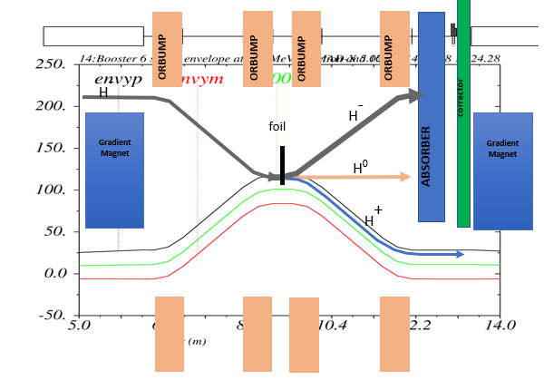
Booster Injection Layout
Spool
Ion pump
Spool
Ion pump
Straight section layout highly constrained
Lengthen straight by 1 m – new shorter gradient magnets either side
Injection absorber within straight section lattice
Vertical injection
  Elevation inj. Beam @ foil = dy [ORBUMP] + dy [V paint]
Dedicated phase space painting outside injection straight
GM f-f 6.68m
Foil and painting
600 ug/cm2 nano-diamond foil -> optimized during operation
Anti-correlated transverse phase space painting using sin and cos function
Nominally 1% H- to miss foil and 99.984 % stripping efficiency-> 170W H- and ~30W H0 & H0*
Fate of beam off foil:
H- missing foil: minimize through BTL collimation
H0* (n>3): uncontrolled loss
H+: circulating beam + uncontrolled loss from LAS
John Johnstone – “H0 Stark Stripping and Component Irradiation in Fermilab Booster”
Jean-Francois Ostiguy – “ 6D Simulations of PIP-II Booster Injection”
-- Loss distribution from Large Angle Scattering from foil interactions

Slide 9
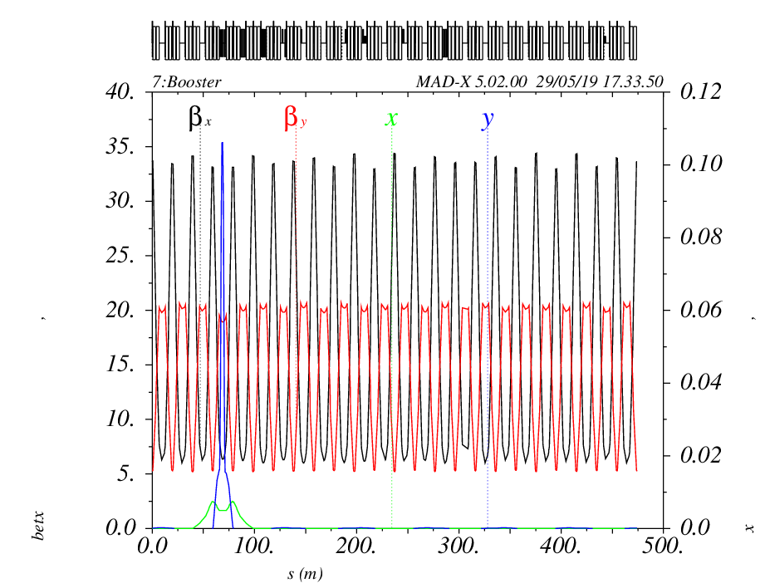
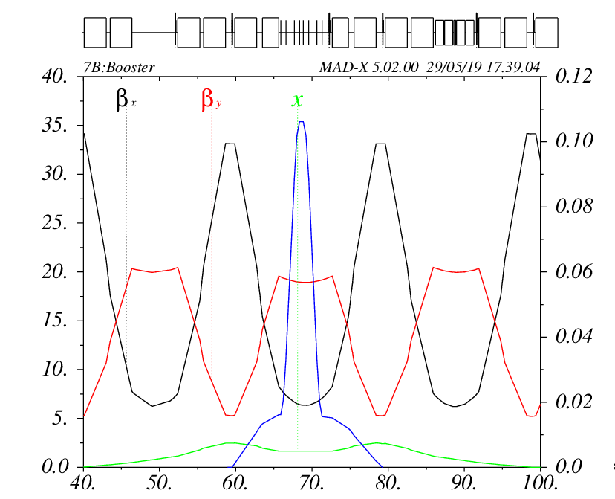
Booster RCS Lattice with New PIP- II Injection Insert
Current Booster → PIP-II
Injection Energy increased from 400 MeV to 800 MeV
Resonant Rep Rate increased from 15 Hz to 20 Hz
Injected beam power increase from 4.5 kW to 17 kW
PIP-II requires waste beam absorber (must be in ring)
Booster Lattice
D-F-O-F-D-OO-D-F-O Lattice circumference 474 m tunes
symmetric straights - short “O” 0.88m & long “OO” 5.68m
New injection Insert
βx ~ 6.3m and βy ~ 19m with Dx ~2.2m at injection foil
Base tunes Qx ~ 6.78 and Qy ~6.81
Injection Insert
Notch kickers +
extraction kickers
L10
S11
L11
S12
L12
D
D
F
F
D
D
F
D
D
F
F
F
F
ORBUMP
βx,y [m]
x,y [m]
V. paint
ORBUMP (97mm) + Vertical Painting
S [m]
Horizontal Painting (6mm)

Slide 10
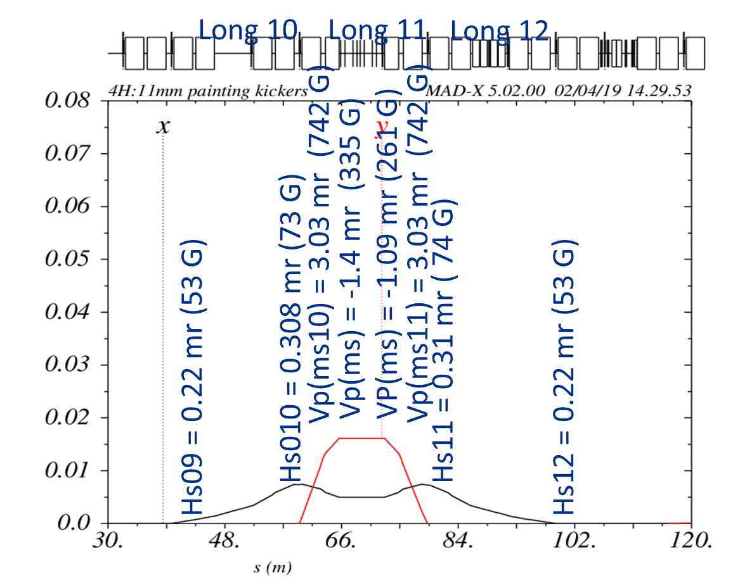
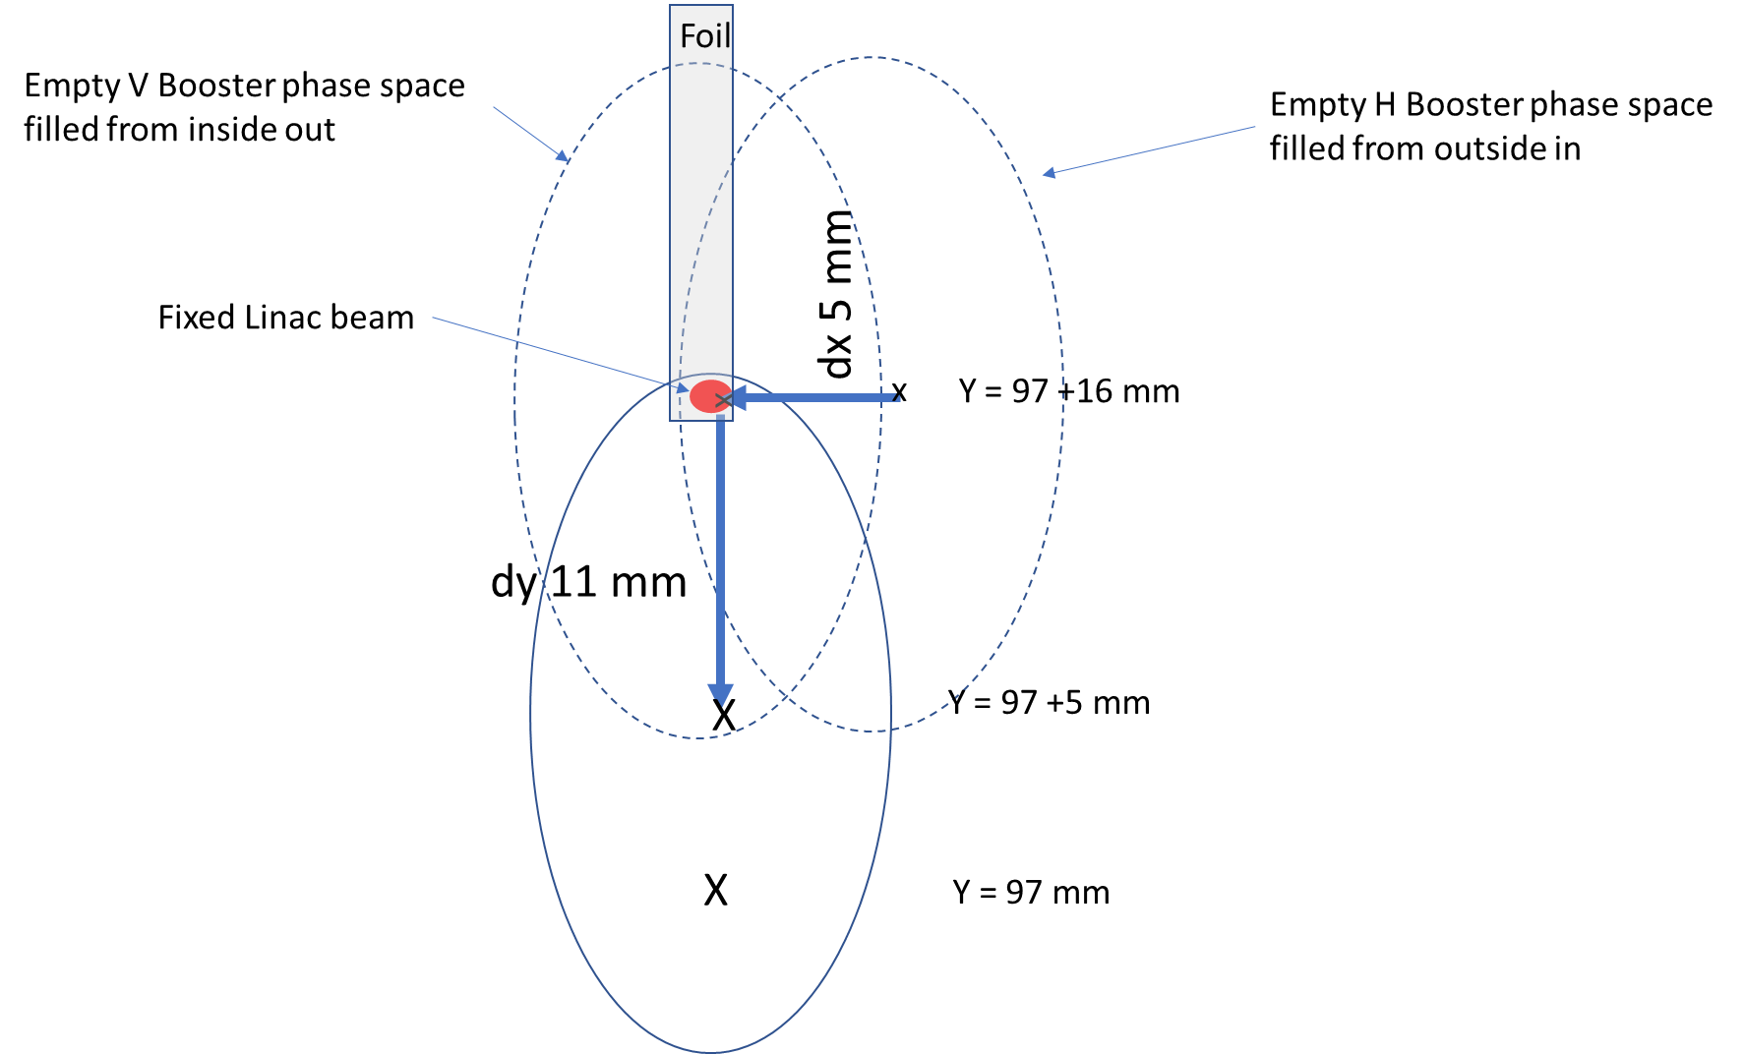
Phase Space painting
Default is anti-correlated
PyORBIT final Booster distribution w/SC
SNS style
Nano diamond foil
25mm
7mm
J.-F. Ostiguy

Slide 11
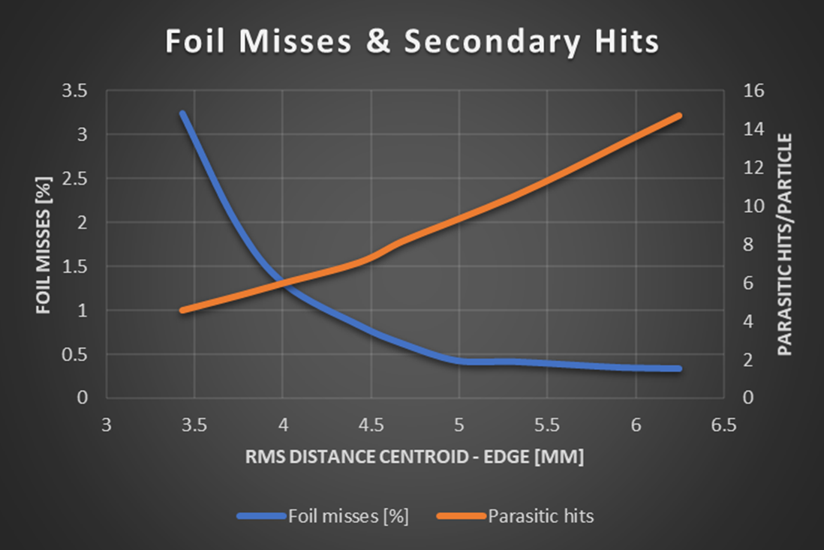
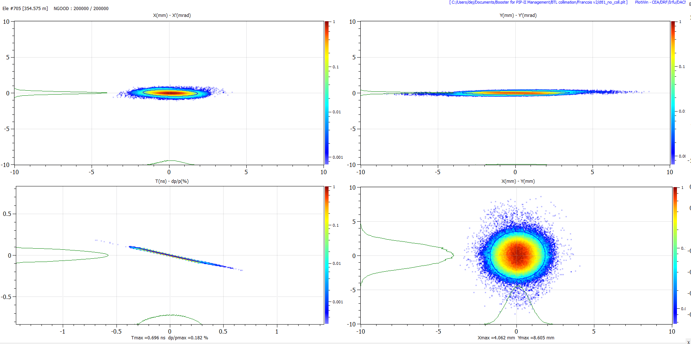
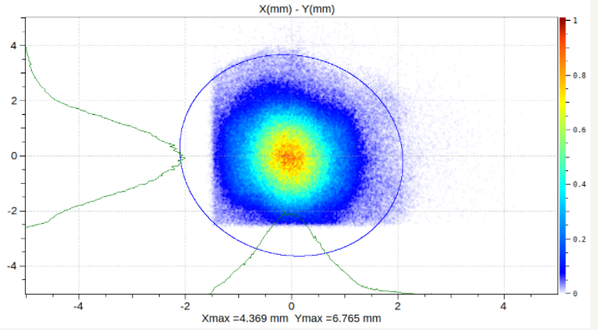
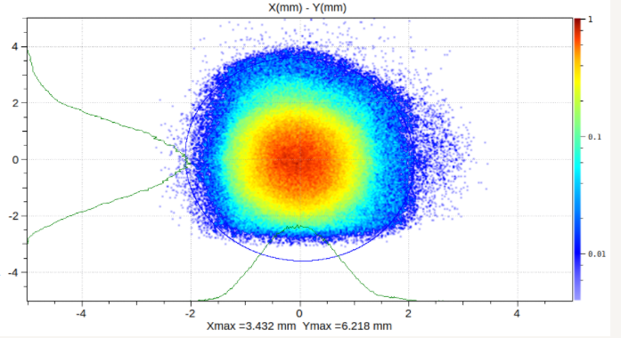

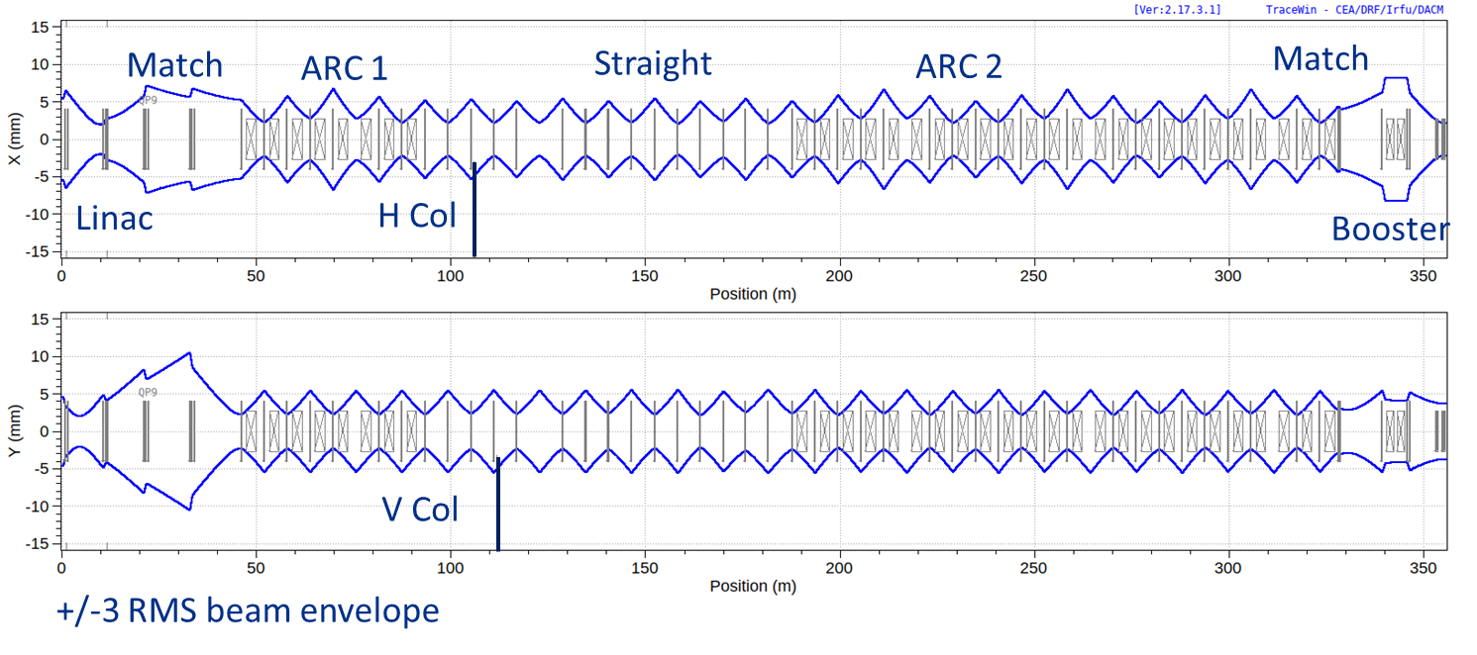
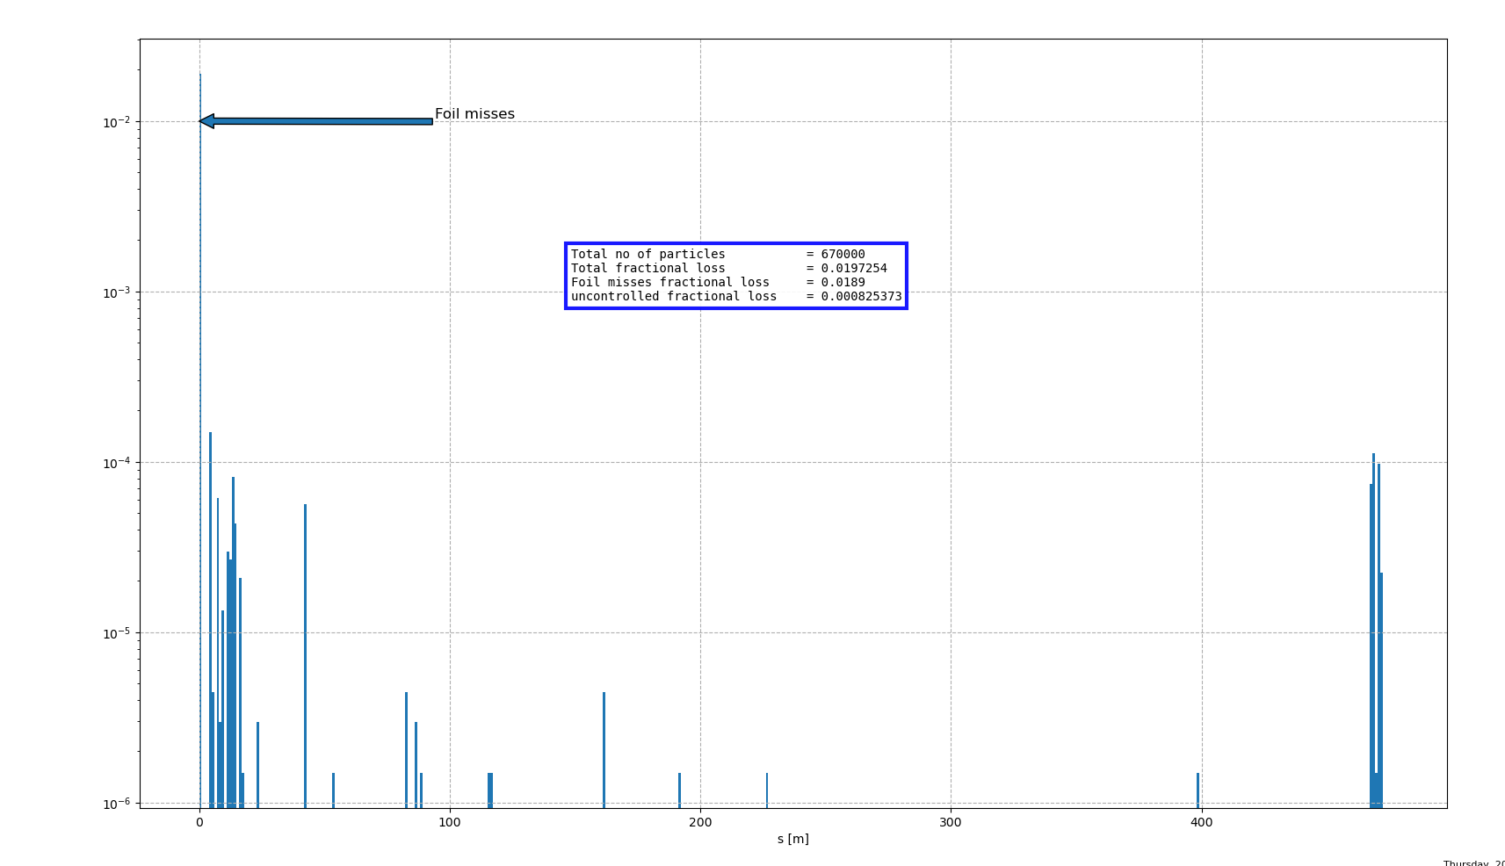
Linac beam on the foil
Linac beam on foil
With BTL
collimation
With phase
adjustment
No collimation
δ
Move beam centroid
farther from the edge
to eliminate H- missing foil
Miss foil ->inj absorber
Implemented Coulomb scattering in PyORBIT foil model

Slide 12
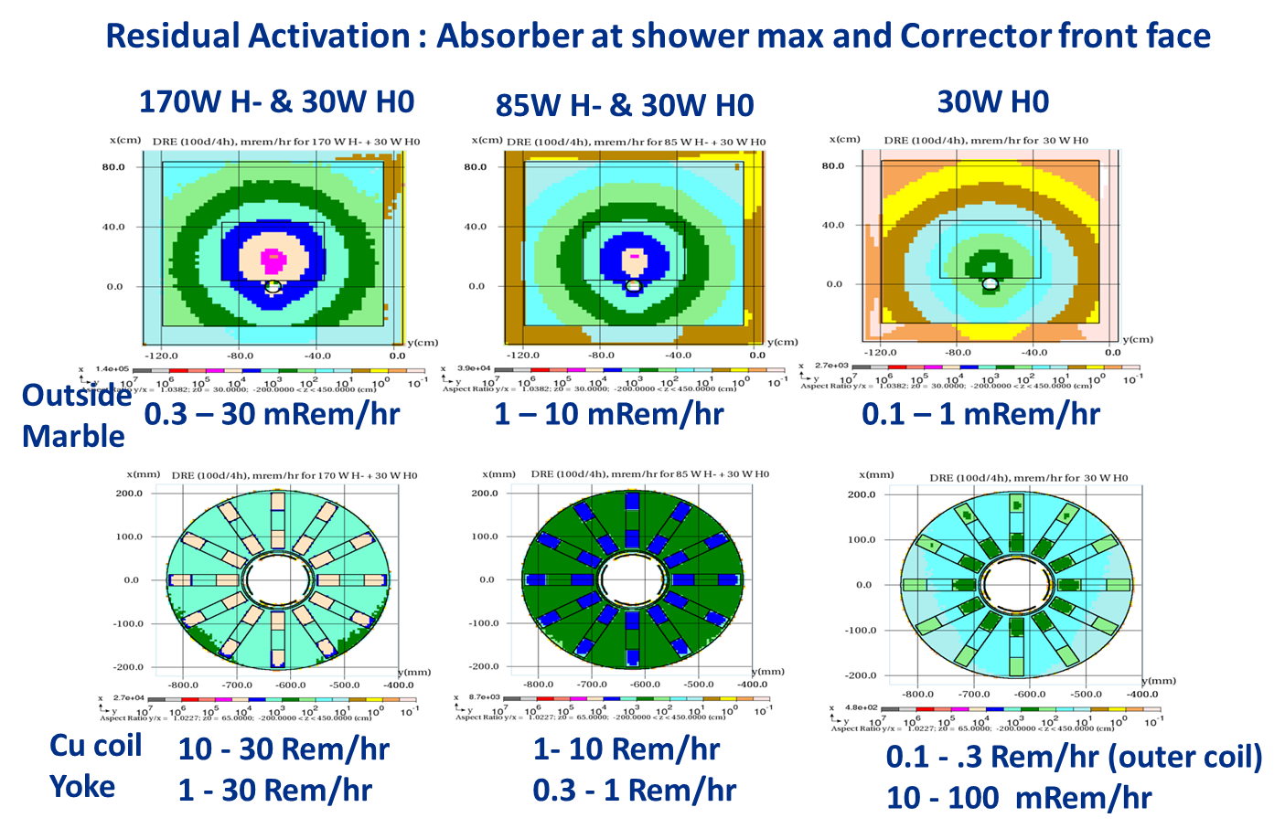
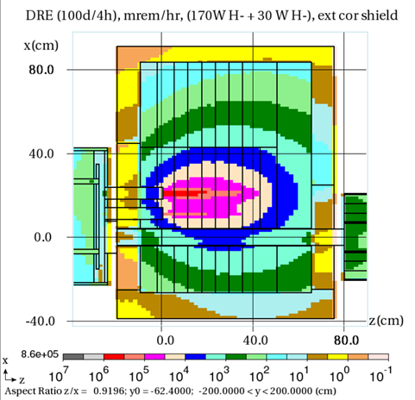
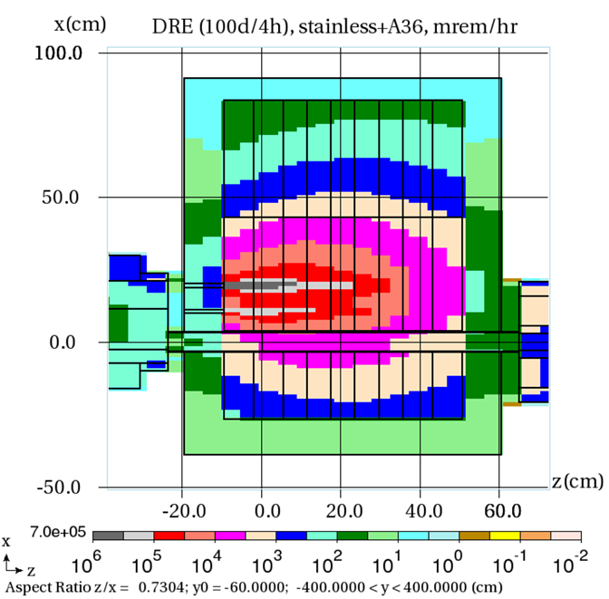
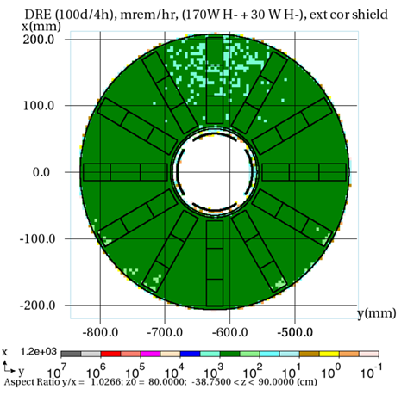
Booster Injection Absorber
Longitudinal
Option if space Available
i.e. replace BMA w/H&V Dipole
Absorber length increased by 15 cm
Use 200 W incident power
Significant reduction in activation of corrector <500 mRem/hr
Absorber 60 cm Marble 10
Total 80 cm
Residual on downstream
Exterior marble ~ 80 mRem/hr
MARS V. Pronskikh
Residual activation of absorber external surface << 50 mrem/hr on contact for all loads
Corrector activation problematic for highest beam loads due to H- missing foil
  Want to eliminate linac beam from missing foil & keep centroid of Linac beam close to foil corner
  Collimate the edge of distribution adjacent to foil edge in the BTL (FDR completed for BTL collimators)

Slide 13
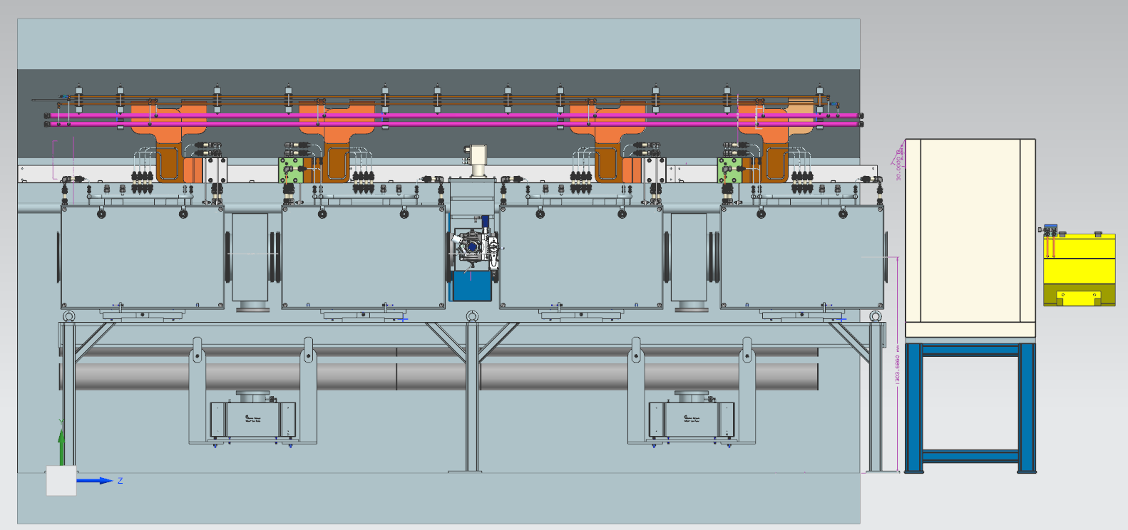
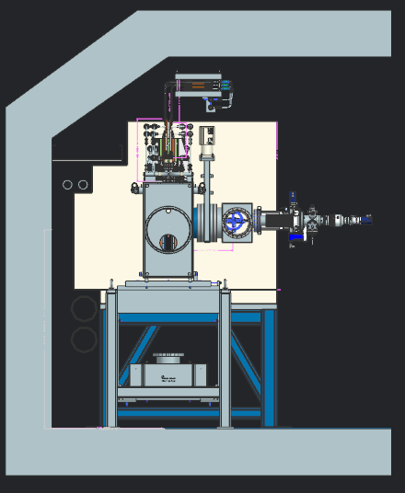
Preliminary Layout of PIP-II Injection elements
Current distribution stripline
20 kA (3 kA rms)
Injection
Absorber
ORBUMP 1
ORBUMP 2
ORBUMP 3
ORBUMP 4
BMA
Foil changer
Corrector
Spool piece
Ion pump
Spool piece
Ion pump
6.68 m f-f gradient magnet
Stripline mounted on girder and supported by ceiling
Complete girder with magnets, spool pieces, foil changer, & ion pump
moved and installed as a single unit
Stripline re-attached to girder after girder is installed.
Injection absorber stacked on stand in tunnel (to be installed before ORBUMP girder)
Power supply cables to attach to upstream end of stripline

Slide 14
Inclusion of PAR in Complex wrt supplying Booster with beam
Linac beam in BTL diverted from Booster to PAR (Meiqin Xiao)
  install a multi-turn phase space painting system in PAR for injection
    Single turn extraction for Expanded Physics program
    Single turn extraction from PAR to Booster
      Uses BTL to transport protons to Booster
      Single turn injection in Booster typically utilizes Lambertson/ kicker combo with 90 deg separation
      Inject into well formed stationary RF bucket ( minimize RF manipulation for acceleration)
Why single turn injection (into Booster) ?
  Better fit for RCS resonant excitation (short injection period ~ 1.9 us vs 500 us)
  Lower losses in Booster at injection (losses from multi-turn injection transferred to PAR)
    Eliminate LAS from circulating protons scattering in foil
    Potentially loss from Internal injection absorber from H- missing foil (although this several mitigation schemes)
What happens to new PIPP-II Long11 injection components?
  ORBUMP magnets & power supply recycled for use in PAR ?
  Injection absorber remain in place or recycled?
  Painting magnets can they be recycled?
  New shorter gradient magnets either side of straight would remain

Slide 15
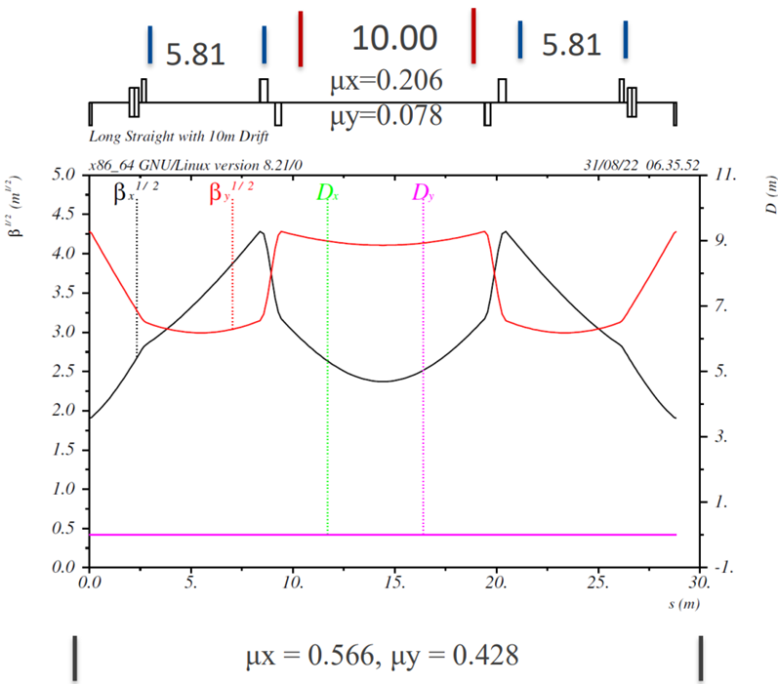
Injection into PAR
A 10 m injection straight in between doublets with 5.8m short straights either side
Lattice functions similar to Booster
Zero dispersion straight
The waste beam directed to a well shielded external absorber (capable of multi-kW beam load i.e. 2 to 5 % of expected beam power)
Requires additional stripping foil(s) to convert H0 & H- to protons for transport to absorber similar to other facilities (JPARC & SNS)
Several potential Chicane design options including
  DC chicane similar to SNS
  Pulsed chicane similar to JPARC & FNAL
John Johnstone

Slide 16
Take Aways
We have developed a robust design of a complicated multi-turn injection region with phase space painting.
Design based upon symmetric, local, four bump -> keep waste beam away from Booster aperture
Developed a robust flexible painting scheme
Accommodates injection waste beam absorber (in ring ☹) with potential of expanding length
We have developed/developing the hardware to support this robust design
  Developed a set of ORBUMP magnets
  Developing a pulsed ORBUMP power supply
  Developing pulsed dual plane painting magnets
  Foil changing system based upon commercial 5-axis motion control
  BTL collimation scheme to minimize beam load on injection absorber
  BTL 650 normal conducting “de-bunching” cavity for dp/p matching
Single turn injection into Booster is intriguing as a potential way of loss reduction and simpler injection
  PAR looks to potentially accomplish this goal
  Multi-turn injection into PAR needs to be developed
  Single turn injection into Booster needs to be developed
  Favor options which re-utilize Booster multi-turn injection components (without sacrifice)

Slide 17

Thank you for your Attention
Questions?

Slide 18
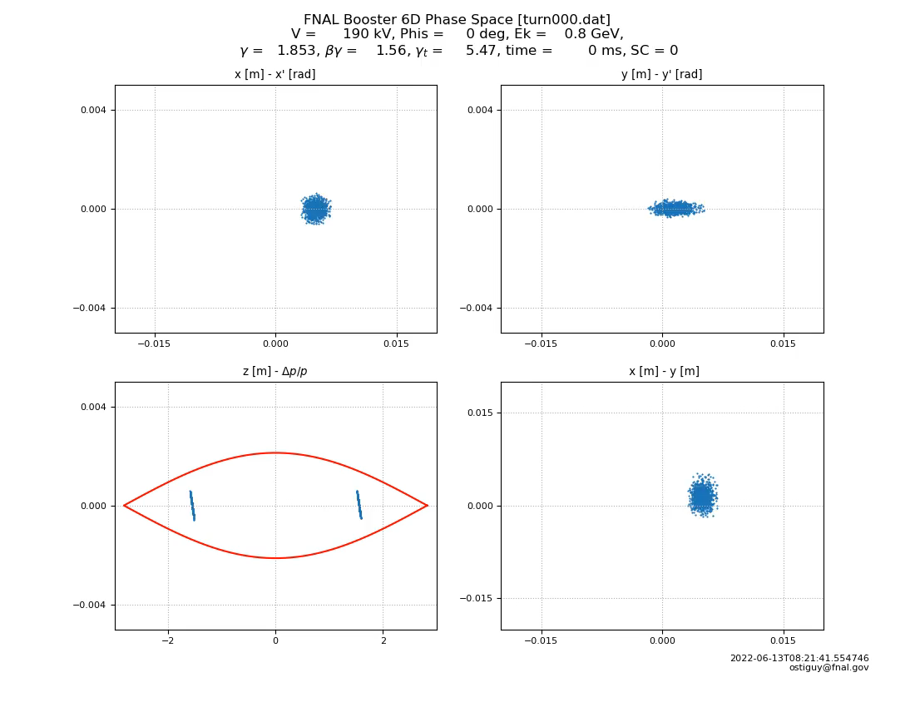
Painting video

