Slide 1
ACE – Accelerator Capabilities Enhancement – MI RF
Joseph E. Dey
January 30, 2023

Slide 2
PIP-II – Accelerator Upgrades - Main Injector
In table 9.12 of the PIP-II Final Design Report, it can be found that an individual
Main Injector cavity needs to be able to supply 240 kW of power.

Slide 3
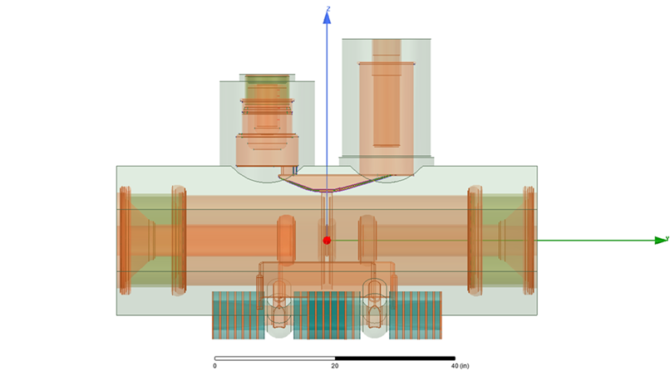
PIP-II – Accelerator Upgrades - Main Injector
coupling loop
Drawing by Ding Sun
Single Power Amplifier (PA) Main Injector (MI) cavity drawing. Coupling loop shows how cavity was always envisioned to be able to support dual PA operation.

Slide 4
PIP-II – Accelerator Upgrades - Main Injector
Station 5 of the Main Injector was upgraded to a Dual PA cavity and has operated in this mode for the last two years with beam intensities up to 5.4E13. It can supply 400 kW of power. The two PAs operate in a push-pull mode and easily surpasses the 240 kW needed for PIP-II operations. All twenty MI cavities will be updated to Dual PA operation.

Slide 5
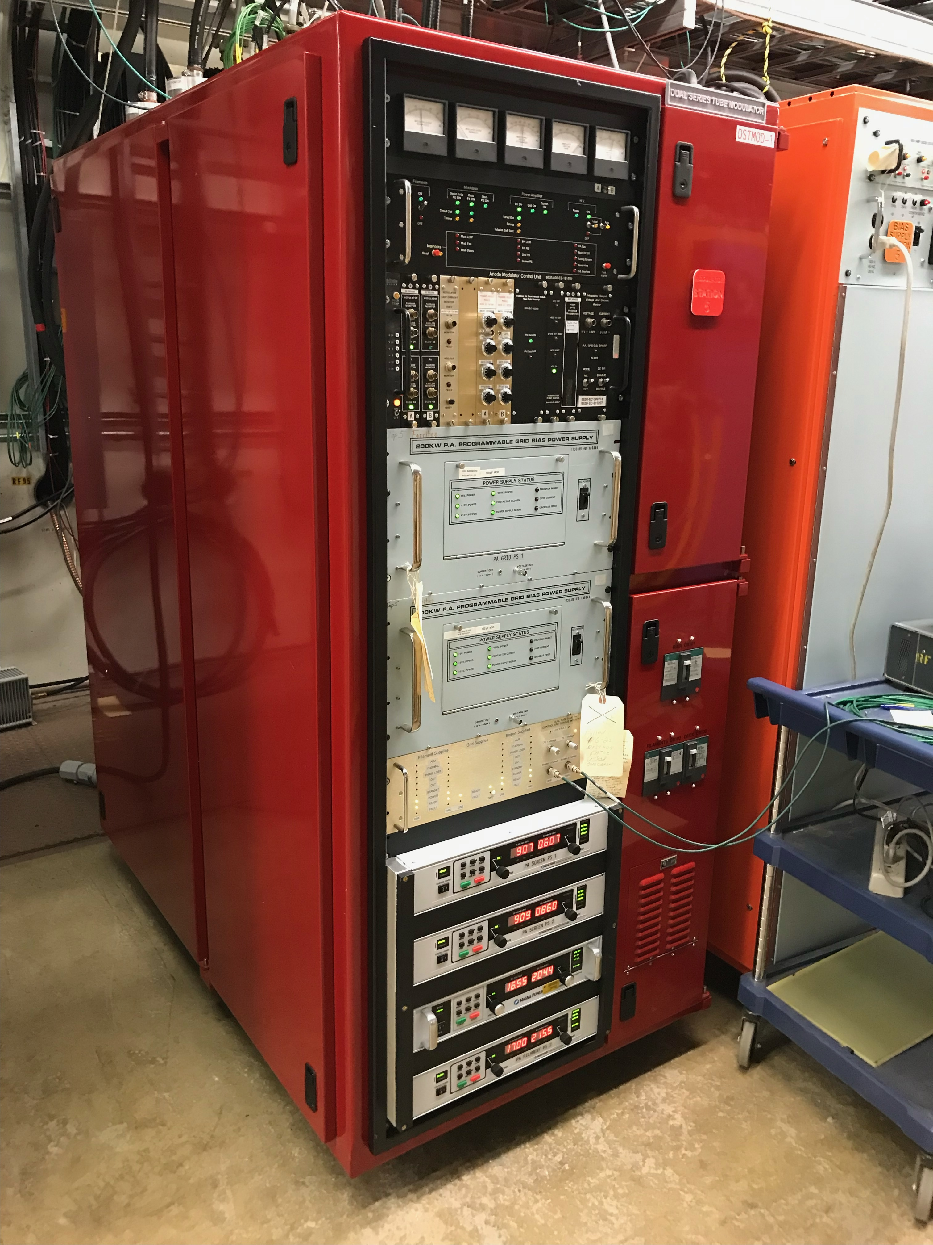
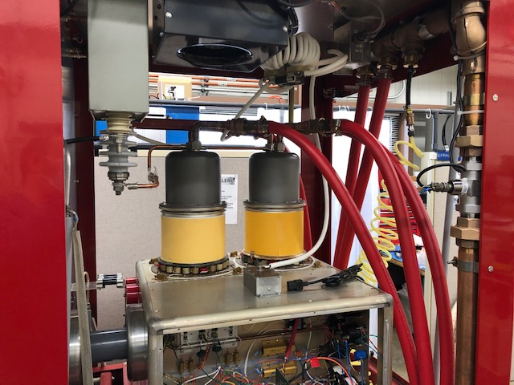
PIP-II – Accelerator Upgrades - Main Injector
Dual Series Tube Modulator
PIP-II will also upgrade all the modulators to Dual PA operation.

Slide 6
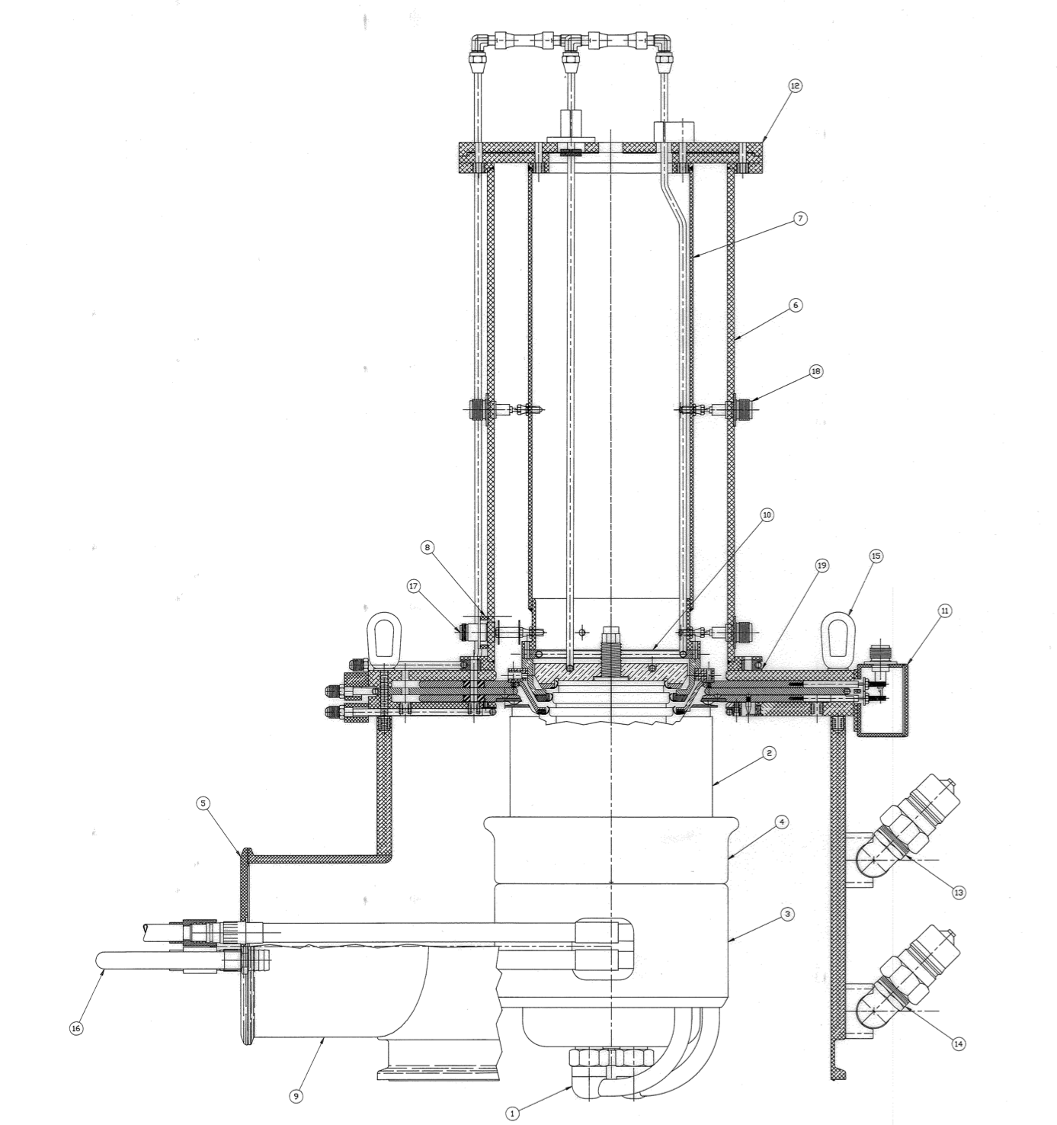
PIP-II – Accelerator Upgrades - Main Injector
Main Injector Power Amplifiers
PIP-II will build a total of 40 new power amplifiers for the twenty Dual PA cavities.

Slide 7
PIP-II – Accelerator Upgrades - Main Injector
8 kW 53 MHz Solid State Amplifier
Each PA will have it’s own 8 kW solid state amplifier after the the PIP-II Upgrade.
Solid State RF Amplifier

Slide 8
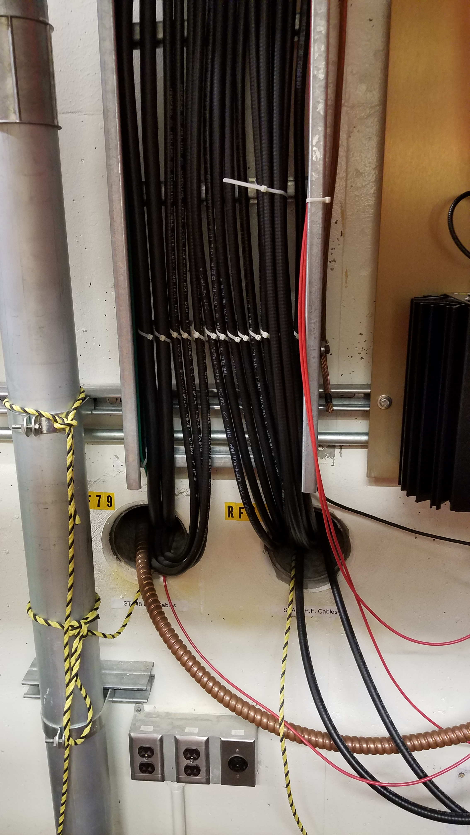
PIP-II – Accelerator Upgrades - Main Injector
Cable Pull
Each Dual PA requires additional cables pulled from RF gallery to the tunnel for operation of the additional power amplifier.

Slide 9
PIP-II – Accelerator Upgrades - Main Injector
Operations of MI Station #5
Excerpt from PIP-II Final Design Report

Slide 10
ACE – Main Injector Enhancement

Slide 11
ACE – Main Injector Requirements
Civil construction to add 17 Main Injector RF stations at MI-60
  Additional chilled water capability
  New electrical utilities
Civil construction for three additional anode supplies
Larger and improved cooling pond
Removal of all NuMI items in the MI-60 tunnel straight section.
17 Main Injector cavities
34 200 kW power amplifiers
34 8 kW 53 MHz solid state amplifiers
17 dual series tube modulators
37 new bias supplies

Slide 12
ACE – Main Injector Requirements
Four new MI Solid State Longitudinal Damper Amplifiers
PiRM for each station (IRM replacement)
All new cable pulled for the 17 new stations
LLRF would need to be updated to ARRIA 10 FPGA

Slide 13
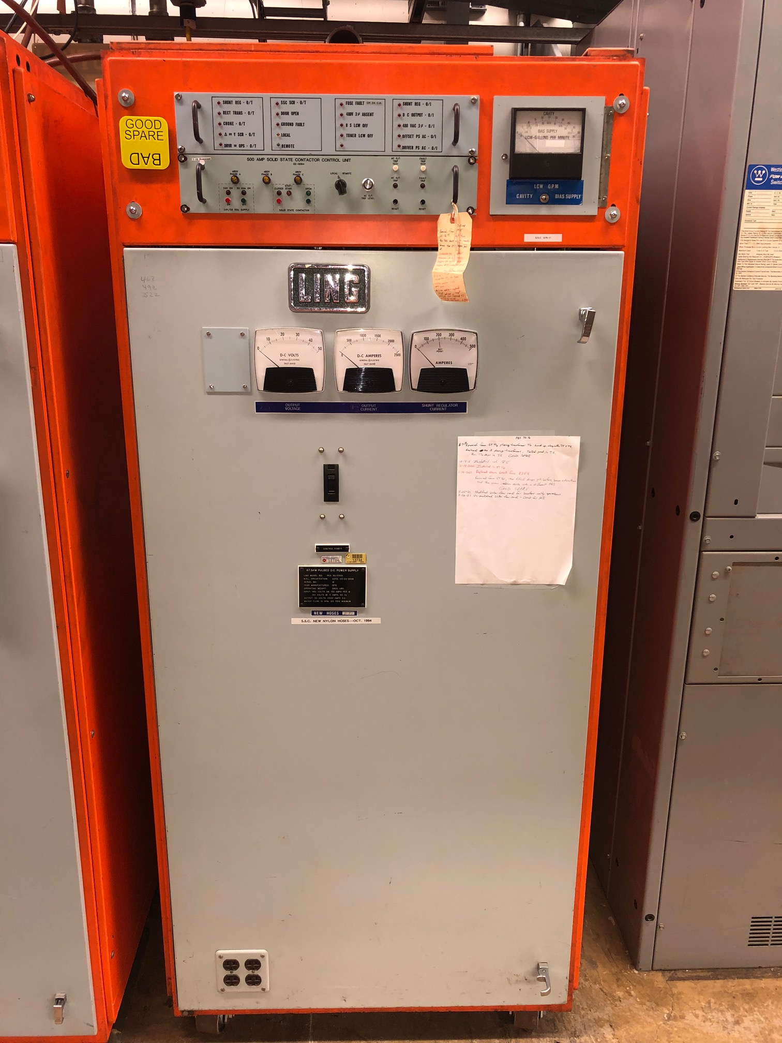
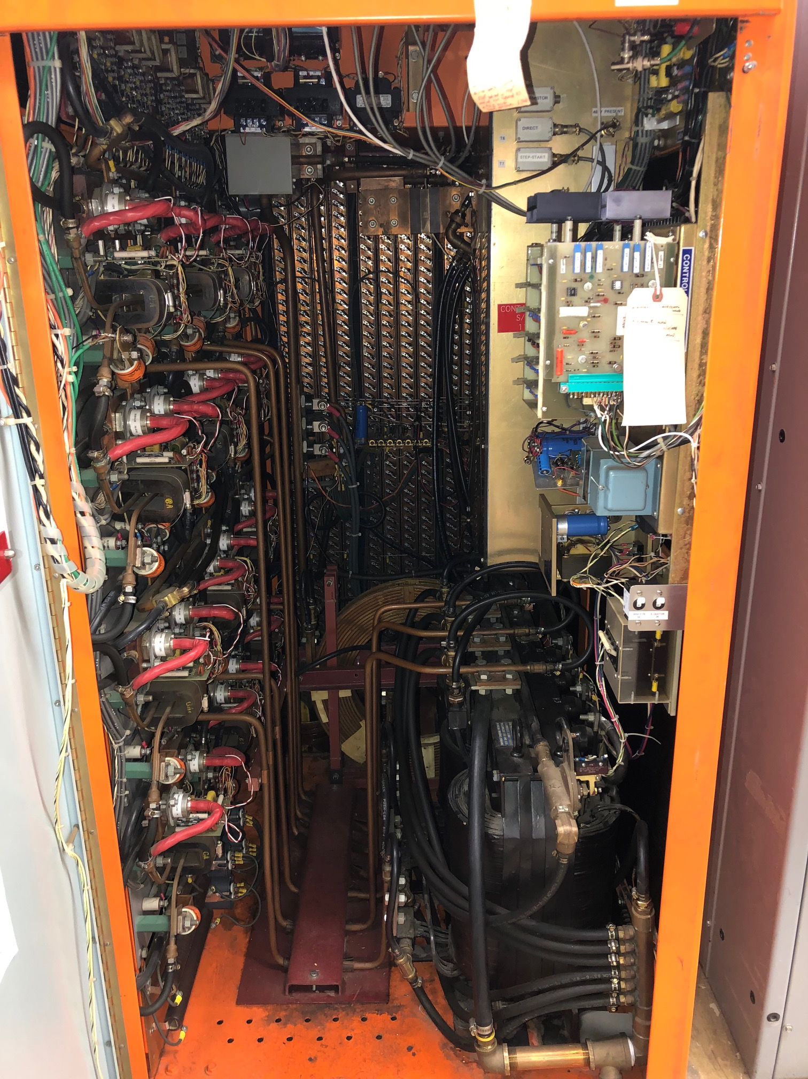
ACE – Main Injector Requirements
MI Bias Supply
50-year-old design and numerous parts are outdated.
ACE would need 37.

Slide 14
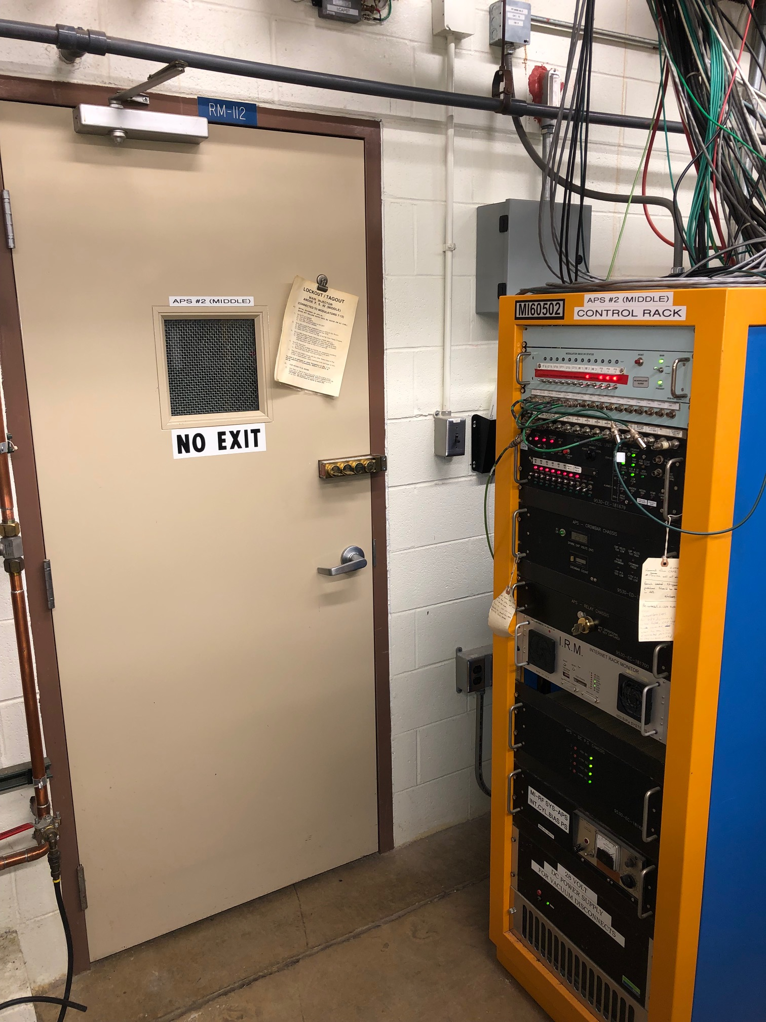
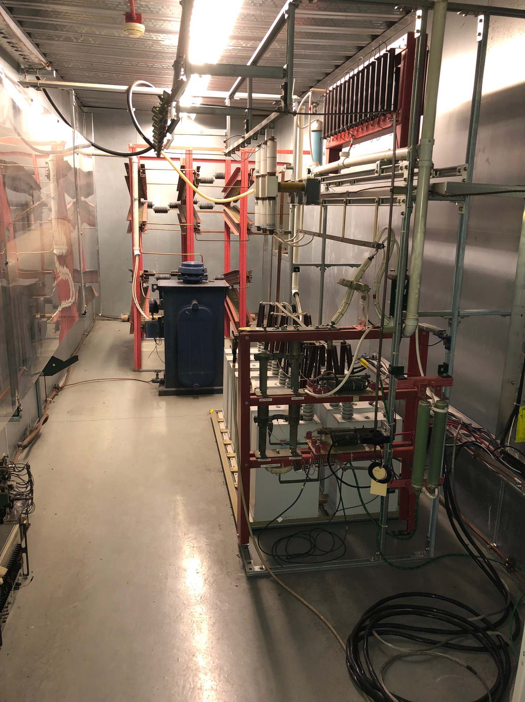
ACE – Main Injector Requirements
MI Anode Supplies
ACE would need an additional three.

Slide 15
ACE – Main Injector Requirements
17 Additional MI cavities
Arrangement between the quads in the tunnel.

Slide 16
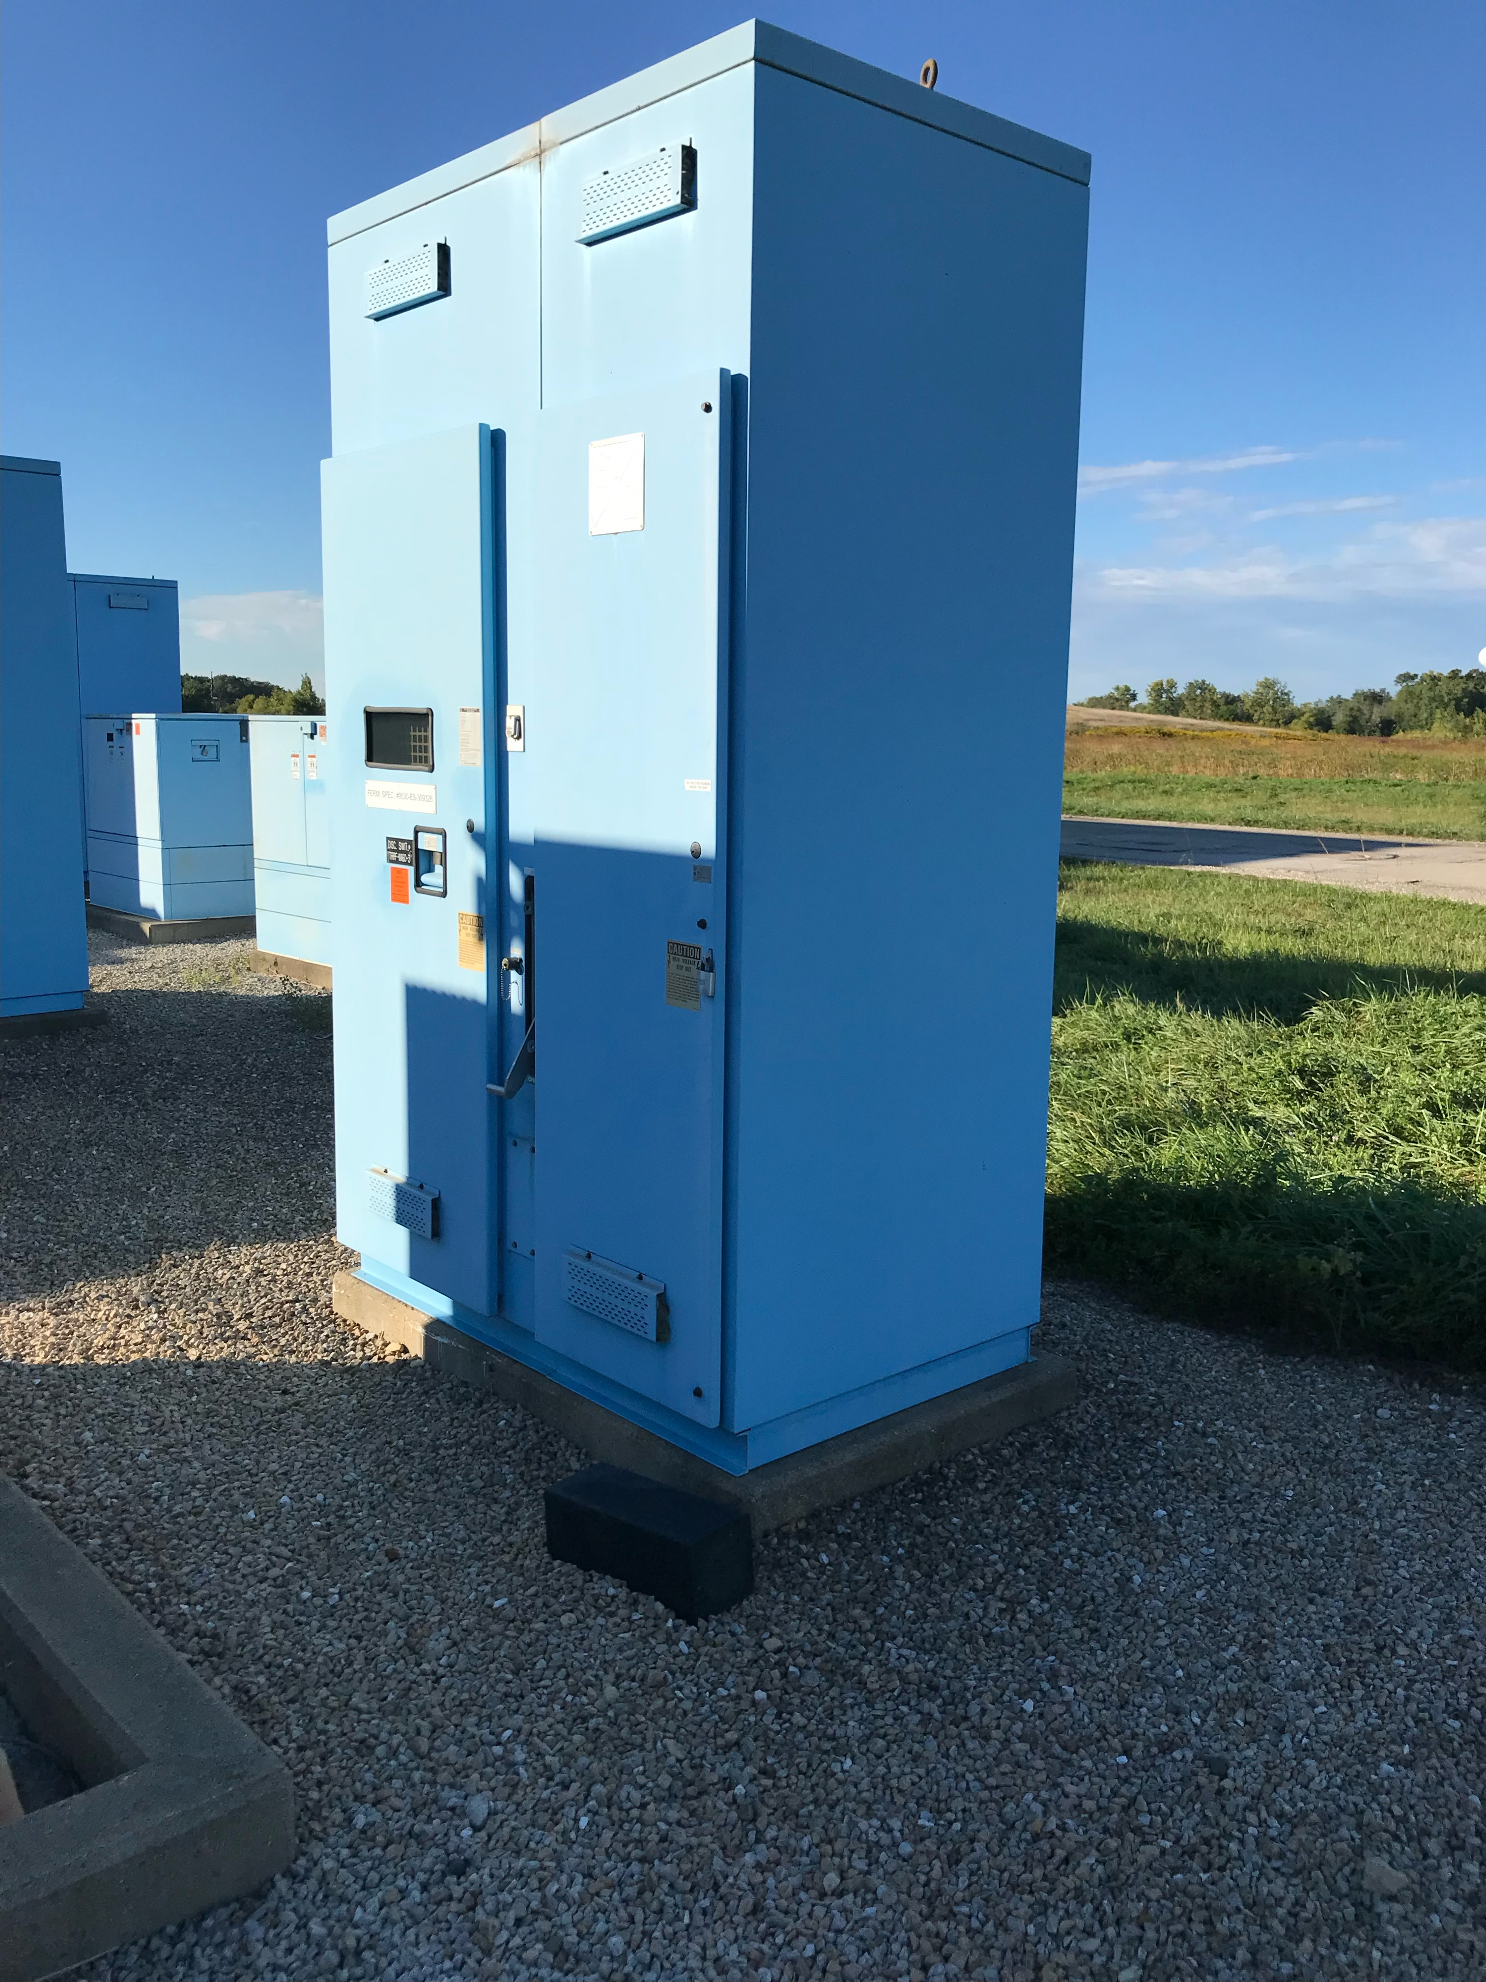
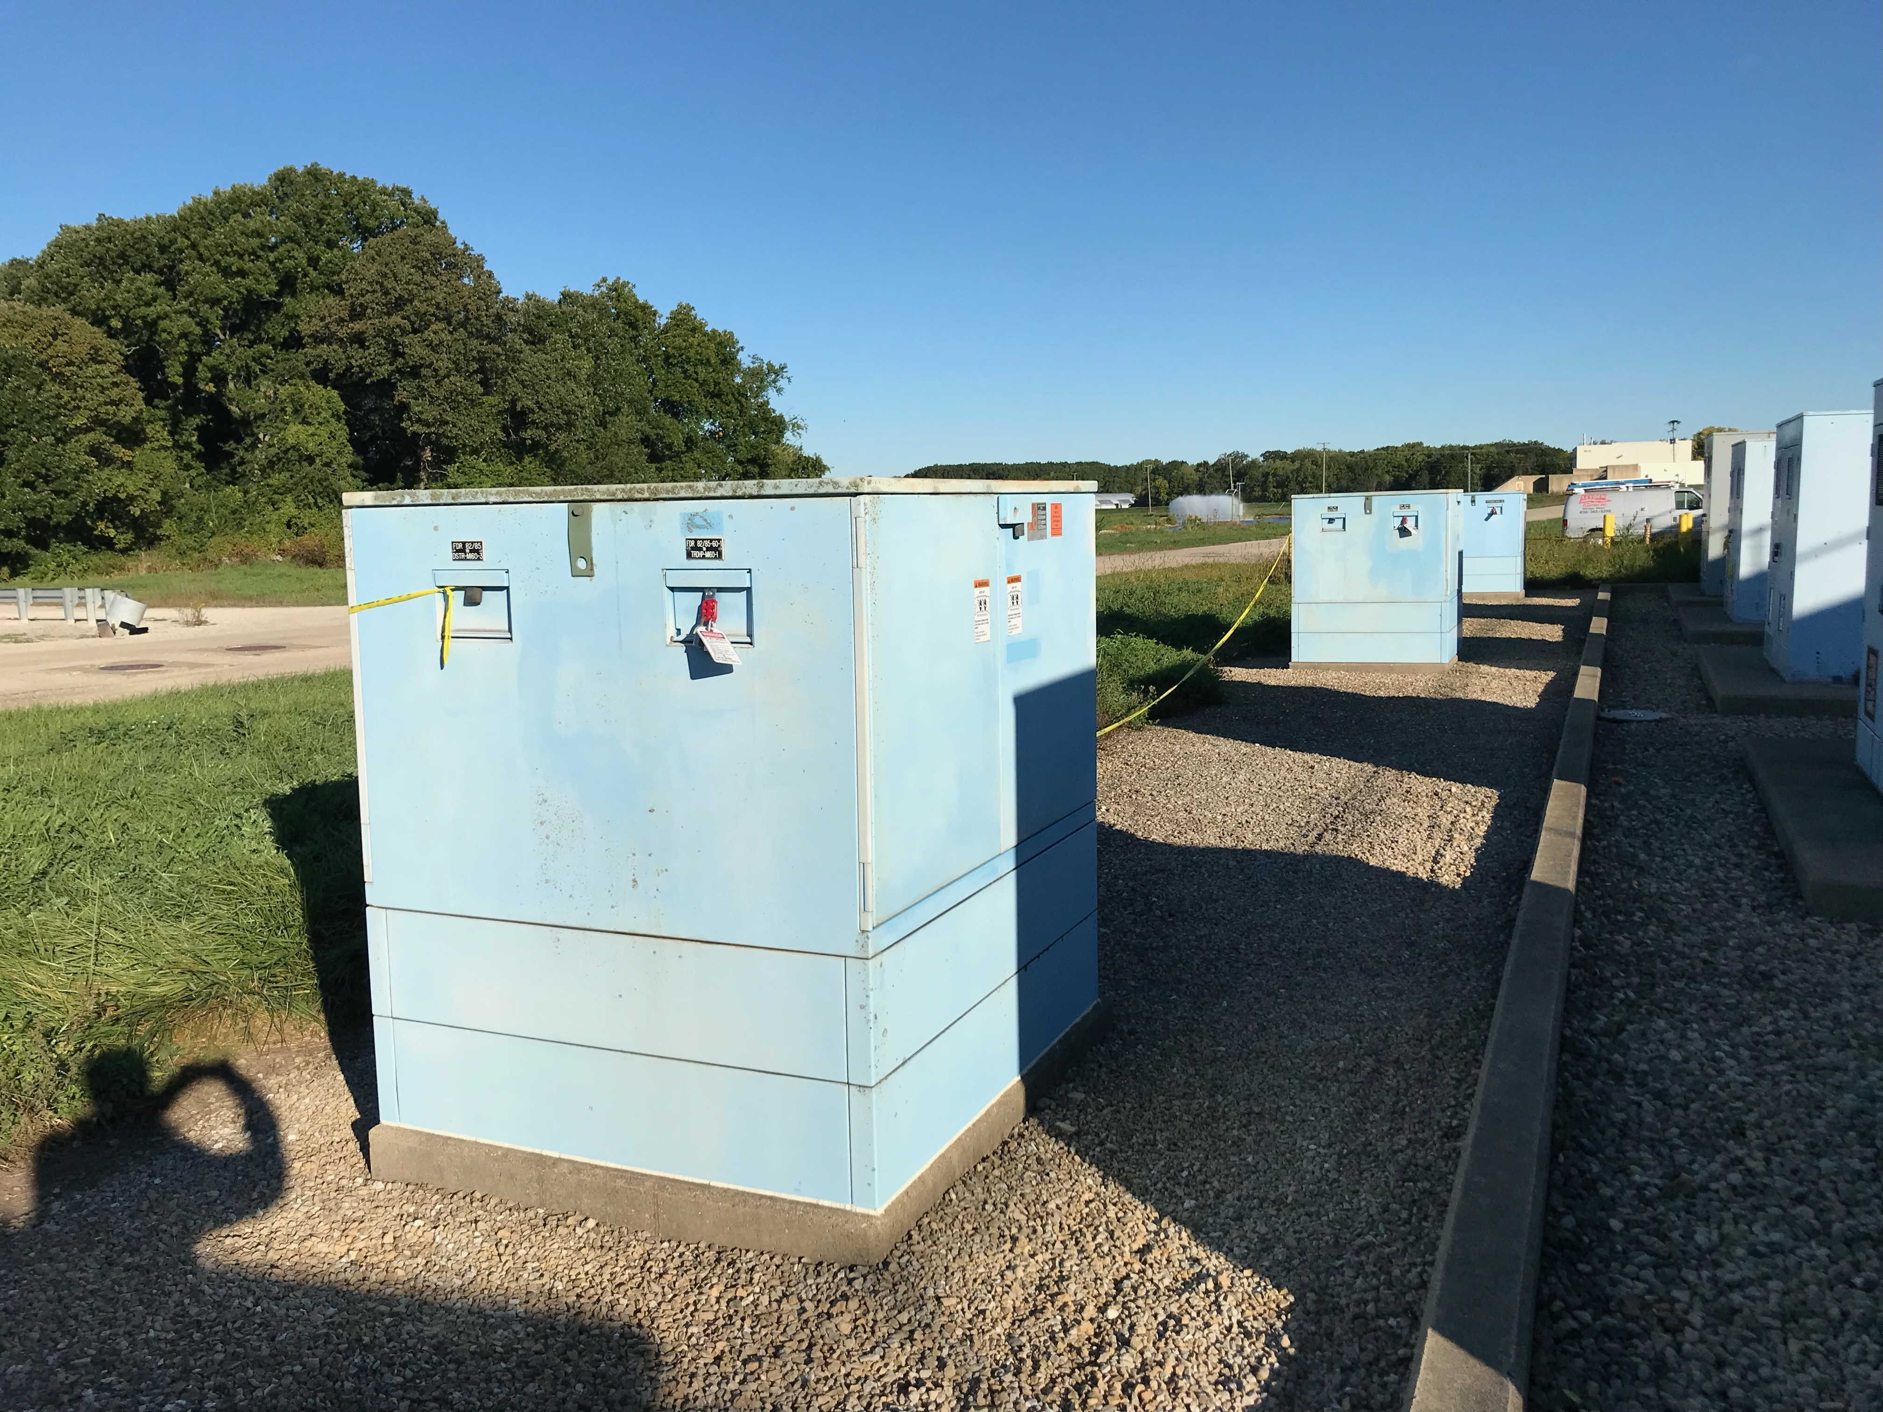
ACE – Main Injector Requirements
MI-60 Electrical Utilities
Additional 13.8 kV utilities would need to be added for the anode supplies and stations.

Slide 17
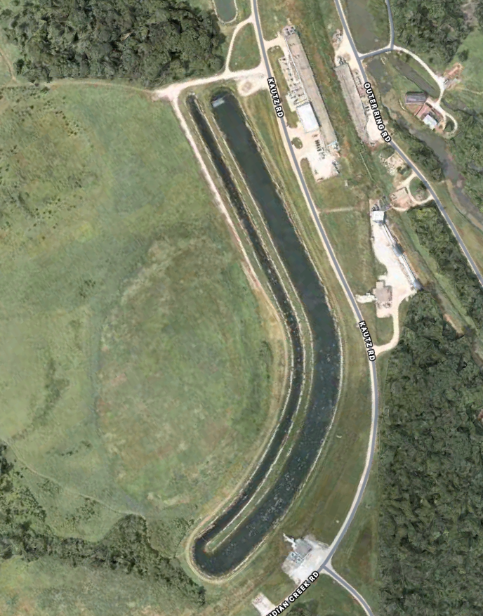
ACE – Main Injector Requirements
MI-60 cooling pond – larger and needs to be improved.
AppleTM Maps

Slide 18
ACE – Summary
We have the power to accelerate at 500 GeV/s.
Will require an additional 17 MI RF stations to maintain the same bucket area.
Civil construction for additional RF gallery, penetrations, anode supplies, and transformers will be needed.

Slide 19
ACE
Backup Slides

Slide 20
ACE – Initial M&S Cost Estimates
Main Injector Bias Supply (41 @ $220 k) $9.02 M
Main Injector Cavities (18 @ $611 k) $11 M
Main Injector 200 kW Power Amplifiers (36 @ $44.2 k) $1.59 M
CPI Eimac Y567B vacuum tube (72 @ $27.76 k) $2 M
8 kW 53 MHz Solid State Amplifier (56 @ $186 k) $10.42 M
Dual Series Tube Modulator (18 @ $142.9 k) $2.57 M
Solid State Amplifiers for Longitudinal Damper (4 @ $324K) $1.3 M
LLRF update $40k
PiRM (45 @ $2K) $90k

Slide 21
ACE – Initial Labor Cost Estimates
MI Cavites 161,500 hrs
Station Racks 28,339 hrs
MI Cavity Installation 11,340 hrs
Anode Supplies 24,000 hrs
Power Amplifier assembly 7,200 hrs
Modulator assembly 31,720 hrs
Bias Supply assembly 82,000 hrs
LLRF 12,000 hrs
8 kW Solid State driver testing and installation 2,000 hrs
NuMI Removal 4,000 hrs
PiRM install 2,000 hrs
(1,768 hrs = 1 FTE) Total of 366,099 hours = 207.1 FTE

Slide 22
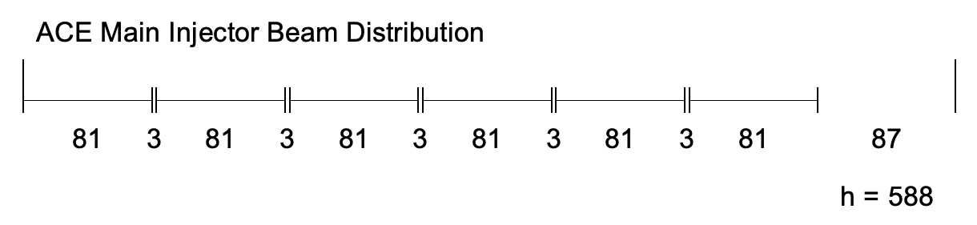
ACE – Main Injector Enhancement – Beam Distribution

Slide 23
ACE – Main Injector Enhancement – 30 GeV Peak Current
Fundamental Peak Current
I_{p} = I_{b} = 2.114 A

Slide 24
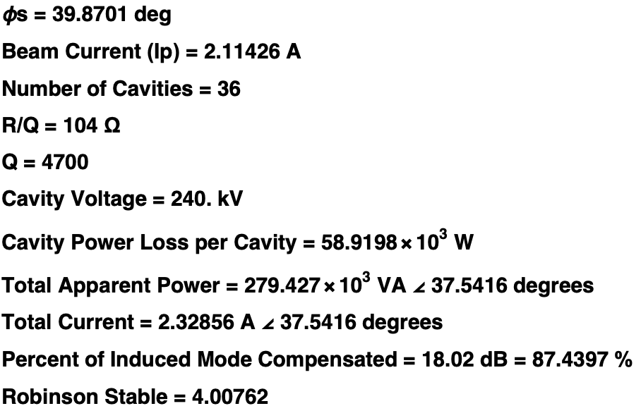
ACE – Main Injector Enhancement – 30 GeV Robinson Stability

Slide 25
ACE – Main Injector Enhancement – 30 GeV Vector Diagram

Slide 26
ACE – Main Injector Enhancement – 30 GeV Vector Diagram

Slide 27
ACE – Main Injector Enhancement – Modulator

Slide 28
ACE – Main Injector Enhancement – Modulator

Slide 29
ACE – Main Injector Enhancement – Modulator

Slide 30
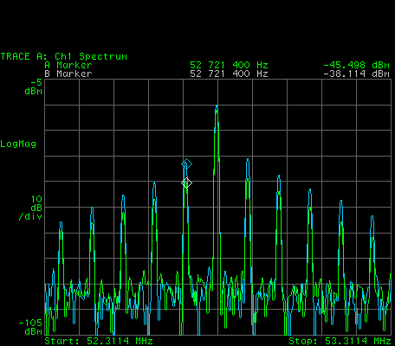
ACE – Main Injector Enhancement – BLC
Feedforward Beam Loading Compensation and Direct RF Feedback is used on each of the Main Injector stations to obtain a Robinson Stability factor of 4.

