Slide 1
ACE – Main Injector Power Supplies and Infrastructure
Denton Morris
30, January 2023
Notes:
Instructor: Please print out the slide deck and notes pages. The notes pages have the words associated with the brief bulleted event on the slide. Please present the slides in presentation mode as there are animations to help pace and guide the discussion.

Slide 2
Overview
Magnet and Power Supply Changes to Increase MI Ramp Rate
  Options for new power supplies or more power supplies
  Cooling changes needed
Reliability
  Magnets
    Dipoles
    Quads
  Bus tunnel penetrations
  Cooling Ponds
  Sump Discharge Lines
Additional Systems to Consider
Modernization of Additional Systems
2
MI Department | D. Morris
1/30/2023

Slide 3
MI Cycle Lengths
Current MI cycle repetition rate is 1.2 seconds (Power based on PIP-II expectations)
1.2 Sec results in ~1.25 MW on target
1.13 Sec (current MI ramp length) results in ~ 1.33 MW
0.9 Sec results in ~1.6 MW
0.65 Sec results in ~2.2 MW
* This peaks at 500 GeV/second!
(Steve Hays address this in 2005!)
This requires more voltage
than currently available!
3
MI Department | D. Morris
1/30/2023

Slide 4
Power Supply Limits and Options – Dipole
MI has 12 main dipole PS in a folded loop:
Total ring inductance (Henry) = .65000
Total ring resistance (ohms) = .28600
Desired Max. Operating Voltage for Holding PS = 0.201E+04
Desired Max. Operating Voltage for Ramping PSs = 0.201E+04
Number of power supplies = 12
Maximum Voltage Available from Holding PS = 2200.0
Maximum Voltage Available from Ramping PS = 2200.0
Too Increase the dipole bus voltage you can:
Replace all 12 power supplies with higher voltage supplies
Double the number of power supplies at each MI service building (from two to four)
Add additional power supply service buildings (with tunnel penetrations) between existing
  service buildings.
The first two of these approaches double the voltage to ground from ~500 V to ~1000 V.
4
MI Department | D. Morris
1/30/2023

Slide 5
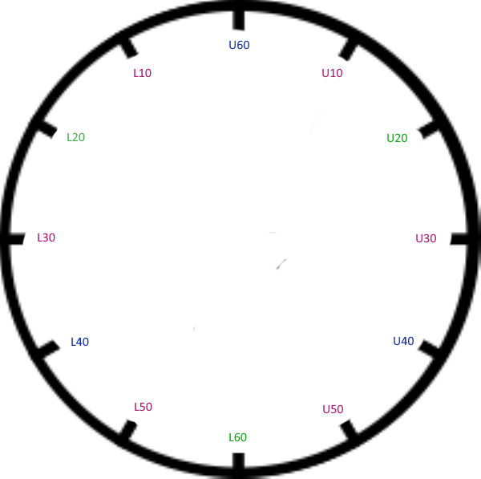
Power Supply Limits and Options – Dipole
MI10 MI20 MI30 MI40 MI50 MI60
MI10 MI20 MI30 MI40 MI50 MI60
5
MI Department | D. Morris
1/30/2023

Slide 6
Power Supply Limits and Options – Dipole
RAMP CALCULATIONS (0.65 second):
Peak ramp current (amps) = 7033.4
Total RMS ramp current (amps) = 3348.2
Min. and max. ramp voltage (volts) = -20754. 23833.
Maximum number of power supplies = 12
Ramp power (watts) = 0.32062E+07
FEEDER CALCULATIONS :
Peak feeder current (amps) = 6533.9
RMS feeder current (amps) = 2762.5
RMS feeder volt-amps (v-a) = 0.66030E+08
REAL/REACTIVE POWER CALCULATIONS :
Peak real power (watts) = 0.14004E+09
Peak reactive power (vars) = 0.93873E+08
Average real power (watts) = 0.32400E+07
Average reactive power (vars) = 0.23221E+08
Peak volt-amps = 0.15617E+09
Average volt-amps = 0.41907E+08
6
MI Department | D. Morris
1/30/2023

Slide 7
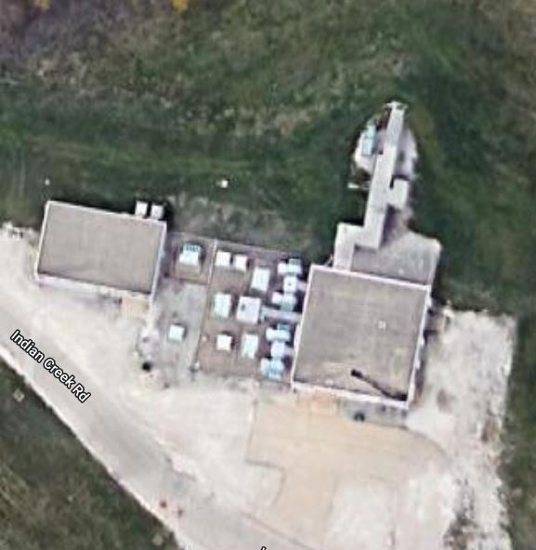
Power Supply Limits and Options – Dipole
Example:
MI-40 with two higher voltage dipole PS
Replacing the power supply may require increasing the transformer pad size.
May not have enough room inside the building for new power supplies.
7
MI Department | D. Morris
1/30/2023

Slide 8
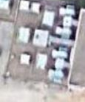
Power Supply Limits and Options – Dipole
Option:
Add a second PS in addition to the current PS at each power supply, doubling the voltage.
This would also require increasing the service building footprint for the additional power supplies
8
MI Department | D. Morris
1/30/2023

Slide 9
Power Supply Limits and Options – Quads
MI has two quad busses (focusing and defocusing) with three power supplies on each bus. They are located symmetrically around the ring with defocusing PS at MI-10, 30 and 50, focusing PS at MI-20, 40 and 60.
Maximum voltage to ground is currently ~500 Volts
Total ring inductance (Henry) = .23600
Total ring resistance (ohms) = .64000
Desired Max. Operating Voltage for Holding PS = 880.
Desired Max. Operating Voltage for Ramping PS = 0.110E+04
Number of power supplies = 6 (3 per bus)
Maximum Voltage Available from Holding PS = 1300.0
Maximum Voltage Available from Ramping PS = 940.00
9
MI Department | D. Morris
1/30/2023

Slide 10
Power Supply Limits and Options – Quads
RAMP CALCULATIONS (0.65 second) :
Peak ramp current (amps) = 2829.7
Total RMS ramp current (amps) = 1347.1
Min. and max. ramp voltage (volts) = -2841.5 4748.8
Maximum number of power supplies = 6
Ramp power (watts) = 0.11613E+07
FEEDER CALCULATIONS :
Peak feeder current (amps) = 552.83
RMS feeder current (amps) = 192.66
RMS feeder volt-amps (v-a) = 0.46050E+07
REAL/REACTIVE POWER CALCULATIONS :
Peak real power (watts) = 0.11226E+08
Peak reactive power (vars) = 0.71034E+07
Average real power (watts) = 0.11633E+07
Average reactive power (vars) = 0.17025E+07
Peak volt-amps = 0.13214E+08
Average volt-amps = 0.29162E+07
10
MI Department | D. Morris
1/30/2023

Slide 11
Power Supply Limits and Options – Quads
Two obvious options:
Double the voltage of the current Quad power supplies
  Requires fewer building modifications
  Doubles the voltage to ground on the quads (~1000 Volts)
    Quads are already susceptible to ground faults
Add three new Quad power supplies at the unused locations
  Requires an additional transformer/pad and power supply space in the Service Building
  Requires adding new bus penetrations to the tunnel
  Need major changes to MECAR for PS turn on sequencing
  Maintains the current voltage to ground (~500 Volts)
3. Adding power supplies between existing service buildings leads to an asymmetrical voltage distribution and more than 500 volts to ground.
11
MI Department | D. Morris
1/30/2023

Slide 12
Power Supply Limits and Options – Quads
MI Quad Defocusing Bus Example
MI10
MI20
MI60
Alternate QD
Configuration
MI30
MI50
MI10
MI40
Current QD
Configuration
MI30
MI50
MI10 MI20 MI30 MI40 MI50 MI60 MI10
12
MI Department | D. Morris
1/30/2023

Slide 13
Power Supply Limits and Options – Feeders
MI pulsed power feeder current configuration does not have the overhead to support the upgrades discussed. Need to upgrade the feeders.
There are available conduits in some areas (which may be used by LBNF feeders soon) but MI-60 and MI-10 to MI-20 (LBNF utility rework) do not have available conduits.
This also requires expanding Kautz Road Substation
Adding two 345 kV transformers
Adding two additional harmonic filters
Expand the KRS building
KRS replacement is already in planning stages. We need to incorporate changes now if we plan to pursue this option!
Can we replace 13.8 KV feeders with 30+ KV feeders?
13
MI Department | D. Morris
1/30/2023

Slide 14
Cost Estimates (Doubling the Number of Power Supplies)
In 2005 Steve Hays estimated the costs for doubling the power supplies for
the Main Injector dipole and quad busses.
M&S | 2005 Dollars
Service Building Civil | ???
Power Supplies | $9.0 million
Feeders | $2 million
Kautz Road Substation
2 – 345 kV Transformers | $2.2 million
Construction/Installation | $1.8 million
Building Changes | $1.0 million
Harmonic Filters | $0.5 million
Outdated
14
MI Department | D. Morris
1/30/2023

Slide 15
Support Utilities - LCW
To protect power supply components, we keep the LCW cooling supply temperature at or below 38 C (100 F).
LCW water heat exchanges with the MI ponds, with a temperature differential (pond input versus LCW output) as low as ~5 C (~9 F). This results in us not being able to maintain LCW temperatures below 38 C during the peak heat of Summer.
Increasing the heat load will require some combination of:
Larger capacity heat exchangers
Deeper ponds (no increase in power consumption)
Cooling towers (adds 25kW per tower)
Unique evaporative cooling on the pond surface
Pond shading
???
15
MI Department | D. Morris
1/30/2023

Slide 16
Reliability and Up-time
Switching topics…
Addressing reliability of :
Magnets
  Dipoles
  Quads
Bus and tunnel penetrations
Cooling Ponds
Tunnel Sump Discharge System
16
MI Department | D. Morris
1/30/2023

Slide 17
Reliability– Dipoles
Main Injector dipole magnets are very robust, among the more reliable
magnets made. From commissioning to date (25 years) we have not experienced
a failure of an MI dipole.
Increasing the voltage to ground and the RMS current in the magnets is
not expected to cause a degradation in reliability.
Biggest risk is abuse (full power with no cooling, mechanical damage while
transported or stored).
17
MI Department | D. Morris
1/30/2023

Slide 18
Reliability– Quads
Main Injector quad magnet reliability is very different than that of the dipoles.
(Remember, the MI quads are reworked Main Ring quads built over 50 years ago!)
Paul Derwent reviewed the MI quad failure rates for IQC and IQD style magnets.
(Beams Doc #7934)
He concluded, after identifying infant mortality outliers, that in any year there was a
10% to 20% chance of an IQC or IQD failure.
Quad Type | # In Use | # Failed
IQB | 127 | 10
IQC | 32 | 6
IQD | 48 | 3
IQE | 1 | 0
WQB* | 6 | 0
*WQB quads are more robust and could be used as upgrades to IQBs. Need modified design for IQC/D/E.
**May not fit everywhere.
18
MI Department | D. Morris
1/30/2023

Slide 19
Reliability– Quads
Increased beam on target goes hand in hand with uptime.
Originally a quad magnet change-out would take 24-30 hours. This was using multiple crews around the clock.
Today it takes 1 to 2 weeks:
Fewer resources
New work planning and approval process that lends itself to delays,
especially when addressing changes to the work plan or planning at
inconvenient times.
*This needs to be streamlined to get us back to a ~30 hours process if possible.
19
MI Department | D. Morris
1/30/2023

Slide 20
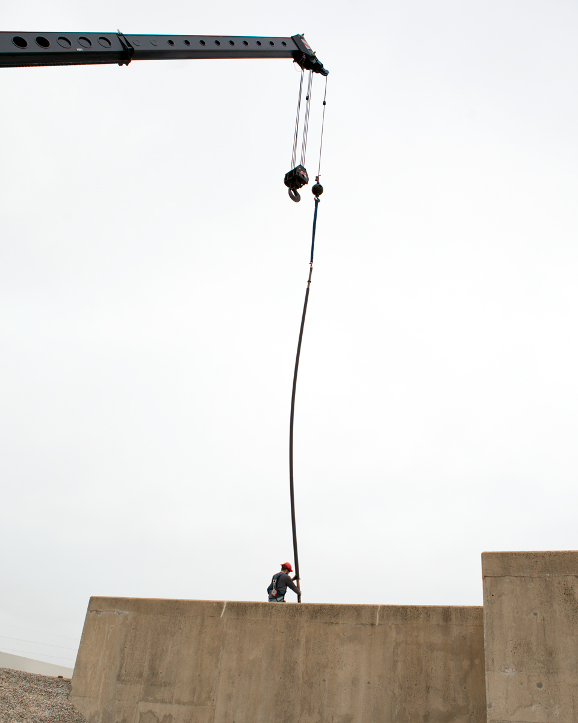
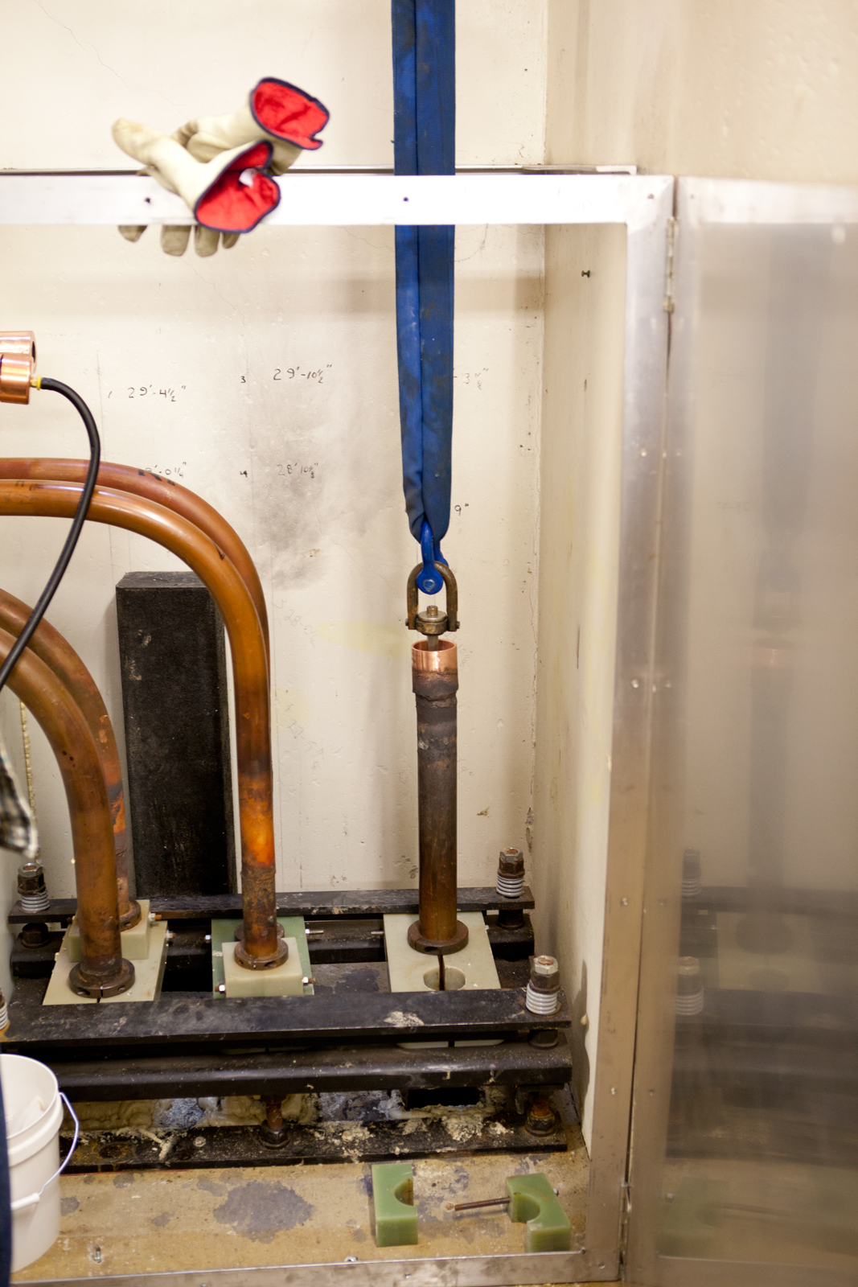
MI Bus Penetrations
SCOPE
PROJECT SCOPE Scope includes the disassembly, modification and reassembly of the Main Injector vertical main power supply buss penetrations. There are 5 service building with vertical buss and 2 with angled buss penetrations. There are 42 total penetrations The PVC insulating liners, which are failing, will be replaced with HPDE.
DRIVING CONSIDERATIONS The vertical penetrations were built using PVC and there is a joint in the PVC liner. This joint fatigues and cracks over time allowing water to enter which leads to a ground fault on the power distribution system. We would like to replace the PVC with a single piece HDPE liner to prevent stress cracks and ground faults
CAMPUS MASTER PLAN ALIGNMENT Provides better machine reliability for future operations
COST
TOTAL PROJECT COST (Vertical only) $500,000 ($700,000 for all penetrations)
COST ESTIMATE CLASSIFICATION 35% contingency
FUNDING SOURCE / STATUS TBD / Unfunded
PROJECT PLAN STATUS Not started
DEMOLITION INCLUDED TBD..
IMPACT ON OPERATING COSTS none
RISKS/ALTERNATIVES
ASSOCIATED RISKS Failure of any of the 42 penetrations during operations will result in at least 2 weeks of unscheduled downtime.
RISK MITIGATION STRATEGY (if not funded) We do have a temporary plan to push a split HDPE pipe up from the tunnel in hope to clear the ground fault until a scheduled downtime would allow a repair
ALTERNATIVES CONSIDERED / RECOMMENDED Build new penetrations. This could be an alternative for the diagonal penetrations, but looks more costly.

Slide 21
Reliability– Bus
From Augustine. Needs updating or use as extra slide (Dated/ check numbers)
Vertical Penetrations (each, 5 total building locations)
$500,000 plus lab labor of 320 hours (~7 years ago!)
Diagonal Penetrations (each, 2 total)
  $100,000 Each, Plus Lab labor (2016)
Task | Manpower | M&S ($) | Duration (days) | Unit coast (per day) | total cost
Prepare work area | Mechanical crew |  | 1 | In House | 16 man hours
Remove Buss
Cut bus and remove poly beads | Rigging crew | 0 | 1 | 4000 | 4000
Remove buss from peneatration | Rigging crew and crain | 5000 | 1 | 6000 | 6000
Remove PVC from penetration | Rigging crew | 0 | 3 | 4000 | 12000
 |  |  |  |  | 0
Reinstall buss | Rigging crew and crain | 5000 | 1 | 6000 | 6000
Braze buss | brazing crew |  | 2 | In House | 32 man hours
Return to service | Mechanical crew |  | 1 | In House | 16 man hours
Misc M&S supplies |  |  |  | 2000 | 2000
 |  |  |  | Total M&S (Including T&M Labor)
 |  |  |  | 40000
 |  |  |  | Total In House Labor (Mechanical tech)
 |  |  |  | 64 man hours
21
MI Department | D. Morris
1/30/2023

Slide 22
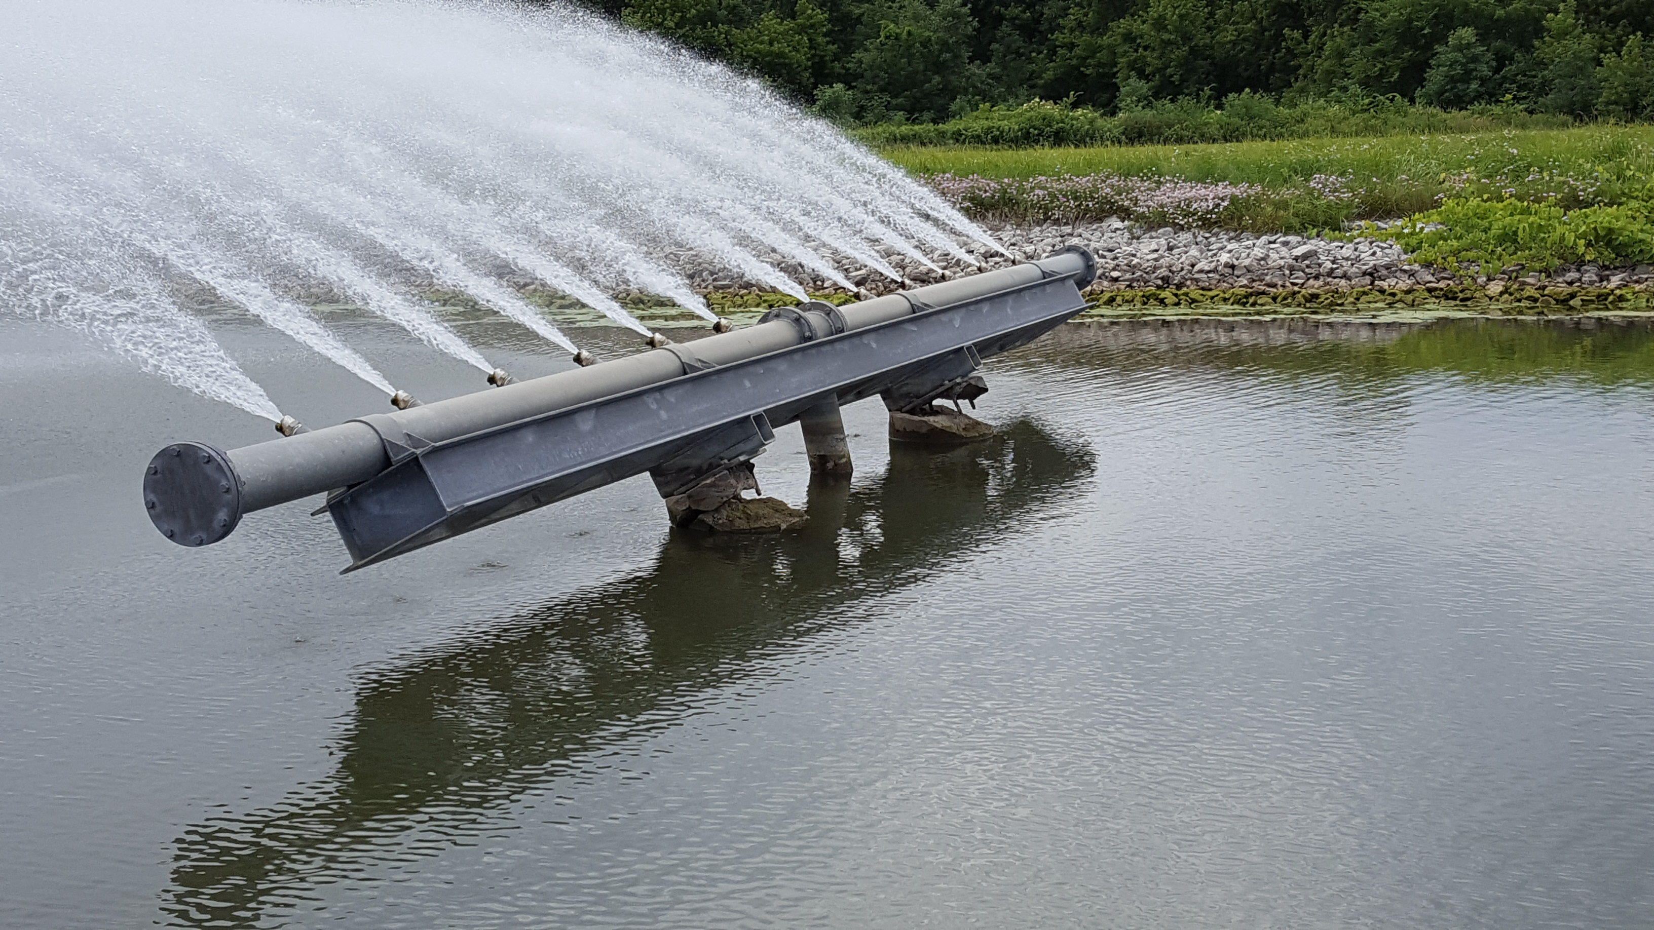
MI Cooling Towers
SCOPE
PROJECT SCOPE Scope includes the installation of 6 total cooling towers, one at each of the Main Injector service buildings. These towers will assist the cooling ponds and will be in addition to the existing cooling system of the accelerator.
DRIVING CONSIDERATIONS The current cooling system becomes limited during the summer months primarily due to solar energy incident on the ponds. When the pond water becomes too hot, we need to reduce or stop operations to prevent damage to the accelerator components.
CAMPUS MASTER PLAN ALIGNMENT Future operations with LBNF and PIP II will desire operations during summer months to meet delivery expectations
COST
TOTAL PROJECT COST $6M
COST ESTIMATE CLASSIFICATION 50% contingency
FUNDING SOURCE / STATUS TBD / Unfunded
PROJECT PLAN STATUS Not started
DEMOLITION INCLUDED TBD.
IMPACT ON OPERATING COSTS: The cooling towers will draw about 25KW each for a total of 150KW. They will operate one third of the year. In addition to electrical needs, the towers will require a service contract to maintain the towers. The contract cost TBD
RISKS/ALTERNATIVES
ASSOCIATED RISKS Overheating of the cooling system will age accelerator components Running near the upper limit of our cooling system will cause a reduction in delivered beam due to the slowing of the accelerator repetition rate or complete turn off. The accelerator complex not meeting the expectations/goals.
RISK MITIGATION STRATEGY (if not funded) If this project is not funded we will likely continue scheduling all maintenance periods during summer months to prevent interruptions in operations
ALTERNATIVES CONSIDERED / RECOMMENDED Do nothing and keep the inlet cooling water temperature below 100F by reducing the accelerator operations. This reduction will result in less beam being delivered. Shade the ponds from the sun. This alternative has been found to be expensive and requires a large amount of maintenance. Dig the ponds deeper. Construction costs are large compared to cooling towers so we do not recommend this alternative, however it is a simpler solution to the towers. Use VFD for temperature regulation instead of 3-Way mixing valve to offset energy consumption
MI Department | D. Morris

Slide 23
Main Injector Sump Lines
SCOPE
PROJECT SCOPE Scope includes The replacement of the Main Injector sump lines that discharge into the cooling ponds.
DRIVING CONSIDERATIONS The Main Injector sump lines are iron pipes that were installed without cathodic protection. Over time these lines have rusted and separated. When this occurs, we create a sink hole which compromises our radiation and creates a backflow of mud and silt into the sump pit. Under extreme conditions, the Main Injector tunnel can flood locally.
CAMPUS MASTER PLAN ALIGNMENT Machine reliability.
COST
TOTAL PROJECT COST $1,500,000
COST ESTIMATE CLASSIFICATION 35% contingency
FUNDING SOURCE / STATUS TBD / Unfunded
PROJECT PLAN STATUS Not started
DEMOLITION INCLUDED TBD..
IMPACT ON OPERATING COSTS none
RISKS/ALTERNATIVES
ASSOCIATED RISKS Compromised radiation shielding Tunnel Flooding Underdrain becoming clogged with silt
RISK MITIGATION STRATEGY (if not funded) As a temporary fix, we will run hose through the tunnel to the next sump. The repair will be made during the following maintenance shutdown and the sink hole will be roped off.
ALTERNATIVES CONSIDERED / RECOMMENDED Abandon the current sump line and look into a directional bore. This is not the best from a radiation shielding standpoint but should be investigated as a cost savings measure.

Slide 24
Support Utilities – Sump Discharge Lines
Identifier
11A, 11B
10A, 10B | 2019-08-08 | Sinkhole discovered during LBNF site prep work
9A, 9B | 2019-10-31 | Silt discharge noticed in pond. Sink hole located behind MI-20 SB
8A, 8B | 2018-10-17 | Discharging muddy water. Broken sump discharge line
7A, 7B
6A, 6B | 2014-09-10 | Silt in sump pit. Sink hole starting on berm
5A, 5B | 2015-12-02 | Sink hole near MI-40 air handler
4A, 4B
3A, 3B | Pre 6/24/2022 | Sinkhole discovered during by FESS sometime prior to June 2022
12A, 12B | 2017-04-05 | Water flowing into air handler shaft
1A, 1B
2A, 2B | Pre 6/24/2022 | Sinkhole near MI-60N pond vault
13A, 13B | Pre 2007 | Line replaced/rerouted. Sinkhole remains. Occupied by animal?
21A 21B
22A 22B
19A, 19B
16A, 16B
15A, 15B
Eighteen sump discharge lines. Nine have already failed and were repaired/patched at the
failure point. Only one was completely replaced. (A second line is being replaced in 2023)
24
MI Department | D. Morris
1/30/2023

Slide 25
Support Utilities – Sump Discharge Lines
Since 2013, we have been addressing Main Injector sinkholes that are a direct result from sump pump piping failures due to internal erosion and external corrosion. The following repairs have been completed since 2013:
MI31: Release: 589322-425 Cost: $76.6K Duration: 7 Weeks
MI40: Release: 623433-25 Cost: $80.7K Duration: 6 Weeks
MI52: Release: 623433-143 Cost: $55K Duration: 4 Weeks
Q118: Release: 623433-225 Cost: $48.5K Duration: 2 Weeks
Full replacement ~$165,000. Does not include machine downtime due sink hole impact to shielding or for shielding recertification (alignment, ES&H analysis, ISD…).
25
MI Department | D. Morris
1/30/2023

Slide 26
Additional Magnet/Power Supply Systems to Consider
In addition to the main dipole and quad magnet systems we must also investigate
potential issues with RMS current, slew rates, timing for:
Correction element magnets, cables and power supplies (Including Recycler
  Quad compensation loop).
Lambertson magnet, cables and power supplies
Injection, extraction and abort kickers
Possible additional Mu metal magnetic shielding for Recycler ($150k materials for
  original installation in 2000.)
26
MI Department | D. Morris
1/30/2023

Slide 27
Additional Modernizations Tasks
MI bus/ps regulation DCCT 6 head replacement $200k M&S
MI Damper upgrade $150K M&S
MI Spare Quad magnets (214 installed)
  $300K new, $100K rebuilds (robustly – like dipoles)
?
?
27
MI Department | D. Morris
1/30/2023

Slide 28
Summary
Need EE Support, Mechanical Support, TD, ISD to evaluate the feasibility of the magnet power supply options
Costs
reliability
Risk
Sustainability.
Independent of ramp upgrades we need to address
Failing infrastructure (bus penetrations, sump discharge lines)
Work planning process to improve uptime
At this time resources are very limited and not available to address many of these issues.
28
MI Department | D. Morris
1/30/2023

Slide 29
Cost Summary (with uncalculated uncertainty)
Power Supply Transformers:
Double number of power supplies
18 transformers x $500k (delivered, not installed) = $9 million
Building additions ~1,000 sq-ft x $1,300/sq-ft x 6 = $7.8 million
Cost for additional penetrations = $????
Double the voltage of all power supplies
18 transformers x $1.2 million (delivered, not installed) = $21.6 million
Does not include costs for feeders ($8 Million?), VCBs, Switch cabinets, power supplies or KRS upgrade
New Quad Magnets (WQB style): $35-$45 million
Cooling upgrages:
Adding 5 cooling towers: $6 million
Deeper ponds: $????
Alternatives: $????
Existing bus penetrations modifications: $700k (2016 dollars)
Sump discharge line replacements: 18 x $165k = $3 million
29
MI Department | D. Morris
1/30/2023

