Slide 1
Accelerator Capabilities Enhancement (ACE) Workshop
Main Injector Controls and Instrumentation
Kyle J. Hazelwood
January 30, 2023

Slide 2
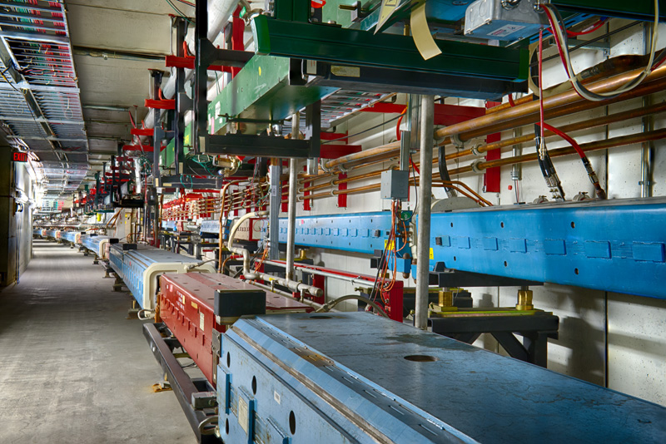
Outline
Criteria
Upgrades and Enhancements
Summary

Slide 3
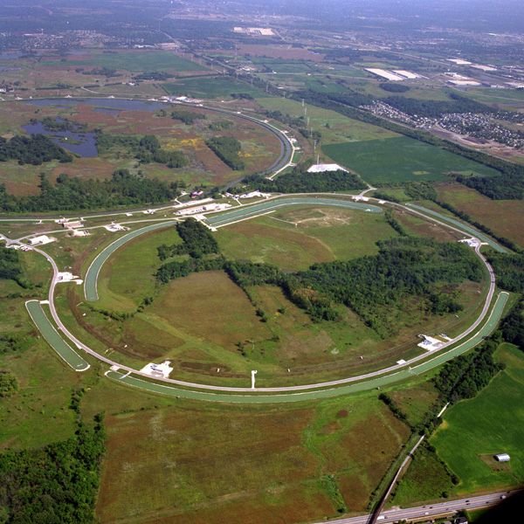
Criteria
2 MW MI Fast Ramp Proposal 2MW
Is enhancement or upgrade necessary or desirable for proposal
PIP-II PIPII
Is enhancement or upgrade necessary or desirable for PIP-II era
Reliability R
Would enhancement or upgrade significantly increase uptime or lower maintenance and upkeep
Sustainability S
Would enhancement or upgrade make operations more sustainable (less energy, less waste, smaller environmental impact)
Performance P
Would enhancement or upgrade increase operations performance (more beam, more efficiently)
Criticality C[0-3]
How critical is this item to present or future operations
Cost $[1-3]
Relative estimate of cost
Labor L[1-3]
Relative estimate of labor

Slide 4
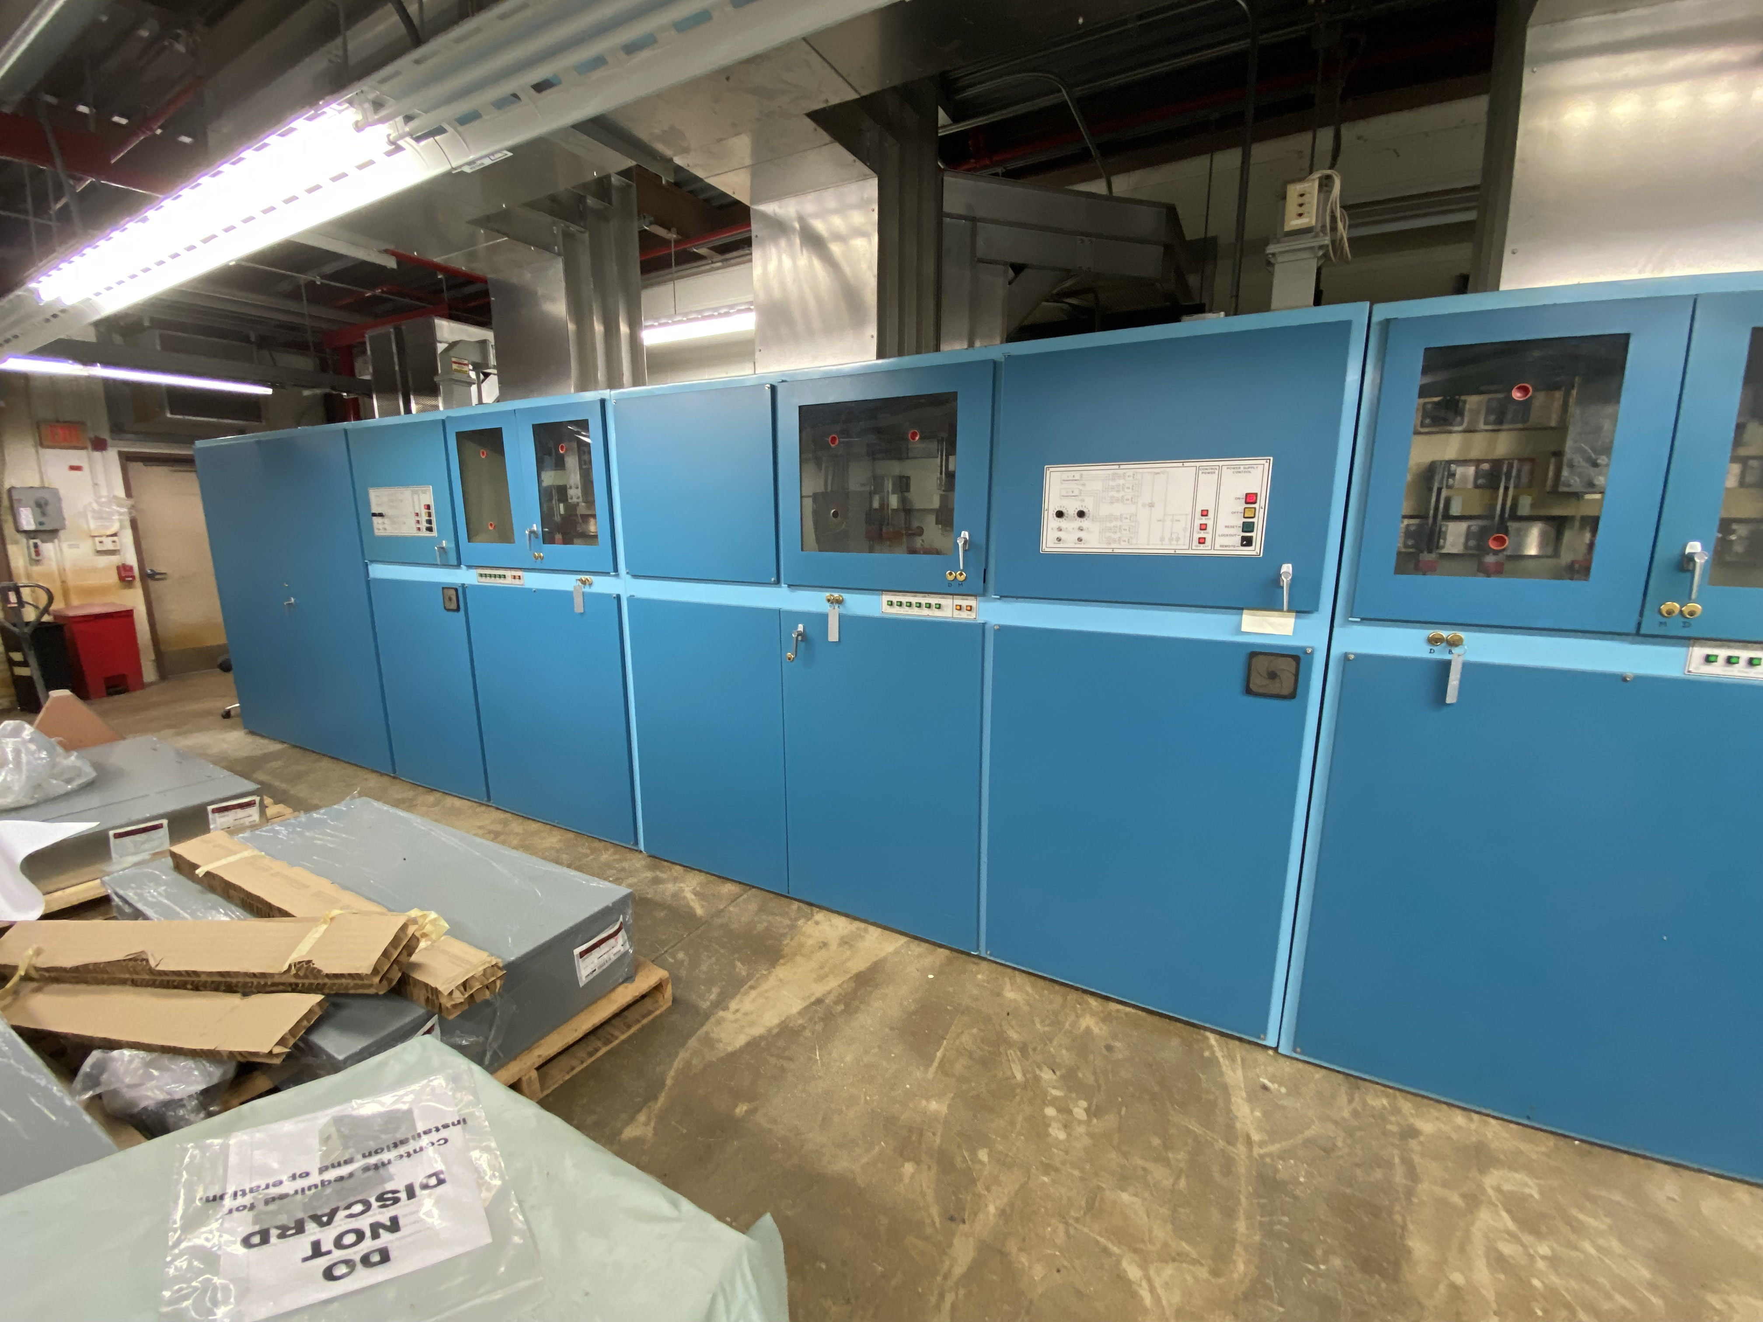
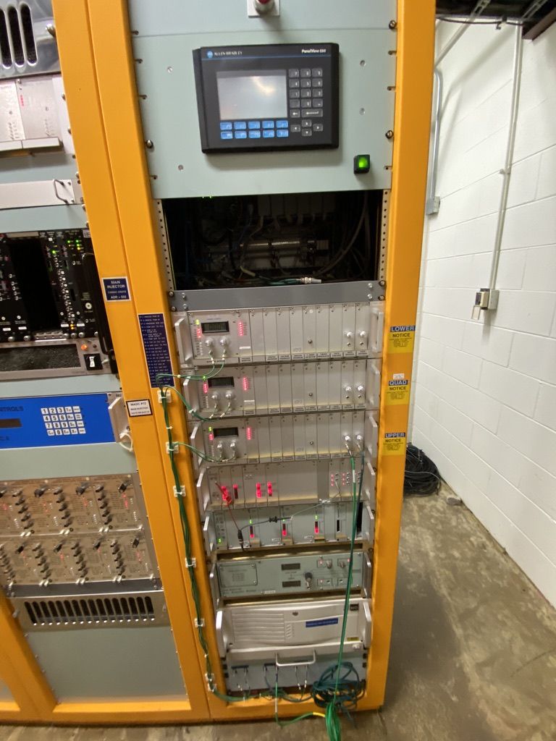
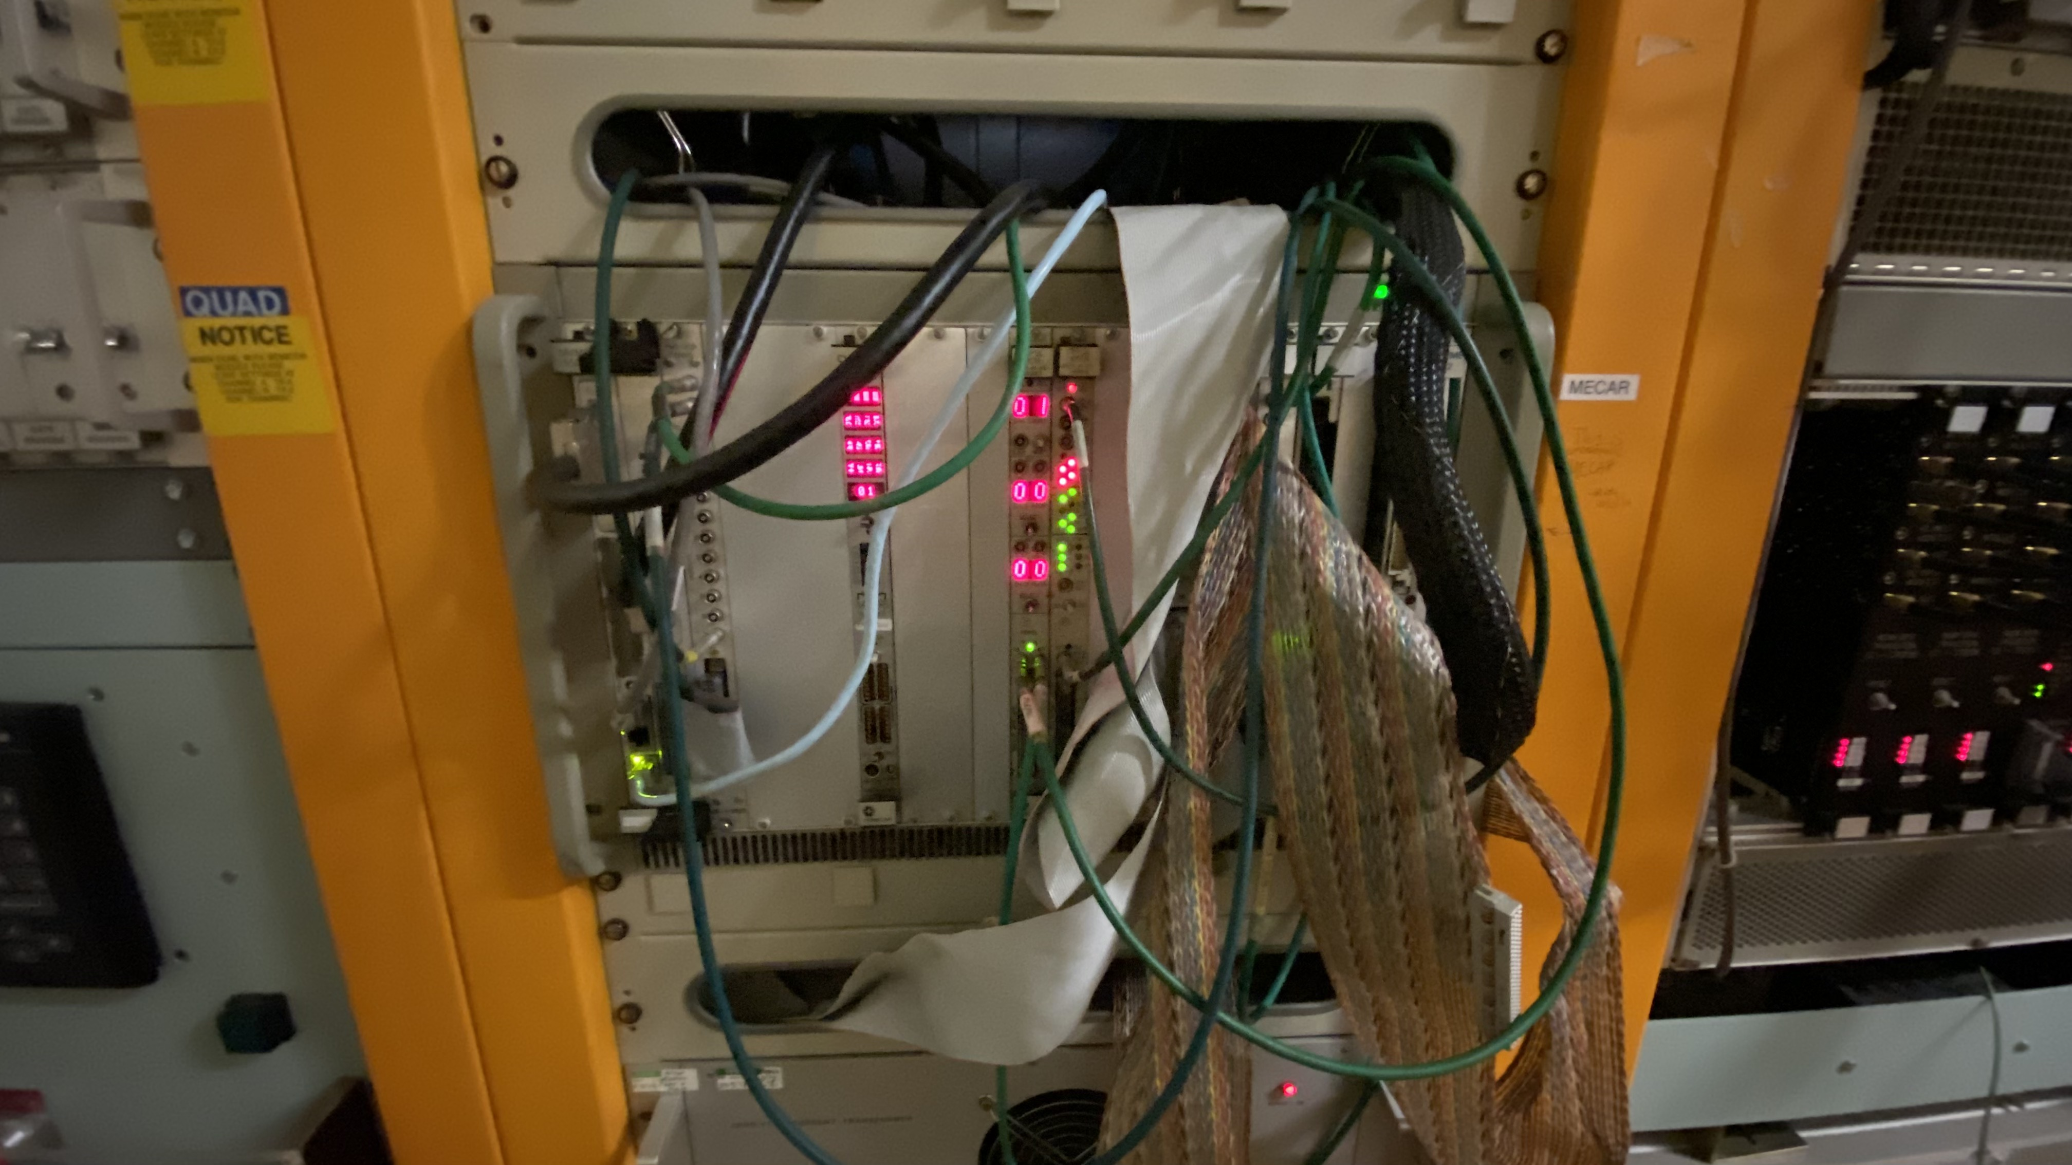
Main Injector Power Supply Controls
Most of the Main Injector main power supply controls are original to 1990’s construction
PS PLCs (2MW, R, C3, $2, L2)
50 (24 just for MI quad and bend supplies)
$150k, 800 hrs
PS PLC Control Power (2MW, R, C3, $1, L2)
10 (8 remaining)
$56k, 320 hrs
DC PS Control Communications (2MW, R, C3, $1, L2)
~$50k, ~100’s hrs
Bus DCCTs (2MW, R, C3, $2, L?)
7
~$112k
PS Data Link (2MW, R, C3, $1, L?)
CAMAC based
MECAR (2MW, R, S, P, C3, $1, L2)
VME based
Sustainability opportunity

Slide 5
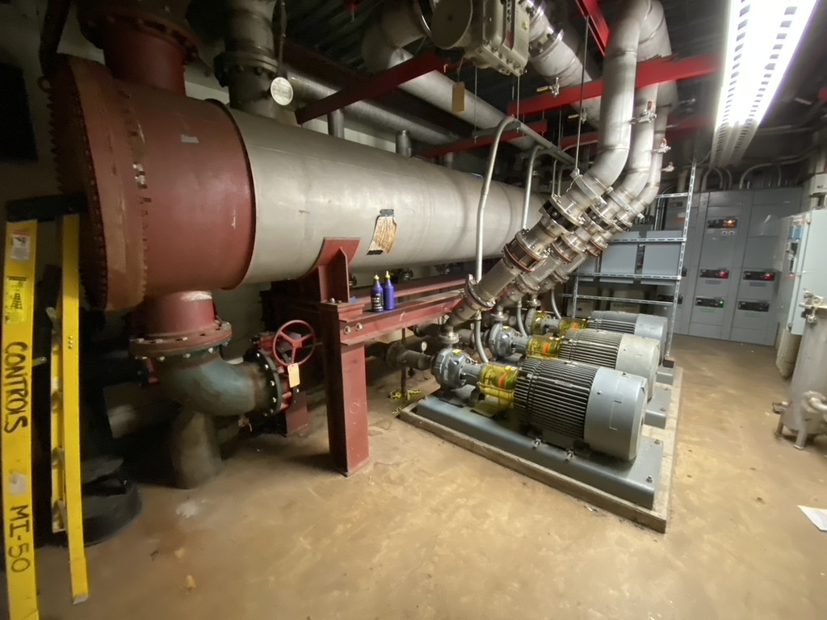
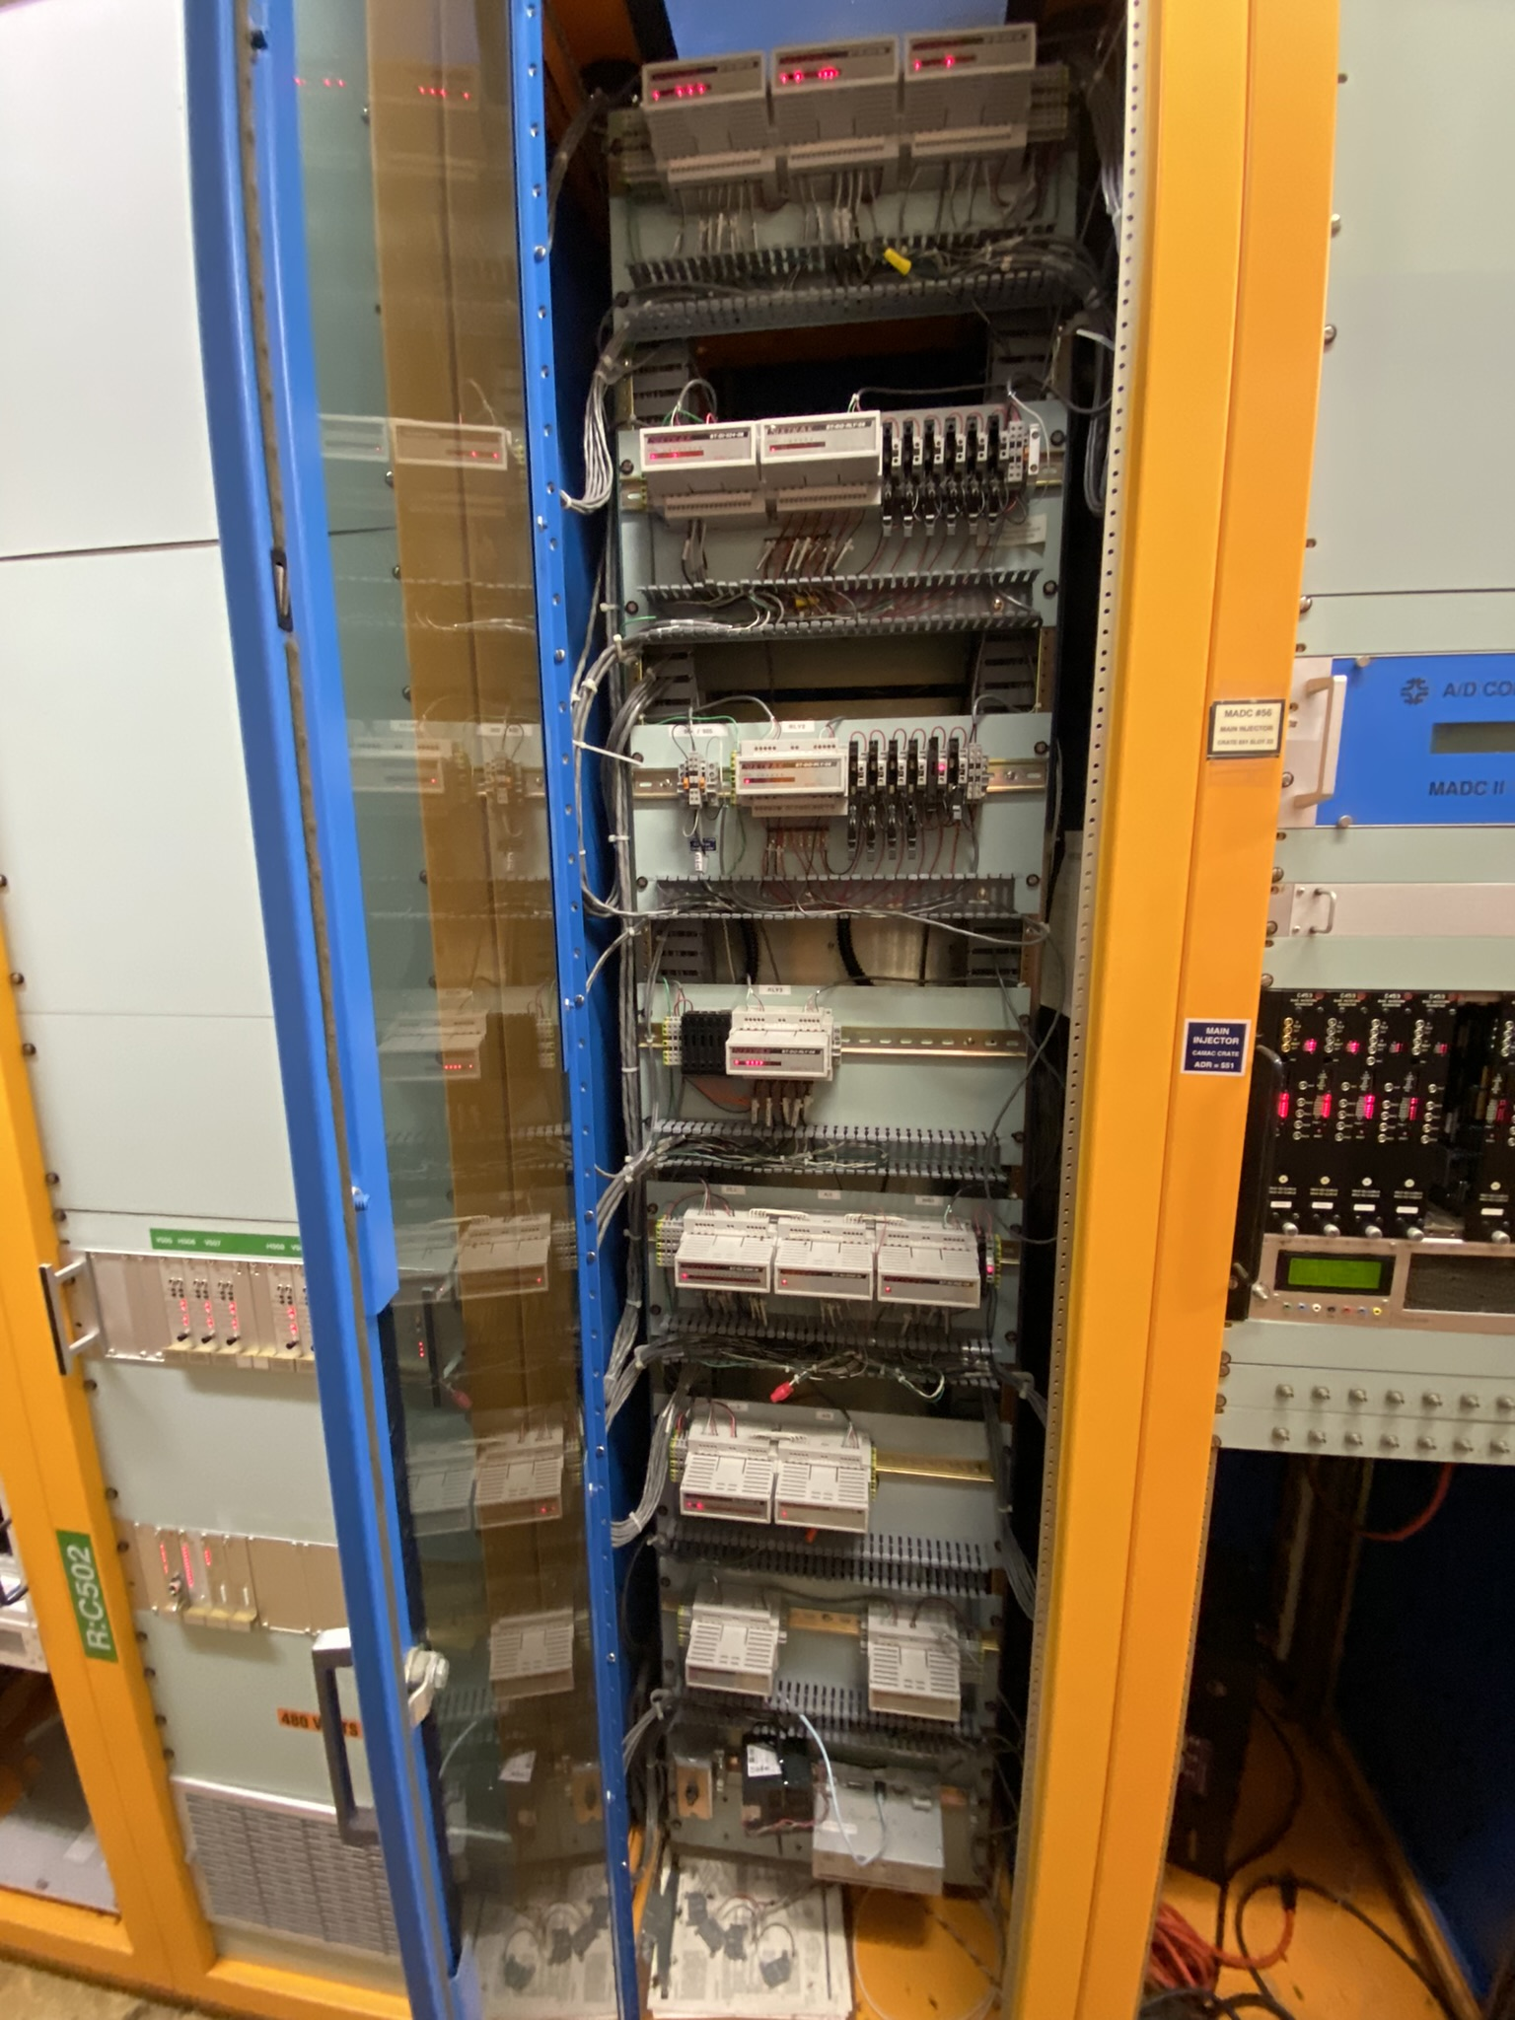
Water Cooling Controls
Main Injector water cooling controls needs to be replaced
House PLCs (2MW, R, C3 , $2, L2)
Magnet, RF, Cavity systems
SixTrack system obsolete
House VMEs (2MW, R, C3 , $1, L1)
Advantage Starter Cards (2MW, R, S, C3, $2, L2)
~50 between LCW and pond pumps
Obsolete
Some pond have been replaced with Variable Frequency Drives (VFD)
VFD offer new way to regulate LCW temperature while lowering energy use

Slide 6
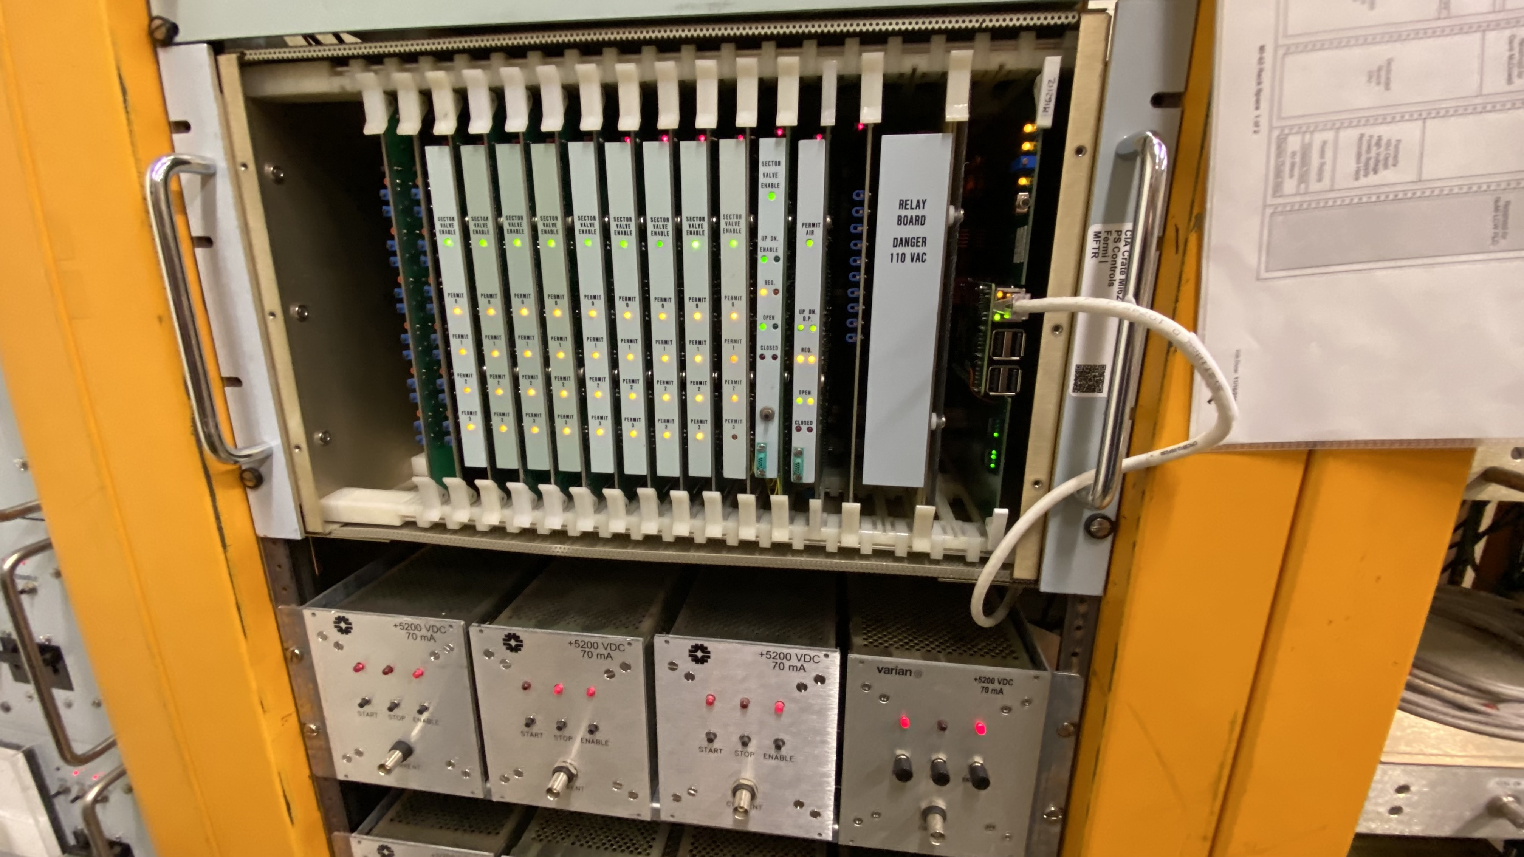
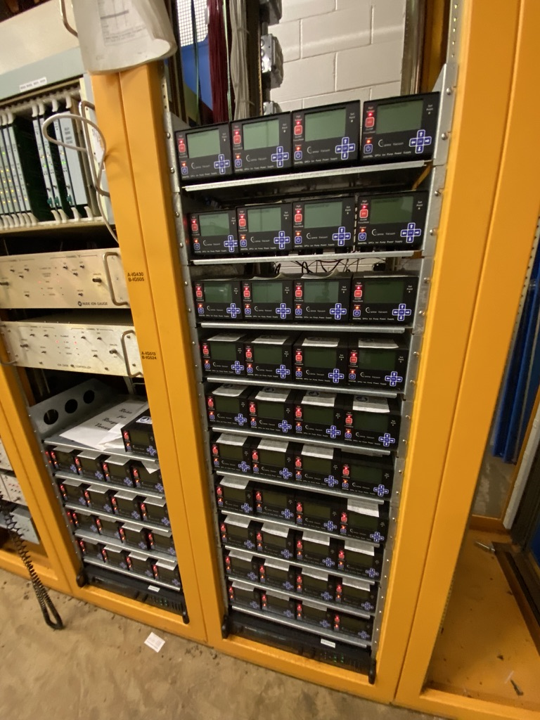
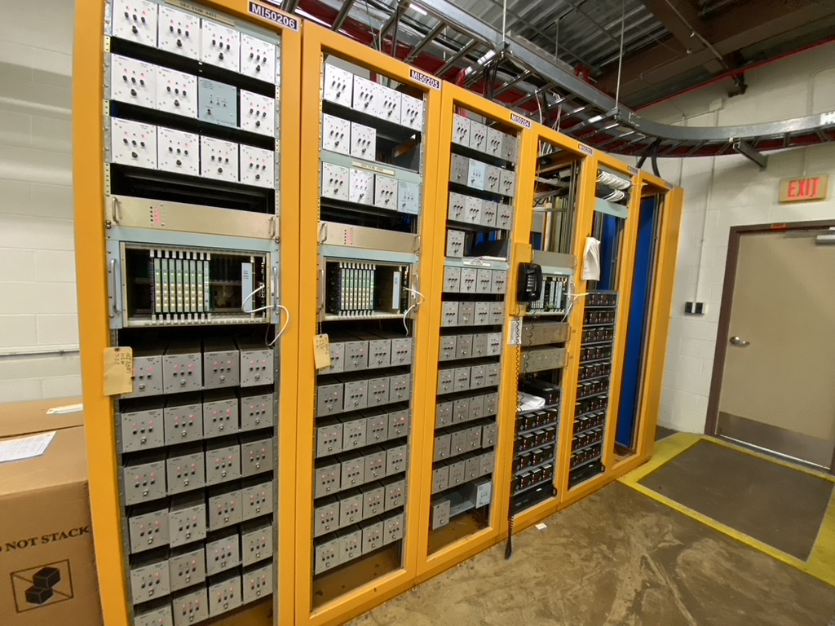
Vacuum Controls
All Main Injector, 8 GeV and 1/3 of Recycler running on obsolete CIA system
Ion Pump PS (PIPII, R, S, P, C3 , $3, L3)
~500
~$500-750k, 1000 hrs
Networked Ethernet IPs in use in Recycler
Beam Valve Control (PIPII, R, C3, $1, L2)
~1-2 per house
~$100k, ~250 hrs
Need to replicate CIA crate beam valve control, sector permit
Could be used to increase IP vacuum readback frequency

Slide 7
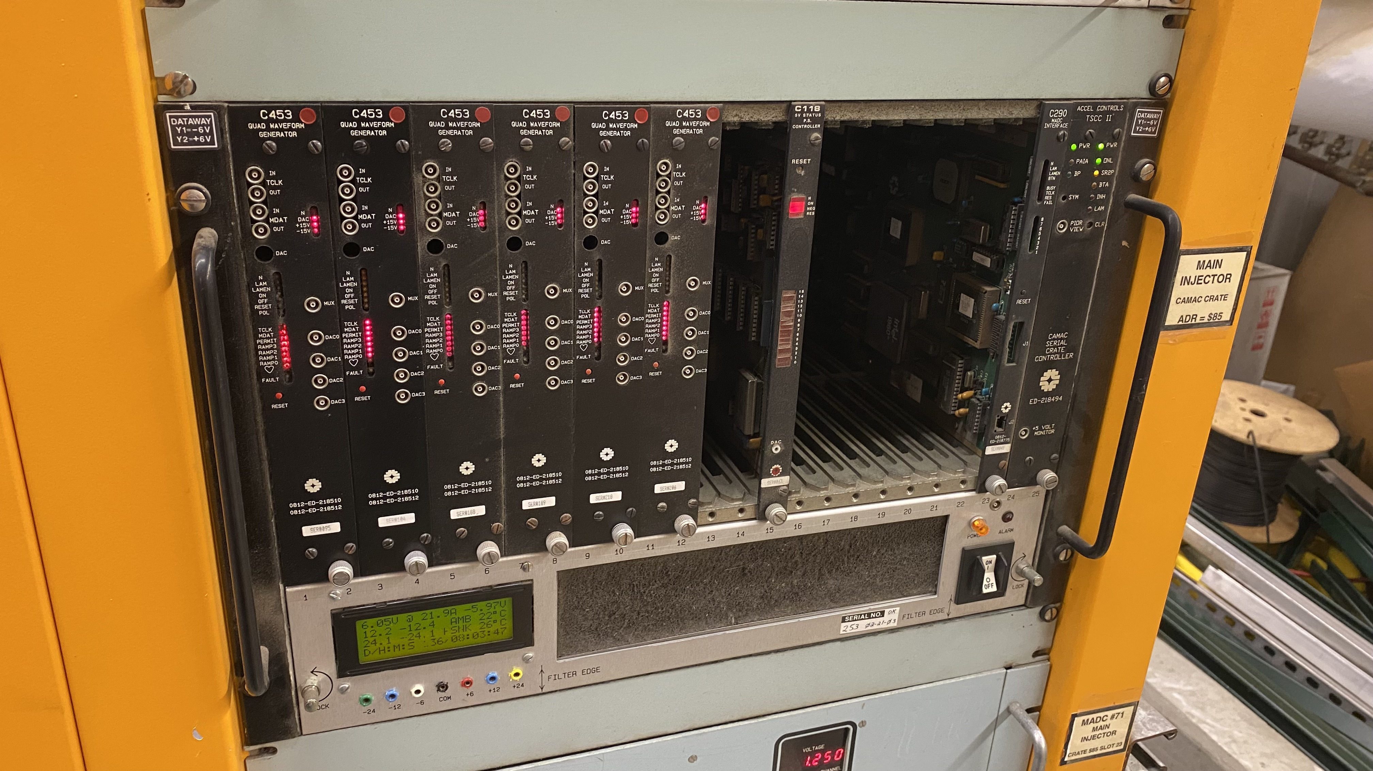
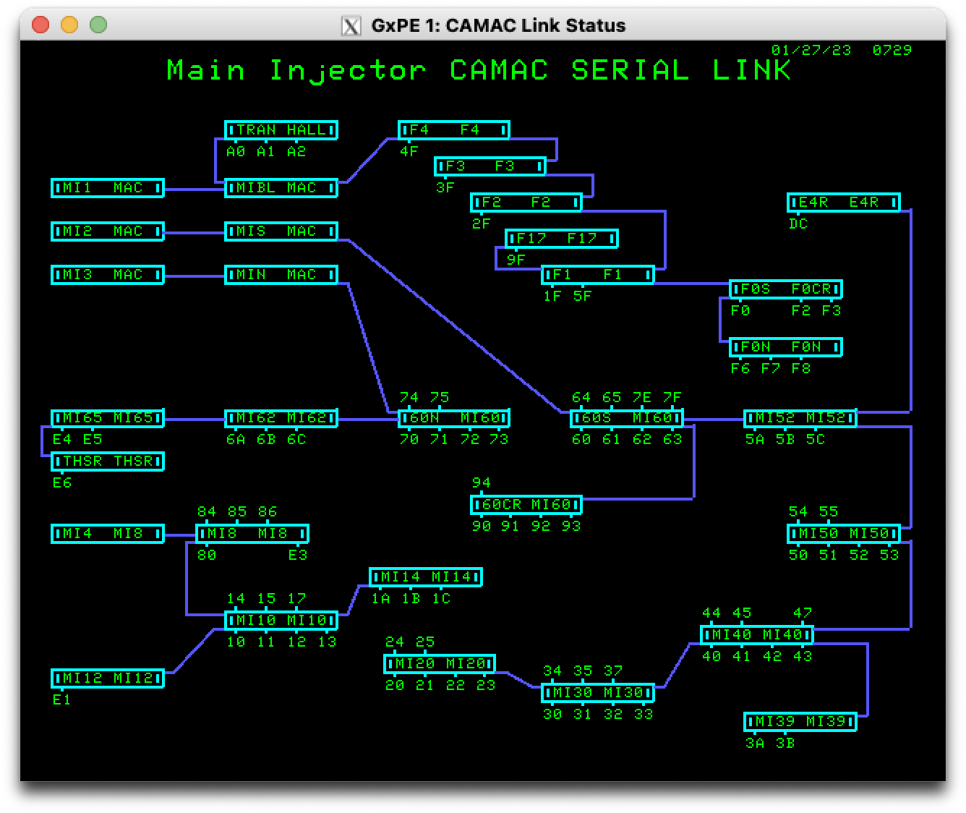
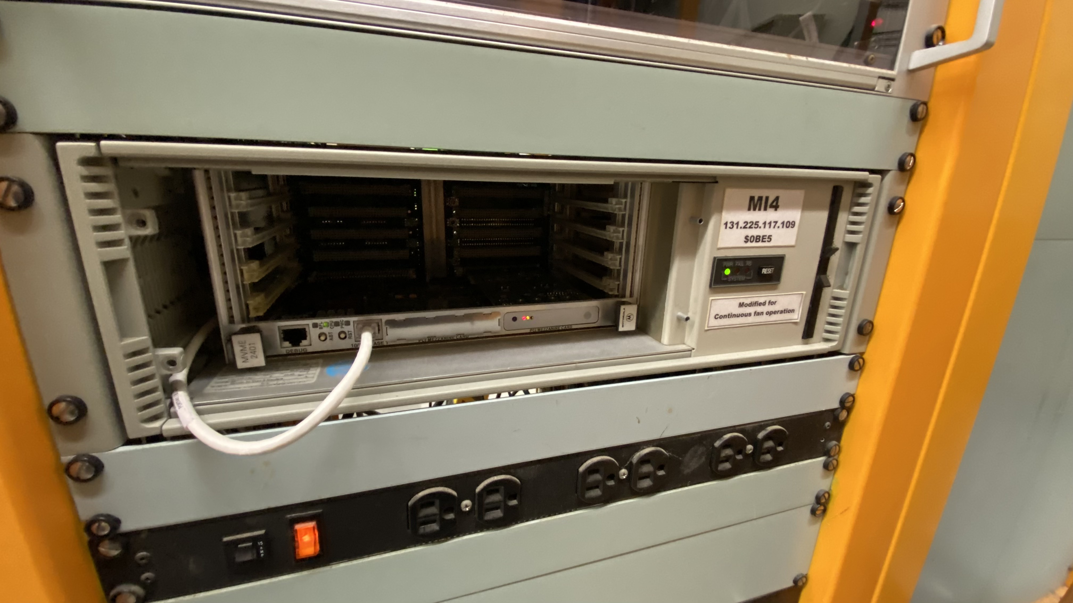
Field Bus
Much of the PS ramp waveforms, timing, clock, signals, ADC, machine protection is handled via CAMAC, a 1970’s tech
CAMAC Cards (R, P, C3, $3, L3)
~603,
~$2M+, 1000’s hrs
CAMAC Crates (R, P, C3, $3, L3)
`~88
~$1M
CAMAC VME Front Ends (R, P, C2, $1, L1)
4
~$50k
CAMAC ADC (R, P, C1, $2, L2)
Need more channels, less multiplexed
We can’t currently read adjacent corrector currents in Recycler
Greater resolution

Slide 8
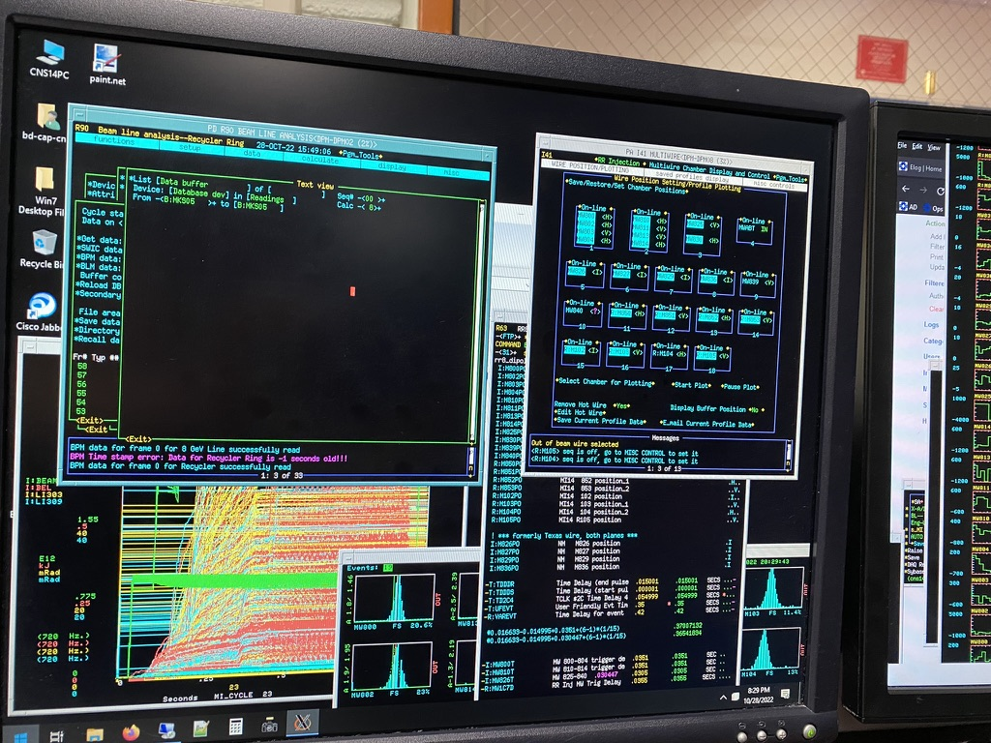
Software
Many client applications were originally written 25+ years ago
Client Applications (R, P, C2, $1, L3)
Console Programs, Comfort Displays
~100 for Main Injector, Recycler, 8 GeV
1000’s hrs
More Data (P, S, C1, $?, L2)
More resolution
Better timestamp synchronization
More waveform data
Data Logging (R, P, S, C2, $2, L2)
We save a very small fraction of our machine data
~5 TB per day to save all existing readbacks
Issue tracking (R, P, S, C1, $1, L1)
Elog is great ☺, but does a poor job of tracking resolution of issues that take longer than a few shifts
APIs (R, P, S, C1, $1, L1)
Convenient, intuitive, flexible access to machine data and machine settings

Slide 9
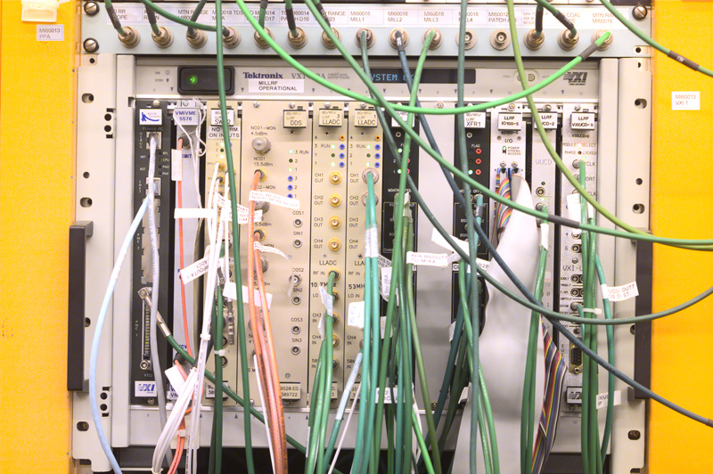
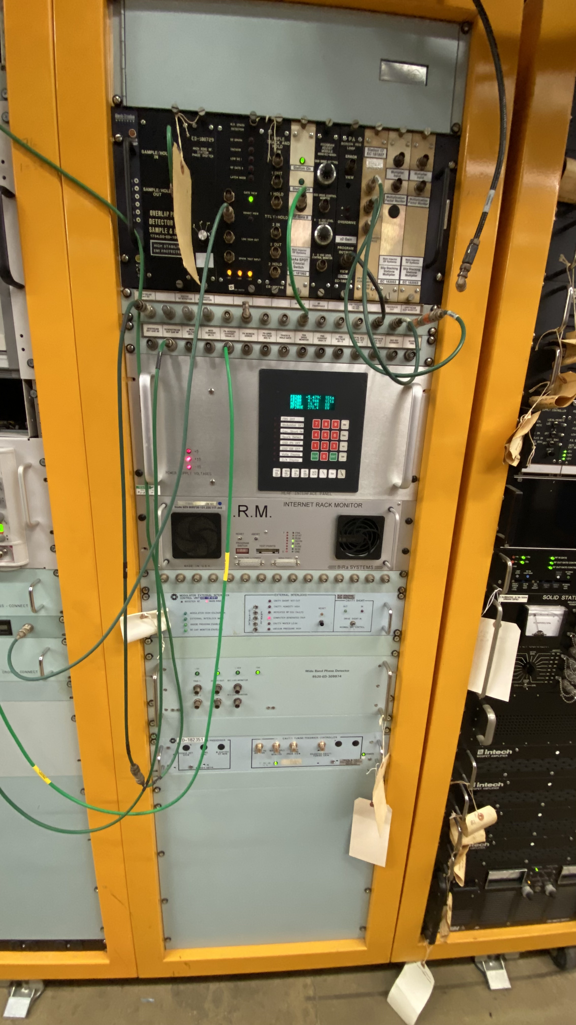
RF Controls
Most RF controls are in need of replacement
LLRF VXI Crates (2MW, PIPII, R, P, C3 , $2, L2)
Needed for Main Injector and Recycler
HLRF IRM Nodes (2MW, PIPII, R, P, C3 , $2, L2)
44
Proposed PiRM nodes
Anode Controls (2MW, PIPII, R, P, C3 , $1, L2)
Damper Controls (PIPII, R, P, C3 , $2, L2)

Slide 10
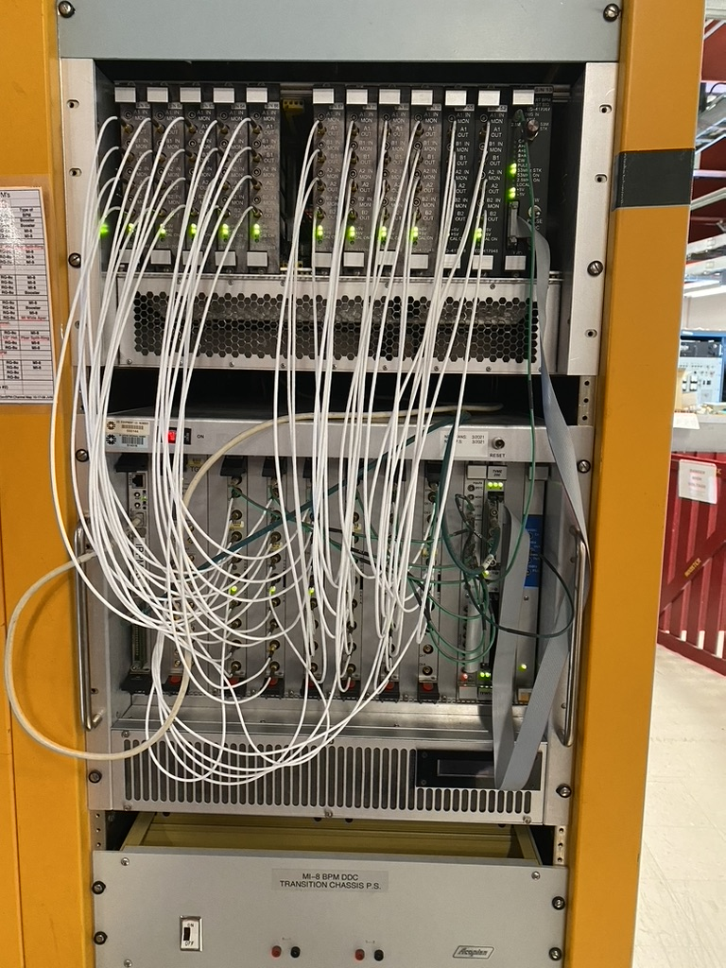
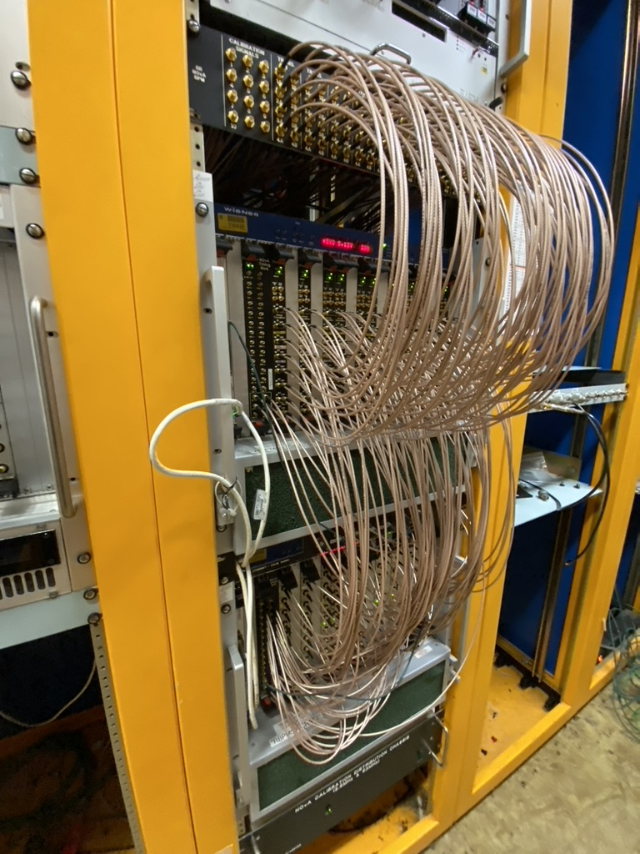
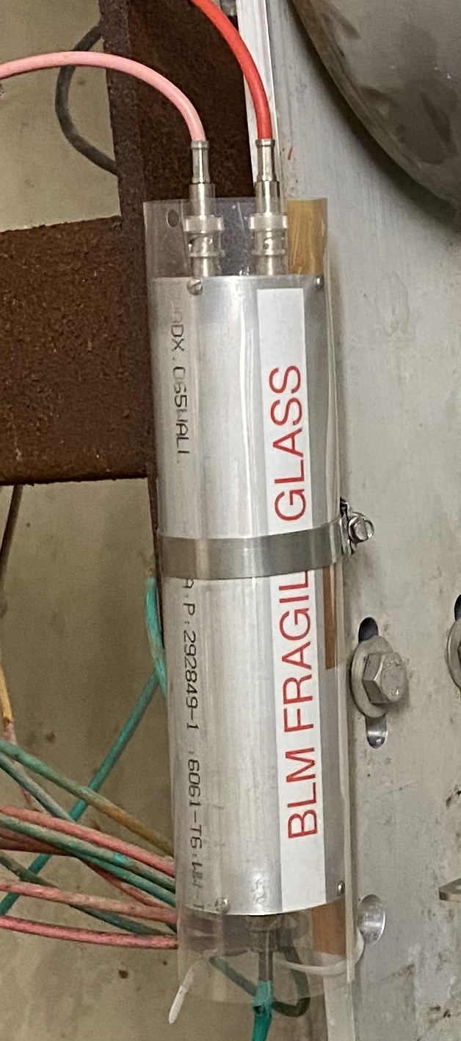
Beam Instrumentation
Much of our beam instrumentation is EOL. Most systems were designed for manual tuning and studies
Beam Position Monitors (PIPII, R, P, C3, $3, L2)
8 GeV, Recycler, MI
Digitizers obsolete, few spares
VME based
Beam Loss Monitors (PIPII, R, P, C3, $3, L2)
Ionization chambers need refurbishment
VME based
Wire Profile Monitors (PIPII, R, P, C3, $2, L2)
Motion controls need refurbishment
Better wire frame, can designs desired
Bias planes, dual planes, C-channels
SWIC scanner + VME FE scheme dated
Ion Profile Monitors (PIPII, R, P, C1, $2, L2)
Fast HV switch to preserve Micro channel plate lifetime

Slide 11
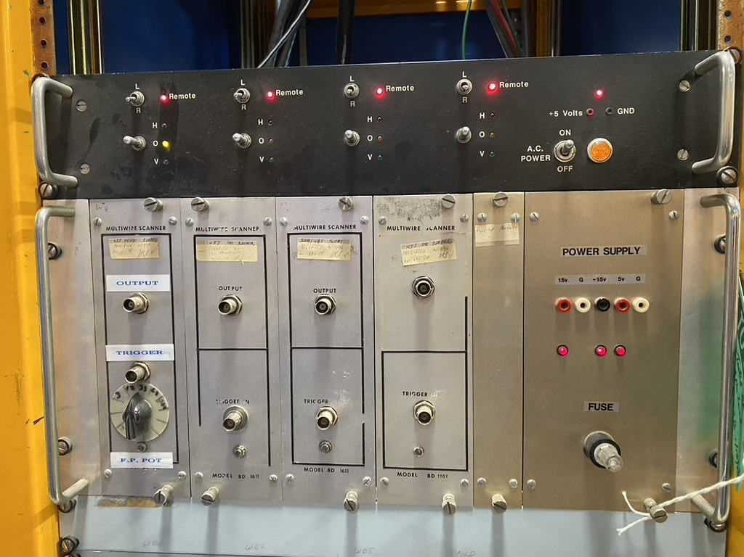
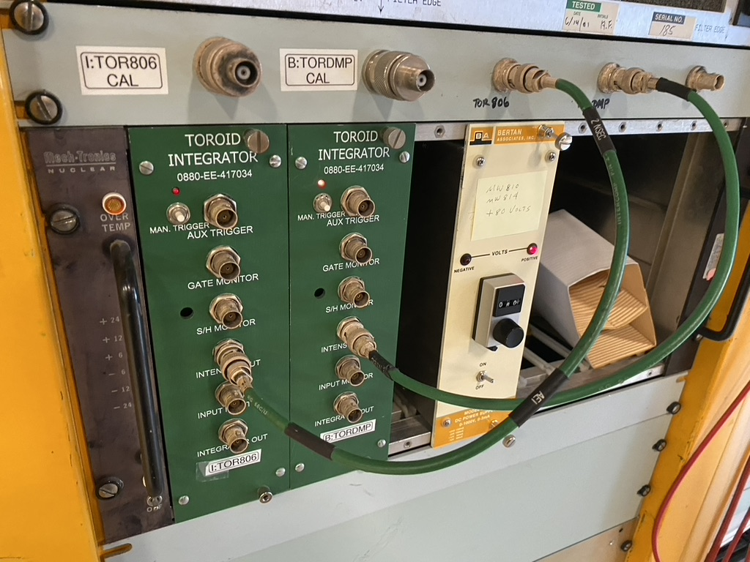
Beam Instrumentation (Continued)
Toroids (PIPII, R, P, C2, $2, L2)
VME/NIM based
Beam Intensity DCCT (PIPII, R, P, C3, $2, L2)
VME based
Hardware is approaching beam intensity limits for PIP-II
More Non-invasive Measurements (PIPII, R, P, C2, $3, L2)
Electron beam profile monitor?
Halo profile monitors?
Tune measurement?

Slide 12
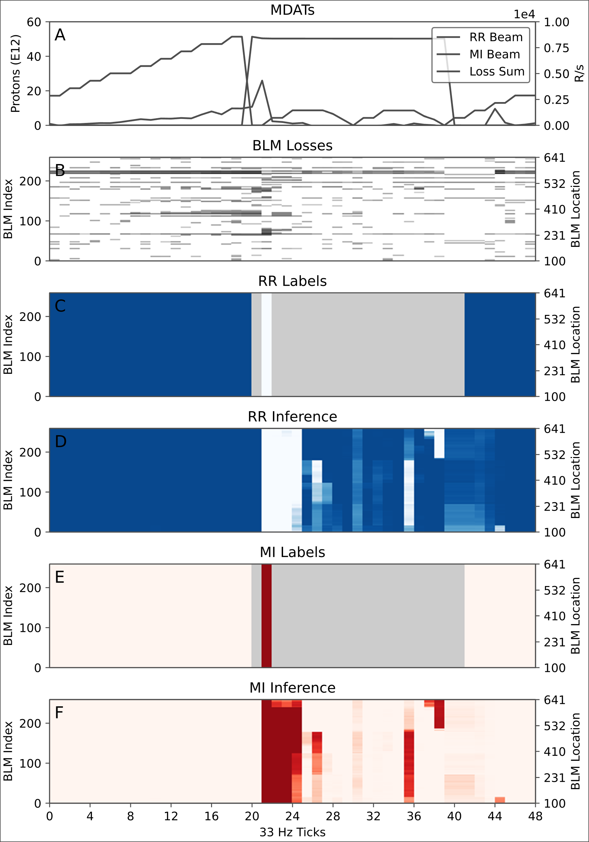
Automation
The vast majority of Main Injector, Recycler and 8 GeV are tuned manually.
Orbit Control (2MW, PIPII, R, P, C3 , $1, L2)
More autotunes
Tune Control (2MW, PIPII, R, P, C3 , $2, L2)
Need active tune readback (Dampers?)
Artificial Intelligence, Machine Learning (2MW, PIPII, R, P, S, C3 , $2, L2)
Anomaly Detection
Tuning, studies are often hampered by broke instrumentation only discovered in post
Multi-objective Optimization
Optimize the machine using multiple sub-systems for multiple objectives
Better regulation schemes
Slow spill duty factor
Main Injector ramp regulation
Energy savings
Inference, realtime diagnostics
Digital Twins (better machine models)
Natural Language Processing (Elog searches?)
Automated Tunnel Surveys, Robotics (2MW, PIPII, R, P, S, C3, $2, L2)

Slide 13
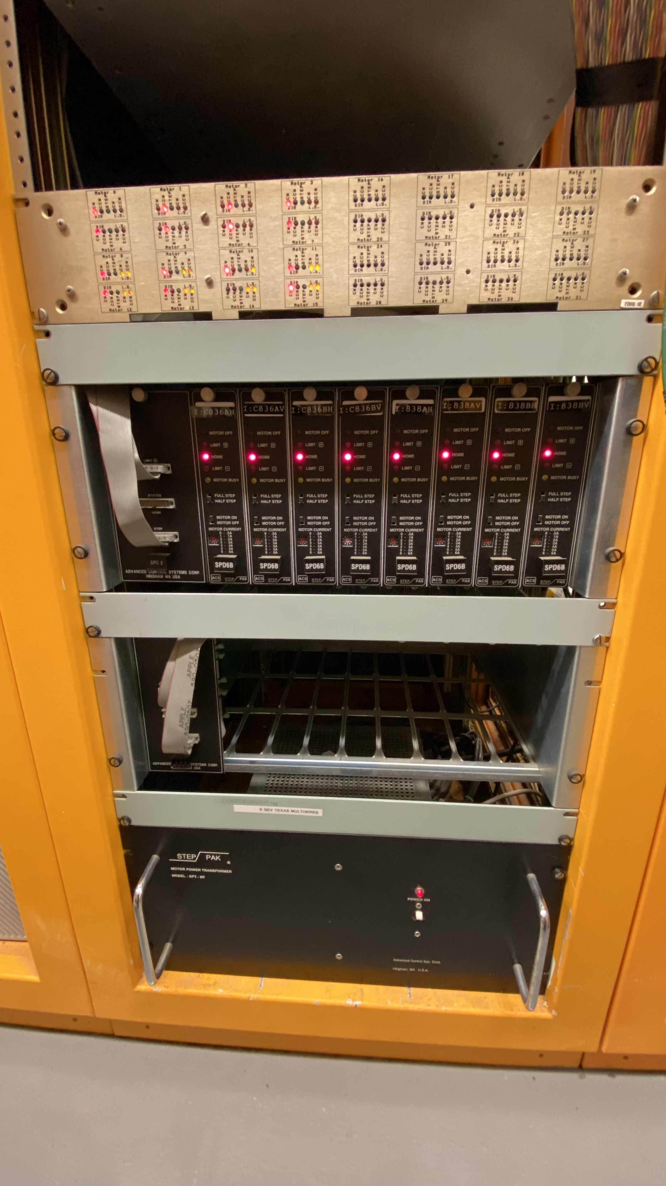
Miscellaneous
Not every needed upgrade fits into a neat category
Computer Room (2MW, PIPII, R, P, C3 , $3, L2)
Limited cooling
At max capacity
Generator needed
Kautz Road Sub-station (KRS) Controls (2MW, R, P, C3 , $2, L2)
Building Monitoring/Metering (R, P, S, C3 , $2, L2)
Opportunity for sustainability
Cabling Replacement (2MW, PIPII, R, P, S, C3 , $3, L3)
Radiation damaged cables, cable liftetimes
Investigate other insulation materials
Motion Controls (R, P, C3 , $2, L2)
Main Injector, Recycler, 8 GeV Collimators
Wire Profile Monitors
Ion Profile Monitors
Septa tanks
Crawling Wire
Total Loss Monitors (2MW, PIPII, R, S, C2, $2, L2)

Slide 14
Summary
There are no obvious Controls or Instrumentation technological obstacles that would prevent the 2 MW Fast Ramp Upgrade
Just a matter of resources and support
Increasing reliability should be prioritized the same as any increase in Main Injector duty factor or beam intensity
Majority of Main Injector controls is EOL, there is much that should be replaced/upgraded
Much of our instrumentation is oriented towards manual tuning and studies
Need more focus on providing streaming readings for future automation
While both Main Injector and Recycler currently have beam transmission efficiencies of ~98%, this may be insufficient for future machine operations
Tunnel activation, personnel exposure
Component lifetimes
More effort and support should be given to machine automation to help improve overall machine efficiencies
AI/ML has great promise
Opportunities exist, and should be explored to increase Main Injector sustainability
Need to actively rotate out aged systems
Attracting and retaining talent is already hard, few want to work on dated systems
More investigation is needed to adequately scope costs and labor
ACORN is doing some of this investigation already
This amount of work will require significant increases in personnel and funds

