Slide 1
ACE Workshop
Installation Considerations for Option Zero
Cons Gattuso
January 31st, 2023

Slide 2
Agenda
How we plan for our installation activities.
Considerations that will need to be considered for this planning.
  Task classification
  Work force
  Interfacing with project activities
Summary

Slide 3




Planning Cycle
1.0 Define scope
2.0 Shutdown planning
Each activity is review and place in the shutdown with the following criteria: Readiness of task, interference with other activities, resources needed to complete the work.
Each task is defined what task. This ranges from maintenance activities, to new installations.
6.0 Lessons learned
Process were reviewed and feedback given for future installations.
3.0 Executing work
Task are executed.
4.0 Close out/check out
5.0 HEP
Work is completed and machine checkouts are performed.
Beam is established to users.

Slide 4
Shutdown 2023 Planning and Execution (Typical)
Milestone 0
Milestone 1
Milestone 7
Refine Shutdown Parameters.
Milestone 3
Complete shutdown.
Define Shutdown Coordinators.
First pass resource level Schedule.
Milestone 5
Milestone 4
Milestone 6
Milestone 8
Final resource level Schedule.
Start Shutdown.
Complete
Startup.
Milestone 2
Second pass resource level Schedule.
ID Jobs to the 90% level.
Milestone 9
Return HEP.
DEC
JAN
FEB
MAR
APR
MAY
JUN
JULY
AUG
SEP
OCT
NOV
DEC
Define Scope
Plan
Execute
Close out
HEP
Plan phase 1:Determine Jobs and Define schedule
Plan phase 2: Finalize Schedule
Plan Phase 3:Execute Shutdown
Close out
Lessons Learned
Crew Marching orders
We plan for ~40 weeks
of running and ~12 of
maintenance period.
Planning timeline
  Set target dates to keep our planning on track
  Installation strategy
    Task sequencing (priority, readiness of material and crew)
    Balancing the number and type of people involved to complete our work
    Lessons learned from previous shutdowns
    Incorporate a level of flexibility within the schedule

Slide 6
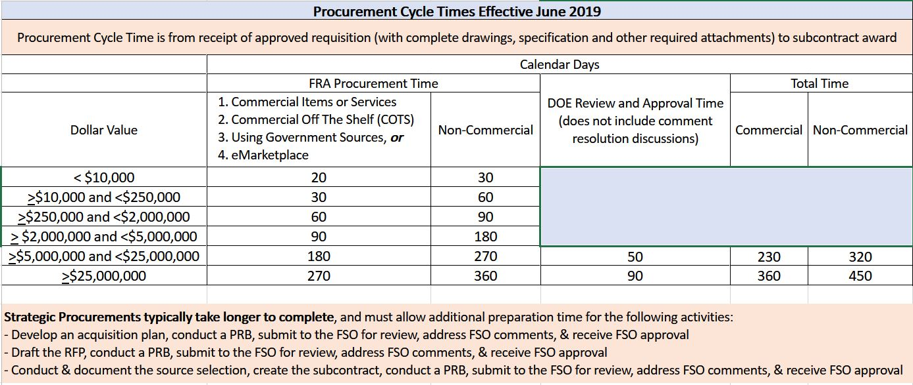
Planning Considerations
For any given upgrade, the following items need to be considered:
    Task/Project Classification
      AIP (Accelerator Improvement Project)
      413B (DOE Capital Asset Project)
      GPP (General Plant Project)
    Depending on Classification
      Time maybe needed for formalized review and approval.
    Procurement Cycle Times (Guidance given to LBNF)
    Primary work impact area
      Prep work that may need to be done
        Removal of old equipment
        Reworking of general area
        Radiation cool off period
      Can Upgrades be done while we are running
    Secondary impact issues
      Vacuum, power, etc.
    Component delivery
      Long lead time from vendor
      Partial shipments vs single shipment
      Storage Space
    Who will be conducting the work
      Fermi labor, contractors/trades
      Contractor availability

Slide 7
Planning Considerations
For any given upgrade, the following items need to be considered:
    Task/Project Installation Activities
      PIPII
      LBNF-DUNE
      Activities range from:
      Fabrications
      Pre-Installation certifications/testing
      Installation
      Post-installation testing and commissioning
    Type and Quantity of Labor needed to Support Installation (Example)
      We currently have 5 mechanical crews to support ~ 16 miles of Accelerators/Beamlines
        Typical crew composition
          1 Crew leader
          3-4 Support technicians
      We have the same protentional resource issue with all our support departments.
    Task Managers/Construction Coordinators
      Accelerator Directorate has a total of 15 individuals (some with multipole qualifications)
        General construction (5)
        Rigging/millwright (7)
        Electrical (3)
        Mech/piping/HVAC (10)
Projects are be counting on the same experts.
Work Planning and Control
  Changes being made need to be incorporated into our work processes.
  New safety guidelines
    Material handling
    Training class

Slide 8
Accelerator Improvement Projects (AIPs)
Up to $20M, but more than $5M requires DOE to notify Congress
Must cover a complete deliverable
All funds must be received the first year
  If it is a long project, it ties up money that won’t be spent that year
Funds do not cover conceptual design – AIP starts when ready to “baseline”
Baseline (budget, milestones) is documented in a project plan
Follow project rules, tailored to the size and risk level
  For example: change control, basis of estimate forms, resource-loaded schedule, earned value management, quarterly reports to DOE
  Not constrained by critical decisions (e.g. CD-3) – can start buying/building one component while still finishing design on others
Good rule of thumb is 30% contingency if no major risks
Don’t forget project management costs (project manager and project controls specialist) and lab overheads (~7.5% on M&S, fully-loaded labor costs ~$300k/FTE)

Slide 9
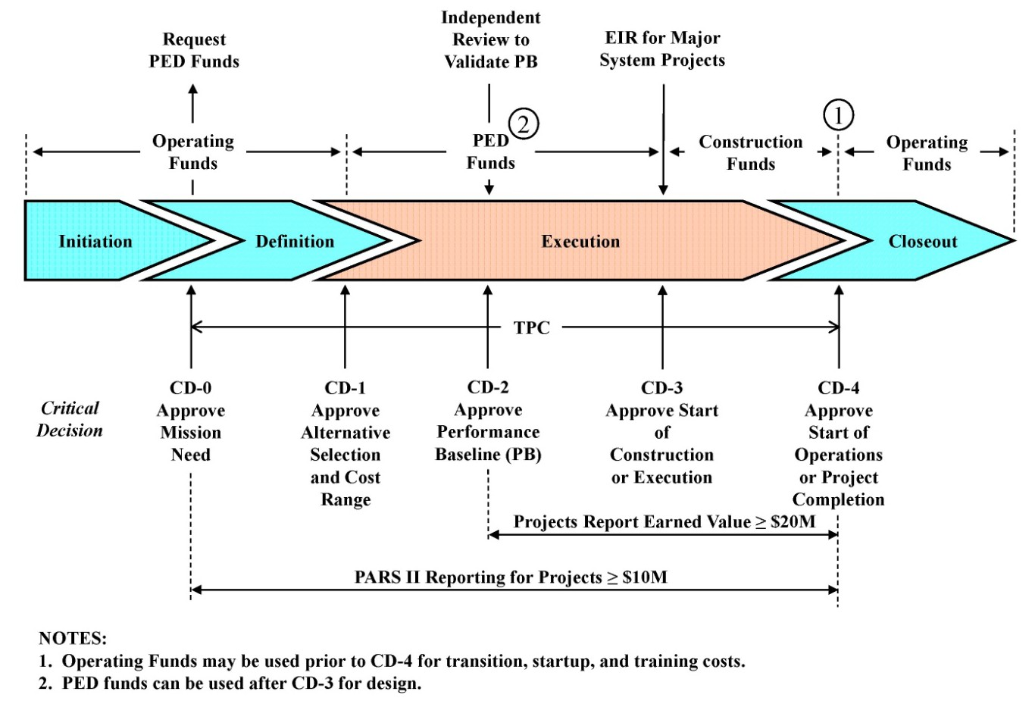
413B
All DOE Capital Asset projects greater than $50M are required to be managed under the DOE 413.b Program and Project Management for the Acquisition of Capital Assets

Slide 10
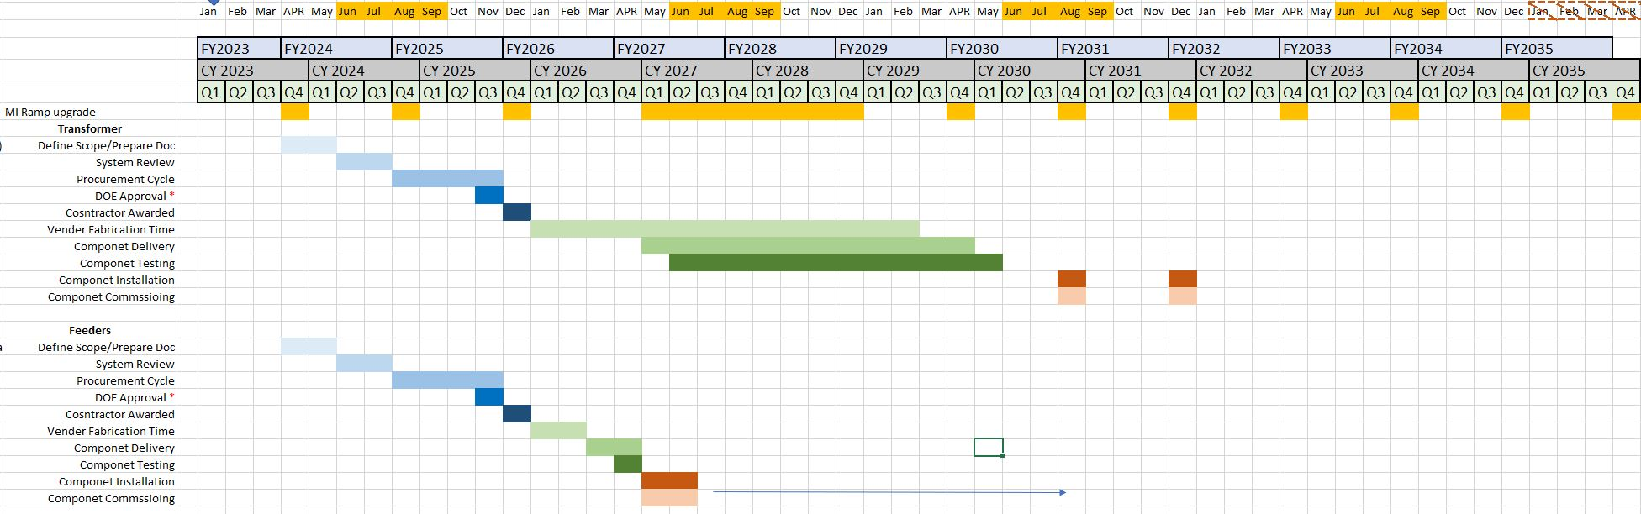
Example of MI Pulse Power and Transformer Replacement
PIPII and LBNF
Assumptions: (AIP Funding)
Shutdown are kept fixed
Scope: (2-3 weeks per transformer)
  One for one transformer and feeder replacement.
  Taking partial delivery of installation components.
  One for one replacement.
Potential time slot that could be taken advantage of…
Currently scheduled shutdowns

Slide 11
Summary Considerations
                Planning Is Critical
  Determine which funding option task fits in (AIP, 413b, GPP, etc.)
    Review process associated by funding type
    Procurement process cycle
    Vendor fabrication and delivery profiles
    Testing
  Interplay of tasks
    Interface between project installation activities (LBNF/PIPII)
    Normal shutdown maintenance activities (reaching the limit of support)
    Resources need to complete the task
      Fermi Labor
      Trades
  Beam based studies (both pre/post installation)
    Impact to HEP
    Turn-on and commissioning
      Shielding Assessment Document (SAD), run conditions, commissioning task that will impact HEP
Moving forward what needs to be determined:
  Sequencing of task/upgrades
    If possible, we want to make incremental gain.
    Understanding the relationship between tasks.
    Priority & Readiness of tasks
  Understanding our labor resources availability.
    Fermilab
    Trades

Slide 12
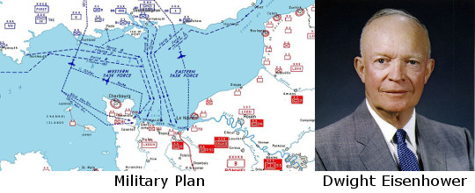
Plans are worthless, but
planning is essential.
Thank you

Slide 13
PIP-II and LBNF accelerator milestones

Slide 14
Accelerator ramp-up schedule
 | FY29 |  |  |  | FY30 |  |  |  | FY31 |  |  |  | FY32 |  |  |  | FY33 |  |  |  | FY34
 | 1 | 2 | 3 | 4 | 1 | 2 | 3 | 4 | 1 | 2 | 3 | 4 | 1 | 2 | 3 | 4 | 1 | 2 | 3 | 4 | 1 | 2 | 3 | 4
startup and commission beam in Booster
establish beam to BNB and work on increasing Booster intensity
startup MI and commission beam in MI/RR
beam to Mu2e, increasing to 4E12 per Booster batch, 2 batches per 1.2s
beam to BNB, increasing to 6.25E12 per Booster batch (as beam dump if no user) |  |  |  |  |  |  |  |  |  |  |  |  | if requested |  |  |  | if requested
commission slip stacking with limited pulses to dump
establish beam to LBNF
beam to LBNF at 700 kW increase power to 900 kW
beam to LBNF increasing power to 1.2 MW
Current Summer Shutdown

Slide 15
About Me – Relevant Experience
Role
  AD Shutdown Manager
    May 2011 - Present
  LBNF Installation Coordinator
    September 2019 – Present
Relevant Experience
  Run Coordinator
    August 2007 - October 2011
  Recycler Ring Deputy Department Head
    June 2005 - August 2007
  MI/RR Department
    October 1997 - June 2005
  Operations Department
    May 1990 - October 1997
Senior Engineering Physics
B.S. Physics
Elmhurst University
1989

