Slide 1
Fermilab Accelerator Capabilities Enhancement Workshop Conclusion and Outlook
A. Valishev
31 January 2023

Slide 2
Opening and Disclaimer
The proposal to accelerate beam delivery to LBNF/DUNE via the MI cycle time reduction is promising and feasible
This brief talk ia preliminary list of findings and action items. Please note where I did not capture the messages correctly and provide your comments/feedback.
We expect to produce a workshop summary, as communicated in the goals, to begin formulating a staged plan that will include
  Key elements of the program
  Timeline
  Cost ranges
  Risks and mitigation plans

Slide 3
MI beam power in numbers
 |  | PIP-II Booster Intensity
Scenario | Present | PIP-II | A | B
MI 120 GeV ramp rate | 1.333 | 1.2 | 0.9 | 0.7
Booster I | 4.5 | 6.5 | 6.5 | 6.5
Booster ramp rate | 15 | 20 | 20 | 20
Number of batches | 12 | 12 | 12 | 12
MI power | 0.865 | 1.25 | 1.666 | 2.142
cycles for 8 GeV | 6 | 12 | 6 | 2
Available 8 GeV power | 29 | 83 | 56 | 24

Slide 4
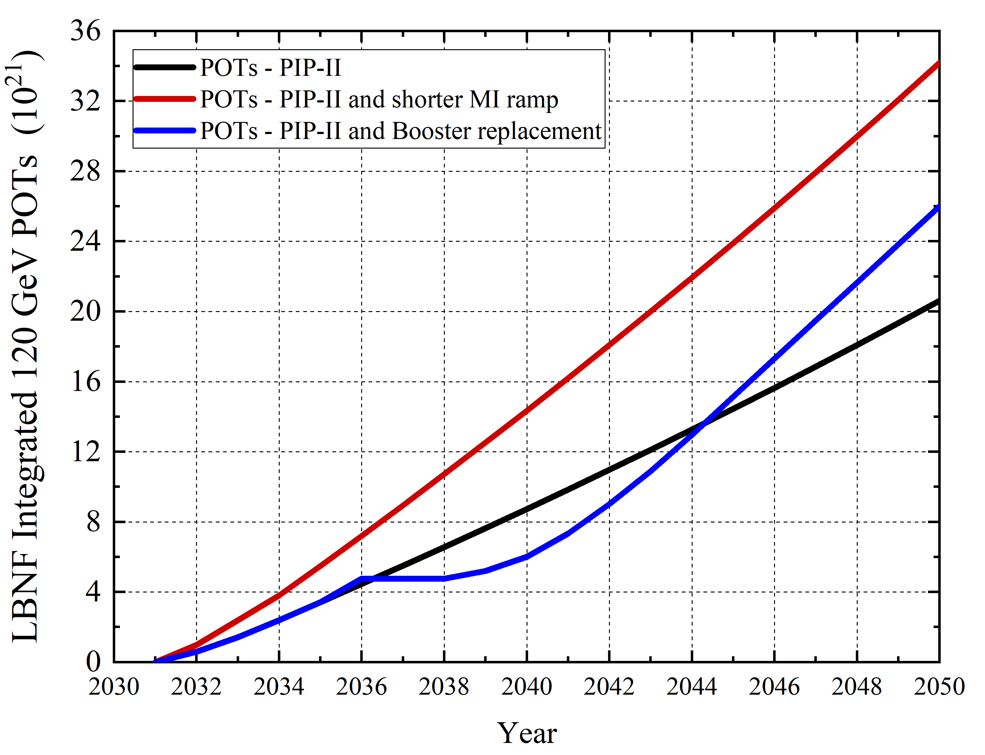
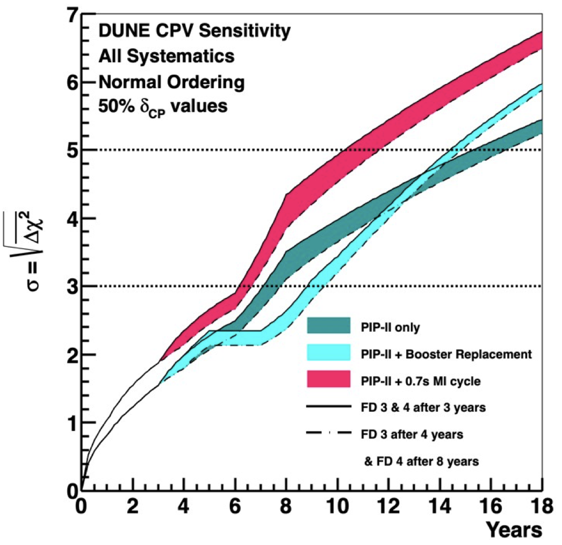
LBNF beam delivery scenarios and Physics
Shorter cycle time also
good for reconstruction
All curves assume 57% overall ops efficiency

Slide 5
Path to higher number of neutrinos
The number of produced neutrinos will be determined by
  Maximum proton flux produced by the accelerator
  Overall efficiency of operations
  Ability of target station to convert protons to neutrinos

Slide 6
Booster in the PIP-II era
Upgrades to enable operation with PIP-II parameters are being implemented
Accelerator Complex Studies Task Force has been working to identify vulnerabilities in the complex, validate upgrades and modernization for sustained operation
  Upgrade of all RF cavities to wide-bore design
  Modernization of systems (BLM, BPM, LCW)
  Improve understanding of transition crossing with high-intensity beam, e-cloud
  The present plan has a lengthy commissioning period to reach PIP-II specs in operation. Painting injection can be lossy (J-PARC). Proposed strategy to accelerate commissioning and improve operational efficiency by implementing PAR (*)
    Stripping injection moved off Booster tunnel, better loss control
    Improved reliability of operations
    Potential for increased injection energy
    Initial design considerations completed. Next step – timeline compatible with the overall plan

Slide 7
Main Injector is becoming the center piece of any scenario
Machine designed/built in 1990-s with 10-year life time in mind.
The reliability of MI and cycle time reduction are tightly coupled
  Must modernize infrastructure to run reliably
    Site power (KRS, feeders)
    MI power (transformers, supplies and related systems)
    Cooling
    Quadrupole magnets
    LLRF
    Controls, ....
  These upgrades constitute most complexity and cost for the entire plan, O($100M)

Slide 8
Main Injector for >1.2MW
Loss control and shielding are specific to running at high power >1.5MW
  May require addition of shielding
RF system upgrade is necessary – adding 17 RF stations. (coupled to modernization: running Main Ring RF cavities into 2030-s!)
  Involves civil construction for additional RF gallery, penetrations, anode supplies, and transformers
Feedback system

Slide 9
LBNF Primary Beamline
Beamline was designed for 2.4MW
Relatively straightforward upgrade to enable pulsing at 0.65 s
However, may involve civil construction or changes to the LBNF building design

Slide 10
Staged Targetry Beam-Power on Target Ramp-up Strategy
1.2
LBNF Beam Construction
1.2 MW
1.X
Stage 1
Design/R&D
Validate
Stage 1 Op ? MW
1.X
Stage 2
Design/R&D
Build/Test
Validate
Stage 2 Op ? MW
2.4+
Stage 3
Design/R&D
Build/Test/LSD?
Validate
Stage 3 Op ? MW
Stage 1 – Push current designs (1.2 MW) to validated limitations
Stage 2 – Design and build 2nd generation components with modifications to existing designs to raise limits while maintaining reasonable useful Nu flux/POT
Stage 3 – Design and build fully optimized next generation systems to take full advantage of maximum POT from accelerator complex (may not be needed)
For each stage, plan for needed activities and R&D, identify external dependencies, make estimates given listed assumptions, and predict approximate maximum Beam-power goals/ranges for each stage.

Slide 11
Horn R&D Estimates
Horn | Task | Labor (0.3 FTE) | Duration
A | Option Zero Mars EDEP | 1 scientist | 2 months
 | FEA Conductors Stripline thermal + structural Spider supports Water tank Hangers | 2 engineers | 4-6 months
B | Option Zero Mars EDEP | 1 scientist | 2 months
 | FEA Horn B conductors Stripline thermal+ structural Stripline CFD Water tank Hangers Crosshairs | 2 engineers | 4-6 months
C | Option Zero Mars EDEP | 1 scientist | 2 months
 | FEA Horn C conductors | 2 engineers | 2 months
Implications of ACE 2+MW operation
  Higher thermal load from beam – affects inner conductor due to higher heat and thermal stress
  Increased pulse rate – affects stripline due to fatigue
Notes:
Engineers: technical manager + FEA engineer

Slide 12
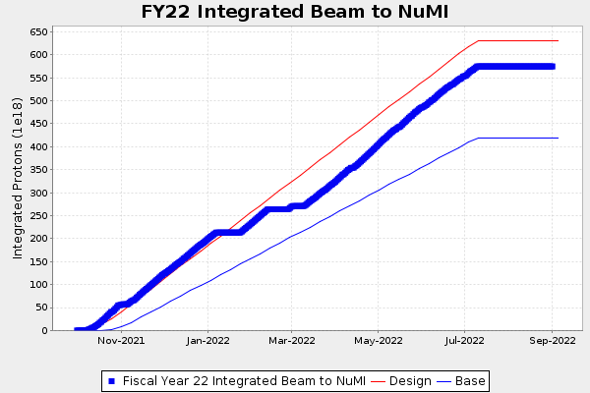
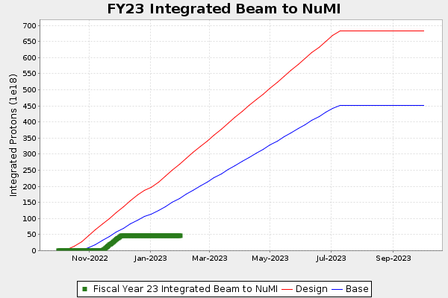
Operation efficiency
Key factors for beam delivery to experiments
High-power operation.
  Good tuning, low losses.
  FY22 <P>=76% of P_{max}
High uptime during running periods.
  Achieved by through reliability and the ability to rapidly repair of equipment that breaks.
  FY22 uptime 69% of scheduled
Maximize the length of the running periods each year.
  Minimum duration of shutdowns.
  FY22 scheduled 77% of CY
Overall FY22 efficiency 41%, PIP-II goal 57%
To maximize physics, most productive approach
  Invest in reliability, availability and stability over max power
  Reduce shutdown duration, improve work planning control

Slide 13
PIP-II and LBNF accelerator milestones – recent revision

Slide 14
Conclusions
The proposal to accelerate beam delivery to LBNF/DUNE via the MI cycle time reduction is promising and feasible
  The ACE study did not identify showstoppers
It is the right time to launch a campaign of upgrades, similar to PIP, to modernize the complex and enable more efficient beam delivery to the upcoming HEP program
  The plan is open to gradual implementation in many aspects (e.g. Staged Targetry ramp-up)
What is next
  Summarize key conclusions of the workshop (February)
  Identify the team, formulate the plan and begin engineering/implementation (July)

