Slide 1
LArPix ASICs and Hardware DB
Leon Mualem
Caltech

Slide 2
LArPix ASIC testing results (for DB/analysis)
Tested nearly 20,000 ASICs of 3 types so far
Each with unique serial number
Multiple channels, 32 or 64 per device
Several statistics measured in each test for each device
Multiple test types
Summary
networking/config
periodic sampling/noise
Multiple test sessions possible
Different pass/fail criteria depending on date/test conditions

Slide 3
LArPix ASIC DB Items
Defined several parts (Type IDs) for initial testing in spreadsheet
ASIC v1
ASIC v2
ASIC v2b
Tile board 1
Tile board 2
Created Type ID in database for all 5 (Thanks Vladimir and Jim)

Slide 4
LArPix ASIC DB entry status
Following Hajime’s tutorial docs completed the specification
Created specific parts (EID) with serial numbers (v1 ASIC)
Via DUNE Hardware Database web interface
Via REST API
curl from command line python/bash scripts
Created test types (HWDB web interface) and entered multiple sets of test data (REST API scripts)
summary
net
bps

Slide 5
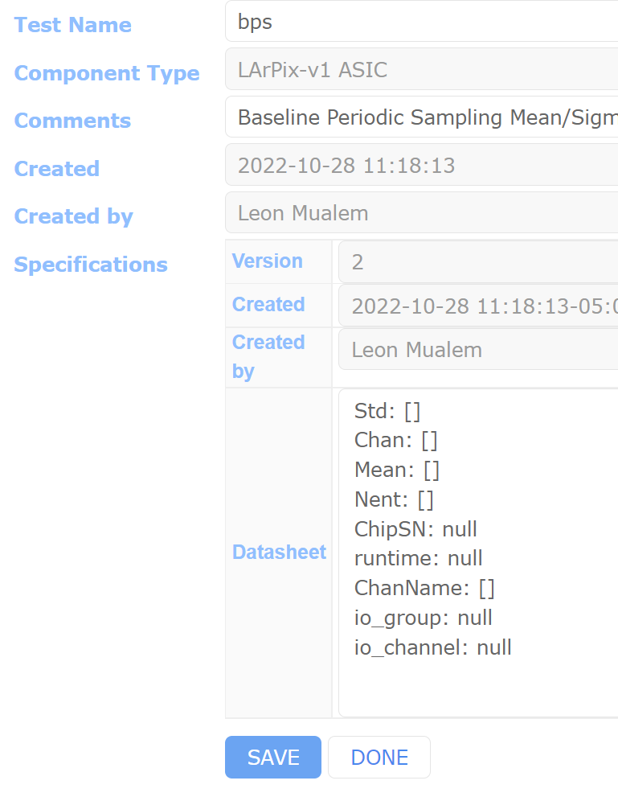
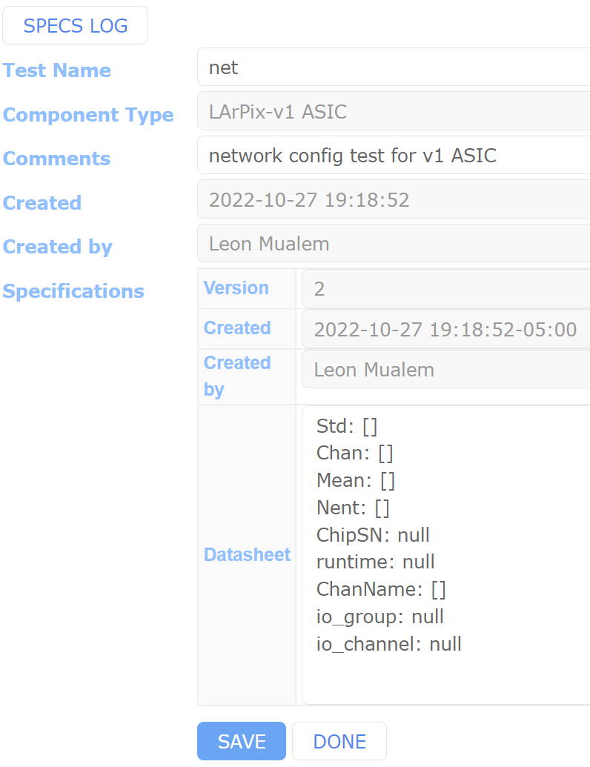
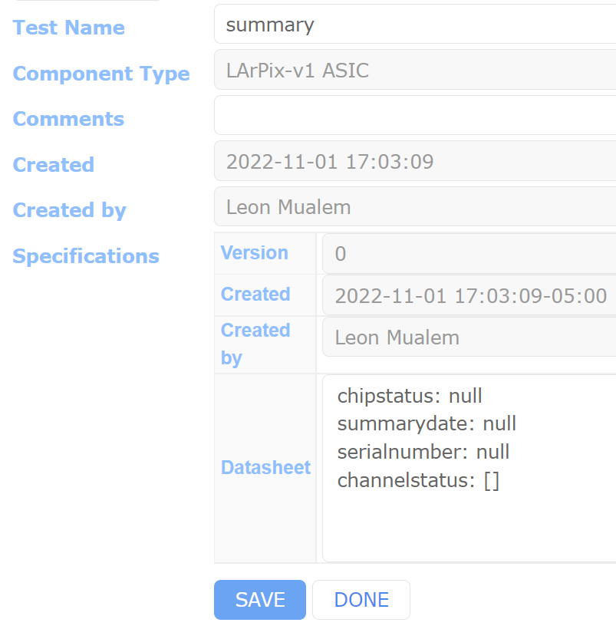
LArPix ASIC Test Types

Slide 6
LArPix ASIC DB usage
Found that each request takes about 0.3s
Create new EID
Read test data
Parallel requests can speed retrieval a lot
Able to run about 200 requests in parallel
Parallel part (EID) creation leads to conflicts in the DB
{"data":["(psycopg2.errors.UniqueViolation) duplicate key value violates unique constraint \"components_external_id_idx\"","DETAIL: Key (part_id)=(D10100100001-00164) already exists.",""],"status":"ERROR"}

Slide 7
LArPix ASIC DB usage
Retrieval of test data for a large number of EID will be very time consuming
Without parallelizing requests, 10,000 items would take about 50 minutes
A full complement of Near Detector ASICs (>300,000 items) would take about 1 day

Slide 8
Some issues
Retrieving information about many items (N) requires at least N curl calls
This is very time consuming (and inefficient)
Can there be a wildcard, or more direct postgres access?
HWDB interface has one. Presumably REST API must too.
Creating many EIDs in parallel can return the same EID for multiple transactions
Can this be made safer/more efficient?
EID do not require distinct contents
I can make many EIDs with the same serial number
Can the database/application throw an error instead?
Feedback from the REST API is opaque – Just get “ERROR” or “Bad Request”
How to find EID of a part with a given serial number?
This is a common issue I see when adding later tests to the database. At the tester I have a serial number, but not the EID unless I cache it when created (redundant data)
I found issue with reading json with -999. was different from -999.0, maybe particular to parser?

Slide 9
Some other questions
How should we handle specifications for tests?
Testing pass/fail limits should be documented
Ideally in the database that holds the test results
<type id>/test/criteria/
How does different versions of test specifications work?
Should there be protection against duplicating data?
Rogue script could put millions of redundant data in the DB

Slide 10
Summary
I’m able to define tests and enter data for part QC testing
Works with hwdb interface (web) and REST API (curl calls)
I see performance issues with using the database for a large number of parts
Calls for test data for O(10^5) parts could take hours
Need to understand how to record/use specifications (DUNE question?)
Would love to use the DB to correlate test results (test station vs. tile board)
This seems like it will be difficult to efficiently perform with thousands of items
Maybe I’m missing some capabilities or misinterpreting

