Slide 1
Impressions from the High Order Mode Workshop,
Daresbury, 25-27 June 2012
V. Yakovlev
PX meeting, July 13, 2012

Slide 2
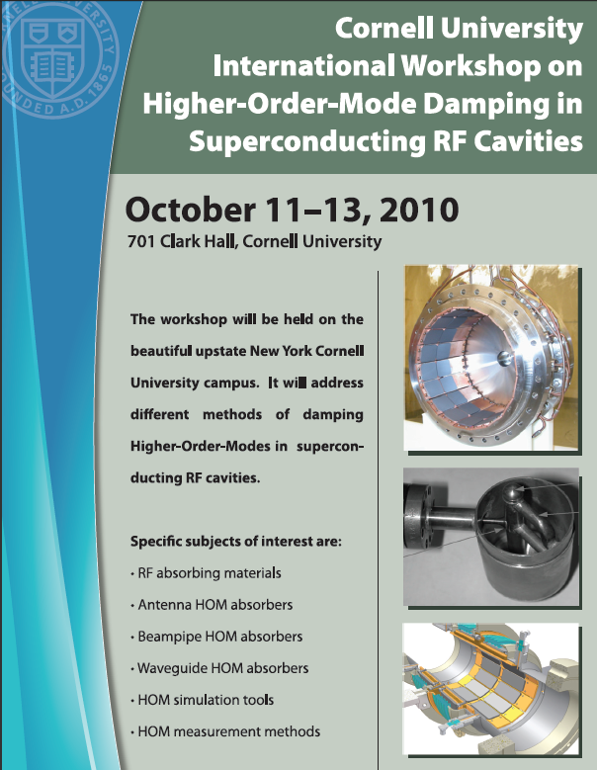
The first HOM
Workshop
Cornell, 2010
(M.Liepe)

Slide 3
The second HOM
Workshop
Daresbury, 2012
(R. Jones)

Slide 4
Topics:
HOM BPM diagnostics and measurement methods
HOM couplers and influence of FP couplers
Novel HOM suppression in TEM and other cavity shapes
Special considerations in third harmonic, deflecting and crab cavities
RF absorbing materials
Antenna HOM absorbers
Beam-pipe HOM absorbers
Waveguide HOM absorbers
HOM simulation tools and models
Working Groups:
HOM Damping Requirements on a Project Basis (J. Sekutowicz,
V.P. Yakovlev and N.A. Solyak )
B . HOM-based Diagnostics (N. Baboi, C. Welsch and R.M. Jones)
RF Simulations and Beam Dynamics (M. Liepe, O. Napoly
and S. Molloy)
D. HOM Damping Couplers and Loads (J. Delayen and G. Burt)
E. Low-level RF, Controls and System Integration (T. Power)

Slide 5
Attendees:
• Rob Ainsworth Royal Holloway, University of London
• Rob Appleby, Uniman/CI
• Nicoleta Baboi, DESY
• David Brett, University of Manchester/Cockcroft
• Rachael Buckley, STFC/ASTeC
• Stephen Buckley, STFC/ASTeC
• Graeme Burt, Lancaster University
• John Byrd, LBNL
• Lee Carver, University of Manchester
• Swapan Chattopadhyay, Cockcroft Institute
• Yahia Chergui, engineering, electricity and electronics
• John Corlett, LBNL
• Kathrin Cottel, DESY
• Tomasz Cybulski, Cockcroft Institute
• Jean Delayen, Old Dominion University
• Daniel Doherty, Lancaster University
• Nathan Eddy, Fermilab
• Thomas Flisgen, University of Rostock
• Tomasz Galek, Universität Rostock
• Philippe Goudket, ASTeC/STFC
• Pengda Gu, Diamond Light Source
• Harald Hahn, BNL
• Ben Hall, Lancaster University
• Lee Hammons, Brookhaven National Laboratory
• Roger Jones, University of Manchester/Cockcroft Inst.
• Alexander Kalinin, ASTeC Daresbury Laboratory STFC
• Philipp Kolb, TRIUMF
• Taro Konomi, Institute for Molecular Science
• Frank Krawczyk, Los Alamos National Laboratory
• Vladimir Kudrin, ITE, Darmstadt
• Matthias Liepe, Cornell University
• Chris Lingwood, Lancaster University
• Cong Liu, TEMF TU Darmstadt
• Peter McIntosh, STFC
• Fan-bo Meng, Institute of High Energy Physics
• Boris Militsyn, STFC ASTeC
• Stephen Molloy, ESS
• Alireza Nassiri, ANL
• Inna Nesmiyan, University of Manchester/CI
• Axel Neumann, Helmholtz Zentrum Berlin
• Ruediger Onken, DESY
• Shivaji Pande, Diamond Light Source Ltd
• Shrikant Pattalwar, ASTeC
• Tom Powers, Jefferson Lab
• Massimiliano Putignano, University of Liverpool
• Bernard Riemann, Dortmund University
• Jacek Sekutowicz, DESY
• Ian Shinton
• Jonathan Smith, Tech-X UK Ltd
• Susan Smith, STFC
• Nicholas Valles, Cornell University
• Ursula van Rienen, Rostock University
• Ken Watanabe, KEK
• Carsten Welsch, Cockcroft
• Alan Wheelhouse, ASTeC/STFC
• Guoxing Xia, University of Manchester
• Vyacheslav Yakovlev, Fermilab
• Pei Zhang, The University of Manchester/ DESY

Slide 6
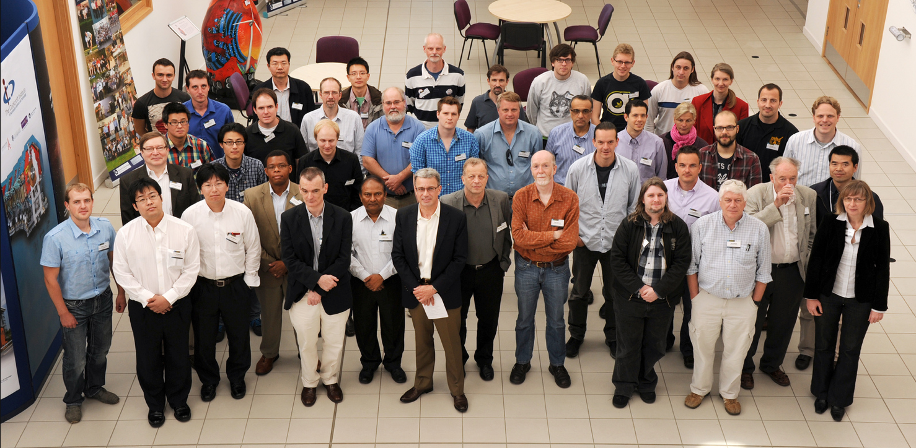
http://www.cockcroft.ac.uk/events/HOMSC12/programme.html

Slide 7
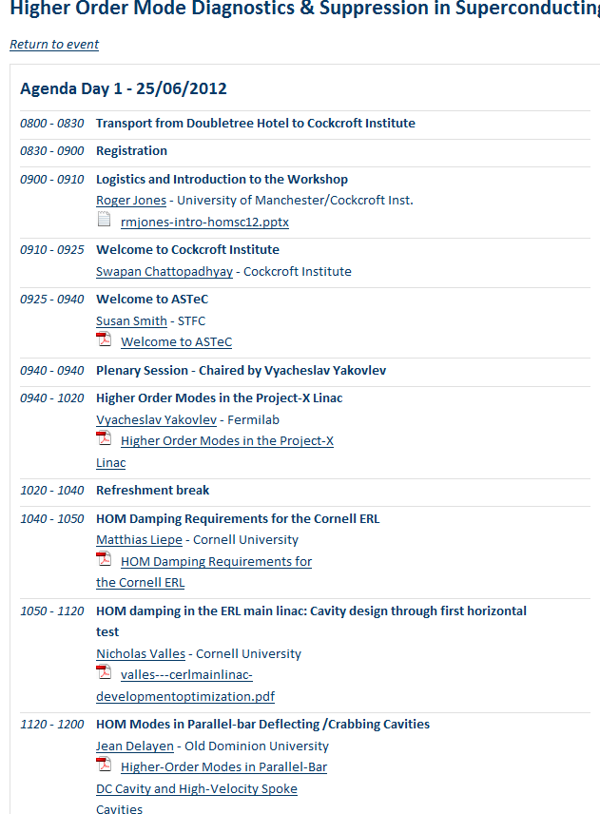

Slide 8
Working group A: 8 presentations.
A. Neumann | HZB | Cavity and HOM design for the BERLinPro ERL project
Ken Wanatabe | KEK | Development of the HOM coupler and the rf feedthrough for cERL injector at KEK
Ali Nassiri | ANL | Status of SiC-Based High-Power Waveguide Dampers R&D for the Short –Pulse X-Ray Project at the Advanced Photon Source
Philippe Kolb | Triumf | HOM considerations for the TRIUMF eLINAC
Lee Hammons | BNL | Development of SRF gun and HOM consideration at BNL
Nicoleta Baboi | DESY | HOM Damping Requirements at the European XFEL
Matthias Liepe | Cornell | HOM damping in the Cornell ERL SRF injector module: HOM measurements and high current beam operation
Rob Ainsworth | RHUL | HOM damping requirements and accelerating structure design for ESS

Slide 9
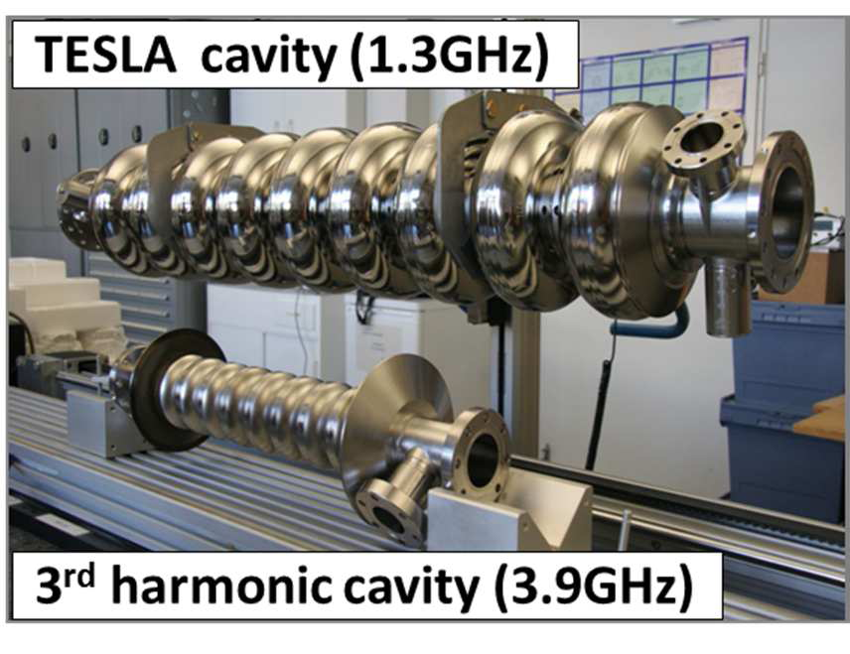
Introduction: TESLA and 3rd Harmonic Cavities
Common features
9 cells/cavity
8 cavities / module
2 HOM couplers in adjacent pipes
TESLA cavities
1.3 GHz
3rd harmonic cavity
3.9 GHz
Purpose: flatten RF field
Scaled down from 1.3 GHz cavity, but pipes larger for better damping
Built at Fermilab
Nicoleta Baboi, DESY

Slide 10
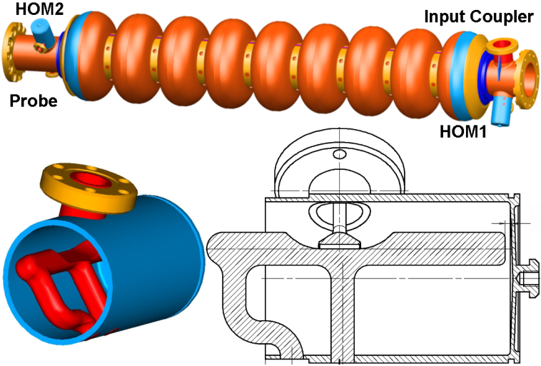
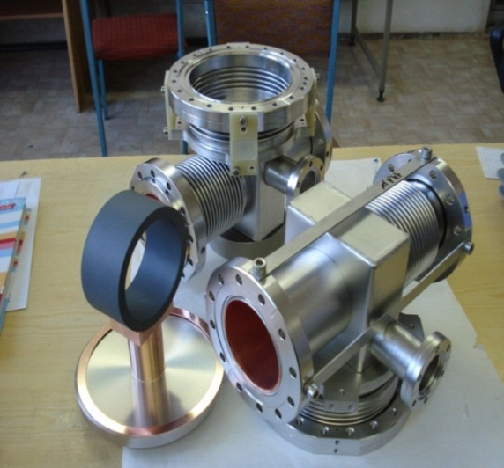
HOM Damping in 1.3 GHz Cavities
trapped &
quasi trapped modes:
~ resonant effects
propagating modes
~ single bunch effects
f /GHz
10⁰
f₀
10¹
10²
10³
HOM couplers
HOM absorbers
J. Sekutowicz
J. Sekutowicz’s talk
J. Sekutowicz et al., IPAC10, Kyoto, p. 4092
N. Mildner et al., SRF 2005, Cornell, p. 593

Slide 11
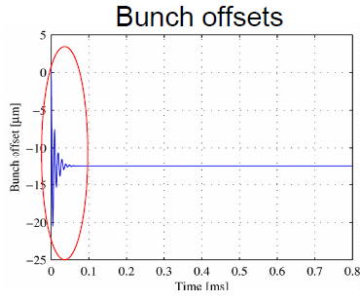
HOM Damping in 1.3 GHz Cavities: Multi-bunch Beam Dynamics (w/o 3.9 GHz Cavities)
Beam
Frequency: 5 MHz
Train length: 800 μs
Charge: 1 nC / bunch
Energy: 20 GeV
(not latest nominal parameters)
Cavities
Considered dipole modes in bands 1, 2, strongest in 3rd band
worse Qs than measured in TTF cavities (typically 10⁵)
Misalignment: 0.5 mm rms
Detuning: 0.1 % rms
Inject beam on-axis
100 linacs were simulated
(average over 100 linacs)
st. dev.
ave.
N. Baboi, LINAC 2004, Lübeck, p. 357

Slide 12
HOM Damping in 1.3 GHz Cavities: HOM Damping Requirements in the 1.3 GHz Cavities
From HOM Workshop, Cornell, 2010 (J. Sekutowicz)
Average HOM Power / Cavity:
0.5 W
Worst case HOM peak power per cavity in case of resonant mode excitation:
2 kW
90% of HOM power:
< 100 GHz
Required HOM damping for strongest modes
Monopole modes: Q < 10⁵
Dipole modes: Q < 10⁵

Slide 13
Summary
Modes in the 1.3 GHz cavities
High R/Q modes are damped to Q ≈ 10⁵ or better
Beam dynamics (w/o 3.9 GHz cavities) show small multi-bunch emittance growth
HOMs in 3.9 GHz cavities
Even better damped than in 1.3 GHz cavities
No multi-bunch problems observed (yet) at FLASH
Every second cavity is rotated → compensate coupler kicks

Slide 14
Same order Modes and Higher order modes for ESS linac – Rob Ainsworth

Slide 17
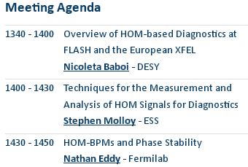
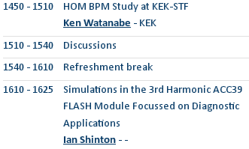
WGs B&E

Slide 18
WG D: HOM Couplers and Loads
Taro Konomi (KEK)
M. Liepe, N. Valles, Cornell

Slide 20
Introduction and Motivation: b. European XFEL
The 27000 high quality bunches/s will generate high average brilliance photon beam at
very short wavelength:
1.6·10²⁵ photons/0.1%bw/s/mm²/mrad² @ 1 Å.
Two addition features could make the XFEL photon beam even more attractive.
The first is an increased, to several µ-seconds, intra pulse distance between bunches,
which will allow for less technically demanding detectors.
The second is a few kHz photon burst repetition rate, which will allow to use less expensive optical lasers (few kHz rep.-rate) for pump-and-probe experiments.
With the present nominal beam these features will lead to substantially reduced number of bunches/s and significantly lower average brilliance.

Slide 21
HOMSC-2013 at Fermilab!

