Slide 1
Update on PS studes
A. Bross
Scintillator R&D Meeting
December 9th, 2022

Slide 2
Search for Optical-quality PS
Given the ongoing issues with the polymer from American Styrenics, I began searching for new suppliers.
None in the US
Found the following companies produce a product that might be appropriate
  Resirene (Mexico)
    Still trying to get samples. Not clear what they are
  Taita (Taiwan)
    Have sample, made samples
  Trinseo (China)
    Will not supply to US. Partnership with AmSty

Slide 3
Analysis of old material: AmSty 665
Sample A – 2008 - Batch ID: WH19048L12
Sample B – 2013 - Batch ID: 0724809600
Sample C – 2018 - Batch ID: G1014HR101
Sample D – 2021 - Batch ID: K0811HR101
Made samples 5 cm long and 3mm long (disks) for measurement in our Cary spectrophotometer.
  Transmission of the 5 cm piece relative to the 3 mm piece as a fn of wavelength
Took the 2013 sample as the reference and then did an A-B of the measurements

Slide 4
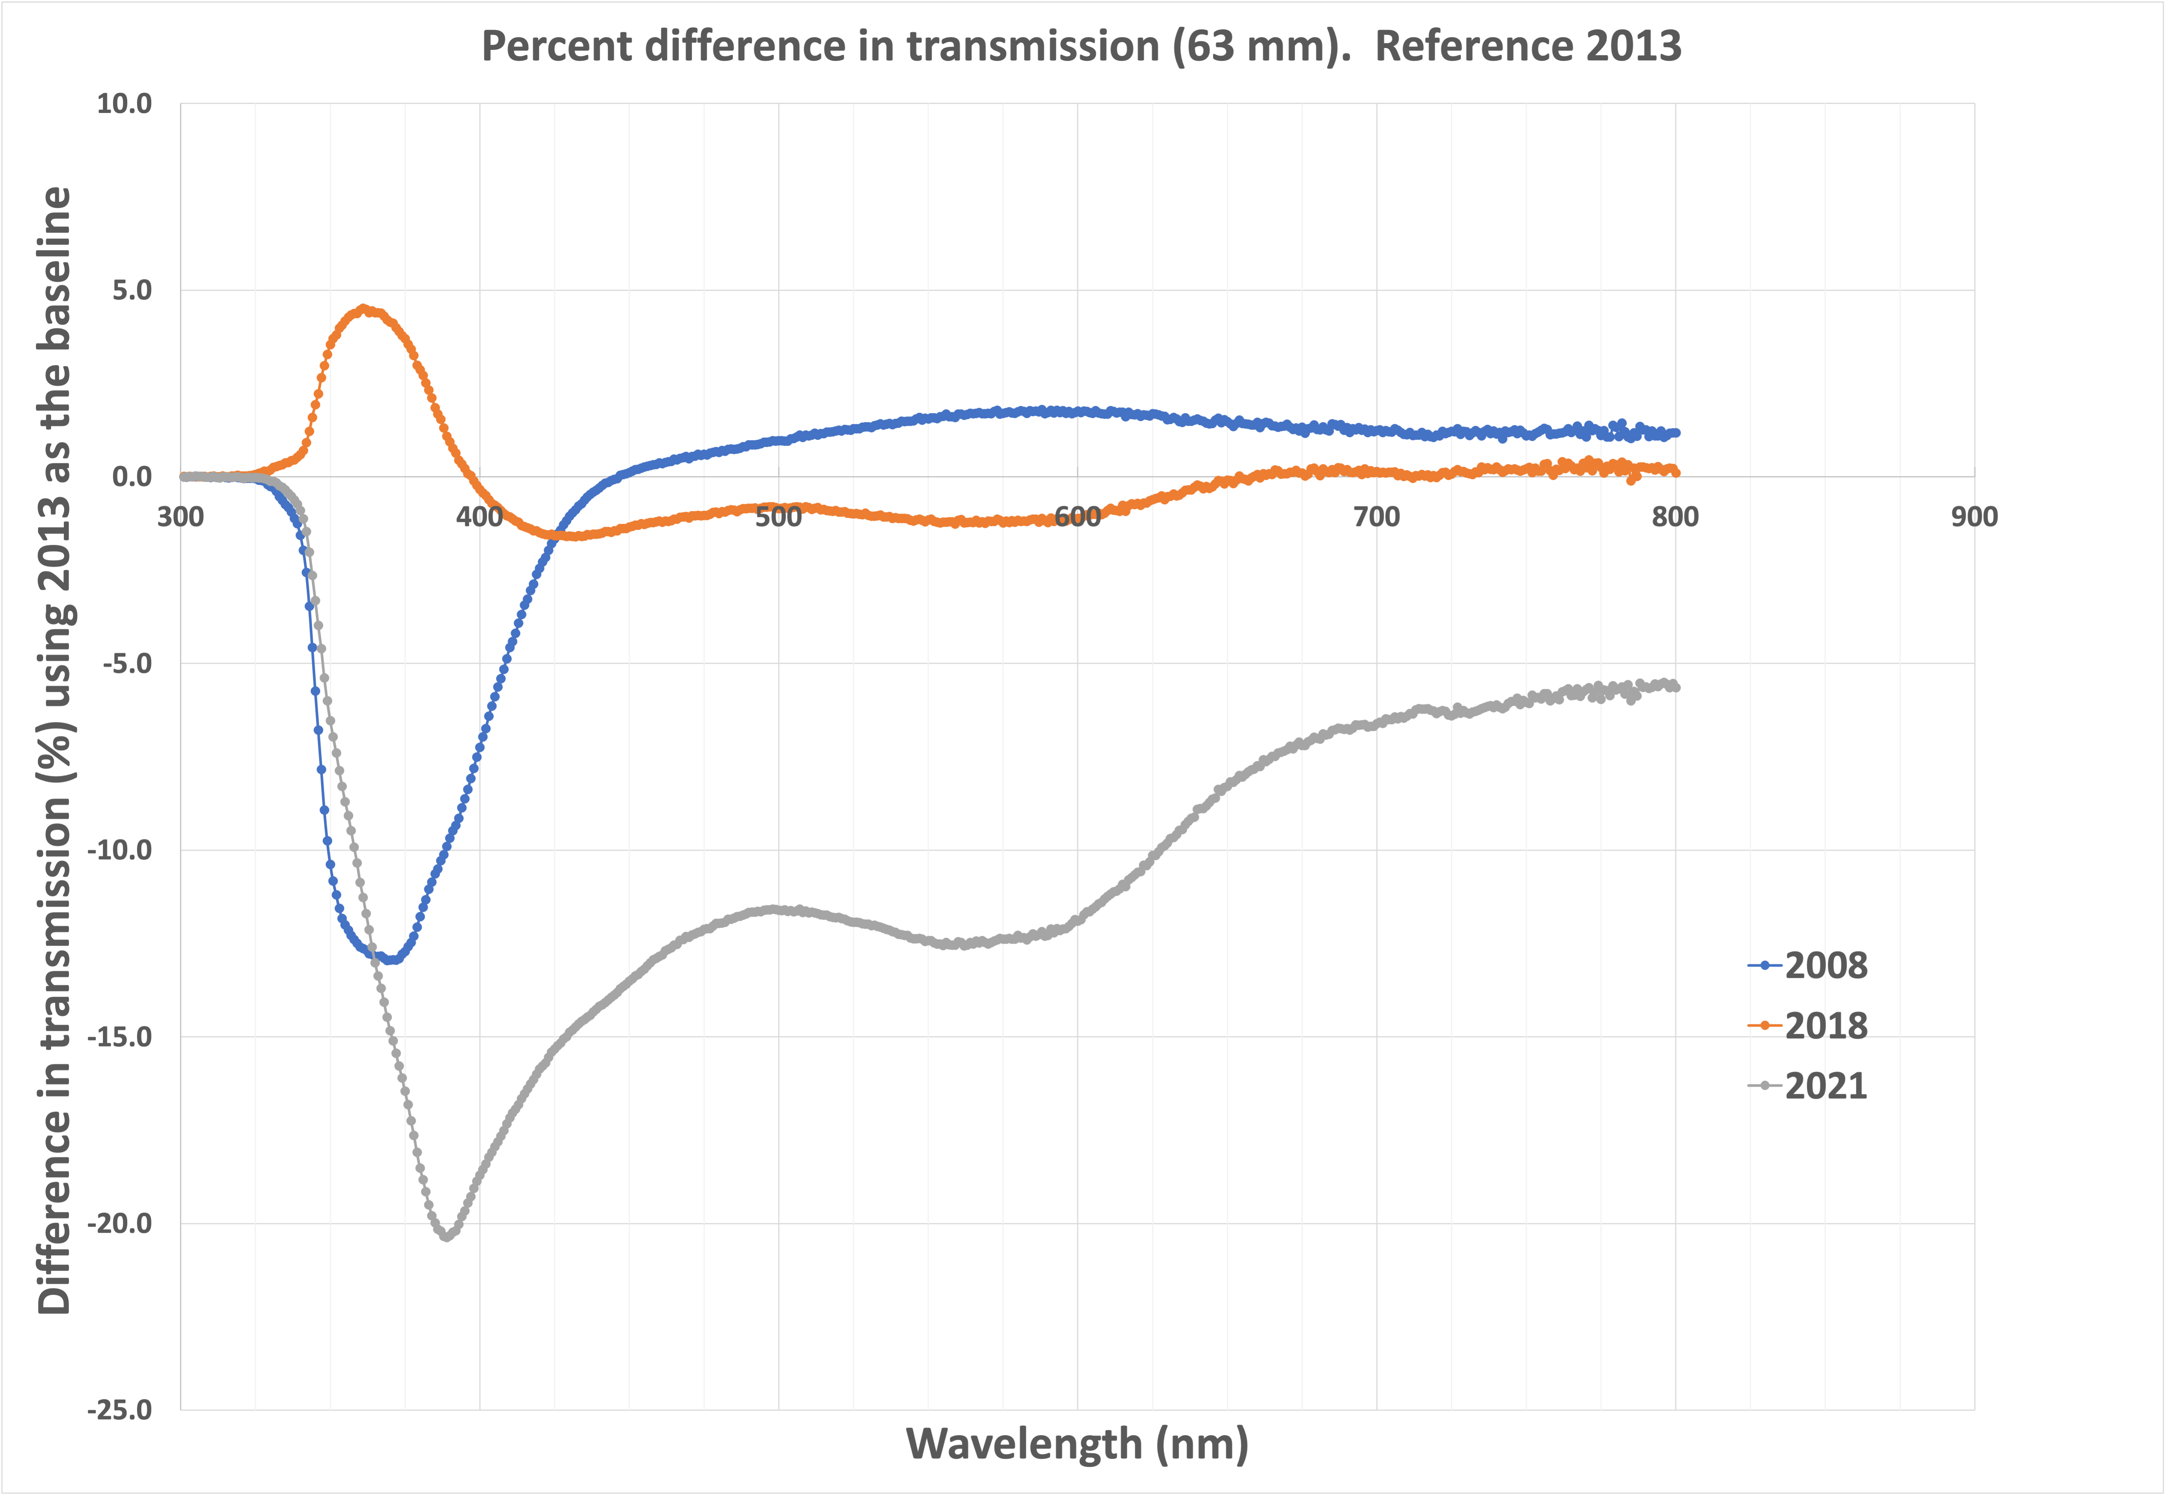
Results

Slide 5
Discussion
We see very large differences.
  The band 400-450 nm very important (POPOP fluorescence)
We sent a report to AmSty with these data and the samples plus PS pellets from each lot.
  They claimed they see NO difference and referred us to the distributor. DEAD END
How important?
  Ralf’s light propagation MC indicates that the mean # of bounces before a photon is collected by the WLS fiber is ~10. They means the pathlength is 𝒪 40 cm.
    The data on the previous plot are only for 5 cm!
mu2e did not use the 2021 material

Slide 6
Moving on
Preparing new samples of all material we have in hand
  The Taita material looks very good
Prepared twice-distilled monomer polymerized PS samples to use a reference
Will take more data
We will need the light collection MC to inform
  Available students?

