Slide 1
Selecting Guide Stars for the Dark Energy Survey
Research project during TRAC summer internship
By: Elba M. Sepúlveda
Mentor: Eric Neilsen

Slide 2
Table of contents
What is DES project?
DECam
Purpose of the study
Problem
Method
Color index
Analysis of color index
Results
Conclusion

Slide 3
What is Dark Energy Survey Project
The Dark Energy Survey (DES) is designed to probe the origin of the accelerating universe and help uncover the nature of dark energy by measuring the 14-billion-year history of cosmic expansion with high precision.
Notes:
The Dark Energy Survey (DES) is a project funded by Department of Energy (DOE), NSF and other agencies according to Fermilab (2010). Dark Energy Survey (2010) is designed to probe the origin of the accelerating universe and help uncover the nature of dark energy by measuring the 14-billion-year history of cosmic expansion with high precision. To achieve this goal more than 120 scientist of all over the world, students and postdocs are collaborating. This effort requires the construction of a unique astronomical instrument composed of an array of digital chips called charge-coupled devices (CCDs).

Slide 4
DECam
They completed and tested one of the largest cameras named DECam.
It is a large, 570 Megapixel camera that will hold 74 CCDs.
This was constructed specifically to be sensitive to the red shifted light from distant galaxies and stars.
This will permit to measure the redshift of stars very precisely.
DECam will have the widest field of view of the southern hemisphere in the NOAO ground-based optical/infrared system of imagers.
The field of view is 2.2 degree in diameter, so a large view area of the sky can be imaged in each exposure.
Notes:
CCD Camera
DES (2010) explains that charge-coupled devices (CCDs) are composed of photosensitive chips that convert light into electrons. Each chip is divided into millions of pixels. It works like an ordinary digital camera but with larger resolution. These chips are more sensitive than a conventional digital camera, particularly for red and near-infrared wavelengths. They can record more light for a given exposure time. The electrons generated by the light that hits each pixel, then are converted to a digital value that a computer can store or display. This permits to have a wide sharp image of the sky area recorded in plates and digitally files.

Slide 5
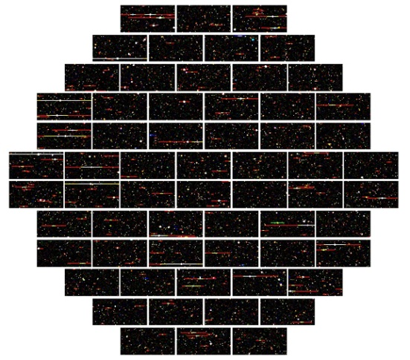
DECam
It is capable of record data from an area of the sky 20 times the size of the moon as seen from earth.
A system of five lenses was required to have a wide view.
The biggest of these lenses is almost 1 meter in diameter.
The camera is is being installed in Cerro Tololo Inter-American Observatory in Chile.
The collection of programs used to operate the camera is called SISPI.
Notes:
In astrophysics, redshift happens when light seen coming from an object that is moving away, is proportionally increased in wavelength, or shifted to the red end of the spectrum. Lang (2011) exposed that the redshift can be explained by Doppler shift or by loss in photon energy increased with distance. In space is caused only by Doppler shift because in vacuum there is no way for photons to lose energy and there is no place for lost energy to go. Appenzeller (2009) explains that when observing distant objects is observing the past of the universe to obtain information on the history and evolution of our world. In astronomy the wavelength change is expressed by the “redshift” z which is defined as:
$$z=\frac{λ_{observed}−λ_{emitted}}{λ_{emitted}}=\frac{a_{observed}}{a_{emitted}}−1$$
where λ_{observed} is the observed wavelength, λ_{emitted} is the emitted wavelength and a_{observed}/a_{emitted} is the ratio of the cosmic scale when observed or emitted.

Slide 6
Purpose of this study
This analysis is required in order to select stars for the guider, a SISPI program that keeps the pointing of the telescope steady during an exposure.
Without this program it will be impossible to run the telescope in order to have good exposures with DECam.

Slide 7
The problem:
The Naval Observatory Merged Astrometric Dataset (NOMAD) catalog is a compilation of stellar data from many sources.
In some areas of the sky, in one filter the brightness reported by NOMAD can be off by many magnitudes.
We can attempt to either correct the problems , or avoid using the filter in which they occur.
Is it possible to calculate useful estimates of stellar magnitudes from NOMAD, despite the problems in the NOMAD data?

Slide 8
Graph of the stars with magnitudes >14
This graph showed that there is a problem with stellar magnitudes in the NOMAD catalog.

Slide 9
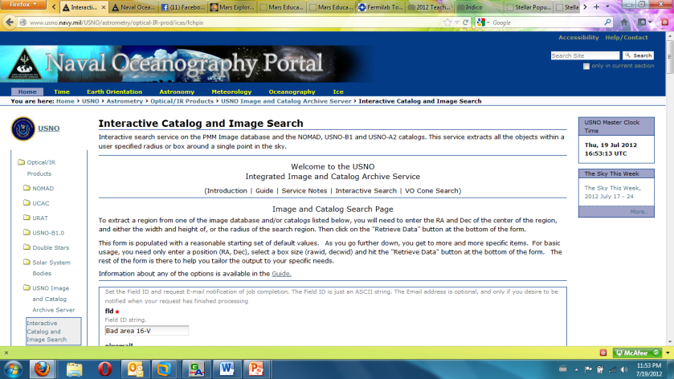
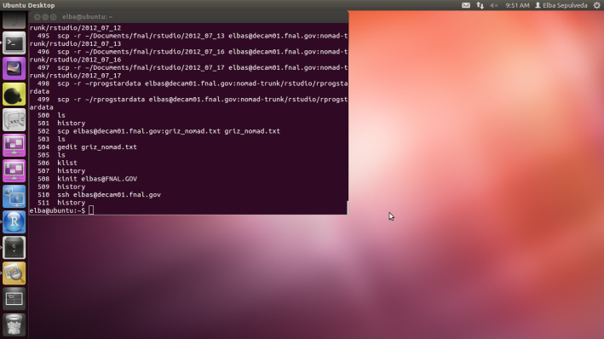
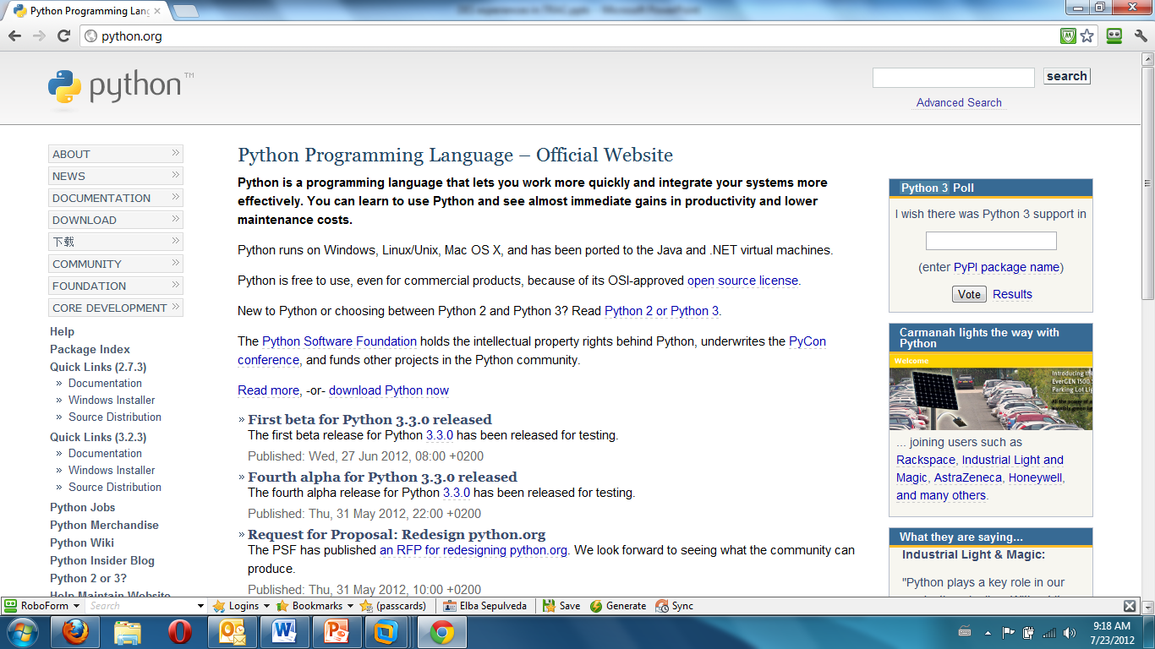
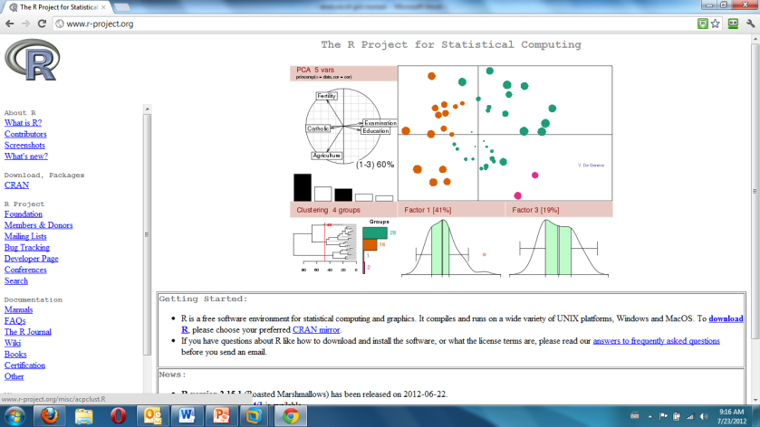
Method
ugriz catalog of Smith, Allam, Tucker et al
Computer assisted database search (CADS).
Analysis of magnitude and color index graphs.

Slide 10
Naval Oceanography Portal (NOP)
Provides:
An interactive catalog made and maintained by the United States Naval Meteorology and Oceanography Command (NMOC).
Important information about the location of the stars in space, meeting needs in the military, scientific, and civilian communities.
Notes:
The Naval Oceanography Portal (NOP) provides an interactive catalog made and maintained by the United States Naval Meteorology and Oceanography Command (NMOC). It provides important information about the location of the stars in space, meeting needs in the military, scientific, and civilian communities. It is located in: http://www.usno.navy.mil but for this research the following interactive portal were used:

Slide 11
Ubuntu Linux
Using terminal commands must be directed in the DECam01 directory.
I used a Python Application Program Interface (API) to extract the needed data from NOMAD catalog.

Slide 12
Python programming
Python is an open source software, object-oriented scripting language that is freeware, portable and powerful. Is supported by the Python online community. Provides the simplicity and ease use of scripting language, along with advanced programming tools.

Slide 13
R
Venables and Smith (2004) indicate that R is an integrated suite of software environment for data manipulation, calculations, and a graphical display. R is available as free software.

Slide 14
Color index
McDonald Observatory (2012) was the first to develop UBVRI filter system in the 1950s and has become standard in astronomy.
Magnitude of a star
m_{a} - m_{b} = -2.5 log( F_{a}/F_{b} )
Fukugita, Ichikawa, Gunn, Doi, Shimasaku and Schneider (1996) explains that the u'g'r'i'z' are the five color bands for calibration of the Sloan Digital Sky Survey Photometric System.
Chromey (2010) explains that the color index is:
$CI=mλ_{shorter}−mλ_{longer}$
Inglis (2004) defines it to measure the difference in the apparent magnitude of a star at the two (2) standard wavelength used as a measure of the star’s color and temperature.
Notes:
Inglis (2004) explains that the color index is the term used by scientists to measure the difference in the apparent magnitude of a star at the two (2) standard wavelength used as a measure of the star’s color and temperature. Chromey (2010) indicates that the equation used by convention is:
$$CI=mλ_{shorter}−mλ_{longer}$$
CI is the color index while m is the magnitude of the star of different wavelength. Commonly is written like B-V

Slide 15
HR diagram
Notes:
According to James (2007) the system of classifying stars by their brightness was developed by ancient scientists based on the physiology of the human eye. Later, modern astronomers defined the magnitudes as the logarithms of the flux or the power of the light received from a star per unit area. This is expressed by the following formula:
m_{a} - m_{b} = -2.5 log( F_{a}/F_{b} )
Where m_{a} and m_{b} are the magnitudes of stars a and b, and F_{a} and F_{b} are the fluxes (power per unit area) from each of these stars. Actually scientists use an instrument called a bolometer to measure the total power per unit area arriving from a star. Using an instrument instead of a naked eye is more precise to measure the star brightness. Also, a magnitude for a given star in red light is very different from a magnitude measured in blue light. The star's photosphere at a high temperature predominately radiates blue light, but at a low temperature, it predominately radiates red light. This effect has lead astronomers to develop systems for expressing a star's magnitude in terms of color filters.

Slide 16
Johnson-Cousins Filter
Band | Range
 | Minimum | Maximum
U | 3200 Å | 4000 Å
B | 4000 Å | 5000 Å
V | 5000 Å | 7000 Å
R | 5500 Å | 8000 Å
I | 7000 Å | 9000 Å
Transmission
Notes:
James (2007) explains that the most common photometry system is the Johnson-Cousins system. This system divides the spectrum into broad bands of ultraviolet (U), blue (B), visible (V), red (R), and infrared (I) light. Johnson and Morgan (1953) indicate and defined the photometry system based on magnitudes and color indices of stars. According to the University of Texas McDonald Observatory (2012), the system Johnson – Cousins was first developed in the 1950s at the site using the 0.9-meter telescope. The UBVRI filter system has become standard in astronomy. These filters correspond to the wavelength stated in the following table:

Slide 17
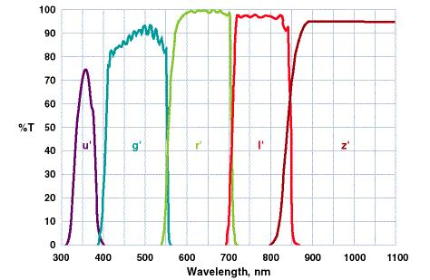
U’g’r’i’z’ filter
Transmission
Filter | Wavelength | Width | Color
u’ | 3500 Å | 600 Å
g’ | 4800 Å | 1400 Å | Blue green
r’ | 6250 Å | 1400 Å | Red
i’ | 7700 Å | 1500 Å
z’ | 9100 Å | 1200 Å
Notes:
Fukugita, Ichikawa, Gunn, Doi, Shimasaku and Schneider (1996) explains that the
u'g'r'i'z' are the transformations for calibration of the Sloan Digital Sky Survey Photometric System. Also they are five color bands that divide the entire range of wavelength from 3000 Å to the sensitivity limit of silicon CCD at 11000 Å. as seen in the following table:

Slide 18
Magnitude graphs: g vs B
Preliminary and final results for 103,547 stars.
Linear behavior of selected stars in NOMAD and the ugriz catalog of Smith, Allam, Tucker et al.
g₀ = 1.2067787 Δg/ΔB=0.915597
STE g₀ = 0.0116 STE Δg/ΔB = 0.0007
The slope of 0.915597 is very near 1.0 meaning that both g and B are very similar in values. While the magnitude of B increases, the magnitude of g also increases at a constant rate.

Slide 19
Magnitude graphs g vs V
Preliminary and final results for 103,547 stars.
Linear behavior of selected stars in NOMAD and the ugriz catalog of Smith, Allam, Tucker et al.
g₀ = 0.5527 Δg/ΔB=0.9290
STE g₀ = 0.0114 STE Δg/ΔB = 0.0007
The slope of 0.9290 is very near 1.0 meaning that both g and V are very similar in values. While the magnitude of V increases, the magnitude of g also increases at a constant rate.

Slide 20
Color index graphs: g-B vs B-V
Preliminary and final results for 103,547 stars.
Linear behavior of selected stars in NOMAD and the ugriz catalog of Smith, Allam, Tucker et al.
g₀ = 0.57 ΔgmB/ΔBmV= -0.65
STE g₀ = 0.0010 STE ΔgmB/ΔBmV = -0.0024
The slope of -0.65 is very near 0.0 meaning a shallow slope, or the line is almost horizontal.

Slide 21
Analysis of Data
The same process of plotting magnitudes and color index graphs were performed for the following pairs of variables:
r' vs V
r'-V vs B-V
i' vs J
i'-J vs V-J
i'-J vs J-K
z’ vs J
z-J vs V-J
z-J vs J-K

Slide 22
Conclusion
The NOMAD catalog includes stellar magnitudes in the B, V, R, J, H, and K bandpasses.
We see evidence that there are large errors in the R band magnitudes in some areas of the sky.
We measure strong correlations between the B, V, and J magnitudes in NOMAD and the g, r, i, and z band magnitudes that will be used in DES.
Therefore, we can estimate DES magnitudes from the good data in NOMAD, and avoid using the problematic R band data.

Slide 23
References
Allyn Smith, J. Tucker, D.L., Kent, S. Richmond, M. W., Fukugita, M., Ichikawa, T., Ichikawa, S., Jorgensen, A.M., Uomoto, A., Gunn, J.E., Hamabe, M., Watanabe, M., Tolea, A., Henden, A., Annis, J., Pier, J. R., McKay, T.A., Brinkmann, J., Chen, B., Holtzman, J., Shinasaku, K. and York, D. (April, 2002). The u’g’r’I’z’ Standard-Star System. The Astronomical Journal. 123:2121-2144.
Annis, J. (2005). DECam Observation Tactical Planner. DES DECam SISPI Functional Requirements, p. 30. Retrieved from http://des-docdb.fnal.gov/0000/000009/001/DECam-instr-FRD.pdf
Appenzeller, I. (2009). High – Redshift Galaxies: Light from the Early Universe. New York, United States: Springer Dordrecht Heildelberg London New York.
Dark Energy Survey. (2010). Dark Energy Survey. Retrieved from http://www.darkenergysurvey.org/news/
Fermilab. (October, 2010). Experiment DES DECam. Retrieved from http://www.fnal.gov/pub/presspass/factsheets/pdfs/experiment_DES_DECam.pdf
Fermilab. (May, 2012). DECam team celebrates completion of project. Fermilab Today. Retrieved from http://www.fnal.gov/pub/today/archive_2012/today12-05-30.html
Fukugita, M., Ichikawa, T., Gunn, J. E., Doi, M., Shimasaku, K., and Schneider, D. P. (1996). The Sloan Digital Sky Survey Photometric System. Astronomy Journal, 111, 1748. Retrieved from http://articles.adsabs.harvard.edu/cgi-bin/nph-iarticle_query?letter=.&classic=YES&bibcode=1996AJ....111.1748F&page=&type=SCREEN_VIEW&data_type=PDF_HIGH&send=GET&filetype=.pdf

Slide 24
References
Inglis, M. (2004). Astronomy of the Milky Way: Observer’s Guide to the Southern Sky. Singapore: Springer Verlag London Limited.
James Brainerd, J. (2007). Astrophysics Spectator. Retrieved from http://www.astrophysicsspectator.com/About.html
Johnson, H.L. and Morgan, W.W. (may, 1953). Fundamental Stellar Photometry for Standards of Spectral Type on the Revised System of the Yerkes Spectral Atlas. 117 (3). Retrieved from http://articles.adsabs.harvard.edu/cgi-bin/nph-iarticle_query?1953ApJ...117..313J&amp;data_type=PDF_HIGH&amp;whole_paper=YES&amp;type=PRINTER&amp;filetype=.pdf
Lang, G. T. (2011). Unified Fuid Dynamic Theory of Physics: A Physical Explanation of Gravity, Matter, Electromagnetic Forces, Photons, the Strong and Weak forces, Quantum Mechanics, and much more. United States: AuthorHouse.
Lutz, M. and Ascher, D. (1999). Learning Python. United States: O’Reilly & Associates, Inc.
Naval Meteorology and Oceanography Command. (2012). Naval Oceanography Portal. Retrieved from http://www.usno.navy.mil/
Nielsen, E. (2012). The DES Starfinder. United States: Fermilab.
University of Texas McDonald Observatory (2012). UBVRI Filters. Retrieved from http://mcdonaldobservatory.org/research/instruments/ubvri-filters
Venables, W.N., Smith, D. M. and the Development Core Team. (2004). An Introduction to R, Notes on R: A Programming Environment for Data Analysis and Graphics. United Kigndom: Network Theory Limited.
Worthey G. and Lee, H. (March, 2011). An Empirical UBV RI JHK Color-Temperature Calibration for Stars. The Astrophysical Journal Supplement Series. 193:1 (11pp).

Slide 25
Elba M. Sepúlveda
DES Project/TRAC program
elbas@fnal.gov
July 2012

