Slide 1
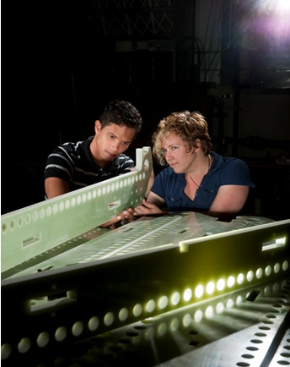
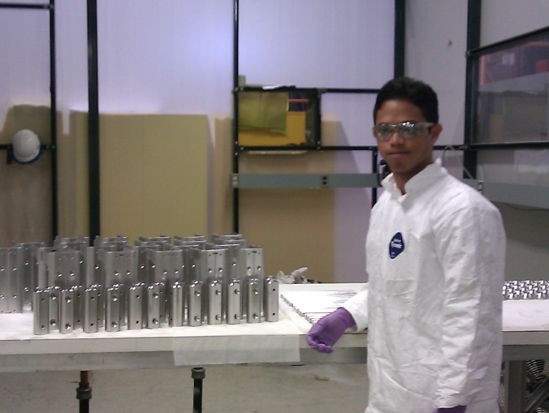
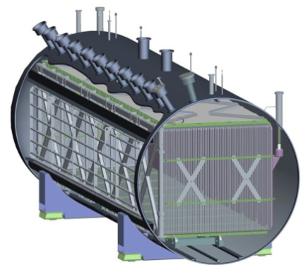
MicroBooNE Assembly: LArTPC Work Experience
Daniel H. Gutiérrez Velázquez
Fermi National Accelerator Laboratory
PPD – Neutrino
MicroBooNE

Slide 2
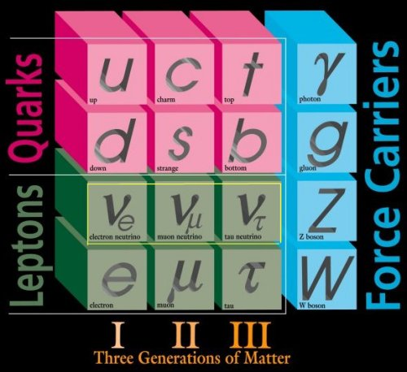
What is MicroBooNE?
The name MicroBooNE comes from the past experiment named MiniBooNE. These are Booster Neutrino Experiments.
Is an experiment that will take really important data from neutrino’s oscillations and interactions.
It is a neutrino detector. What are Neutrinos?
Least massive particles in the
Standard Model which interact
with the other particles only
through weak force.
There are three types of
neutrinos ν_{e}, ν_{μ}, ν_{τ}.

Slide 3
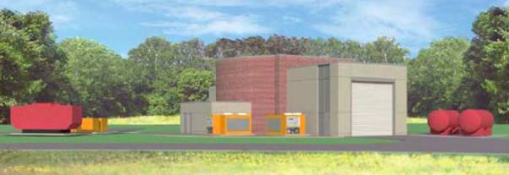
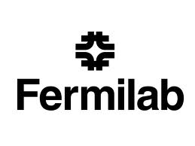
The MicroBooNE’s objective and location
Will be located here, at Fermilab, the experiment will build and operate a large 170 ton Liquid Argon Time Projection Chamber (LArTPC) located along the Fermilab Booster Neutrino Beam line (BNB). The experiment will measure low energy neutrino cross sections and investigate the low energy excess events observed by the MiniBooNE experiment. The detector serves as the necessary next step in a phased program towards the construction of massive kiloton scale LArTPC detectors.
(www-microboone.fnal.gov/)

Slide 4
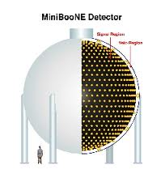
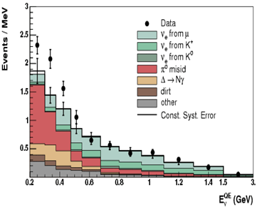
What was the MiniBooNE excess?
The MiniBoone excess shows electrons and photons that cannot be differentiate between each other (showering particles). In a non-showering particle they may differentiate in to a muon or a pion with the size of the Cerenkov ring.

Slide 5
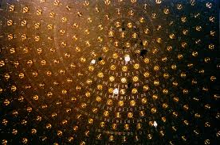
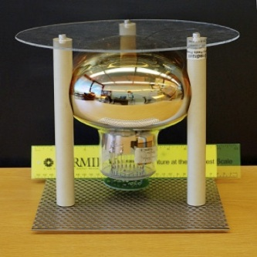
Why MiniBooNE cannot differentiate between electrons and photons?
The MiniBooNE is a spherical vessel filled with mineral oil and the walls are equipped with photomultipliers (PMT). The PMTs detect the light from the particles that result from each event of neutrino’s interaction with a nucleus. In a showering particle it get a fuzzy Cerenkov ring (these are e⁺, e⁻, γ, π⁰). In a non-showering particle it get a clean Cerenkov ring (these are μ⁺, μ⁻, π⁺, π⁻) that can differentiate between a muon or a pion using the size of the ring.

Slide 6
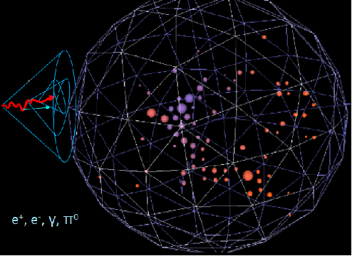
MiniBooNE showering particle
Fuzzy Cerenkov
ring

Slide 7
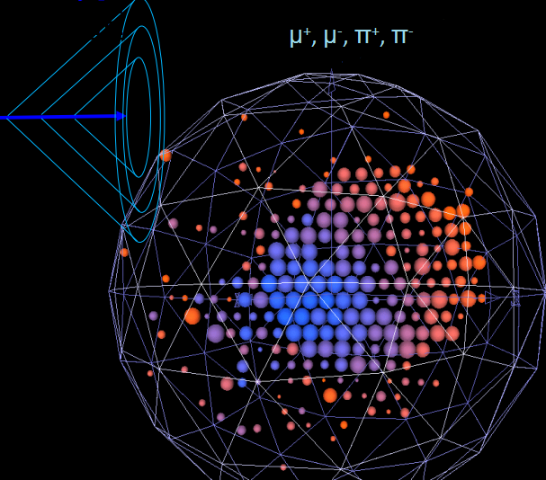
MiniBooNE non-showering particle
Clean Cerenkov
ring

Slide 8
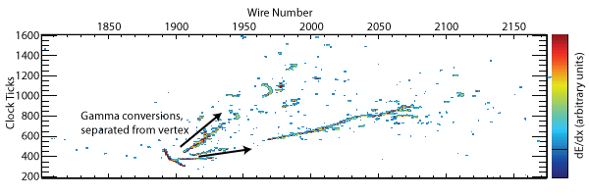
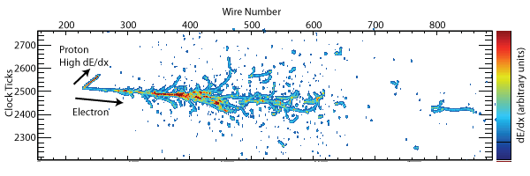
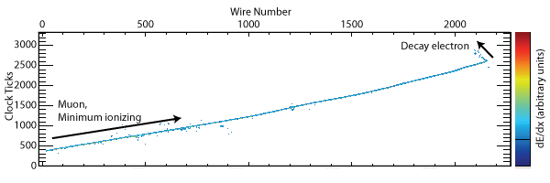
MicroBooNE LArTPC
A liquid argon time projection chamber (LArTPC) exploits features of pure liquid argon that allow ionization electrons to be transported along uniform electric field lines over several meters to wire chamber planes. A LArTPC delivers excellent neutrino interaction characterization.

Slide 9
MicroBooNE vs. MiniBooNE
The MicroBooNE can differentiate between a photon and an electron in a showering particle event, through the wire planes of the TPC which catch the charge of the particle. If is an electron it will get some charge and if is a photon it will get double the charge because of pair production.
γ → e⁺e⁻ (pair production)
MicroBooNE will solve the mystery of the MiniBooNE excess and improve cross sections measurements.
vs.

Slide 10
Possible excess explanations
The MicroBooNE analysis is performed under two assumptions: that the low energy excess is due to an electron-like event and that the low energy excess is due to a photon-like event. If the excess is due to a photon-like event, a possible explanation may be new unknown cross sections. If the excess is due to a electron-like event, a possible explanation may be the existence of a sterile neutrino (3+1, 3+2… theories) that known neutrinos can oscillate to it. Something like this indicate more physics beyond what the Standard Model describes.

Slide 11
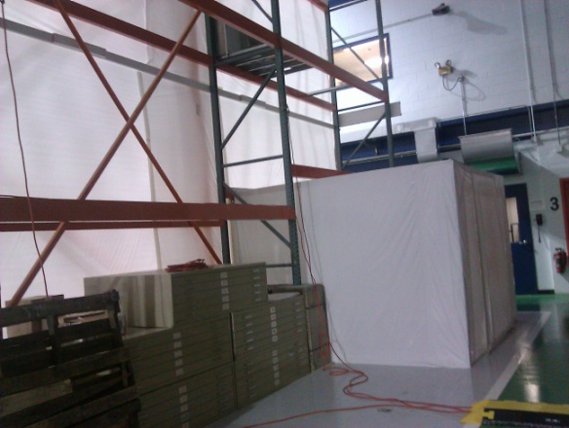
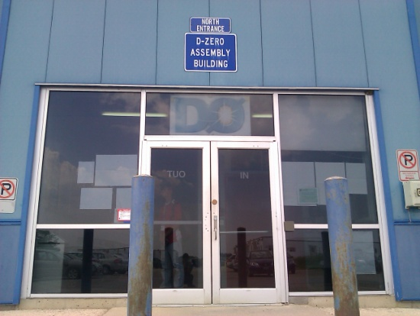
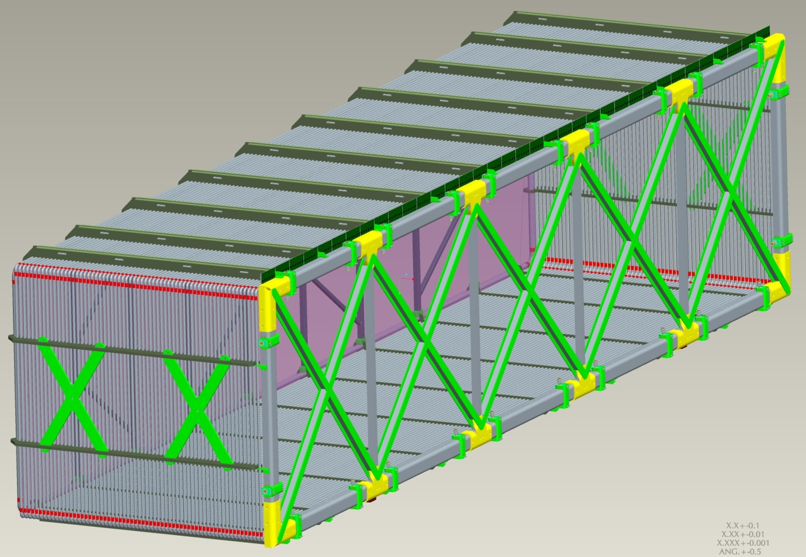
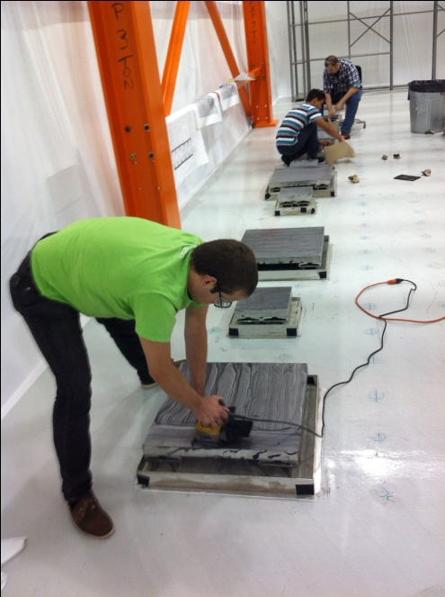
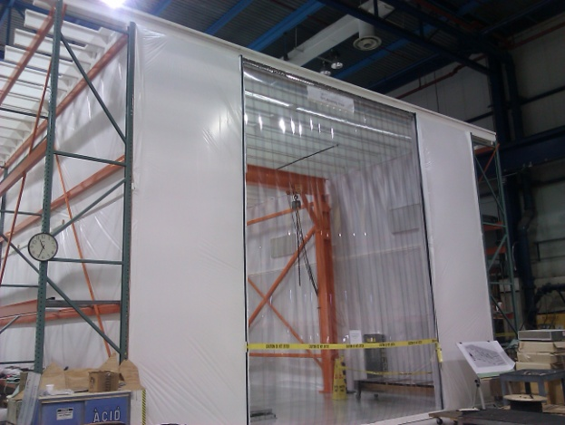
LArTPC assembly area
D-Zero Assembly TPC
Building assembly
clean room
entrance
TPC
TPC assembly Cleaning
clean room the room

Slide 12
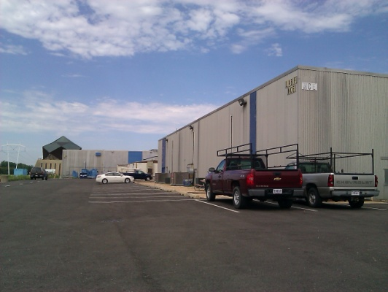
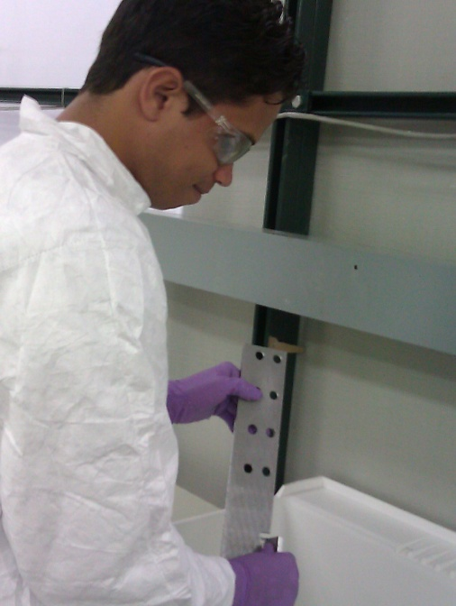
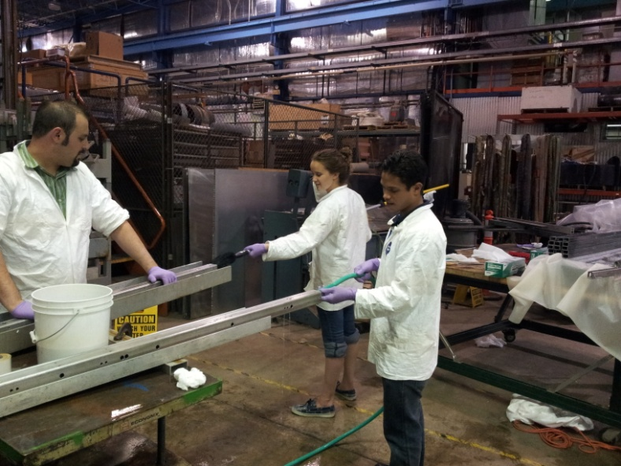
Cleaning the TPC
Before the assembly, the TPC parts most be really clean. We are cleaning the TPC parts in the Lab F. Most of the TPC parts are stainless steel. We used several tool for the cleaning including brushes, sponges, isopropyl alcohol, distilled water, etc.

Slide 13
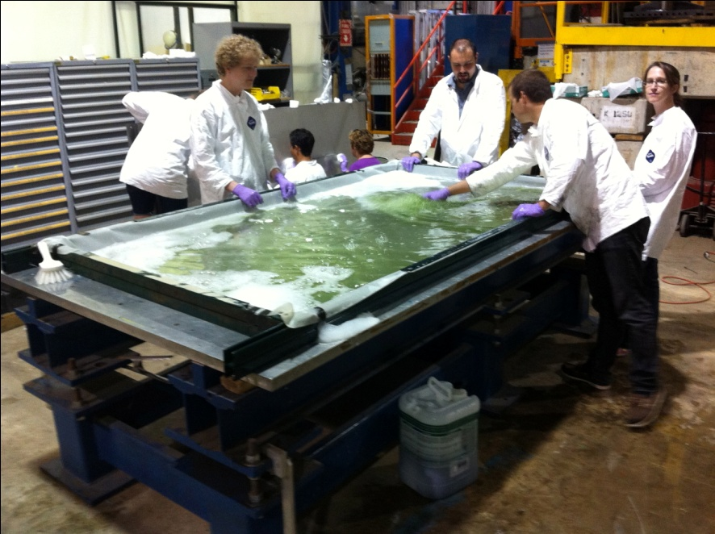
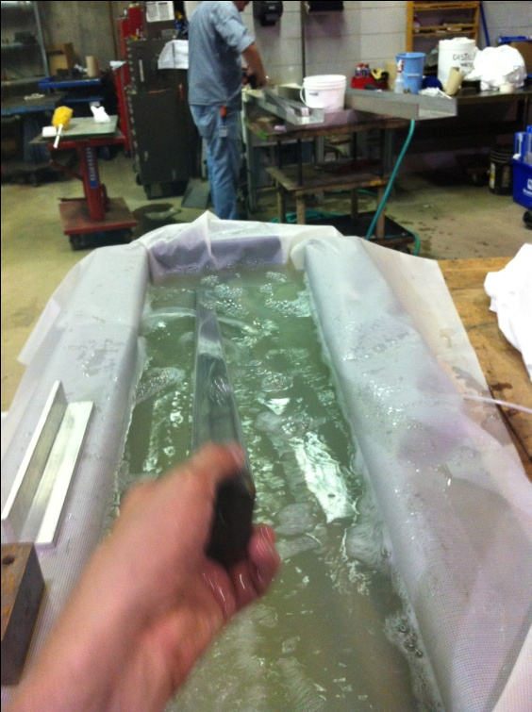
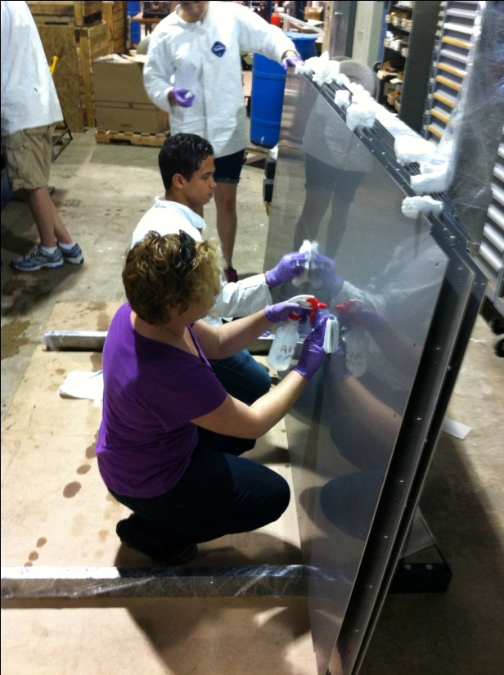
Set up baths
For huge parts like the cathode planes, we had to set up baths with the available equipment.

Slide 14
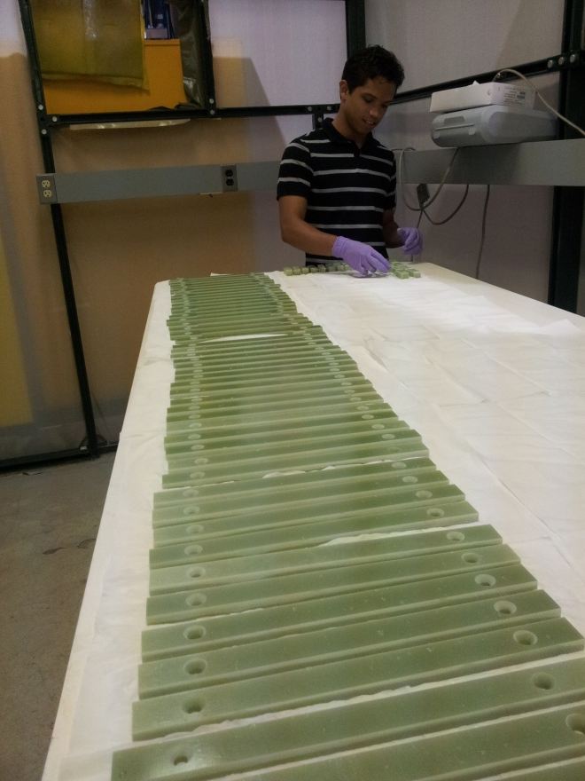
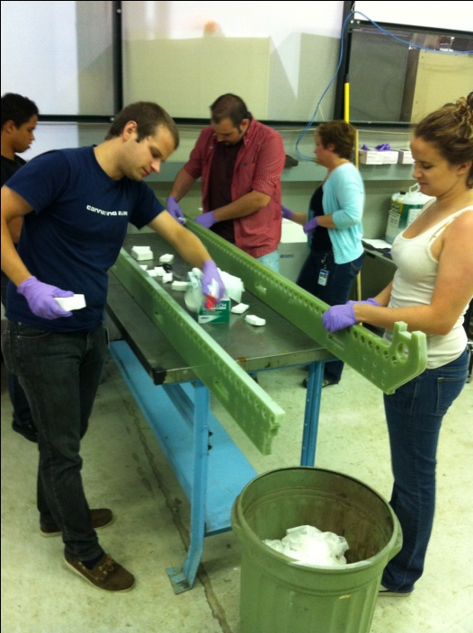
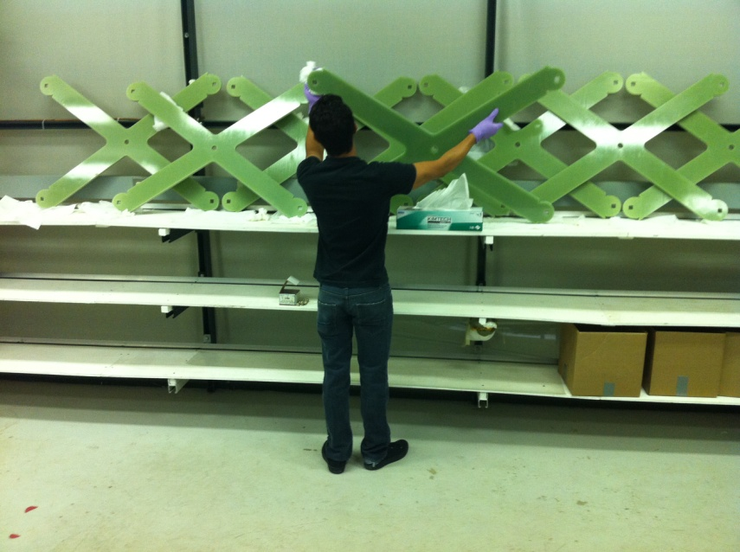
More cleaning
The G-10 parts of the TPC (same material of circuit panels) are more difficult to clean because they absorb water.

Slide 15
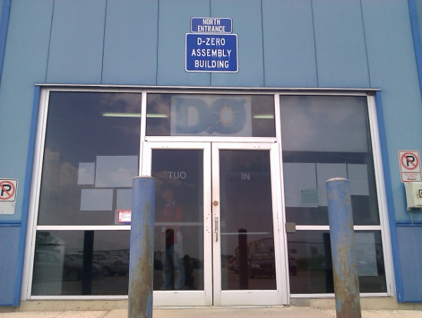
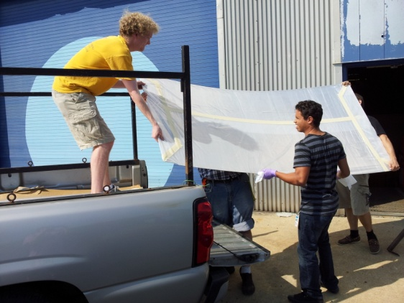
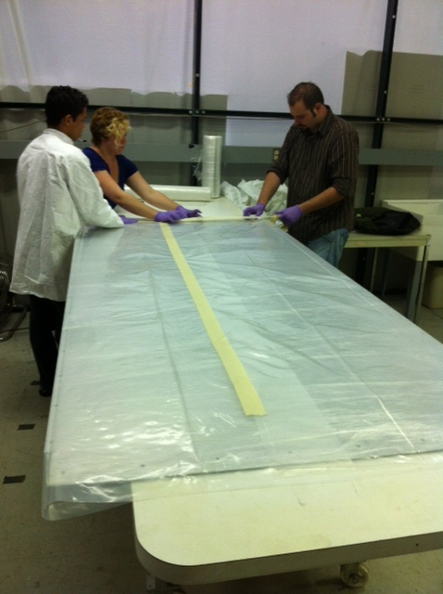
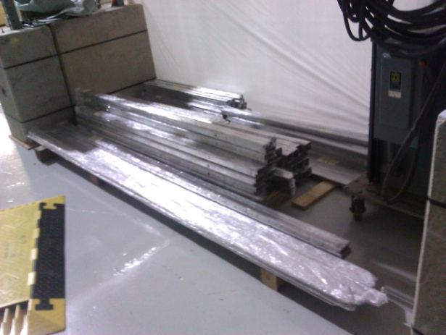
After cleaning
After cleaning the parts, we double wrapped, transport and store them at D-Zero Assembly Building until the start of the assembly.

Slide 16
Importance of the cleaning
The TPC will be submerged in Liquid Argon inside a cryostat. The main importance of cleaning the TPC parts is to maintain the purity of the Liquid Argon. If there are other substances beside the Liquid Argon, the particles that come from the interaction events may be absorbs by the substances and affect the data. Most of the TPC pieces are made of stainless steel, without the proper cleaning, metal pieces from the cut of the parts will stay stick. If there are metal pieces floating in the LAr, it may distort the electric field that is supposed to be uniform and mess up the particles track reconstruction and time of flight calculation.

Slide 17
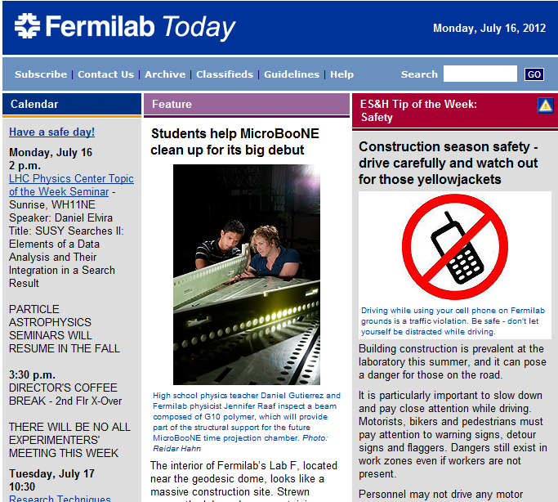
MicroBooNE news

Slide 18
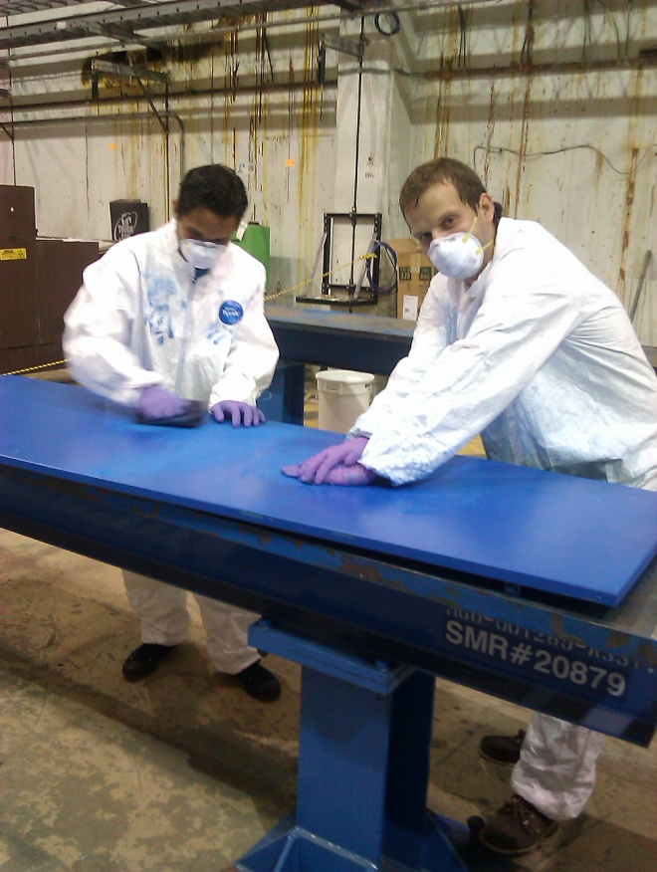
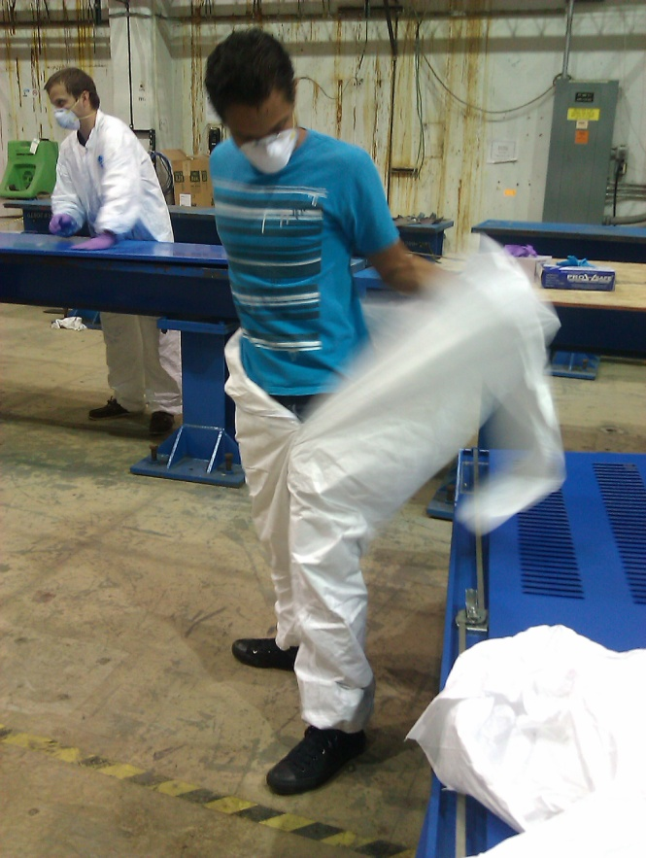
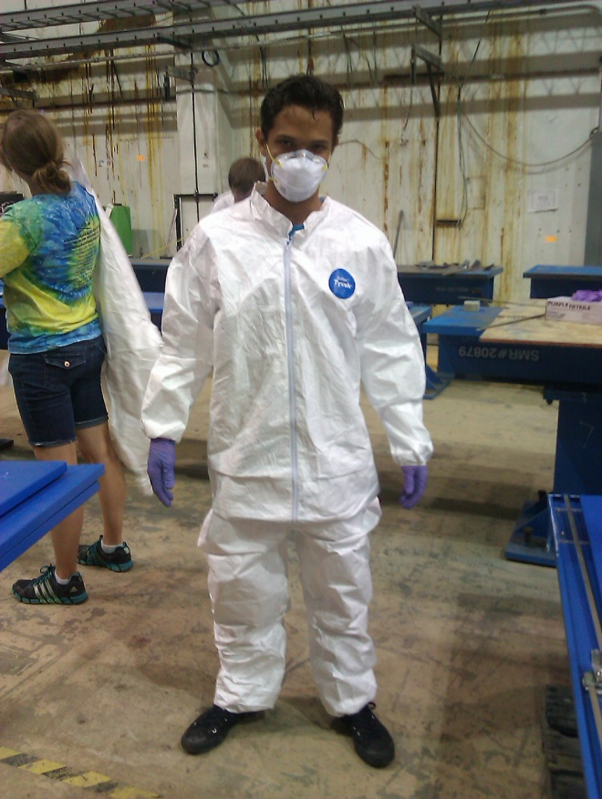
Sanding and painting electronic racks
In the Grid Computing Center we are sanding and painting the MicroBooNE electronics racks. These are electronics racks from old experiments that are being recycled for use in MicroBooNE.

Slide 19
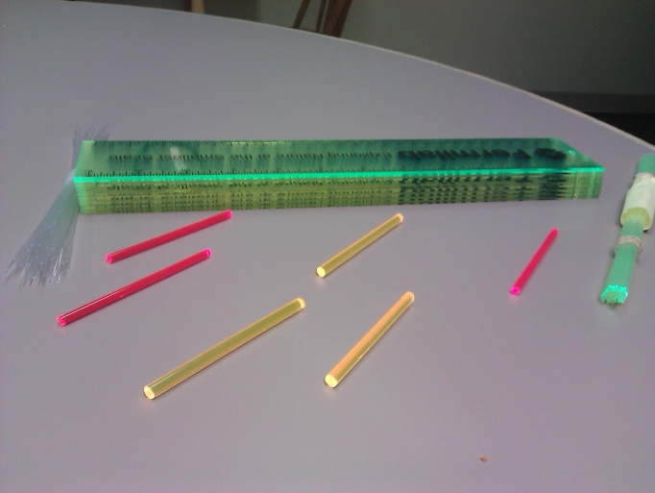
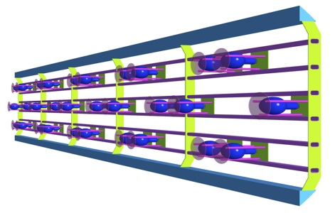
Transfer of knowledge to the classroom
After developed a class of the Standard Model (SM), the teacher will show images of different tools that scientist use to study the SM and will do a demonstration using wavelength shifters.
The MicroBooNE will have wavelength shifters (TPB) because the PMTs cannot detect UV light, the wavelength shifter turn UV light in to visible light.
TPB

Slide 20
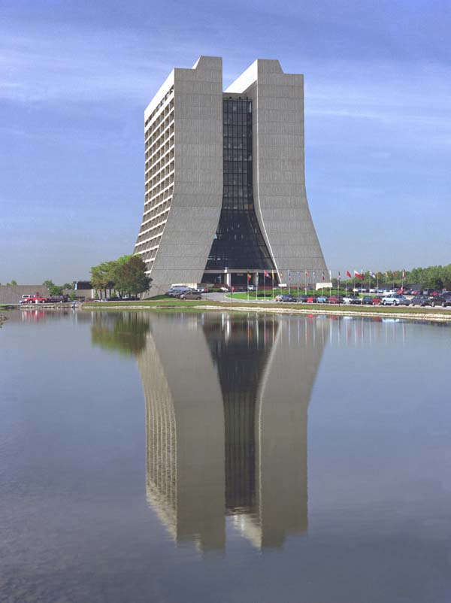
Acknowledgment
Harry Cheung
Bjoern Penning
Jennifer Raaf
Hector Méndez
Tom Jordan

Slide 21
Reference
http://www-microboone.fnal.gov
The MicroBooNE TDR (2/24/2012-DocDB 1821-v12): The MicroBooNE Collaboration

Slide 22
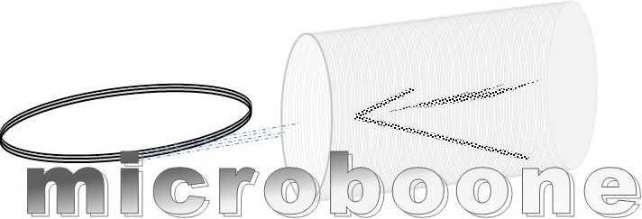
THE END

