Slide 1
TSD
12/9
Tony Busch

Slide 2
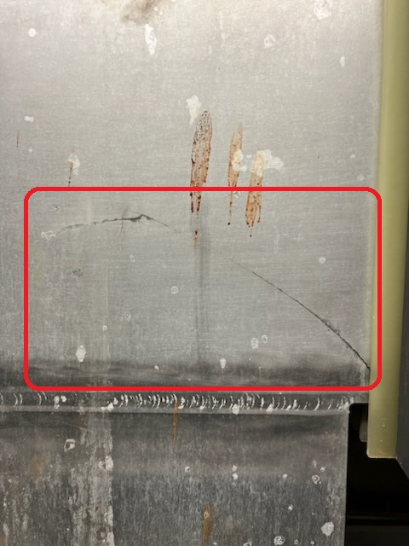
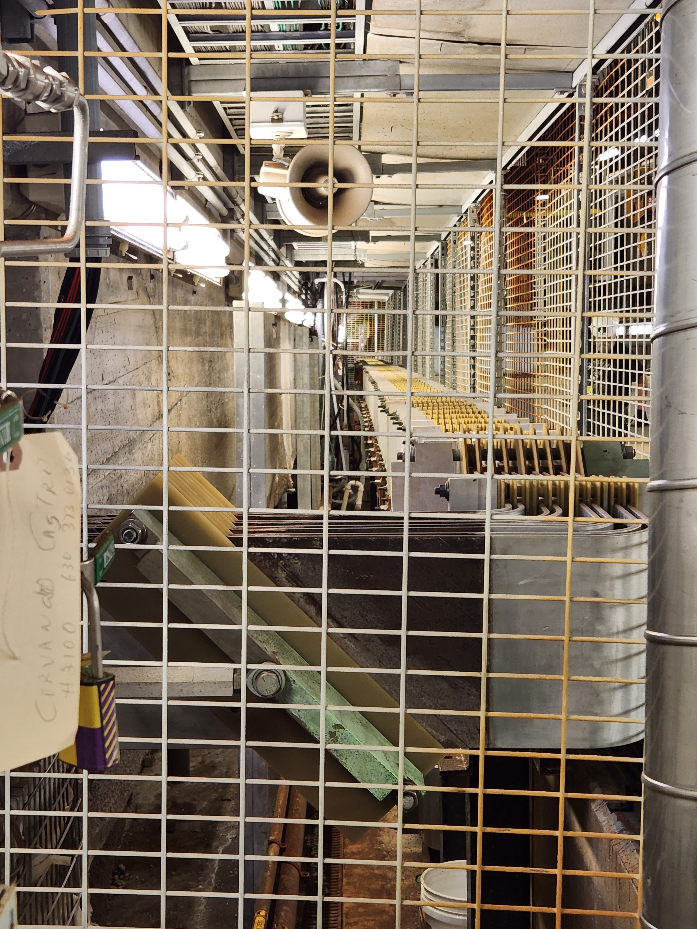
Initial findings
Sunday inspection of the Numi Horn stripline found a crack on the stripline above the Horn 2 penetration.

Slide 3
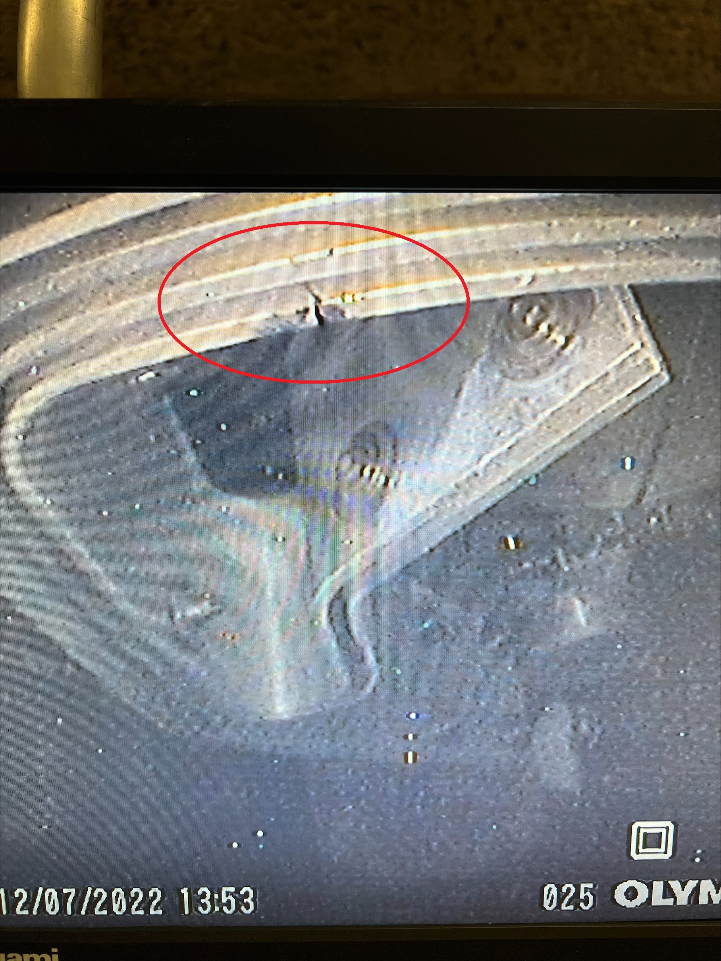
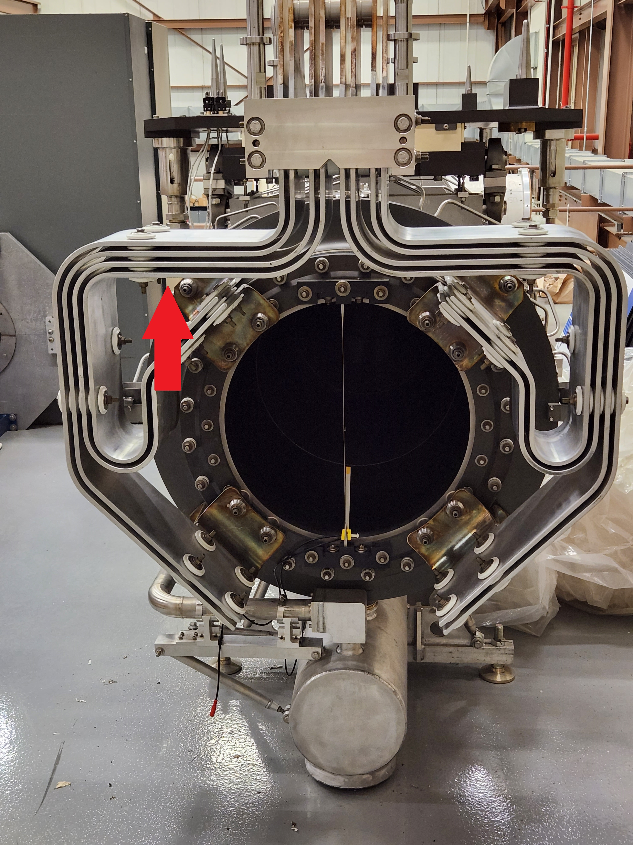
Horn inspection
Using a borescope down a survey port a crack was found on the Horn 2 stripline.

Slide 4
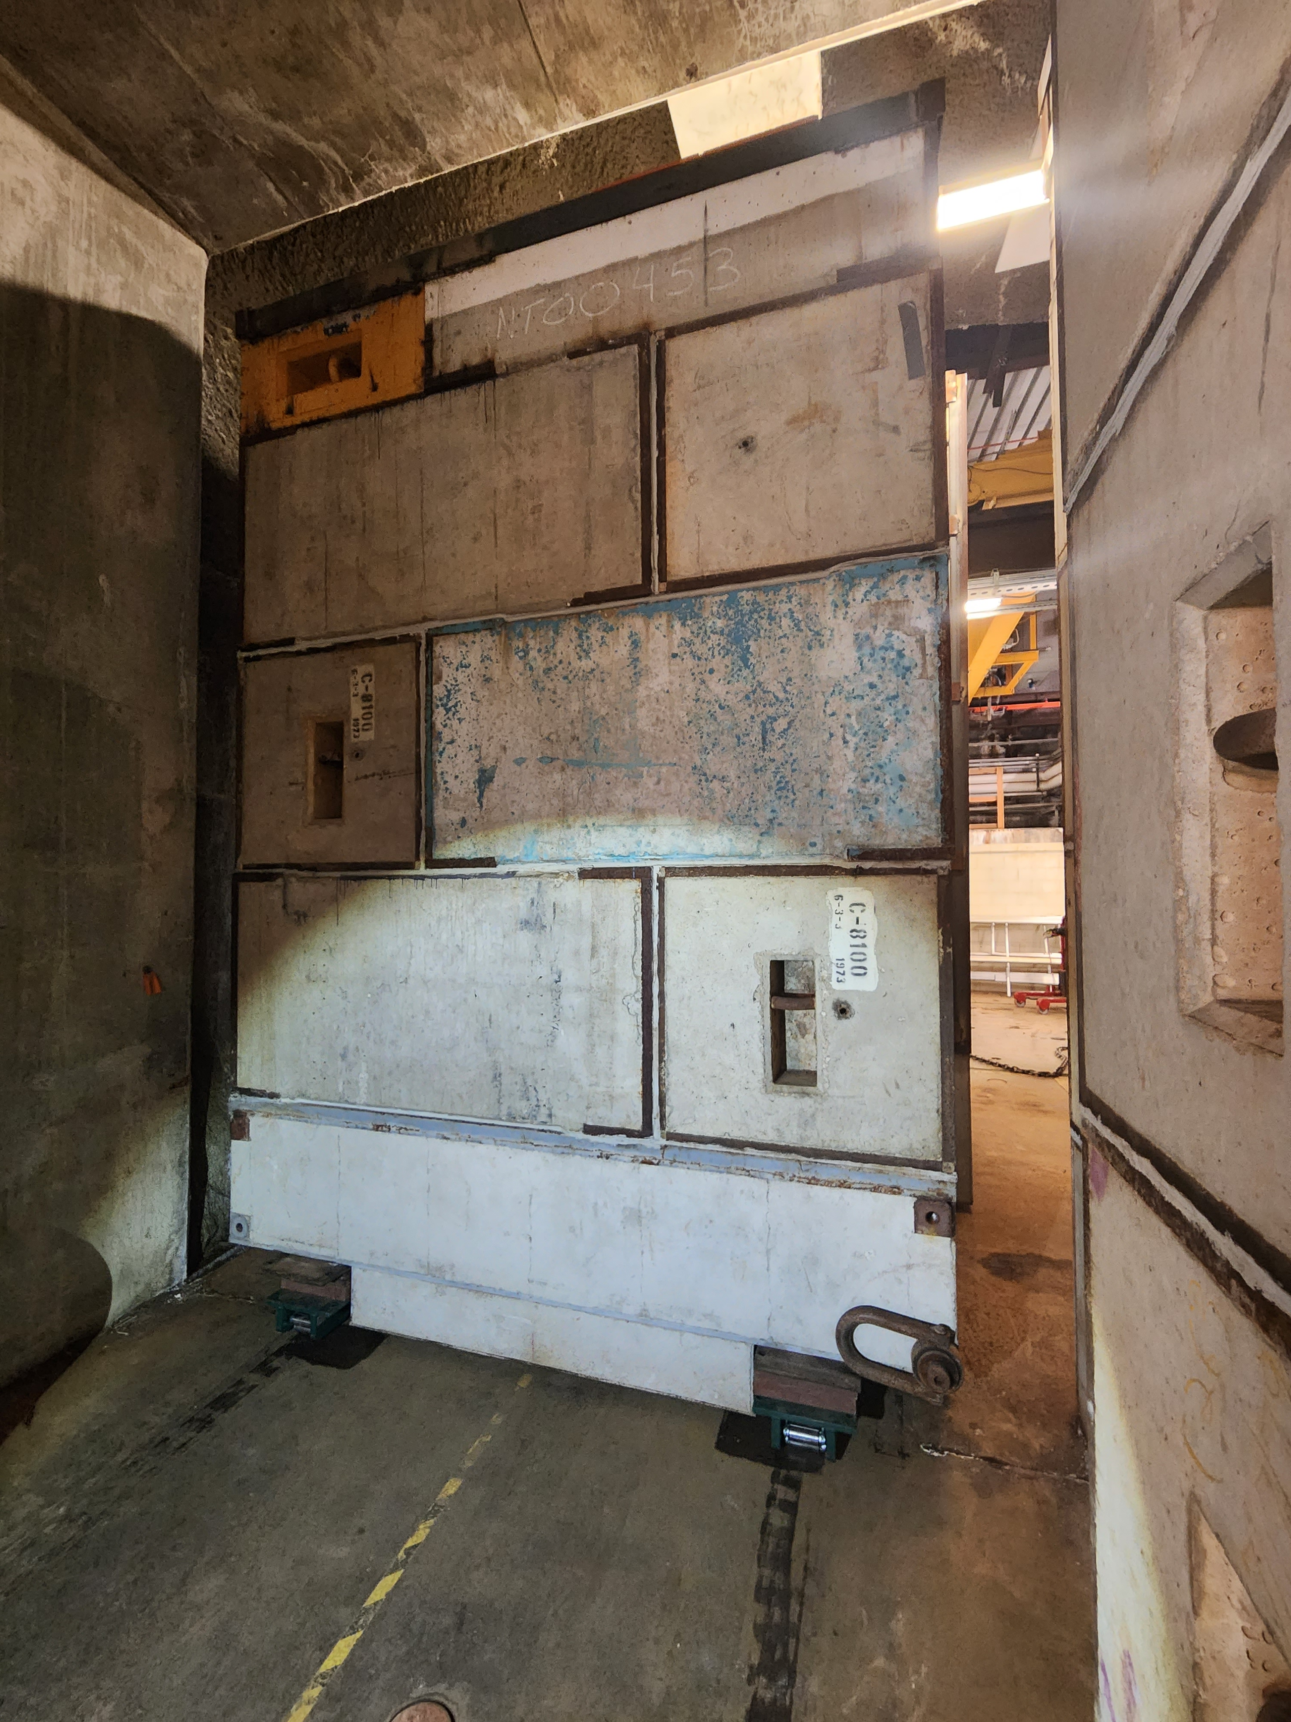
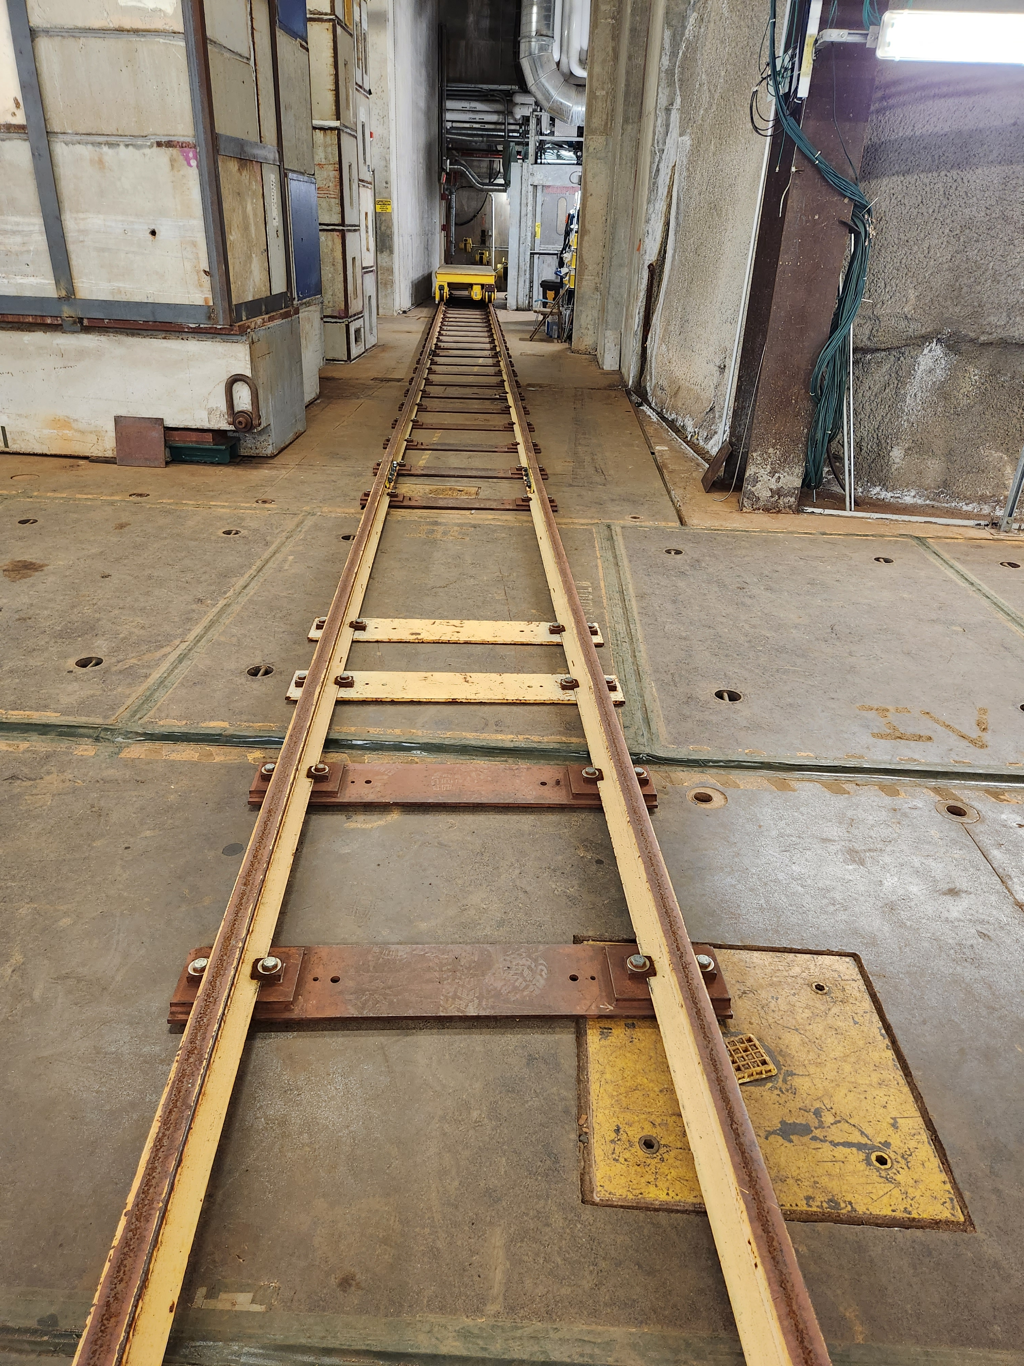
Moving forward
Week of 12/12 remove Horn 2 and perform inspection.
Move Horn to C0 on 12/17 0600.
Start fabrication of stripline replacement.
Pulse testing of new Horn

